Slide 1
Reviewing Using the Instructional Materials Evaluation Tool: ELA
Module 101: High-quality Text, Evidence-based Discussion and Writing, and Building Knowledge
www.achievethecore.org
Notes:
This module was last updated on October 2016.

Slide 2
Essential Questions
How does the Instructional Materials Evaluation Tool (IMET) reflect the major features of the Standards and the Shifts?
What understandings support high-quality, accurate application of the IMET metrics?
Notes:
Estimated time for slides 2-10: 10 minutes
Big Idea:
These are the overarching questions we’ll be considering as we move through the IMET training.
Details:
Have participants read over the Essential Questions (p. 1).
Whether you are here to learn as a future trainer of reviewers, a reviewer yourself, or as a learner, we’ll hope that you will ask questions, let us know if you don’t agree with something, and participate in conversations with your colleagues.
Looking at materials with a critical eye on content and alignment to standards, although done in the past, is more important than ever in ensuring our students are moving through the K-12 system and graduating ready for the demands of career and/or college.
Our major purpose while we are together is to build a deeper understanding of the IMET as a tool to analyze instructional material alignment to the Common Core State Standards (or any state college- and career-ready standards).

Slide 3
Goals
Understand how aligned materials embody the shifts inherent in the Common Core State Standards
Understand the precise meaning of each metric
Recognize examples and non-examples related to each IMET criteria metric
Notes:
Big Idea:
These are our goals for the IMET module training.
Details:
Both the Essential Questions and goals are printed on your agenda and we’ll refer back to them at the conclusion of the training.
Have participants read over the goals (p. 1).
The first goal speaks to the understanding we will build regarding the major shifts, or changes inherent in college- and career-ready standards and how the IMET ensures alignment to them.
The second and third goals reflect the work we’ll begin as we go through the IMET and apply the tool to evaluate actual material examples for alignment to the Standards.
.

Slide 4
The quality of instructional materials in our classrooms has a large impact on student learning.
“There is strong evidence that the choice of instructional materials has large effects on student learning – effects that rival in size those that are associated with differences in teacher effectiveness.”
Chingos & Whitehurst,
Choosing Blindly: Instructional Materials, Teacher Effectiveness, and the Common Core
Notes:
Big Idea:
The quality of instructional materials in our classrooms has a large impact on student learning. Why is this work important?
Details:
Instructional materials in classrooms matter. If we are going to realize the promise of college and career readiness, we must pay attention to the choice of materials offered to teachers and students.
We all know the emphasis placed on ensuring effective teaching over the past decades. Perhaps we should be hearing as much about the choice of curricular materials.
With that in mind, we must recognize that reviewing materials is a time-intensive process. And it is an investment that pays off in the long run, because if teachers and students do not have well-aligned materials, the promise of the standards and college and career readiness may not come true.
Quote is drawn from a Brookings Institution report from 2012, available here: https://www.brookings.edu/research/choosing-blindly-instructional-materials-teacher-effectiveness-and-the-common-core/

Slide 5
Agenda and Upcoming Modules
Today - Module 101:
Introduction to the IMET
Non-Negotiable 1: High-quality Text
Alignment Criterion 1: Range and Quality of Texts
Module 102:
Non-Negotiable 2: Evidence-based Discussion and Writing
Alignment Criterion 2: Questions, Tasks, and Assignments
Module 103:
Non-Negotiable 3: Building Knowledge
Alignment Criterion 3: Building Knowledge with Texts, Vocabulary, and Tasks
Alignment Criterion 4: Access for All Students
Module 104: (K-2 supplement): Foundational Skills
Notes:
Adjust this agenda based on your time allocation.
Big Idea:
This is the frame for the day- we’re going to focus on getting to know the IMET and the first Non-Negotiable and Alignment Criteria, focused on the quality of the texts included in a program.
Details:
Today we will work through the background information that led to the development of the IMET, and the goals of the Common Core Shifts.
We’ll walk through the first Non-Negotiable criterion in the IMET: High-quality Text and take a closer look at the Alignment Criterion that goes along with this NN.
We’ll do some examining of texts and tasks associated with a submission along the way, considering what well-aligned materials include.

Slide 6
Norms for Our Work
Consider two norms you’d like to see us adhere to for the next two days.
Discuss your thoughts with your shoulder partner.
Be ready to share.
Notes:
Big Idea:
Norms will help groups work effectively with the content in the IMET Modules.
Details:
Optional: If the group has established norms, insert here. If not, take the time to allow table groups to narrow down to 2 suggested norms and then chart the suggestions, noting repeats. Material needed: chart paper, markers

Slide 7

History of the IMET
Achieve
Student Achievement Partners
Council of Chief State School Officers
Notes:
Big Idea:
As states adopted the Common Core State Standards (CCSS), there was demand for a tool to analyze instructional material alignment. States, districts and educators needed a common language for talking about and evaluating materials against the Common Core State Standards or any college- and career- ready standards.
Details:
There was interest in reviews that would cross state lines so we could begin to answer the question together: What does alignment look like in materials?
Achieve, SAP, and Council of Chief State School Officers worked together to craft a toolkit to help stakeholders analyze alignment in materials.
The IMET is one tool in a comprehensive toolkit available on achievethecore.org to support educators in identifying alignment in materials.
The IMET went through a revision process in 2016 in order to better aid users. The new version more clearly emphasizes building knowledge and attends to writing and vocabulary more explicitly, based on feedback from the field.

Slide 8

IMET Sources
Common Core State Standards for English Language Arts & Literacy in History/Social Studies, Science, and Technical Subjects
Supplement to Appendix A of the Common Core State Standards for ELA/Literacy: New Research on Text Complexity
Notes:
Big Idea:
The adoption of the CCSS across dozens of states presents a rare opportunity to align standards, materials, and assessment. The IMET criteria, developed because educators needed a common tool for identifying alignment to the Common Core State Standards, are drawn directly from the Standards themselves and the research from the Supplement to Appendix A of the CCSS on Text Complexity.
Details:
The second resource provides the updated research base for the text complexity grade band progression outlined in Standard 10.

Slide 9
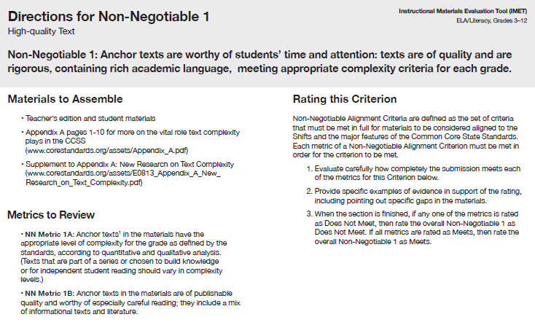
When to Use the IMET
Purchasing or evaluating new materials
Evaluating materials currently in use
Developing materials
Understanding key design principles
Notes:
Big Idea:
The IMET can be used in a variety of situations:
Details:
Procurement: alignment to the Standards is a critical factor to consider when purchasing.
Evaluating materials in use: analysis of materials will illuminate flaws in alignment and offer opportunities for thoughtful planning to modify resources.
Developing materials: guidance for creating aligned curricula
Professional learning: valuable understanding of instructional approach and components and pedagogy can be gained from reviewing materials using the IMET

Slide 10
The IMET: An Overview
Versions for ELA/Literacy: Kindergarten–2nd grade, and 3rd–12th grades
  For Math: Kindergarten–8th grade, and High School
Comprehensive curricula
3 Levels of Alignment:
  Non-Negotiable (NN) Alignment Criteria
  Alignment Criteria (AC)
  Indicators of Quality
www.achievethecore.org
Notes:
Big Idea:
There are three tiers, or levels, with associated metrics to determine alignment to the CCSS Standards and Shifts. They are prioritized in the following way: Non-Negotiable Alignment Criteria, Alignment Criteria, and Indicators of Quality.
Details:
Today we will be working with the 3-12 version. The two versions reflect the differences in the ELA standards and instructional priorities at the primary grades. We will make note of differences in the K-2 version and the 3-12 version as we move through the Alignment Criteria.
Now that you have an idea of what the IMET is, we’ll dig into the content. We’ll begin with a review of the 3 ELA Shifts. Even if you are familiar with the Shifts, I encourage you to reflect on how your understanding of them has deepened or grown since you first heard about them. This will also provide us with a common understanding and foundation as we move through the IMET.

Slide 11
3 Shifts
Regular practice with
complex texts and their
academic language
Reading, writing, and
speaking grounded in
evidence from text,
both literary and
informational
Building knowledge
through
content-rich
non-fiction
Notes:
The following slides provide a review of the 3 ELA Shifts. Depending on the needs of the group, this information may need to be adjusted. See the Facilitator Guide for options.
Estimated time for slides 11-20: 15 minutes
Big Idea:
The 3 Shifts in ELA and Literacy can be summed up this way: complex text, evidence, and knowledge.
Details:
Refer to p. 2 in the handout
When the Council of Chief State School Officers and National Governors’ Association began drafting a set of standards to prepare students for college and career, they used evidence of what students would need to be able to do by the end of a K-12 education. In order to prepare students adequately for college, career, and life, there were some changes needed. These changes or shifts are reflected in the Standards and can be summarized this way.
The Three Non Negotiables in the IMET mirror the 3 Shifts in ELA standards
Any one of these shifts could be studied much more deeply and there’s a plethora of great materials available for you or your group to investigate as time or interest permits.
How many of you are familiar with the 3 Shifts in ELA and Literacy?

Slide 12
Shift 1: Text Complexity
HS to College Gap
Complexity predicts college success (ACT study)
High rates of remediation
CCSS staircase of complexity:
ES → HS
Engaging with complex language and rich vocabulary
Regular practice with
complex texts and their
academic language
Notes:
Big Idea:
Text complexity is the first shift because, for the first time, the Standards require that texts at the center of instruction be of certain quality. This stems from the fact that research showed text complexity to be the biggest factor in predicting college and career readiness. If a student cannot handle complex text, he/she is more likely to need remedial coursework, and is less likely to graduate from college. Exposure to rich, complex text and its academic language is a requirement for all students.
Read Aloud (corresponds to the check mark bullets on the slide):
The gap between the complexity of college and high school texts is large. An analysis done by Williamson in 2008 found military, college, citizenship, and workplace domains all required reading in the 1105-1395L complexity. His research indicated there was a gap of as large as 230L points between what students were reading in HS and what was required in college, career, citizenship, and the military.
Why the focus on text complexity? Research, namely The 2006 ACT Study, Reading Between the Lines, informed the writing of the CCSS for ELA & Literacy. This research, which will be summarized on the next few slides, showed that what students can read, in terms of complexity is the greatest predictor of success in college (ACT study).
National remediation rates in ELA and Math hover around 42% at community colleges and 20% at 4 year colleges. Overall, as many as 69% of incoming freshman need remedial coursework despite having high school diplomas. In California the rates hover at 68% according to the National Center for Public Policy and Higher Education in The Governance Divide report.
College and career-ready standards include a staircase of increasing text complexity from elementary through high school, so the job of preparing students begins early and continues seamlessly through high school..
Complex text is filled with complex language and vocabulary absent in simpler materials. Students must be exposed to rich vocabulary and complex language beginning in the earliest years through read aloud to build a solid foundation for reading comprehension of increasingly complex materials through high school.
Details: Note to presenter: These details are for your information. The ACT study research will be illustrated on the next few slides.
The report Reading Between the Lines examined what factors differentiated those students who equaled or exceeded the benchmark score (21 out of 36) in the reading section of the ACT college admissions test from those who did not.
Prior ACT research had shown that students achieving the benchmark score or better in reading—which only about half (51 percent) of the roughly half million test takers in the 2004–2005 academic year had done—had a high probability (75 percent chance) of earning a C or better in an introductory level course in U.S. history or psychology (two common reading-intensive courses taken by first-year college students) and a 50 percent chance of earning a B or better in such a course.
The report was based on 2005 High School students taking the ACT and trends from the previous 10 years.
The report can be accessed at: http://www.act.org/research/policymakers/pdf/reading_report.pdf

Slide 13
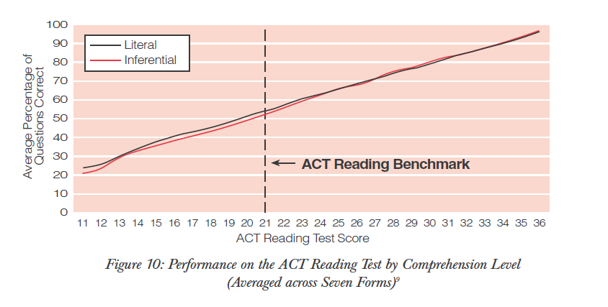
Students who can read literally can read inferentially.
Notes:
Big Idea:
The 2006 ACT study, Reading Between the Lines, provided guidance to the team of writers commissioned by the National Governors Association and the Council of Chief State School Officers as they set out to create the next generation of K-12 standards in order to help ensure all students would graduate college and career ready.
Details:
Researchers investigated what factors differentiated college- and career-ready students from those who were not. First, they looked at the ability to make inferences.
Weaker scorers got inferential questions right proportional to the stronger scorers.
That is, if a student were able to answer literal questions, he/she was equally able to answer inferential questions. The lines match equally up the Average Percentage of Questions Correct axis.
Facilitator Note: (Optional) If there is time, the facilitator may choose to tell participants what the axis values measure (average percentage of questions correct and ACT Reading Test Score) and black and red lines (performance on literal and inferential questions) and give them a minute to discuss. This may also be given on the next 2 slides.

Slide 14
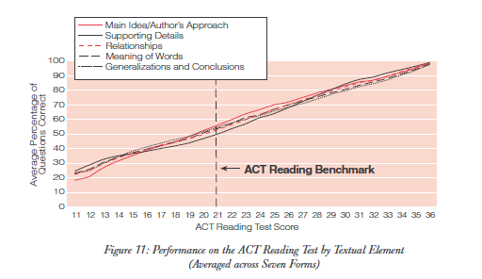
Students who can perform one strategy can perform all strategies.
Notes:
Big Idea:
Researchers investigated whether reading strategies were the differentiating factor.
Details:
They were not. Students who could use one strategy could basically use them all equally well.
If the ability to make inferences and the ability to use reading strategies were not the factors which differentiated those students who (according to this measure) were ready for college-level work from those who were not, what was the factor?

Slide 15
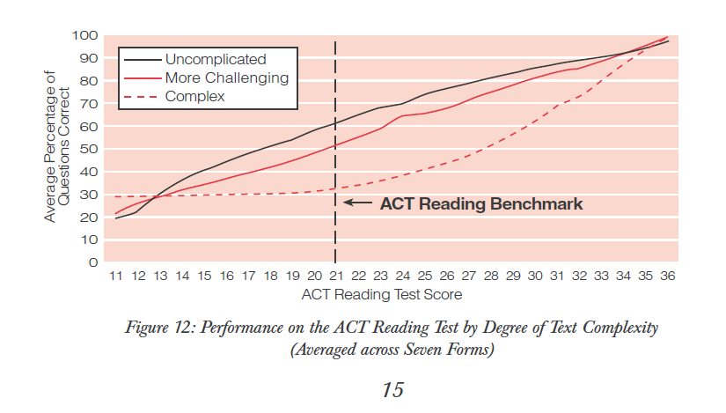
Ability to read complex text differentiates college-ready readers.
Notes:
Big Idea:
The lines indicating uncomplicated, more challenging, and complex text separated, indicating the differentiating factor was the ability to read complex text.
Details:
Students with a benchmark score of 21 got only 30% of the complex text questions correct, while they were able to answer 60% correctly in uncomplicated text. 30% is just a bit better than random guessing!
From ACT (2006) Reading Between the Lines, p. 15. This data was pulled from ALL the students who took the ACT in 2005 and the study has been replicated. So the sample size is huge: a half million students take the ACT most years.

Slide 16
Shift 2: Evidence
College and workplace writing
Major emphasis of the ELA Standards
Hallmarks of strong readers and writers
Equity
Reading, writing and speaking grounded in evidence from text,
both literary and
informational
Notes:
Big Idea:
Requiring evidence gained from reading when speaking and writing is the second shift.
Read Aloud (corresponds to the check point bullets on the slide):
Most college and workplace writing requires evidence. A meta analysis of research report by Steve Graham and Michael Hebert of Vanderbilt University (“Evidence for How Writing Can Improve Reading”) highlights empirical evidence for improving reading comprehension through writing (i.e., having students answer TDQs, summarize, take notes, respond to reading, and generally increase opportunities to write, learn spelling, and receive direct instruction on writing).
The ability to cite evidence differentiates strong from weak student performance on the NAEP assessment. Beck, McKeown and their colleagues’ research (detailed below) also pointed to the critical role text dependent questions and evidence from text played in improving student learning. The ability to find and marshal evidence from sources is therefore is a major emphasis of the ELA Standards: Reading Standard 1, Writing Standard 9, Speaking and Listening standards 2, 3, and 4, all focus on the gathering, evaluating, and presenting of evidence from text.
Being able to locate and deploy evidence are hallmarks of strong readers and writers in society.
Requiring evidence from sources leads to equity in education. When students must rely on background knowledge or experience, the playing field is not level. Students having the background or experience are privileged. When evidence is drawn from sources used in the classroom, all have access to the information and it can be debated based on merit.
Details: Note to presenter: These details are for you as background information in presenting this slide.
Instruction over the past decades moved away from requiring evidence in speaking and writing – sometimes students did not even have to read a passage to answer a question. Students with knowledge had a leg up over students without experience or knowledge.
This shift helps level the playing field and teaches students valuable college and career skills.
These are the findings of the McKeown, Beck & Blake (2009) “Rethinking Comprehension Instruction: A Comparison of Instruction for Strategies and Content Approaches” study. The study compared 3 groups of students using a traditional basal program (control group), a comprehension strategies focused approach, and a “content approach” i.e., an approach focused on the text and what it says.
“The effectiveness of the two experimental comprehension instructional approaches (content and strategies) and a control approach were compared.
Content instruction focused student attention on the content of the text through open, meaning-based questions about the text.
Strategies instruction taught specific procedures to guide their access to text during reading of the text.
Control approach lessons were developed using questions available in the teacher's edition of the basal reading program used in the participating classrooms.
Student participants were all fifth graders in a low-performing urban district.”
In all three cases there was conversation, but in classrooms where the questions focused on content, the conversations were longer and better (length and quality of recall and text-focus).

Slide 17
Shift 3: Knowledge
Large research base
Knowledge crucial to comprehension
Very little nonfiction in school
College & workplace focus on nonfiction
Informational text harder
Building knowledge
through content-rich
non-fiction
Notes:
Big Idea:
Shift 3 requires the building knowledge through the study of content-rich non-fiction.
Read Aloud (corresponds to the check point bullets on the slide):
According to research, knowledge and vocabulary play big roles in comprehension.
Students are required to read very little informational text in elementary and middle school, yet knowledge is critical to comprehension.
Non-fiction makes up the vast majority of required reading in college/workplace, yet much of what students are asked to read in elementary school has been fiction. Following the report of the National Reading Panel, the literacy block was extended, while Social Studies and Science became something teachers maybe squeezed into elementary classrooms. This shift requires students work with a balance of informational and literary texts to build the knowledge critical for comprehension.
This shift also acknowledges the preparation students need to be ready for the college and workplace focus on nonfiction.
Informational text is harder for students to comprehend than narrative text, so regular instruction and practice is necessary.
Details: Note to presenter: These details are for you as background information in presenting this slide.
Academic language improves when students speak and write using evidence from texts.
This shift restores content and knowledge, especially in elementary grades, to the literacy block.
As we will see, as we dig more deeply into the criteria for alignment, the building of knowledge is a consideration in planning curriculum. This is a critical shift as we prepare students for college and career.

Slide 18

Everyone knows knowledge plays a role in comprehension, but how big of a role?
“The Baseball Study” Recht & Leslie (1988)
Notes:
Big Idea:
Recht and Leslie (1988) sought to answer exactly this question, by comparing the relative impact of reading ability to the impact of knowledge of a topic. They had students read a passage about baseball and then tested students’ comprehension of the passage.
Details:
“Effect of Prior Knowledge on Good and Poor Readers‘ Memory of Text” from Journal of Educational Psychology 1988, Vol. SO, No. 1, 16-20
Had 7th and 8th grade students read a short text about baseball and tested them for comprehension using:
Verbal retelling
Reenactment with figurines
Verbal summary
Rating ideas from the story in terms of importance

Slide 19
The Baseball Study
Recht & Leslie (1988)
Compared reading comprehension for four categories of students:
High reading ability, High knowledge of baseball | High reading ability, Low knowledge of baseball
Low reading ability, High knowledge of baseball | Low reading ability, Low knowledge of baseball
Notes:
Big Idea:
To understand the role knowledge played in comprehension, Recht and Leslie undertook a study in 1988. Students were divided into 4 groups as shown and then asked to read a passage about baseball. They then took a test of their comprehension.
Details:
<Ask participants to predict what % of questions on a reading comprehension test each category of student would get right. Participants should draw a grid on their paper and put an actual % of predicted questions correct in each quadrant. Tell them that the colors are so they can quickly match the group with the graphs on the next slide.>
“The high-ability /high-knowledge cell had 10 boys and 6 girls; the high ability/low-knowledge cell had 3 boys and 13 girls; the low-ability/high-knowledge cell had 12 boys and 4 girls; and the low-ability/low knowledge cell had 7 boys and 9 girls.”
High reading ability was defined as 70th percentile or higher on a standardized test of reading. Low reading ability was defined as 30th percentile or lower.
High knowledge of baseball was defined as 70th percentile or higher on a test of baseball knowledge. Low baseball ability was defined as 30th percentile or lower.

Slide 20
Knowledge of the topic had a much bigger impact on comprehension than generalized reading ability did.
Notes:
Big Idea:
With sufficient prior knowledge, “low ability” students performed similarly to higher ability students (p. 19 of study). The difference in their performance was not statistically significant. This is why knowledge and content are considered one of the shifts. Content matters!
Details:
After the participants predict percentages, show them this slide and give them a minute to take it in. They should notice that the low reading ability students with high knowledge outperformed the high reading ability students with low knowledge. In addition, there is little difference between the two high knowledge groups and the two low knowledge groups.
From p. 18, table 1, Recht & Leslie 1988. (Qualitative Measure) Note: conversion from raw numbers to percentages achieved by dividing score by achieved by total possible score.
Frequently Asked Questions:
Is this study generalizable? Yes! In fact a European study replicated the finding exactly with students of a totally different background on the topic of soccer. Additional research has shown similar results on a wide variety of other topic and subject areas.
Is the impact here from knowledge or from interest? Knowledge. It’s hard to disentangle these variables, but a separate study using basketball was able to distinguish the two and found that the one that had the major impact was knowledge.
If knowledge is so important, does this undermine the value of close reading? No. Close reading teaches students how to gain knowledge from text by attending to it carefully. But, as we will soon discuss, high volume reading of informational text is also necessary to build the base of knowledge and vocabulary necessary to succeed with close reading. This is a BOTH, AND type of question, not an either/or.
What topics (or how many) are covered is not that important. What is critical is that students are reading on topics so they build knowledge and vocabulary.

Slide 21

Activity: Color the Shifts
Notes:
Need highlighters on the table – one set per participant (yellow, green and pink).
Estimated time for slides 21 - 23: 10-15 minutes
Big Idea:
Today we will be working with the IMET for grades 3-12 and we’ll now have a chance to open it up. This activity is designed to build familiarity with the tool and structure, and also as an introduction to the content and design.
Details: (Activity Instructions)
Before I turn you loose to scan the IMET, please notice the structure of the document itself. Beginning on page 5, the page with the grey shading across the top, criteria are listed with all of the metrics below. <Show this and instruct participants to read the whole page)>
Take 10 minutes now and examine the pages showing the overview of the criteria with the associated metrics. (Pages 5, 9, 13, 17, 22, 31, and 36 are the criteria overview pages.) There are 7 of them, so don’t read too closely, but look for evidence of the 3 shifts we just reviewed in the IMET criteria.
As you go through, highlight evidence of the 3 shifts, both in the criteria and the metrics. We’ll use the following colors to highlight the evidence you find (shown on the next slide). Yellow for Shift 1, green for Shift 2, and pink for Shift 3.

Slide 22
ELA Shifts
Regular practice with complex text and its academic language
Reading, writing, and speaking grounded from evidence from text, both literary and informational
Building knowledge through content-rich nonfiction
Notes:
Materials: Pink, yellow, green highlighters – one set for each participant.
Big Idea:
After the participants have had time to highlight, quickly debrief where participants found evidence of the 3 shifts.
Details:
For example, Non-Negotiable 1 calls for text complexity analysis. Non-Negotiable 2 requires text-dependent questions and the citation of evidence.
Some of the criteria do include more than one shift. This reinforces the integrated nature of literacy and the ELA Shifts.

Slide 23
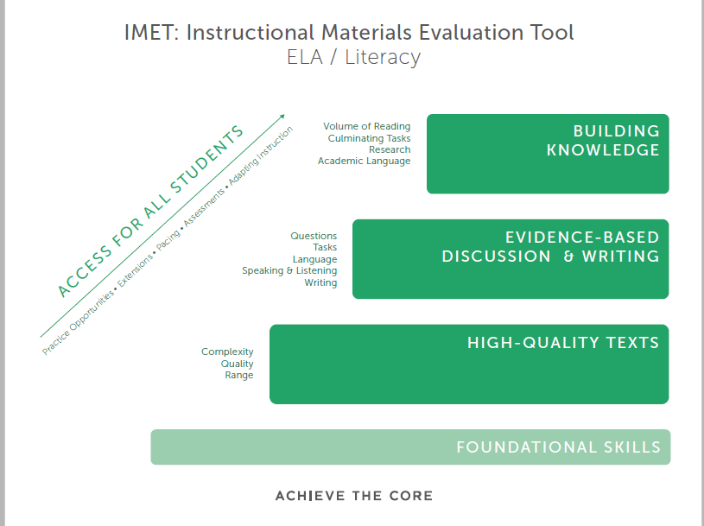
Notes:
Big Idea:
As you can see, the shifts and priorities of the CCSS are represented directly in the IMET. This graphic illustrates the connection between the IMET criteria and the integrated nature of literacy in aligned materials.
Details:
Found on p. 3 of handout
Foundational Skills are quite literally the floor, and while they aren’t required in each grade they set up the surface that grounds this work.
High-quality text, evidence-based discussion and writing, and building knowledge each represent a “stair step”. All three are critical in this work.
Access for All Students is a driving force—ultimately, making the work itself worthwhile.
This visual should serve to crystalize the metrics in the IMET document and highlight what matters most.

Slide 24
Structure of the IMET
Front matter – Purpose, Getting Started
Non-Negotiable Alignment Criteria
  High Quality Text
  Evidence-based Discussion and Writing
  Building Knowledge
  (K-2) Foundational Skills
4 Alignment Criteria
Summary Worksheet
Notes:
Make sure participants have the IMET in front of them as you walk through the sections. They may choose to tab the document to help orient themselves to the sections.
Estimated time for slides 24-26: 5 to 10 minutes
Big Idea:
This document can be overwhelming, so it is worth it to spend some time on understanding the structure of the document before beginning.
Details:
The front matter on the IMET pages 2-4 is brief; it is mandatory to allocate time to read in your review sessions. These narrative and bulleted sections include a lot of the information we will be going over today.
When you are working with a group, all of the information is summarized for any end user in the document itself.
There are 2 tiers, or levels of alignment, with associated metrics to determine degree of alignment to the CCSS Standards and Shifts.
They are prioritized in the following way:
First, there are the Non-Negotiable Alignment Criteria (the gatekeepers). These begin on page 5. There are three (3) for 3-12, and you’ll see that the K-2 version has a fourth: Foundational Skills.
Then, there are four (4) Alignment Criteria which support the Non-Negotiables in materials. These Alignment Criteria help analyze alignment at a deeper level beyond the Non-Negotiable criteria.
The fourth AC supports access for all students. These are found beginning on the IMET page 40 for K-2 and 36 for 3-12.
Other indicators of quality should be developed by evaluators while considering the needs of schools, districts, and networks when utilizing the IMET– this tool is by no means the only consideration you’ll want to use for determining whether a program meets your needs. However, the NN and ACs comprehensively address whether the materials adequately express the shifts in ELA instruction that we reviewed today.

Slide 25
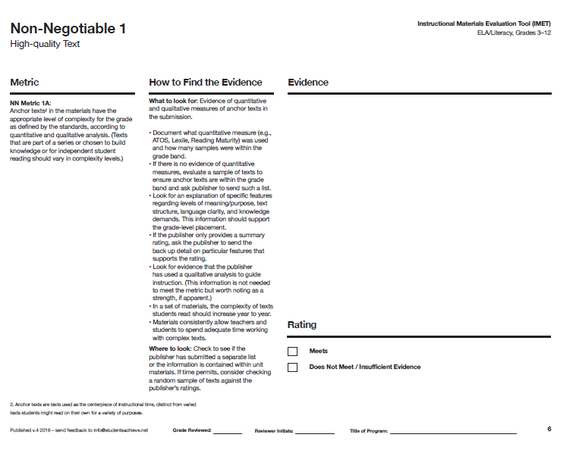
Navigating the Tool: Begin with Section 1,
Non-Negotiable Alignment Criteria
Metric to determine if the Non-Negotiable
Criteria is met
Decide: Meet Non-Negotiable?
IMET p. 6
Notes:
Big Idea:
The ELA IMET includes three Non-Negotiable Alignment Criteria. Non-Negotiable Criteria metrics each are rated “meets” or “does not meet” and, for the criterion to be met, every metric within the criterion must be rated as “meets.”
Details:
Evidence is collected for each metric and scored on the page.
Notice that there is plenty of room for including evidence right on the document
Available electronically at http://achievethecore.org/page/1946/instructional-materials-evaluation-tool

Slide 26
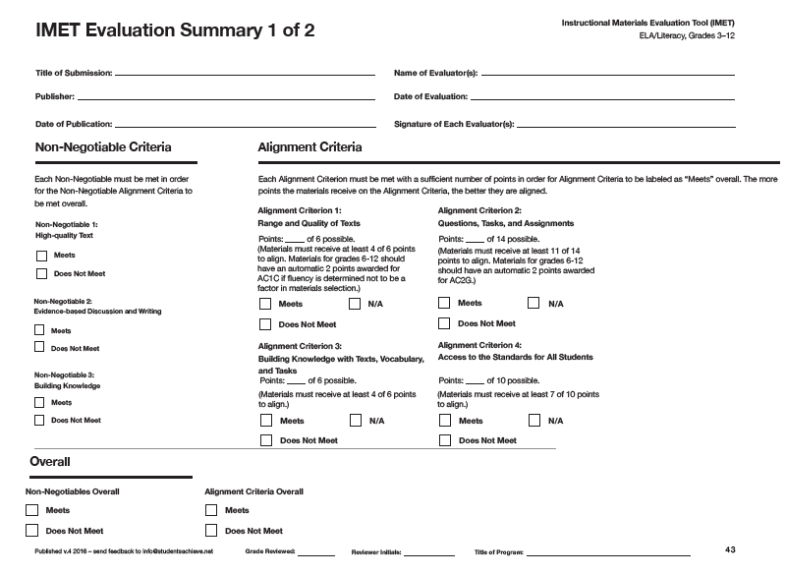
Navigating the Tool: End with Evaluation Summary
IMET p. 43
Notes:
Big Idea:
Finally, there is a summary document on the last page where ratings are collected in full.
Details:
At the end of the tool, there is a summary page that allows users to compile all ratings for the review in order to summarize and document evidence of alignment.
Ask participants to read the sentence under both the Non-Negotiable and Alignment Criteria sections and discuss the differences between the two types of criteria. (This point will be reinforced on the next slide)
Are there any general questions about the IMET layout?
We’ll now move into the content

Slide 27
Non-Negotiable 1: High-quality Text
Notes:
Estimated time for slides 28 - 48: 30-45 minutes
Big Idea:
The first Non-Negotiable in the IMET is high-quality text.
Details:
Based on our previous discussions about the instructional shifts called for in CCSS, why would high-quality text be given such prominence in the IMET as the first Non-Negotiable?

Slide 28
High-quality Text
Non-Negotiable 1: Anchor texts are worthy of students’ time and attention. Texts are of quality, containing rich academic language, and are rigorous, meeting the text complexity criteria for each grade.
  Metric 1A: Anchor texts in the materials have the appropriate level of complexity for the grade as defined by the standards, according to quantitative and qualitative analysis. (Texts that are part of a series or chosen to build knowledge or for independent reading should vary in complexity levels.)
  Metric 1B: Anchor texts in the materials are of publishable quality and worthy of especially careful reading; they include a mix of informational texts and literature.
IMET p. 5
Notes:
Big Idea:
The first Non-Negotiable focuses on the worthiness of texts included in a submission.
Details:
Found on p. 4 in handout
Materials need to include the complexity levels of anchor texts, or significant instructional texts for close reading, to show they are appropriately placed in the grade band. They should be accompanied by a number of texts at varying levels of complexity in order to grow knowledge and vocabulary. Anchor texts, because they are more complex, will typically require more instructional time and, therefore, may be fewer in number.
If we offer students opportunities to first hear good, rich text read aloud from the earliest grades (there are no complexity guidelines for K-1 in student reading materials), and increasing in complexity as they move through the grades, that gap between end of high school, college, and “regular life” materials we spoke of earlier will be eradicated.
This does not mean that every text in a submission must be complex. It means that all students should be exposed to increasingly complex texts as outlined by Reading Standard 10. Texts will be used for a variety of purposes – developing foundational skills, fluency, independent reading, etc. This metric calls for the provision of evidence regarding the complexity of all texts included to ensure students are increasingly offered opportunities to learn to navigate increasingly complex text, a hallmark of readiness for life.
Again, when considering complexity in the primary grades, it is the complexity of the read alouds being evaluated until 2nd grade, when complexity is considered in student reading material.

Slide 29
Metric 1A: Anchor texts in the materials have the appropriate level of complexity for the grade as defined by the standards, according to quantitative and qualitative analysis.
Text Complexity: What Is It and Why?
CCSS.ELA-Literacy.CCRA.R.10
Read and comprehend complex literary and informational texts independently and proficiently.
For example, in 4th grade:
By the end of the year, read and comprehend informational texts, including history/social studies, science, and technical texts in the grades 4-5 complexity band proficiently, with scaffolding as needed at the high end of the range.
IMET p. 6
Notes:
Big Idea:
Our College- & Career-ready standards map backwards from the complexity of texts in first-year college or entry-level career, creating a staircase of complexity from when students first enter school until they graduate in 12th grade.
Details:
Standard 10 is the complexity standard, shown here, setting the expectation that all students read grade band complexity texts. This is further described in Appendix A of the Standards.
Do notice two important phrases in the grade 4 example. First, these are end of year expectations and second, that scaffolding at the high end of the 4-5 range is given as needed. Not all texts have to be complex, but practice and instruction do need to prepare students to meet these expectations.
It‘s important to note that complexity bands have not changed in grades K-1, when students are learning to read. However, primary teachers should be intentional in the texts they read aloud, ensuring they are exposing our youngest learners to rich texts that build a coherent body of knowledge. Texts read aloud in these grades should be 2-3 years above students’ grade level.
We’ll spend the next set of slides moving through text complexity in depth to understand the features of complex text and how to assess them as reviewers.

Slide 30
What Makes a Text Complex?
Subtle and/or frequent transitions
Multiple and/or subtle themes and purposes
Density of information
Unfamiliar settings, topics, or events
Lack of repetition, overlap, or similarity in words and sentences
Complex sentences
Uncommon vocabulary
Lack of words, sentences, or paragraphs that review or pull things together for the student
Longer paragraphs
Any text structure which is less narrative and/or mixes structures
Notes:
This slide includes animation so that each of the features comes in on the click. Tell participants that there are 3 features of complex text that make text difficult for students. Ask them to consider which of these might be the three which cause most difficulty as you explain them. Click through and explain, then give them a few minutes to talk to their partners. On the next clicks, the two factors causing the most difficulty (vocabulary and unfamiliar settings, topics or events) will enlarge.
Big Idea:
Say, “To understand text complexity, first consider the features of complex text.”
Details:
Go through each of the definitions.
These qualities, or features, of text can be present in text in any number of ways. Ten factorial ways, actually (factorial =10 x 9 x 8 x 7 … which equals 3,628,800).
Subtle and/or frequent transitions: the author does not give you clues (next, thus, consequently) before moving to a new idea
Multiple and/or subtle themes and purposes: the author does not directly state or clearly offer, what his purpose for writing is, or the big ideas are hard to figure out.
Dense information: informational text tends to pack ideas in very tightly and authors may assume that readers know more about the topic than students might actually know.
Unfamiliar settings, topics or events: it is harder to visualize and imagine what you have never experienced. This is why contemporary fiction can be read so fast and is considered so enjoyable. Almost everything is familiar.
Lack of repetition, overlap, or similarity in words and sentences: the author keeps moving to new ideas or settings and does not stop to summarize or support what he has just discussed. Or he finds new ways to express the same idea. If the reader didn’t understand right away, or doesn’t realize the new phrasing is a restating of the original idea, it is easy in both cases to get lost.
Complex sentences: sentences with lots of parts to them, or lots of variation in sentence length and styles
Uncommon vocabulary: not likely to be familiar to many students at this level.
Lack of….: the author does not repeat ideas or summarize much. Also may not offer clues to the reader through words like: “next”, “as we just saw”, “in conclusion”, “because”
Lengthy paragraphs: long, dense paragraphs
Text structures: narrative structure is story-like. It is easier to follow than problem – solution, or cause and effect. When an author mixes up structures (which textbooks and articles often do) that gets even trickier to follow.
[further activity instructions]
“In terms of DIFFICULTY (hard for the student), two of these stand out. Turn and talk about which they are.”
Allow participants 1-2 minutes to discuss.
NOTE: Click cursor twice to get the two most difficult features to be highlighted.
Correct answer: The first two that cause the most difficulty by far are “Uncommon vocabulary” and “Unfamiliar settings, topics or events.” These are clear number 1, 2, although difficult to say which is 1 and which is 2 because they overlap. Texts with uncommon vocabulary often have unfamiliar topics and vice versa. So we can’t distinguish between them but we have a ton of research about how strongly they connect to comprehension. Number 3--and a distant number 3--is syntax.
Might want to point out how little attention all of this gets from publishers and educators: in general, vocabulary not nearly enough and knowledge and syntax, almost none. Ask teachers to think about an elevator speech they might give about their ELA program-- they might talk about balanced literacy, guided reading, comprehension strategies, basals… chances are they won’t even mention vocabulary and certainly not knowledge.

Slide 31
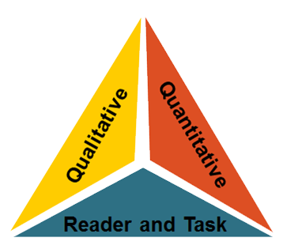
Analyzing Text Quality
Notes:
Big Idea:
Appendix A of the Standards helps define the factors that we should be using to make text quality assessment: quantitative measures that rely on algorithms to assess “readability,” qualitative measures that rely on skilled readers to consider meaning, knowledge demands, and other factors, and reader and task measures that rely on teachers to make informed judgments about how difficult their group of readers may find the text given their motivation, reading skills, etc.
Details:
Appendix A in the CCSS identifies the following factors as determining text complexity:
Quantitative measures look at factors impacting “readability” as measured by particular computer programs.
Qualitative measures examine levels of meaning, knowledge demands, language features, text structure, and use of graphics as measured by an attentive reader.
Reader and Task considers additional “outside” factors that might impact the difficulty of reading the text.
Ask: “Why is it difficult to get a true measure of text complexity without considering each of these three dimensions?”

Slide 32
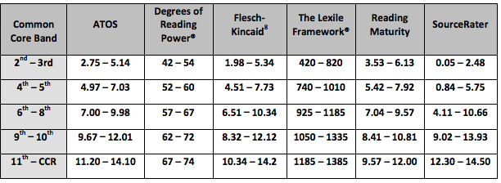
Analyzing Text Complexity: Quantitative
Verify that each text has been placed within a grade band based on at least one quantitative measure.
Notes:
Big Idea:
When analyzing text complexity, the first step is to consider quantitative text complexity. “The Common Scale for Text Complexity” is a research-based scale used to identify text bands for college and career-ready standards.
Details:
Found on p. 5 of the handout.
You probably recognize at least “Lexile” and “Flesch-Kincaid.”
Remember the quantitative complexity can be generated through different formulas, giving different weight to word length, sentence length, etc.
Also notice the overlap in grade bands. The 2,3 Lexile band is 420-820 but the 4,5 begins at 740. This reflects the summer dip that many researchers have found.
Remember, these are the Lexiles we are pressing for by the end of the year for keystone or anchor texts.

Slide 33

Practice: Analyzing Text Quality
Read the excerpt from The Great Fire, and, with your table group, analyze the quality of the text:
  Quantitative Analysis: Study the two measures and determine the appropriate grade band.
  Qualitative Analysis: Using the rubric, evaluate the qualitative features of the text. Provide evidence for each feature. Place the passage in the appropriate grade.
  Quality Criteria: Considering the qualitative criteria, is this text worth reading?
1
2
3
Notes:
Locate The Great Fire excerpt in your handout packet on pages 6 and 7 and tab it now, because we will use it now and be returning to it later.
Big Idea:
We will now practice analyzing text complexity.
Details:
“Included in your packet is an excerpt from The Great Fire. We are going to work with this text in a couple of different ways, so I’d like you to first read the text (beginning on p. 6) of your participant packet.”
“You will then use the quantitative complexity measure of the text (Lexile and Flesch-Kincaid) from the Common Core Scale for Text Complexity to decide on grade-band placement for the text. “
“As you will see, it is helpful to use more than one measure to practice placing text.”
“After you’ve read the text, work with a shoulder partner to circle the corresponding grade bands for each measure, and determine in what grade band you would recommend placing this excerpt (page 6 in participant handout).”
<Pause for reading/analysis.>
Debrief: “What did you find?” (6-8th band because this is where the recommendations from Lexile and F-K overlap). This is the first step in honing in on an appropriate placement. However, it’s also important for teachers to see that Lexile is not a one and done, hard and fast science. There is a lot of variation as you can see here.

Slide 34

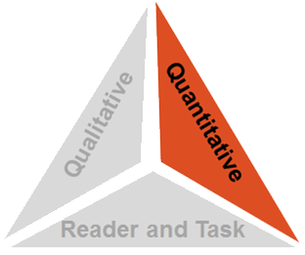
Quantitative Text Complexity
  Grapes of Wrath Lexile Score: 680L
  Grade Band Placement: 2-3?
Notes:
Big Idea:
As we discussed earlier, no one measure is sufficient to determine complexity, and the novel on this screen is a very clear case in point. Simply relying on computer algorithms of readability, as quantitative text complexity programs do is not sufficient for text placement.
Details:
Of course, when you consider Steinbeck’s use of simple language and dialogue as a stylistic choice, it makes sense that the text is very readable– but I think we can all agree that second and third graders are not yet prepared to take on the Joads!
Picking a worthwhile, appropriately complex text does not mean picking any text within a Lexile band!
This example highlights what quantitative measures can and cannot provide. They are:
Excellent at situating informational texts
Good at offering a starting point for placing narrative fiction, but obviously can’t take the maturity of meaning and theme into account
Unable to rate drama and poetry
Not helpful for K-1 texts, when there is often too little text to get a readability score, so measures don’t offer scores in this range. Also, there are no requirements for text complexity in student reading material in grades K and 1.

Slide 35
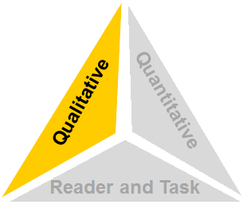
Qualitative Measures
Qualitative measures consider:
  Text Structures
  Language Features
  Meaning/Purpose
  Knowledge Demands
..
Notes:
Big Idea:
Qualitative text complexity analysis can also help teachers identify what is going to make the text difficult for students. This helps when planning instruction.
Details:
Now we are going to move into the qualitative analysis. Qualitative measures add information to the process of determining text complexity that quantitative measures CANNOT assess.
A qualitative analyses of text complexity represents an informed decision about complexity in terms of several factors discernible to a human reader applying trained judgment to the task.
It’s important that this analysis is done systematically. Qualitative analysis is what guides placement in the grade level and time of year.

Slide 36
Text Complexity
Layers of meaning
Structure
Text features
Knowledge
Background & experiences
Language
Vocabulary
Purpose
Concept complexity
Genre
Organization
Sentence length and structure
Figurative language
Regional/ historical usage (dialects)
Meaning
Content knowledge
Intertextuality
Disciplinary knowledge
Notes:
Big Idea:
Think back to the list of what makes a text complex. In evaluating qualitative text complexity, these elements can be classified and evaluated for the potential difficulty they will cause students. Instruction can then focus on those areas and teach students how to navigate them by asking a question or slowing down.
Details:
Found on p. 8 in handout
Text Structure: Is the text informational or narrative? Is the text simple, well-marked, and/or chronological in order? Or, does the text include more complex structures such as flashbacks or, in the case of informational text, the use of discipline-specific, complex structures?
Language Features: Does text use literal, clear, contemporary language or figurative, ironic, or archaic language?
Meaning/Purpose: Does the text have a SINGLE, explicit meaning or are there multiple meanings, such as what a reader would find in satire?
Knowledge Demands: Does the text make assumptions about the extent of readers’ experiences and content background knowledge? Do readers need specific content knowledge or no background knowledge?
Meaning, Structure, Language, and Knowledge demands contribute to qualitative text complexity. The knowledge of what makes a text complex allows us to target instruction and support students in learning how to navigate through and build knowledge from complex text. Aligned materials should include this analysis for teachers.
Define language as vocabulary and syntax (sentence length and structure) Evaluating qualitative text complexity is best done collaboratively.
We will practice evaluating a text’s qualitative features in just a few minutes.

Slide 37
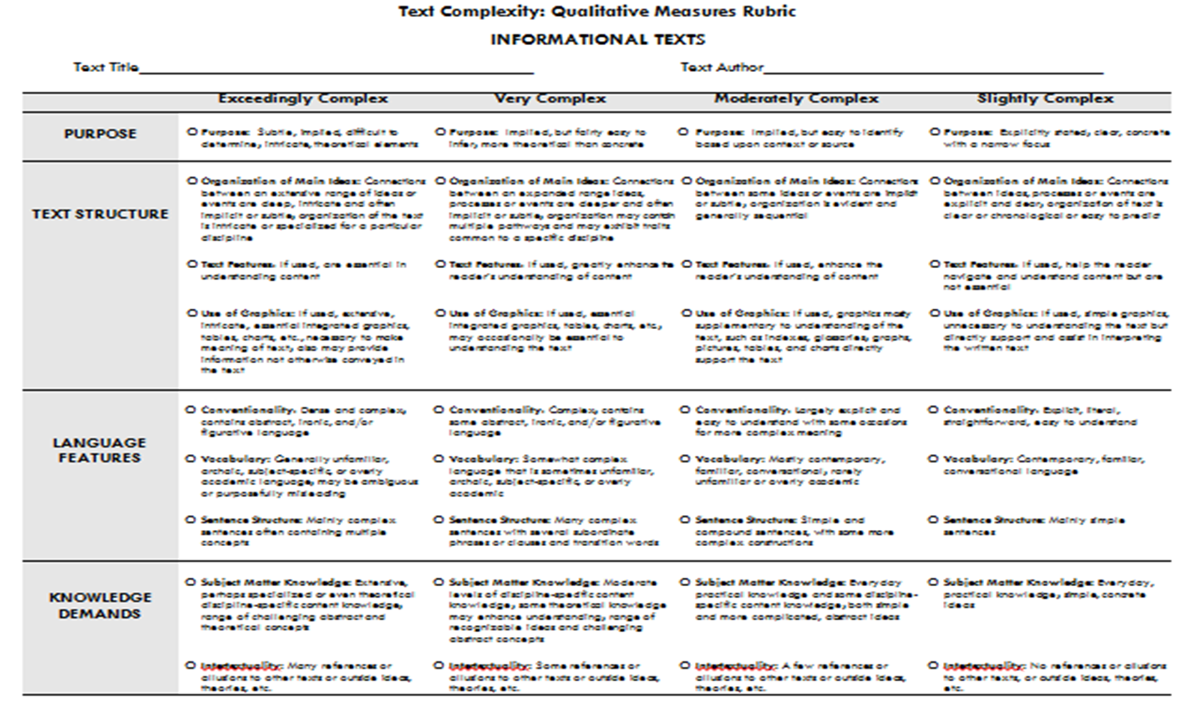
Tool: Analyzing Text Quality
Notes:
Big Idea:
Evaluating text for these qualitative features—structure, meaning/purpose, language features and knowledge demands—helps educators decide if a piece is appropriate for the grade band. This rubric can be used to systematically analyze qualitative features of text.
Details:
Found on p. 9 of handout
A qualitative analysis of text complexity represents an informed decision about complexity in terms of several factors discernible to a human reader applying trained judgment to the task. It’s important that this analysis is done systematically.
Relying solely on quantitative measures is not sufficient. Consideration must be given to how accessible the text is for students in broader terms.
Narrative structure is always easiest.
Informational structures include: compare and contrast, chronological, problem/solution, goal/action/outcome, descriptive, instructional, opinion, argument, or a text which combines any number of these. The last of these is the hardest, and one reason why textbooks are so difficult for so many people as they employ all of these structures. Nonfiction can have a narrative structure.
When thinking of knowledge, think also about “density of knowledge” as this has been shown to also add to complexity.
It is not only “Levels of Meaning or Purpose” but how subtle the difference.
This rubric was developed by the State Collaboratives on Assessment and Student Standards, a working group of the Council of Chief State School Officers. It is based on the research referenced in Appendix A of the Common Core State Standards, Appendix A, page 6. http://www.corestandards.org/assets/Appendix_A.pdf .
The rubrics are available on achievethecore.org.

Slide 38
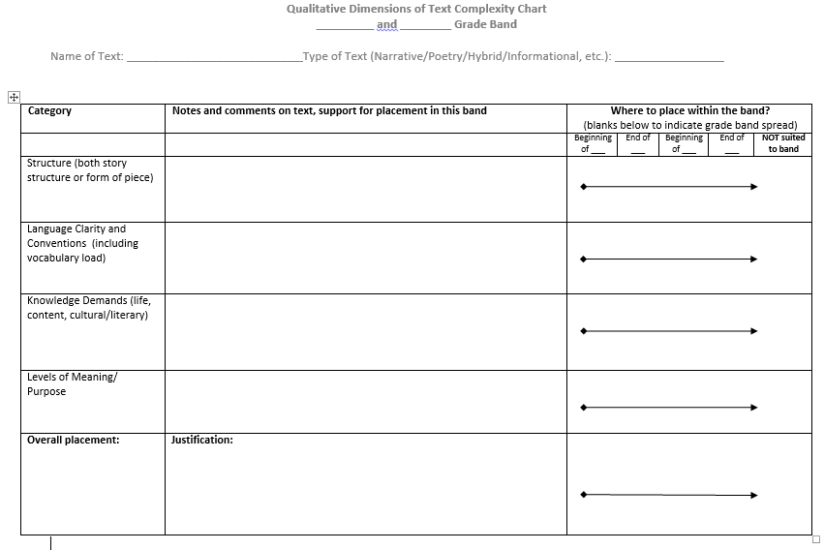
Tool: Grade-Band Placement
Notes:
This tool is in the handout on p. 11. We will not use it today, but it is helpful for teams developing materials and in analyzing materials to ensure pieces are placed appropriately, with complexity increasing gradually across the grade and grade bands.
Big Idea:
In materials, there should be evidence that this qualitative analysis has been done and materials are appropriately placed.
Details:
Be sure they understand that a text can be on either side of the band in any one dimension or even more than one but still within the band as a whole.
One method which I think is in the tool and has been very helpful is “What trumps?”. In other words, looking at your evaluation as a whole to determine which feature or features most influenced your decision as to what band to put the text in. If they’ve never done this before, it takes practice.
Publishers should provide text complexity analysis information, since this work is knowledge and time intensive.

Slide 39
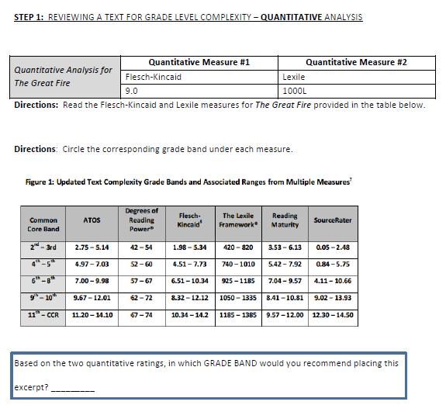
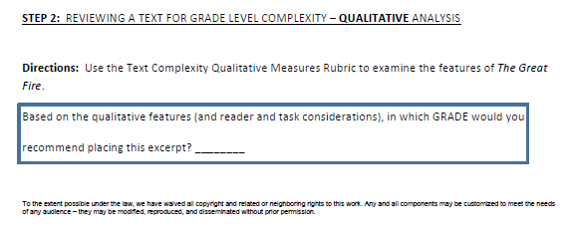
Tool: Quantitative and Qualitative Analysis
Notes:
Details:
You’ll use this, found on p. 12 in your handout, to note your findings.

Slide 40
Practice: Analyzing Text Quality
Read the excerpt from The Great Fire and, with your table group, analyze the quality of the text:
  Quantitative Analysis: Study the two measures and determine the appropriate grade band.
  Qualitative Analysis: Using the rubric, evaluate the qualitative features of the text. Provide evidence for each feature. Place the passage in the appropriate grade.
  Quality Criteria: Considering the qualitative criteria, is this text worth reading?
1
2
3
Notes:
Big Idea:
Having read The Great Fire already, now work with your shoulder partner and consider how it measures qualitatively.
Details:
Found again on p. 13 in handout
Remember, there are 4 categories: “purpose, text structure, language features and knowledge demands.”
Have them discuss with shoulder partner where the text is slightly to exceedingly complex using the rubric descriptors to guide assessment.
Have participants complete the tool on p. 12
Circulate; as pairs finish, have them check their work with the answer key in their handout packet on pp. 15-16.
Debrief the process, distributing the answer key for participants to review their work.

Slide 41
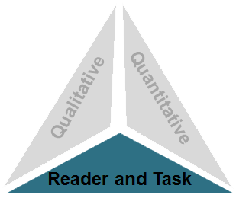
Reader and Task Considerations
Finally, there are factors relating to your readers and the task to consider:
  Desired Outcomes/Understandings
  Complexity of Content
  Specific student needs
  Reading Skills
  Motivation & Engagement
  Prior Knowledge
Notes:
Big Idea:
Reader and task considerations are the final factor in evaluating text complexity. When evaluating materials, or deciding upon texts for inclusion in curriculum, these factors should be taken into consideration
Details:
We need to consider our individual students and the tasks we have in mind before making a final decision about how (if!) to use the text with our students.
On this slide, we’ve outlined six factors to consider in this category.
Engage the whole group in a short discussion of how their consideration of reader and task factors would bear on their judgment regarding a final placement recommendation, and/or whether the reading was right for their particular classroom.
Considering their readers and the task you’re envisioning helps teachers think through the implications of using a particular text in the classroom, and may help fit the text into a specific grade.
Teachers need to be strategic about what they want students to learn by reading a text – and if they can’t answer than in a compelling way, the text probably isn’t worth reading.

Slide 42
Practice: Analyzing Text Quality
Read the excerpt from The Great Fire, and, with your table group, analyze the quality of the text:
  Quantitative Analysis: Study the two measures and determine the appropriate grade band.
  Qualitative Analysis: Using the rubric, evaluate the qualitative features of the text. Provide evidence for each feature. Place the passage in the appropriate grade.
  Quality Criteria: Considering the qualitative criteria, is this text worth reading?
1
2
3
Notes:
Big Idea:
We will wrap up our work with The Great Fire by considering if this is a text worth reading.
[Go to the next slide.]

Slide 43


  Metric 1B: Anchor texts in the materials are of publishable quality and worthy of especially careful reading; they include a mix of informational texts and literature.
Consider: Which of these K-2 read aloud texts are worthy of careful reading?
Discuss: What would instructions supporting careful reading look like for teachers or students? What actions and directions would materials include?
IMET p. 7
Notes:
Big Idea:
The second metric for NN1 is 1B, the quality of anchor texts--illustrated here with a K-2 example.
Details:
In K-2, the anchor text would be one read aloud; that is something that the students could likely not yet access on their own. So, once included texts are examined for how they are sequenced to build knowledge and vocabulary, we turn our attention to text placement.
The number of instructional minutes is limited. When considering which texts deserve more time and attention, which are featured for reading and rereading, we want to ensure they are really of quality. This does not mean all texts are read closely. This AC checks for the alignment of instructional purpose with the texts included.
Background: As we’ve previously mentioned, the popular basals are filled with literature for Tier 1 instruction. The shifts force us to closely consider our selections and this Alignment Criterion is the check.
Consider the impact of using each of these two texts. Even if you have not read the texts, what do you think reading aloud and work with of each of these texts entail? Which would be considered worthy of reading and rereading to build knowledge and reading comprehension?
Back to packet- p. 16. Discuss: Would The Great Fire be an appropriate piece to include in a 6-8 program?
Debrief the process, pointing out the answer key for participants to review their work.
Ask: How would The Great Fire provide evidence for Non-Negotiable 1?

Slide 44
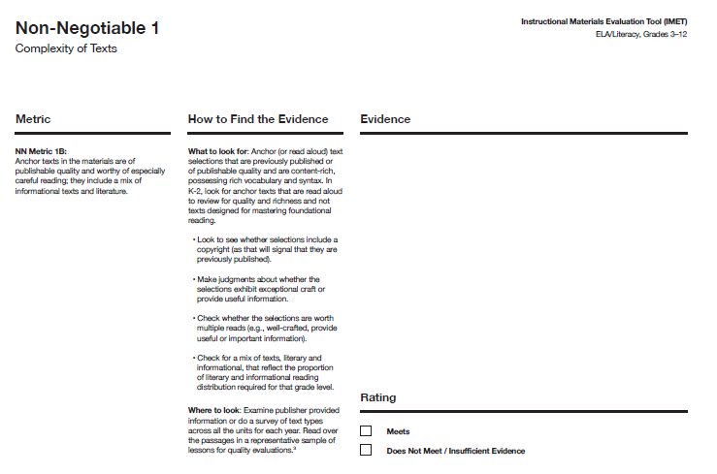
How Does This Look in the IMET?
Metric to determine if the Non-Negotiable
Criterion is met
Decide: Meet Non-Negotiable?
IMET p. 7
Notes:
Big Idea:
Bringing this learning on text complexity back to the IMET, you want to know whether the level of thinking around text complexity in which we just engaged has occurred for texts included in a submission.
Details:
Is the evidence of quantitative and qualitative analysis present and available to educators?
Are the texts appropriately placed and increasing in complexity over the year(s)?
Looking at the How to Find the Evidence column for NN1 (IMET p. 7), you’ll see that, if this level of analysis is not available within a program or submission, it may be requested from the publisher.

Slide 45
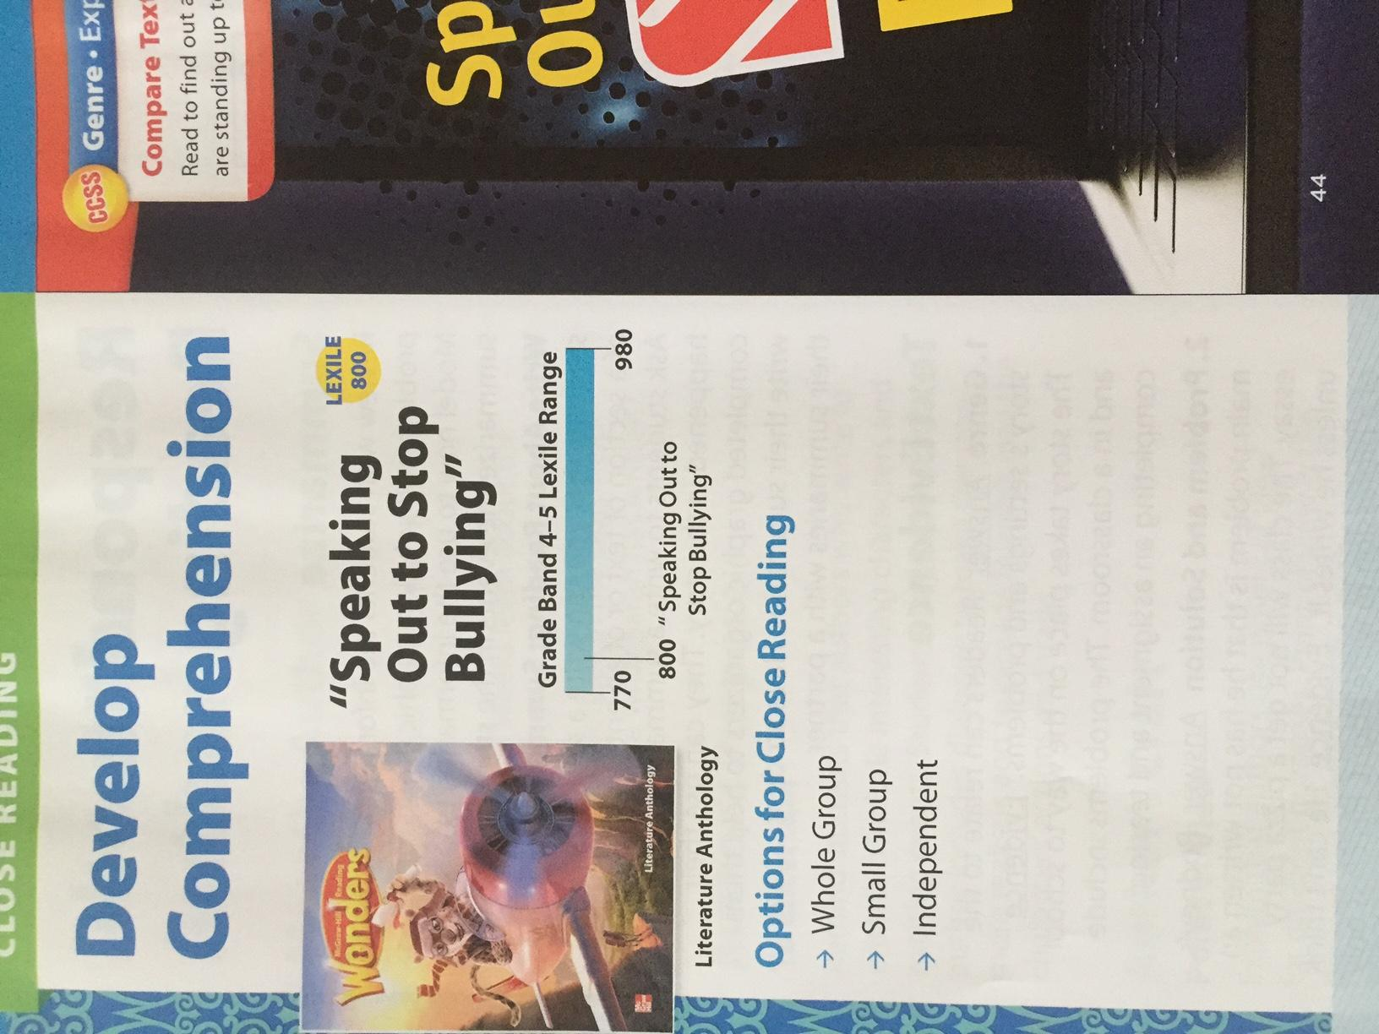
Example or Non-example?
High-quality Text
Notes:
Big Idea:
Considering IMET Non-Negotiable 1A, what might we look for in aligned materials? Let’s take a look at some examples and non-examples from real materials.
Details:
Found in handout on p. 17.
We’ll begin with a non-example.
This example is drawn from a grade 4 basal series.
The teacher is only provided a Lexile measure with the options of whole group, small group, or independent for the close reading lesson. There is no guidance on qualitative text complexity, just a Lexile measure.
Discerning examples from non-examples when reviewing is essential, both to help calibrate and to support ratings with evidence.

Slide 46
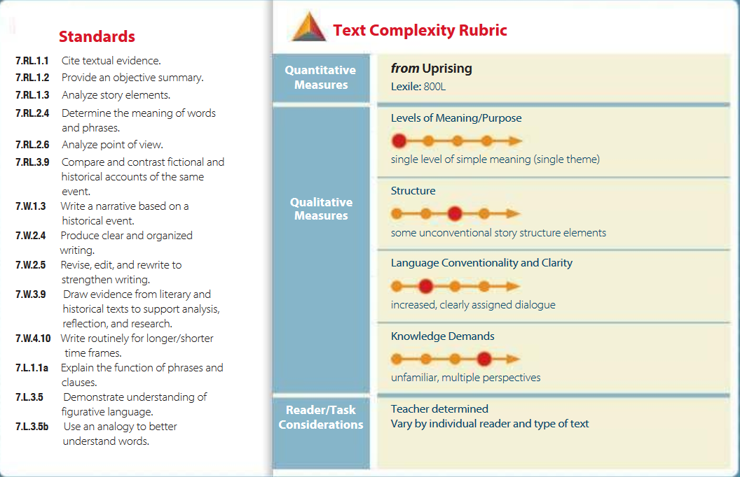
Example or Non-example?
High-quality Text
Notes:
Big Idea:
In materials, there should be evidence that this qualitative analysis has been done on all significant texts. This indicates materials are appropriately placed in terms of complexity building from 2-12, and that the analysis has been used to guide instruction.
Details:
In handout on pp. 17-18.
This type of systematic analysis takes practice and time. In a comprehensive submission, this information should be provided by the developer.
If the information is not provided, it should be gathered; otherwise, we won’t be sure we are getting rigorous content in front of our students. There is one more example in your packet.
The publisher is providing text complexity information, both quantitative and qualitative, for the teacher. This gives the teacher valuable information about why the text is placed as it is and how to best support students in accessing it.
Remind participants text can be on either side of the band in any one dimension, or even more than one, but still within the band as a whole.
Review teams might choose to verify that the analysis provided by publishers is accurate as they read and review individual lessons or units.

Slide 47
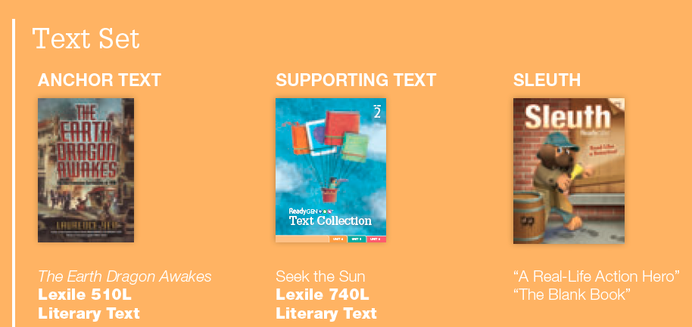
Example or Non-example?
High Quality Text
Notes:
Big Idea:
This is an example of connected texts included in Ready Gen, grade 2. The text on the left, The Earth Dragon Awakes, is labeled as the anchor text, with other supporting texts placed with it in materials.
Details:
The expectation is that these texts are complex and worthy of spending instructional time with all students.
This is an example of the high-quality text selections you’d expect to see as evidence of AC Metric 1B.
To fully ascertain the quality of texts, it is recommended that reviewers read a representative sample of passages/texts to discern whether the texts are content-rich and are worthy of multiple reads, etc.

Slide 48
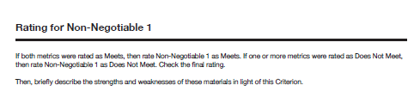
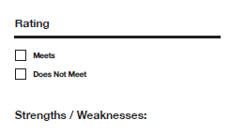
Rating
IMET p. 8
Notes:
Big Idea:
At this point when evaluating materials, an evidentiary statement is crafted to summarize the findings around Non-Negotiable 1.
Details:
If the materials meet the metrics for Non-Negotiable 1,depending on the purpose for the review, the review team should move on to Alignment Criteria 1and consider the alignment of the included texts, or move on to Non-Negotiable 2 before deciding whether to go deeper in analyzing alignment.
If it does not meet, the team will need to consider protocols for next steps. Does the publisher need to provide a list of text complexity measures of the texts included? Does the team need to do the analysis? These are points to consider in drafting your own review protocol.
We are now going to take the IMET out of order, as you might during a real review, and move on to Alignment Criterion 1, which provides a look at the texts included in a submission in more in depth.

Slide 49
Alignment Criterion 1:
Range and Quality of Texts
Notes:
Estimated time for slides 50 - 58: 45 minutes
Big Idea:
We are now going to move to Alignment Criterion 1, the Range and Quality of Texts, to continue our study of the texts included in materials.
Details:
We’ve found that when training on the IMET, it is easier to work through Non-Negotiable 1 and Alignment Criteria 1 together, and then move to the next Non-Negotiable with the related Alignment Criteria in sequence.

Slide 50
Range and Quality of Texts
Alignment Criterion 1: Range and Quality of Texts: Materials reflect the distribution of text types and genres required by the Standards and are at the right text complexity for grade level, student, and task.
Metric 1A: Balance of text types and instructional time
Metric 1B: Reflect text characteristics and genres called for by the standards
Metric 1C: Support materials provide opportunities for a range and volume of reading to achieve fluency
Example | Non-Example
IMET p. 17
Notes:
Big Idea:
There are three Alignment Criteria that support the Non-Negotiables. This first Alignment Criterion guides reviewers in considering the range and quality of texts included in materials.
Details:
Alignment Criterion 1 leads reviewers in analyzing the texts included in any submission. The metrics guide reviewers to look for evidence of alignment.
Is there a wide range of texts of varying complexity included for a variety of educational purposes?
Are the genres and characteristics of texts called for by the standards well represented?
Do materials include a range and volume of texts so students have opportunities to practice reading and rereading so they become fluent readers?
We’ll take a closer look at each of the associated metrics now.
<Allow participants to read the Alignment Criterion and metrics on page 17 of the IMET.>

Slide 51
Alignment Criterion 1A: Materials should reflect the balance of texts and instructional time called for in the Standards.
Range and Quality of Texts
Given this shift, what do you think is the percentage of informational texts, including literary nonfiction, the Standards require for both instruction and assessment? (Jot it down on a post-it.)
  In the elementary school grades?
    50% informational and 50% literary (grades K-5)
  In the middle school grades?
    55% informational and 45% literary (grades 6-8)
  In high school?
    70% informational and 30% literary (grades 9-12)
IMET p. 18
Notes:
First click brings up the 3 grade bands. As you continue clicking (per the instruction in Details, below), the percentages for each band will appear on the screen. This slide provides background for AC 1A.
Big Idea:
When we think about the balance of texts used in instruction, what should that look like to adequately prepare students for college and career by 12th grade? This recommendation in the Standards aims to align instruction with the NAEP Reading Framework.
Details:
<Allow participants a moment to read through the slide, then ask them to guess the balance for each grade band.>
It may be good to note that the governors who sponsored the CCSS made a specific request that the NAEP framework be honored in the CCSS.
Three things to remember as you evaluate instructional and assessment materials for range of texts:
Literary nonfiction should be classified as informational text.
The percentages of informational texts are 50% in ES, 55% in MS, and 70% in HS.
Teaching informational text is a shared responsibility with science and history teachers in MS and HS, but assessments should reflect the required percentages at those grades.
The question may arise that, given the above, how much informational text should be in secondary school ELA programs. The Standards don’t supply an answer to this. Some would say, and have, that everything that is read in science, technical subjects and social studies is informational so English classes should have only narrative fiction or literature. A substantial amount of text, though not necessarily a majority, in English classes should be informational.

Slide 52
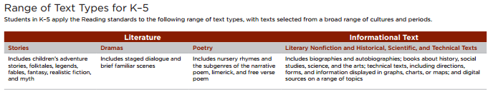
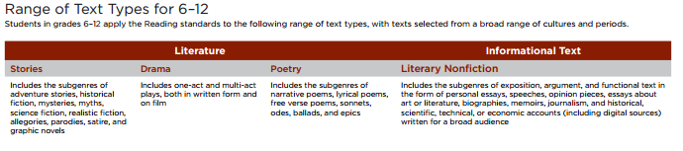
Alignment Criterion 1B: A large majority of texts included in the instructional materials reflect the text characteristics and genres that are specifically required by the Standards at each grade level.
Range and Quality of Texts
IMET p. 19
Notes:
Big Idea:
The CCSS outline the range of text types to be used instructionally so students are practicing with and learning about a wide range of materials.
Details:
Found on p. 19 of handout
The state standards might not contain this exact wording, but the intention of rigorous standards for all students would include a range of text characteristics and genres.
For example, when our IMET group was reviewing a common 5th grade program, it was noted that only one poem was included in the year of instruction. Teachers didn’t feel that was sufficient. This AC addresses this range of texts.

Slide 53
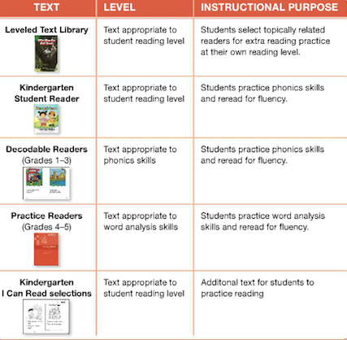
Alignment Criterion 1C: Support materials for the anchor text(s) provide opportunities for students to engage in a range and volume of reading to achieve reading fluency of grade-level complex text as required by the Foundational Skills Standards.
Range and Quality of Texts
IMET p. 20
Notes:
Big Idea:
AC 1C points to the need for students to not only be reading anchor texts full class, but to include a range and volume of reading practice that will help intentionally build their reading fluency.
Details:
Be sure to not only ensure that additional texts are included, but that they strategically build students’ ability in this area.
Note the texts intended to support fluency may be different from the qualitative and quantitative requirements of anchor texts.
This example is included in the handout on p. 20.

Slide 54
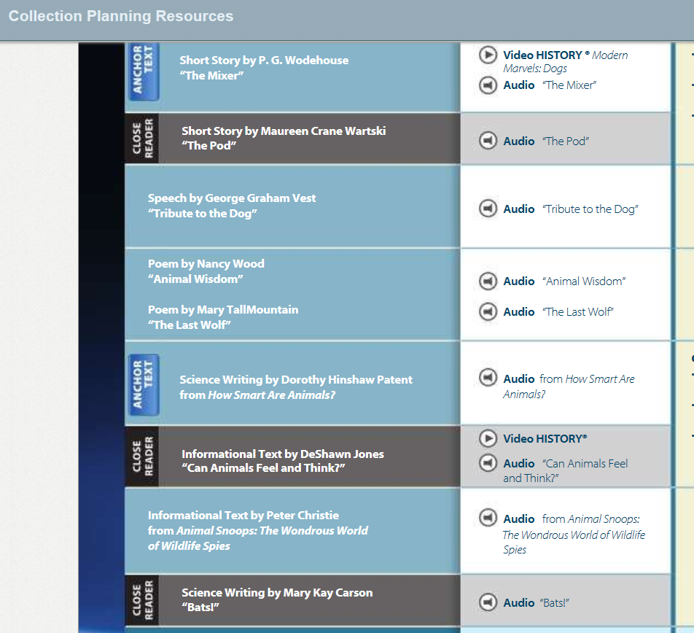
Range and Quality of Texts
Notes:
Big Idea:
AC 1C points to the need for students to not only be reading anchor texts full class, but to have a range and volume of reading that will help intentionally build their reading fluency.
Details:
This grade 6 example from Collections shows the varied types of texts students see in a series of lessons, all for a range of purposes.
The example is in the handout on p. 21.

Slide 55
Range and Quality of Texts
Practice: Assessing Alignment Criterion 1
Louisiana Guidebook Overview, Grades 3-5
Expeditionary Learning ELA Curriculum Plan, Grades 3-5
Individually rate the materials against AC 1, noting evidence and questions.
Be ready to share evidence you collected for metrics A-C.
Notes:
Big Idea:
In your handout are 2 excerpts from comprehensive materials (on pp. 22-29). Using the IMET criteria metrics, look over the excerpts to find evidence of alignment for Alignment Criterion 1.
Details:
Note: The two examples begin with Louisiana Guidebook excerpt on pp. 22-27 and Expeditionary Learning from EngageNY on pp. 28-29. Both examples should be used for the activity.
“What evidence can you find of text balance, a range of text types, and the inclusion of texts to practice and achieve reading fluency?”
“Note your evidence on your IMET and be prepared to share.”

Slide 56
Let’s reach consensus:
Range and Quality of Texts
What evidence did you find where your materials were in alignment with the criterion?
What other evidence would you want to collect?
Notes:
Big Idea:
Share evidence found for each metric. Note the places where more information would be needed.
Details:
Evidence might include:
AC 1A: Both programs appear to include a 50-50 balance of literary and informational text.
AC 1B: Anchor (central) texts are identified in the overviews. More information might be needed to ascertain that Standards-required text characteristics and genres are covered. This might be found in a text list or other overview documents.
AC 1C: There is not sufficient information included regarding fluency, though text sets are mentioned in the LA Guidebooks. Reviewers would need to look further into teacher directions and text lists provided by the publisher to gather appropriate evidence.

Slide 57
Essential Questions
How does the Instructional Materials Evaluation Tool (IMET) reflect the major features of the Standards and the Shifts?
What understandings support high-quality, accurate application of the IMET metrics?
Notes:
Big Idea:
Wherever you end the session, insert these questions and goals to reflect back on what is still unclear and what has been learned.

Slide 58
Goals
Understand how aligned materials embody the shifts inherent in the Common Core State Standards
Understand the precise meaning of each metric
Recognize examples and non-examples related to each IMET criteria metric
Notes:
Big Idea:
How has our work today helped clarify these goals?

