Slide 1
Reviewing Using the Instructional Materials Evaluation Tool: ELA
Module 102: Questions, Tasks, and Assignments
www.achievethecore.org
Notes:
This module was last updated on October 2016.

Slide 2
Essential Questions
How does the Instructional Materials Evaluation Tool (IMET) reflect the major features of the Standards and the Shifts?
What understandings support high-quality, accurate application of the IMET metrics?
Notes:
Estimated time for slides 2-10: 5-10 minutes (more if teams did not do 101)
Big Idea:
These are the overarching questions we’ll be considering as we move through the IMET training.
Details:
Have participants read over the Essential Questions (p. 1).
Whether you are here to learn as a future trainer of reviewers, a reviewer yourself, or as a learner, we’ll hope that you will ask questions, let us know if you don’t agree with something, and participate in conversations with your colleagues.
Looking at materials with a critical eye on content and alignment to standards, although done in the past, is more important than ever in ensuring our students are moving through the K-12 system and graduating ready for the demands of career and/or college.
Our major purpose while we are together is to build a deeper understanding of the IMET as a tool to analyze instructional material alignment to the Common Core State Standards (or any state college- and career-ready standards).

Slide 3
Goals
Understand how aligned materials embody the shifts inherent in the Common Core State Standards
Understand the precise meaning of each metric
Recognize examples and non-examples related to each IMET criteria metric
Notes:
Big Idea:
These are our goals for the IMET module training.
Details:
Both the Essential Questions and Goals are printed on your agenda and we’ll refer back to them at the conclusion of the training.
Have participants read over the goals (p. 1).
The first goal speaks to the understanding we will build regarding the major shifts, or changes inherent in college- and career-ready standards and how the IMET ensures alignment to them.
The second and third goals reflect the work we’ll begin as we go through the IMET and apply the tool to evaluate actual material examples for alignment to the Standards.
Both the Essential Questions and goals are printed on your agenda and we’ll refer back to them at the conclusion of the training.

Slide 4
The quality of instructional materials in our classrooms has a large impact on student learning.
“There is strong evidence that the choice of instructional materials has large effects on student learning – effects that rival in size those that are associated with differences in teacher effectiveness.”
Chingos & Whitehurst,
Choosing Blindly: Instructional Materials, Teacher Effectiveness, and the Common Core
Notes:
Facilitator Notes: Skip this slide if participants already discussed this slide in Module 101
Big Idea:
The quality of instructional materials in our classrooms has a large impact on student learning. Why is this work important?
Details:
Instructional materials in classrooms matter. If we are going to realize the promise of college and career readiness, we must pay attention to the choice of materials offered to teachers and students.
We all know the emphasis placed over the past decades on ensuring effective teaching. Perhaps we should be hearing as much about the choice of curricular materials.
With that in mind, we must recognize that reviewing materials is a time-intensive process. And it is an investment that pays off in the long run, because if teachers and students do not have well-aligned materials, the promise of the standards and college and career readiness may not come true.
Quote is drawn from a Brookings Institution report from 2012, available here: https://www.brookings.edu/research/choosing-blindly-instructional-materials-teacher-effectiveness-and-the-common-core/

Slide 5
Agenda
Module 102:
Non-Negotiable 2: Evidence-based Discussion and Writing
Alignment Criterion 2: Questions, Tasks, and Assignments
Notes:
Adjust this agenda based on your time allocation.
Big Idea:
This is the frame for the day.
Details:
Today we will work through the second Non-Negotiable criteria in the IMET: Evidence-based Discussion and Writing.
We will then look closely at the alignment criteria metrics that dig deeper into the quality of questions, tasks, and assignments.
The next module looks at Non-Negotiable 3, as well as the alignment criteria for building knowledge and access for all students.

Slide 6
Norms for Our Work
Consider two norms you’d like to see us adhere to for the next two days.
Discuss your thoughts with your shoulder partner.
Be ready to share.
Notes:
Facilitator Note: If the group has already established norms with Module 101, omit this slide.
Big Idea:
Norms will help groups work effectively with the content in the IMET Modules.
Details:
Optional: If the group has established norms, insert here. If not, take the time to allow table groups to narrow down to 2 suggested norms and then chart the suggestions, noting repeats. Material needed: chart paper, markers

Slide 7
Non-Negotiable 2: Evidence-based Discussion and Writing
Notes:
Estimated time for slides 8-21: 45-50 minutes
Big Idea:
Once you have an idea of the quality of the texts in a program, attention should be paid to what is happening with those texts. Non-Negotiable 2 is Evidence-based Discussion and Writing.

Slide 8
Evidence-based Discussion and Writing
Non-Negotiable 2: Materials provide opportunities for rich and rigorous evidence-based discussions and writing about texts to build strong literacy skills.
Metric 2A: At least 80% of all questions, tasks, and assignments in the materials are text-dependent, requiring students to draw on textual evidence to support both what is explicit as well as valid inferences from the text. The overwhelming majority of these questions and tasks are text-specific.
Metric 2B: Materials include frequent opportunities for evidence-based discussions and writing to support careful analyses, well-defended claims, and clear information about texts to address the analytical thinking required by the Standards at each grade level.
IMET p. 9
Notes:
Big Idea:
Reading Standard 1 requires the use of textual evidence to determine what the texts says, to make logical inferences, and to support conclusions in both writing and speaking. If we expect students to become adept with this, we need materials which guide students in gathering evidence and growing knowledge.
Details:
Found on p. 2 in handout
Briefly discuss with the person sitting next to you what these metrics require for materials to meet Non-Negotiable 2, highlighting or underlining the important words.
Note that while multiple standards will be addressed with every text, not every standard must be addressed with every text. Understanding the text is paramount.
The two metrics under this NN underscore the integrated nature of reading, writing, and speaking.

Slide 9
Evidence-based Discussion and Writing
Metric 2A: At least 80% of all questions, tasks, and assignments in the materials are text-dependent, requiring students to draw on textual evidence to support both what is explicit as well as valid inferences from the text. The overwhelming majority of these questions and tasks are text-specific.
Notes:
Big Idea:
In order to look closely at Metric 2A, we need to have a clear idea of what text-dependent and text-specific questions and tasks look like and mean.
Go to the next slide.

Slide 10
Considering Text Dependency
Does answering the question require that students have read the passage?
Is the question tied to a passage (not stand-alone)?
Does the question require students to cite or use evidence from the passage to determine the correct answer?
Does the question require students to follow the details of, make inferences from, and/or evaluate what is read?
Notes:
Big Idea:
Text-dependent questions help students make meaning from text, solidify learning, and teach them how to better approach reading the next text.
Details:
Background: When surveying elementary basal programs, a large % of the questions asked of students were found to not be text dependent; that is, they could be answered without any evidence of having read.
These criteria can be helpful in determining whether a question can be considered text dependent.

Slide 11
Practice: Analyzing Question Quality
With your partner, analyze the sample questions for The Great Fire excerpt in your handouts.
Use the criteria on the next page in your packet to guide your analysis of text dependency.
Compare your responses to the Answer Key on the next page.
Notes:
Handout in packet on p. 3. There is animation added to show the first two numbers and click when ready to refer participants to the answer key.
Big Idea:
On the next page in your packet are some sample questions that could be paired with The Great Fire excerpt you read and worked with during the last session.
Details:
Refer to the handout on p. 3.
[Allow participants 10 minutes to evaluate the questions using the criteria listed on the handout to guide their analysis.] Are the questions text-dependent?
Debrief using the answer key and discuss any questions that prove difficult.

Slide 12
Defining Text-Specific Questions
Text-specific questions are a subset of text-dependent questions.
The questions probe the specifics of the text and avoid “canned” questions that could be asked of any text.
These questions can only be applied to one specific text.
Notes:
Big Idea:
Non-Negotiable 2 also requires that the vast majority of the text-dependent questions be text-specific. Text-specific questions are text-dependent questions tailored to the specific text under consideration and are an indication that they have been crafted to address the specific complexities of the text. They are a higher quality of question.
Details:
Found on p. 7 in handout
Text-specific questions are a type of text-dependent question. As with the relationship between a rectangle and a square: all squares are rectangles, but not all rectangles are squares. In the same way, all text-specific questions are text-dependent, but not all text-dependent questions are text-specific.
These questions are unique to the text and cannot be applied to another text.
The standards call for questions which are text-dependent and text-specific.

Slide 13
Text-Dependent
Text-Specific
What is the author’s message in the text?
What is the main idea of the passage?
What details can you find that support the main idea?
Why does Monk ask this question, “Which ‘We the People’ has ‘troubled the nation’”?
Why does Monk claim that popular sovereignty is the form of government in America?
What evidence is there in paragraph three regarding Marshall’s claim about the “evolving nature of the constitution”?
Notes:
Big Idea:
Participants will be able to identify a text-specific question. Text-specific questions focus on what is complex and worthy of study in this particular text.
Details:
Found on p. 7 in handout
These are all real life examples of other sorts of questions compared to a text-dependent one about the same text.
It is easy for participants to see that the questions on the left side can be asked of any text, while the questions on the right can only be answered by reading the excerpt by Monk.

Slide 14
Evidence-based Discussion and Writing
Metric 2B: Materials include frequent opportunities for evidence-based discussions and writing to support careful analyses, well-defended claims, and clear information about texts to address the analytical thinking required by the Standards at each grade level.
Text dependency is not enough.
Questions must reflect the analytical thinking required by the Standards for the grade level.
Materials must include opportunities for evidence- based discussions AND writing.
Notes:
Big Idea:
Non-Negotiable 2 not only requires questions be text dependent, but also that they must reflect the thinking required by the Standards for the grade level. Students must have the opportunity to show and share their thinking by providing evidence both orally and in written assignments.

Slide 15

Example or Non-Example?
Notes:
Big Idea:
In materials, consider what writing looks like in a way that requires students to demonstrate the thinking required of the standards.
Details:
Refer to your handout on p. 8.
High-quality text-dependent questions are the second non-negotiable criteria for aligned materials. While this resource is described as CC aligned, this writing prompt is a NON-example.
While text dependency has been a relatively easy shift, in that we are seeing far more teaching and learning anchored in the text, there are fewer (though still some) non-examples, as shown here.
Say: “Take a moment to read the example. What do you notice about this task? How could it be improved?”
Some answers may include:
The task does not require students to go back to the text or to demonstrate a deep understanding of what they have read. There is no direction to refer to any text(s) or to use evidence. It is not clear how the Venn diagram connects to the assignment.
The example is also off because it assumes that if someone gets excited about playing with puppies, then they will have a positive attitude towards animals in general.
Although the instructions do not specifically require or call for evidence/using the text, these could be simply poor instructions. Not sure what grade this is but where, other than the text, would these students likely get much information on this topic? In other words– poor instructions are not the same as failure to require text-based evidence. This example is likely just that.

Slide 16
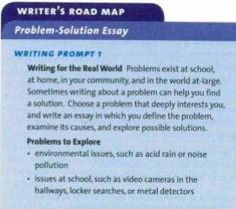
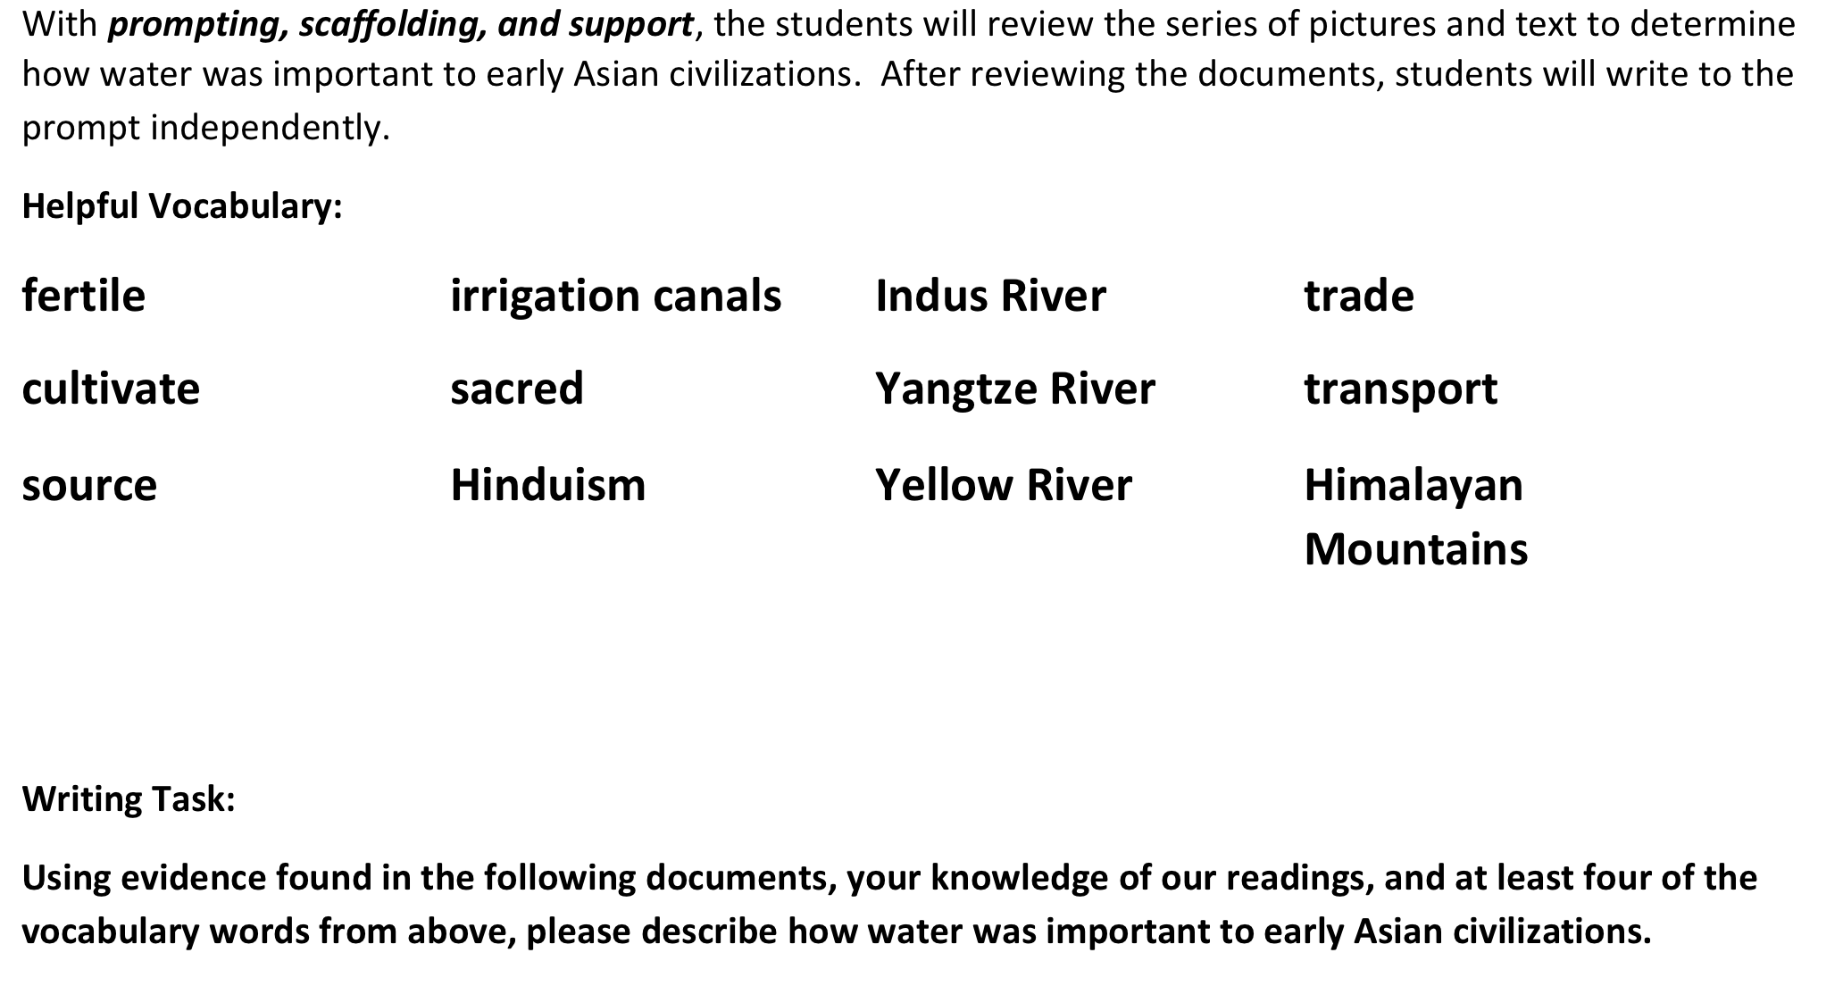
Writing to Sources: Materials should require writing to sources at all grade levels (about ¾ of tasks), with minimal use of decontextualized prompts and an expectation to use evidence.
Evidence-based Discussion and Writing
Moving From | Moving To
IMET p. 11
Notes:
In the handout, the sample on the right is expanded to include the entire sample lesson.
Big Idea:
These two examples illustrate how writing expectations have shifted with the new Standards.
Details:
In handout, pp. 8-9
Look at these two writing tasks: On the left is a grade 9 task as compared with (read aloud Document Based Questions, 2nd grade task) on the right.
In the prompt on the left, which represents what we are moving from in instructional materials, students are asked to “choose a problem that deeply interests you.” The prompt is not text-dependent.
The second piece requires students to demonstrate a deep understanding of the central texts used in class.
Often writing activities consume more time than shorter answers to text-dependent questions. Thus it is even more important these are text dependent, specific and aligned. The culminating assignment on the right falls after students have worked through the Core Knowledge Unit on the Asian civilizations. They’ve encountered read alouds, pictures and documents to build knowledge about the importance of water to the cultures, and are now supported in writing using the vocabulary of the unit.
The prompt on the left does not reference any text, nor does it support students in choosing or writing the essay.

Slide 17
Evidence-based Discussion and Writing
Engage with texts of sufficient complexity and make assertions about those texts based on textual evidence.
Draw evidence from literary or informational texts to support analysis, reflection, and research, underlies standards-aligned writing tasks.
CCSS writing requires writing to sources in instructional materials.
Integration of reading and writing is fundamental.
Notes:
Big Idea:
Non Negotiable 2 , Metric 2B, expects evidence-based discussions and writing to support careful analyses, well-defended claims and the analytical thinking required by the standards.
Details:
The CCSS demand that students directly engage with texts of sufficient complexity and make assertions about those texts based on textual evidence. Reading comprehension tasks should provide students instruction and practice aligned to standard 1 and at least one other standard as a foundation for text-based claims or inferences. Similarly, Writing Standard 9, which asks students to draw evidence from literary or informational texts to support analysis, reflection, and research, underlies standards-aligned writing tasks. With the exception of some narrative tasks, which will be discussed later, CCSS writing requires writing to sources in both instruction and assessment.”
The integration of reading and writing is fundamental to the CCSS. It is not only possible to align writing prompts to both reading and writing standards, but it’s also desirable. Writing prompts should allow students ample opportunity to address questions across the domains. The reading standards, in fact, often provide the language used in the prompt itself, while the writing standards outline the mode of the response. Later today we’ll talk also about the integration of the Language standards with the Writing and Reading standards.”
This means reviewers must look for questions, tasks, and assignments that require discussion AND writing to ensure that both of these opportunities are present and prominent.

Slide 18
Evidence-based Discussion and Writing
Practice: Writing to Sources
Activity – Analyzing Prompts for Text-Dependency
Working in pairs at your table, take the next 10 minutes to analyze the writing prompts in the envelope for the activity.
Sort the prompts into piles: text-dependent, not text-dependent, unsure.
To save time, we are not giving you the associated passages for this activity. But you can figure out which prompts are not text-dependent without them!
Notes:
This activity requires advanced preparation. The prompts on Activity sheet on pp. 10-11 should be cut apart and readied to be passed out to small groups or partnerships. The activity can be adjusted to having partnerships discuss the prompts and indicate yes or no for text dependent on the sheet itself. Both the participant and facilitator packet includes the answer key on pp. 12-13.
Big Idea:
As a materials reviewer, you will need to analyze prompts and writing assignments to ensure writing to sources is required. This ensures students are expected and taught how to meet the expectations of the CCSS.
Details: (activity instructions)
<On your tables (or in your packet on pp. 10-11) you’ll find a sampling of writing prompts. Work with your partner(s) to sort the prompts, discussing what makes them text-dependent or not. Take about 10 minutes to discuss the prompts and we’ll reconvene to discuss the activity.>

Slide 19
Evidence-based Discussion and Writing
Practice: Writing to Sources
Discuss:
What clues did you come up with that helped you determine text dependency of the prompts?
Did you have difficulty classifying any of the prompts? If so, which ones? Why?
Notes:
Big Idea:
Debrief the sorting/classifying activity.
Details:
Allow 5 minutes for initial discussion. The answer key is in the handout packet on pp. 12-13.
Allow a few additional minutes of discussion once participants receive the answer key.

Slide 20
Practice: Text-Dependent and Text-Specific Questions
Evidence-based Discussion and Writing
Use the passages (Fossil Fish Found! and Earthquakes) and associated question sets to gather evidence for the NN 2 metrics.
Be prepared to share your findings.
Notes:
Big Idea:
Passages and question sets are in the handout packet. It is time to practice in some passages drawn from grade 5 materials.
Details:
Refer to your handout, pp. 14-26.
In your handout, there are two non-fiction lessons, Fossil Fish Found! and Earthquakes. Skim and annotate the passages and read the associated question sets. This is what reviewers are instructed to do with occasional sets of questions. Collect evidence – examples and non-examples of alignment from the questions and tasks.
Take 8 -10 minutes to look at the Fossil Fish Found! and Earthquakes lessons. Skim the stories and look closely at the questions and tasks. Notice that, with the Earthquakes assignment, the notetaker students are to fill out is filled in (this is the teacher answer key). Students would be working to complete this organizer. Gather evidence of text dependency in the questions and tasks.
Debrief the evidence pairs found using the next slide.
The Earthquakes piece is part of a grade 5 unit on natural disasters. The culminating unit task involves writing an opinion letter to describe how governments should respond to natural disasters.

Slide 21
Let’s reach consensus:
Evidence-based Discussion and Writing
What evidence did you find where the passages and question sets were in alignment with the criteria?
What other evidence would you want to collect?
Notes:
Big Idea:
Debrief their findings from Fossil Fish Found! and Earthquakes.
Details:
Remember that we have just looked at one passage from a submission. The IMET instructs teams to “dip in” and look closely at the quality of texts and the associated task sets every fourth story. So, conclusions about the whole program should not be drawn from one text and task. What we are looking for is quality across the year and years in any given set of materials.
Fossil Fish Found!: The questions in both examples are text dependent. The questions associated with Fossil Fish Found! are very low-level and although they force students to use evidence from the text (RI.5.1), the level of thinking the students must do is not aligned with the intent of the Standards. The writing tasks associated are very low level, merely copying and matching names and letters.
Earthquakes: The questions associated with Earthquakes forces the students to consider the sequence of events and provide evidence from the text. The task itself has students writing (use of notetaker), while the Fossil Fish tasks have matching work done by hand, not actual student thinking through writing.
As we move into the alignment criteria, we’ll take a deeper dive into the quality of questions and tasks.

Slide 22
Alignment Criterion 2: Questions, Tasks, and Assignments
Notes:
Estimated time for slides 23-48: 45-60 minutes
Big Idea:
The Alignment Criteria must each be met for materials to be considered aligned to the shifts and major features of the Standards. Each AC has metrics associated with it; a specific number of these metrics must be met or partially met in order for the criterion as a whole to be met. AC 2 digs deeply into the questions, tasks and assignments found within a program.
Note that while NN 2 is more thoroughly focused on the questions and tasks that accompany an anchor text, AC2 focuses on any of the questions, tasks, and assignments that are part of the comprehensive curriculum. This also includes grammar and foundational skills.
Move to the next slide.

Slide 23
Questions, Tasks, and Assignments
Alignment Criterion 2: Questions, Tasks, and Assignments: Materials support students in building reading comprehension, in finding and producing the textual evidence to support their responses, and in developing grade level academic language.
AC Metric 2A: High-quality sequences of text-dependent questions
AC Metric 2B: Academic language (vocabulary and syntax)
AC Metric 2C: Balance of writing types
AC Metric 2D: Developing writing skills
AC Metric 2E: Speaking & Listening
AC Metric 2F: Grammar & Conventions
AC Metric 2G: Foundational Skills
Example | Non-Example
IMET p. 22
Notes:
Facilitator Note: To provide more active engagement here, have participants make eye contact with someone across the room and join them while standing. Have a conversation about what is important in the metrics of this criterion. Switch partners several times to give pairs time to discuss all of the metrics.
Big Idea:
We are moving now to Alignment Criterion 2, looking more deeply at what students are guided to do within a program. Once materials have been analyzed for the requirement that evidence be used in writing and speaking, AC 2 guides reviewers to more deeply examine what students are asked to do when working with texts, as well as how grammar and foundational skills are addressed.
Details:
Found on p. 27 in handout.
Read AC 2, the metrics and the How to Find Evidence columns, underlining what is important in each of the metrics. Note that there are 7 metrics associated with AC2.

Slide 24

Questions, Tasks, and Assignments
Read The Making of a Scientist.
Notes:
Big Idea:
Allow participants to read The Making of a Scientist on pp. 30-32 in the handout packet (pp. 3-5 of the lesson).
Details:
We will use this lesson to find evidence for AC 2 in just a minute.

Slide 25
Alignment Criterion 2A: High-quality sequences of text-dependent questions are prevalent in the materials and build to a deep understanding of the knowledge and central ideas of the text.
Questions, Tasks, and Assignments
What was Feynman’s father trying to teach his son with the tiles? What sentence is the main point of this scene?
In this section of the text, Feynman put the word “doing” (in the final paragraph) in italics to draw attention to it. Why is he focusing on that word, and how does it connect to the lesson his father is trying to teach him in this example?
Why does Feynman’s father tell him about the lice and the mites on birds?
IMET p. 23
Notes:
Big Idea:
Text-dependent questions are not just checks for understanding. They are designed to deepen the students’ understanding of the passage. When analyzing question and tasks sets, these metrics are used to analyze alignment to the Standards.
In the Feynman lesson you just read, these are some of the questions that guide students through the text. They are designed to support students in making meaning from the text.
Details:
Challenging portions of the text often need explaining. Why deliberately craft questions that address the most difficult parts of a text? Might want to give participants a turn and talk to discuss.
The reason this is done is that there are many ways a text can be difficult but it is still finite; the more we call this to students’ attention both through text-dependent questions and through the discussion of how students learn and put things together (metacognition), the better.
These questions providing support in building understanding of each of the examples, so when the students are asked to write, they have the raw material.
Students are asked to draw conclusions based on evidence and can have discussions to clarify their thinking with well-crafted questions.
Students practice foundational skills through, in this case, rereading.
Metric 2A requires series of questions guide students in understanding what the text is saying, not just practicing reading skills.
This is an aligned set of questions in terms of AC 2A - these are 3 examples of the aligned set of questions that accompany the text in the directions for teachers/ guiding questions for students portion of the lesson plan.
If the team working with the IMET needs more practice and information about text-dependent questions and tasks, there is a PD module available to provide more support.

Slide 26
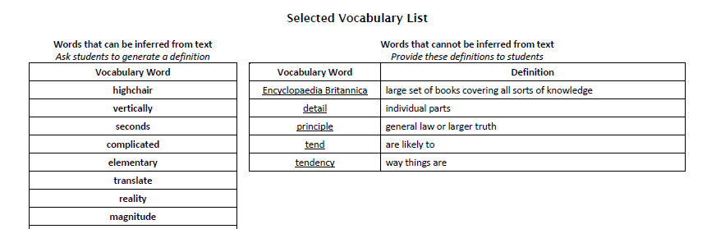
Questions, Tasks, and Assignments
Alignment Criterion 2B: Questions and tasks in the materials support students in understanding the academic language (vocabulary and syntax) prevalent in complex texts.
IMET p. 24
Notes:
Big Idea:
Alignment Criterion 2B specifically points to the need for text-based questions and tasks that call attention to the academic language that makes up complex text.
Details:
Found on p. 40 in handout
Meaning should be determined from the context of what is read, not through isolated vocabulary activities that are disassociated from text
Materials should requires students to return to the text to analyze the impact of word choice and/or sentence structure, in context.

Slide 27
The three vocabulary tiers are vital to comprehension, but Tiers 2 and 3 typically require more deliberate effort.
Questions, Tasks, and Assignments
Tier 1
Tier 2
Tier 3
Words of everyday speech
Appear in a range of texts
Specific to a domain or field of study
Ex: lava, amoeba, legislature, aorta, circumference
Ex: relative, accumulate, formulate, specificity
Ex: chair, book, drive
Consider these words found in the Feynman lesson:
highchair
vertically
seconds
complicated
elementary
translate
reality
magnitude
frightened
consequence
slightest
peck
lice
flakes
protein
Notes:
Big Idea:
These are words that are drawn from the lesson. So how do we build vocabulary instruction that will build the student capacity that is so critical in understanding passages containing these words?
Details:
The CCSS vocabulary standards, found in both the Reading and Language standards, are based on the work of Isabell Beck and Margaret McKeown and colleagues (Robust Vocabulary Instruction, Bringing Words to Life). They classify words into tiers to help teachers decide how to most effectively teach vocabulary.
How many of you know the 3-tier classification system?

Slide 28
Questions, Tasks, and Assignments
Guidelines for Vocabulary
  Focus primarily on tier 2 words?
  Target words or phrases that are central to understanding the text?
  Ask students to use context to determine meaning?
  Ask about the meaning of figurative language, not labels of literary terms?
  Require use of resources?
  Attend to the particulars of the standards at each grade?
Notes:
Big Idea:
When evaluating materials, look for their treatment of vocabulary.
Details:
Check whether questions and tasks guide students to determine the meaning of these words from the context or how they are being used in the text.
Look for questions and tasks that require students to explain the impact of specific word choices on the text with emphasis on those words that are consequential to the meaning of the text.
Look for ample opportunities for students to practice the use of academic vocabulary in their speaking and writing.
Look for ample opportunities for students to notice and practice using academic language.

Slide 29
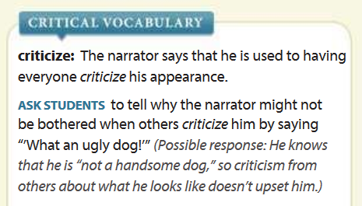
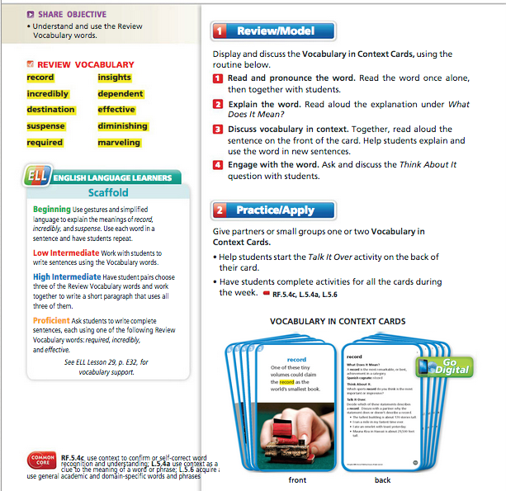
Academic Vocabulary: Examples or Non-Examples?
Questions, Tasks, and Assignments
Notes:
Big Idea:
Consider the two examples from “CCSS-aligned” textbooks. The one on the left has students working with vocabulary “in context” on cards. The words are supported with a picture and a sentence definition not drawn from the central text. The example on the right is embedded in the context of the central selection.
Which do you think aligns with the expectations of Alignment Criterion 2B?
Details:
Found in p. 42 in handout.
Vocabulary in context means related to words and phrases in more than one sentence. The context of a story or text passage will better support students in learning vocabulary. In the example on the left, the context of the passage is not mentioned or available to the students.
In the example on the right, students have the passage at the ready. They can refer back to the text for evidence and justification for reasoning about words or phrases.

Slide 30

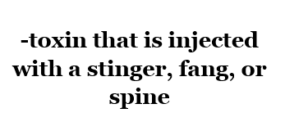
Questions, Tasks, and Assignments
Example
Notes:
Facilitator Notes: Sample task is from Expeditionary Learning (Grade 4, Module 2B, Unit 1, Lesson 8)
Big Idea:
Here is an example of a task that is aligned to AC2B
Details:
Found on p. 43 in handout
This slide shows a sample of a 4th grade Vocabulary Word Cards Lesson shows that students are building academic vocabulary through both learning words and meaning from more traditional flashcards and then reading to look for evidence of the words in the context of their texts on animal defense mechanisms.
Take a look at your materials and look back at The Making of A Scientist. Where do you see examples of 2B in this assignment?
Answers: words are defined beside the text itself; vocabulary is listed at the end of the materials with a note about whether words can be inferred based on meaning; “vocabulary task” is the 2nd component of the first page of the lesson plan; Q’s 2 and 4 examine use of specific words and use of italics.

Slide 31
Questions, Tasks, and Assignments
Alignment Criterion 2C: Materials focus on argument and informative writing in the specified proportions. Alternately, they may reflect blended forms in similar proportions (e.g. exposition and persuasion).
3-5 | 6-8 | 9-12
Exposition 35% | Exposition 35% | Exposition 40%
Opinion 30% | Opinion 35% | Opinion 40%
Narrative 35% | Narrative 30% | Narrative 20%
IMET p. 25
Notes:
“We’ll now turn to the other 5 Alignment Criteria to define them and illustrate some examples and non-examples.”
Big Idea:
Alignment Criterion 2C moves beyond writing as a means of answering text-dependent questions and into more extended writing tasks where students must construct an argument or present information. The balance between types of writing is a critical shift.
Details:
Found on p. 44 in handout.
The proportions of expository, opinion, and narrative writing by grade level band are highlighted here.
Note that this is a slight variance from the K-2 expectations, where a range of writing tasks are expected but without the proportion requirements.
Reviewers must examine the writing tasks and culminating tasks in order to determine how well they match with the grade level distribution.

Slide 32
Questions, Tasks, and Assignments
Example
Culminating Task: In the final paragraph Feynman says he “was given something wonderful when he was a child.” Using two of the examples from the text, explain what he was given and how it influenced his life.
Notes:
Big Idea:
Take a look at the culminating task for The Making of a Scientist.
Details:
What is strong about this task? Will the outcome be expository, opinion, or narrative? What is required from students?
The task will be expository.
Students will need to use evidence from the reading and question responses to write.
They will also need a deep understanding of the central ideas of the text to complete the assignment.

Slide 33
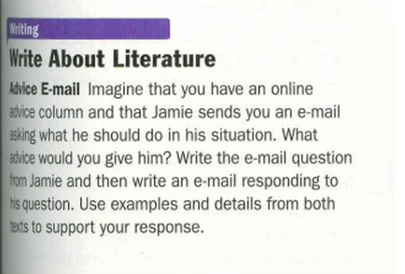
Alignment Criterion 2D: Materials support students’ developing writing skills over the course of the school year. This includes writing opportunities for students that are prominent and varied.
Questions, Tasks, and Assignments
Do students write to build understanding of text as well as for teachers to assess understanding of text?
IMET p. 26
Notes:
Big Idea:
Alignment Criterion 2D will ask your team to look at the writing tasks across the submission. To become proficient writers, students should be offered and expected to write across the curriculum, for a variety of purposes and audiences.
Details:
Found on p. 44 in handout.
This is an example of a varied grade 9 writing task. It asks students to write a question from a character, then respond using information from a second text.
Frequent, varied writing assignments provides students the practice opportunities they need to become proficient writers. Materials should feature both writing assignments and instructional support.
An example is shown on the next slide.

Slide 34
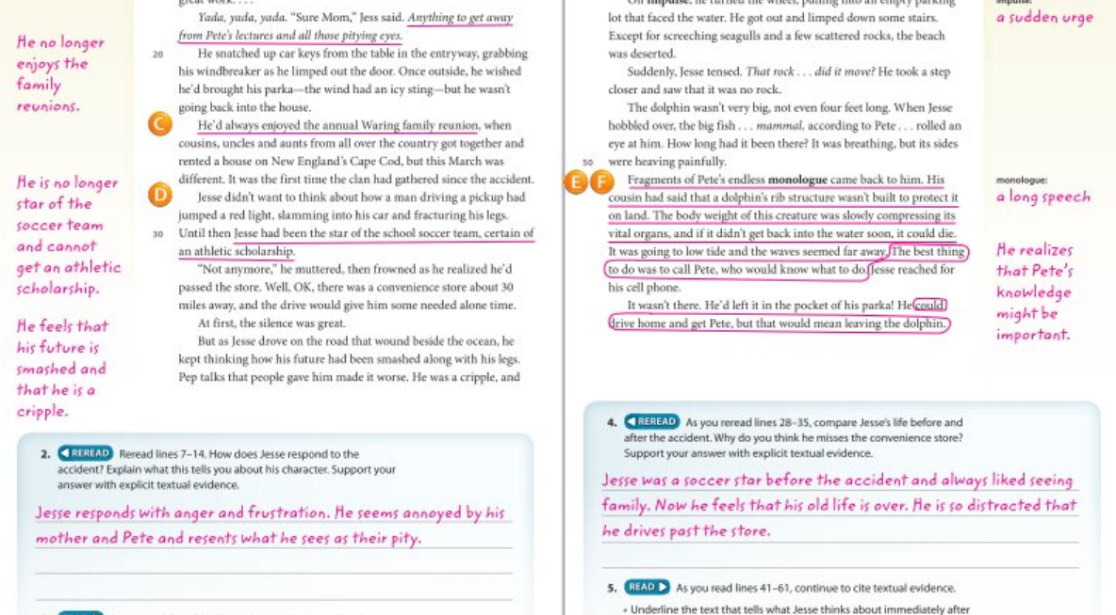
Alignment Criterion 2D: Example
Questions, Tasks, and Assignments
Notes:
Big Idea:
In aligned materials, writing and reading are integrating in meaningful ways to support students in making meaning from text. This should happen often and in a variety of ways. This is an example of using writing to make meaning from text in grade 9.
Details:
Handout in packet, p. 45
Varied writing means varied across the materials in terms of purpose, length, form and type. Students should be using writing to convey and synthesize thinking about things they are learning through listening, discussion and reading. In this example, students are using writing to respond to questions about the text and to show their thinking. This is very powerful for the student and the teacher.
This is an example of varied writing. If assignments and uses like these are included across the submission, along with prominent culminating tasks, writing opportunities would be considered prominent and varied.

Slide 35
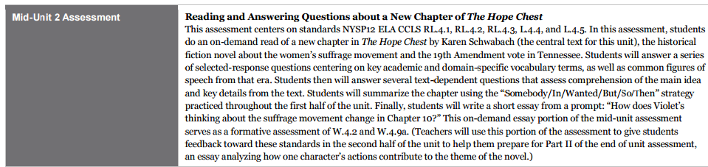
Questions, Tasks, and Assignments
Example
Notes:
Big Idea:
Note that AC2D not only calls for prominent and varied writing tasks, but for materials that support students’ developing skills.
Details:
The next example on your handout is a description of one of the assessments in the grade 4 Expeditionary Learning curriculum, in unit 2. A clear description of the task and teacher notes are written out for you on p. 46 in your handout.
What do you notice about this task, and the highlighted teacher note? How does this support students’ as they are developing writing skills?

Slide 36
Questions, Tasks, and Assignments
    Alignment Criterion 2E: Materials integrate speaking and listening into lessons, questions, and tasks and build in frequent opportunities for collaborative discussions.
What do the Standards say about speaking and listening?
Read either the 6-8 or K-2 Speaking and Listening Standards. Discuss with your shoulder partner what you notice.
IMET p. 27
Notes:
Big Idea:
Alignment Criterion 2E focuses on the critical need for speaking and listening opportunities to be a part of instruction. Discussion has to be one of the best scaffolds for getting students into complex text and supporting students in strong writing and thinking.
Details:
Take a moment to read the 6-8 or K-2 grade level’s S&L standards and discuss with your shoulder partner what you notice. (If you are using paper copies of the Common Core State Standards, refer to page 23 for the K-2 Standards or page 49 for 6-8.)
When you dig into materials, these expectations should be present! Why? [answers below]
Speaking and listening are tied together – discussions require the practice of both.
In elementary school, speaking and listening is support for struggling students and new-to-English speakers. It can empower learners and provide preparation for writing.
We must teach children how to have conversations – many do not know how. Teachers often ask for more support in orchestrating classroom discussions. Aligned materials include support.

Slide 37
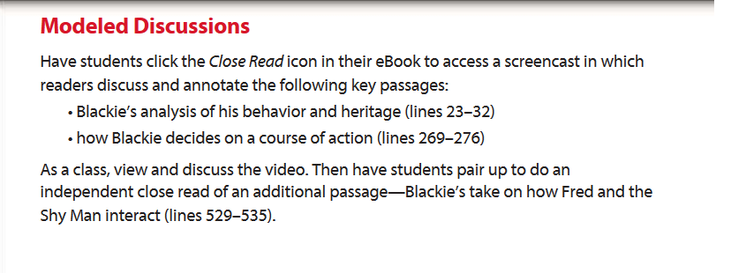
Example
Questions, Tasks, and Assignments
Notes:
Big Idea: Support for classroom discourse should be present in materials to allow all students access to the Speaking and Listening Standards.
Details:
In this task, students are asked to watch a video where discussion and annotation are modeled. Then, in pairs, students use the model to continue working on the text under study. This is an example of well-aligned support for students using discussion to process the complex text under study.
Next, we are going to hear from a Common Core State Standard workgroup member about the importance of speaking and listening.

Slide 38
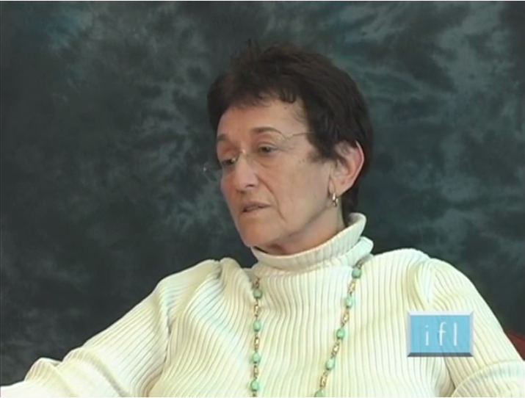
Questions, Tasks, and Assignments
Why speaking and listening?
Consider the following:
Lauren Resnick, University of Pittsburgh
  How does Accountable Talk provide the conditions for all students to be focusing on text?
  What are the roles of Accountable Talk in improving learning?
  Why does having all students engaging in the work of the lesson address the “equity” issue?
Notes:
Prepare the video clip and have speaker capability set up in advance of the slide. http://ifl.pitt.edu/index.php/educator_resources/video_library/ask_the_educator/lauren_resnick
(Video title: How Does Accountable Talk promote learning?)
Big Idea:
This clip of Lauren Resnick, a professor at the University of Pittsburgh, illustrates the critical importance of having students engage in a range of conversations. As you watch and listen, consider the questions on the right of the screen, also in your packet with space to take notes. This provides background for the Speaking and Listening criteria.
Details:
You can find our discussion questions in your packet on p. 47.
<After clip, discuss and debrief>

Slide 39
    Alignment Criterion 2F: Materials include explicit instruction of the grammar and conventions standards for grade level as applied in increasingly sophisticated contexts, with opportunities for application both in and out of context.
Questions, Tasks and Assignments
Conventions of Standard English
Knowledge of Language
There are standards for two topics:
Grammar and usage
Punctuation, capitalization, and spelling
Instructional materials should follow the specific emphases in the standards.
In addition, materials should also include “refreshers” from earlier grades.
Students must become proficient not just at using the “correct words” (the conventions), but also at choosing the “right words” to convey the intended meaning and the intended effect.
Use language precisely and effectively, not just correctly.
IMET p. 28
Notes:
Big Idea:
The Language Standards include students’ knowledge and application of conventions and vocabulary. Since vocabulary is covered in AC2B with questions and tasks, AC2F deals exclusively with knowledge and application of conventions and language.
Details:
In the conventions category at each grade, there are standards for two topics:
1. Grammar and usage
2. Punctuation, capitalization, and spelling
Within these two topics, there is usually a different emphasis at each grade or grade band. For example in Conventions, for spelling the emphasis grows in the following way:
Lower elementary grades -- students are required (not surprisingly) to learn spelling patterns.
Upper elementary grades -- This requirement evolves to requiring use of resources to determine correct spelling.
Grades 6-12 -- The requirement is simply to “spell correctly.”
The last bullet indicates materials should include refreshers from earlier grades. Reviewers might ask, How do we know which conventions should be included from earlier grades? Refer to the chart in the Standards on page 30. In the case of Language, reviewers should pay close attention to the Standards.
Beyond conventions, students are also expected to understand how word choice can have intentional meaning, and make use of precise and effective word choice.

Slide 40

Notes:
Big Idea
Reviewers need to look for evidence of explicit grammar instruction in and out of context.
Details
Found on p. 48 in handout
Take a look at the weekly planner found in the Journeys Curriculum. Where would you begin in order to evaluate AC2F?
Note: the “out of context” grammar is clearly labeled in the planner. Reviewers would have to take a look at the work with the anchor text in order to see whether grammar instruction within the context of the text is included.

Slide 41
Questions, Tasks, and Assignments
    Alignment Criterion 2G: Materials address grade-level standards for foundational skills by providing instruction and diagnostic support in phonics, word recognition, and fluency through a research-based and transparent progression to develop proficient readers
To clarify the progression of foundational skills,
go to the Standards!
IMET p. 29
Notes:
Reading Standards: Foundational Skills are only applicable for grades K-5. For teams working with materials in grades 6 and up, this criteria is not applicable.
For teams working with K-2, NN4 is present in the K-2 IMET to provide more in depth guidance here. This module is available as an add-on for K-2 reviewers– Module 104.
Please differentiate this part of the module to be appropriate for the team with whom you are working.
Big Idea:
The Reading Standards: Foundational Skills are reflected in Alignment Criterion 2G on the IMET. As you would expect, there are differences between the K-2 and 3-12 IMETs for this criteria.
Details:
Have participants read p. 29 of IMET. What does this section of IMET suggest are the key component of materials that support the instruction of foundational skills?
The key components are:
A variety of materials for systematic, regular and frequent practice off all foundational skills.
A transparent progression of foundational skill instruction in phonics, word recognition, vocabulary, syntax, and reading fluency.
Routines and procedures that support this component of instruction
A connection to making meaning– comprehension and purpose.
Frequent practice of oral and silent reading to achieve fluency.

Slide 42
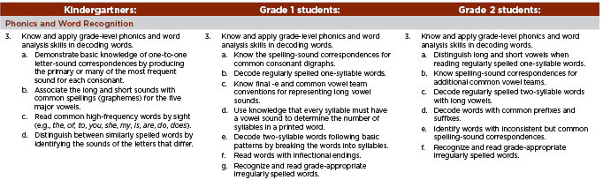
The Standards include Reading Foundational Skills for grades K–5 in these categories.
Questions, Tasks, and Assignments
K-5
Phonics and Word Recognition
Fluency
K-1
Print Concepts
Phonological Awareness
Examine the standards:
Notes:
For K-2 and 3-5
(Optional): Included in your packet on p. 49 is the Reading Foundational Skills Scavenger Hunt worksheet and activity. If participants are not familiar with the Foundational Skills Standards, this activity builds knowledge of the progression of skills required at each grade level. Allow 10 minutes for the completion of the Scavenger Hunt and 3-5 minutes for debrief, if used.
Big Idea:
There is a progression of foundational skills called for in the Standards.
Details:
Reviewers of K-5 materials need to be familiar with the Standards. Appendix A of the Common Core State Standards provides further detail on the research behind and the progression of the foundational skills sequence.

Slide 43
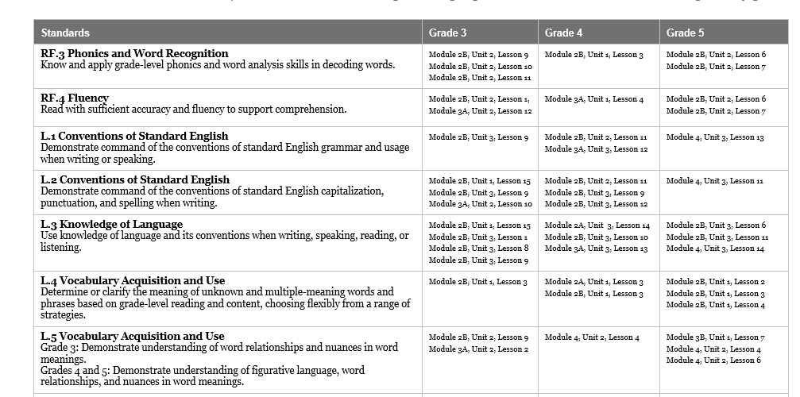
Example
Notes:
Big Idea:
Instructional materials must include explicit opportunities to build foundational skills.
Details:
Found on p. 50 in handout
To gauge the quality of these materials, reviewers would have to look more closely at the content and ensure that it meets the expectations outlined in the How to Find Evidence column on the IMET.
This example shows how the Expeditionary Learning curriculum provides users with a sequence showing how and where related foundational skills and language standards are taught, by grade level.

Slide 44
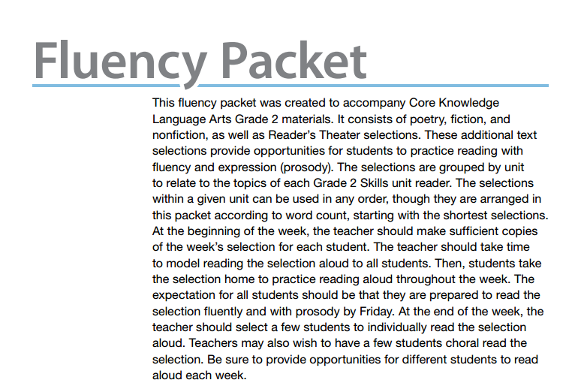
Example
Notes:
Big Idea:
This example comes from the fluency packets associated with CKLA - The texts are tied by topic to the grade level skills unit reader, and give time for students to practice fluency and prosody on a regular basis.

Slide 45
Questions, Tasks, and Assignments
With your partner, refer back to the metrics for Alignment Criterion 2.
Consider The Making of a Scientist. As a reviewer today, where did you find examples of alignment for Alignment Criteria 2?
What would you still need to investigate?
Notes:
Big Idea:
The Alignment Criterion 2 indicators allow reviewers to analyze the quality of the questions, assignments, and tasks in any program. Remember that we have just looked at single passages. The IMET instructs teams to “dip in” and look closely at the quality of texts and the associated task sets every fourth story. So, conclusions about the whole program should not be drawn from one text and task. What we are looking for is quality across the year and years in any given set of materials.
Details:
In the materials we were able to see examples of AC2A, 2B and 2C, and some opportunities for 2F Speaking and Listening, though more would be expected.
Reviewers would need to look much more closely in order to evaluate materials for 2D, 2E, and 2G.
And, of course, we are just looking at one sample. To accurately gauge program alignment, the IMET recommends reviewers analyze every 4th set of questions and tasks.

Slide 46
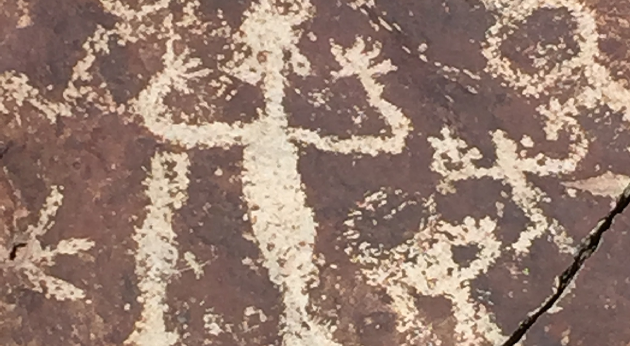
Break
Notes:
Insert slide wherever a break is needed

Slide 47
Essential Questions
How does the Instructional Materials Evaluation Tool (IMET) reflect the major features of the Standards and the Shifts?
What understandings support high-quality, accurate application of the IMET metrics?
Notes:
Big Idea:
Wherever you end the session, insert these questions and goals to reflect back on what is still unclear and what has been learned.

Slide 48
Goals
Understand how aligned materials embody the shifts inherent in the Common Core State Standards
Understand the precise meaning of each metric
Recognize examples and non-examples related to each IMET criteria metric
Notes:
Big Idea:
How has our work today helped clarify these goals?

