Slide 1
Reviewing Using the Instructional Materials Evaluation Tool: Mathematics
Module 101: Focus and Coherence
(Non-Negotiable Criteria 1 and 2)
www.achievethecore.org
Notes:
This module was last updated on December 2016.

Slide 2
“In general, teachers are much more likely to cover topics presented in the materials selected by their school or district than to cover topics not included; they are likely to follow the sequence of topics in the selected materials; and their pedagogical approach is influenced by the instructional design of the materials. The evidence is clear that instructional interactions between students and teachers are framed by the instructional materials that are provided by their schools and districts.”
Chingos & Whitehurst,
Choosing Blindly: Instructional Materials, Teacher Effectiveness, and the Common Core
Notes:
Big Idea: Why is this work important?
Talking Points:
- <Have participants read the quote.> Ask: How many of you does this resonate with?
Instructional materials may be one of the most important factors in student learning.
In moving to CCSS, the textbook is an important guide for teaching the standards, especially for new teachers, but also for more experienced teachers who are learning what the new standards mean. That’s why it’s so important that instructional materials get it right!
Details: Quote is drawn from a Brookings Institution report from 2012, available here: http://www.brookings.edu/~/media/research/files/reports/2012/4/10%20curriculum%20chingos%20whitehurst/0410_curriculum_chingos_whitehurst.pdf

Slide 3
Essential Questions
How does the Instructional Materials Evaluation Tool (IMET) reflect the major features of the Standards and the Shifts?
What understandings support high-quality, accurate application of the IMET metrics?
Notes:
Big Idea: Share essential questions and frame the session
Depending on how the modules are delivered, this slide may be used to have participants reflect on what they have learned so far, or just reviewed quickly to remind participants of the purpose of the work.
Talking Points:
These questions will be guiding our thinking as we work through all of the modules. We will come back to reflect on them at the end of each module.
In the modules, we are digging into what the Standards and Shifts look like in instructional materials – the IMET is the too to help us to do it.
To use the tool accurately, we need to bring our knowledge and understanding of CCSS, and think about how our own understandings get applied through a new lens.
It is important to set aside personal style or preference when teaching the materials. The goal of the IMET is not to find your perfect match in terms of your own teaching style it is a fairly legalistic and bureaucratic task on whether or not the materials reflect these high level shifts .

Slide 4
Goals
Understand how aligned materials embody the shifts inherent in the Common Core State Standards
Understand the precise meaning of each metric of the IMET
Recognize examples and non-examples related to each metric of Non-Negotiable 1 and 2 of the IMET
Notes:
Big Idea: Share goals of the session
Talking Points:
The goals outline what participants will know and be able to do at the end of this module.
As the goals imply, engaging in this process is a constant cycle of learning. What we know about the CCSS informs how we look at the IMET; what we learn about the IMET deepens our understanding of CCSS.
The second goal refers to the fact that the IMET is designed to focus on the Standards as well as the shifts required by them. The structure shows the primacy of Focus and Coherence as non-negotiables, which are the topics for this module.

Slide 5
What Is the IMET?
The Instructional Materials Evaluation Tool (IMET) is designed to help educators determine whether instructional materials are aligned to the Shifts and major features of the Common Core State Standards
Notes:
Big Idea: Define the IMET and the purpose of it.
Talking Points:
There are lots of ways to judge the quality of textbooks.
The IMET is a tool to judge alignment to common core state standards.
There are 2 versions of the IMET: K-8 and HS. These modules will focus on K-8.
Also available for Literacy in K-2 and 3-12.
All versions available on Achieve the Core. (http://achievethecore.org/page/783/instructional-materials-evaluation-tool-imet)

Slide 6
What’s In the IMET?
Non-Negotiable Alignment Criteria
  Freedom from Obstacles to Focus
  Focus and Coherence
Alignment Criteria
  Rigor and Balance
  Standards for Mathematical Practice
  Access for All Students
Notes:
Big Idea: Give a high-level overview of the tool
Talking Points:
There are two types of criteria in the IMET – Non-Negotiable and Alignment. Each criterion has metrics to help determine whether the criterion is met.
The Non-Negotiable criteria evaluate the way instructional materials treat the most important shifts required by the CCSS- focus and coherence.
The Alignment criteria evaluate other important aspects of the shifts and standards.
You will know all of this well by the end of the 2 days.

Slide 7
How Do the Publisher’s Criteria Support Use of the IMET?
Developed by the CCSSM writing team, to support faithful implementation by providing criteria for alignment to the Standards
Provides detail and further guidance on criteria and metrics of the IMET
Notes:
Big Idea: Define the Publishers’ Criteria and explain how it can support users of the IMET
Talking Points:
The Publishers’ Criteria (K-8 and High School), created in 2012 by the Standards’ authors, were written to capture the overarching instructional practice goals which should be present in Common Core-aligned materials.
They are publisher-facing documents that offer guidance on how to embed the Standards and Shifts into instructional materials.
It is helpful for reviewers to be familiar with the Publishers’ Criteria and the document can be a helpful reference during the training and review processes.
K-8 Publishers’ Criteria can be found here: http://www.corestandards.org/assets/Math_Publishers_Criteria_K-8_Summer%202012_FINAL.pdf

Slide 8

“These standards are not intended to be new names for old ways of doing business. They are a call to take the next step.”
−CCSSM, page 5
Notes:
Big Idea: The Standards require change in the way we do business, especially in instructional materials
Talking Points:
This quote comes from the introduction in Common Core State Standards document.
This is the message for everyone involved. In the past, state standards might have been revised and it didn’t necessarily have an impact on instructional materials, which mean that what happened in the classroom was business as usual.
That can’t happen here—there are some real shifts represented with these standards. There is no room for old ways of doing business in instructional materials.
This means that materials need to do more than just swapping topics from one grade to another.
<The facilitator may choose to share a personal story of changes in district and/or state to help in framing the need for change.>

Slide 9
How is Reviewing Using the IMET Different?
Traditionally, judging alignment has been approached as a crosswalking exercise. But crosswalking can result in large percentages of “aligned content” while obscuring the fact that the materials in question align not at all to the letter or the spirit of the standards being implemented.
- K-8 Publishers’ Criteria, Spring 2013, p. 1
Notes:
Big Idea: This review process may be very different from how we’ve looked at materials in the past
Talking Points:
<Have participants read the slide>
Although it’s important to make sure that all required content is included, cross-walking often leads to a bureaucratic checklist about what content is covered in books.
Ask: How many people have been a part of a review process that required cross-walking?
The IMET requires a process that looks for materials that truly embody the shifts required by the Standards.
This will allow us to avoid books which may have a Table of Contents that reads like the Standards but doesn’t take into account that some clusters of Standards require more time or attention, or misses the Standards’ emphasis on a balance of rigor.

Slide 10



The CCSS Requires Three Shifts in Mathematics
Focus: Focus strongly where the Standards focus.
Coherence: Think across grades, and link to major topics within grades.
Rigor: In major topics, pursue conceptual understanding, procedural skill and fluency, and application.
Notes:
Big Idea: Give a reminder of the shifts which are the basis for the IMET
Note: This module is designed for participants who are already very familiar with the shifts required by CCSS.

Slide 11

Notes:
Big Idea: Quick visual reminder of the shift of Focus
Talking Points:
<Ask: What does this tell you about the shift of Focus?><2 minutes>

Slide 12
Shift 1: Focus
Narrow the scope of content
Focus deeply on what is emphasized in the Standards
Move away from "mile wide, inch deep"
Less topic coverage can be associated with higher scores on those topics covered
Focus strongly where the Standards focus
Notes:
Big Idea: Review of the shift of Focus.
Talking Points: (corresponds to each bullet on the slide)
Significantly narrow the scope of content and deepen how time and energy is spent in the math classroom. This is that notion of “the power of the eraser.” We don’t focus and do less just to do less; we focus to allow the time to go more deeply into content.
Focus deeply on what is emphasized in the Standards, so that students gain strong foundations. Rather than skating through a lot of topics (covering the curriculum), there are fewer topics on the list– but the expectations in those topics are much deeper. Without focus, deep understanding of core math concepts for all students cannot be realized. Relate to Algebra and HS graduation.
Move away from "mile wide, inch deep" curricula. Many math teachers in the U.S. can relate to a “mile wide, inch deep” curriculum where instruction feels rushed. Prior to CCSSM, teachers might even realize that students don’t have a solid understanding and move on anyway, due to the pressure to cover everything.
“Less topic coverage can be associated with higher scores on those topics covered because students have more time to master the content that is taught.” -Ginsburg, et al., 2005
(Summary information for the slide.) The Trends in International Math and Science Study (TIMSS) not only ranks assessment performance of many industrialized nations, but also analyzes the education systems of those countries. It showed that curriculum in the U.S. “covers” far more topics than those countries that significantly outperform us. In fact, the TIMSS study revealed that in grade 4, high scoring Hong Kong covered only 52% of the topics assessed in TIMSS. However, the U.S., on average, covered 83%. In the U.S. we have been covering more topics with the net result of learning less about them. In essence, we need to “go slow to go fast”- when students have a deep understanding of major topics, they are able to make connections and figure out problems, even those they haven’t been explicitly taught.

Slide 13

Notes:
Big Idea: Quick visual reminder of the shift of Coherence
Talking Points:
<Ask: What does this tell you about the shift of Coherence?> <2 minutes>

Slide 14
Shift 2: Coherence
Connect learning within and across grades
Each standard is not a new event, but an extension of previous learning
Mathematics makes sense.
Think across grades and link to major topics within grades
Notes:
Big Idea: Review of the shift of Coherence
Talking Points: (corresponds to each bullet on the slide)
There are two types of coherence required by the Standards: connecting topics within a given grade and connecting learning across grades. Both of these enhance students’ understanding of mathematical concepts. The organization of the Standards themselves build on previous learning, sometimes explicitly in the language of the cluster headings.
Teachers should be able to count on conceptual understanding of core content and build on it. Sometimes cluster headings specifically state that students are building on previous learning, but even when it’s not explicitly named in a standard or cluster, connecting to previous learning is part of the design of the Standards. Typically, current math instructional materials spend as much as 25% of the instructional school year on reviewing and re-teaching previous grade level expectations, not as an extension but rather as a re-teaching which doesn’t leverage the coherence of mathematical ideas to focus on the important content. This eliminates the idea for teachers that “it doesn’t really matter whether my students learned this topic, they will see it again next year.”
Mathematics makes sense – this is what high-performing mathematics get. It speaks to the idea that math does not consist of a list of isolated topics, but the connectedness is what helps us make sense of math.

Slide 15

Notes:
Big Idea: Quick visual reminder of the shift of Rigor
Talking Points:
<Ask: What does this tell you about the shift of Rigor?> <2 minutes>

Slide 16
Shift 3: Rigor
The CCSSM require a balance of:
  -Conceptual understanding
  -Procedural skill and fluency
  -Application in problem solving situations
Equal intensity in time, activities, and resources
In major topics, pursue conceptual understanding, procedural skill and fluency, and application
Notes:
Big Idea: Review of the shift of Rigor
Talking Points:
Although rigor has a lot of uses in education, there is a very precise definition in the CCSS and what they require.
In the context of the Common Core State Standards, rigor means pursuing conceptual understanding, procedural skill and fluency, and application as they are called for in the Standards.
It is about the depth of what is expected in the Standards, and also about what one should expect to see in instructional materials.
Rigor in the CCSS speaks to the balance of three components and the fact that each requires specific attention in instructional materials. This doesn’t mean that it’s an equal amount of time in each lesson (20 min/20 min/20 min) but equal over the course of the year, as required by the Standards.
Often, bias comes into play when we think about rigor and whether a specific aspect is more important. However, the Standards require a balance of all 3 aspects.

Slide 17
How Is the IMET Organized?
Review the cards – each represents a metric from the IMET.
As a group, sort the metrics based on which category they fall under:
  Freedom from obstacle to Focus
  Focus and Coherence
  Rigor and Balance
  Standards for Mathematical Practice
  Support for All Learners
Notes:
Big Idea: This activity provides an opportunity for participants to see all the metrics at once as well as to see how the metrics are organized into criteria.
Talking Points:<15-20 minutes>
There are 14 metrics in the IMET.
These aren’t just random things that a few people got together and named to be what a book should have to be CCSS-aligned. These metrics relate directly to the structure of the Standards: the call for focus and coherence, the balance of rigor in the Standards, as well as other features around the MP’s and accessibility.
Here are the metrics: sort them into the categories on the slide. The goal of the activity is to read through all the metrics and get a sense of what is in the IMET and how the metrics are organized to reflect the shifts and major features of the Standards.
Remind participants:
Don’t use the IMET.
There is no prize; it’s not a competition. The point is to discuss the metrics and learn together.

Slide 18
Activity Discussion Questions
How did you decide how to sort the metric?
Are there any that you’re still not sure about?
Which metrics were hardest to classify? Did any correspond to more than one category?
Notes:
Big Idea: Debrief the activity
Talking Points:
Since the point of the activity is for participants to build familiarity with the metrics of the IMET and how they are organized into criteria, discussion should focus on any ideas or questions that came up during the activity.

Slide 19
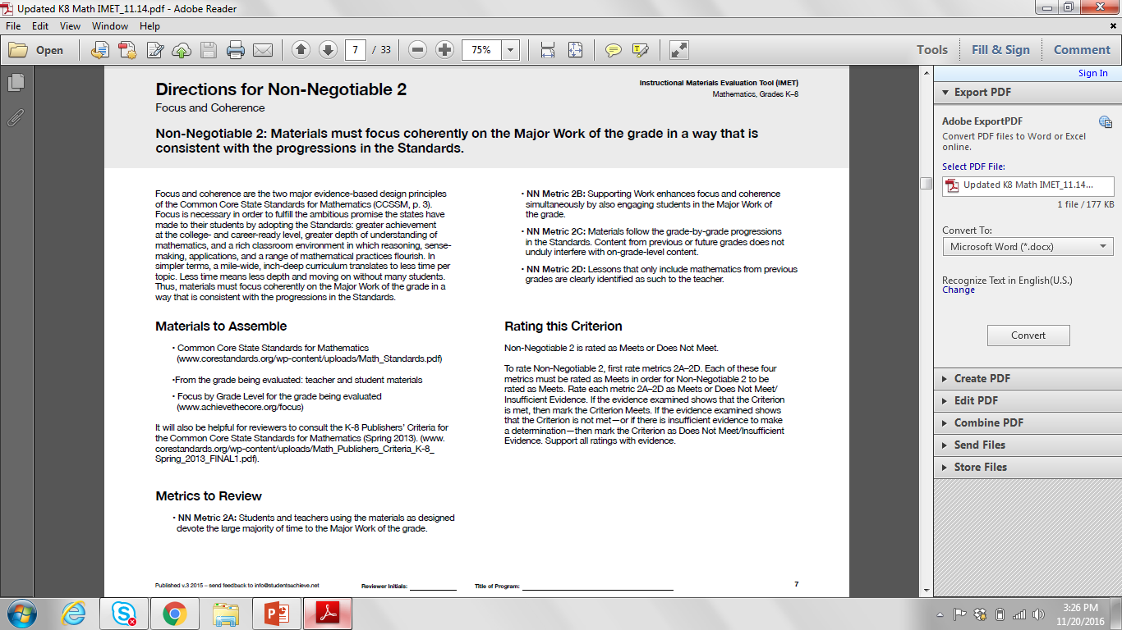
IMET p. 7
Notes:
Big Idea (slides 19 and 20): Show how the IMET is organized
Talking Points:
This is an example of the overview page that is provided for each criterion of the IMET.
It includes a narrative description of the criterion, a list of materials that may be needed, a list of the metrics that make up the criterion, as well as information on how to score the criterion.
Reviewers should use these pages to understand each of the criteria before diving deep into the individual metrics.

Slide 20
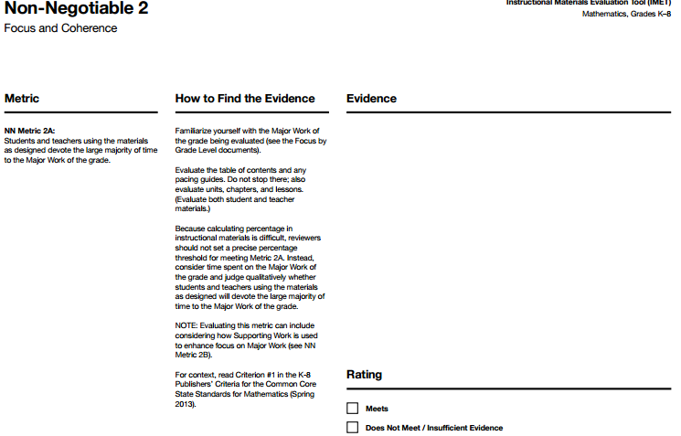
Navigating the Tool
Criterion
Lots of space for evidence!!
Metric (used to determine if the
Criterion is met)
Decide: Meets Metric?
Guidance for rating metric
Notes:
Big Idea (slides 19 and 20): Show how the IMET is organized
Talking Points:
Criterion (either Non-Negotiable or Alignment is named at the top of the page).
The metric, which you just sorted into criteria, is the indicator that is being rated. (While NN1 only has one metric, every other criterion has multiple metrics that must be evaluated.)
“How to find evidence” column provides information about where to look, examples and, often, a citation of a specific Publishers’ Criterion to look at for more information.
Space for evidence sets the expectation that there should be copious evidence provided by reviewers.
After evidence is collected, reviewers will check their rating for the metric. This intentionally follows the collection of evidence.

Slide 21
Non Negotiable Criterion 1:
Freedom from Obstacles to Focus

Slide 22
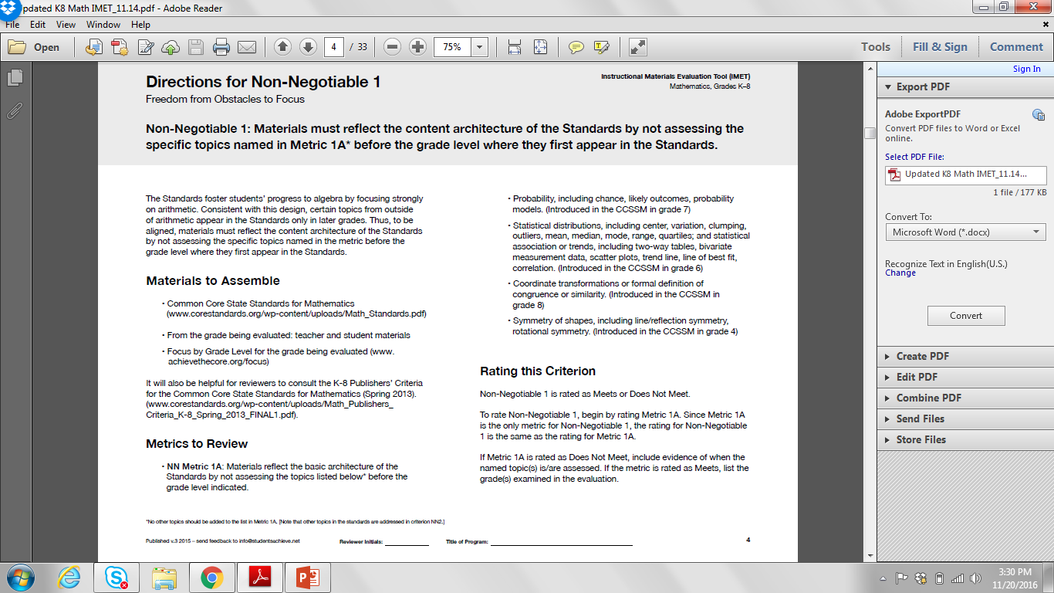
Focus
Non-Negotiable 1: Materials must reflect the content architecture of the Standards by not assessing the specific topics named in Metric 1A* before the grade level where they first appear in the Standards.
IMET p. 4
Notes:
Big Idea: Introduce Non-Negotiable 1 and the associated metric
Talking Points:
The first Criterion relates to the first Shift – focus.
This is the only criterion with only one metric.
Designed to be a very straightforward criterion, which can serve as a screening device to identify materials that may have major issues of alignment.
The asterisk in the criterion makes clear that this criterion should not be expanded to look for more topics that are assessed early than those outlined in the metric. In Non-Negotiable 2, reviewers will get more into other topics that may appear early. Due to the nature of this metric as a gatekeeper, reviews should be limited to the named topics (which we’ll take a look at in a couple of slides).

Slide 23
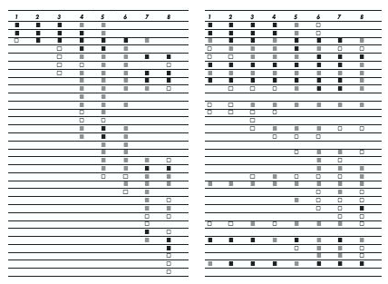
The Shape of Math in A+ Countries
Mathematics topics intended at each grade by at least two-thirds of A+ countries
Mathematics topics intended at each grade by at least two-thirds of 21 U.S. states
¹ Schmidt, Houang, & Cogan, “A Coherent Curriculum: The Case of Mathematics.” (2002).
Notes:
Big Idea: Use a visual to highlight the difference between how math is taught in high-performing countries and how math was taught in the US
Talking Points:
You can visually see that the overall shape of math topics in A+ countries and those typical in the US (pre-Common Core) is different.
There are no detailed labels here as to not detract from the goal. That being said, each row is a math topic, like fractions, or congruence.
In 2/3rds of the high-performing countries, the foundations are laid and then further knowledge is built on them. The design principle is focus and coherent progressions. On the contrary, in the U.S., the design principle is to teach everything every year that can possibly be taught, as well as many things that cannot.
In 2/3rds of the high-performing countries, note the amount of time that is spent in grades 1-3 on so few topics and the return on that investment of instructional minutes in middle school. It is easy to see the uniqueness of each grade level as opposed to the nearly identical grade levels in the U.S.
This graph makes clear that to have focused materials, we have to get rid of some topics.
Background information: The A+ countries were identified as Singapore, Korea, Japan, Hong Kong, Belgium (Flemish-speaking), and the Czech Republic based on grade 8 math scores. For more information, see https://www.aft.org/sites/default/files/periodicals/curriculum.pdf

Slide 24
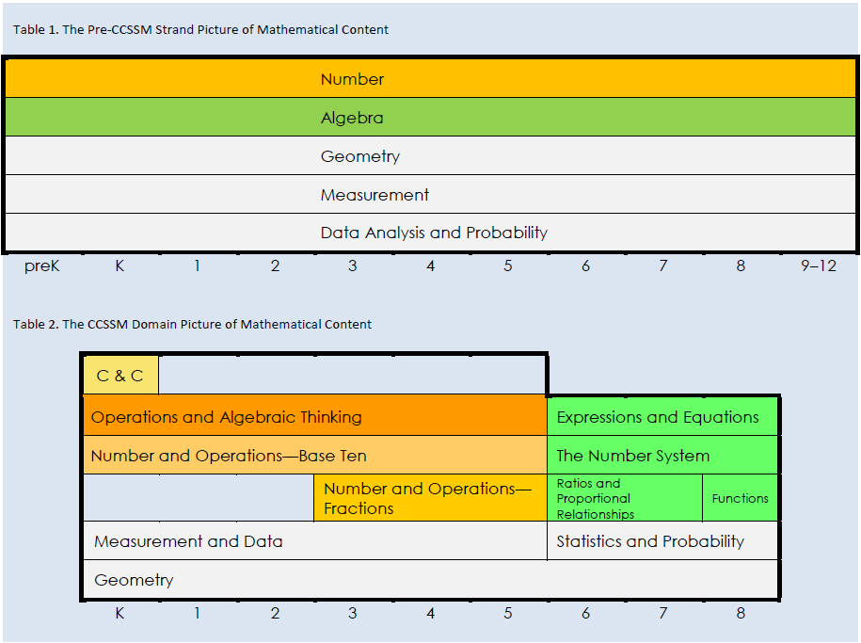
Focus Through Domains
Notes:
Big Idea: The domain-level organization of the Standards is a helpful way to see the focus required.
Talking Points:
The two tables give the big picture of the way that content is organized in the CCSS, and how it shifted from past versions.
The top table shows the traditional domain organization of mathematical standards. All 5 domains were equally important in all grades K-8.
The bottom table shows the reorganization under CCSS.
The color-coding shows how the domain of Number has been split up into multiple domains within K-5 in order to emphasize the importance of this work in the elementary grades. The green shading shows that Algebra has been turned into the major focus of the middle school grades. Everything is no longer created equal.
Background information: This graphic comes from Jason Zimba’s article <http://achievethecore.org/content/upload/What%20Content%20is%20Visibly%20Emphasized%20in%20the%20CCSSM.pdf>

Slide 25
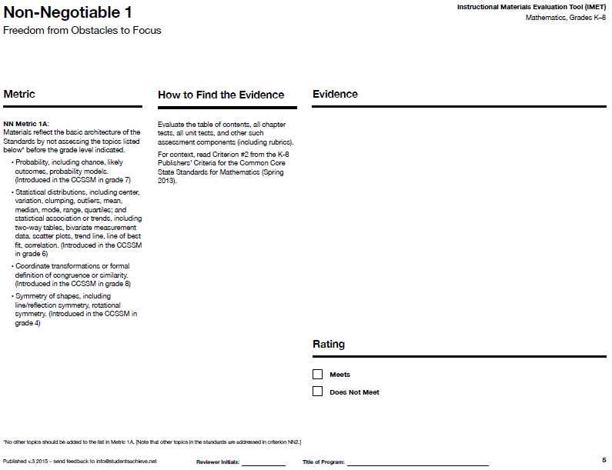
IMET p. 5
Notes:
Big Idea: Move from general information about focus to the specifics of NN Metric 1A.
Talking Points:
We are now going to look in-depth at NN Metric 1A, the only metric for Non-Negotiable 1. <Read metric.>
This metric is a quick way to check for obstacles to alignment at a high level.

Slide 26
NN 1A: Topics That Crowd Out Focus in Elementary Grades
Probability, including chance, likely outcomes, probability models (introduced in grade 7)
Statistical distributions, including center, variation, clumping, outliers, mean, median, mode, range, quartiles; and statistical association or trends, including two-way tables, bivariate measurement data, scatter plots, trend line, line of best fit, correlation.(introduced in grade 6)
Coordinate transformations or formal definition of congruence or similarity (introduced in grade 8)
Symmetry of shapes, including line/reflection symmetry, rotational symmetry (introduced in grade 4)
Notes:
Big Idea: NN Metric 1A requires reviewers to look for specific topics to make sure they are not assessed before the grade-level they are introduced in the Standards.
Talking Points:
These are the specific topics from NN Metric 1A that reviewers will be looking to see if there are assessment questions on these topics before the grade listed.
<Ask participants to discuss what they see as common attributes of these topics.> <2 minutes>
These topics are common offenders that turn up in materials that don’t respect the “power of the eraser” to make sure that students have time to go in-depth in the Major Work of the grade. (They are often the topics that get repeated in each grade like we saw on slide 25.)
This metric in the Publishers’ Criteria was almost like a preventive measure to send the message to publishers that they must change their materials to align.
This metric only focuses on assessments which are defined in the “how to find evidence” column. We focus on assessment since this is a quick check for “frequent offenders” and looking at assessments allows us to quickly see if these topics are included.
There will be opportunities to look to see if there are other topics that take away focus from the Major Work of the grade in later metrics (NN Metric 2A and 2C.)

Slide 27
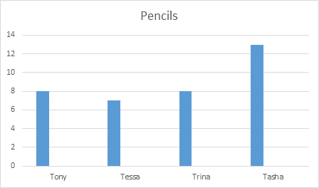
Is It Statistics?
If Mrs. Brown collects all of the pencils from the students and shares them equally among the students, how many pencils will each student get?
What is the average number of pencils the students have?
Handout p. 3
Notes:
Big Idea: The line between statistics and operations can be a bit blurry.
Talking Points:
This is an example of two different questions from grade 3 instructional materials. One can be considered a non-example and one as an example of NN Metric 1A.
<Ask participants to consider both questions related to the graph. Have them discuss whether each one, on an assessment, would count as evidence against materials meeting NN Metric 1A (because it introduced statistical distribution.)> <3 minutes>
The question on the left provides an opportunity for students to apply their understanding of the operations and solving word problems to data. So, it would not count as evidence against materials meeting NN 1A, even though it is essentially asking students to find the average.
The question on the right, however, ask students to think about the mean as a statistical distribution which goes beyond grade 3 expectations and would be evidence against materials meeting NN 1A.
Background information:
From the MD progression document: “In grade 3, a whole-number division problem formulated using a data display could be well aligned, but a discussion of the resulting quotient in relation to the shape of the data distribution is not.” <http://achievethecore.org/page/254/progressions-documents-for-the-common-core-state-standards-for-mathematics-detail-pg>

Slide 28
NN Metric 1A:
What are we looking for?
Where do we look?
IMET p. 5
Notes:
Big Idea: This slide provides an opportunity for participants to summarize their understanding of NN Metric 1A.
Talking Points:
(Participants should use the IMET to help answer these questions.)
Ask:
Can someone remind us what NN Metric 1A would look like?
What guidance do we get about how to find evidence for this metric?

Slide 29
Non Negotiable Criterion 2:
Focus and Coherence

Slide 30
Focus
Non-Negotiable 2: Materials must focus coherently on the Major Work of the grade in a way that is
consistent with the progressions in the Standards.
IMET p. 7
Notes:
Big Idea: Introduce Non-Negotiable 2 and the metric under it associated with Focus.
Talking Points:
The second Non-Negotiable Criterion relates to both Focus and Coherence.
This criterion has 4 metrics – we will discuss each in turn.
This is where the metrics start to get a little more complex to evaluate.

Slide 31
Key Areas of Focus in Mathematics
Grade(s) | Focus Areas
K–2 | Addition and subtraction – concepts, skills, and problem solving and place value
3–5 | Multiplication and division of whole numbers and fractions – concepts, skills, and problem solving
6 | Ratios and proportional relationships; early expressions and equations
7 | Ratios and proportional relationships; arithmetic of rational numbers
8 | Linear algebra and linear functions
Notes:
Big Idea: Highlight the areas for focus which are the Major Work for K-8
Talking Points:
Each grade level has specific clusters designated as Major Work. This table gives a simplified list of the Major Work of each grade band.
Most teachers you talk to would name these as the most important topics for their grade. Emphasize this point. These are the things kids need most time and energy on in order to be successful in mathematics.
This focus is built into the structure of the Standards.

Slide 32
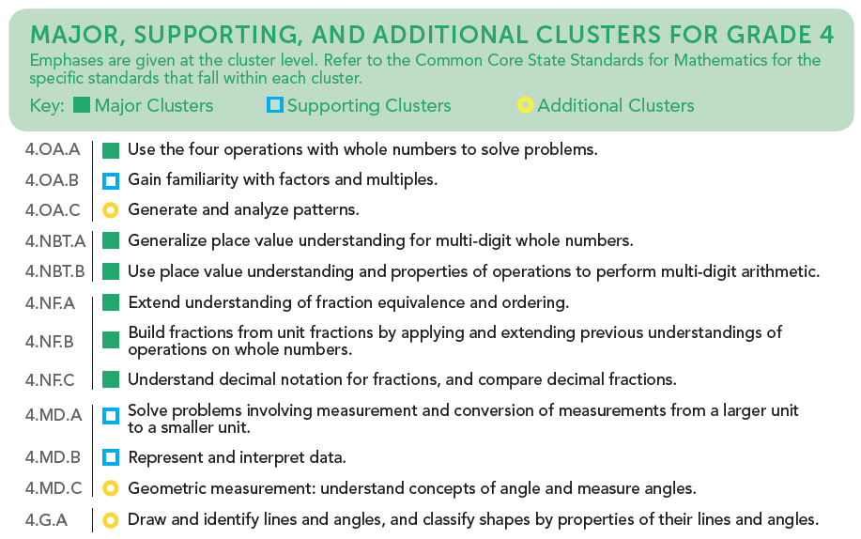
Cluster Emphases
Notes:
Big Idea: The “Focus by Grade Level” document names the Major/Supporting/Additional Work for each grade.
Participants should have a copy of the Grade 4 document to reference during the PD modules.
Talking Points:
These documents are available in K-8 to outline Major, Supporting, and Additional clusters for each grade.
This shows the cluster level alignment for grade 4 and should be used in conjunction with the full Standards to understand how individual standards are classified.
Note that “Supporting” and “Additional” clusters are not “Nice to Know” concepts. ALL of the standards are important, but these emphasis labels help a teacher know what is most important, which ideas support a deep conceptual understanding of the most important ideas, and which are setting the groundwork for future math concepts.
Note: These documents can be downloaded (a single grade, or the whole group, K-8) at www.achievethecore.org

Slide 33
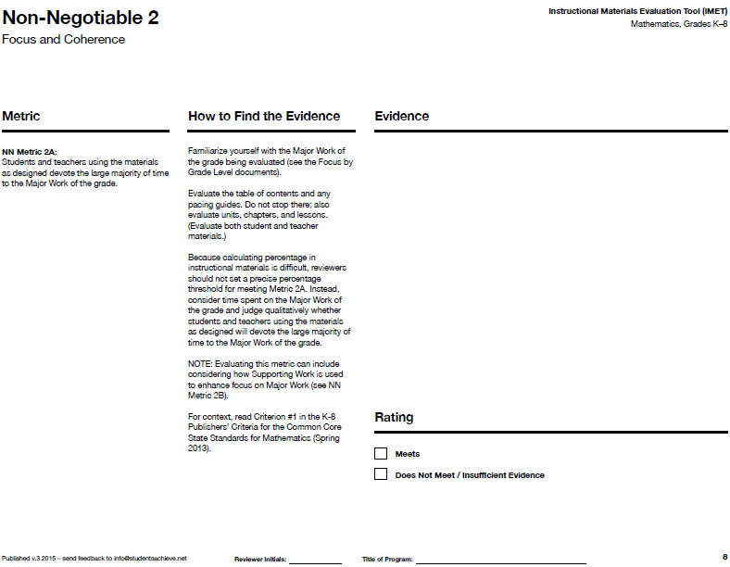
IMET p. 8
Notes:
Big Idea: Move from general information about Major Work to the specifics of NN Metric 2A.
Talking Points:
The designation of Major Work clusters forms the basis of what reviewers look for when evaluating NN Metric 2A. <Read metric.>
This metric allows us to go deeper into how materials are attending to focus.

Slide 34
What Is a “large majority of time”?
“Major Work is not the only work in the Standards, but materials are highly unlikely to be aligned to the Standards’ focus unless they dedicate the large majority of their time* on the Major Work of each grade.”
*At least 65% and up to approximately 85% of class time, with Grades K–2 nearer the upper end of that range, should be devoted to the Major Work of the grade.
- K-8 Publishers’ Criteria, Spring 2013, p. 8
Notes:
Big Idea: Clarify the meaning of the phrase “large majority of time” in NN Metric 2A
Talking Points:
Because the Major Work topics are so crucial to Algebra readiness, the Standards emphasize the need for more time and intensity on these topics. Instructional materials also need to reflect that emphasis by devoting a large majority of time to Major Work.
In the Publishers’ Criteria, there is a range of the amount of time that should be on Major Work. <Read information on slide.> These are just general guidelines to help reviewers and does not mean that if you calculate that a book spends 64% of the lessons on Major Work that it would not meet this metric.
The recommendation for more time in the lower grades comes from the research that shows that developing an understanding of number and place value is essential to students’ long-term success in mathematics.

Slide 35
What is the Major Work?
Know your Major Work! What should 4th graders be spending the large majority of their time on?
Use the chart and check whether each chapter title is:
  Major Work
  Supporting/Additional work
  Off-grade-level content
  Not sure
IMET p. 8
Handout p. 4
Notes:
Big Idea: This activity gives participants a chance to get more familiar with the Major Work of grade 4, as well as come to the understanding that a surface-level look at materials does not provide the opportunity to evaluate them against the IMET metrics.
Talking Points:
Knowing Major Work is about more than just reading the focus chart. To use the IMET, reviewers really need to know the Major Work backwards and forwards.
When looking at the chapter titles, cross-reference them with the standards and determine if each chapter would be Major Work, Supporting/Additional Work, or off-grade level content or if you’re not sure. Try to make your best guess based on the information you have.
<After participants have time to work, review answers and discuss any that caused confusion or people weren’t sure about.> <15 minutes>
Possible points for discussion include:
For many of these chapter titles, you would need to review the lessons to understand if they are actually addressing Major Work, Supporting, or Additional Work or off-grade level content.
General answers are listed below, with starred chapters particularly likely to fall into the “Not Sure” category. Expect that there will be more chapter titles classified as “Not Sure” which is a good indicator that participants are starting to understand the complexity of this work.
Major Work: Multiplying Greater Numbers, Adding and Subtracting Fractions, Big Numbers, Estimation and Computation, Decimals and their Uses, Dividing by 1-digit Numbers, Comparing with Multiplication, Multiply Fractions by Whole Numbers
Supporting/Additional: Measurement Conversions, Naming and Constructing Geometric Figures*, Number Patterns*,
Not grade 4: Reflections and Symmetry, Rates

Slide 36
NN 2A: Students and teachers using the materials as designed devote the large majority of time to the Major Work of the grade.
Examine the table of contents. Write your answers to the following two questions:
  What evidence is there that this materials would or would not spend the large majority of time on the Major Work of the grade?
  What else would you need to look at to be able to give a rating of “Meets” or “Not Meets” for NN Metric 2A?
IMET p. 8
Handout p. 5-11
Notes:
Big Idea: This activity gives participants to get a taste of what it will be like to review materials for NN Metric 1A.
Talking Points:
Continue using the Focus document and the standards to analyze this table of contents against Metric 2A.
This may be your first step in evaluating NN Metric 2A in the materials that you review. The table of contents provides a good starting place and due to time constraints, that is all we’ll be looking at today.
For that reason, gather as much evidence as you can and give your best “gut check” rating.
Also note what else you would need to look at to determine your ratings (e.g., specific chapters/lessons you would want to look at more closely, parts of the book you would want to review).
Use the IMET to record evidence.
Note: there is not a specific procedure to evaluate this metric since it is a qualitative measure. It is OK for people at your table to use different methods to analyze the table of contents to evaluate this metric.
<Give participants time to review the document independently and write their answers to the question and then time to discuss as a group.> <15 minutes>
It can be a very powerful conversation to compare methods and see that various methods lead to the same conclusion – these materials most likely do not meet the metric.

Slide 37
Debrief NN Metric 2A
Gut check: Would these materials meet NN Metric 2A? What is your evidence?
What else would you need to look at to be able to rate this metric?
Notes:
Big Idea: Give participants an opportunity to share their findings
Notes to guide discussion:
There are 7 units that seem to focus on the Major Work (Part 1: Units 2,3,4; Part 2: Units 2,3,4,7). There are 6 units that don’t seem to focus on the Major Work (Part 1: Units 1,6,7; Part 2: 1,5,6). There are 2 units that may be connecting Supporting Work to Major Work. So reviewers may want to look carefully at Part 1: Unit 5 and Part 2: Unit 8 to see how Major Work is addressed within the chapters.
Some of the chapters on Major Work may include significant amounts of review. (See NBT 4-10 to 4-19.) Reviewers would want to look carefully at those lessons to see if they are review or if they are there to help students understand the Major Work of the grade.
Some participants may notice that certain topics do not get enough attention (i.e., 4.OA.A.1 is only addressed in OA4-12, even though it is a brand new concepts for this grade.) Let participants know that this particular metric is only about looking at the time spent on Major Work collectively. In NN Metric 2C and Alignment Criterion 1, reviewers will look at how well particular standards are addressed.

Slide 38
NN Metric 2A:
What are we looking for?
Where do we look?
IMET p. 8
Notes:
Big Idea: This slide provides an opportunity for participants to summarize their understanding of NN Metric 2A.
Talking Points:
(Participants should use the IMET to help answer these questions.)
Ask:
Can someone remind us what NN Metric 2A would look like?
What guidance do we get about how to find evidence for this metric?

Slide 39
Coherence
NN Metric 2B: Supporting Work enhances focus and coherence simultaneously by also engaging students in the Major Work of the grade.
IMET p. 9
Notes:
Big Idea: Introduce the next metric for Non-Negotiable 2
Talking Points:
The next metric under NN2 provides a bridge between NN Metric 2A which is about focus and later metrics in the Criteria that are about coherence.

Slide 40
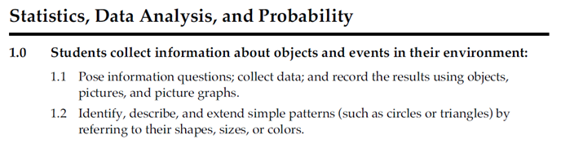
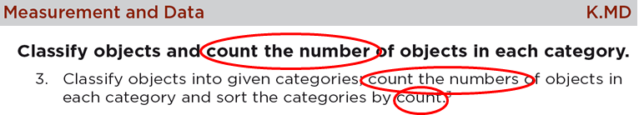
Coherence is Built Into the Standards
Notes:
Big Idea: Often, Supporting Work is connected to Major Work by the specific language of the standards.
Talking Points:
The top standard is from a specific state’s Kindergarten standards before they adopted Common Core. You can see that it is statistical work. In the bottom excerpt from CCSS, the same ideas of data are present, however, it is clearly tied to counting – part of the Major Work of Kindergarten.
Often, when looking at supporting standards, the standard itself requires connecting to Major Work in order to make sure it’s fully addressed. Therefore, to meet the Standards as written, materials must connect Major Work to Supporting Work.

Slide 41
Coherence: Link to Major Topics Within Grades
Example: Data Representation
3.MD.B.3 Draw a scaled picture graph and a scaled bar graph to represent a data set with several categories. Solve one- and two-step “how many more” and “how many less” problems using information presented in scaled bar graphs. For example, draw a bar graph in which each square in the bar graph might represent 5 pets.
Notes:
**This slide is optional, depending on the needs and background of participants.**
Big Idea: Share another example of a standard that connects Major Work to supporting.
Talking Points:
This grade 3 standard comes from the Measurement and Data domain and is part of a cluster that is Supporting Work, while solving word problems is Major Work as part of the Operations and Algebraic Thinking domain.
This is coherence within the grade level which we will be looking for in NN Metric 2B.
Instead of bar charts being “yet another thing to cover,” detracting from focus, the standard is telling you how to “aim” bar charts back around to the Major Work of the grade. These connections are explicit in the standards. While, in the past, picture or bar graphs might have been distinct things to be assessed, now they need to be connected to the Major Work of the grade.

Slide 42
Coherence: Link to Major Topics Within Grades
Example: Statistics
8.SP.A.3 Use the equation of a linear model to solve problems in the context of bivariate measurement data, interpreting the slope and intercept. For example, in a linear model for a biology experiment, interpret a slope of 1.5cm/hr as meaning that an additional hour of sunlight each day is associated with an additional 1.5 cm in mature plant height.
Notes:
**This slide is optional, depending on the needs and background of participants.**
Big Idea: Share another example of a standard that connects Major Work to Supporting.
Talking Points:
This grade 8 standard comes from the Statistics and Probability domain and is part of a cluster that is Supporting Work, while working with equations and understanding slope is Major Work as part of the Expressions and Equations and Functions domains.
This is coherence within the grade level which we will be looking for in NN Metric 2B.
Instead of statistics being “yet another thing to cover,” detracting from focus, this 8th grade standard tells you how to link working with bivariate data to the Major Work of the grade: linear algebra and functions.

Slide 43
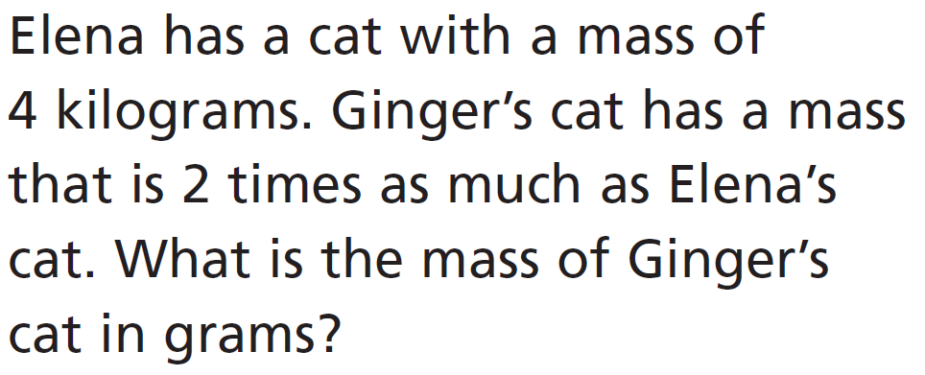
NN 2B: Supporting Work enhances focus and coherence simultaneously by also engaging students in the Major Work of the grade.
4.MD.A.2 and 4.OA.A.1
Handout p. 12
Notes:
**This slide is optional, depending on the needs and background of participants. If participants are not familiar with grade 4, it may be helpful for them to look at an example before looking for their own connections on slide 44.**
Big Idea: Show an example of a question that connects Major and Supporting Work.
Talking Points:
This problem shows an example of how materials can relate measurement word problems to the Major Work of grade 4 (multiplicative comparisons).

Slide 44
Where are the connections?
Look at the Focus in Grade 4 and the full Standards documents.
Identify supporting standards that have mathematical connections to major clusters and standards. Describe the connections you would expect to see in materials.
IMET p. 9
Notes:
Big Idea: Give participants an opportunity to identify connections between Major and Supporting Work
Participants may benefit from consulting the Coherence Map to see connections between Supporting and Major Work (http://achievethecore.org/coherence-map/)
Talking Points:
When you are evaluating NN Metric 2B, the first thing you need to know is where there should be connections between Supporting and Major Work in the grade level you are reviewing.
We’re going to take a look at the Supporting Work of Grade 4. To do this, use the Focus in Grade 4 document to identify the clusters that are Supporting Work. Then, read those cluster headings and standards to identify connections to the Major Work of Grade 4.
Although there are sometimes connections between Additional Work and Major Work, they occur less often and are less baked into the language of the Standards, so for this metric, we just look at Supporting Work.
<Have participants review the grade and discuss connections to Major Work that are required by the standards. <4 minutes>
Some connections participants might note:
4.OA.B(.4) could connect to 4.OA.A, as students solve word problems involving identifying factors. It could also connect to work with 4.NF.A.1 as students use an understanding of factors and multiples to build equivalent fractions.
4.MD.A.1 connects to an understanding of decimals (4.NF.C) when working with the metric system.
4.MD.A.2 requires students to solve word problems (4.OA.A) including those that involve fractions (4.NF.B) and decimals (4.NF.C)
4.MD.A.3 is an application standard, so it applies back to 4.OA.A.
4.MD.B.4 requires students to think about equivalent fractions (4.NF.A.1) as they are plotting data and solving word problems with adding and subtracting fractions (4.NF.B.3d)

Slide 45
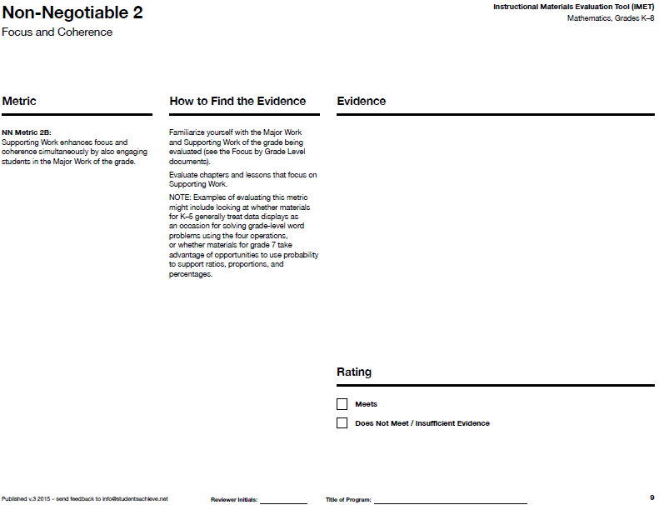
NN Metric 2B:
What are we looking for?
Where do we look?
IMET p. 9
Notes:
Big Idea: This slide provides an opportunity for participants to summarize their understanding of NN Metric 2B.
Talking Points:
(Participants should use the IMET to help answer these questions.)
Ask:
Can someone remind us what NN Metric 2B would look like?
What guidance do we get about how to find evidence for this metric? Spend some time looking at the metric and then we’ll ask a few people to share out.
Where do we find that?
Supporting is a good place to start, but also in Major Work.

Slide 46
Coherence
Non-Negotiable 2: Materials must focus coherently on the Major Work of the grade in a way that is
consistent with the progressions in the Standards.
IMET p. 7
Notes:
Big Idea: Introduce the next set of metrics for Non-Negotiable 2 that hone in on coherence across grades
Talking Points:
We will be taking a look at the last two metrics in NN2 that specifically relate to coherence (2C and 2D).
These metrics require looking at the connections to previous and future content.

Slide 47
NN 2C: Materials follow the grade-by-grade progressions in the Standards…
Based on high-performing countries
Allows for coherence between grades
Develops topics across many years to ensure conceptual understanding (think fraction multiplication)
Notes:
Big Idea: Explain the meaning of the first sentence of NN metric 2C, specifically the phrase “progressions in the Standards”
Talking Points:
As the standards were being developed, there was a lot of attention put into how mathematical ideas grow and build on each other. This was based on the progression of these ideas in high-performing countries.
These progressions allow for ideas to develop across grades and requires that instructional materials build on previous work.
We can see that specifically in the progression of fraction multiplication where students build on their understanding of whole number multiplication in grade 4 and grade 5 by working with specific types of fraction multiplication before they develop full fluency with fraction multiplication in grade 6.
Note: This metric is talking about progressions with a lower case p – which means that reviewers do not need to ensure that every idea in the Progressions Documents is evident in the materials. In reviewing this metric, reviewers look at a high level to make sure the general ideas of the progressions are present in the materials. For reviewers who are unfamiliar with the grade level, the Progressions Documents can serve as a good resource.

Slide 48
Progression of Fraction Multiplication in CCSS
Grade 4
4.NF.B.4 Apply and extend previous understandings of multiplication to multiply a fraction by a whole number.
Grade 5
5.NF.B.4 Apply and extend previous understandings of multiplication to multiply a fraction or whole number by a fraction.
5.NF.B.7 Apply and extend previous understandings of division to divide unit fractions by whole numbers and whole numbers by unit fractions.
Grade 6
6.NS.A Apply and extend previous understandings of multiplication and division to divide fractions by fractions.
6.NS.A.1 Interpret and compute quotients of fractions, and solve word problems involving division of fractions by fractions, e.g., by using visual fraction models and equations to represent the problem.
Notes:
Big Idea: The work of multiplying fractions is a great example of ideas developing and progressing across grades
Talking Points:
Looking at the progression of multiplying and dividing fractions, you will see that, over these 3 years, the students are building on previous knowledge and not just repeating the same thing each year. You’ll see that, in grade 4, students apply and extend previous understandings of multiplication to multiply a fraction by a whole number. In grade 5, that knowledge and skill is extended to multiply a fraction or whole number by a fraction. Also in grade 5, students extend previous understandings of division to divide unit fractions by whole numbers and the reverse. In grade 6, students will continue to build on the foundations laid and will divide fractions by fractions. These are clear and carefully laid progressions that you can expect to see in the instructional materials.
More background available: http://www.air.org/sites/default/files/downloads/report/MathStandards_0.pdf

Slide 49
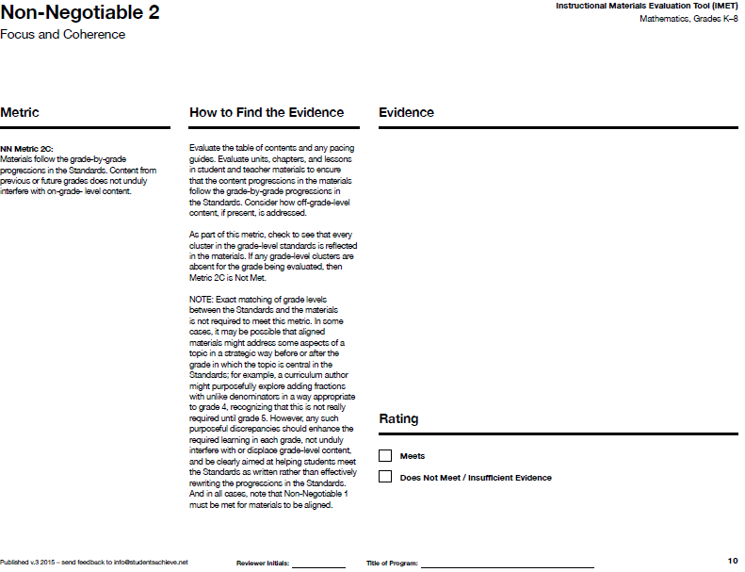
IMET p.10
Notes:
Big Idea: Move from general information about coherence to the specifics of NN Metric 2C.
Talking Points:
We are now going to look in-depth at NN Metric 2C. <Read metric.>

Slide 50
NN 2C: …Content from previous or future grades does not unduly interfere with on-grade-level content.
Does not mean that every lesson has to be on grade-level
Discrepancies should enhance grade-level learning, not distract from it.
Notes:
Big Idea: Explain the meaning of the second sentence of NN metric 2C, specifically about off-grade-level content
Talking Points:
Part of meeting the progressions required in the Standards means that there cannot be too much off-grade-level content. If there is too much time and energy spent on this content, it will be almost impossible to meet the requirements of the grade level
<Have participants read the note in the “How to find evidence” column for this metric.>
As with every metric besides NN 1A, one example of off-grade-level materials would not mean that a book does not pass this metric. Reviewers need to use professional judgement to determine whether any choices to include off-grade-level content are enhancing students’ learning of grade-level materials.

Slide 51
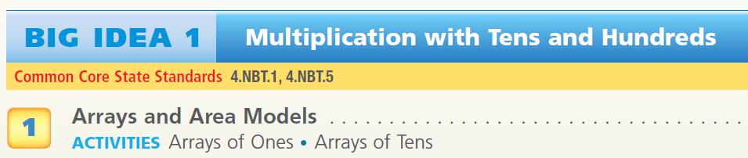
  NN 2C: Materials follow the grade-by-grade progressions in the Standards. Content from previous or future grades does not unduly interfere with on-grade-level content.
Examine the chapter outline.
Discuss:
What evidence is there that these materials are based on the progressions of the Standards?
Is there off-grade level material? Does it enhance grade-level learning?
If so, what other information would you need to determine a rating of “Meets” or “Not Meets”?
IMET p. 10
Handout p. 13
Notes:
Big Idea: Practice reviewing materials for metric 2C and introduce an example of what may be considered off-grade-level content that is still meeting the metric.
Talking Points:
You’re now going to get a chance to get a taste of what reviewing NN Metric 2C is like and consider the types of questions you will need to be asking your team as you review.
Just as before, this text excerpt is not enough to allow you to actually make a determination about whether these materials would meet or not meet NN Metric 2C.
This represents the lesson titles and objectives from a chapter of a grade 4 book.
<Give participants time to review the chapter outline and discuss what evidence they see that would suggest this book would or would not meet NN Metric 2C.> <8 minutes>
This chapter is an example of how materials can move students from a grade 3 understanding of multiplication that is based on arrays and area models to grade 4 work with multi-digit multiplication.
Note: If it doesn’t come up, this example is a good opportunity to bring up the standard algorithm for multiplication. “The shortcut method” listed in lessons 9 and 13 is actually the standard algorithm. This provides an opportunity to discuss that, although the standard algorithm for multiplication is not named until the grade 5 standards, it is a strategy that is based on place value (4.NBT.B.5) and therefore should not be considered off-grade-level content.

Slide 52
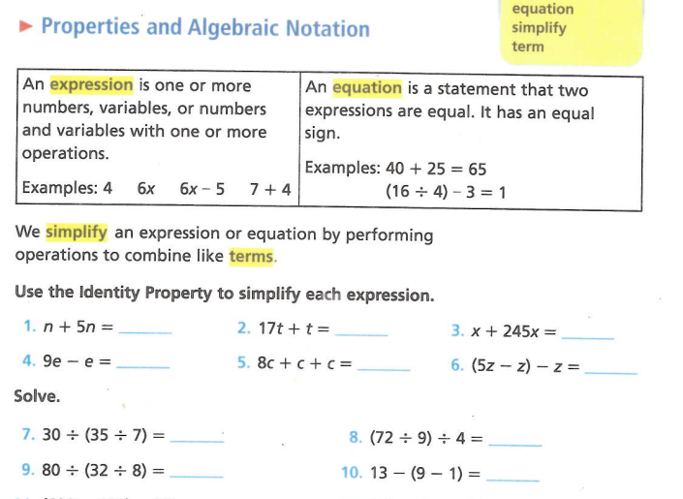
NN 2C: Materials follow the grade-by-grade progressions in the Standards. Content from previous or future grades does not unduly interfere with on-grade-level content.
4.NBT.B
IMET p. 10
Handout p. 14
Notes:
Big Idea: Provide an example of off-grade-level materials that does not enhance grade-level learning alongside an example that does enhance grade-level learning.
Talking Points:
The second part of NN Metric 2C asks reviewers to look at any off-grade-level content that is present and determine whether it unduly interferes with grade-level content. We are going to look at two examples from grade 4 books –in one example, the off-grade-level content unduly interferes with grade-level content; in the other example, it does not unduly interfere.
<Give participants time to review both examples and discuss whether including this in a grade 4 book unduly interferes with grade-level content.> <10 minutes>
Example 1:
The materials this comes from claims that this lesson aligns to 4.NBT.B because it draws on properties of operations. However, the work students are being asked to do – write equivalent expressions by combining like terms – is grade 6 work.
This is not a case where students are deepening their understanding of grade 4 standards, rather it is distracting from the progressions by introducing future-grade level content.
Example 2:
This is another example of materials that introduce future content. The grade 4 content names specific denominators that students should be working with. However, this problem introduces denominators of 15 and 18 which are not named in the standard.
The work with these other denominators is allowing students to develop a deeper understanding of equivalent fractions in this problem. Therefore, it would not be evidence against these materials meeting NN Metric 2C.
While this single problem does not mean that materials would not meet NN Metric 2C, when looking at the entire grade-level materials, it would be important to note how often students are working with denominators outside of the given range for grade 4. Reviewers would want to see that materials are thoughtfully using other denominators in order to target the specific learning goals of grade 4 in regards to understanding equivalent fractions.
Note: Just like with all of our examples, one worksheet like this in materials doesn’t mean that these materials would meet the metric. Reviewers need to look at many chapters and lessons to gather evidence that will allow them to make a holistic decision about the materials for each metric.

Slide 53
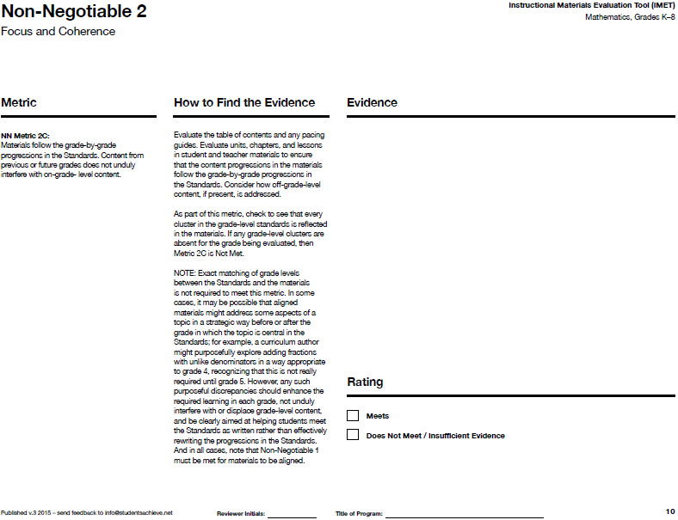
NN Metric 2C:
What are we looking for?
Where do we look?
IMET p. 10
Notes:
Big Idea: This slide provides an opportunity for participants to summarize their understanding of NN Metric 2C.
Talking Points:
(Participants should use the IMET to help answer these questions.)
Ask:
Can someone remind us what NN Metric 2C would look like?
What guidance do we get about how to find evidence for this metric?

Slide 54
Coherence
Non-Negotiable 2: Materials must focus coherently on the Major Work of the grade in a way that is
consistent with the progressions in the Standards.
IMET p. 11
Notes:
Big Idea: Remind participants that we are still looking at metrics in Non-Negotiable 2
Talking Points:
We will now take a look at NN Metric 2D.

Slide 55

IMET p. 11
Notes:
Big Idea: Show NN Metric 2D.
Talking Points:
The next metric focuses on prior grade-level content and how it is identified to the teacher. <Read metric.>

Slide 56
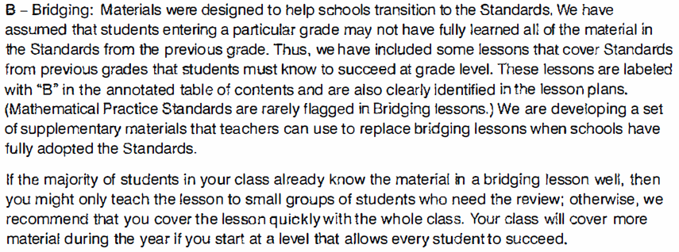
  NN 2D: Lessons that only include mathematics from previous grades are clearly identified as such to the teacher.
IMET p. 11
Handout p. 15
Notes:
Big Idea: Provide an example of materials that clearly identify material as review
Talking Points:
We’re moving on to the our next metric on coherence. NN Metric 2F states “Review of material from previous grades is clearly identified as such to the teacher, and teacher and students can see what their specific responsibility is for the current year.”
While we know that including lots of review of previous grade content can interfere with both focus and coherence, there are reasons that publishers may want to include some review of previous content.
This metric notes that, if there is review, it needs to be clearly indicated.
<Have participants read the example and determine whether this is an example of review being clearly identified as such.> <2 minutes>
This is one way that a publisher may choose to clearly identify review materials. This ensures that the user of the materials can make decisions about what’s best for their students.
Note: This metric just requires review to be identified; evidence for this metric should not consist of how much of the materials is review. That evidence would be used to evaluate NN Metric 2C.

Slide 57
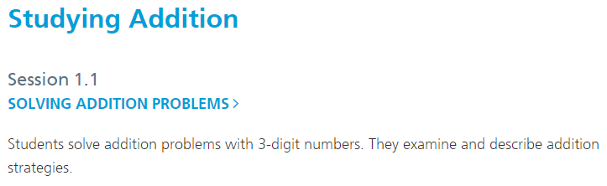
NN 2D: Lessons that only include mathematics from previous grades are clearly identified as such to the teacher.
IMET p. 11
Handout p. 16
Notes:
Big Idea: provide an example of lessons that are review being identified as such
Talking Points:
In your handouts, you have the unit overview from a 4th grade unit on Addition. You will see a brief description of each session plus the identified standard
<Have participants review the table of contents and discuss whether this is an example of meeting NN Metric 2D.> <10 minutes>
Looking at this unit overview, you may have noticed that there seems to be review of 3rd grade content in many of the lessons. By 4th grade, work should focus on making sure students can fluently add multi-digit numbers using the standard algorithm. This unit spends the majority of the time on different strategies that may or may not lead to fluency.
The fact that there is off grade-level comment will have been noted in NN Metric 2C. In this metric, the job of the reviewer is just to note whether these lessons have been identified as review for the teacher.
Some people who look at this example say that the fact that the standards alignment is listed as “supports 4.NBT.4” is enough to identify the lessons as review. However, most people argue that this doesn’t meet the metric’s expectation that previous grade content is clearly identified. It may be that the lessons are clearly marked as review at another point in the Teacher’s Guide but from this sample, it doesn’t look like lessons 1.1 – 1.3 are clearly identified as review.
Note: Just like with all of our examples, one excerpt like this in materials doesn’t mean that these materials would meet the metric. Reviewers need to look at many samples from the materials to gather evidence that will allow them to make a holistic decision about the materials for each metric.

Slide 58
NN Metric 2D:
What are we looking for?
Where do we look?
IMET p. 11
Notes:
Big Idea: This slide provides an opportunity for participants to summarize their understanding of NN Metric 2D.
Talking Points:
(Participants should use the IMET to help answer these questions.)
Ask:
Can someone remind us what NN Metric 2D would look like?
What guidance do we get about how to find evidence for this metric?

Slide 59
Wrapping Up

Slide 60
Non-Negotiable Criteria and Metrics
NN #1: Freedom from Obstacles to Focus
1A: Obstacles to Focus
NN #2: Focus and coherence
2A: Large majority of time on Major Work of the grade
2B: Connecting Supporting and Major Work
2C: Following the progression
2D: Review lessons are identified
Notes:
Big Idea: Give participants a big picture view of the metrics covered in this module
Talking Points:
These are all the metrics you learned about today!
There is a short-hand name to describe each metric. Many reviewers feel that it is helpful to have this on hand as they begin the review process to help them remember the metrics and think about where evidence they are finding in books fit in.

Slide 61
Essential Questions -- Discuss
How does the Instructional Materials Evaluation Tool (IMET) reflect the major features of the Standards and the Shifts?
What understandings support high-quality, accurate application of the IMET metrics?
Notes:
Big Idea: Give participants an opportunity to reflect on the essential questions for the session
Talking Points:
Either in pairs or in writing, have participants describe what they’ve learned in this session as it relates to the essential questions

