Slide 1
Reviewing Using the Instructional Materials Evaluation Tool: Mathematics
Module 102: Rigor and Balance (AC 1)
www.achievethecore.org
Notes:
This module was last updated on December 2016.

Slide 2
Essential Questions
How does the Instructional Materials Evaluation Tool (IMET) reflect the major features of the Standards and the Shifts?
What understandings support high-quality, accurate application of the IMET metrics?
Notes:
Big Idea: Share essential questions and frame the session.
Depending on how the modules are delivered, this slide may be used to have participants reflect on what they have learned so far, or just reviewed quickly to remind participants of the purpose of the work.
Talking Points:
These questions will be guiding our thinking as we work through all of the modules. We will come back to reflect on them at the end of each module.
In the modules, we are digging into what the Standards and Shifts look like in instructional materials – the IMET is the tool to help us to do it.
To use the tool accurately, we need to bring our knowledge and understanding of CCSS, and think about how our own understandings get applied through a new lens.
It is important to set aside personal style or preference when teaching the materials. The goal of the IMET is not to find your perfect match in terms of your own teaching style; it is a fairly legalistic and bureaucratic task on whether or not the materials reflect these high level shifts.

Slide 3
Goals
Understand how aligned materials embody the shifts inherent in the Common Core State Standards
Understand the precise meaning of each metric of the IMET
Recognize examples and non-examples related to each metric of Alignment Criterion 1
Notes:
Big Idea: Share goals of the session.
Talking Points:
The goals outline what participants will know and be able to do at the end of this module.
As the goals imply, engaging in this process is a constant cycle of learning. What we know about the CCSS informs how we look at the IMET; what we learn about the IMET deepens our understanding of CCSS.
The second goal refers to the fact that the IMET is designed to focus on the Standards as well as the shifts required by them. The structure shows the primacy of Focus and Coherence as non-negotiables, which are the topics for this module.

Slide 4
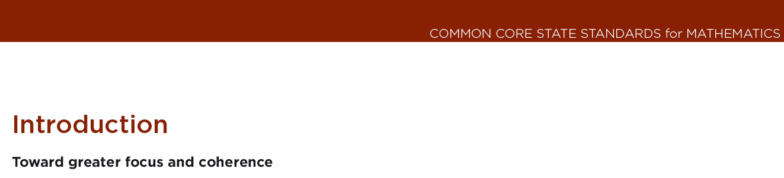
Non Negotiable vs. Alignment Criteria
Non- Negotiable Criteria | Alignment Criteria
Each metric rated Meets/Does Not Meet | Each metric rated Meets/Partially Meets/Does Not Meet
Every metric must be met to rate the criterion as Meets | Must receive 5 out of 6 points to rate the criterion as Meets
Notes:
Big Idea: Differentiate between Non-Negotiable and Alignment criteria.
Talking Points:
We looked at two Non-Negotiable criteria in Module 101. For these criteria, each metric was rated as “meets” or “does not meet” and materials needed to meet every metric in order to be considered aligned. Focus and Coherence are considered to be non-negotiable. The reason for this is right in the introduction to the Standards themselves. The introduction starts with a sub-head that outlines the most important shifts required by the Standards. <Click to reveal.>
As we move to the Alignment Criteria in this module and the next, we are looking at metrics that may be a little more subjective. Because of that, they are scored out of 2 points and each metric can be rated as “meets” (2), “partially meets” (1), or “does not meet” (0). For materials to meet any single criterion, they need to receive 5 out of 6 points on the metrics associated with that criterion.

Slide 5
Alignment Criterion 1: Rigor and Balance

Slide 6
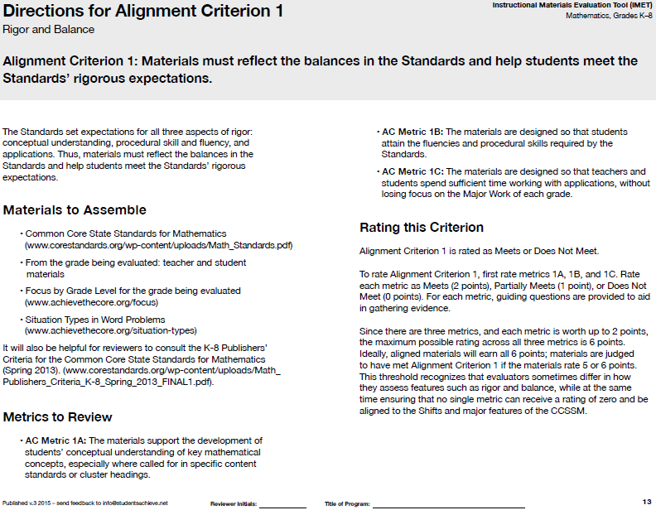
Rigor
Alignment Criterion 1: Materials must reflect the balances in the Standards and help students meet the Standards’ rigorous expectations.
IMET p. 13
Notes:
Big Idea: Introduce Alignment Criterion 1 and the associated metrics.
Talking Points:
We are moving from the Non-Negotiable criterion of the last module to the first Alignment Criterion: Rigor and Balance.
This metric addresses the third Shift—Rigor—but it is an Alignment Criterion because the metrics have more room for interpretation by reviewers.
This criterion has three metrics, and each of the metrics has associated questions to help reviewers collect evidence and make a decision about the rating.

Slide 7
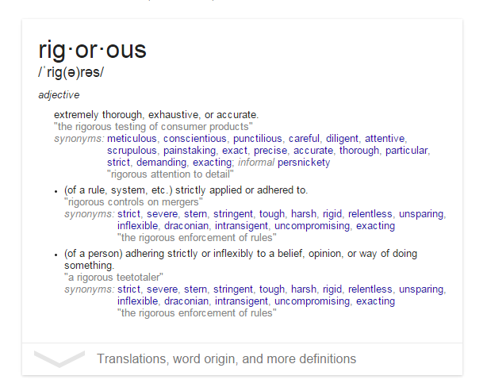
What Is Rigor?
Notes:
Big Idea: Define rigor as it relates to the Shift required by the Standards.
Talking Points:
How do people in education use the word “rigorous?” What do you mean?
What does it mean → “the company has a rigorous hiring process?”
This word “rigor” is one that gets thrown around a lot, particularly in the education world.
<Ask participants to write down two sentences that use the word “rigorous”:
One that uses it in a sentence in the context of education
One that uses it in a sentence outside the context of education.> <2 minutes>
As participants share, highlight the connections between the context in education and the context outside of education. Point out that it usually refers to some vague ideas about the difficulty of problems in the education world.
Although this idea of difficulty comes into play with this Shift, there is a more previse definition we are going for.
To put a point on this, take a look at the definition of rigor provided by Google. <Click PPT to reveal the definition.>
This idea of being extremely thorough and exhaustive characterizes what is so important in instructional materials. That’s a pretty good definition of how we want our students to understand and be able to do mathematics.

Slide 8
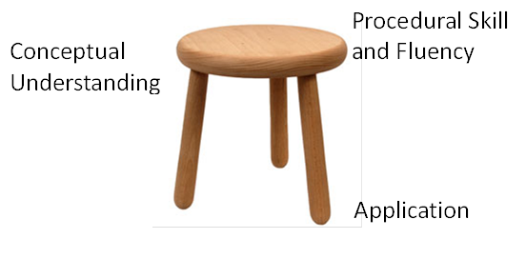
The Three-Legged Stool
Notes:
Big Idea: Emphasize importance of each component with the visual of the three-legged stool that is representative of the balance needed for the three parts of rigor.
Talking Points:
In considering this idea of thorough and exhaustive instruction, we can consider that each of the three aspects of rigor plays an important role in ensuring students are powerful mathematicians.
For a long time in math, there were very strong and opposing opinions about what was most important in instruction.
The math wars are over.
This visual gets to the balance of each aspect of rigor that is necessary. These three components can be thought of as three legs of a stool; each is equally critical to establishing stability.
The three aspects of rigor are not always separate. Conceptual understanding needs to underpin fluency work; fluency can be practiced in the context of applications, and applications can build conceptual understanding.
Nor are the three aspects of rigor always together. Fluency requires dedicated practice to that end. Rich applications cannot always be shoehorned into the mathematical topic of the day. And conceptual understanding will not come along for free unless explicitly taught.
We are now going to discuss each of the 3 aspects of rigor and the metric associated with each one.

Slide 9
Conceptual Understanding
AC Metric 1A: The materials support the development of students’ conceptual understanding of key mathematical concepts, especially where called for in specific content Standards or cluster headings.
IMET pp. 14-15
Notes:
Big Idea: Introduce the Alignment Criterion Metric 1A, which relates to conceptual understanding.
Talking Points:
We will be taking a look at the first metric in AC 1 which specifically focuses on conceptual understanding.
Unlike the metrics in the Non-Negotiables, these metrics will have questions associated with them to help guide evidence collection.
Before we get into all of the nuances of the metric, we are going to get more into what exactly the Standards require in terms of conceptual understanding.

Slide 10
Conceptual Understanding
Teach more than “how to get the answer” and instead support students’ ability to access concepts from a number of perspectives
Students are able to see math as more than a set of mnemonics or discrete procedures
Conceptual understanding is about mathematical ideas, often distinct from context.
Conceptual understanding supports the other aspects of rigor (procedural skill and fluency, and application)
Notes:
Big Idea: Explain what is meant by conceptual understanding as it relates to the CCSSM.
Talking Points:
You can’t really measure the word “understand” in assessment, but you can measure it in instruction.
The first aspect of rigor we are going to look at is building solid conceptual understanding. Once we have a set of standards that are focused, teachers and students have the time and space to develop solid conceptual understanding.
Students are expected to build deep conceptual understanding of equivalent fractions and how they represent the same number.
There is no longer the pressure to quickly teach students how to superficially get to the answer, often relying on tricks or mnemonics. The standards instead require a real commitment to understanding mathematics, not just how to get the answer.
So to go back to our grade 4 example, students need to understand more than just “multiply the top and bottom number to make an equivalent fraction.” They need to understand what it means for numbers to be written in equivalent forms.
Conceptual understanding is produced through rich problems, hands-on activities, skillful questioning, student discussion, etc.
Conceptual understanding is about big ideas in math (place value system, functions, meaning of operations). Sometimes they are about context, but since this aspect of rigor is about understanding mathematical idea, it needs to be distinct from application.
Conceptual understanding supports the other aspects of rigor. This doesn’t mean that it’s most important, but the Standards are structured to ensure students understand mathematical ideas before applying them or developing fluency.

Slide 11
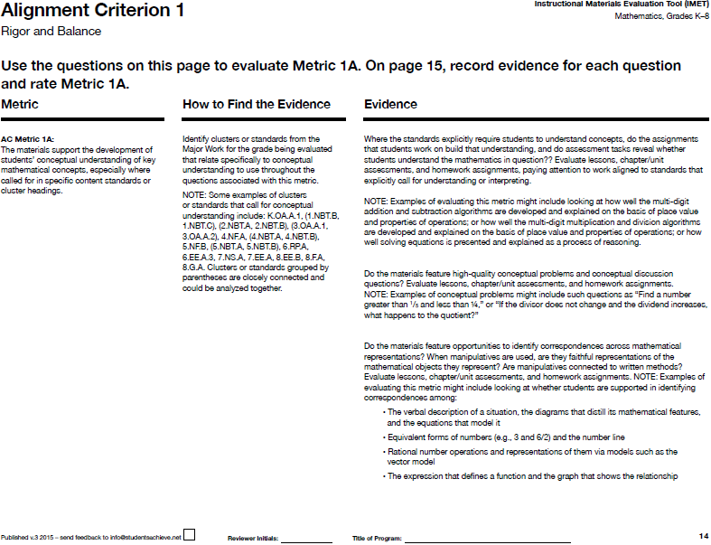
IMET p. 14
Notes:
Big Idea: Show AC Metric 1A with the associated questions.
Talking Points:
The first metric in AC 1 attends specifically to conceptual understanding. <Read metric.>
This metric also presents the first instance of associated questions, a feature of many of the metrics in the Alignment Criteria. These questions are designed to help reviewers gather evidence to rate the metric. <Read questions.> Note that the questions don’t get rated individually, only the metric.

Slide 12
AC 1A: Where the Standards explicitly require students to understand concepts, do the assignments that students work on build that understanding and do assessment tasks reveal whether students understand the mathematics in question?
4.OA.A Use the four operations with whole numbers to solve problems.
4.OA.A.1 Interpret a multiplication equation as a comparison, e.g., interpret 35 = 5 × 7 as a statement that 35 is 5 times as many as 7 and 7 times as many as 5. Represent verbal statements of multiplicative comparisons as multiplication equations.
4.OA.B.4 Find all factor pairs for a whole number in the range 1–100. Recognize that a whole number is a multiple of each of its factors. Determine whether a given whole number in the range 1–100 is a multiple of a given one-digit number. Determine whether a given whole number in the range 1–100 is prime or composite.
4.MD.A.3 Apply the area and perimeter formulas for rectangles in real world and mathematical problems. For example, find the width of a rectangular room given the area of the flooring and the length, by viewing the area formula as a multiplication equation with an unknown factor.
IMET pp. 14-15
Handout p. 2
Notes:
Big Idea: Identify places where conceptual understanding is specifically called for in the standards, as required in the first question under AC Metric 1A.
Talking Points:
To better understand what is required by AC Metric 1A, we are going to look at the associated questions. The first question asks reviewers, “Is conceptual understanding attended to thoroughly where the Standards set explicit expectations for understanding or interpreting?” This question is important because the Standards do not set the expectation that every Standard requires conceptual understanding. We need to pay attention to the word “explicit” in the question and follow the Standards as they point us toward the appropriate aspect of rigor.
Some standards very clearly target conceptual understanding- we usually see “understand,” “explain,” or “interpret” in them. Many standards target different aspects of rigor in different parts. Of the 4 standards you are going to look at, 1 targets conceptual understanding; 2 do not, and 1 has a part that targets conceptual understanding.
<Ask participants to consider the listed standards and discuss which one(s) are targeting conceptual understanding and how they know.> <6 minutes>
Possible points of discussion
If you’re stuck in identifying whether it’s conceptual understanding, think about related topics that kids learned in previous grades.
4.OA.A. As a cluster, is less about conceptual understanding and more about application. Although there are standards under the cluster that target conceptual understanding, this is mostly about application.
4.OA.A.1 is targeting conceptual understanding because students are being asked to understand multiplication and comparison and interpret it.
4.OA.B.4 is mostly about the procedural skill of finding factor pairs.
Although the standard is mostly procedural, the second sentence which starts with “recognize” actually does describe a concept. Thus, that is the piece of that standard that is conceptual.
4.MD.A.3 is targeting application. Students are asked to apply the understanding of area they developed in grade 3 to real-world and mathematical problems in grade 4.
Taking it out of the cluster can make it harder to define → other standards in the cluster may be more clearly about conceptual understanding.
Ask participants to read the “How to find evidence” column and point out that these are just some suggested clusters/standards to start with. In evaluating this metric, reviewers should look for evidence on as many clusters/standards that call for conceptual understanding as possible.

Slide 13
  AC 1A: Do the materials feature high-quality conceptual problems and conceptual discussion questions?
[I]n solving problems, students learn new mathematics, whereas in working exercises, students apply what they have already learned to build mastery. Problems are problems because students haven’t yet learned how to solve them; students are learning from solving them.
- K-8 Publishers’ Criteria, Spring 2013, p. 17
IMET pp. 14-15
Notes:
Big Idea: Help reviewers understand what constitutes a conceptual problem in materials.
Talking Points:
The second question for AC Metric 1A asks reviewers to look for high-quality problems and discussion questions that ensure students are engaging with conceptual understanding.
When considering this, it’s important to think about what constitutes a problem.
Typically, we see textbooks as being full of problems, but the Publishers’ Criteria makes the distinction between problems and exercises.
To ensure students get to the full depth of conceptual understanding required by the Standards, it is important that instructional materials have problems, as well as high-quality discussion questions.
We can recognize problems as places where students are asked to use what they already know to answer mathematical questions that they haven’t been taught to solve.

Slide 14
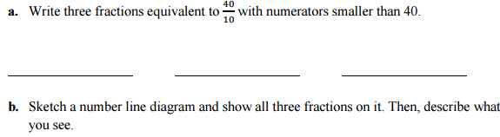
AC 1A: Do the materials feature high-quality conceptual problems and conceptual discussion questions?
4.NF.A
IMET pp. 14-15
Handout p. 3
Notes:
Big Idea: Give participants an opportunity to see examples of conceptual problems .
Talking Points:
Now we are going to look at a few conceptual problems for 4.NF.A – this is a cluster that specifically calls for conceptual understanding.
<Give participants time to solve the problem and discuss why this constitutes a conceptual problem.> <8 minutes>
The constraints of part a require students to think about different ways to create equivalent fractions.
The questions in part b asks students to relate their understanding of equivalent fractions to the number line which helps support their work of understanding fractions as numbers.
One way of recognizing high-quality problems is to consider whether this problem provides opportunities for discussion and will allow teachers to see what students understand about equivalent fractions.

Slide 15
AC 1A: Do the materials feature high-quality conceptual problems and conceptual discussion questions?
4.NF.C
Which number is larger?
1.7 or 17 twelfths
Explain how you can tell without drawing a
picture.
IMET pp. 14-15
Handout p. 3
Notes:
Big Idea: Give participants an opportunity to see an example of a conceptual discussion question.
Talking Points:
Now we are going to look at a discussion question for 4.NF.C – this is a cluster that specifically calls for conceptual understanding.
<Give participants time to solve the problem and discuss why this constitutes a conceptual problem.> <5 minutes>
Asking students to explain their reasoning without a visual model means that students will have to reason about the fact that 1.7 is equal to 17 tenths and then they can use reasoning they developed in grade 3 to compare fractions with the same numerator and different denominators.
Conceptual discussions could result even if this question allowed for a picture to be drawn.
Good quality questions are easy to discuss.
This question may elicit a range of responses from students which will enable teachers to lead a class discussion about conceptual
understanding around decimals and comparing numbers.
The choice to ask students not to draw a picture was done in order to help students to generalize—an important part of developing
conceptual understanding. In addition, students would have a very difficult time drawing pictures that accurately allow them to compare tenths and
twelfths.
The questions on this slide and the previous are not complex, but they are specifically designed to elicit student thinking about the
conceptual understanding required in the Standards.

Slide 16
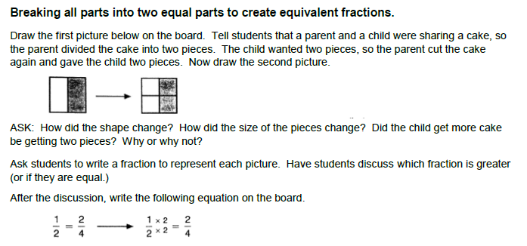
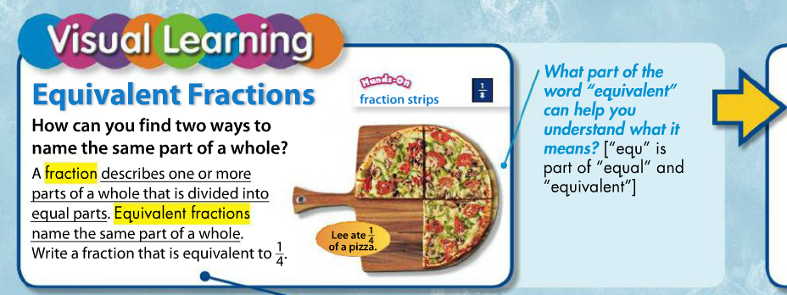
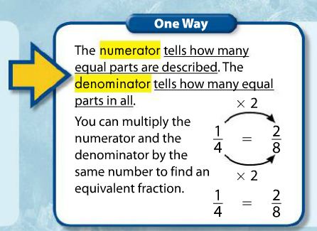
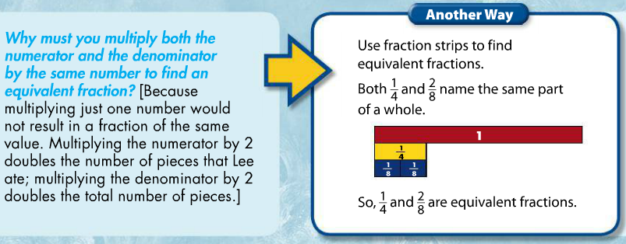
AC 1A: Do the materials feature opportunities to identify correspondences across mathematical representations?
IMET pp. 14-15
Handout p. 4
Notes:
Big Idea: Give participants an opportunity to compare two different examples of connecting mathematical representations.
Talking Points:
The third question under AC Metric 1A has to do with the use of representations. The question is asking whether there are opportunities to connect different mathematical representations. So we are not just looking for visual models to be present, but instead for there to be identified correspondences between representations that deepen understanding of mathematical concepts.
You will see many standards that explicitly require this—such as 4.NF.A.1—which require connecting visual models to the symbolic representation of equivalent fractions.
Now, you are going to look at two brief excerpts that address this standard. One is an example of how materials identify correspondences across mathematical representations and one is a non-example.
<Give participants time to review the lesson excerpts and discuss which is the example and which is the non-example for identifying correspondences across mathematical representations.> <5 minutes>
Example 1:
The first excerpt asks students to consider the connection between the visual model and the symbolic representation. Students connect changes to the number of pieces that don’t change the size of the whole. The teacher makes clear the connection between the cutting in the visual model and the procedure for multiplying the numerator and the denominator by the same number to create equivalent fractions.
Example 2:
The second excerpt displays various representations (the pizza, symbolic notation, and fraction tiles), but there is no correspondence identified between the various models.
Note: Just like with all of our examples, one part of a lesson like this in materials doesn’t mean that these materials would meet the metric. Reviewers need to look at many lessons and student materials to gather evidence that will allow them to make a holistic decision about the materials for each metric.

Slide 17
AC Metric 1A: Review a Full Lesson
Review the grade 4 lesson on pp. 5-8 of your handout.
Note evidence for each question associated with AC Metric 1A on p. 15 of your IMET.
Discuss:
  Gut check: Would these materials meet, partially meet, or not meet AC 1A? What is your evidence?
  What other things would you want to look at in these materials to determine your rating?
Notes:
Big Idea: Give participants an opportunity to review a full lesson against AC Metric 1A.
Taking Points:
As we’ve talked about, it’s impossible to rate materials based on a single problem, lesson, or even unit. That being said, we want to give you an opportunity to look more holistically at materials against the rubric.
You are going to review a lesson and gather as much evidence as you can against the metric for AC 1A, using the questions associated with the metric.
Although you won’t be able to give a rating, give a gut check about whether you think this series would receive 0, 1, or 2 points for this metric, assuming that this lesson was typical of their approach to application.
Also note what else you would need to look at to determine your ratings, or specific questions you have about these materials.
<Give participants time to review the lesson and discuss their gut check ratings and the evidence they found.><15 minutes>
This lesson starts with a discussion question that asks students to consider the conceptual understanding required to make sense of decimal fractions (which is greater 0.25 or 0.3?).
While students work to answer this question, they are encouraged to use representations that help them relate the visual model to the symbolic for of the number.
In the “Decimal Compare” game, students have the opportunity to continue comparing decimal fractions using their conceptual understanding of what decimals mean.

Slide 18
Procedural Skill and Fluency
AC Metric 1B: The materials are designed so that students attain the fluencies and procedural skills required by the Standards.
IMET pp. 16-17
Notes:
Big Idea: Introduce Alignment Criterion Metric 1B which relates to procedural skill and fluency.
Talking Points:
We will be taking a look at the second metric in AC 1 which specifically focuses on procedural skill and fluency.
This metric has two related questions to help reviewers find evidence toward the rating.
Before we get into all of the nuances of the metric, we are going to get more into what exactly the Standards require in terms of procedural skill and fluency.

Slide 19
Procedural Skill and Fluency
The Standards require speed and accuracy in calculation.
Materials structure class time and/or homework time for students to practice core functions such as single-digit multiplication so that they are more able to understand and manipulate more complex concepts
Notes:
Big Idea: The standards require procedural skill and fluency.
Talking Points:
There are two interrelated parts of this aspect of rigor: fluency and procedural skill. There are specific places in the standards where each is called for, and, often, developing procedural skill rests on students having fluency. For example, to develop procedural skill with multi-digit multiplications, students need to be fluent with their multiplication facts.
You can think of fluency in terms of being fluent in a foreign language: you don’t have to fumble or pause to remember words—it just flows.
The standards do not require memorization absent understanding. This is the outcome of a carefully laid out learning progression.
We can’t expect fluency to be a natural outcome without materials that specifically include support for students to develop fluency.

Slide 20
Required Fluencies in K-6
Grade | Standard | Required Fluency
K | K.OA.5 | Add/subtract within 5
1 | 1.OA.6 | Add/subtract within 10
2 | 2.OA.2 2.NBT.5 | Add/subtract within 20 (know single-digit sums from memory) Add/subtract within 100
3 | 3.OA.7 3.NBT.2 | Multiply/divide within 100 (know single-digit products from memory) Add/subtract within 1000
4 | 4.NBT.4 | Add/subtract within 1,000,000
5 | 5.NBT.5 | Multi-digit multiplication
6 | 6.NS.2,3 | Multi-digit division Multi-digit decimal operations
Notes:
Big Idea: Define the required fluencies called for by the CCSSM in grades K-6.
Talking Points:
Fluency is defined as being fast and accurate.
The Standards cite specific fluencies that are required K-6. (This ensures that students have all the needed fluencies for doing higher-level work by the time they finish grade 6.)
Fluency is different for each grade level. Some fluencies are with paper and pencil (e.g., add/subtract within 1000 in grade 3), some by memory (e.g., add/subtract within 10 in grade 1.)

Slide 21
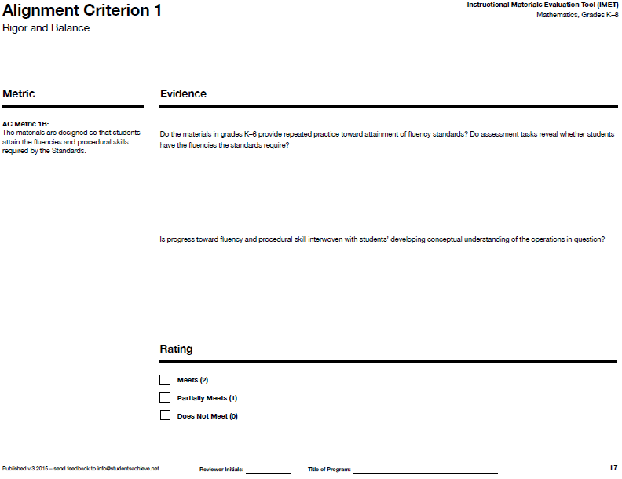
IMET p. 17
Notes:
Big Idea: Move from general information about procedural skill and fluency to the specifics of AC Metric 1B.
Talking Points:
The second metric in AC 1 attends specifically to procedural skill and fluency. <Read metric.>
Like AC 1A, this metric has associated questions. These questions are designed to help reviewers gather evidence to rate the metric. <Read questions.>
Note that the questions don’t get rated individually, only the metric.

Slide 22
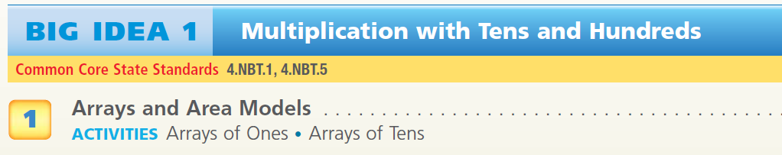
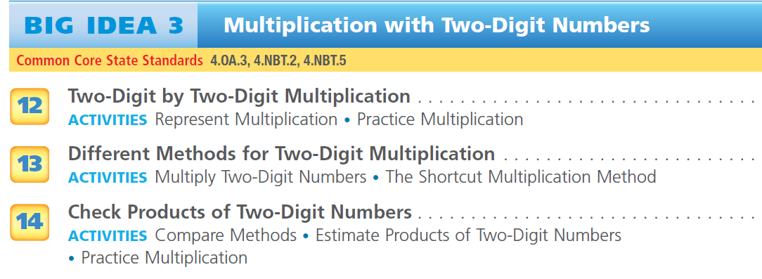
AC 1B: Is progress toward fluency and procedural skill interwoven with students’ developing conceptual understanding of the operations in question?
IMET pp. 16-17
Handout p. 9
Notes:
Big Idea: Give participants an opportunity to see an example of interweaving procedural skill and conceptual understanding.
Talking Points:
Now we are going to look at the first question used to gather evidence for AC Metric 1B: “Is progress toward fluency and procedural skill interwoven with students’ developing conceptual understanding of the operations in question?”
We are going to revisit a chapter overview on multiplication that we looked at in the last module.
<Give participants time to review the chapter outline and discuss how they see the interplay of procedural skill with conceptual understanding. Also, have participants go to p. 20 and read suggestions for standards> <5 minutes>
You can see from the chapter titles that there is work in this chapter both on developing conceptual understanding (building from grade 3 area models and arrays, bringing in place value) with procedural skill towards the end of the chapter where students will be able to apply this understanding to practicing procedural skill.
Although the grade 4 standards do not require fluency with multi-digit multiplication (that comes up in 5. NBT.B.5), this shows how the work of grade 4 is to move students toward fluency by incorporating both understanding and skill. Good materials must invest in developing fluency before the standards require it.
Note: As with all of our examples, just looking at the lesson titles of one chapter doesn’t mean that these materials would meet the metric. Reviewers need to look at these lessons and other materials to gather evidence that will allow them to make a holistic decision about the materials for each metric.

Slide 23
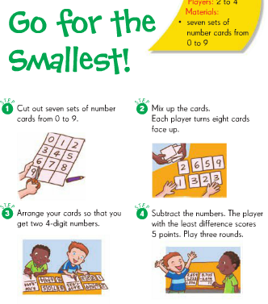
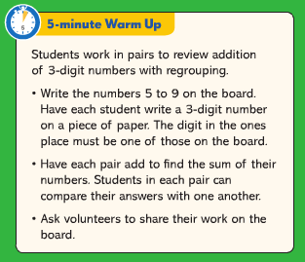
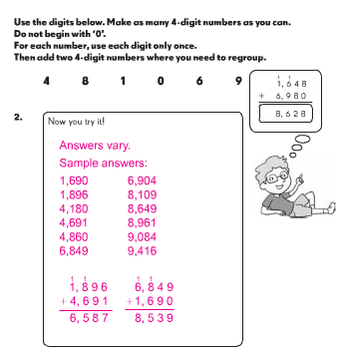
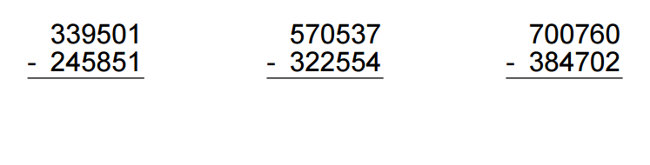
AC 1B: Do the materials in grades K–6 provide repeated practice toward attainment of fluency Standards?
IMET pp. 16-17
Notes:
Big Idea: Give participants an opportunity to see a variety of ways to provide practice toward attainment of fluency standards.
Talking Points:
Now we are going to look at the second question used to gather evidence for AC Metric 1B: “Do the materials in grades K–6 provide repeated practice toward attainment of fluency Standards?” Since there are only requirements for fluency in K-6, this question will not be used in reviews of grade 7 and 8 materials.
Developing fluency takes time and attention in classrooms and this practice can take a variety of forms depending on the grade level and needs of the learners. Often, we only think of fluency practice as timed tests. However, just doing timed tests doesn’t allow students to develop fluency. Therefore, materials need repeated practice.
Throughout the year, we want to see different forms of repeated practice.
<Click through the examples and allow participants a chance to look at them and discuss the variety of types of practice that are shown.> <2 minutes>
Note: Just like with all of our examples, just having one of these activities in a book doesn’t mean that these materials would meet the metric. Reviewers need to look carefully at multiple points in the materials to gather evidence that will allow them to make a holistic decision about the materials for each metric.

Slide 24
AC Metric 1B: Review a Full Lesson
Review the grade 4 lesson on pp. 10-13 of your handout.
Note evidence for each question associated with AC Metric 1B on p. 17 of your IMET.
Discuss:
  Gut check: Would these materials meet, partially meet, or not meet AC 1B? What is your evidence?
  What other things would you want to look at in these materials to determine your rating?
Notes:
Big Idea: Give participants an opportunity to review a full lesson against AC Metric 1B.
Talking Points:
As we’ve talked about, it’s impossible to rate materials based on a single problem, lesson, or even unit. That being said, we want to give you an opportunity to look more holistically at materials against this metric.
You are going to review a lesson and gather as much evidence as you can against AC Metric 1B, using the questions under the metric.
Although you won’t be able to give a rating, give a gut check about whether you think this series would receive 0, 1, or 2 points for this criterion, assuming that this lesson was typical of their approach to conceptual understanding.
Also note what else you would need to look at to determine your rating or specific questions you have about these materials.
<Give participants time to review the lesson and discuss evidence for each questions.> <10-15 minutes>
This lesson provides a strong example of how materials can interweave conceptual understanding with developing procedural skill and fluency. The use of place value blocks builds on conceptual understanding of addition that students developed in grades 1-3. In the lesson, the materials connect the models to the standard algorithm which students use to fluently add multi-digit numbers in grade 4.
The practice worksheets that are provided allow students to have practice using the standard algorithm to develop that skill.
Note: It is not possible to evaluate whether these materials provide repeated practice with fluency over the course of the year based on this lesson excerpt.

Slide 25
Application
AC Metric 1C: The materials are designed so that teachers and students spend sufficient time working with applications, without losing focus on the Major Work of each grade.
IMET pp. 18-19
Notes:
Big Idea: Introduce the Alignment Criterion Metric 1C which relates to application.
Talking Points:
We will be taking a look at the last metric in AC 1 which specifically focuses on application.
This metric includes three questions to help reviewers find evidence and rate the metric.
Before we get into all of the nuances of the metric, we are going to get more into what exactly the Standards require in terms of application.

Slide 26
Application
Students can use appropriate concepts and procedures for application even when not prompted to do so.
Teachers provide opportunities at all grade levels for students to apply math concepts in “real world” situations, recognizing this means different things in K-2, 3-5, and 6-8
Notes:
Big Idea: Explain application as it relates to the CCSSM.
Talking Points:
Using mathematics in problem solving contexts is the third aspect of rigor that must be present in instructional materials.
This is the “why we learn math” piece. We learn it so we can apply it in situations that require mathematical knowledge. There are requirements for application all the way throughout the grades in the CCSS.
It is important to note that this is not always indicated by the word “apply” appearing in a standard. For example, 4.NF.C.4 is Apply and extend previous understandings of multiplication to multiply a fraction by a whole number. Because this standard in not talking about applying the understanding to real-world problems, it wouldn’t be considered Application. On the other hand, the sub-standard 4.NF.C.4c Solve word problems involving multiplication of a fraction by a whole number, e.g., by using visual fraction models and equations to represent the problem, is targeting Application
The Standards also acknowledge there is a progression of complexity that students should be tackling in application problems that increases as the grades go up. So students in Kindergarten and grade 1 are working with basic single-step problems with addition and subtraction. Students in grade 2 work with two-step problems. In grade 3, students begin working with multi-step problems that grow in complexity through grade 8.
Application problems often provide an opportunity for students to make connections across clusters or domains in order to solve the problems.

Slide 27
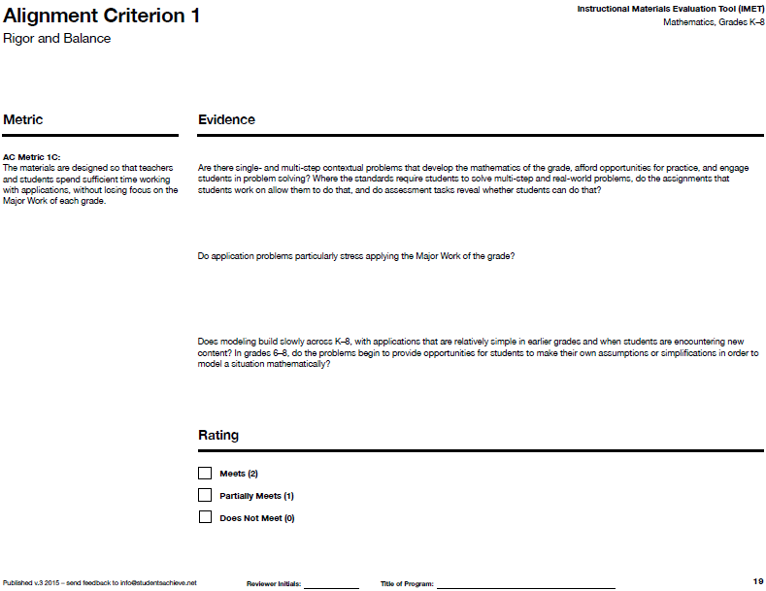
IMET p. 19
Notes:
Big Idea: Move from general information about application to the specifics of AC Metric 1C.
Talking Points:
The third metric in AC 1 attends specifically to application. <Read metric.>
Like the other metrics in AC 1, this metric has associated questions<Read questions.> Note that once again the questions don’t get rated individually, only the metric.

Slide 28
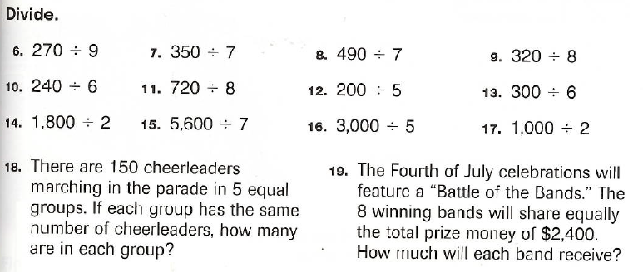
AC 1C: Are there single- and multi-step contextual problems that develop the mathematics of the grade, afford opportunities for practice, and engage students in problem solving?
A grower packs 4,568 peaches. He packs the most peaches possible, dividing them equally into 9 boxes, and then gives away the remaining peaches.
    How many of the remaining peaches does he give away?
    If he sells 7 boxes, how many peaches does he have left?
IMET pp. 18-19
Handout p. 14
Notes:
Big Idea: Give participants an opportunity to see contrasting examples of contextual problems that engage students in the work of the grade.
Talking Points:
We are going to look at the first question under AC Metric 1C: “Are there are single- and multi-step contextual problems that develop the mathematics of the grade, afford opportunities for practice, and engage students in problem solving?”
We are going to look at excerpts from two different materials. One is an example that meets the metric, and one is not.
<Give participants time to look at the 2 problem sets and identify which meets the metric and which not and why.> <6 minutes>
Example 1:
This question is a multi-step problem that requires students to identify which operations they will need to use to solve it. It provides the opportunity for students to work with numbers of the magnitude that is appropriate for the grade and it ask students to consider remainders.
Example 2:
Although these are not multi-step problems, that is not the main reason they do not meet the metric. (Not every problem in grade 4 materials should be multi-step.)
The issue with these word problems is that they don’t afford students much opportunity to practice problem solving or applying mathematical concepts to the real world. They will be able to solve them using the exact same operation and technique they used in the previous 17 exercises.
Too often, this is what we see in instructional materials which doesn’t allow the opportunity for students to engage in problem solving.
Note: Just like with all of our examples, just having one of these problems in a book doesn’t mean that these materials would meet or not meet the metric. Reviewers need to look carefully at multiple chapters and lessons that align to standards that target Application in order to gather evidence that will allow them to make a holistic decision about the materials for each metric.

Slide 29
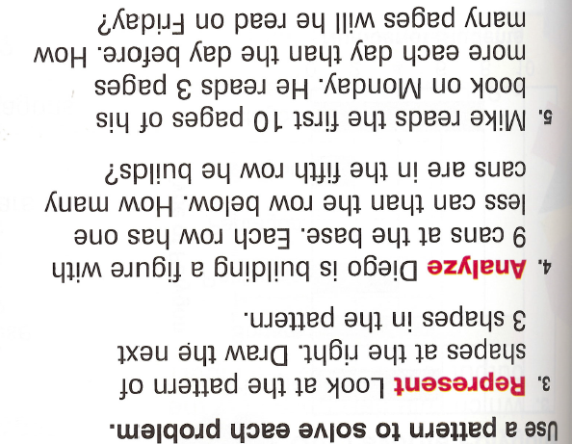
AC 1C: Do application problems particularly stress applying the Major Work of the grade?
1) A clown needs 275 balloons for a party he is going to, but the balloons only come in packs of 8. How many packs of balloons does he need to buy?
2) A florist splits 878 flowers into vases by putting 9 flowers in each vase. She needs more flowers to fill the last vase. How many more flowers does she need so that the last vase also has 9?
IMET pp. 18-19
Handout p. 15
Notes:
Big Idea: Give participants an opportunity to see word problems that are not requiring students to engage in applications in the Major Work of the grade.
Talking Points:
The second question under AC Metric 1C is “Do application problems particularly stress applying the Major Work of the grade? “
Again, we’re going to look at two excerpts, one that meets the metric and one that does not.
<Give participants time to read the questions and discuss which one stresses applying the major work of the grade and which does not.> <6 minutes>
Example 1:
These questions do not provide an opportunity for students to engage with the Major Work of the grade. While there may be a case that these questions align to 4.OA.C.3 Generate a number or shape pattern that follows a given rule. Identify apparent features of the pattern that were not explicit in the rule itself, this standards is not part of the major work of grade 4.
The questions really don’t ask students to do much mathematical work that relates to operations or algebraic thinking. Although students need to interpret the questions, this is not the kind of Application problems we should see in aligned materials.
Example 2:
These questions align to 4.OA.A.3 Solve multistep word problems posed with whole numbers and having whole-number answers using the four operations, including problems in which remainders must be interpreted. Represent these problems using equations with a letter standing for the unknown quantity. Assess the reasonableness of answers using mental computation and estimation strategies including rounding which sets the expectation for Application and aligns to the Major Work of the grade.
It is also worth noting that they are providing a variety of ways that a student would need to interpret the remainder which will help to ensure that students will be engaging in rich problem solving.
Note: Just like with all of our examples, one set of questions like this in materials doesn’t mean that these materials would not meet the metric. Reviewers need to look at many lessons and student materials to gather evidence that will allow them to make a holistic decision about the materials for each metric.

Slide 30
  AC 1C: Does modeling build slowly across K–8, with applications that are relatively simple in earlier grades and when students are encountering new content? In grades 6–8, do the problems begin to provide opportunities for students to make their own assumptions or simplifications in order to model a situation mathematically?
2.OA.A.1
A pencil costs 59 cents, and a sticker costs 20 cents less. How much do a pencil and a sticker cost together?
7.EE.B.4
Shelbi is running in a half marathon today. About ½ hour before the race, she parks her car in a garage about ¼ mile from the starting line. The prices for parking are shown in the following table:
As she is running, she remembers that she only has $13. What is the slowest pace Shelbi can run, in minutes per mile, and still pay less than $13 for parking? Explain your answer. State any assumptions you made.
Less than 1 hour | $8
1 hour to less than 2 hours | $12
2 hours to less than 3 hours | $15
3 hours or more | $18
IMET pp. 18-19
Handout p. 16
Notes:
Big Idea: Give participants an opportunity to see how modeling demands build across grade levels.
Talking Points:
The last questions under AC Metric 1C are “Does modeling build slowly across K–8, with applications that are relatively simple in earlier grades and when students are encountering new content? In grades 6–8, do the problems begin to provide opportunities for students to make their own assumptions or simplifications in order to model a situation mathematically?“
The main point of these questions is to ensure that students are given grade-appropriate modeling work. This should look very different in early elementary than middle school grades. Sometimes, the specific grade-level standards identify the complexity of the problems students should be looking at (see K.OA.A.2 vs. 4.OA.A.3) but beyond what’s listed in the Standards, materials need to make sure that middle school students are engaging with applications on a higher level. This will ensure that students are prepared for the extensive work with modeling they will encounter in high school.
<Give participants time to read and solve the questions and discuss the differences in complexity.> <6 minutes>
Although the grade 2 problem is just two sentences, you can see that the ability to model this problem will be a challenge for a grade 2 student.
In the grade 7 problem, it doesn’t just have more text, it is also asking students for more mathematically complex modeling. Students have to find information about the length of a half marathon (it is hyperlinked in the materials) and may make some assumptions to simplify the problem and create the model they can use to solve it.
Note: Just like with all of our examples, one set of questions like this in materials doesn’t mean that these materials would meet the metric. Reviewers need to look at many lessons and student materials to gather evidence that will allow them to make a holistic decision about the materials for each metric.

Slide 31
AC Metric 1C: Review a Full Lesson
Review the grade 4 lesson on pp. 17-20 of your handout.
Note evidence for each question associated with AC Metric 1C on p. 19 of your IMET.
Discuss:
  Gut check: Would these materials meet, partially meet, or not meet AC 1C? What is your evidence?
  What other things would you want to look at in these materials to determine your rating?
Notes:
Big Idea: Give participants an opportunity to review a full lesson against AC Metric 1C.
Taking Points:
As we’ve talked about, it’s impossible to rate materials based on a single problem, lesson, or even unit. That being said, we want to give you an opportunity to look more holistically at materials against this metric.
You are going to review a lesson and gather as much evidence as you can against AC Metric 1C, using the questions under the metric.
Although you won’t be able to give a rating, give a gut check about whether you think this series would receive 0, 1, or 2 points for this criterion, assuming that this lesson was typical of their approach to application.
Also note what else you would need to look at to determine your rating or specific questions you have about these materials.
<Give participants time to review the lesson and discuss evidence for each questions.> <10-15 minutes>
On its own, this lesson would merit a 0 rating on this metric, however, that does not mean, when reviewing the series, it would receive a 0 on this rating.
On the plus side, there are application problems provided for a standard that is targeting Application (4.NF.B.4c). There are a variety of problem types in the practice including a two-step (#22) and problems that ask students to bring in an understanding of multiplication with whole numbers, as it relates to the Major Work of the grade (#26 ask students to consider multiplication as scaling, #23 draws on the distributive property.)
The reason that this example does not meet the metric relates mostly to the first question – students do not actually engage in problem solving. In the “Problem-Based Interactive Learning” section on p. 26, students are told that they will be working with situations that require them to multiply a whole number by a fraction, thus taking out the opportunity for students to authentically problem solve. This lesson represents the traditional approach to word problems, where students do a whole page of problems that require the same operation.
In looking at the entire grade-level set of materials, reviewers would want to investigate whether students only had the opportunity to solve application problems in lessons like this. In aligned materials, students should have opportunities to solve a variety of application problems without being told which operation to use.

Slide 32
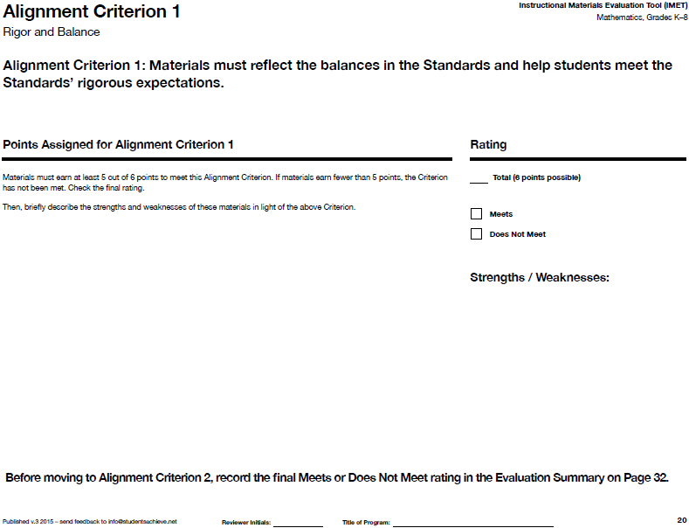
IMET p. 24
Notes:
Big Idea: Show summary page for AC 1.
Talking Points:
After completing your review of the metrics for AC 1, you will complete a summary page where you total the number of points earned for each metric. Because this is an Alignment Criterion, materials need to receive 5 of 6 points to be considered aligned. There is also space to note strengths and weaknesses of the materials as they relate to AC 1.

Slide 33
Wrapping Up

Slide 34
Alignment Criterion 1 and Metrics
AC #1: Balance and Rigor
1A: Conceptual Understanding
1B: Procedural Skill and Fluency
1C: Application
Notes:
Big Idea: Give participants a big picture view of the metrics covered in this module.
Talking Points:
These are all the metrics you learned about today!
There is a short-hand name to describe each metric. Many reviewers feel that it is helpful to have this on hand as they begin the review process to help them remember the metrics and think about where evidence they are finding in books fit in.

Slide 35
Essential Questions -- Discuss
How does the Instructional Materials Evaluation Tool (IMET) reflect the major features of the Standards and the Shifts?
What understandings support high-quality, accurate application of the IMET metrics?
Notes:
Big Idea: Give participants an opportunity to reflect on the essential questions for the session.
Details:
Either in pairs or in writing, have participants describe what they’ve learned in this session as it relates to the essential questions

