Slide 1
Text Complexity: Scaffolding Student Access
The webinar will begin shortly. You may wish to download the handouts (check the tab on your webinar control panel) while you wait.
Core Advocate Webinar
February 16, 2016
7:00 – 8:00 EST
Notes:
This slide will show as they log in
(7:00 - 7:05 pm)

Slide 2
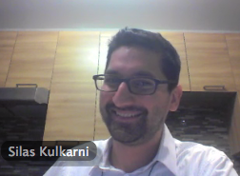
Introductions
Joanie Funderburk, Sandra Alberti, Janelle Fann - Field Impact Team
Silas Kulkarni - ELA/Literacy Team
Notes:
JOANIE
Introduce who we are
The webinar was born to extend and support the Core Advocates program, and the chance to help teachers implement changes in their classrooms – give very brief info on CA here

Slide 3
Core Advocates
Core Advocates are educators who:
  Believe in the potential of the CCSS to prepare all students for college and careers;
  Are eager to support their colleagues and communities in understanding and advocating for the CCSS and CCSS-aligned instruction;
  Understand and embrace the shifts in instruction and assessment required by the CCSS
Notes:
JOANIE
Introduce who we are
The webinar was born to extend and support the Core Advocates program, and the chance to help teachers implement changes in their classrooms – give very brief info on CA here

Slide 4
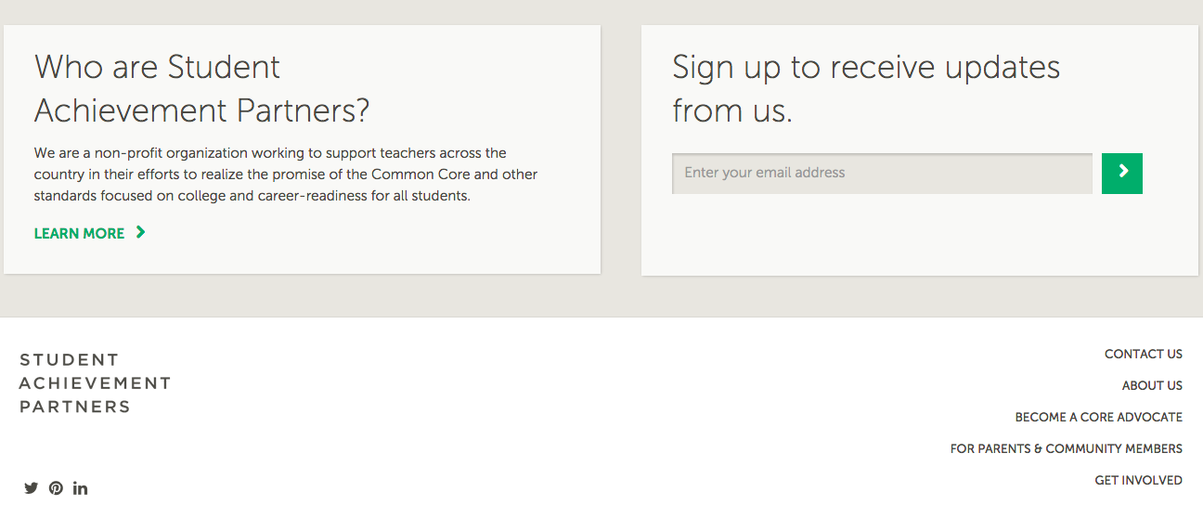
To learn more about Core Advocates…
Contact Janelle Fann(jfann@studentsachieve.net ) or Joanie Funderburk (jfunderburk@studentsachieve.net)
Complete this survey to join our database (and mailing lists): http://bitly.com/joincoreadvocates
Visit our website: www.achievethecore.org
Notes:
SANDRA
For those who don’t already know…

Slide 5

For Tweeters…
Please feel free to tweet during and after the webinar using #coreadvocates
@achievethecore and @JoanieFun, @salberti, @silaskulkarni
Notes:
SANDRA

Slide 6
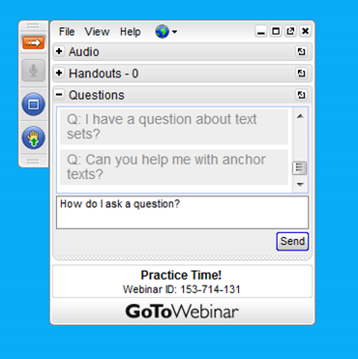
Webinar protocols
During the webinar
– Accessing Documents
– Questions option
– Polling
After the webinar
– Survey
– Access to recorded webinar
Notes:
JANELLE

Slide 7
Goals of the webinar
Understand the connection of analyzing text complexity to scaffolding student access.
Become familiar with tools for analyzing the complexity of a text and planning for instruction.
Consider how to create and sequence questions that support all students in accessing complex text and the lightbulb moment.
Notes:
JOANIE
Slides 2 - 6: 5 minutes
(be here at 7:10 pm)

Slide 8
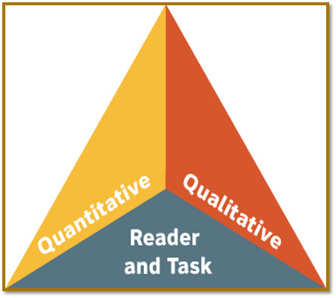
What we won’t cover today
Text complexity overview (101)
Quantitative Text Complexity Analysis
How to select texts appropriate to your grade level
Notes:
JOANIE/SANDRA

Slide 9
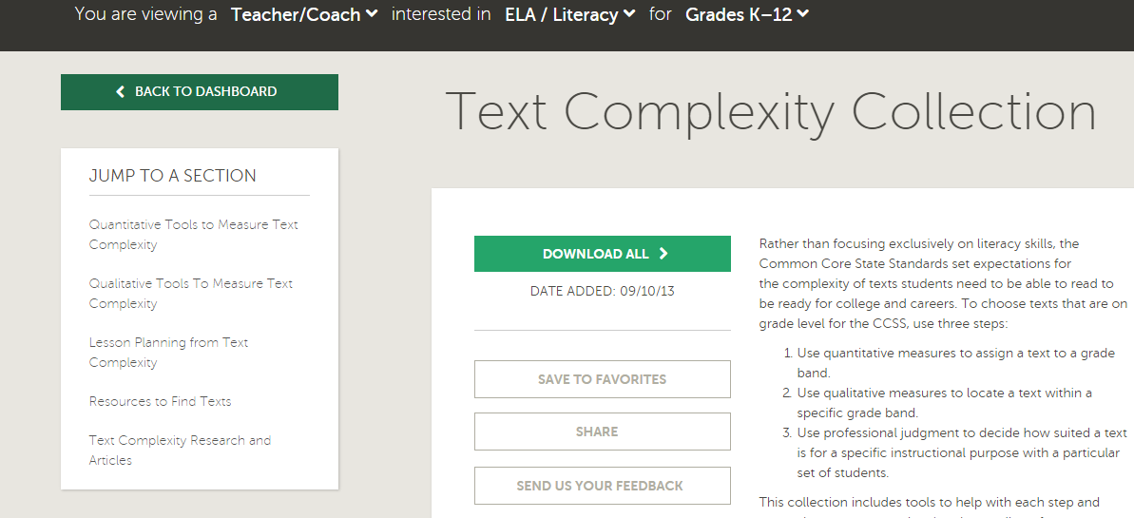
Text Complexity Collection
http://achievethecore.org/page/642/text-complexity-collection-list-pg
Notes:
JOANIE/SANDRA

Slide 10
Where do I start when planning instruction around a complex text?
Notes:
JOANIE
Pass to Silas

Slide 11


What’s the big idea?
The text is important, but so is what students get out of the text.
Not complex text for complex text’s sake, rather complex text for learning.
Complexity and Evidence go hand-in-hand.
Notes:
SILAS

Slide 12
What is complex text?
dense information
lack of words, sentences, or paragraphs that review or connect ideas for the student
lengthy paragraphs
complex sentences (syntax)
text structure that is less narrative and/or mixes structures
subtle and/or frequent transitions
multiple and/or subtle themes and purposes
uncommon vocabulary
unfamiliar settings, topics, or events
lack of repetition, overlap, or similarity in words and sentences
Notes:
SILAS

Slide 13
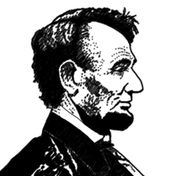

Not just complex, but rich, too!
Rich texts:
  illuminate major themes of the discipline
  help the reader to understand an alternative perspective
  are vivid, insightful, descriptive, beautiful
  make the content come to life
Notes:
SILAS

Slide 14
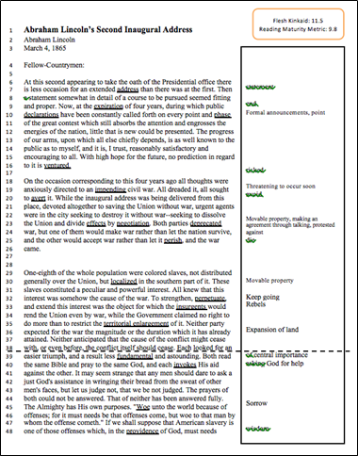
Lincoln’s 2nd Inaugural Address
Read the whole text.
Re-read focusing on just lines 39-59.
What was your “lightbulb moment” when reading this portion the text?
What would you want students to take away or experience from this excerpt?
Notes:
SILAS

Slide 15
Question:
What “lightbulb moment” do we want students to experience from this portion of Lincoln’s 2nd Inaugural Address?
Use the “Question” tab on your control panel to submit your response.
Notes:
JANELLE

Slide 16

Now that we know where we want our students to go...
Notes:
SILAS

Slide 17
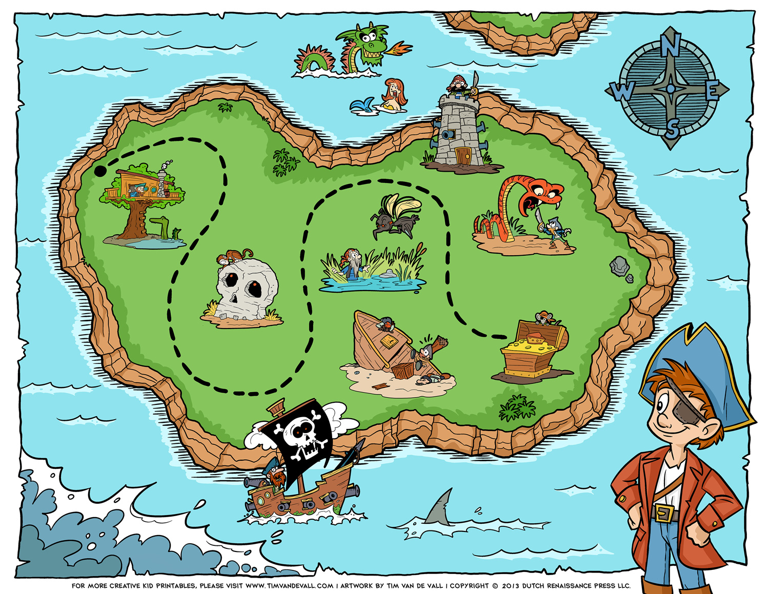

How do we help them find their way there?
Notes:
SILAS

Slide 18

One rule… No theft!
Notes:
SILAS

Slide 19
Where will students struggle in the path to this lightbulb?
Notes:
SILAS

Slide 20
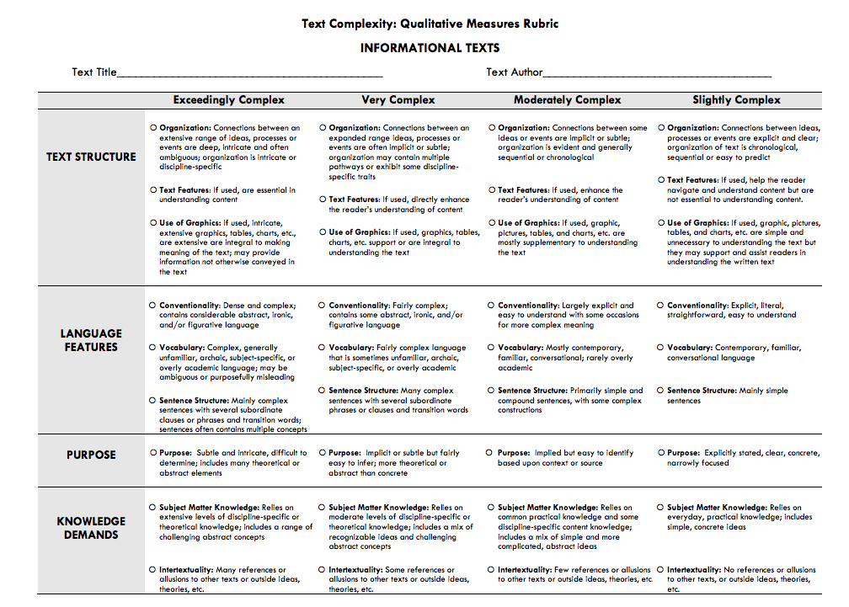
Qualitative Measures
file:///.file/id=6571367.14328587
Notes:
SILAS

Slide 21
Your Turn: Qualitative Analysis of Lincoln’s 2nd Inaugural Address
Notes:
SILAS

Slide 22
Poll:
Qualitatively, which elements of the text require the most scaffolding for student access?
Notes:
JANELLE
Multiple-Choice options:
Purpose/Meaning
Text Structure
Language Features
Knowledge Demands

Slide 23
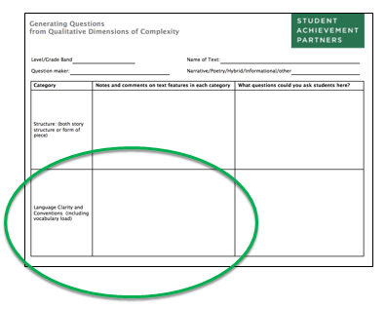
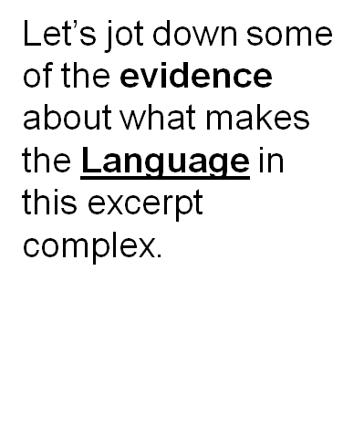
It’s not the rating, it’s the evidence!
Notes:
SILAS

Slide 24
Jot down some examples in each of these categories
Vocabulary!!!
Syntax
Archaic language
Words used with alternative definitions
Figurative language
Notes:
SILAS
Ideally I’d like them to share out their examples here, but I fear there just isn’t time. Nonetheless I’d like for them to at least put a few ideas down on their paper. Then I will read out a bunch of examples in each category, and ask if anyone has examples I missed.
Finally I will emphasize to them that they could have done a similar exercise for any of the four dimensions of qualitative complexity, but that since our time is limited we just did one area together. If they were doing this for lesson planning they would do all four areas. Also good to emp

Slide 25
Many elements of Language complexity
Vocabulary!!!
  invoke, aid, discern...
Syntax
Archaic language
Words used with alternative definitions
Figurative language
Notes:
SILAS

Slide 26
Many elements of Language complexity
Vocabulary!!!
  invoke, aid, discern...
Syntax
  “It may seem strange that any men should dare to ask a just God’s assistance in wringing their bread from the sweat of other men’s faces, but let us judge not, that we be not judged.”
Archaic language
Words used with alternative definitions
Figurative language
Notes:
SILAS

Slide 27
Many elements of Language complexity
Vocabulary!!!
  invoke, aid, discern...
Syntax
  “It may seem strange that any men should dare to ask a just God’s assistance in wringing their bread from the sweat of other men’s faces, but let us judge not, that we be not judged.”
Archaic language
  “woe to that man, by whom the offense cometh.”
Words used with alternative definitions
Figurative language
Notes:
SILAS

Slide 28
Many elements of Language complexity
Vocabulary!!!
  invoke, aid, discern...
Syntax
  “It may seem strange that any men should dare to ask a just God’s assistance in wringing their bread from the sweat of other men’s faces, but let us judge not, that we be not judged.”
Archaic language
  “woe to that man, by whom the offense cometh.”
Words used with alternative definitions
  pass away, drawn
Figurative language
Notes:
SILAS

Slide 29
Many elements of Language complexity
Vocabulary!!!
  invoke, aid, discern...
Syntax
  “It may seem strange that any men should dare to ask a just God’s assistance in wringing their bread from the sweat of other men’s faces, but let us judge not, that we be not judged.”
Archaic language
  “woe to that man, by whom the offense cometh.”
Words used with alternative definitions
  pass away, drawn
Figurative language
  [drop of blood] “drawn by the sword”
Notes:
SILAS

Slide 30
Why didn’t we do the other three areas together?
We should!
Don’t be surprised if one area (i.e. meaning, knowledge etc) is much more complex than others. It is rarely equal.
Which area is most complex varies dramatically from text to text.
Notes:
SILAS
Finally I will emphasize to them that they could have done a similar exercise for any of the four dimensions of qualitative complexity, but that since our time is limited we just did one area together. If they were doing this for lesson planning they would do all four areas. For point 3, mention that poetry and literature are often very simple on language, but hugely complex on meaning, whereas science texts often have fairly complex structure (hypothesis, lit review, methods, inclusion of data charts) and hugely complex knowledge demands.

Slide 31
Pause and reflect:
How do the concepts of complex text and corresponding big ideas connect to your classroom?
Notes:
JOANIE

Slide 32
Once I have identified the big idea and elements of complexity, how do I plan for instruction?
Notes:
JOANIE
Hand-off to SILAS

Slide 33
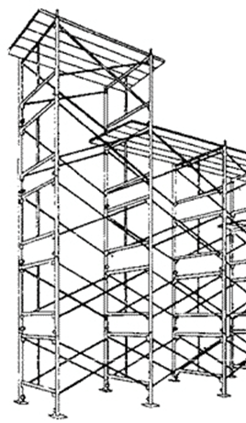
Reader and Task Considerations
“Students who struggle greatly to read texts within (or even below) their text complexity [level] must be given the support needed to enable them to read at an appropriate level of complexity. Even many students on course for college and career readiness are likely to need scaffolding as they master higher levels of text complexity.”
(CCSS -ELA; Appendix A, p. 9)
Notes:
SILAS

Slide 34
Planning for Complexity
All students need access to the complex ideas and the knowledge contained in complex texts.
Exposure to only simplified texts, or those with restricted, limited, or thin meaning will not result in college and career readiness.
There is no evidence that struggling readers catch up by reading simpler texts. In fact, the opposite is true.
Notes:
SILAS
“Leveled text creates leveled societies.”

Slide 35
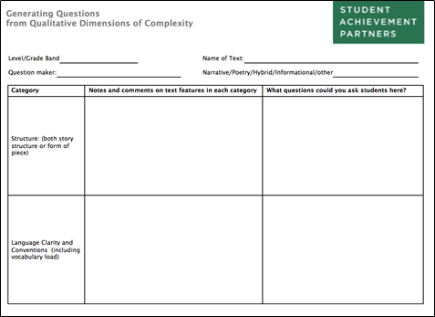
Planning for Complexity
Notes:
SILAS

Slide 36
“Memory is the residue of thought.”
-Daniel Willingham
Questions not answers.
Questions and tasks are clues!
Questions and tasks model the thought processes of proficient readers.
Notes:
SILAS
Remember, no stealing the light bulb.

Slide 37
Craft Questions for Lincoln’s 2nd Inaugural Address
Notes:
SILAS

Slide 38
Some examples
Inferring vocabulary:
  In lines 55-56 Lincoln describes the bondsman’s toil [i.e. the slave’s work] as “unrequited.” What might “unrequited” mean?
Parsing syntax:
  With your group, divide the sentence in lines 54-59 into chunks.
  Paraphrase each chunk.
  Rewrite the sentence as a whole in your own words.
Interpreting figurative language
  Re-read lines 57-58
  Lash means “whip.” What is “a drop of blood drawn with the lash?”
  What is a drop of blood “drawn with the sword?”
Notes:
SILAS

Slide 39
How do we help them find their way there?
Notes:
SILAS

Slide 40

The role of the teacher
Notes:
SILAS

Slide 41
How can carefully crafted and sequenced questions create a “bread crumb trail” to the big idea(s)
of a complex text?
Notes:
JOANIE
Hand-off to SILAS

Slide 42
Carefully crafted and sequenced questions
Anticipate areas of complexity that will create difficulty for students.
Design questions that will help students navigate the difficulty without stealing their lightbulb moments.
Consider a sequence of these questions that will lead students to the big idea of the complex text.
Notes:
SILAS

Slide 43
Sample questions and sequence
Where in this speech does Lincoln start talking about God and religion? Why does he do this?
When Lincoln says, "Both read the same Bible…" who are the "both" he is referring to?
Lincoln uses several quotes from the Bible in this speech. Find two examples of this (indicated by his use of quotation marks)?
Re-read lines 49-51. What does Lincoln say that God gives “to both North and South?” Why?
Why is the bondsman’s toil “unrequited”?
What does a “drop of blood drawn with the lash” mean? What is a drop of blood “drawn by the sword”?
Explain the sentence from lines 54-59 in your own words.
Why does Lincoln consider “the judgments of the Lord…true and righteous altogether?”
What is Lincoln saying to the nation in this sentence (and this speech)?
Notes:
SILAS
“judgements of the Lord...” Psalm 19:9 in the King James Bible.

Slide 44
Supporting Struggling Learners: DOs
add line numbers
provide an audio recording of the text
pre-teach vocabulary
provide a glossary
build knowledge and vocabulary with less complex texts prior to reading
ask questions that are text-dependent and text-specific
Notes:
SILAS

Slide 45
Supporting Struggling Learners: DON’Ts
assign this text as homework
expect students to answer text-based questions individually and silently
re-write the text in simpler language
remove or alter complex language and vocabulary
explain the meaning of the text prior to reading
write a summary of the text for students
steal their lightbulbs!
Notes:
SILAS

Slide 46
Question:
How will you apply these ideas around carefully crafted and sequenced questions with your students?
Use the “Question” tab on your control panel to submit your response.
Notes:
JOANIE

Slide 47
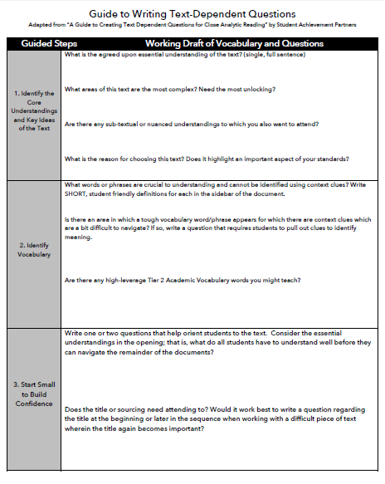
A tool to help
This guide walks
you through
the process step-
by-step.
Also try the
lesson planning
tool on
achievethecore.org
Notes:
SILAS

Slide 48

Notes:
SILAS

Slide 49
What questions do you have?
Notes:
JOANIE

Slide 50
Follow Up
Analyze an upcoming text for its qualitative complexity, and design questions that scaffold access around the text’s complex features.
Use the “Generating Questions from Qualitative Dimensions of Complexity” tool and the “Guide to Writing Text-Dependent Questions” for an upcoming text.
Utilize the Lesson Planning Tool on Achievethecore.org.
Notes:
JOANIE
slides Follow up, Upcoming webinar, Thank you - 5 minutes
(be here by 7:55 pm)

Slide 51
Upcoming Webinars
March Webinar: Rigor in Math
Tuesday, March 15, 2016
7:00 - 8:00 pm EDT
Register here: https://attendee.gotowebinar.com/register/7259842554101714946
Notes:
JOANIE

Slide 52
Thank You!
Notes:
JOANIE

Slide 53
Resources
www.Achievethecore.org
Submit your action steps here http://bit.ly/1EYfuMQ

