Slide 1
The Instructional Practice Suite for Math
The webinar will begin shortly. You may wish to download the handouts (check the tab on your webinar control panel) while you wait.
Core Advocate Webinar
January 19, 2016
7:00 – 8:00 EST

Slide 2
Introductions - Webinar Hosts
Sandra Alberti, Janelle Fann, Joanie Funderburk - Field Impact Team
Barbara Beske - Math Team

Slide 3
Core Advocates
Core Advocates are educators who:
  Believe in the potential of the CCSS to prepare all students for college and careers;
  Are eager to support their colleagues and communities in understanding and advocating for the CCSS and CCSS-aligned instruction;
  Understand and embrace the shifts in instruction and assessment required by the CCSS

Slide 4
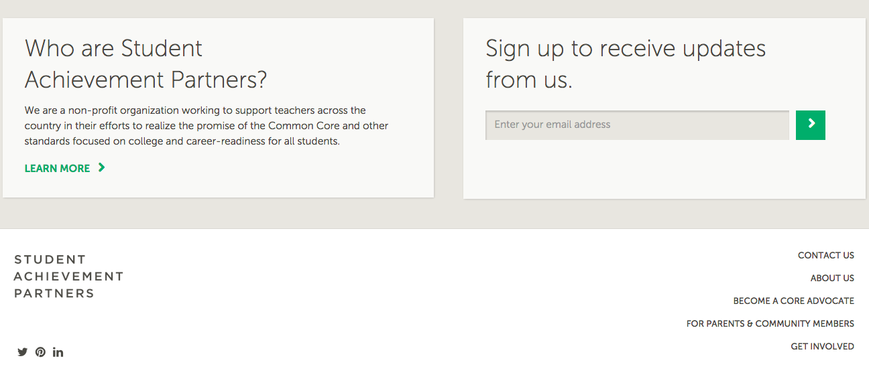
To learn more about Core Advocates…
Contact Janelle Fann (jfann@studentsachieve.net ) or Joanie Funderburk (jfunderburk@studentsachieve.net)
Join our database (and mailing lists): bitly.com/joincoreadvocates
Visit our website: www.achievethecore.org

Slide 5

For Tweeters…
Please feel free to tweet during and after the webinar using #coreadvocates
@achievethecore,
@salberti, @joaniefun, @beske3

Slide 6
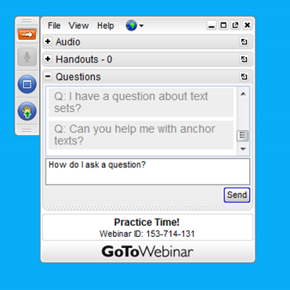
Webinar protocols
During the webinar
– Accessing Documents
– Questions option
– Polling
After the webinar
– Survey
– Access to recorded webinar

Slide 7
Goals of the webinar
Gain a basic understanding of the design and functionality of the tools in the Instructional Practice Suite for Math and what they support
Consider how the Instructional Practice Suite of tools work together in a teaching-learning cycle for teachers
Be familiar with Teaching the Core - a resource for full length classroom videos annotated to the Instructional Practice Guide: Coaching tool

Slide 8
What tools are in the Instructional Practice Suite for Math?

Slide 9
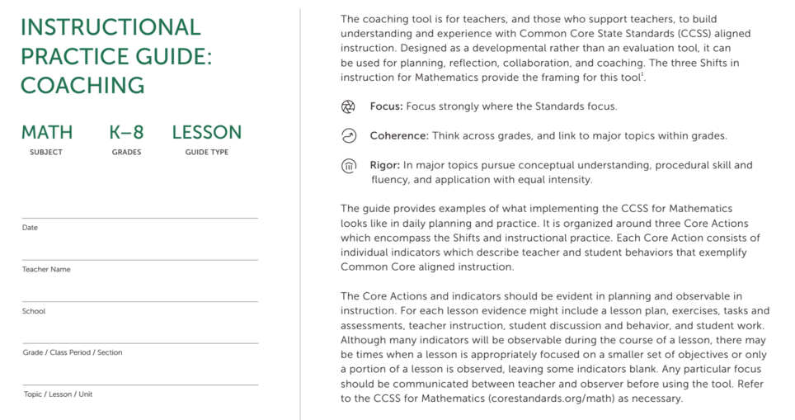
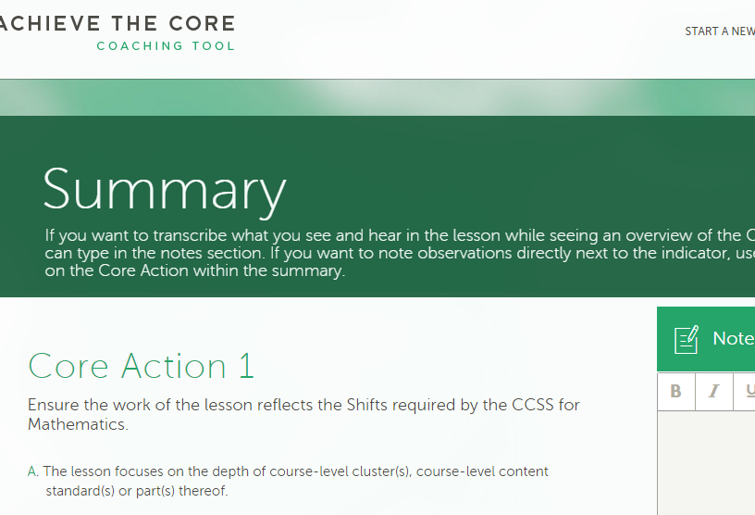
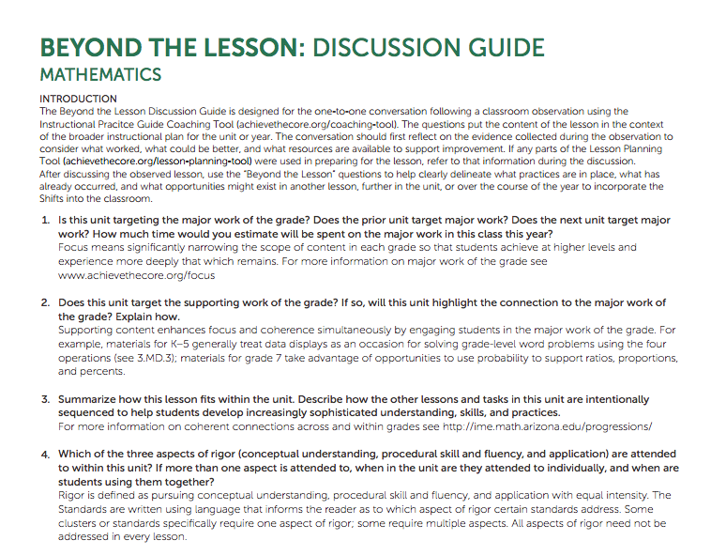

Instructional Practice Suite for Math

Slide 10
Polls: What is your experience with the Instructional Practice Suite of Tools for Math?

Slide 11
Elements of the tools
SUPPORT TEACHERS
in applying the Shifts in their practice - in short and long term planning and in instruction
by developing and improving their use of instructional practices that allow students to learn mathematics
in giving students opportunities to strengthen their math skills and understanding through engagement in the mathematical practices

Slide 12
Instructional Practice Guide: Coaching Tool

Slide 13
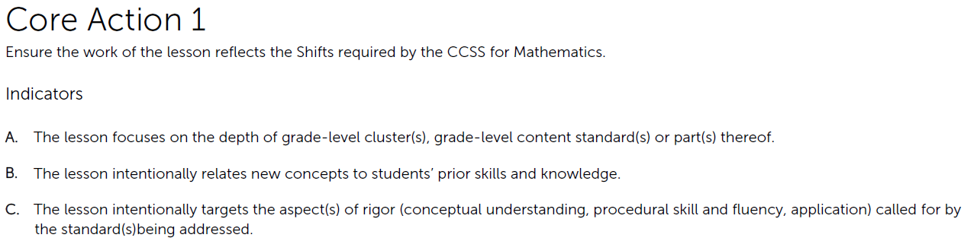
Instructional Practice Guide: Coaching Tool

Slide 14
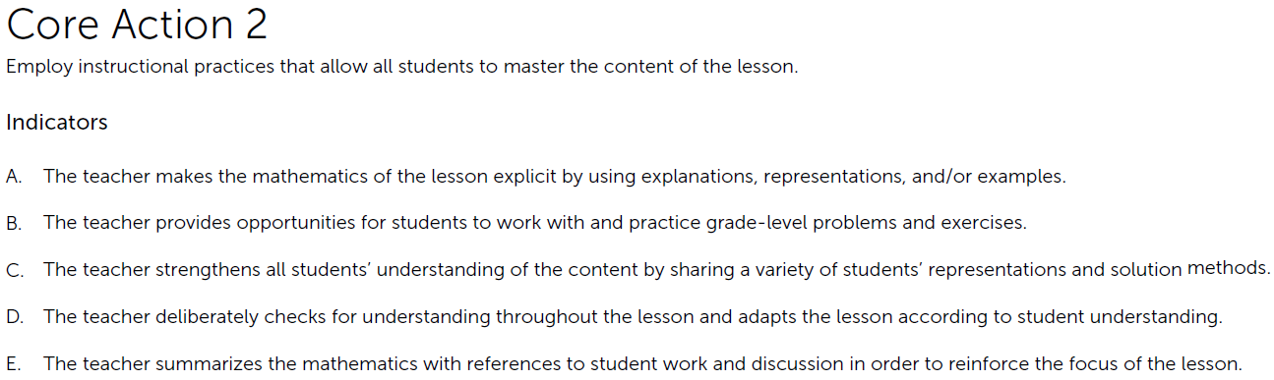
Instructional Practice Guide: Coaching Tool

Slide 15
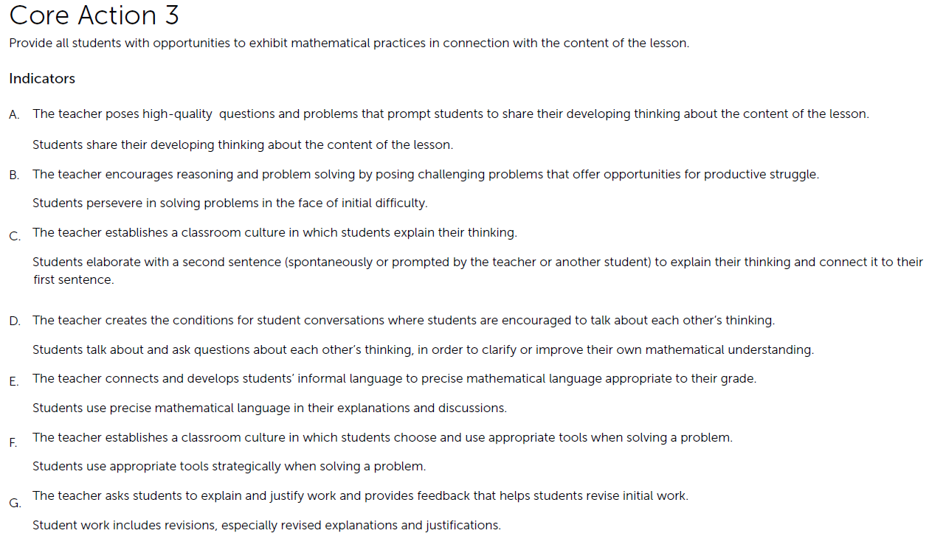
Instructional Practice Guide: Coaching Tool

Slide 16
Instructional Practice Guide: Coaching Tool
Helpful uses...
Lesson planning
PLC/teacher team meetings
Discussing instructional strategies
Selecting a focus area for improvement
Peer observation
Coach observation
Reviewing classroom video
Unhelpful... (don’t do this!)
evaluate teachers
serve as a checklist of what every teacher should do every day
rate a teacher’s effectiveness
mandate instructional practices
rank how well a teacher is performing

Slide 17
Question: Which of the uses of the IPG is most relevant for you?
Use the “Question” tab on your control panel to submit your response.

Slide 18
Instructional Practice Guide: Beyond the Lesson

Slide 19
Instructional Practice Guide: Beyond the Lesson
Puts the content of the lesson in the context of the broader instructional plan for the unit or year
Allows for conversations about Focus, Coherence, and Rigor that cannot always be captured in the discussion of a single lesson
Sparks conversation about monitoring student progress and creating a mathematically rich classroom environment

Slide 20
Question: Which one or two questions from the list can you commit to asking yourself or the teachers you support?
Use the “Question” tab on your control panel to submit your response.

Slide 21
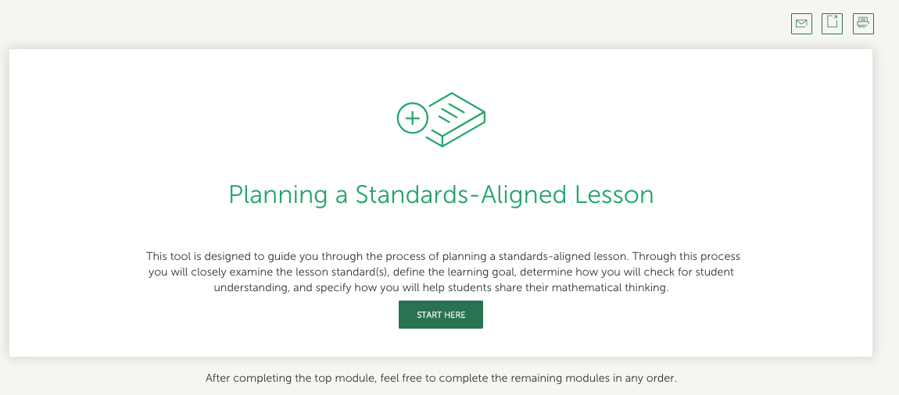
Instructional Practice Guide: Lesson Planning Tool

Slide 22
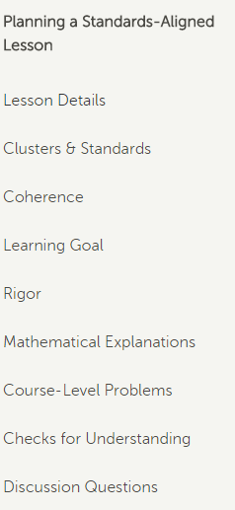
Instructional Practice Guide: Lesson Planning Tool
Planning a Standards-Aligned Lesson
Lesson Details
Clusters & Standards
Coherence
Learning Goal
Rigor
Mathematical Explanations
Grade-Level Problems
Checks for Understanding
Discussion Questions

Slide 23

Instructional Practice Guide: Lesson Planning Tool

Slide 24
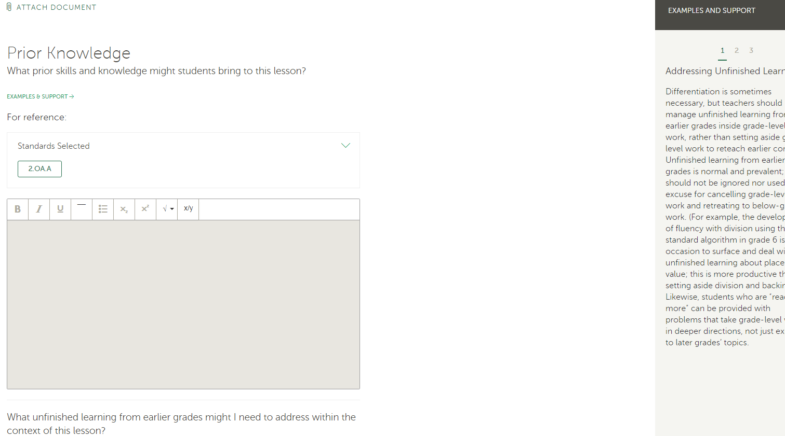
Instructional Practice Guide: Lesson Planning Tool

Slide 25
Instructional Practice Guide: Lesson Planning Tool

Slide 26
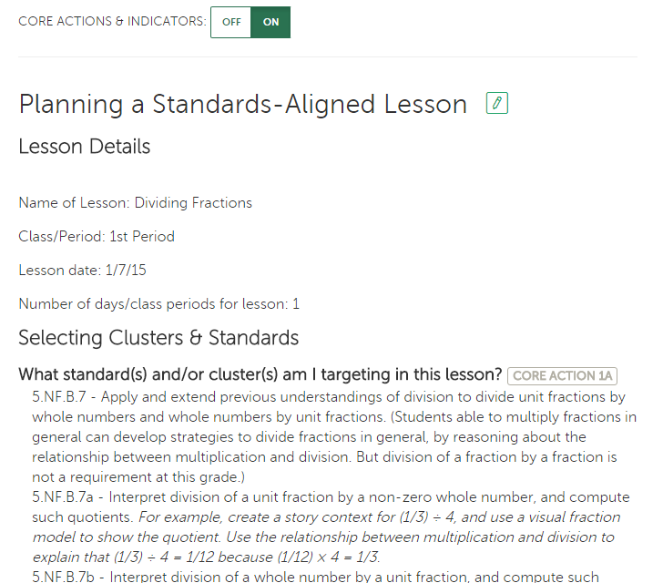
Instructional Practice Guide: Lesson Planning Tool

Slide 27
Question:
In what ways have you used these tools and/or what tools are you most looking forward to further engaging with?
Use the “Question” tab on your control panel to submit your response.

Slide 28
How do the tools in the Instructional Practice Suite work together?

Slide 29

Teaching – Learning Cycle*
*Graphic courtesy of Cherry Creek Schools
Centennial, CO

Slide 30
Teaching – Learning Cycle*
Lesson Planning Tool
Coaching Tool
*Graphic courtesy of Cherry Creek Schools
Centennial, CO

Slide 31
Teaching – Learning Cycle*
Coaching Tool
*Graphic courtesy of Cherry Creek Schools
Centennial, CO

Slide 32
Teaching – Learning Cycle*
Coaching Tool & conversations
Beyond the Lesson
*Graphic courtesy of Cherry Creek Schools
Centennial, CO

Slide 33
Teaching – Learning Cycle*
Coaching Conversations &
Reflection
Lesson Planning Tool
*Graphic courtesy of Cherry Creek Schools
Centennial, CO

Slide 34
Question:
How might the Suite of Instructional Tools enhance your current planning-teaching processes?
Use the “Question” tab on your control panel to submit your response.

Slide 35
How do the videos on Teaching the Core support the Instructional Practice Suite?

Slide 36

Teaching the Core

Slide 37
Poll: Have you seen or used the videos on Teaching the Core?

Slide 38

Teaching the Core

Slide 39
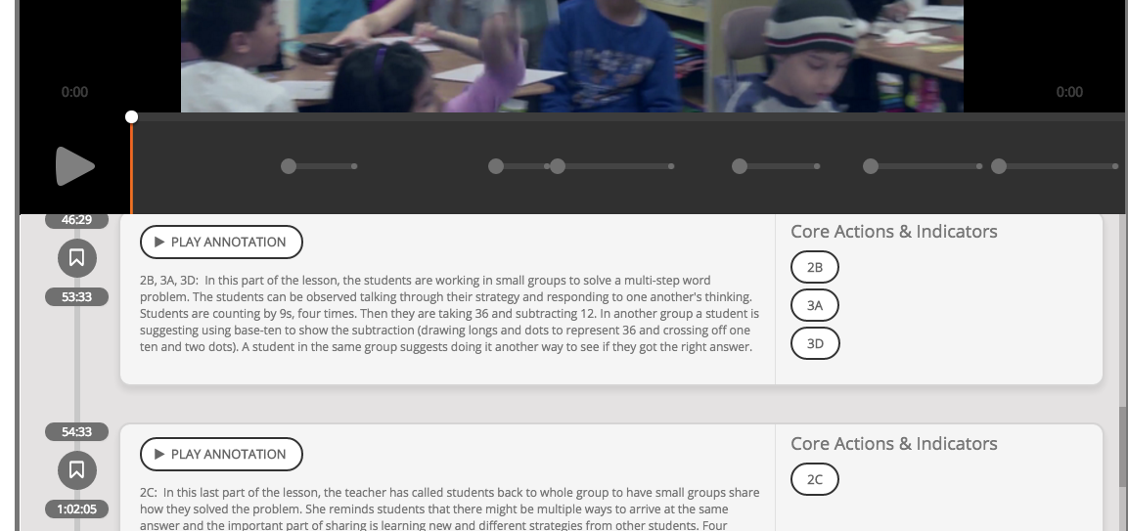
Teaching the Core

Slide 40
Your questions?
Use the “Question” tab on your control panel to submit your questions.

Slide 41
Follow Up
Use any of the tools in the Instructional Practice Suite and tell us how they helped you do your job better.
Watch a Teaching the Core video yourself or with colleagues with the IPG in hand and have a conversation about what you see.
Share information about these tools with your colleagues!
Submit comments and reflections here.

Slide 42
Upcoming Webinars
Text Complexity
  Tuesday, February 16, 2015
  7:00 – 8:00 pm EST
Register here

Slide 43
Thank You!

Slide 44
Resources
www.Achievethecore.org
Submit your action steps here http://bit.ly/1EYfuMQ

