Slide 1
The Coherence Map
The webinar will begin shortly. You may wish to download the handouts (check the tab on your webinar control panel) while you wait.
Core Advocate Webinar
October 19, 2015
7:00 – 8:00 EDT

Slide 2
Introductions
Joanie Funderburk, Field Impact Team
Jason Zimba, a Lead Writer CCSSM & Founding Partner SAP
Amanda Vitello, Digital Product Manager
Core Advocates are educators who:
Believe in the potential of the CCSS to prepare all students for college and careers;
Are eager to support their colleagues and communities in understanding and advocating for the CCSS and CCSS-aligned instruction;
Understand and embrace the shifts in instruction and assessment required by the CCSS

Slide 3
To learn more about Core Advocates…
Contact Max Wagner (wagnerm@studentsachieve.net ) or Joanie Funderburk (jfunderburk@studentsachieve.net)
Complete this survey to join our database (and mailing lists): http://www.tfaforms.com/362186
Visit our website: www.achievethecore.org

Slide 4
For Tweeters…
Please feel free to tweet during and after the webinar using #coreadvocates
@achievethecore, @JoanieFun, @salberti,

Slide 5
Webinar protocols
During the webinar
– Accessing Documents
– Questions option
– Polling
After the webinar
– Survey
– Access to recorded webinar

Slide 6
Goals of the webinar
1. Understand how the Coherence Map originated and developed into its current form.
2. Understand the Coherence Map as a visual representation of the mathematical connections that live within the CCSS.
3. Understand how the Coherence Map contributes to effective teaching practices and increased student learning.

Slide 7
Polls: Getting to Know You!

Slide 8
How did the Coherence Map originate & develop into its current form?

Slide 9
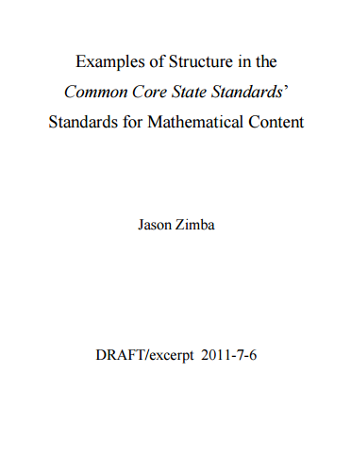
2011: Capture the design thinking that went into CCSS-M

Slide 10
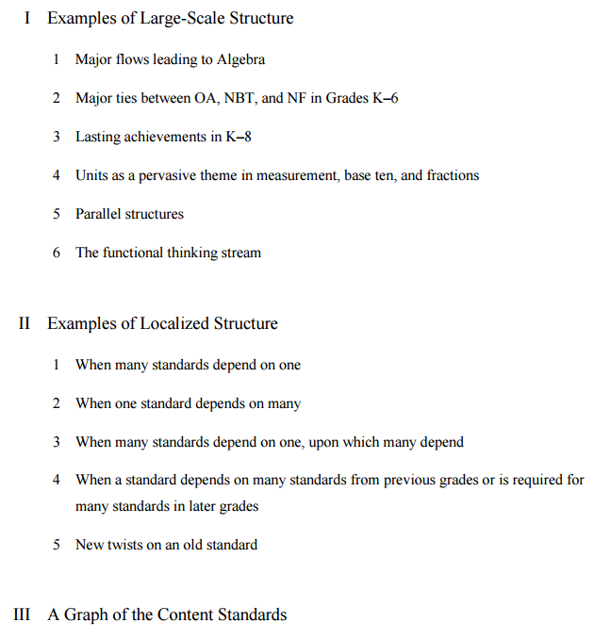

Slide 11
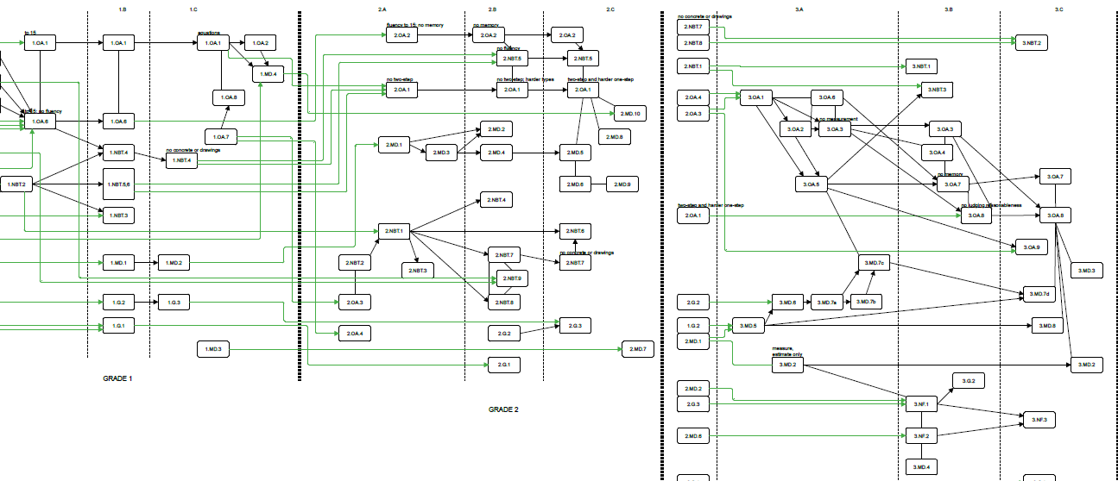
The “Wiring Diagram”

Slide 12
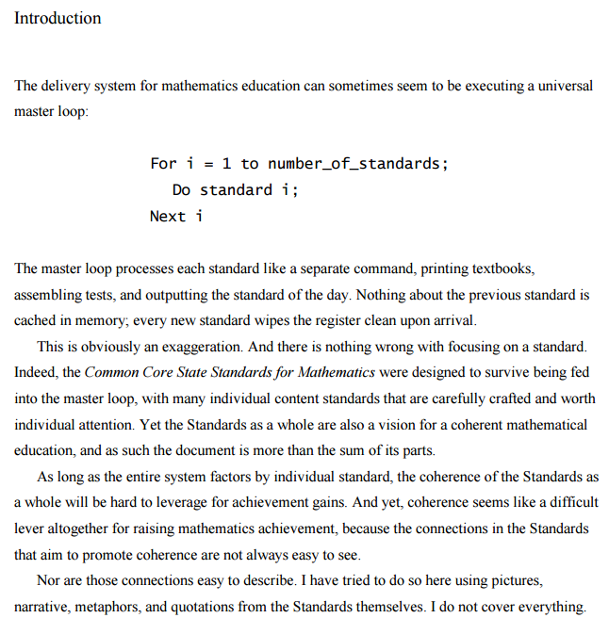
The promises and perils of lists

Slide 13
Why is it important to know how the math standards connect to one another?
How do the connections (and teachers’ knowledge of them) contribute to student learning?
Use the “Question” tab on your control panel to submit your response.

Slide 14
How does the Coherence Map show the connections that live within the CCSSM?

Slide 15
Your turn! Coherence across grades
Standard A: Understand a rational number as a point on the number line. Extend number line diagrams and coordinate axes familiar from previous grades to represent points on the line and in the plane with negative number coordinates.
Standard B: Understand a fraction as a number on the number line; represent fractions on a number line diagram.
Standard C: Represent whole numbers as lengths from 0 on a number line diagram with equally spaced points corresponding to the numbers 0, 1, 2

Slide 16
Coherence across grades
What thinking did you use to order the standards?
What knowledge of the mathematics did you use to order these standards?
What knowledge of the standards did you use to order these standards?

Slide 17
Your turn! Coherence within a grade
Standard 8.SP.A.3:
Use the equation of a linear model to solve problems in the context of bivariate measurement data, interpreting the slope and intercept.
Which other standard(s), taught in conjunction with this one, would support and reinforce the same mathematical concept(s)?

Slide 18
Coherence within a grade
Was this task more or less difficult for you than ordering standards? Why?
What mathematical knowledge was required to make this determination?
What knowledge of the standards was required to make this determination?

Slide 19
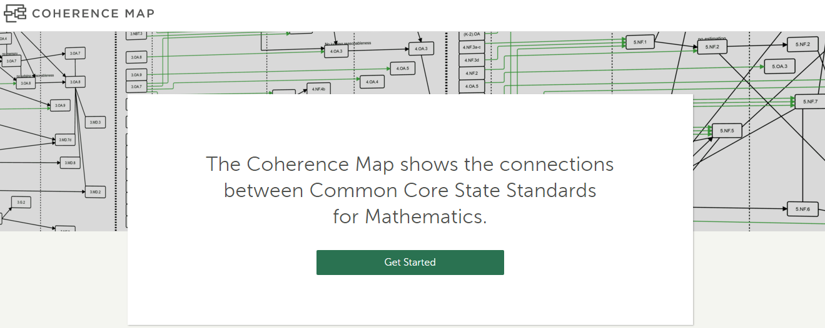
Let’s take a tour

Slide 20
How might you use the Coherence Map in your setting?

Slide 21
How can the Coherence Map contribute to effective teaching practices and increased student learning?

Slide 22
How would you use the Coherence Map to...
Help a vertical planning team determine how they can better prepare students for the 8th grade algebra standards?

Slide 23
How would you use the Coherence Map to...
Help team teachers who have multi-grade classes, for example, a K/1 class, or a 2/3 class?

Slide 24
How would you use the Coherence Map to...
Support a new 5th grade teacher with students who have significant learning gaps?
A principal has recommended using Tuesdays/Thursday to do leveled groups during math instructional time, using worksheets to help students get up to grade level.

Slide 25
Call to Action!
Use the Coherence Map in the way that is most helpful to you
Share (Twitter, Facebook, Pinterest, etc.) HOW you used the link to help you in planning to support student learning
If tweeting, use #coreadvocates
“I used the Coherence Map to…..

Slide 26
Taking it even further...
Share the concept map with other teachers in your setting (PLC meeting, PD, etc.)
Create a “concept connection” map for high school standards in your local context
Review released assessment items (SBAC, PARCC, NY state, SAT, ACT, etc.) to include in the Coherence Map
Identify short videos that illustrate a particular standard well or support teacher content knowledge
Your other ideas?

Slide 27
What questions do you have?

Slide 28
Upcoming Webinars
November Core Advocate Webinar:
The Instructional Practice Suite for ELA
Tuesday, November 17, 2015 7:00 - 8:00 pm EST
Register here: http://bit.ly/1Gmkvz2

Slide 29
Thank You!

Slide 30
Resources
www.Achievethecore.org
www.achievethecore.org/coherence-map
Submit your action steps here http://bit.ly/1EYfuMQ

Slide 31
Additional Resources
https://www.engageny.org/resource/released-2015-3-8-ela-and-mathematics-state-test-questions
http://parcc.pearson.com/practice-tests/math/
http://sampleitems.smarterbalanced.org/itempreview/sbac/index.htm
www.tinyurl.com/ccssmgraph
http://commoncoretools.me/wp-content/uploads/2011/12/ccssatlas_2011_12_01_1257.pdf

