Slide 1
Instructional Materials Make a Difference: Why we should spend more time choosing and how you can play a role
The webinar will begin shortly. You may wish to download the handouts (check the tab on your webinar control panel) while you wait.
Core Advocate Webinar
May 24, 2016
7:00 – 8:00 EDT
Notes:
This slide will show as they log in

Slide 2
Introductions
Joanie Funderburk, Sandra Alberti, & Janelle Fann Field Impact Team
Stacy Wetcher, Project Manager
Core Advocates are educators who:
  Believe in the potential of the CCSS to prepare all students for college and careers;
  Are eager to support their colleagues and communities in understanding and advocating for the CCSS and CCSS-aligned instruction;
  Understand and embrace the shifts in instruction and assessment required by the CCSS
Notes:
ALL
Introduce who we are
The webinar was born to extend and support the Core Advocates program, and the chance to help teachers implement changes in their classrooms – give very brief info on CA here

Slide 3

To learn more about Core Advocates…
Contact Janelle Fann(jfann@studentsachieve.net ) or Joanie Funderburk (jfunderburk@studentsachieve.net)
Complete this survey to join our database (and mailing lists): http://bitly.com/joincoreadvocates
Visit our website: www.achievethecore.org
Notes:
JOANIE/SANDRA
For those who don’t already know…

Slide 4

For Tweeters…
Please feel free to tweet during and after the webinar using #coreadvocates
@achievethecore and @JoanieFun, @salberti
Notes:
JOANIESANDRA

Slide 5

Webinar protocols
During the webinar
– Accessing Documents
– Questions option
– Polling
After the webinar
– Survey
– Access to recorded webinar
Notes:
JOANIE/SANDRA

Slide 6
Goals of the webinar
Consider ways schools and districts have traditionally selected materials, and understand why many of these processes should change
Learn about the IMET and other resources that can help in selecting and/or using instructional materials
Share strategies for influencing how materials are chosen/used in your setting
Notes:
JOANIE/SANDRA

Slide 7
Question:
What factors has your school/district traditionally considered in materials adoption?
Use the Questions tab on your control panel to share your response!
Notes:
Expected responses:
Support for special populations
Access to online resources
Philosophical frameworks (instructional approaches, etc.)
Ethics concerns (racial representation, etc.)
Cost
Teacher approval
Aligned to standards

Slide 8
Materials Selection: THEN
Lack of transparency in processes
Processes done in isolation
Political forces drove decisions
Vendor relationships drove decisions
Inconsistent definitions and ratings of quality
Content alignment rarely a driving force
  durability, use of appealing graphics
Notes:
CO-PRESENTER

Slide 9
Materials Selection: How do we Improve?
Standards and Shifts at the forefront
Common understanding of quality
Utilize relevant outside information
Include the right people in the decision making process
Notes:
CO-PRESENTER
*Note that Alignment to Standards and Shifts and Common Understanding of Quality are complicated!!

Slide 10
Materials Selection: Considerations
Carefully select the review team
Train reviewers to recognize the Standards and the Shifts
Acknowledge that most materials are not perfectly aligned
Understand and factor in time requirements
Notes:
CO-PRESENTER

Slide 11
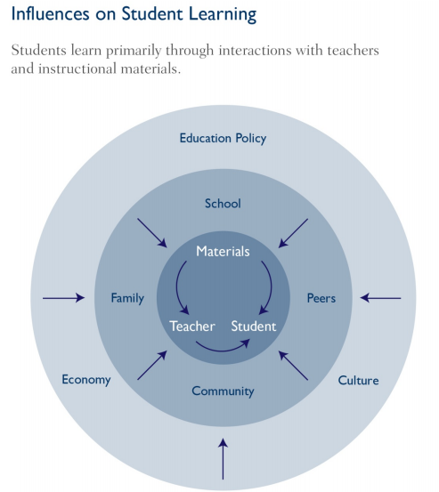
Strong Materials Impact Student Learning
  “…choice of instructional materials can have an impact as large as or larger than the impact of teacher quality. But whereas improving teacher quality through changes in the preparation and professional development of teachers and the human resources policies surrounding their employment is challenging, expensive, and time-consuming, making better choices among available instructional materials should be relatively easy, inexpensive, and quick.”
Chingos and Whitehurst, “Choosing Blindly: Instructional Materials, Teacher Effectiveness and the Common Core,” Brown Center on Education Policy at Brookings, (April 10, 2012), http://www.brookings.edu/research/reports/2012/04/10-curriculum-chingos-whitehurst.
Notes:
Why it is so important to have quality resources available.

Slide 12
“In general, teachers are much more likely to cover topics presented in the materials selected by their school or district than to cover topics not included; they are likely to follow the sequence of topics in the selected materials; and their pedagogical approach is influenced by the instructional design of the materials. The evidence is clear that instructional interactions between students and teachers are framed by the instructional materials that are provided by their schools and districts.”
Chingos & Whitehurst, Choosing Blindly: Instructional Materials, Teacher Effectiveness, and the Common Core

Slide 13
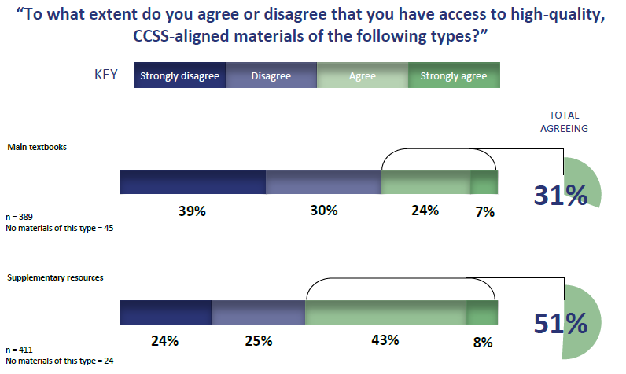
Inconsistent Access To Materials (1 of 2)
“From Adoption to Practice: Teacher Perspectives On the Common Core” http://www.edweek.org/media/ewrc_teacherscommoncore_2014.pdf
Notes:
Most educators do NOT have access to quality resources

Slide 14
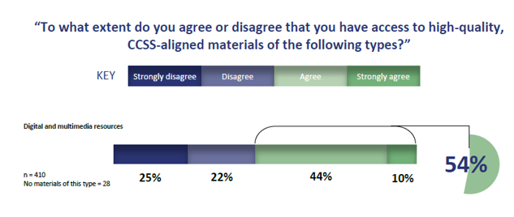
Inconsistent Access To Materials (2 of 2)
“From Adoption to Practice: Teacher Perspectives On the Common Core” http://www.edweek.org/media/ewrc_teacherscommoncore_2014.pdf
Notes:
All of this leads to teachers writing their own because they feel compelled to OR GOOGLING

Slide 15

Challenge of Selecting Quality Materials
Notes:
CO-PRESENTER
Analogy around buying cereal:
-want something healthy
-so much effort in making everything look delicious
-everything SAYS it’s healthy
-everything has ingredients listed
STILL hard to know
Companies have invested a lot in marketing to make you think they have exactly what you need. We need tools to sort through that information.

Slide 16
Poll:
How are you (or teachers you work with) responding to lack of quality materials?
Notes:
JOANIE/SANDRA
Options (allow them to select more than one)
Using old materials until something better comes along
Supplementing old materials
Piecing together from multiple resources
Writing our own materials
Finding materials for free online

Slide 17
Question:
What are your biggest challenges regarding aligned materials?
Use the “Question” tab on your control panel to submit your response.
Notes:
JOANIE/SANDRA

Slide 18
What resources are available to help schools/districts select/use materials?
Notes:
JOANIE/SANDRA
Hand-off to CO-PRESENTER

Slide 19
Instructional Materials Evaluation Tool
Comprehensive tool for reviewing materials for alignment to the Standards and the Shifts
  ELA K-2
  ELA 3-HS
  Math K-8
  Math HS
Professional Learning Modules to train review teams
Use for selecting new materials OR reviewing current materials
Notes:
CO-PRESENTER

Slide 20
Format of the IMET
Non-negotiable Alignment Criteria
  Must be met in full for materials to be considered aligned to the Standards and the Shifts
  Every individual metric must be met
Additional Alignment Criteria
A specific number of metrics must be met or partially met
Indicators of Quality
Notes:
CO-PRESENTER

Slide 21
Format of the IMET
Metrics
  specific descriptors
How to find evidence
  suggestions on what to review to determine whether or not the metric is met
Evidence
  support ratings with evidence from the materials
Notes:
CO-PRESENTER

Slide 22
ELA IMET: Text-Dependent Questions
NN2: At least 80% of all questions in the submission are high-quality text-dependent and text-specific questions. The overwhelming majority of these questions are text-specific and draw student attention to the text.
Metric 2A: At least 80% of all questions and tasks should be text-dependent to reflect the requirements of Reading Standard
Metric 2B: Questions and tasks accurately address the analytical thinking required by the Standards at each grade level.
Notes:
CO-PRESENTER

Slide 23
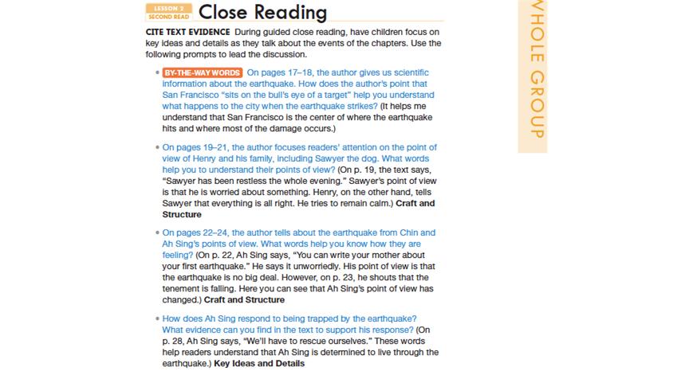

Which meets NN2?
Example A
Example B
Notes:
A: NON-EXAMPLE:
•The task does not require students to go back to the text or to demonstrate a deep understanding of what they have read. There is no direction to refer to any text(s) or to use evidence. It is not clear how the Venn diagram connects to the assignment.
•The example is also off because it assumes that if someone gets excited about playing with puppies, then they will have a positive attitude towards animals in general.
•Although the instructions do not specifically require or call for evidence/using the text, these could be simply poor instructions. Not sure what grade this is but where, other than the text, would these students likely get much information on this topic? In other words– poor instructions are not the same as failure to require text-based evidence. This example is likely just that.
B: EXAMPLE:
•an example because all of the questions are text dependent and text specific.
•Question 1 helps students understand the use of a phrase in context. This is a vocabulary standard (L.2.4) – determine or clarify the meaning of unknown and multiple meaning words and phrases based on grade 2 reading and content.
•Questions 2 and 3 focus on point of view in craft and structure – acknowledge differences in the points of view of characters.
•Question 4 aligns with the expectations of RL.2.3 – describe how characters in a story respond to major events and challenges, as well as RL.1 – using evidence to demonstrate understanding of key details.

Slide 24
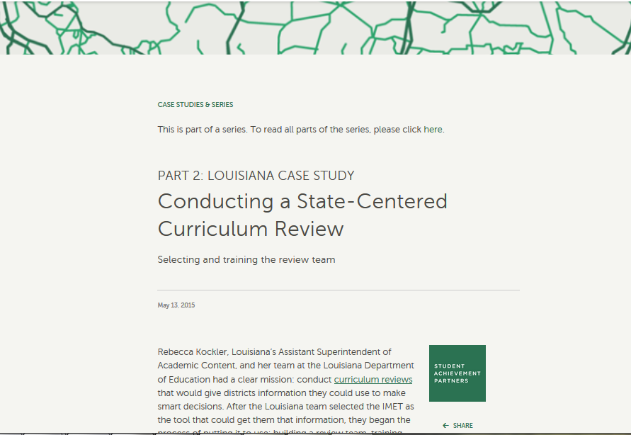
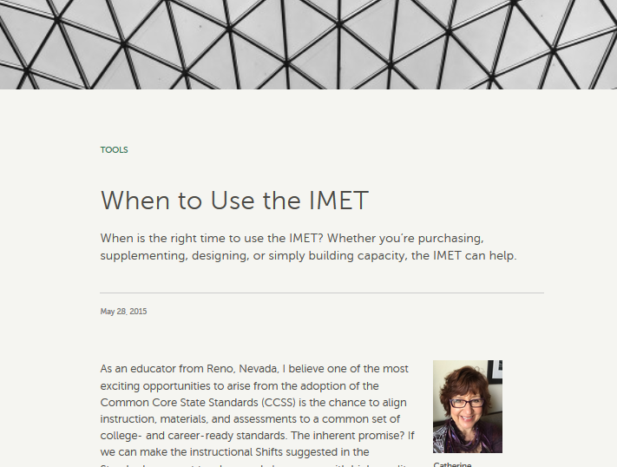

The Aligned blog
Aligned is an AchievetheCore.org published blog dedicated to the conversation about aligned instructional materials.
  Recognizing CCSS Alignment in Instructional Materials
  Making the Most of Your Existing Materials
  Reviewing Materials and Making Decisions

Slide 25
Learn more on Aligned
Recognizing CCSS Alignment in Instructional Materials
Knowing the Common Core = Knowing the Shifts
The Standards for Mathematical Practice & Instructional Materials
Common Confusions about CCSS-Aligned ELA Materials
ELA in the Common Core Classroom
Mathematics in the Common Core Classroom
What Needs to Change in Instructional Materials: Math
What Needs to Change in Instructional Materials: ELA
Making the Most of Your Existing Materials
Top Five Ways to Improve Your Basal Reading Program
Supplementing Your Anchor Math Curriculum with Rich Tasks
Essential Knowledge for Adapting Math Instructional Materials
Top Five Ways to Make the Most of Your Math Materials
Creating a Coherent Math Curriculum
The Shifts and ELLs
A More Powerful Teacher’s Guide
Using Complex Texts with All Readers
Reviewing Materials and Making Decisions
Top 5 Tips for Building and Training Your Review Team
Training Materials for the ELA/Literacy IMET
Training Materials for the Math IMET
Customizing the IMET PD Training for a Local Setting
Decision-Making that Matters: 10 Ways Teachers Can Impact Curricular Decisions
Traditional Reviews vs. the IMET
Why Not Just Crosswalk?

Slide 26
EdReports
Background:
EdReports.org has looked at over 100 K-8 materials that all are marketed to be Common Core aligned. Educator reviewers spend ~200 hours per review, looking to see how well the materials address Focus, Coherence, Rigor and the Standards for Mathematical Practice.
For More Information:
Detailed reports with qualitative evidence can be
found at EdReports.org.

Slide 27
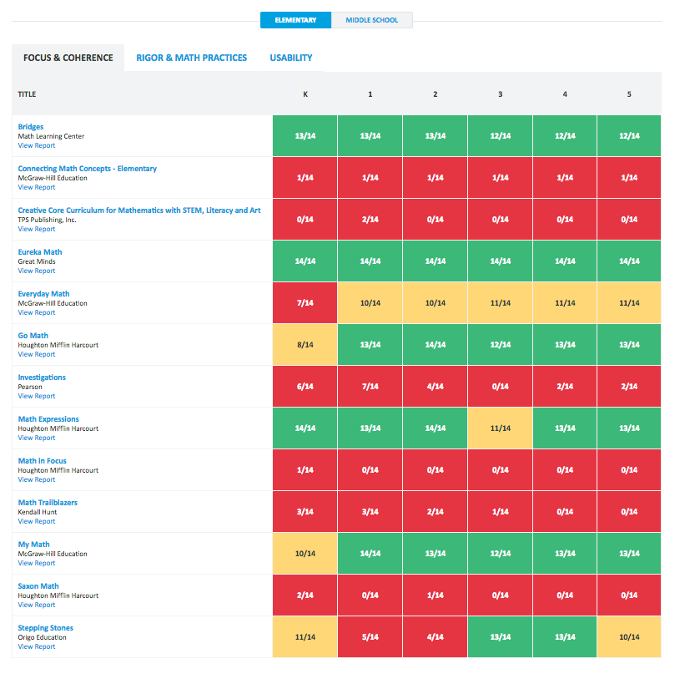
State of K-8 Materials Alignment
http://www.edreports.org/

Slide 28
Question:
What do you notice? What are the implications for schools, teachers, students? How might you use this information?
Use the “Question” tab on your control panel to submit your response.
Notes:
JOANIE/SANDRA

Slide 29
What can educators do to influence the selection/use of materials?
Notes:
JOANIE/SANDRA
Hand-off to CO-PRESENTER

Slide 30
Scenario 1
The Peach Tree School District is mid-sized with a high population of ELL students
Early purchasers of materials labeled as aligned to the CCSS
Most materials very similar to previous (pre-CCSS) edition
Three years in, little change in student outcomes
No funds to purchase new materials for another 3 years
Notes:
CO-PRESENTER

Slide 31
Question:
What could educators do to support the work in this scenario?
Use the “Question” tab on your control panel to submit your response.
Notes:
JOANI/SANDRA

Slide 32
Scenario 2
Brimley Canyon School District has postponed purchasing materials in response to EdReports data that only one product reviewed was aligned
Delay created opportunity for collaboration and learning among teachers
District now ready to adopt; internal committee with no content expertise will provide a recommendation
Parents/teachers allowed to provide comment in a meeting at the end of May
Notes:
CO-PRESENTER

Slide 33
Question:
What could educators do to support the work in this scenario?
Use the “Question” tab on your control panel to submit your response.
Notes:
JOANI/SANDRA

Slide 34
Scenario 3
Western Regional School District respects the authority and expertise of teachers in the district, and teachers have the freedom to develop their own materials, scope & sequence
A 7th grade ELA teacher spends a full semester on Shakespeare; a high school math teacher delves deeply into personal finance and how credit cards work
Overall drop in district scores cause some teachers to want common materials; others concerned that they will have to teach to a script
Notes:
CO-PRESENTER

Slide 35
Question:
What could educators do to support the work in this scenario?
Use the “Question” tab on your control panel to submit your response.
Notes:
JOANI/SANDRA

Slide 36
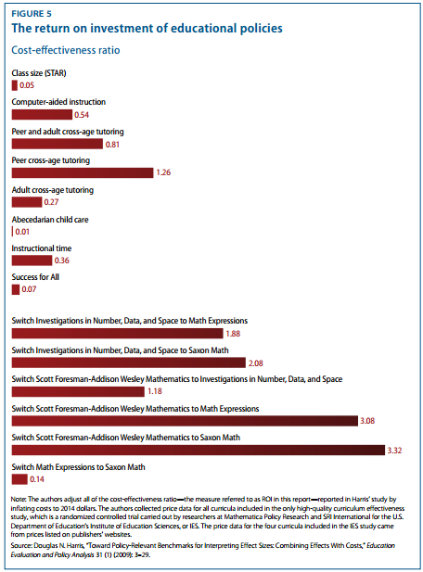
Investing In Selecting Materials Pays Off
Other
Educational Policies
Switching Instructional Materials
Boser, Chingos and Straus ,“The Hidden Value of Curriculum Reform – Do States and Districts Receive the Most Bang for Their Curriculum Buck?,” Center for American Progress, (October 2015),
https://cdn.americanprogress.org/wp-content/uploads/2015/10/06111518/CurriculumMatters-report.pdf
Notes:
One of the reasons that investing in materials pays off is that it effects teacher practice.
Louisiana found that districts that shifted to highly aligned instructional materials in math not only improved student outcomes but the teachers’ practice improved. Professional development became focused on the specific materials (instead of “general”) and supported teachers in becoming better practitioners.

Slide 37
Follow Up
Determine where your school or district is in their materials adoption process and how you can get involved.
Use the IMET (or parts thereof) to review current materials for alignment.
Notes:
JOANIE/SANDRA

Slide 38
What questions do you have?
Notes:
JOANIE/SANDRA and CO-PRESENTER

Slide 39
Upcoming Webinars
Next webinar
Instructional Advocacy to Improve Practice
June 21, 2016 from 7:00 - 8:00 pm EDT.
Register here: https://attendee.gotowebinar.com/register/3694673904023830785
Notes:
JOANIE/SANDRA

Slide 40
Thank You!
Notes:
JOANIE/SANDRA

Slide 41
Resources
www.Achievethecore.org
Submit your action steps here http://bit.ly/1EYfuMQ

