Slide 1
Grade 4: Alignment to Mathematics Grade-Level Standards
Notes:
This module was last updated on January 2017.
Over the past several years, we have seen several changes in states K-12 assessment systems as states work (sometimes collaboratively) to design assessment systems that provide information on students’ progress toward college and career readiness in mathematics and English language arts. For many states, this was a major change from previous assessments, which were largely characterized by multiple-choice items that were not reflective of the comprehensive set of skills defined by college and career ready standards.
The goal of this module is to provide guidance on grade 4 item development and alignment, highlighting the Council of Chief State School Officers Criteria for High-Quality Assessments and the collective experiences of the assessment consortia and individual states throughout their multi-year assessment design processes.

Slide 2
Session Objective
The purpose of these materials is to help develop understanding of the expectations of high-quality summative assessment items. The concepts shown throughout these modules can be useful for classroom questioning and assessment, but the items themselves may need to be slightly modified.

Slide 3
CCSSO Section C: Align to Standards – Mathematics
Criterion C.1: Focusing strongly on the content most
needed for success in later
mathematics
Criterion C.2: Assessing a balance of concepts, procedures, and applications
Criterion C.3: Connecting practice to content
Criterion C.4: Requiring a range of cognitive demand
Criterion C.5: Ensuring high-quality items and a
variety of item types
Notes:
Based on the need to provide guidance for what high-quality assessments looked like, the Council of Chief State School Officers created the Criteria for Procuring and Evaluating High-Quality Assessments. More information on this document can be found in the “Test Level Considerations” presentation for Mathematics. The full document is also available online. http://ccsso.org/News_and_Events/Press_Releases/State_Chiefs_Release_Criteria_for_High-Quality_Assessment.html
In 2013, CCSSO worked with their stakeholders, the Chief State School Officers, to draft principles of high-quality assessments. These principles described the characteristics of high-quality assessments aligned to college and career readiness. Through the end of 2013 and into 2014, CCSSO continued working with their stakeholders to clarify what these principles mean. The principles became criteria with metrics used to judge whether these principles were realized in assessment systems. These are the criteria on which this review of assessment systems will be based.
There are six sections of the CCSSO Criteria. Overarching goals and technical quality (e.g., accessibility, validity, and reliability) come first. Then two sections on content alignment. Then reports, administration, and a section where states can add criteria reflecting individual state needs. The overall document is designed to be “drop in” for a state’s RFP and can be modified as needed. It could also could serve as a “drop in” checklist of criteria for evaluating an existing assessment. For the purpose of this module, we will focus on Section C: Align to Standards – Mathematics. The slide shows the five content alignment criteria in Section C of the CCSSO document, which is the section covering mathematics.
College and career readiness has specific implications for math content, math instruction, and therefore, math assessment. We are not talking about just *any* mathematics, by the way, but mathematics that aims at college and career readiness. States require assessments that match the depth, breadth, and rigor of the standards, accurately measure student progress towards college and career readiness, and provide valid data to inform teaching and learning.

Slide 4
Notes:
Criteria 1 emphasizes the content most needed for success in later mathematics. Throughout this presentation, this will be referred to as “major work of the grade” or just “major work.” This table shows the grade 4 content clusters classified as Major, Supporting, and Additional.
Major Clusters coherently capture the emphases at each grade; Supporting Clusters have natural connections to Major Clusters; and Additional Clusters stand well on their own, with weaker natural connections to the Major Clusters. PARCC, Smarter Balanced, and several states working independently on developing aligned assessments used these designations to inform the proportional representation of content reflected in their summative test blueprints.
It is also worth pointing out that the structure of the standards organized by domain, then by cluster, reveal things that are different in these standards than states’ previous standards. For example, there has never been a standards document before that uses Ratios and Proportional Relationships as a top-level organizer; the fact that CCSS uses it as a top-level organizer signals its emphasis in the document. In general, standards that are college and career ready based on evidence will drive towards a substantial amount of algebra for all students during middle school. The major work designations trace that trajectory.

Slide 5
Ten Principles of CCSS-Aligned Items
1. Most items aligned to standards in supporting clusters connect to the major work of the grade.
2. Items are designed to address the aspect(s) of rigor (conceptual understanding, procedural skill, and application) evident in the language of the content standards.
3. Items are designed to attend to content limits articulated in the standards.
4. Most items aligned to a single content standard should assess the central concern of the standard.
5. Representations are well suited to the mathematics that students are learning and serve an important purpose within the item itself.
6. Items use mathematically precise language, are free from mathematical errors or ambiguities, and are aligned to the mathematically appropriate standard.
7. The demands of items measuring the Standards for Mathematical Practice are appropriate to the targeted grade level.
8. Item types are chosen to match the item’s purpose and as part of the evidence required by the standards.
9. Most items measuring the Standards for Mathematical Practice are also aligned to content standards representing the major work of the grade.
10. Items written at the cluster or domain level measure key integration points not necessarily articulated in individual standards but plausibly implied directly by what is written.
Notes:
Here are ten principles that can be used to guide the creation of CCSS-aligned assessment items. This list was generated based on common issues identified by the assessment consortia as well as individual states as they worked to develop next-generation assessment systems. You will also note connections back to the CCSSO criteria. For example, alignment principles 1 and 9 are used to support Criterion 1, focusing strongly on the content needed for success in later mathematics. Note that these two also use the phrase “major work of the grade” as defined in the previous slide. As another example, Principle 2 is directly tied to Criterion 2, assessing a balance of concepts, procedures, and applications.
Each principle will be illustrated through examples selected from publicly available sources or created by Student Achievement Partners content staff.
Please note that in grade 4 all of the example items shown in this presentation are intended to be delivered without a calculator.

Slide 6
Alignment Principle #1
Most items aligned to standards in supporting
clusters connect to the major work of the grade.
Notes:
The word “supporting” that is used to describe a subset of the K-8 Common Core State Standards for Mathematics signals that these standards are well connected to the content representing the major work of the grade. Many of the standards in the Measurement & Data domain, for example, require students to solve problems based on the grade-level work in the Operations & Algebraic Thinking and the Number & Operations – Fractions domains. These connections reinforce the important work in grades K-8, allowing students to engage deeply with the content instead of seeing mathematics as a set of discrete topics.

Slide 7
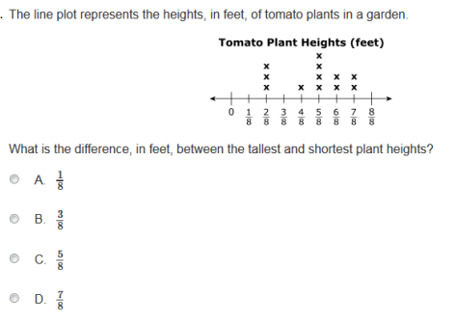
Most items aligned to standards in supporting clusters connect to the major work of the grade.
4.MD.B.4 Make a line plot to display a data set of measurements in fractions of a unit (1/2, 1/4, 1/8). Solve problems involving addition and subtraction of fractions by using information presented in line plots.
Notes:
© Item retrieved from the PARCC Grade 4 EOY Test. Available from https://prc.parcconline.org/assessments/parcc-released-items; accessed April 2016.
Let’s look at this example item written to illustrate Alignment Principle 1.
Answer key: C
What makes this item a good illustration of Alignment Principle 1?
This example highlights the alignment principle by connecting the work of line plots directly to the work of adding fractions with like denominators, part of the major work of grade 4. While it may be desirable to assess the standard with a multi-part question where students construct the line plot and use it to solve a problem, some programs may choose not to use those kinds of multi-part items that can introduce dependencies that are difficult to score. For these programs, it is important that measurement of supporting standards strongly emphasize the connections back to the major work of the grade to clearly align to the shifts of focus and coherence evident in college and career ready standards.

Slide 8
Alignment Principle #2
Items are designed to address the aspect(s) of rigor (conceptual understanding, procedural skill, and application) evident in the language of the content standards.
Notes:
The language used in the standards provides information about which aspects of rigor should be targeted in items written for those standards. Words and phrases like “extend previous understandings,” “fluently multiply,” and “solve” signal a need for items that measure conceptual understanding, procedural skill, and application, respectively. The following slides provide examples of grade 4 items, the standards to which they are written, and the key words signaling the aspects of rigor.

Slide 9
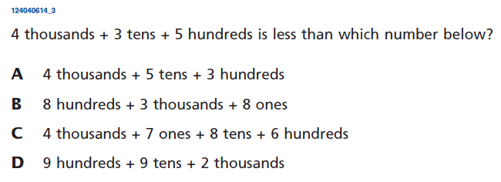
Items are designed to address the aspect(s) of rigor (conceptual understanding, procedural skill, and application) evident in the language of the content standards.
4.NBT.A.2 Read and write multi-digit whole numbers using base-ten numerals, number names, and expanded form. Compare two multi-digit numbers based on the meanings of the digits in each place, using >, =, and < symbols to record the results of comparisons.
Notes:
© Item retrieved from EngageNY.org of the New York State Education Department. 2014 Grade 4 Mathematics Test Released Questions. Internet. Internet access no longer available; accessed April 14, 2016.
Let’s look at this example item written to illustrate Alignment Principle 2.
Answer key: C
What makes this item a good illustration of Alignment Principle 2?
Although the first sentence of standard 4.NBT.A.2 sounds pretty procedural in nature, the text that follows strongly emphasizes the need for items to measure students’ conceptual understanding, primarily by basing comparisons on the meanings of the digits in each place. Historically, we have seen assessments that do not vary the order of digits, leading to a very shallow understanding of place value. This item corrects that issue by presenting answer choices in which students must carefully consider the place value of each digit and how it contributes to the magnitude of the number.

Slide 10
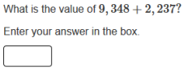
Items are designed to address the aspect(s) of rigor (conceptual understanding, procedural skill, and application) evident in the language of the content standards.
4.NBT.B.4 Fluently add and subtract multi-digit whole numbers using the standard algorithm.
Notes:
© Item retrieved from the PARCC Grade 4 EOY Test. Available from https://prc.parcconline.org/assessments/parcc-released-items; accessed April 2016.
Let’s look at this example item written to illustrate Alignment Principle 2.
Answer key: 11,585
What makes this item a good illustration of Alignment Principle 2?
Standards that explicitly call on students to perform operations fluently should show little variation in their overall structure and should overwhelmingly reflect procedural skill. While some assessment programs may use the NBT domain as a ceiling for application problems, such items should be in addition to procedural problems measuring these skills and not in place of them. Previous assessments that measured procedural skill via multiple choice questions were likely overestimating students’ ability to solve these kinds of problems as the answer choices were limited in number giving students whose answers weren’t listed the opportunity to do the problem over again until producing an answer that matched those listed. This “do over” effect interferes with our ability to get a clean measure of the accuracy component.

Slide 11
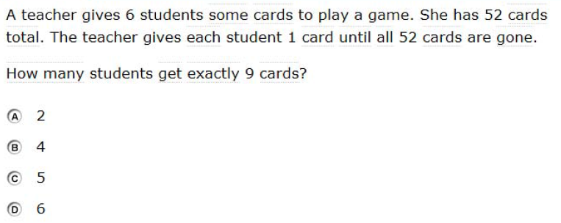
Items are designed to address the aspect(s) of rigor (conceptual understanding, procedural skill, and application) evident in the language of the content standards.
4.OA.A.3 Solve multistep word problems posed with whole numbers and having whole-number answers using the four operations, including problems in which remainders must be interpreted. Represent these problems using equations with a letter standing for the unknown quantity. Assess the reasonableness of answers using mental computation and estimation strategies including rounding.
Notes:
© Item retrieved from the Smarter Balanced Grade 4 Practice Test. Available from http://www.smarterbalanced.org/assessments/; accessed April 2016.
Let’s look at this example item written to illustrate Alignment Principle 2.
Answer key: B
What makes this item a good illustration of Alignment Principle 2?
This item shows a straightforward application problem aligned to a standard with language suggesting that application is the primary component of rigor.

Slide 12
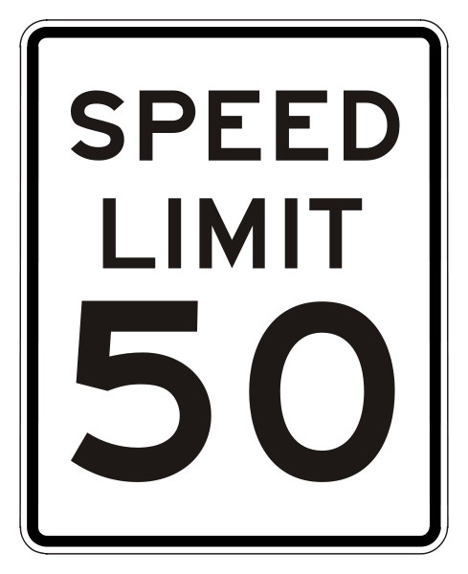
Alignment Principle #3
Items are designed to attend to the content limits articulated in the standards.
Notes:
Content limits are often established at the grade level, so it is essential that item writers know and understand the content standards for the entire grade level, not just a single standard for which they may be authoring items. Operations & Algebraic Thinking, Number & Operations in Base Ten, and Number & Operations – Fractions domains all have specific content limits that must be attended to even in items where the direct target of measurement is in a different domain. For example, if students are solving two-step word problems using the four operations in grade 3, and one of the steps happens to be addition, it is important to pay attention to the ceiling established in NBT for addition even though the item will be aligned to the standard in OA.

Slide 13
Items are designed to attend to the content limits articulated in the standards.
4.OA.A.3 Solve multi-step word problems posed with whole numbers and having whole-number answers using the four operations, including problems in which remainders must be interpreted. Represent these problems using equations with a letter standing for the unknown quantity. Assess the reasonableness of answers using mental computation and estimation strategies including rounding.
4.NBT.B.5 Multiply a whole number of up to four digits by a one-digit whole number, and multiply two two-digit numbers, using strategies based on place value and the properties of operations. Illustrate and explain the calculation by using equations, rectangular arrays, and/or area models.
Notes:
© Item retrieved from EngageNY.org of the New York State Education Department. 2014 Grade 4 Mathematics Test Released Questions. Internet. Internet access no longer available; accessed April 14, 2016.
Let’s look at this example item written to illustrate Alignment Principle 3.
Answer key: 242
What makes this item a good illustration of Alignment Principle 3?
In this item students are solving a multi-step problem with whole numbers, an expectation of 4.OA.A.3. The item writer carefully attends to the content limit for multiplication set by the NBT domain, specifically standard 4.NBT.B.5. The NBT domain often sets limits on the kinds of application problems that students do aligned to the OA expectations. It should be noted that these items reflect the ceiling of the grade-level application problems, and that other problems within the assessment should use smaller numbers, like those articulated within the OA domain.

Slide 14
Alignment Principle #4
Most items aligned to a single content standard should assess the central concern of the standard.
Notes:
Covering the “breadth” of a standard has often meant attending to every noun, verb, and strategy articulated in the standard and breaking it down into very fine-grained, measurable outcomes. It is common for item authors to look at the “e.g.” portion of the standard and write items that measure each example given. Often these examples illustrate strategies that are useful as part of teaching and learning to help students become mathematically proficient. Items should be designed in such a way that make certain strategies more efficient and/or appealing when such strategies are articulated. However, summative assessments are designed to measure what students have learned and less so how they learned it; therefore, we want the items to measure the core desired outcome of the standard, not merely emphasize the choice of strategy.

Slide 15
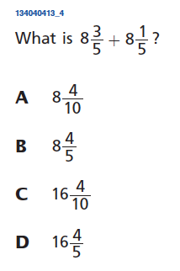
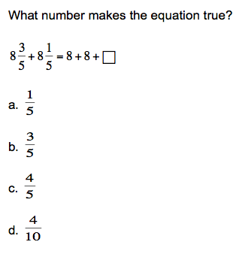
Most items aligned to a single content standard should assess the central concern of the standard.
Central Concern
Not the Central Concern
4.NF.B.3c Add and subtract mixed numbers with like denominators, e.g., by replacing each mixed number with an equivalent fraction, and/or by using properties of operations and the relationship between addition and subtraction.
Notes:
© Item retrieved from EngageNY.org of the New York State Education Department. 2014 Grade 4 Mathematics Test Released Questions. Internet. Internet access no longer available; accessed April 14, 2016.
Let’s look at this example item written to illustrate Alignment Principle 4.
Answer key: D; C
What makes this item a good illustration of Alignment Principle 4?
This item illustrates the alignment principle by measuring the primary outcome articulated in the standard: that students can add and subtract mixed numbers with like denominators. Often when standards have an “e.g.,” test developers and item writers treat the different strategies mentioned like a checklist for item development. Especially on summative assessments, we want items that address the central concern and allow students to use whichever strategy works best for any given item rather than assessing the strategy itself. Including those strategies as part of high-quality instruction will help to ensure that students are successful on questions like the one shown. Slight variations on the item shown, such as showing a problem with a missing addend, can help to ensure that students have a comprehensive understanding of addition and subtraction of mixed numbers and can help vary the difficulty of aligned items where this is an important design consideration, while still avoiding the temptation to make a particular strategy the one students must use.

Slide 16
Alignment Principle #5
Representations are well suited to the mathematics that students are learning and serve an important purpose within the item itself.
Notes:
Representations, such as number lines and area models, should be well connected to the mathematics that students are learning and serve an important purpose within the item itself.
When developing an item an item writer should ask: “Is there something mathematically important about including this representation?” If the answer is “Yes,” then the item writer should proceed. The next question the item writer must ask when developing an item should be: “Is the representation giving the appearance of a particular solution path even though other strategies are viable and likely?” The answer to this question should be “No.” Answering these questions will help an item writer decide whether to include a particular representation.

Slide 17
Representations are well suited to the mathematics that students are learning and serve an important purpose within the item itself.
Enter the decimal value for the number located at point N.
4.NF.C Understand decimal notation for fractions, and compare decimal fractions.
Notes:
© Item adapted from the Smarter Balanced Grade 4 Claim 1 Item Specifications. Available from http://www.smarterbalanced.org/assessments/; accessed April 2016.
Let’s look at this example item written to illustrate Alignment Principle 5.
Answer key: 0.64
What makes this item a good illustration of Alignment Principle 5?
The number line makes its first appearance in the standards in grade 2 once students have already had a couple of years of instruction on whole numbers. It remains an important representation for the next several years as students are introduced to more and more numbers that comprise the number system. In grade 3, students spend significant time understanding that fractions are numbers and locating them on a number line. The grade 4 item shown extends students’ work with fractions and connects that work to decimals by relating them to fractions with denominators 10 and 100. This item draws on students’ understanding of partitioning and fraction equivalence to raise its complexity (less complex items would partition the distance from .6 to .7 into tenths instead of fifths). While those less complex versions are important on the assessment also, this item nicely captures the intent of the conceptual understanding at the cluster level and uses a familiar representation, the number line, as a support for developing this understanding.

Slide 18
Alignment Principle #6
Items use mathematically precise language, are free from mathematical errors or ambiguities, and are aligned to the mathematically appropriate standard.
Notes:
This alignment principle covers a range of issues related to the mathematical and technical quality of items, from using “least” instead of “fewest,” to failing to adequately specify what is meant by “one cubic unit” in a visual image. This is one of the more challenging aspects to train writers and reviewers on due to the type of specific content knowledge needed to successfully identify issues. Incorporating mathematicians into review processes for at least a subset of the total development can provide some assurance that this principle is being well attended to by item authors and/or reviewers.

Slide 19
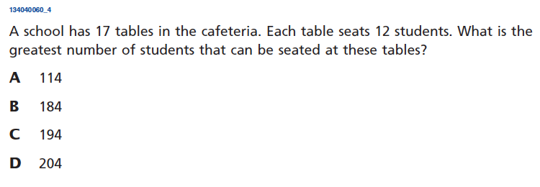
Items use mathematically precise language, are free from mathematical errors or ambiguities, and are aligned to the mathematically appropriate standard.
Common Issue
A school has 17 tables in the cafeteria. Each table seats 12 students. How many students can be seated at the tables?
4.NBT.B.5 Multiply a whole number of up to four digits by a one-digit whole number, and multiply two two-digit numbers, using strategies based on place value and the properties of operations. Illustrate and explain the calculation by using equations, rectangular arrays, and/or area models.
Notes:
© Item retrieved from EngageNY.org of the New York State Education Department. 2014 Grade 4 Mathematics Test Released Questions. Internet. Internet access no longer available; accessed April 14, 2016.
Let’s look at this example item written to illustrate Alignment Principle 6.
Answer key: D
What makes this item a good illustration of Alignment Principle 6?
Sometimes, mathematical precision can be nuanced. The omission of certain words such as “greatest” can lead to multiple answer choices being mathematically correct. In this case, 114 students can be seated at the 17 tables, but that is not the greatest number. This is a common issue found across grade levels.

Slide 20
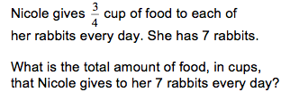
Items use mathematically precise language, are free from mathematical errors or ambiguities, and are aligned to the mathematically appropriate standard.
4.NF.B.4.c Solve word problems involving multiplication of a fraction by a whole number, e.g., by using visual fraction models and equations to represent the problem.
5.NF.B.6 Solve real-world problems involving multiplication of fractions and mixed numbers, e.g., by using visual fraction models or equations to represent the problem.
Notes:
Let’s look at this example item written to illustrate Alignment Principle 6.
Answer key: 21/4 or 5 ¼; 18
What makes this item a good illustration of Alignment Principle 6?
A close reading of standards 4.NF.B.4c and 5.NF.B.6 reveal an important consideration for alignment of word problems in the NF domain. We often see items like the one shown for grade 5 showing up as aligned to 4.NF.B.4.c. To improve alignment, it is important to help item writers and reviewers understand the subtle distinction between the grade 4 “multiply a fraction by a whole number” and the extension of that work in grade 5 to “multiply a whole number by a fraction” (see 5.NF.B.4). These two examples in context help illustrate that subtle difference in the language of the standards at each grade. In a well-aligned test, grade 4 problems should be mostly limited to multiplication of a fraction by a whole number as stated in the standard.

Slide 21
Alignment Principle #7
The demands of items measuring the Standards for Mathematical Practice are appropriate to the targeted grade level.
Notes:
The Standards for Mathematical Practice should reflect a growing arc of sophistication in assessment items. In early grades, students might give examples or non-examples to show their understanding of a particular claim, but are not asked to prove it or show that it is true for all cases. Similarly, younger students begin modeling real-world situations with equations, but do not engage in the full modeling cycle shown in the high school standards.

Slide 22
The demands of items measuring the Standards for Mathematical Practice are appropriate to the targeted grade level.
Which situation can be represented by the equation 3 x 4 = ☐?
A kitten weighs 4 pounds. A puppy weighs 3 times as much as the kitten. How much does the puppy weigh?
A kitten weighs 4 pounds. A puppy weighs 3 times as much as the kitten. How much do they weigh altogether?
A kitten weighs 4 pounds. A puppy weighs 3 pounds more than the kitten. How much do they weigh altogether?
A kitten weighs 4 pounds. A puppy weighs 3 pounds more than the kitten. How much does the puppy weigh?
MP4. Model with mathematics.
4.OA.A.2 Multiply or divide to solve word problems involving multiplicative comparison, e.g., by using drawings and equations with a symbol for the unknown number to represent the problem, distinguishing multiplicative comparison from additive comparison.
Notes:
© Item adapted from the Smarter Balanced Grade 4 Claim 4 Item Specifications. Available from http://www.smarterbalanced.org/assessments/; accessed April 2016.
Let’s look at this example item written to illustrate Alignment Principle 7.
Answer key: A
What makes this item a good illustration of Alignment Principle 7?
This example illustrates some of the important work that younger students should be doing with mathematical modeling. As stated in the text for MP4, “In early grades, this (applying mathematics to solve problems) might be as simple as writing an addition equation to describe a situation.” As students progress through the grades, the equations they write become increasingly more complex as do the scenarios they are modeling. Younger students should spend plenty of time thinking about the numbers in an equation and what they represent, should be given opportunities to create equations given a scenario, and should learn that sometimes there is more than one correct equation that can represent the same scenario.

Slide 23
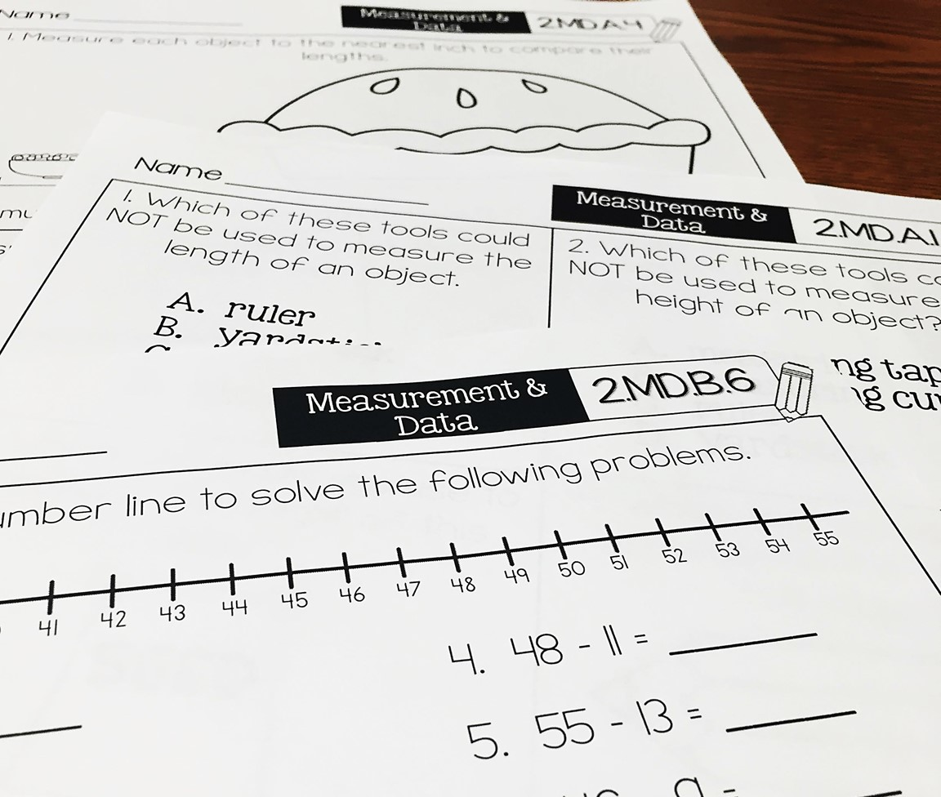
Alignment Principle #8
Item types are chosen to match the item’s purpose and as part of the evidence required by the standards.
Notes:
With many assessments moving online, choices of item type have a lot of driving factors: accessibility, cost, and content. In this section, we will show examples of items that are designed well to meet the evidence required by the standards and are well suited to a particular item’s purpose. This is not to say that a balanced assessment that meets the demands of the standards must include all of these item types nor that this is an exhaustive list of available item types, but that an aligned assessment will include multiple item types. These are illustrations of good ways to collect the evidence required by the standards, but decisions ultimately must be made after carefully considering how to effectively balance cost, content, and accessibility.

Slide 24
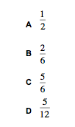
Item types are chosen to match the item’s purpose and as part of the evidence required by the standards.
4.NF.A.2 Compare two fractions with different numerators and different denominators, e.g., by creating common denominators or numerators, or by comparing to a benchmark fraction such as 1/2. Recognize that comparisons are valid only when the two fractions refer to the same whole. Record the results of comparisons with symbols >, =, or <, and justify the conclusions, e.g., by using a visual fraction model.
Notes:
© Item retrieved from EngageNY.org of the New York State Education Department. 2014 Grade 4 Mathematics Test Released Questions. Internet. Internet access no longer available; accessed April 14, 2016.
Let’s look at this example item written to illustrate Alignment Principle 8.
Answer key: C
What makes this item a good illustration of Alignment Principle 8?
There is still room in assessments for carefully crafted multiple-choice items. Comparison items are often difficult to construct because the symbols in early grades are limited to <, >, and =. Providing the symbol as part of the item rather than as an answer choice and asking students to select the one number that makes the comparison true makes good use of the item type. This doesn’t work well as a constructed response. (What student wouldn’t put 100?) No matter what approach a student uses here, he/she must use the key understandings articulated in the standards to make a correct choice. Here, we break the conventional rule of presenting the answer choices in order from least to greatest or greatest to least since that is part of the construct we are measuring.

Slide 25
Item types are chosen to match the item’s purpose and as part of the evidence required by the standards.
4.NBT.B.5 Multiply a whole number of up to four digits by a one-digit whole number, and multiply two two-digit numbers, using strategies based on place value and the properties of operations. Illustrate and explain the calculation by using equations, rectangular arrays, and/or area models.
Notes:
© Item retrieved from the PARCC Grade 4 EOY Test. Available from https://prc.parcconline.org/assessments/parcc-released-items; accessed April 2016.
Let’s look at this example item written to illustrate Alignment Principle 8.
Answer key: 40,312
What makes this item a good illustration of Alignment Principle 8?
Items measuring procedural skill and fluency should largely be administered using either an equation/numeric entry or some other technology that recognizes the number entered as the correct one. Multiple choice falls short here because of the expectation for accuracy. Narrowing the list of potential answers to only four or five greatly impacts the ability to cleanly measure the accuracy component of procedural skill and fluency, allowing students several attempts at the problem if the result of their original attempt doesn’t show up on the list of potential answers. In grade 4, as students are still working toward fluency with multi-digit multiplication, assessments should also attend to the second part of this standard which builds students’ understanding of multiplication.

Slide 26
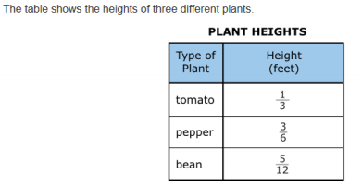
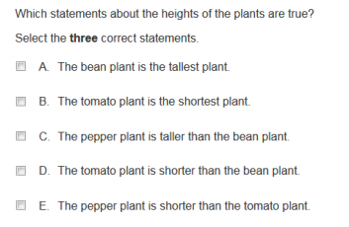
Item types are chosen to match the item’s purpose and as part of the evidence required by the standards.
4.NF.A Extend understanding of fraction equivalence and ordering.
Notes:
© Item retrieved from the PARCC Grade 4 EOY Test. Available from https://prc.parcconline.org/assessments/parcc-released-items; accessed April 2016.
Let’s look at this example item written to illustrate Alignment Principle 8.
Answer key: B, C, D
What makes this item a good illustration of Alignment Principle 8?
Multi-select items can sometimes be used to increase an item’s complexity and difficulty level. Here students are asked to evaluate several different statements about the data shown in the table and to identify the true statements. Instead of just being about making comparisons, this item forces students to really grapple with the meaning of the comparisons connecting them back to the given context.

Slide 27
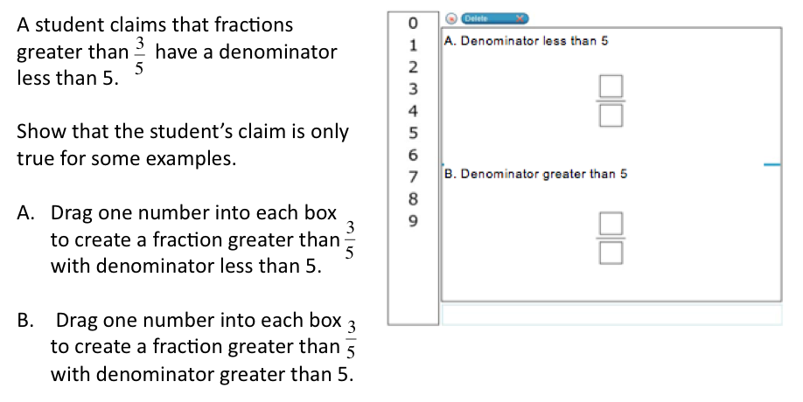
Item types are chosen to match the item’s purpose and as part of the evidence required by the standards.
4.NF.A.2 Compare two fractions with different numerators and different denominators, e.g., by creating common denominators or numerators, or by comparing to a benchmark fraction such as 1/2. Recognize that comparisons are valid only when the two fractions refer to the same whole. Record the results of comparisons with symbols >, =, or <, and justify the conclusions, e.g., by using a visual fraction model.
Notes:
© Item adapted from the Smarter Balanced Grade 4 Practice Test. Available from http://www.smarterbalanced.org/assessments/; accessed April 2016.
Let’s look at this example item written to illustrate Alignment Principle 8.
Answer key: Student creates a fraction greater than 3/5 with denominator less than 5 (such as ¾); Student creates a fraction greater than 3/5 with denominator greater than 5 (such as 6/8)
What makes this item a good illustration of Alignment Principle 8?
Drag-and-drop is a good choice when students are being asked to produce multiple answers, particularly when they are fractions or equations. It allows for the answer space to be clearly labeled. While this item would also work as an equation/numerical entry, this presentation allows the writer to limit the numbers used to a finite set and clearly shows that the expectation is for the student to give two fractions as his/her answer. Some item writers may prefer not to make certain numbers available, such as zero. This slight change is easy to make in the creation of this item type. Some assessment designers may prefer to deliver this kind of item as a numeric entry instead of drag-and-drop to increase access for all students. That variation is a good option where it is available.

Slide 28
Alignment Principle #9
Most items measuring the Standards for Mathematical Practice are also aligned to content standards representing the major work of the grade.
Notes:
Keeping the assessment focused on the major work of the grade is an important design principle in the overall test construction. In measuring the Standards for Mathematical Practice, it is important to help retain the focus of the test by using many items that align to the major work of the grade.

Slide 29
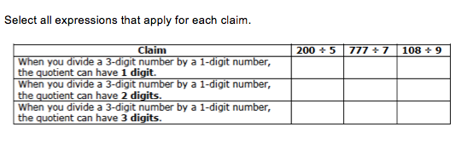
Most items measuring the Standards for Mathematical Practice are also aligned to content standards representing the major work of the grade.
MP.3 Construct viable arguments and critique the reasoning of others.
4.NBT.B.6 Find whole-number quotients and remainders with up to four-digit dividends and one-digit divisors, using strategies based on place value, the properties of operations, and/or the relationship between multiplication and division. Illustrate and explain the calculation by using equations, rectangular arrays, and/or area models.
Notes:
© Item adapted from the Smarter Balanced Grade 4 Claim 3 Item Specifications. Available from http://www.smarterbalanced.org/assessments/; accessed April 2016.
Let’s look at this example item written to illustrate Alignment Principle 9.
Answer key: 200/5: 2 digits; 777/7: 3 digits; 108/9: 2 digits
What makes this item a good illustration of Alignment Principle 9?
This item targets the part of Standard for Mathematical Practice 3 that states “for younger students arguments can make sense and be correct, even though they are not generalized or made formal until later grades.” That is, students are asked to illustrate given claims through examples in this problem but not asked to generalize the claims more broadly to all possible cases for the particular claim or even to evaluate the more general truth or lack there of implied by each claim. In early grades, the word “prove” should not be used as part of item stems as it implies something more mathematically sophisticated than what students are typically doing in grades 3-5.

Slide 30
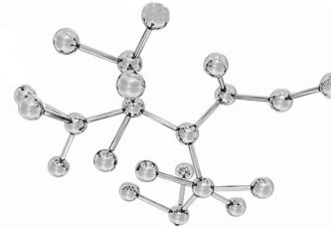
Alignment Principle #10
Items written at the cluster or domain level measure key integration points not necessarily articulated in individual standards but plausibly implied directly by what is written.
Notes:
A few items per test event may serve as opportunities to connect content across standards, domains, or grade levels. These opportunities should be carefully defined with an established purpose tied back to the language and structure of the standards. An item writer might ask: What key connections are students being asked to make to respond to this question that isn’t articulated in any individual standard?

Slide 31
Items written at the cluster or domain level measure key integration points not necessarily articulated in individual standards but plausibly implied directly by what is written.
Primary alignment: NF Domain
Notes:
© Item retrieved from the PARCC Grade 4 EOY Test. Available from https://prc.parcconline.org/assessments/parcc-released-items; accessed April 2016.
Let’s look at this example item written to illustrate Alignment Principle 10.
Answer key: Student zooms in on correct interval, and then places point at correct location.
What makes this item a good illustration of Alignment Principle 10?
This item illustrates the alignment principle, showing an item aligned at the domain level. There are many different ways for students to think about the problem that spans standards within the NF domain. Do they begin by imagining the number line partitioned into one hundred equal distances and using some counting technique or do they begin by noticing that .29 is near 30/100 which is equal to 3/10? Once the student selects the correct interval, he/she is then provided with a new image between two endpoints partitioned into tenths. Several apps available are designed to support students’ development of place-value understanding using this kind of technology. Problems that allow for students to carefully consider their learning within the domain and across grades, and that lend themselves to different approaches and thought processes, can be aligned at the domain level. Items aligned at this level should be carefully checked to ensure that the standards have broadly given students the skills they need to successfully complete them. These items should be carefully selected, used sparingly, and assigned only to item writers with deep content expertise; however, these items play an important role in providing information on whether students are making connections across grades, domains, and standards. These items do not usually align neatly to a single standard, and often reflect a more comprehensive picture of students’ understanding of the content.

Slide 32
Ten Principles of CCSS-Aligned Items
1. Most items aligned to standards in supporting clusters connect to the major work of the grade.
2. Items are designed to address the aspect(s) of rigor (conceptual understanding, procedural skill, and application) evident in the language of the content standards.
3. Items are designed to attend to content limits articulated in the standards.
4. Most items aligned to a single content standard should assess the central concern of the standard.
5. Representations are well suited to the mathematics that students are learning and serve an important purpose within the item itself.
6. Items use mathematically precise language, are free from mathematical errors or ambiguities, and are aligned to the mathematically appropriate standard.
7. The demands of items measuring the Standards for Mathematical Practice are appropriate to the targeted grade level.
8. Item types are chosen to match the item’s purpose and as part of the evidence required by the standards.
9. Most items measuring the Standards for Mathematical Practice are also aligned to content standards representing the major work of the grade.
10. Items written at the cluster or domain level measure key integration points not necessarily articulated in individual standards but plausibly implied directly by what is written.
Notes:
The principles illustrated throughout this module are intended to support those charged with developing summative mathematics assessment items and to support training efforts for those who review the content of items.

Slide 33
Thank You!

