Slide 1
High School: Alignment to Mathematics
Grade-Level Standards
Notes:
This module was last updated on January 2017.
Over the past several years, we have seen several changes in states K-12 assessment systems as states work (sometimes collaboratively) to design assessment systems that provide information on students’ progress toward college and career readiness in mathematics and English language arts. For many states, this was a major change from previous assessments, which were largely characterized by multiple-choice items that were not reflective of the comprehensive set of skills defined by college-and-career ready standards.
The goal of this module is to provide guidance on grade 8 item development and alignment, highlighting the Council of Chief State School Officers Criteria for High-Quality Assessments and the collective experiences of the assessment consortia and individual states throughout their multi-year assessment design processes.

Slide 2
Session Objective
The purpose of these materials is to help develop understanding of the expectations of high-quality summative assessment items. The concepts shown throughout these modules can be useful for classroom questioning and assessment, but the items themselves may need to be slightly modified.

Slide 3
CCSSO Section C: Align to Standards – Mathematics
Criterion C.1: Focusing strongly on the content most
needed for success in later
mathematics
Criterion C.2: Assessing a balance of concepts, procedures, and applications
Criterion C.3: Connecting practice to content
Criterion C.4: Requiring a range of cognitive demand
Criterion C.5: Ensuring high-quality items and a
variety of item types
Notes:
Based on the need to provide guidance for what high-quality assessments looked like, the Council of Chief State School Officers created the Criteria for Procuring and Evaluating High-Quality Assessments. More information on this document can be found in the “Test Level Considerations” presentation for Mathematics. The full document is also available online. http://ccsso.org/News_and_Events/Press_Releases/State_Chiefs_Release_Criteria_for_High-Quality_Assessment.html
In 2013, CCSSO worked with their stakeholders, the Chief State School Officers, to draft principles of high-quality assessments. These principles described the characteristics of high-quality assessments aligned to college and career readiness. Through the end of 2013 and into 2014, CCSSO continued working with their stakeholders to clarify what these principles mean. The principles became criteria with metrics used to judge whether these principles were realized in assessment systems. These are the criteria on which this review of assessment systems will be based.
There are six sections of the CCSSO Criteria. Overarching goals and technical quality (e.g., accessibility, validity, and reliability) come first. Then two sections on content alignment. Then reports, administration, and a section where states can add criteria reflecting individual state needs. The overall document is designed to be “drop in” for a state’s RFP and can be modified as needed. It could also could serve as a “drop in” checklist of criteria for evaluating an existing assessment. For the purpose of this module, we will focus on Section C: Align to Standards – Mathematics. The slide shows the five content alignment criteria in Section C of the CCSSO document, which is the section covering mathematics.
College and career readiness has specific implications for math content, math instruction, and therefore, math assessment. We are not talking about just *any* mathematics, by the way, but mathematics that aims at college and career readiness. States require assessments that match the depth, breadth, and rigor of the standards, accurately measure student progress towards college and career readiness, and provide valid data to inform teaching and learning.

Slide 4
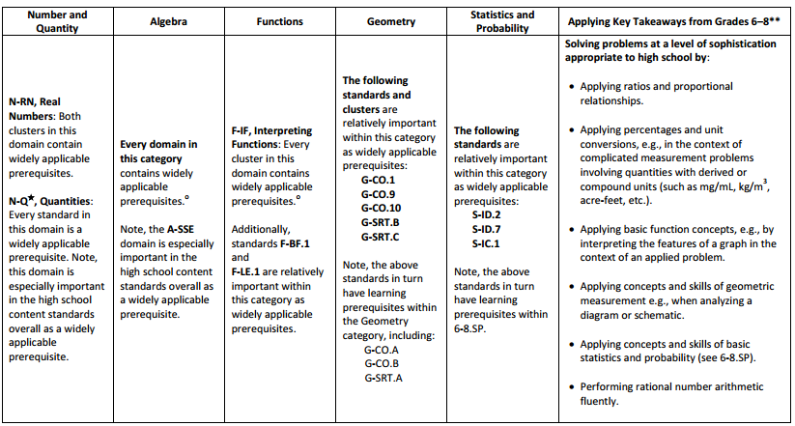
Widely Applicable Prerequisites for a Wide Range of College Majors and Careers
Notes:
Criterion 1 emphasizes the content most needed for success in later mathematics. In earlier grades, this content is referred to as “major work of the grade” or just “major work.” In high school, the mathematics content most needed for success after high school is referred to as “widely applicable prerequisites” to highlight the relationship between certain mathematics content and entry-level, credit-bearing mathematics coursework in postsecondary education programs. The widely applicable prerequisites shown in the table are based on research that looked broadly at which mathematics content was most important across a broad range of postsecondary majors.
PARCC, Smarter Balanced, and several states working independently on developing aligned assessments used these designations to inform the proportional representation of content reflected in their summative test blueprints.
It is also worth pointing out that the structure of the standards organized by conceptual category, then by cluster, illustrates an important difference between these standards and many states’ previous standards. For example, there has never been a standards document before that emphasized Seeing Structure in Expressions as a top-level organizer; the fact that the CCSS use it as a top-level organizer signals its emphasis in the document. In general, standards that are college and career ready based on evidence will drive towards a substantial amount of algebra for all students during middle school. The major work designations trace that trajectory leading up to work in high school on these widely applicable prerequisites.
Note: The star symbol next to the N-Q category indicates it is an important part of the mathematical modeling expectations in high school.

Slide 5
Ten Principles of CCSS-Aligned Items
1. Some items are designed to measure applications of key takeaways from grades 6-8 at a level of sophistication appropriate to high school.
2. Items are designed to address the aspect(s) of rigor (conceptual understanding, procedural skill, and application) evident in the language of the content standards.
3. Items are designed to attend to content limits articulated in the standards.
4. Most items aligned to a single content standard should assess the central concern of the standard.
5. Representations are well suited to the mathematics that students are learning and serve an important purpose within the item itself.
6. Items use mathematically precise language, are free from mathematical errors or ambiguities, and are aligned to the mathematically appropriate standard.
7. The demands of items measuring the Standards for Mathematical Practice are appropriate to the targeted grade level.
8. Item types are chosen to match the item’s purpose and as part of the evidence required by the standards.
9. Most items measuring the Standards for Mathematical Practice are also aligned to content standards representing widely applicable prerequisites.
10. Items written at the cluster, domain, or conceptual-category level measure key integration points not necessarily articulated in individual standards but plausibly implied directly by what is written.
Notes:
Here are ten principles that can be used to guide the creation of CCSS-aligned assessment items. This list was generated based on common issues identified by the assessment consortia as well as individual states as they worked to develop next-generation assessment systems. You will also note connections back to the CCSSO criteria. For example, Alignment Principles 1 and 9 are used to support Criteria 1, focusing strongly on the content needed for success in later mathematics. Note that these two also use the phrase “major work of the grade” as defined in the previous slide. As another example, Principle 2 is directly tied to Criteria 2, assessing a balance of concepts, procedures, and applications.
Each principle will be illustrated through examples selected from publicly available sources or created by Student Achievement Partners content staff.

Slide 6

Alignment Principle #1
Some items are designed to measure applications of key takeaways from grades 6-8 at a level of sophistication appropriate to high school.
Notes:
While some high school assessment developers may not immediately understand the importance of this principle, it is worth noting that the Common Core State Standards have explicit language to support this principle. This requirement is articulated on page 84 of the Common Core State Standards document: “Indeed, some of the highest priority content for college and career readiness comes from Grades 6-8.” Further, this page also states: “Because important standards for college and career readiness are distributed across grades and courses, systems for evaluating college and career readiness should reach as far back in the standards as Grades 6-8.”
It should also be noted that the practice of measuring middle-grades content at the high school level is not new to assessment. The Programme for International Student Assessment, better known as PISA, is delivered to fifteen-year-olds around the world and uses many mathematics questions that measure middle-grades content at a level of sophistication appropriate to the high school level.

Slide 7
Some items are designed to measure applications of key takeaways from grades 6-8 at a level of sophistication appropriate to high school.
Notes:
© Item retrieved from OECD (2013), PISA 2012 Released Mathematics Items, May 2013, https://www.oecd.org/pisa/pisaproducts/pisa-test-questions.htm
Let’s look at this example item written to illustrate Alignment Principle 1.
Answer key: 80
What makes this item a good illustration of Alignment Principle 1?
This PISA item expects that students have a strong foundation in mathematical language associated with circles, which is developed in the grade 7 Geometry CCSS. Students must make sense of the problem and use the relationship between the radius and diameter to formulate a solution. The complexity of the task as one appropriate for high school students is grounded in the fact that most of their work with radius and diameter was likely in the context of computing circumferences and areas, and this item ensures that students can transfer that knowledge to a less familiar problem situation.

Slide 8
Some items are designed to measure applications of key takeaways from grades 6-8 at a level of sophistication appropriate to high school.
Notes:
© Item retrieved from OECD (2013), PISA 2012 Released Mathematics Items, May 2013, https://www.oecd.org/pisa/pisaproducts/pisa-test-questions.htm
(Continued)
Answer key: C
What makes this item a good illustration of Alignment Principle 1?
This part of the item ties back to students’ work in grades 6-8 in the RP domain. The student uses the 40 minute full rotation information as the basis for figuring out where point P will be after 30 minutes and then needs to interpret that in terms of the circle (ferris wheel), starting point, and the direction of rotation.

Slide 9
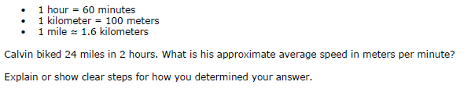
Some items are designed to measure applications of key takeaways from grades 6-8 at a level of sophistication appropriate to high school.
N.Q.A. Reason quantitatively and use units to solve problems.
6.RP.3.d. Use ratio reasoning to convert measurement units; manipulate and transform units appropriately when multiplying or dividing quantities.
Notes:
© Item retrieved from the Smarter Balanced Grade 11 Claim 3 Item Specifications. Available from http://www.smarterbalanced.org/assessments/; accessed April 2016.
Let’s look at this example item written to illustrate Alignment Principle 1.
Answer key: 32
What makes this item a good illustration of Alignment Principle 1?
The Number-Quantities domain in high school provides a nice opportunity to measure applications of some of the key takeaways from grades 6-8. The language of N.Q.A is intentionally broad in scope allowing developers to set grade 6 as the content floor as required by the standards. This items illustrates how the 6th grade RP standard for using ratio reasoning to convert measurement units might look at a high school level of sophistication requiring multiple steps to convert between units.

Slide 10

Alignment Principle #2
Items are designed to address the aspect(s) of rigor (conceptual understanding, procedural skill, and application) evident in the language of the content standards.
Notes:
The language used in the standards provides information about which aspects of rigor should be targeted in items written for those standards. Words and phrases like “extend previous understandings,” “fluently multiply,” and “solve” signal a need for items that measure conceptual understanding, procedural skill, and application, respectively. The following slides provide examples of high school items, the standards to which they are written, and the key words signaling the aspects of rigor.

Slide 11
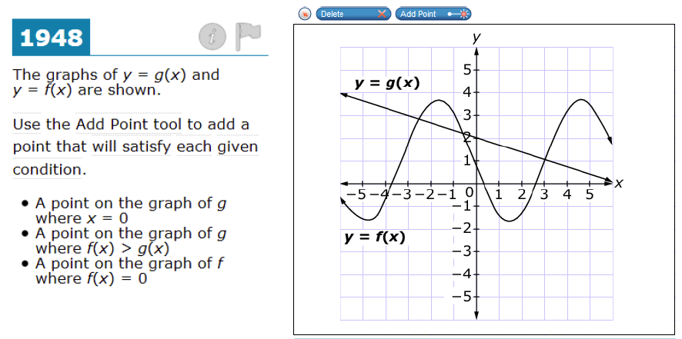
Items are designed to address the aspect(s) of rigor (conceptual understanding, procedural skill, and application) evident in the language of the content standards.
F-IF.A Understand the concept of a function and use function notation.
Notes:
© Item retrieved from the Smarter Balanced 2015 Grade 11 Practice Test. Available from http://www.smarterbalanced.org/assessments/; accessed April 2016.
Let’s look at this example item written to illustrate Alignment Principle 2.
Answer key: Student drags three points to the indicated locations
What makes this item a good illustration of Alignment Principle 2?
This item is aligned to the cluster level which uses the important verb “understand.” This item requires a strong command of the concept of a function and the mathematical notation used to describe functions.

Slide 12
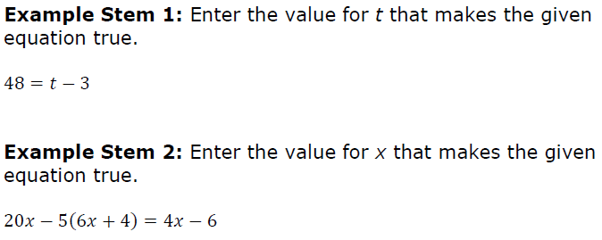
Items are designed to address the aspect(s) of rigor (conceptual understanding, procedural skill, and application) evident in the language of the content standards.
A-REI.B.3 Solve linear equations and inequalities in one variable, including equations with coefficients represented by letters.
Notes:
© Item retrieved from the Smarter Balanced Grade 11 Claim 1 Item Specifications. Available from http://www.smarterbalanced.org/assessments/; accessed April 2016.
Let’s look at this example item written to illustrate Alignment Principle 2.
Answer key: 51; -1
What makes this item a good illustration of Alignment Principle 2?
The expectation of this standard is that high school students spend a significant amount of time solving equations and inequalities in one variable. As with NQ-A, the standard as written sets no clear floor allowing testing programs to include as necessary equations and inequalities that students may have first encountered in grades 6-8. The two examples shown come from the same testing program’s high school item specifications and are intended to illustrate some examples of the types of linear equations students may encounter, a range that is particularly important for testing programs delivering computer-adaptive tests.
For reference, students are first expected to solve equations like the one shown in Example Stem 1 in grade 7 and like the one shown in Example Stem 2 during grade 8. The relevant standards for those grades are listed below.
7.EE.4a. Solve word problems leading to equations of the form px + q = r and p(x + q) = r, where p, q, and r are specific rational numbers. Solve equations of these forms fluently. Compare an algebraic solution to an arithmetic solution, identifying the sequence of the operations used in each approach.
8.EE.C.7b. Solve linear equations with rational number coefficients, including equations whose solutions require expanding expressions using the distributive property and collecting like terms.

Slide 13
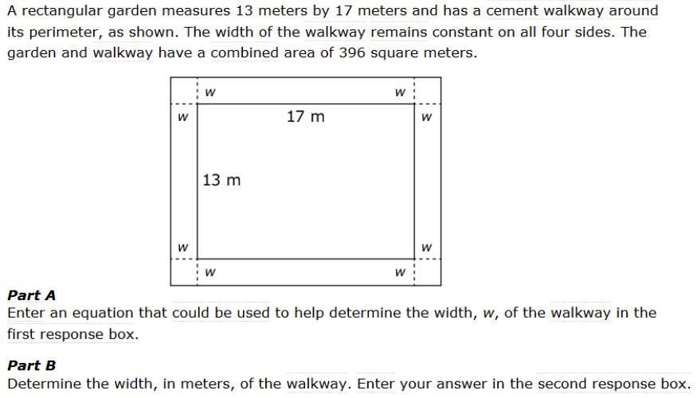
Items are designed to address the aspect(s) of rigor (conceptual understanding, procedural skill, and application) evident in the language of the content standards.
A-CED.A.1. Create equations and inequalities in one variable and use them to solve problems.
Notes:
© Item retrieved from the Smarter Balanced 2015 Grade 11 Practice Test. Available from http://www.smarterbalanced.org/assessments/; accessed April 2016.
Let’s look at this example item written to illustrate Alignment Principle 2.
Answer key: (17+2w)(13+2w)=396, or equivalent
What makes this item a good illustration of Alignment Principle 2?
The context of this item makes it a good example of an application problem. Some might say this isn’t “real world enough,” but we generally like to think about application problems in two ways: those problems that put the mathematics in the service of the real world and those problems that put the real world in the service of the mathematics. This problem fits the second variety where context is used in an application that deepens students’ understanding of important mathematics. Certainly, you will find other examples throughout this presentation of the other variety as well that show strong examples of mathematical applications that are more consistent with how mathematics is used in the real world.

Slide 14
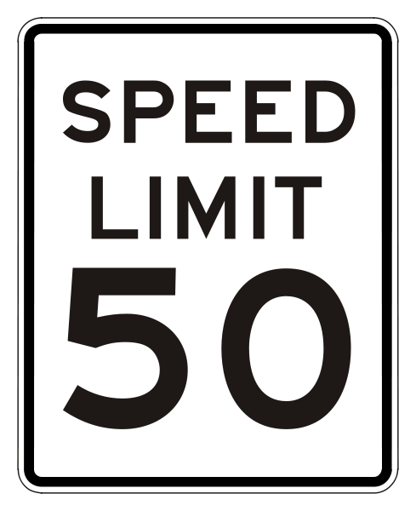

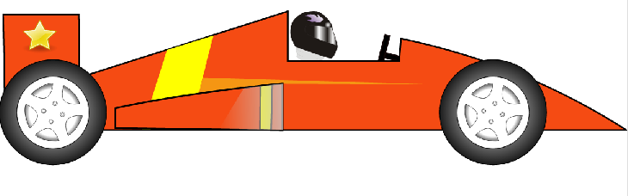
Alignment Principle #3
Items are designed to attend to content limits articulated in the standards.
Notes:
Content limits are often established at the grade level, but high school is a unique case where the standards are not written to a single grade. Therefore, some assessment developers may have to establish clear limits in the case of grade-by-grade testing, and for assessments that measure the breadth of high school standards it is good for item writers to have a solid understanding of the ceiling established across all standards for a comprehensive picture of high school expectations and the ideas that are clearly beyond the expectation of any non-plus standard.

Slide 15
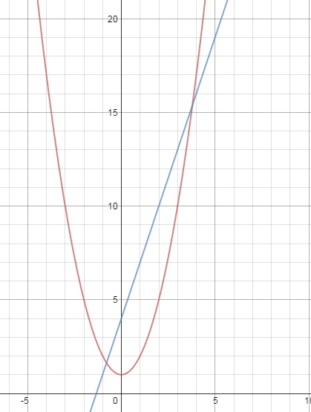
Items are designed to attend to content limits articulated in the standards.
Consider this system of inequalities.
On the graph shown, click to shade the correct region(s).
A-REI.D.12 Graph the solutions to a linear inequality in two variables as a half-plane (excluding the boundary in the case of a strict inequality), and graph the solution set to a system of linear inequalities in two variables as the intersection of the corresponding half-planes.
Notes:
Let’s look at this example item written to illustrate Alignment Principle 3.
Answer key: Student shades the correct region
What makes this item a good illustration of Alignment Principle 3?
This item illustrates what it looks like to exceed the limit implied by the standard. While the standards do require that students work extensively with quadratic equations, the standards do not require them to graph systems that include one or more quadratic inequalities. Of course, this alignment principle is intended to guide standards-aligned summative assessment development, which is in no way intended to cap student learning in the classroom. Staying within the boundaries set by standards on summative assessment ensures that all students have the opportunity to learn the content measured by the assessment – exceeding the ceiling puts that assurance at risk.

Slide 16

Alignment Principle #4
Most items aligned to a single content standard should assess the central concern of the standard.
Notes:
Covering the “breadth” of a standard has often meant attending to every noun, verb, and strategy articulated in the standard and breaking it down into very fine-grained, measurable outcomes. So it is common for item authors to look at the “e.g.” portion of the standard and write items that measure each example given. Often these examples illustrate strategies that are useful as part of teaching and learning to help students become mathematically proficient. Items should be designed in such a way that make certain strategies more efficient and/or appealing when such strategies are articulated. However, summative assessments are designed to measure what students have learned and less how they learned it; therefore, we want the items to measure the core desired outcome of the standard, not merely emphasize the choice of strategy.

Slide 17
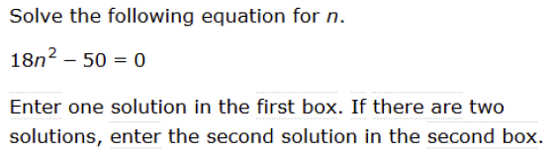

Most items aligned to a single content standard should assess the central concern of the standard.
Central Concern
Not the Central Concern
A-REI.B.4 Solve quadratic equations in one variable.
Notes:
© Item retrieved from the Smarter Balanced 2015 Grade 11 Practice Test. Available from http://www.smarterbalanced.org/assessments/; accessed April 2016.
© Item retrieved from the Smarter Balanced Grade 11 Claim 1 Item Specifications. Available from http://www.smarterbalanced.org/assessments/; accessed April 2016.
Let’s look at this example item written to illustrate Alignment Principle 4.
Answer key: 5/3, -5/3, or equivalent
What makes this item a good illustration of Alignment Principle 4?
These two examples both come from the same assessment program. This program has a specific note related to the item under the label “Not the Central Concern” stating “No more than 5% of this target should come from this task model TM5a.” So while the program recognizes that it is important to have a wide variety of items to allow all students to show what they know, there is also a recognition that the primary concern of the standard here is making sure that students are able to solve problems like the one shown under “Central Concern.” One of the other nice things to note about the item under “Central Concern” is that there is no requirement for students to use a particular method to solve the equation. Especially on summative assessments (those that come after the teaching and learning of specific content), it is critical that students make decisions about what methods and strategies they will use to solve problems rather than those being a requirement of the item. This is another important consideration in interpreting this alignment principle.

Slide 18

Alignment Principle #5
Representations are well suited to the mathematics that students are learning and serve an important purpose within the item itself.
Notes:
Representations, such as number lines and area models, should be well connected to the mathematics that students are learning and serve an important purpose within the item itself.
When developing an item an item writer should ask: “Is there something mathematically important about including this representation?” If the answer is “Yes,” then the item writer should proceed. The next question the item writer must ask when developing an item should be: “Is the representation giving the appearance of a particular solution path even though other strategies are viable and likely?” The answer to this question should be “No.” Answering these questions will help an item writer decide whether to include a particular representation.

Slide 19
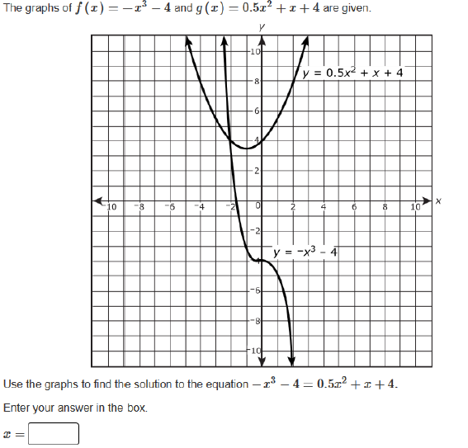
Representations are well suited to the mathematics that students are learning and serve an important purpose within the item itself.
A-REI.D.11 Explain why the x-coordinates of the points where the graphs of the equations y = f(x) and y = g(x) intersect are the solutions of the equation f(x) = g(x); find the solutions approximately, e.g., using technology to graph the functions, make tables of values, or find successive approximations. Include cases where f(x) and/or g(x) are linear, polynomial, rational, absolute value, exponential, and logarithmic functions.★
Notes:
© Item retrieved from the PARCC Grade 11 EOY Test. Available from https://prc.parcconline.org/assessments/parcc-released-items; accessed April 2016.
Let’s look at this example item written to illustrate Alignment Principle 5.
Answer key: -2
What makes this item a good illustration of Alignment Principle 5?
There are a couple of different representations worth noting here, both of which are important and both of which are part of a longer progression. The concept of a function begins in grade 8 with a specific note stating that it isn’t necessary in grade 8 for students to use formal notation. However, by high school function notation is prominently featured in multiple standards and using and understanding it is required to solve a problem like the one shown. The other representation, the coordinate plane, first appears in grade 5 and then remains as an important representation through high school as students gradually move from graphing points in a single quadrant, to graphing points in all four quadrants, to representing equations as curves (which at the outset are just lines). The representations used here allow students to use their understanding of function notation, and make an important distinction between the coordinates of the point of intersection of two graphs and the solution to the equation f(x)=g(x).

Slide 20

Alignment Principle #6
Items use mathematically precise language, are free from mathematical errors or ambiguities, and are aligned to the mathematically appropriate standard.
Notes:
This alignment principle covers a range of issues related to the mathematical and technical quality of items, from using “least” instead of “fewest,” to failing to adequately specify what is meant by “one cubic unit” in a visual image. This is one of the more challenging aspects to train writers and reviewers on due to the type of specific content knowledge needed to successfully identify issues. Incorporating mathematicians into review processes for at least a subset of the total development can provide some assurance that this principle is being well attended to by item authors and/or reviewers.

Slide 21
Items use mathematically precise language, are free from mathematical errors or ambiguities, and are aligned to the mathematically appropriate standard.
Enter the extraneous solution to the equation shown.
A-REI.A.2 Solve simple rational and radical equations in one variable, and give examples showing how extraneous solutions may arise.
Notes:
Let’s look at this example item written to illustrate Alignment Principle 6.
Answer key: n/a
What makes this item a good illustration of Alignment Principle 6?
Standard A-REI.A.2 is very carefully worded to ensure mathematical precision, stating that students should “give examples showing how extraneous solutions may arise.” The issue with the wording of the item is that it presupposes a particular solution strategy, likely one where a student starts by squaring both sides of the equation. If I graph the equations y=sqrt (x) and y=x-6 and then interpret the point of intersection to get a single solution of 9, no extraneous solution arises using that particular method. An extraneous solution is one that is a solution to a particular equation created as part of a specific solution method, but not a solution to the original equation. Since it is specific to a particular method of solving, test questions must be designed in such a way that the methods used to solve a given equation are part of the formulation of the problem.

Slide 22
Items use mathematically precise language, are free from mathematical errors or ambiguities, and are aligned to the mathematically appropriate standard.
F-BF.A.1 Write a function that describes a relationship between two quantities.
Notes:
Let’s look at this example item written to illustrate Alignment Principle 6.
Answer key: n/a
What makes this item a good illustration of Alignment Principle 6?
There are several issues that can creep into items in the high school conceptual category for Functions. This item highlights a few of those issues. Standard F-IF.A.1 states “Understand that a function from one set (called the domain) to another set (called the range) assigns to each element of the domain exactly one element of the range. If f is a function and x is an element of its domain, then f(x) denotes the output of f corresponding to the input x. The graph of f is the graph of the equation y = f(x).” In this standard, we can clearly see that f refers to the function while f(x) refers to the output of function f for input x. One common error is referring to the function as f(x) when really this is the output of the function; in the first sentence of the item it would be better to call the function just f. There are several other sources of ambiguity in this particular item that might lead to the following questions:
Do those values of x represent the whole domain or is the function continuous on a larger interval?
The function appears as though it could be linear, but we have no assurances that it is.
Also what does it mean to enter a function for f(x)? That is like saying ”Enter a function for the output of the function.” [See F-IF.C.8 for more about this language.]

Slide 23

Alignment Principle #7
The demands of items measuring the Standards for Mathematical Practice are appropriate to the targeted grade level.
Notes:
The Standards for Mathematical Practice should reflect a growing arc of sophistication in assessment items. In early grades, students might give examples or non-examples to show their understanding of a particular claim, but are not asked to prove it or show that it is true for all cases. Similarly, younger students begin modeling real-world situations with equations, but do not engage in the full modeling cycle shown in the high school standards.

Slide 24
The demands of items measuring the Standards for Mathematical Practice are appropriate to the targeted grade level.
MP.3. Construct viable arguments and critique the reasoning of others.
A-SSE.A. Interpret the structure of expressions.
Notes:
© Item adapted from the Smarter Balanced Grade 11 Claim 3 Item Specifications. Available from http://www.smarterbalanced.org/assessments/; accessed April 2016.
Let’s look at this example item written to illustrate Alignment Principle 7.
Answer key: FTTT
What makes this item a good illustration of Alignment Principle 7?
Part of the text under Standard for Mathematical Practice 3 states that students: “are able to analyze situations by breaking them into cases, and can recognize and use counterexamples.” By high school, students should have opportunities to think about which cases are important to consider for a particular problem and also have opportunities to think about the relationship between those cases and the truth of a conjecture. This is not an expectation for younger students, but is appropriate in high school.

Slide 25
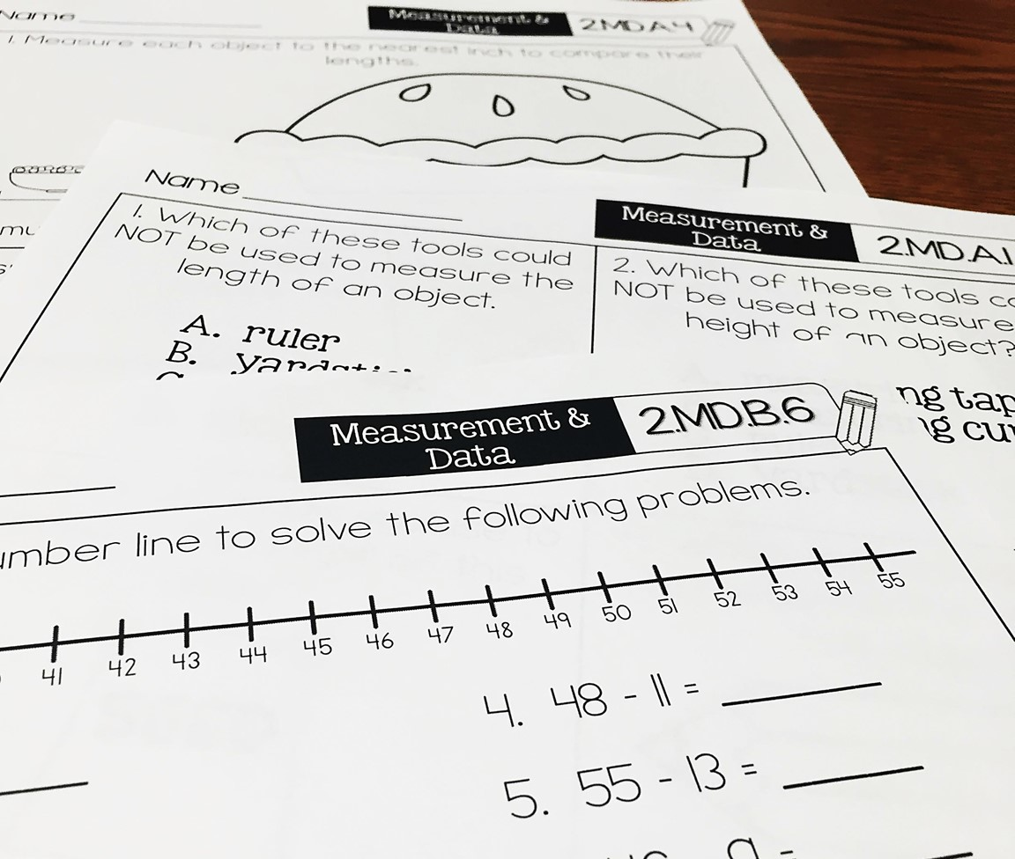
Alignment Principle #8
Item types are chosen to match the item’s purpose and as part of the evidence required by the standards.
Notes:
With many assessments moving online, choices of item type have a lot of driving factors: accessibility, cost, and content. In this section, we will show examples of items that are designed well to meet the evidence required by the standards and are well suited to a particular item’s purpose. This is not to say that a balanced assessment that meets the demands of the standards must include all of these item types nor that this is an exhaustive list of available item types, but that an aligned assessment will include multiple item types. These are illustrations of good ways to collect the evidence required by the standards, but decisions ultimately must be made after carefully considering how to effectively balance cost, content, and accessibility.

Slide 26
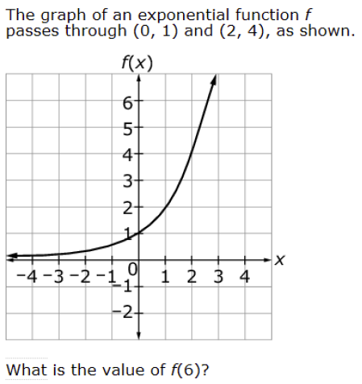
Item types are chosen to match the item’s purpose and as part of the evidence required by the standards.
F-IF.C. Analyze functions using different representations
F-IF.A.2. Use function notation, evaluate functions for inputs in their domains, and interpret statements that use function notation in terms of a context.
Notes:
© Item retrieved from the Smarter Balanced 2015 Grade 11 Practice Test. Available from http://www.smarterbalanced.org/assessments/; accessed April 2016.
Let’s look at this example item written to illustrate Alignment Principle 8.
Answer key: 64
What makes this item a good illustration of Alignment Principle 8?
Having equation and/or numerical entry is often ideal when the answer to a question is a number. Students should be diligent in checking their mathematics to a problem and verifying that their answers seem reasonable; with multiple-choice questions students often are alerted that their answers are not reasonable or correct because they don’t show up on the list of options. For classroom teachers, open response has the added benefit of supporting formative assessment, providing better information to look for and summarize student misconceptions or errors. Since summative assessments often serve as a signal to classroom instruction, selecting item types that are best aligned to the desired evidence should be a top priority.
Because the function in this item is represented graphically, we align it to F-IF.C in addition to its primary alignment to F-IF.A.2, which requires students to evaluate functions for inputs in their domains.

Slide 27
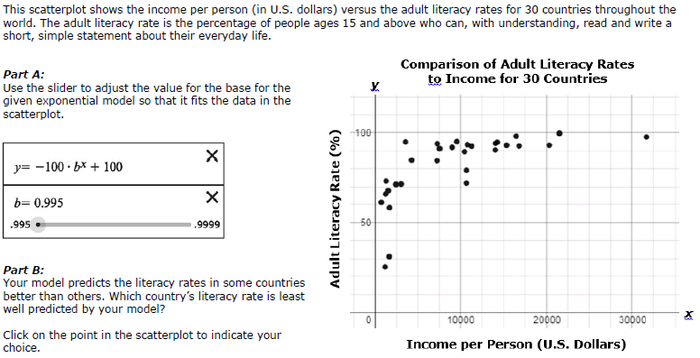
Item types are chosen to match the item’s purpose and as part of the evidence required by the standards.
S-ID.B.6 a. Fit a function to the data. b. Informally assess the fit of a function by plotting and analyzing residuals. [standard intentionally shortened to fit slide]
Notes:
© Item retrieved from the Smarter Balanced Grade 11 Claim 1 Item Specifications. Available from http://www.smarterbalanced.org/assessments/; accessed April 2016.
Let’s look at this example item written to illustrate Alignment Principle 8.
Answer key: Student creates a model within given parameters and selects the correct point based on the model
What makes this item a good illustration of Alignment Principle 8?
The full text of the shortened standard is here:
a. Fit a function to the data; use functions fitted to data to solve problems in the context of the data. Use given functions or choose a function suggested by the context. Emphasize linear, quadratic, and exponential models.
b. Informally assess the fit of a function by plotting and analyzing residuals.
This item mirrors some of the functionality now available in online software programs, apps, and online graphing calculators allowing students to use a “slider” to experiment with adjusting the fit of a model to a data set. The advantage of this approach over traditional methods of generating equations for lines of best fit is that the student must actively engage with the slider, noticing how the curve changes for different values of the variable leading to a stronger understanding of what might otherwise be just a “behind the scenes” computation done by a machine. Part B is an informal assessment of student’s ability to identify and interpret the meaning of a residual.

Slide 28
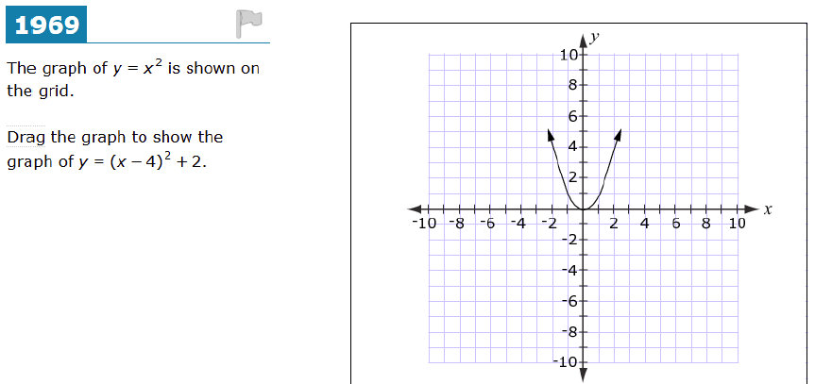
Item types are chosen to match the item’s purpose and as part of the evidence required by the standards.
F-IF.C.7 Graph functions expressed symbolically and show key features of the graph, by hand in simple cases and using technology for more complicated cases.
F-BF.B.3 Identify the effect on the graph of replacing f(x) by f(x) + k, k f(x), f(kx), and f(x + k) for specific values of k (both positive and negative); find the value of k given the graphs. Experiment with cases and illustrate an explanation of the effects on the graph using technology.
Notes:
© Item retrieved from the Smarter Balanced 2015 Grade 11 Practice Test. Available from http://www.smarterbalanced.org/assessments/; accessed April 2016.
Let’s look at this example item written to illustrate Alignment Principle 8.
Answer key: Student drags the graph to the correct location
What makes this item a good illustration of Alignment Principle 8?
Some of the graphing required by the standards can be a bit trickier with online assessments and a limited number of item types. This item takes advantage of drag and drop to measure students’ understanding of the effect of a particular translation on the parent graph (y=x^2). Two standards are listed for alignment – the graphical representation of the answer is a requirement of F-IF.C.7 and the understanding of the relationship between the transformed graph and the original is articulated in F-BF.B.3.

Slide 29
Alignment Principle #9
Most items measuring the Standards for Mathematical Practice are also aligned to content standards representing widely applicable prerequisites.
Notes:
Keeping the assessment focused on the widely applicable prerequisites is an important design principle in the overall test construction. In measuring the Standards for Mathematical Practice, it is important to help retain the focus of the test by using many items that align to the these prerequisite standards.

Slide 30
Most items measuring the Standards for Mathematical Practice are also aligned to content standards representing widely applicable prerequisites.
F-IF.C. Analyze functions using different representations.
Algebra – Seeing Structure in Expressions
MP7. Look for and make use of structure.
Notes:
© Item retrieved from Smarter Balanced Scoring Guide for Selected Short Text Mathematics Items. Available from http://www.smarterbalanced.org/assessments/; accessed April 2016.
Let’s look at this example item written to illustrate Alignment Principle 9.
Answer key: Student correctly matches each function to its graph and explains his/her reasoning
What makes this item a good illustration of Alignment Principle 9?
This item is designed to allow students to use the structure of the expressions that define the three functions to determine which graph matches each. The item strongly reflects the intent of Standard for Mathematical Practice 7: “Look for and make use of structure.” This alignment matches well with the expectations for students within the high school domain A-SSE, a domain that consists of widely applicable prerequisites. The primary emphasis of this item is on whether the student can use the structure of the three expressions to make the matches. The use of function notation and analyzing graphs of functions is also required by the item, so you see a secondary content alignment to the Functions conceptual category, specifically to cluster F-IF.C.

Slide 31

Alignment Principle #10
Items written at the cluster, domain or conceptual-category level measure key integration points not necessarily articulated in individual standards but plausibly implied directly by what is written.
Notes:
A few items per test event may serve as opportunities to connect content across standards, domains, or grade levels. These opportunities should be carefully defined with an established purpose tied back to the language and structure of the standards. An item writer might ask: What key connections are students being asked to make to respond to this question that isn’t articulated in any individual standard?

Slide 32
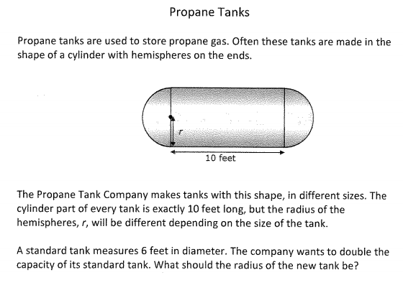
Items written at the cluster, domain or conceptual-category level measure key integration points not necessarily articulated in individual standards but plausibly implied directly by what is written.
G-MG.A Apply geometric concepts in modeling situations.
A-CED.A.2. Create equations in two or more variables to represent relationships between quantities; graph equations on coordinate axes with labels and scales.
Notes:
© Item retrieved from PARCC ITN 2012. Available from https://prc.parcconline.org/assessments/parcc-released-items; accessed April 2016.
Let’s look at this example item written to illustrate Alignment Principle 10.
Answer key: 4.046 feet
What makes this item a good illustration of Alignment Principle 10?
This item integrates work from two conceptual categories – Geometry and Algebra. Students use their knowledge of algebra to create equations that show the relationship between quantities in a geometric modeling scenario. In this case, students are dealing with a known cylinder height, but need to use that information to determine the volume of the standard tank and then set up an equation to determine the radius for a tank double that capacity. This is a nice illustration of this principle and the meaning of “key integration points” that serve as a way to show the coherence of the standards in assessments.

Slide 33
Ten Principles of CCSS-Aligned Items
1. Some items are designed to measure applications of key takeaways from grades 6-8 at a level of sophistication appropriate to high school.
2. Items are designed to address the aspect(s) of rigor (conceptual understanding, procedural skill, and application) evident in the language of the content standards.
3. Items are designed to attend to content limits articulated in the standards.
4. Most items aligned to a single content standard should assess the central concern of the standard.
5. Representations are well suited to the mathematics that students are learning and serve an important purpose within the item itself.
6. Items use mathematically precise language, are free from mathematical errors or ambiguities, and are aligned to the mathematically appropriate standard.
7. The demands of items measuring the Standards for Mathematical Practice are appropriate to the targeted grade level.
8. Item types are chosen to match the item’s purpose and as part of the evidence required by the standards.
9. Most items measuring the Standards for Mathematical Practice are also aligned to content standards representing widely applicable prerequisites.
10. Items written at the cluster, domain or conceptual-category level measure key integration points not necessarily articulated in individual standards but plausibly implied directly by what is written.
Notes:
The principles illustrated throughout this module are intended to support those charged with developing summative mathematics assessment items and to support training efforts for those who review the content of items.

Slide 34
Thank You!

