Slide 1
Using Achieve the Core Tools to Tackle Common Math Issues
Core Advocates Monthly Webinar
December 6, 2017
The webinar will begin shortly. You may wish to download the handouts (check the tab on your webinar control panel) while you wait.

Slide 2
Introductions
Your hosts from the Field Impact Team
Lynda Nguyen, Team Coordinator
Jennie Beltramini, Teacher Engagement Manager
Janelle Fann, Project Manager
Sandra Alberti, Director
Joanie Funderburk, Manager of Professional Learning
This Month’s Guests -
Amanda Vitello, Digital Product Manager, SAP
Tara Warren, CA Core Advocate
Tamara Gloster, CT Core Advocate

Slide 3
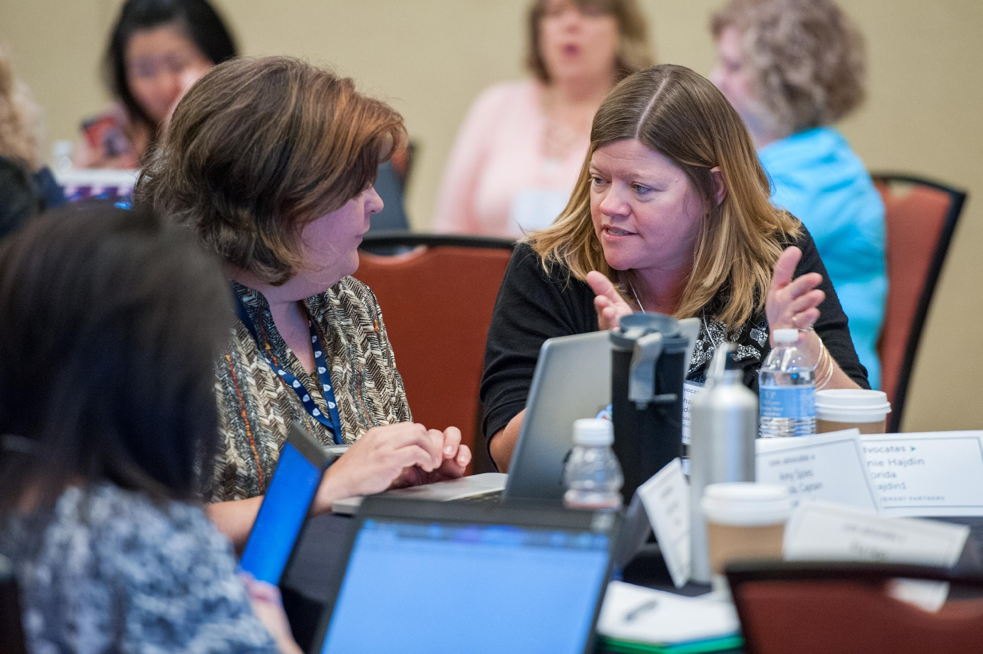
Who are Core Advocates?
Core Advocates are educators who:
  Believe in the potential of high-quality standards to prepare all students for college and careers;
  Are eager to support their colleagues and communities in understanding and advocating for the college- and career-ready standards, and standards-aligned instruction;
  Understand and embrace the Shifts in instruction and assessment required by the college- and career-ready standards
Notes:
CAs are teachers from all over the country who believe in the potential of high quality standards and the importance of all students being prepared for college and careers.
They support their colleagues in understanding and advocating for the standards and embrace the Shifts in instruction.
The Core Advocate network is over 10K educators strong and we’d love for you to join us if you have not already.

Slide 4

Learn more about us!
Contact Jennie Beltramini (jbeltramini@studentsachieve.net ) or Joanie Funderburk (jfunderburk@studentsachieve.net)
Complete this survey to join our database (and mailing lists): www.achievethecore.org/ca-signup
Visit our website: www.achievethecore.org
Notes:
If you’d like to learn more about the network, contact Joanie or Jennie (their emails are here).
We also want to invite you to join the network by signing up at achievethecore.org/ca-signup and visit our website for more info and opportunities

Slide 5

Tweet with us!
Please feel free to tweet during and after the webinar using #coreadvocates
@achievethecore
@JennieBeltro, @teeidub

Slide 6
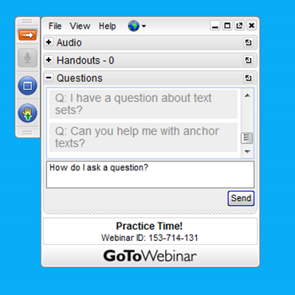
Engage with us!
During the webinar
– Accessing Documents
– Questions option
– Polling
After the webinar
– Survey
– Access to recorded webinar

Slide 7
Goals of the webinar
Understand how to find what you need on achievethecore.org (ATC)
Explore ATC resources you can use to build knowledge, share with groups, or use in your classroom
Hear from educators using ATC tools and resources to improve math instruction
Notes:
We have three main goals for our webinar tonight. They are to...

Slide 8
Section 1: Tour de Core

Slide 9
Poll:
How frequently do you use Achievethecore.org?
Please use the Poll tab on your control panel to respond.

Slide 10

Achieve the Core
Notes:
I want to start off by just walking you through how the site is organized, so that you can easily go to the correct section when you do go. Today on the webinar, I’d like for you all to stay here with me, and NOT go explore the site as we move through. However, when we wrap up, we encourage you to go to www.achievethecore.org to explore the site and find resources you can use tomorrow.
When you go to ATC, you’ll notice there are three ways to navigate into the site: Professional Learning, Planning and Reflection, and classroom resources. Each of these sections has a specific purpose in terms of use.

Slide 11
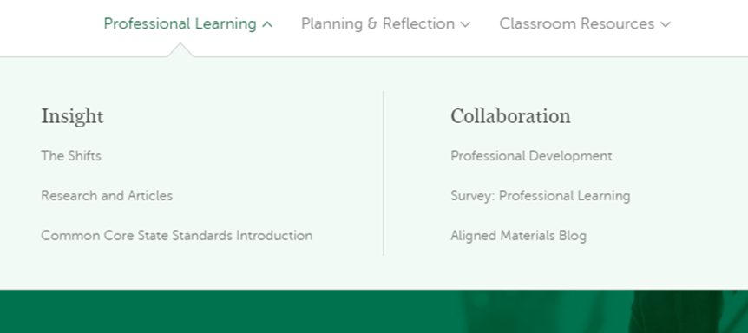
Achieve the Core
Notes:
Resources found in the Professional Learning section will help educators learn more about the shifts and college- and career-ready standards, either on your own or with others.

Slide 12
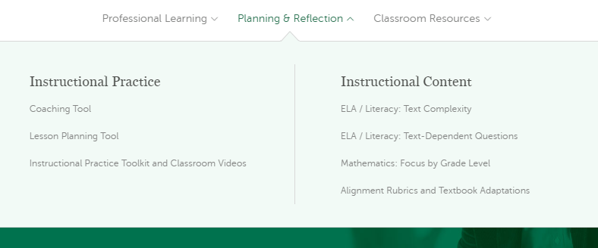
Achieve the Core
Notes:
The Planning and Reflection section provides tools and resources for educators to be better able to plan for instruction or reflect back on previous instruction. You will also find resources for selecting aligned materials and adapting current materials.

Slide 13
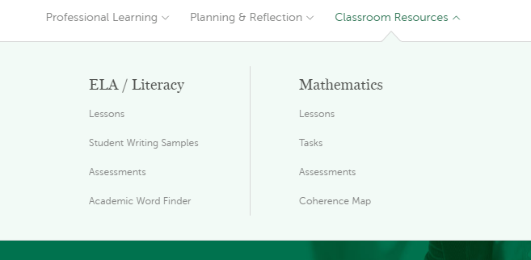
Achieve the Core
Notes:
Finally, the Classroom Resources section provides resources that you can use in your classroom – the more “grab and go” type of resources.

Slide 14

Achieve the Core
Notes:
As you find resources that you love and want to come back to, we encourage you to “favorite” resources, to save them for later. You will find these favorited items in your account.

Slide 15
Achieve the Core
Notes:
To create an account after this session, if you don’t have one already, simply navigate to the upper right of any page and click “sign up”. One note- if you complete the sign up for Core Advocates, then you already have an account for achieve the core.

Slide 16
Common issues that math teachers deal with
Designing coherent math instruction
Creating focus in the math classroom
Integrating the standards into your PLC
Working with imperfect materials
Addressing the elements of rigor in your classroom
Notes:
We’ve heard from lots of you and your colleagues that there are some common issues that you have to address in your classrooms. Here are some of the most frequently cited issues.

Slide 17
Question:
What challenges do you experience as a math teacher?
Please use the Questions tab on your control panel to respond.
Notes:
We want to hear from you - what are some of the challenges, issues, or concerns you have as a math teacher?
While we certainly won’t be able to address all of these issues this evening, we encourage you to explore achievethecore to find resources to support you in addressing your specific issue.

Slide 18
Section 2: Designing Coherent Math Instruction
Notes:
For this evening, we decided to explore one of the most commonly cited issues we hear from math educators - what resources do you have to support designing or implementing coherent math instruction, especially when my curriculum isn’t aligned! Now, what if you said your biggest concern is creating focus in the math classroom? Not to worry - we have a handout that provides resources for all the commonly cited concerns for a math classroom.

Slide 19
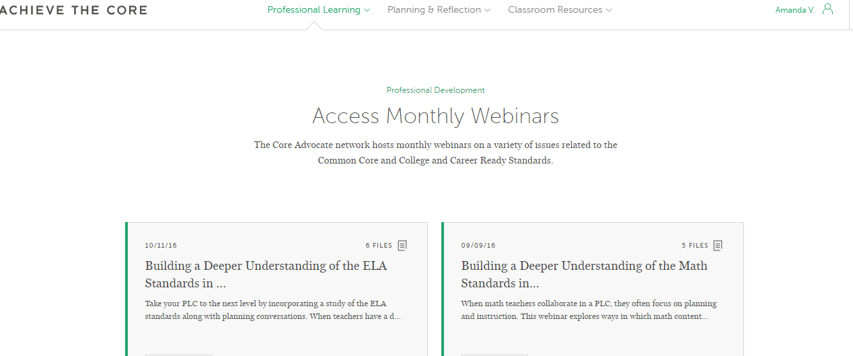
Designing Coherent Math Instruction– Build Knowledge
Webinars
The Coherence Map (2015 October Webinar)
Supporting ALL Learners in Working with Grade-Level Mathematics (March 2017)
Professional learning<Professional Development<Access Monthly Webinars
Notes:
Depending on how you learn best, ATC provides a variety of types of resources to learn about a given topic. Our first set of resources are going to help you grow your own knowledge of a topic, either on your own or with a group. Let’s imagine that your PLC is multi-grade and is focused on vertical alignment. You’ve had some struggles with students coming to older grades without having mastered the standards of previous grades. Within your PLC, you could use a flipped learning model and watch the webinars on the Coherence Map and how to support all learners in working with grade-level mathematics individually to ensure everyone has the same understanding of coherence across the grades. Then, the time in your PLC could be spent discussing what you watched, and how you can use the resources to better align instruction vertically.
Webinars
The Coherence Map (2015 October Webinar): The Coherence Map is an interactive tool that allows teachers to see the connections between math standards within and across grades. You may have seen the previous static version (often referred to as the Zimba Wiring Diagram), but the digital tool will wow you.
Supporting ALL Learners in Working with Grade-Level Mathematics (March 2017):
This webinar explores how to use the vertical and horizontal coherence of the math standards to address students’ unfinished learning within grade level contexts. See how you might use the coherence map and rich math tasks with multiple entry points to explicitly plan to address the needs of all students in your classroom.

Slide 20
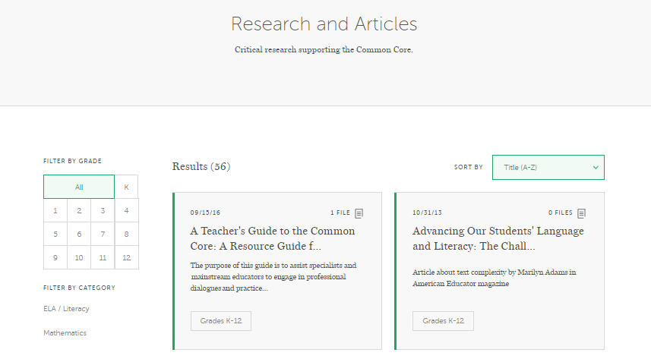
Designing Coherent Math Instruction– Build Knowledge
Research
The Structure is the Standards
Professional learning<Research and Articles
Notes:
Let’s continue with this PLC model, focusing on vertical alignment and coherence across the grades - to really understand the importance of teaching grade-level standards, together you could read an article, “The Structure is in the Standards”, and discuss the implications of the article on your school, your teaching experience, and the academic experience for your students.
The Structure is the Standards: An essay by CCSSM lead writers Phil Daro, William McCallum, and Jason Zimba that describes the importance of the structure of the Standards and cautions against fragmenting the Standards or taking them out of context. The original post can be found here.

Slide 21
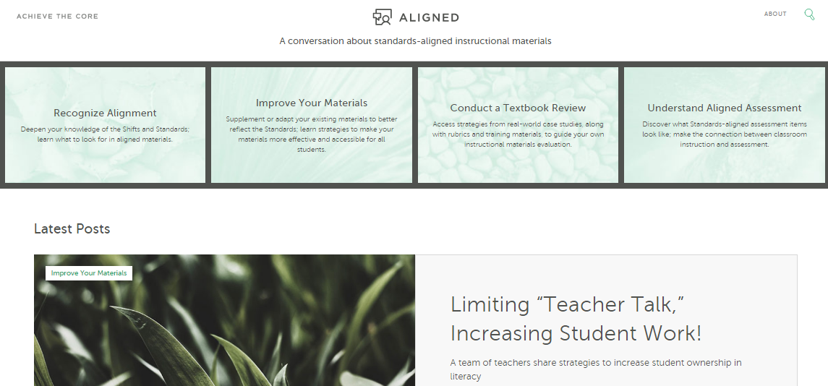
Designing Coherent Math Instruction– Build Knowledge
Aligned Materials Blog
Creating a Coherent Math Curriculum
Navigating the Spiral in Mathematics Textbooks
Forming a United Whole – The Coherence Map
Achievethecore.org/aligned
Notes:
To understand how other educators have taken on the issue of coherent math instruction, the Aligned blog is a great resource. We have educators from across the country write about how they have addressed this concern in their school or district.
Creating a Coherent Math Curriculum: This blog post discusses how the Coherence Map can help you uncover gaps in understanding and find resources to supplement your instructional materials.
Navigating the Spiral in Mathematics Textbooks: A classroom teacher and curriculum coordinator describe how they used the spiral design of their textbook to help them focus on creating coherent instruction.
Forming a United Whole – The Coherence Map: A K-12 STEM District Supervisor explains how he used the Coherence Map to improve his district's math curriculum

Slide 22
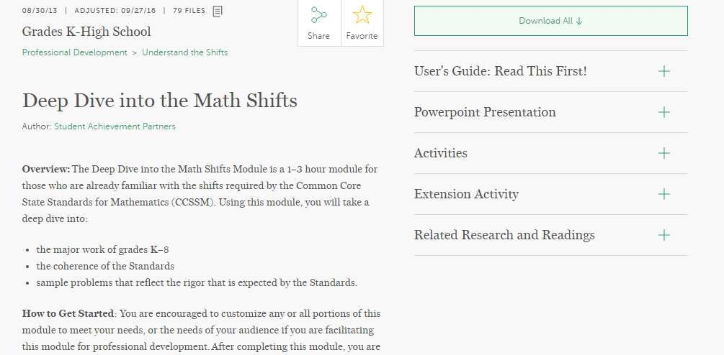
Designing Coherent Math Instruction– Share with Groups
Professional learning<Professional Development<
Understand the Shifts
Notes:
To continue this idea of a PLC working through vertical alignment of instruction, an amazing activity to do is the “Coherence Card Activity”. If you have had the opportunity to participate or lead this activity before, go ahead and type into the chat box “yes”. This activity provides individual standards within a given domain across grades. Teachers need to identify the grade level each standard belongs within. This is an amazing way to see, visually, the impact of not teaching a standard in a given grade.
Coherence Card Activity from the Deep Dive into the Mathematics Shifts: Use the Coherence Activity: Uncovering Progressions and Themes from the Deep Dive Into the Math Shifts Professional Development to support a stronger understanding of coherence.

Slide 23
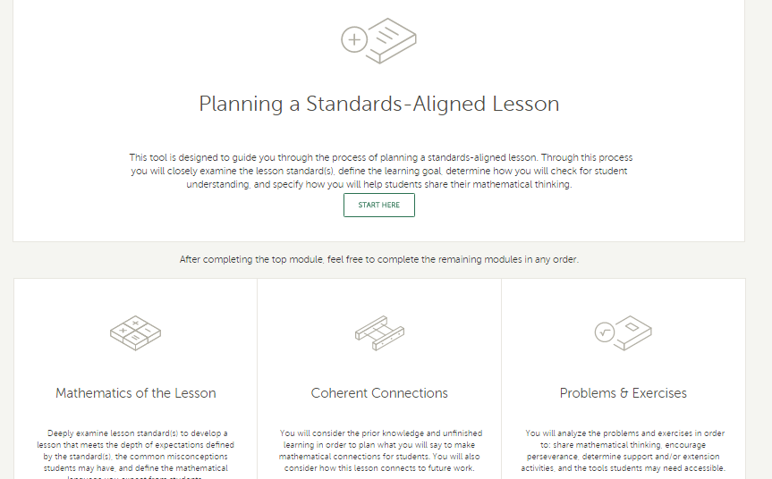
Designing Coherent Math Instruction– Share with Groups
www.achievethecore.org/lesson-planning-tool
Notes:
Let’s say that after all that cross-grade planning, the teachers in your school are really on board with putting a plan together to address the standards within a great, and teachers within a grade decide to plan together. A great resources for common planning is the “Lesson Planning Tool”- a resources that provides guiding questions and supports to help teachers create lessons that align to the Shifts. .There is a specific module that is dedicated to creating coherent connections within a lesson and across grades. It is an excellent resource to engage in a “japanese lesson study” type of activity, and plan together with your peers.
Lesson Planning Tool: This tool provides guiding questions and supports to help teachers create lessons that align to the Shifts required by the Common Core. It includes a module dedicated to creating coherent connections within a lesson.

Slide 24
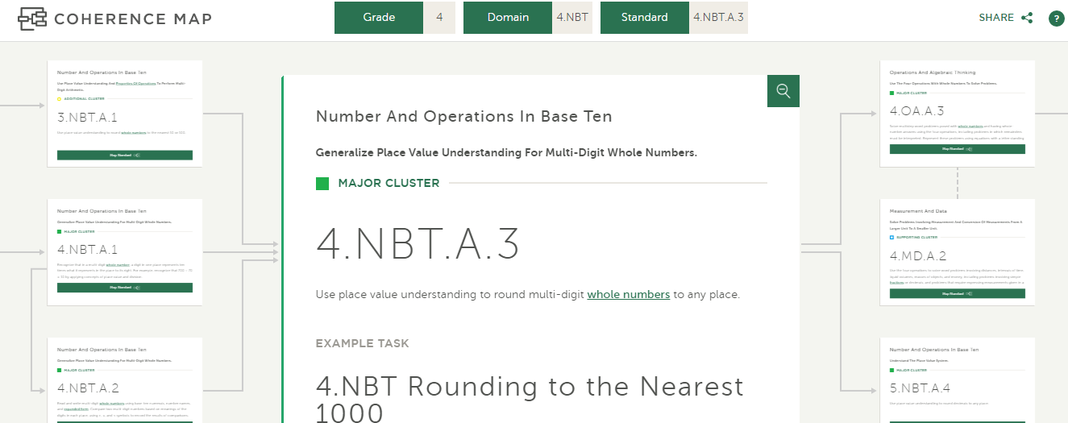
Designing Coherent Math Instruction– Use in Your Classroom
Coherence Map
www.achievethecore.org/coherence-map
Notes:
Finally, as your school determines to pull together a scope and sequence that address coherence, the Coherence Map is a fantastic tool. It illustrates the coherent structure of the Common Core State Standards for Mathematics K-8, with related tasks, assessment items, and other supportive material. It visually illustrates the connections of the standards both within and across grades.
As you consider all these resources for supporting the implementation of a coherent curriculum, which resources are you most excited to try in your school?
Coherence Map: Standards relate to one another, both within and across grades. The Coherence Map is an interactive website that illustrates the coherent structure of the Common Core State Standards for Mathematics K-8, with related tasks, assessment items, and other supportive material.

Slide 25
Question:
How could one or more of the tools mentioned help you in your setting?
Please use the Questions tab on your control panel to respond.

Slide 26
Section 3: Core Advocates Tackling Math Issues

Slide 27
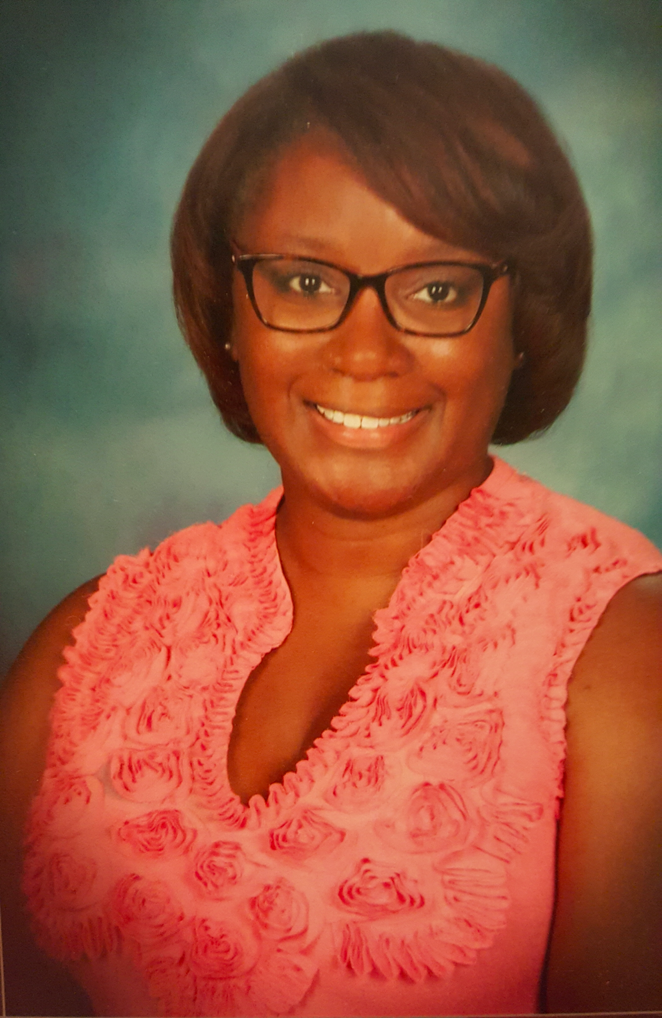
Tara Warren
Teacher, Math Coach
Santa Monica, CA
please enter a photo of yourself here

Slide 28
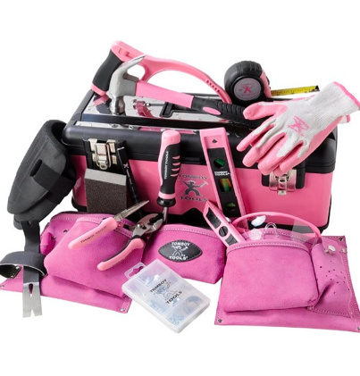
My Story...
(as it relates to this webinar)
15th Year in Education
  11 yrs. in Cincinnati, OH
  4 yrs. in Santa Monica, CA
Teacher
Math Instructional Coach
Notes:
I have been a teacher for 15 years and have had the privilege to work in 2 vastly contrasting districts that pose their own independent issues. You can imagine the tools that I have accumulated in my tool belt over the course of time.

Slide 29

Math Issues in My Current Setting
Vertical articulation
Various levels of learners
How can I help?
Notes:
In my previous work, we did a lot of work becoming familiar with the standards at our grade levels and how that translated vertically. It was a lot of work as an instructional coach but little did I know how I would be able to use this information in the near future. As I began work in a new district, I found that they had the similar challenges that we faced in my previous district with some big exceptions. The students are high achieving which brought a level of comfortability in classrooms and teachers approach. I found that teachers did not always teach in depth because on a skill level, most students were able to attend to the work. It was teaching in depth and being sure to stay on topic. Teachers were teaching beyond their grade level expectations with limited knowledge of their grade level expectations. Basically, teaching was all over the place.

Slide 30

Math Issues in Current Setting
First Step: Focus the Work
Notes:
We started with what should be taught at each grade using the standards and the focus documents.

Slide 31

Math Issues in my Current Setting
Next Step: Vertical Articulation
Notes:
Now that we know what we are supposed to be teaching, how can we use our PLC’s to bring the learning across grades.

Slide 32
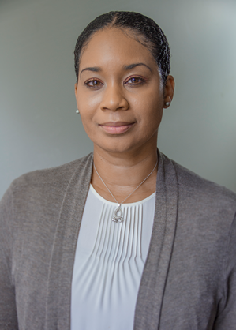
Tamara Gloster
Assistant Director of CREC Teaching & Learning
Hartford, CT
please enter a photo of yourself here
Notes:
Background:
CT Educator for almost 20 years as a:
Secondary Math Teacher
District Math Coach
Administrator for Professional Development Provider

Slide 33

Teacher Evaluation Feedback
Notes:
We all know that classroom teachers are held accountable for student success of academic growth outcomes and achievement.
Here is something that happened to me…. I was talking with a group of teachers and one of them shared their feedback from their administrator saying, the lesson was not rigorous enough.
Unfortunately for this teacher, they didn’t know what that meant. This left the poor teacher frustrated because they didn’t’ get specific feedback, and confused with so many questions. For instance:
How come my lesson was not rigorous?
What does rigor mean?
How do I plan for rigorous instruction? What does it look like?
How will I know when my lesson is rigorous enough?
What instructional opportunities should I have?
How do I know I am doing it right?
I was implementing the standards, but what should I be doing differently?
What about my students? How should they be thinking and how should they be engaging in the learning?
My students are completing their work, so what are students expected to be doing?
… and so on.
Add to this scenario, (generally speaking of-course) most administrators lack the necessary math background to provide specific and meaningful feedback resulting in teacher action to improve their practice. Consequently, the administrator’s stance remains as evaluator never moving along the continuum of supervision to coach or collaborator.
So as a result of the teacher telling me this, I recommended a great tool for this teacher. (Next slide)

Slide 34
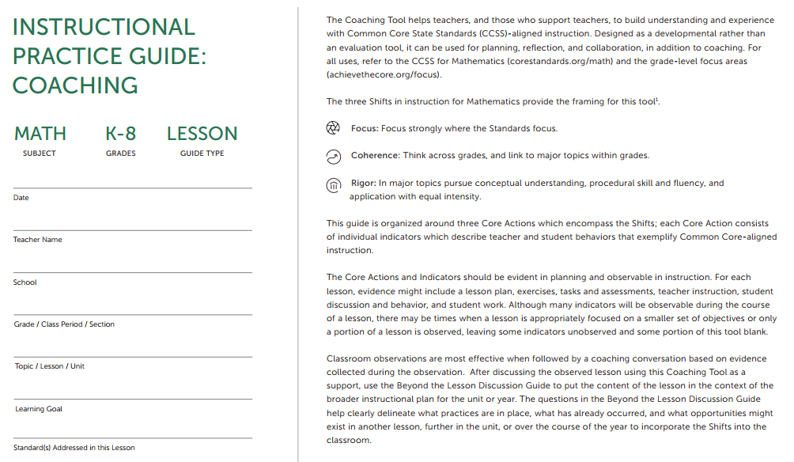
Notes:
This tool (called the Instructional Practice Guide (IPG)) is awesome! The IPG is available for Math for all grades, K – High School. The one I am showing you now is for Math K-8 and there is one for high school. The IPG is digital and in print.
It allows for the teacher to see all at once the dynamics of a rigorous lesson:
Planning to reflect the Shifts
Instructional practices for students learn the content
Opportunities for students to exhibit the Math Practices
The IPG supports:
Designing coherent math instruction, consisting of sets of questions that guide teachers through planning a lesson that exemplifies the Shifts
Creating focus in the math classroom, and
Addressing the elements of Rigor in your math classroom.
This tool helps teachers to consider the standard(s) and/or cluster(s) they have chosen to target, the learning goal(s) for the students, the problems students will engage with, discussions about the mathematics of the lesson, using examples and representations to make the mathematics explicit, self-reflection and analysis of their practice of teaching through individual lessons or a series of lessons. Teachers can focus their work and develop specific practices critical for implementation of CCSS, to name a few.
Basically, this tool really helps teachers to know what rigorous instruction looks like. What teachers should be doing, and what the students should be doing.
This tool compiles everything into one document that teachers can share in PLCs/department meetings and with administrators.
For example (next slide)

Slide 35

Collaborative Approach
Notes:
The teacher can share with the administrator their planning for what is important, math specific instructional strategies and the standards for mathematical practices and student outcomes. The administrator can look at the tool and the lesson, discuss observational evidence collected, and use the tool to provide math specific, purposeful and meaningful feedback to the teacher to improve teacher practice.
It creates a great opportunity for the teacher as well as the administrator giving the administrator the opportunity to coach and collaborate with the teacher to improve the teacher’s practice.
This tool removes the guess work, targets the focus and grounds the conversation. I can’t say enough about the benefits of this tool!

Slide 36
Questions for our Guests?
Notes:
Going back to discussion of the Lesson Planning Tool - if I was to use it to create an aligned lesson, is there an easy way for me to share that lesson with my colleagues?

Slide 37
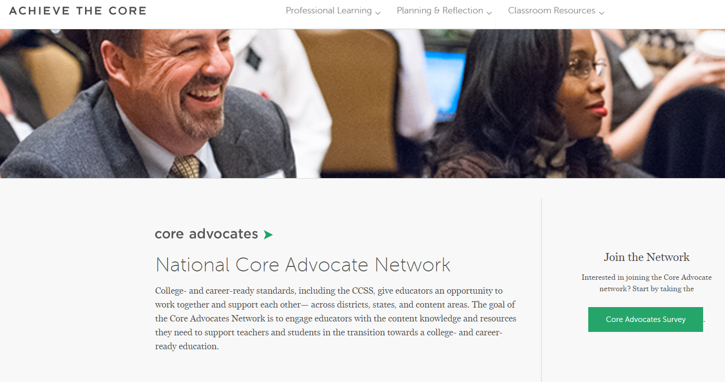
Join our network!
www.achievethecore.org/ca-signup
Notes:
If you found tonight’s webinar helpful, we’d like to invite you to join our Core Advocate network! The Field Impact Team is committed to solving real problems that real teachers have and we know the best way to do this is to know more about what folks are experiencing.
We’d love to learn about who you are, where you work, the types of things you’re interested in and the expertise you already have. This way, we will be able to tailor our webinars and other opportunities to your needs and interests (we may even tap you to be our next webinar panelist). So we encourage you to join the network by filling out this survey completely at atc.org/ca-signup

Slide 38
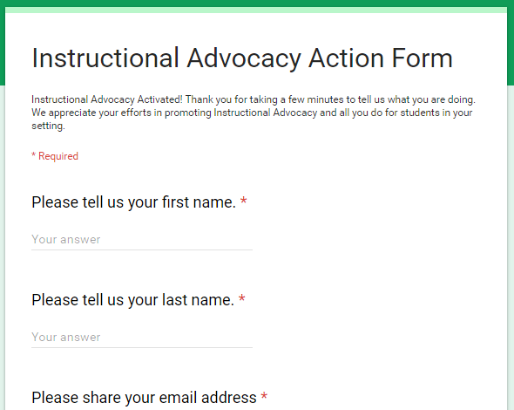
Tell us about your efforts
www.achievethecore.org/educators-taking-action
Notes:
We like to invite Core Advocates to share what they are doing more broadly. Whether its you trying a strategy or a tool, we’d like to know how it went. Please let us know about your advocacy with our IAAF.

Slide 39
Please join us again next month!
Next month’s webinar: Using Achieve the Core to Tackle Common ELA Issues
Wednesday, January 10, 2018 7:00 - 8:00 p.m. ET
Register Here: https://attendee.gotowebinar.com/register/2467369347153271555

Slide 40
Thank You!

