Slide 1
enVisionmath 2.0
Guidance documents

Slide 2
Session Objectives
Teachers will understand the layout and purpose of the guidance documents
Grade-level teams will develop a plan for how they will use guidance documents in planning and instruction

Slide 3
Why Guidance Documents?
Notes:
Big Idea: This section provides background on the development and purpose of the guidance documents.

Slide 4
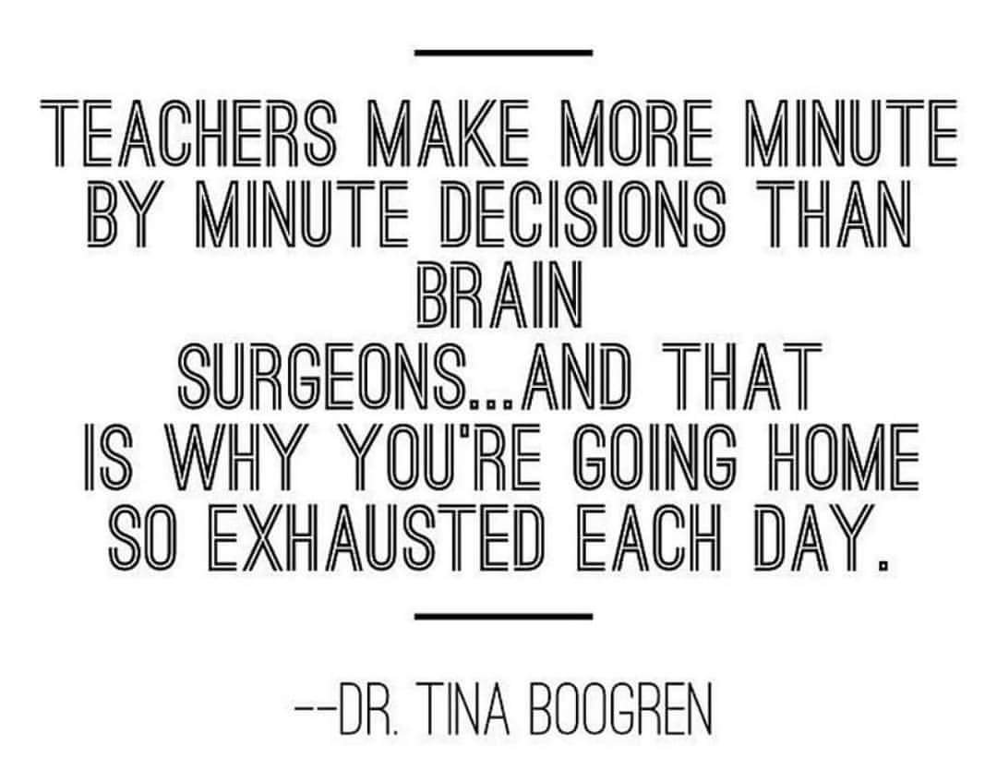
Notes:
Big idea: Acknowledge the hard work and complexity of teaching
Details:
Dr. Boogren works for Marzano Research to support teachers.
This quote is the basis for why the guidance documents were created: To ensure teachers have support to use their instructional materials in ways that are aligned to the standards. This will relieve some of the daily decision-making about instructional materials from teachers so they can focus on their students.

Slide 5
Purpose of the enVisionmath 2.0 Guidance Documents
Provide support to educators about how to use enVisiomath 2.0 in a way that aligns to CCSS
Connect content to expectations of the Standards and progressions
Highlight strong tasks in the program
Recommend changes to Topic Tests
Notes:
Big Idea: Share the purpose of the guidance documents
Details:
The guidance documents provide support to teachers by:
Calling out aligned-features of the program and recommending how to use them across K-5
Suggesting modification to lessons to align to the content expectations of the Standards for each Topic
Suggesting modifications for Topic Test that align to instructional changes, to ensure that students are assessed based on the expectations of the Standards

Slide 6



Defining alignment
Focus strongly where the standards focus.
Coherence: Think across grades and link to major topics within grades.
Rigor: In major topics, pursue conceptual understanding, procedural skill and fluency, and application with equal intensity.
Notes:
Big Idea: The guidance documents are designed to improve the alignment of enVisionmath 2.0 to the Shifts required by the mathematics Standards.
Details:
The purpose of the guidance documents goes beyond a one-to-one cross walking of standards to lessons – although the guidance does ensure that the Standards are fully addressed in the materials. There are some bigger ideas built into the Standards that need to be reflected in materials.
The guidance documents help to ensure that the materials are focused, spending adequate time fully addressing the intent of the major work of the standards; make meaningful connections between topics and across grades to highlight the coherence of mathematics; and attend to the aspect of rigor targeted by the standard.
Handout: Common Core Shifts for Mathematics.
Background Knowledge: There is a 1-2 hour introductory module available at www.achievethecore.org, Professional Development: Introduction to the Math Shifts, (http://achievethecore.org/page/399/introduction-to-the-math-shifts) if you would like a more detailed look at why these moves are prioritized or the research behind them.

Slide 7











Notes:
Big Idea: These documents were the collaborative efforts of educators from 9 districts.
Details:
SAP held a convening in Summer 2017 to bring together educators who use enVisionmath to create the guidance documents.
Participants were from Philadelphia, PA, San Bernardino City, CA, Mastery Charter School, PA, Milwaukee, WI, Clark County, NV, Plainfield, CT, Poudre, CO, East Hartford, CT, Flemington-Raritan, NJ. Participants also included regional and national representatives from Pearson and Achievement Network.

Slide 8
Places for Adaptations in enVisionmath 2.0
Strengthen coherence within and across topics
De-emphasize requirements for students to use a specific model or strategy, unless required by the Standards
Increase opportunities for students to engage with conceptual understanding, as required by the Standards
Align work to the Aspect of Rigor required by individual clusters/standards
Notes:
Big Idea: In analyzing enVisionmath 2.0 and conducting focus groups, several key areas were identified to guide the creation of the guidance documents.
Details:
These areas are addressed at either the program- or topic-level.
Each of these areas of focus are reflected in different parts of the guidance documents, all align to the Shifts and expectations of the Standards.

Slide 9
What’s in the guidance documents?
Getting Started in your grade
Grade-level Topic Guidance
Standards
Excerpt from Progression documents
Essential Question
Anchor Tasks*
Topic Rules of Thumb*
Topic Test modifications
Notes:
Big Idea: Give a high-level overview of the structure of the documents
Details:
The first section of the guidance documents provide an overview document for each grade enVisionmath 2.0. These include Pro Tips that apply across K-5.
For each grade, there are Topic guidance documents that provide specific information on each Topic. The elements marked with an asterisk are only provided for topics aligned to Major Work of the Grade.
Anchor tasks highlight a coherent progression of the most important math of the Topic. Anchor Tasks are intended to be used as a launch for lessons and are worthy of extended instructional time.

Slide 10
Alignment in enVisionmath 2.0
Notes:
Big Idea: Introduce the program rules of thumb that can be applied across all Topics in K-5.

Slide 11
Do the Math
Solve the problem.
Discuss with a partner who has the same problem as you.
Notes:
Big idea: Introduce activity that will allow participants to experience differences in mathematical work in modified Anchor Tasks
Details:
Do not give participants a lot of explanation about the activity. Let them know that they will be completing an Anchor Task from enVisionmath 2.0
Give half of the participants Version #1 and the other half Version #2 of the Grade 2 or Grade 3 problem. The problem is based on the same Solve and Share from enVisionmath 2.0 but Version 1 provides less scaffolding and therefore will elicit a wider range of responses which can lead to a richer mathematical discussion.
Have participants complete their problem and then discuss their work with someone who has the same version.
After that, ask participants to discuss their work with someone who has the other version.
Use the next several slides (12 and 13 for Grade 2 or 14 and 15 for Grade 3) to discuss the difference in answers and the implications for mathematical discussion in a classroom.

Slide 12
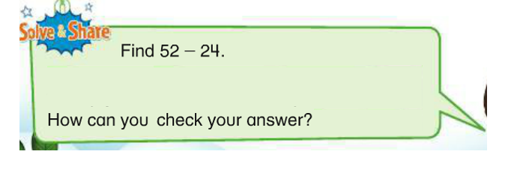
Grade 2 example – Version #1
Notes:
See present notes on Slide 11

Slide 13
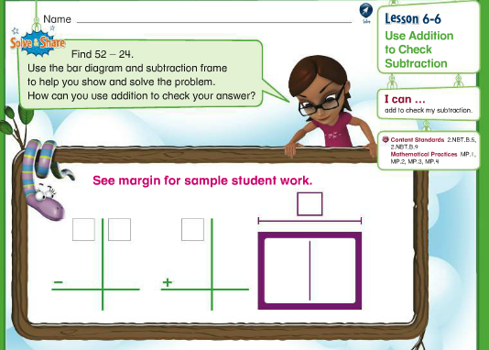
Grade 2 example – Version #2
Notes:
See present notes on Slide 11

Slide 14
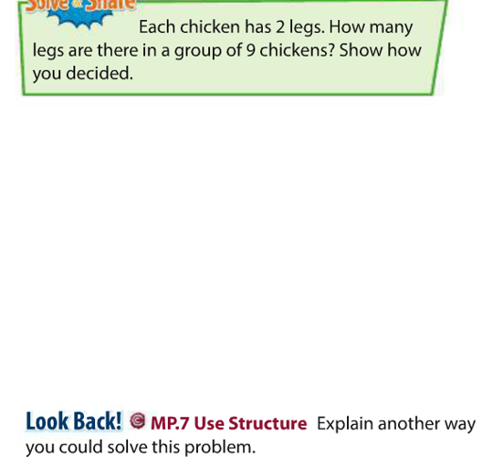
Grade 3 example – Version #1
Notes:
See present notes on Slide 11

Slide 15
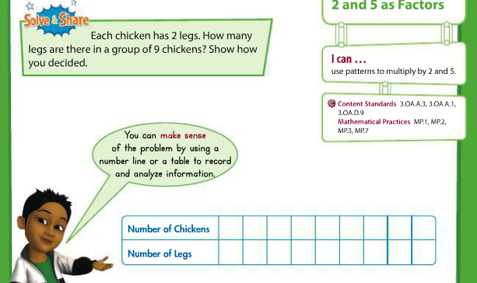
Grade 3 example – Version #2
Notes:
Big Idea: Share an example of over scaffolding which limits the opportunity for students to engage in MP.1 and MP.3
Details:
This example comes from grade 3, lesson 2-1. Students have solved multiplication and division problems in Topic 1.
The requirement to use a table makes solving the problem more about filling in the table than doing the math. Including this scaffolding means that students may not generate different ways to solve 9 x 2 which would be powerful for a math discussion.
In this case, just giving the text of the problem (in the green Solve and Share box) will allow students to solve the problem in a way that makes sense to them.

Slide 16

Pro Tip #1
Remove embedded scaffolding provided for students in problems identified as Anchor Tasks. (Anchor Tasks are identified in each topic as the most essential problems for the Topic based on the expectations of the Standards.) Some of the Anchor Tasks, as they appear in the book, include a lot of direct modeling or a requirement to solve the task in a certain way. Removing this scaffolding increases opportunities for students to engage in mathematical work and make connections between new concepts and skills and prior learning.
Notes:
Big Idea: Introduce the first ‘pro-tip’ found in the Getting Started guide
Details:
In the ‘Getting Started’ guide there are two Pro Tips that are important to follow throughout the program in K-5. They represent big ideas that allow students and teachers to focus more on the mathematics at play in the program.
Pro Tip #1 illustrates the experience you just had. By removing the scaffolding from the Solve and Share, student thinking and class discussion can center on the mathematics of the standards rather than how to complete the worksheet.

Slide 17
Pro Tip #2
Support students in understanding and using strategies and models that are generalizable (e.g., making a ten to add and subtract single digit numbers, using place value to add, subtract, multiply and divide multi-digit numbers), but do not require specific strategies during independent practice or assessment. More guidance is given on this within the Topic Guidance documents.
Notes:
Big idea: Introduce the second Pro Tip in the Getting Started guides.
Details:
This is the second of the two Pro Tips in the ‘Getting Started’ guide.
This builds on the previous Pro Tip in focusing student thinking and classroom discussion on the mathematics.
There are a lot of models and strategies presented in enVisionmath 2.0, and most other instructional materials.
Not all strategies and models are equally useful as students move up through the grades. The emphasis on instruction should be on strategies that generalize.
A note that use of a specific strategy could be required during the instruction of a lesson, in helping students to know and do the mathematics of the grade-level, but use of specific strategies should not be required on the assessment. For assessment, it is important to let students decide which strategy to use because a) you test their knowledge of the content rather than the strategy and b) then students are really exhibiting MP.5 (using tools strategically).

Slide 18
Consider these two standards: What is the goal of each?
1.OA.C Add and subtract within 20.
6. Add and subtract within 20, demonstrating fluency for addition and subtraction within 10. Use strategies such as counting on; making ten (e.g., 8 + 6 = 8 + 2 + 4 = 10 + 4 = 14); decomposing a number leading to a ten (e.g., 13 – 4 = 13 – 3 – 1 = 10 – 1= 9); using the relationship between addition and subtraction (e.g., knowing that 8 + 4 = 12, one knows 12 – 8 = 4); and creating equivalent but easier or known sums (e.g., adding 6 + 7 by creating the known equivalent 6 + 6 + 1 = 12 + 1 = 13).
2.OA.B Add and subtract within 20.
2. Fluently add and subtract within 20 using mental strategies. By end of Grade 2, know from memory all sums of two one-digit numbers.
Notes:
Big Idea: Compare expectations of the standards for adding and subtracting within 20 in grades 1 and 2 to deepen the conversation about strategies and models
Details:
Ask participants to read the standards for grades 1 and 2. Ask: What do you notice?
The cluster-level heading is the same for both grades. The cluster heading, “Add and subtract within 20,” is high-level description of what students are supposed to understand from the standards that are categorized beneath it. So what’s the difference?
Grade 1 develops the strategies for adding and subtracting within 20. In grade 2, students should be fluently adding and subtracting within 20. In other words, students should be choosing their own and/or using the facts they know from memory and performing the operations quickly.
Why do students need fluency in adding and subtracting within 20 early in grade 2?
All other work of grade 2 depends on this standard. If students aren’t fluent with addition and subtraction within 20 early in grade 2, the rest of the grade-level work is going to be difficult.
All the progressions are built in this way, offering a strong conceptual foundation in earlier grades and progressing to fluency in an upper grade. We have two years to support students in reaching the goal of fluently adding and subtracting within 20.
These standards are highlighted to show that there are important differences in grade-level expectations. In enVisionmath 2.0 these differences are not always obvious in the tasks, lessons, and topics, resulting in lots of repeated work which does not progress students toward the skills and understanding needed for other grade-level work.

Slide 19
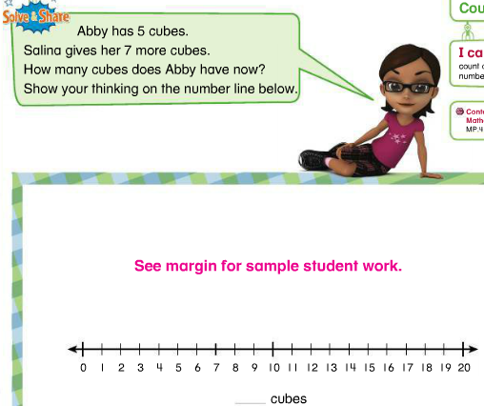
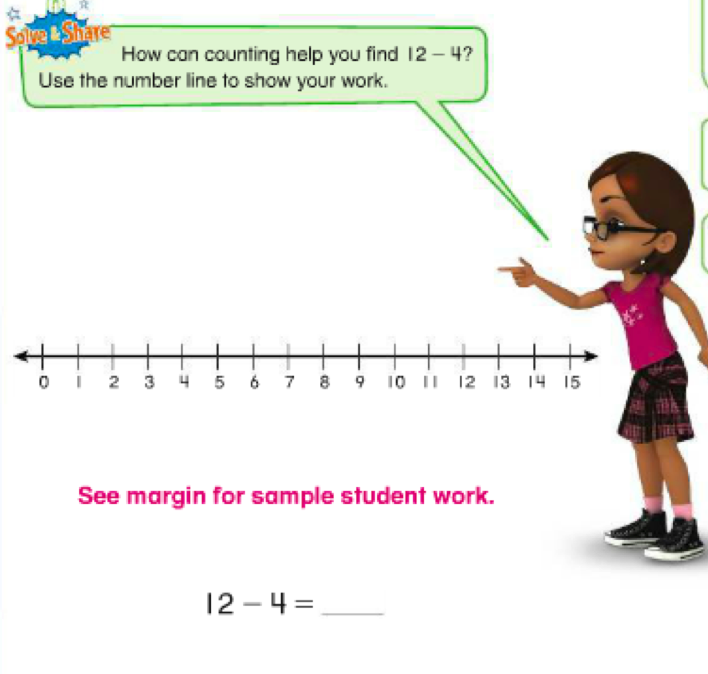
Grade 1 or 2? How sure are you?
Notes:
Big Idea: Illustrate that there is not always a clear distinction between grade-level expectations in enVisionmath 2.0.
Details:
Ask participants to read the tasks on the slide and determine which appears in grade 1 and which appears in grade 2.
Facilitate a short discussion on which problem is for which grade. The purpose of this illustration is to show that it is not clear that these problems belong in different grades, particularly when you look at the standards on the previous slide.
If the standards require different work in grade 1 and grade 2, why do these problems look so similar? It should not be difficult for us to figure out which task belongs in grade 1 versus grade 2,.
enVisionmath 2.0 does not drive quickly enough to the goal of fluency which becomes a barrier as students start adding and subtracting within 100. If the work of grade 1 is repeated in grade 2, teachers and students are not going to get to the other work of grade 2.
The guidance documents provide support for how to use enVisionmath 2.0 in ways that ensure students meet grade-level expectations
Note: Although the answer to the question is not the main purpose of the discussion, the problem on the left is grade 1 and the problem on the right is grade 2.

Slide 20
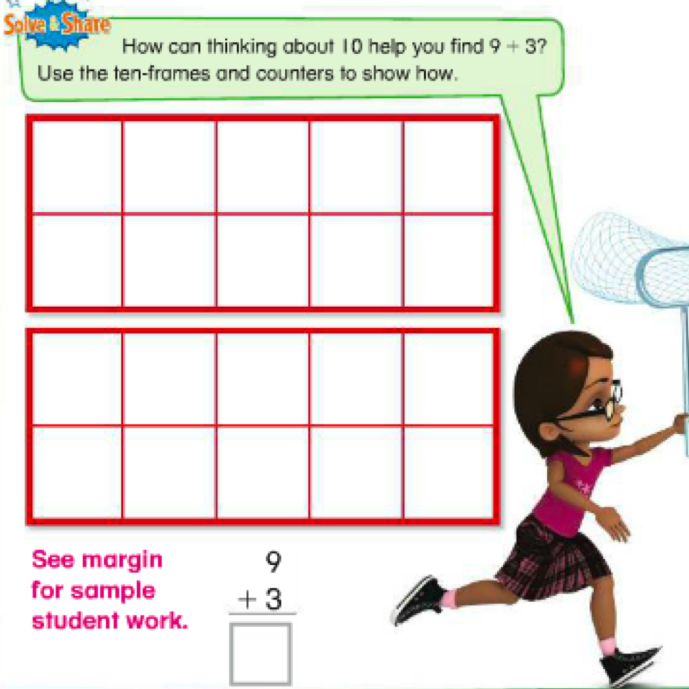
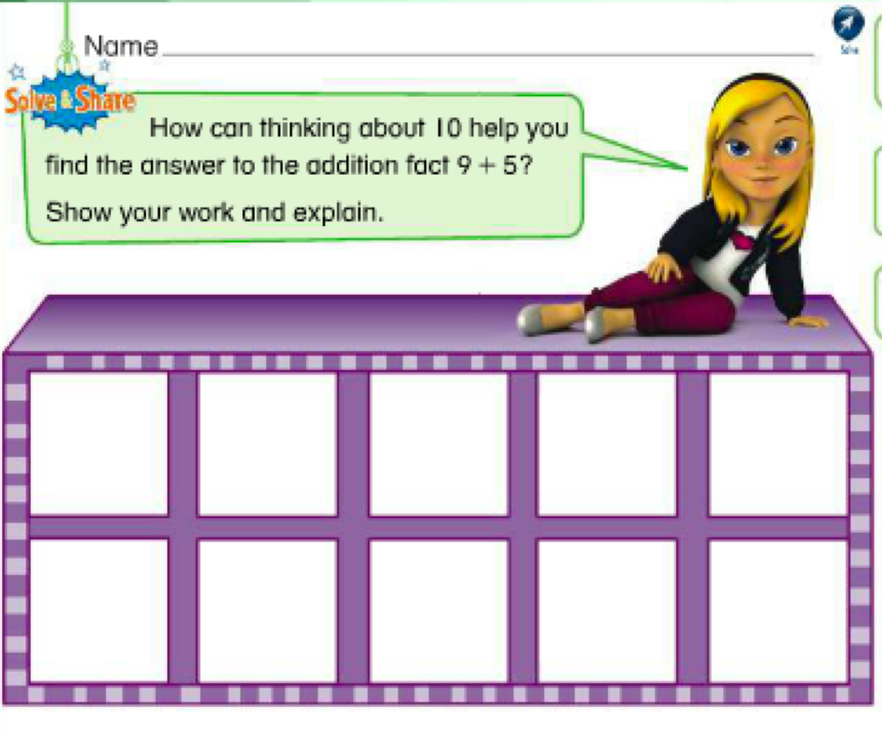
Grade 1 or 2? How sure are you?
Notes:
Big Idea: Illustrate that there is not always a clear distinction between grade-level expectations in enVisionmath 2.0.
Details:
Ask participants to read the tasks on the slide and determine which appears in grade 1 and which appears in grade 2.
Facilitate a short discussion on which problem is for which grade. The purpose of this illustration is to show that it is not clear that these problems belong in different grades, particularly when you look at the standards on the previous slide.
Using a 10 frame and making a 10 is the work of grade 1; supporting individual students in grade 2 the 10 frame is great, but students should be choosing from the strategies they have learned from grade 1 so that they can progress toward fluency.
The guidance documents provide support for how to use enVisionmath 2.0 in ways that ensure students meet grade-level expectations
Note: Although the answer to the question is not the main purpose of the discussion, the problem on the left is grade 2 and the problem on the right is grade 1.

Slide 21
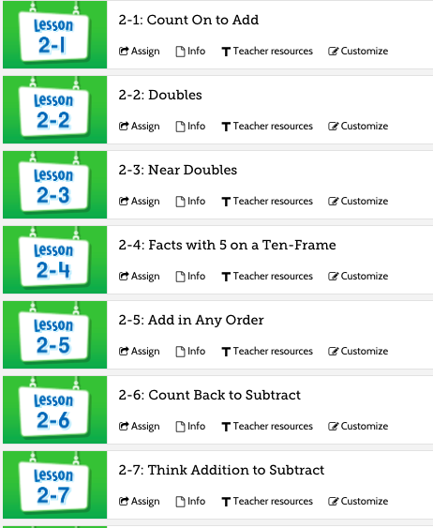
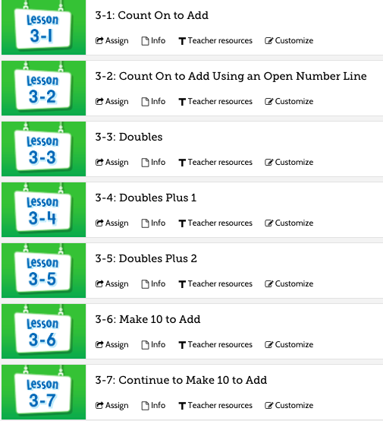
Grade 1 Strategies
Notes:
Big Idea: Compare the sequence of lessons addressing addition and subtraction fluency in enVisionmath2.0
Details:
The overlap of content is also seen at the Topic level.
This slide shows the lesson titles from Topic 2 (Fluently Add and Subtract within 10) and Topic 3 (Addition Facts to 20: Use Strategies) of Grade 1.
Although the Topic titles make clear the difference in expectations between within 10 and within 20, the strategies taught in each topic do not necessarily reflect that.
The program provides many different strategies for adding and subtracting within 10. When students progress to adding and subtracting within 20, the strategies are retaught. MP.8 asks students to make these generalizations on their own. When students progress to adding and subtracting within 20, students should be explaining how the strategy previously learned applies.
Additionally, we want to be focusing on the strategies that will generalize and continue to be useful to students. By deemphasizing the strategies that will lose their relevance, we make room for deeper study of the strategies and models that have longevity. In the case of addition and subtraction, making a 10 generalizes and continues to be useful.
Another issue we can see here comes from treating certain strategies as separate lessons. Many strategies themselves require fluencies that students might not yet have; “doubles plus 1” and “doubles plus 2” require that students are fluent with doubles. Are they fluent with doubles after just one lesson? If a student is not fluent with doubles, it’s a waste of their time to spend instructional time on doubles plus 1. Focusing on strategy

Slide 22
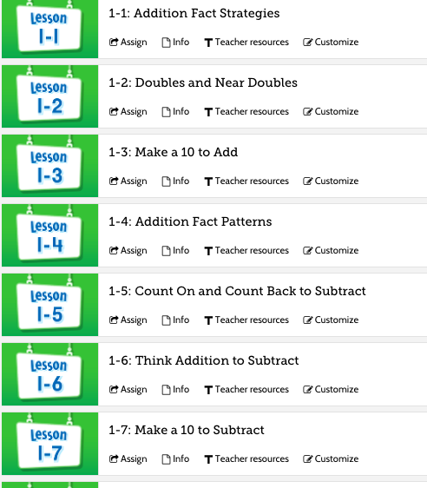
Grade 2 Strategies
Notes:
Big Idea: Compare the sequence of lessons addressing addition and subtraction fluency in enVisionmath2.0
Details:
Looking at some of the lessons in grade 2, we can now see why it was difficult to determine which problem belonged in which grade on the previous slides.
Many of the early lessons in grade 2 are focused on the same strategies that were just taught in grade 1. If we remember the language of the grade 2 standard, students should be progressing toward fluency much faster so that they can continue in the work of grade 2.

Slide 23
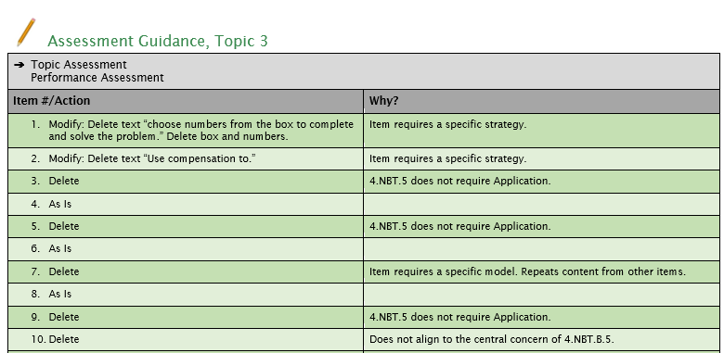
Topic Assessment Guidance
Notes:
Big Idea: Show an example of how Pro Tip #2 plays out in assessment
Details:
There is support for teachers in how to adapt the Topic assessments to align to Pro Tip #2.
The excerpt on the slide shows the assessment guidance for Topic 3 in grade 4.
You can see that questions #1 and #2 have suggested modifications to allow the question to provide data to the teacher about how a student understands and can use math.

Slide 24
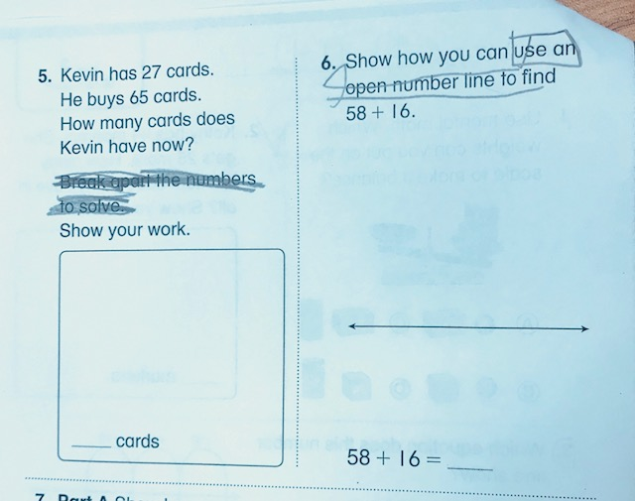
Notes:
Big Idea: Show an example of how a pilot teacher modified Topic Tests
Details:
This grade 2 Topic Test comes from a pilot classroom where the teacher had students cross out directions in order to align the items better to the expectations of the standards

Slide 25
Consider this grade 5 standard
5.NBT.B.6 Find whole-number quotients of whole numbers with up to four-digit dividends and two-digit divisors, using strategies based on place value, the properties of operations, and/or the relationship between multiplication and division. Illustrate and explain the calculation by using equations, rectangular arrays, and/or area models.
Notes:
Big Idea: Establish that 5.NBT.B.6 requires conceptual understanding related to procedural skill
Details:
This is an example of an upper elementary standard that requires students to develop conceptual understanding as they develop procedural skill.
Ask: What might you expect to see on a Topic Assessment for this standard?

Slide 26
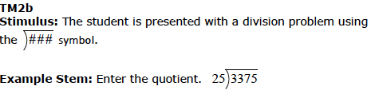
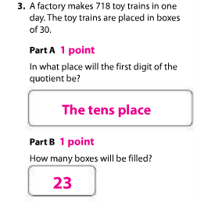

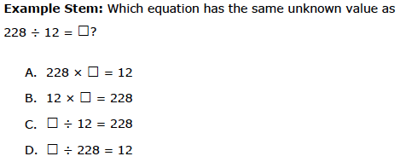
Aligning Items to Aspect of Rigor
enVisionmath 2.0
Smarter Balanced
Notes:
Big Idea: A Topic assessment question misaligned by Aspect of Rigor contrasted with items that provide examples aligning to 5.NBT.B.6 looks like
Details:
Here we see a procedural skill/fluency standard that requires a conceptual foundation, 5.NBT.B.6; however, the item on the left does not adequately target procedure skill. #3 asks students to use a specific strategy and #6 is an application problem.
The items on the right come from the test specifications for the Smarter Balanced Assessment Consortia. SBAC is widely recognized to be an assessment closely aligned to the Standards.
The items on the right are not in context, so they can assess student’s conceptual understanding and procedural skill.
Assessment guidance provides recommendations to ensure that items align to the aspect of rigor targeted by the standard.

Slide 27
Topic Guidance
Notes:
Big Idea: The next section will show the structure of the Topic Guidance section.
Note: Each Major Work Topic in grades K-5 is structured the same. Supporting Work Topics do not include all of the elements listed here.

Slide 28
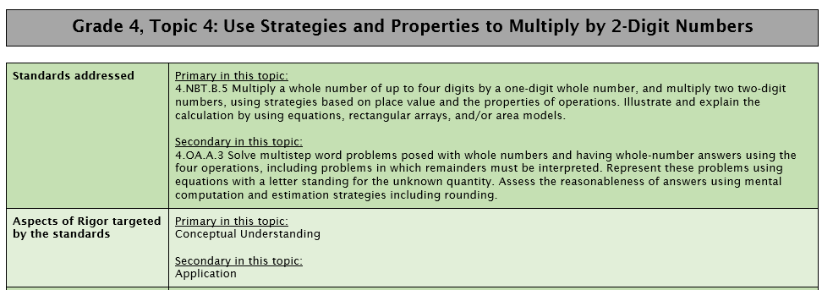
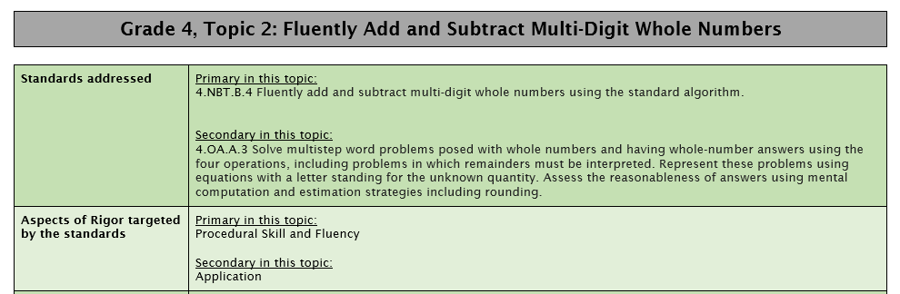
Standards Alignment and Aspects of Rigor
Notes:
Big Idea: Each Topic Guidance section begins by identifying the standards addressed and the targeted aspects of rigor for the Topic.
Details:
The “standards addressed” are the standards identified in the Topic Planner pages of enVisionmath 2.0. Classification into primary and secondary is based on the content of individual lessons and how the standard is addressed over the course of the year. (e.g., 4.NBT.B.5 is identified as a Primary standard in Topic 4 because this is the Topic in which it is fully addressed. 4.OA.A.3 is identified as Secondary here because it is revisited in later Topics.)
The “aspects of rigor targeted by the standards” details the Aspect(s) of Rigor targeted by the standards identified for this topic in enVisionmath 2.0. In this Topic, students will be working with Application problems but the main focus of the work should be on the conceptual understanding and procedural skill required by 4.NBT.B.4.

Slide 29
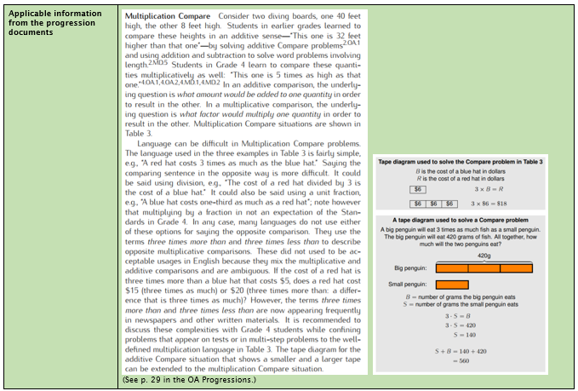
The Progressions
Notes:
Big Idea: Each Topic Guidance section includes excerpts form the Progression Documents
Details:
This information is specific to the work of the Topic and can be very useful in planning for the Topic.
All progression documents can be found at: http://ime.math.arizona.edu/progressions/

Slide 30
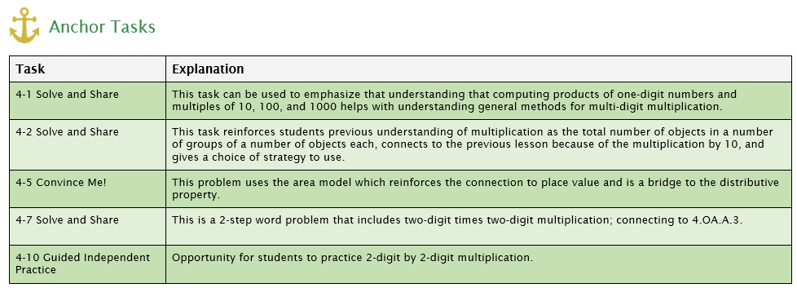
Essential Questions and Anchor Tasks
Notes:
Big Idea: Each Major Work Topic Guidance section includes an essential question and Anchor Tasks
Details:
The Essential Question(s) identify big ideas that unite the work of the Topic.
Anchor Tasks identify elements of enVisionmath 2.0 that have the strongest connections to the expectations of the identified standards and Essential Question(s) for the Topic. The order of the tasks corresponds to the recommended instructional sequence.
Anchor Tasks are worthy of extended instructional time. Occasionally, supplementary tasks or lessons are included to meet the full intent of the identified standards.
The explanation shares the rationale for highlighting the Anchor Task and its place in the sequence.

Slide 31
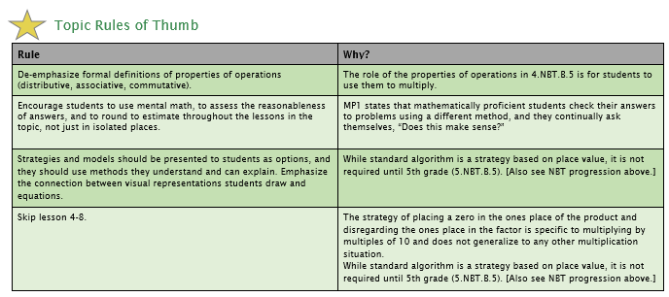
Topic Rules of Thumb
Notes:
Big Idea: Each Major Work Topic Guidance section includes Topic-specific Rules of Thumb
Details:
Topic Rules of Thumb suggest instructional choices designed to better align all of the work of the Topic to the expectations of the Standards. Each Rule of Thumb has a rationale that is based on the Standards and/or the Progression documents.

Slide 32
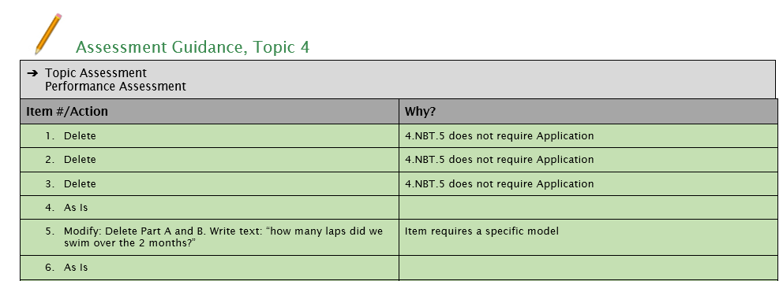
Topic Assessment Guidance
Notes:
Big Idea: Each Topic Guidance section includes guidance for modifying the Topic Assessment.
Details:
Corresponding changes to the Topic Assessment are recommended based on the guidance above. The Topic or Performance Assessment is identified as the more aligned assessment choice.
For each assessment item, an action is recommended in order to improve alignment. Many times, this consists of removing a specific model or strategy and just assessing students’ understanding of the mathematical concept, procedure or application. Some items are recommended to use “as is,” and it is recommended that some items are skipped.

Slide 33
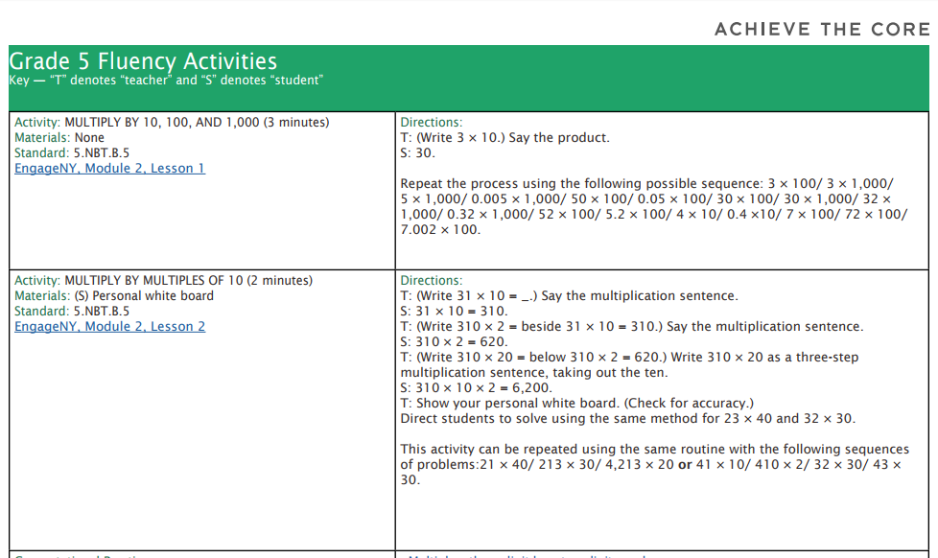
Fluency Resources
Notes:
Big Idea: Introduce the Fluency Guides as a resources for supplementing enVisionmath 2.0.
Details:
Although, some activities in enVisionmath 2.0 align to fluency expectations but most students will need more support to reach grade-level fluency expectations.
Each ‘Getting Started Guide’ has a link to grade-level specific fluency guidance resources can be used as a companion to the enVisionmath 2.0 program.

Slide 34
Implications for your Work
Notes:
Big Idea: Give participants an opportunity to reflect on how the guidance documents can impact their work

Slide 35
Using the guidance documents to plan
Read the standards and progression excerpt.
Discuss anything that is new information or stands out to you.
Solve Anchor Tasks as your students might.
Notes:
Big Idea: Provide time and a protocol for participants to dive into the documents for a Topic they will be teaching soon.

Slide 36
Using the guidance documents to plan
Plan out your Topic. Some things to think about:
Which anchor tasks/lessons may need more than one day?
Which lessons should be skipped or combined?
Read the Topic Rules of Thumb. With post-its, put notes in your teacher’s guide of when and how you will apply the Rules of Thumb.
Notes:
Big Idea: Provide time and a protocol for participants to dive into the documents for a Topic they will be teaching soon.

Slide 37
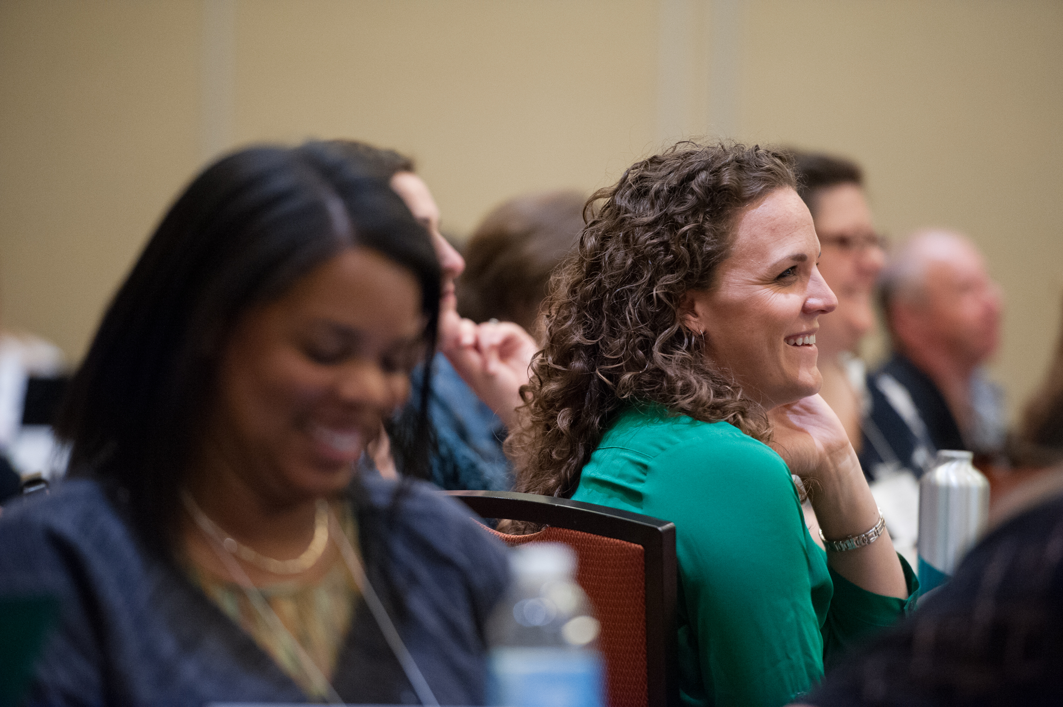
The Core Advocate Network
Who are the Core Advocates?
Core Advocates are educators who:
Believe in the potential of high-quality standards grounded in evidence to prepare all students for college and career.
Understand and embrace the Shifts in instruction and assessment required by college- and career-ready standards.
Are eager to support their colleagues and communities in understanding and translating the Shifts into instructional practice.
What do Core Advocates do?
As instructional advocates, Core Advocates lead other educators in their communities in understanding the Shifts, as well as sharing practices aligned to the Shifts and the standards. Among other actions, Core Advocates:
Lead professional development sessions and professional learning communities.
Create, refine, and share standards-aligned resources with the field.
Advocate for high-quality instruction, instructional resources, and professional learning.
Use and provide feedback on high-quality instructional tools and resources.
How can I get involved?
Join the Core Advocate Network by taking the Core Advocate survey at: www.achievethecore.org/ca-signup
Email coreadvocates@studentsachieve.net with any questions.

Slide 38
Thank You!

