Slide 1
Don't Make Every Math Strategy a Separate Lesson: Developing Understanding and Skill with K-4 Operations
Core Advocates Monthly Webinar
August 8, 2018
The webinar will begin shortly. You may wish to download the handouts (check the tab on your webinar control panel) while you wait.
Notes:
First timer poll
Handouts:
While we’re waiting, we’d like you to participate in a quick poll so we can get an understanding of who’s on the webinar with us tonight.

Slide 2
Introductions
Your hosts from the Professional Learning Team
Jennie Beltramini, Math Specialist
Tori Filler, Literacy Specialist
Nicole Bravo, Project Manager
This Month’s Presenters
Marni Greenstein, Senior Math Specialist
Myuriel von Aspen, Core Advocate

Slide 3
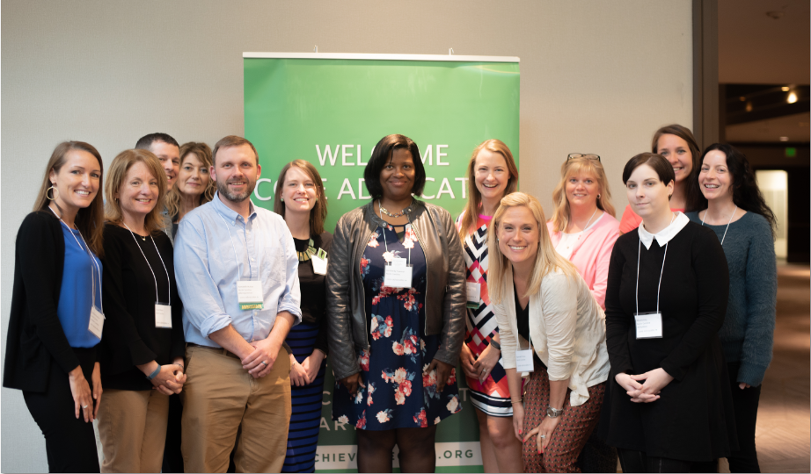
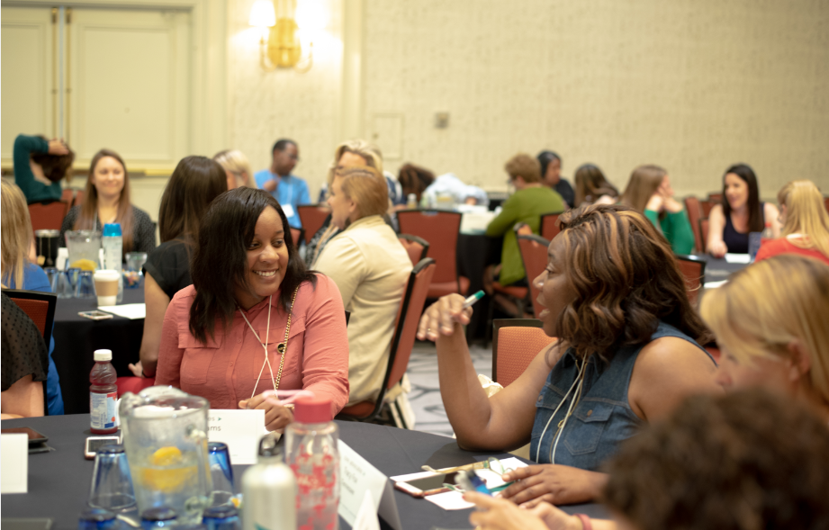
Who Are Core Advocates?
Core Advocates believe in the power of standards to prepare all students for college and/or careers.
They are eager to support and collaborate with their colleagues and communities in understanding and translating the Shifts into instructional practice.
Core Advocates have the tools and knowledge to advocate for high-quality instruction, instructional resources, and professional learning in their communities.
Notes:
CAs are teachers from all over the country who believe in the potential of high quality standards and the importance of all students being prepared for college and careers.
They support their colleagues in understanding and advocating for the standards and embrace the Shifts in instruction
The Core Advocate network is over 10K educator strong and we’d love for you to join us if you have not already

Slide 4
Learn more about us!
Contact Jennie Beltramini (jbeltramini@studentsachieve.net )
Complete this survey to join our database (and mailing list): www.achievethecore.org/ca-signup
Visit our website: www.achievethecore.org
Notes:
If you’d like to learn more about the network, contact Jennie (her email is here).
We also want to invite you to join the network by signing up at achievethecore.org/ca-signup and visit our website for more info and opportunities

Slide 5
Tweet with us!
Please feel free to tweet during and after the webinar using #coreadvocates
@achievethecore
@JennieBeltro
@math_marni
@myurielvonaspen

Slide 6
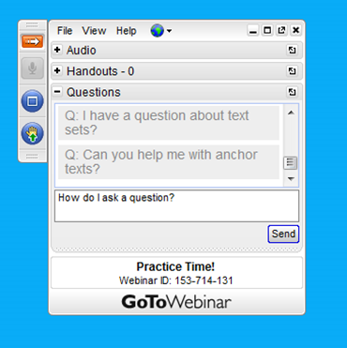
Engage with Us!
During the webinar
– Accessing Documents
– Questions option
– Polling
After the webinar
– Survey
– Access to recorded webinar

Slide 7
Goals of the Webinar
Understand the relationship between conceptual understanding, procedural skill, fluency, and “know from memory”.
Analyze the grades K through 2 progression that ends with fluently adding and subtracting within 20.
Analyze the grades 1 through 4 progression that ends with fluently adding and subtracting multi-digit whole numbers using the standard algorithm.
Notes:
We have three main goals for our webinar tonight. They are to...

Slide 8
Section 1: What is the the relationship between conceptual understanding, procedural skill, fluency, and “know from memory”?

Slide 9
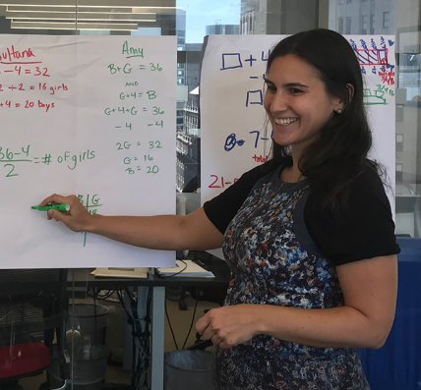
Marni Greenstein
Senior Mathematics Specialist
Student Achievement Partners
Notes:
Janelle

Slide 10
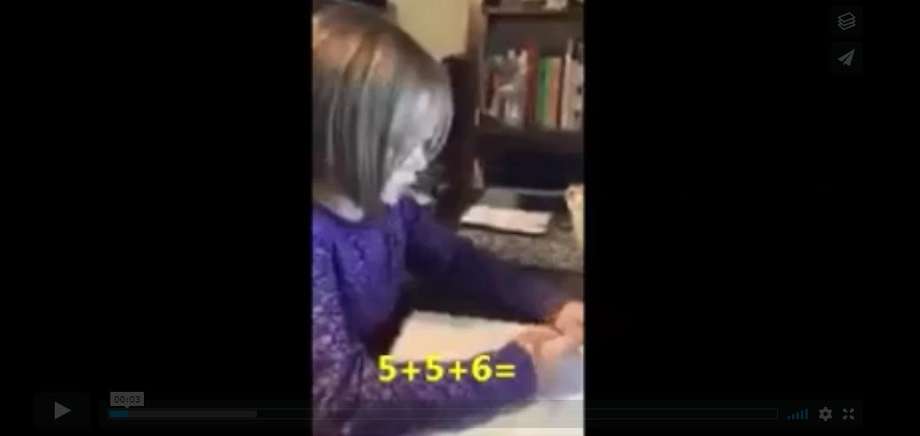
Click here to view the video.
Notes:
We’re going to start with a student working within the K-3 progression to frame our discussion today. This grade 1 student is working on a series of related addition problems within 20.
Ask: What strategies is this student using to add numbers within 20? What does she know? What might she still need to work on?.

Slide 11
Who Learns What When?

Slide 12
A Careful Progression to Addition Fluency
 | Within 5 | Within 10 | Within 20 | Within 100 | Within 1,000 | Within 1,000,000
Grade K
Grade 1
Grade 2
Grade 3
Grade 4
Notes:
The shaded circles represent the fluency expectations for addition and subtraction at each grade. The half-shaded circles indicate where students are developing conceptual understanding to build to the fluency expectations.
It is striking the amount of work that happens in grades 1 and 2 with a good deal of fluency and procedural skill expectations built into grade 2. The work in grade 3 is less as students are developing understanding and fluency with multiplication and division. This heavy emphasis in grade 1 and 2 should be reflected in the way time and energy are spent in classrooms.
One challenge for teachers of a single grade, is the ability to understand their specific grade-level expectations in the context of the whole progression. It is helpful to share this progression so that teachers can understand what’s most important at their grade-level and how to set kids up for later work.

Slide 13
Procedural Skill and Fluency
Procedural Skill and Fluency Standards
Fluency Standards
Know from Memory Standards
Notes:
The terms procedural skill and fluency get thrown around (and debated) a lot. The language of the standards is very specific about where fluency is required and only specify in two standards that students need to know facts from memory. (2.OA.B.2 and 3.OA.C.7).
If you do a Ctrl-F of the standards you will find 10 instances of the word “fluently” in the K-7 standards.
These 12 standards make up a sub-set of the expectations for procedural skill but are key components to make sure students develop the procedural skills required.

Slide 14
Which diagram resonates with you? Why?
Please use the Questions tab on your control panel to respond.
#1
Conceptual Understanding
Procedural Skill
Conceptual Understanding
Procedural Skill
#2
Procedural Skill
Conceptual Understanding

Slide 15
Section 2: How do kindergarten through grade 2 students progress to fluency with addition and subtraction within 20 by the end of second grade?

Slide 16
A Careful Progression to Fluency
 | Within 5 | Within 10 | Within 20 | Within 100 | Within 1,000 | Within 1,000,000
Grade K
Grade 1
Grade 2
Grade 3
Grade 4

Slide 17
Consider these two standards: how do they indicate progression?
1.OA.C Add and subtract within 20.
6. Add and subtract within 20, demonstrating fluency for addition and subtraction within 10. Use strategies such as counting on; making ten (e.g., 8 + 6 = 8 + 2 + 4 = 10 + 4 = 14); decomposing a number leading to a ten (e.g., 13 – 4 = 13 – 3 – 1 = 10 – 1= 9); using the relationship between addition and subtraction (e.g., knowing that 8 + 4 = 12, one knows 12 – 8 = 4); and creating equivalent but easier or known sums (e.g., adding 6 + 7 by creating the known equivalent 6 + 6 + 1 = 12 + 1 = 13).
2.OA.B Add and subtract within 20.
2. Fluently add and subtract within 20 using mental strategies. By end of Grade 2, know from memory all sums of two one-digit numbers.
Notes:
Give participants time to talk about this in partners.
Although the clusters say the same thing, there’s a difference in expectations between grade 1 and 2. Fluency within 20 needs to happen early on in grade 2 in order to make sure students are able to do the NBT work.

Slide 18
From the CC/OA Progression
Fluency in each grade involves a mixture of just knowing some answers, knowing some answers from patterns (e.g., “adding 0 yields the same number”), and knowing some answers from the use of strategies. It is important to push sensitively and encouragingly toward fluency of the designated numbers at each grade level, recognizing that fluency will be a mixture of these kinds of thinking which may differ across students.

Slide 19
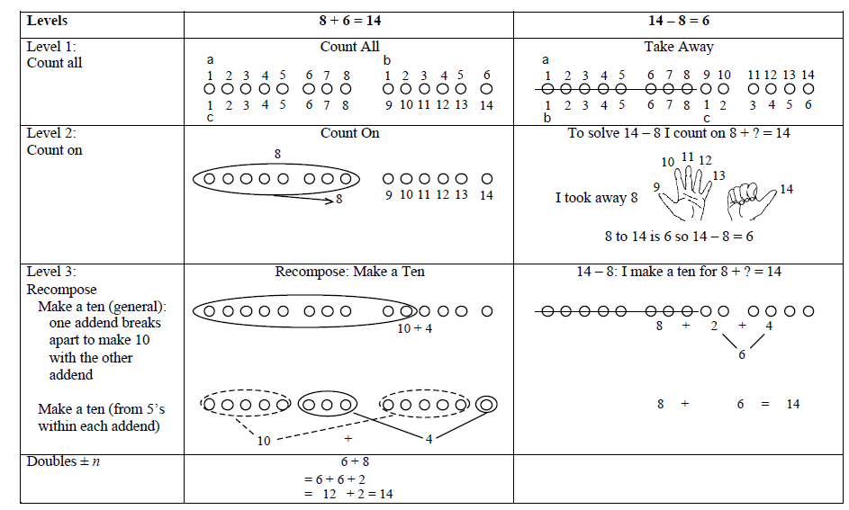

Slide 20
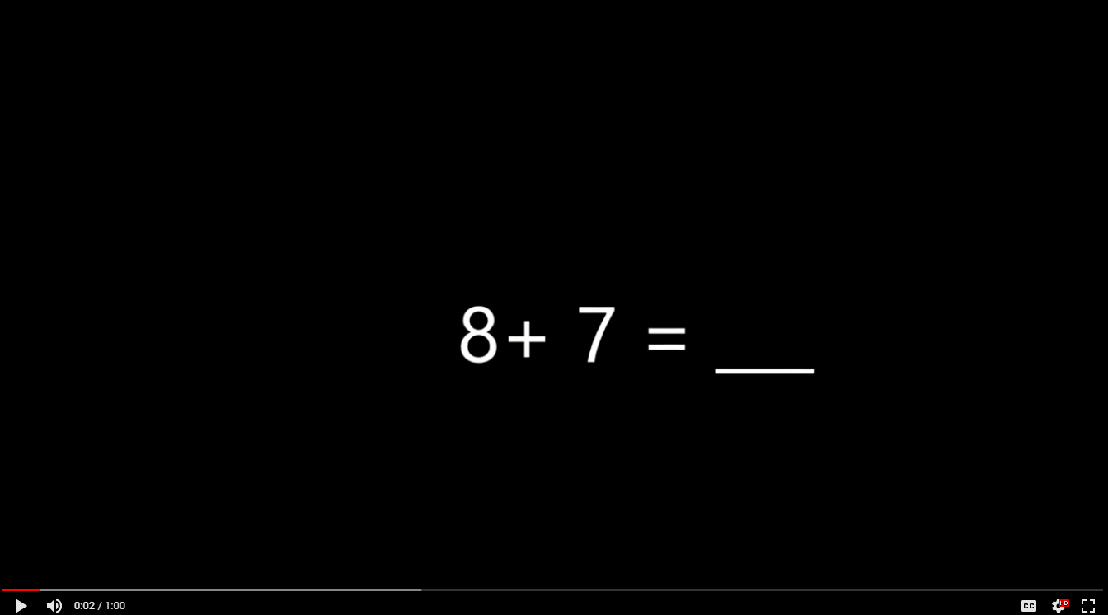
Does the student know each fact from memory?
Does he use a level 1, 2 or 3 strategy?
Click here to view the video.

Slide 21
 | Know from memory? | If not, what strategy did the student use? Level 1: Counting All Level 2: Counting On Level 3: Recompose
8 + 7 = ___ | Yes No | Seems like he counted on using his fingers (Level 2)
5 + 2 = ___ | Yes No
3 + 5 = ___ | Yes No | Seems like he used the commutative property and then counted on (Level 2)
4 + 10 = ___ | Yes No

Slide 22
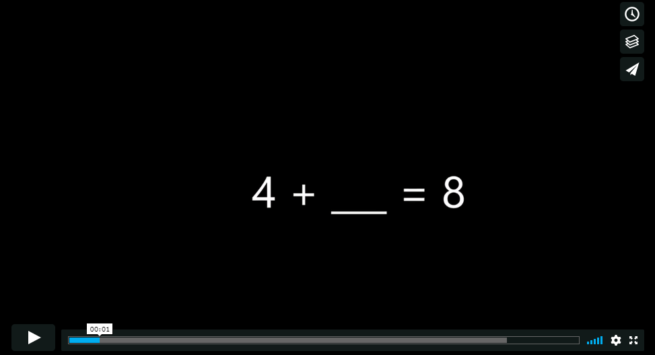
Does the student know each fact from memory?
Does he use a level 1, 2 or 3 strategy?
Click here to view the video.

Slide 23
 | Know from memory? | If not, what strategy did the student use? Level 1: Counting All Level 2: Counting On Level 3: Recompose
4 + ___= 8 | Yes No | Knows 4+4 = 8 from memory. Using the relationship between addition and subtraction
___ + 5 = 9 | Yes No | Unclear whether he knows 5+4 = 9 from memory or is using 4+4=8 and adjusting (Level 3)

Slide 24
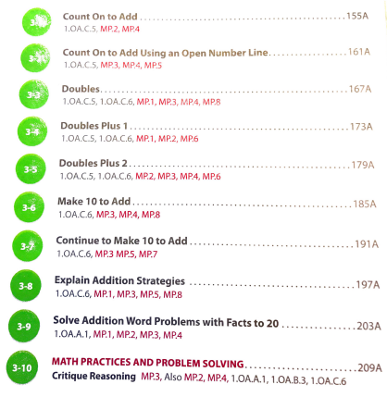
1st grade - Chapter 3

Slide 25
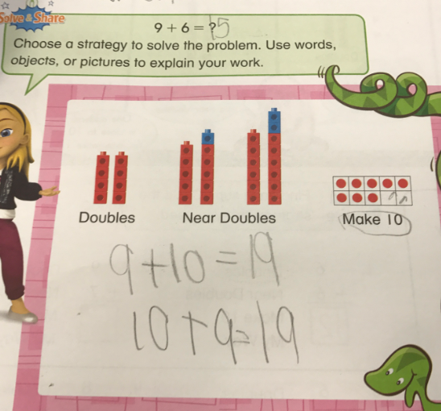
Notes:
As kids are moving towards fluency, we need to think about the type of tasks we are giving them and how that’s impacting their ability to develop fluency. Many textbooks mandate a different specific strategy in each lesson rather than allowing kids to use the strategy that makes sense to them and builds on what they know.
You can see in this example that the students wrote in a 15 at the top. Although we don’t know what Level strategy they used, the rest of the page doesn’t help give us any more information than that. The student wasn’t sure what to do with the strategies listed and seemed to pick one and then write related equations.

Slide 26
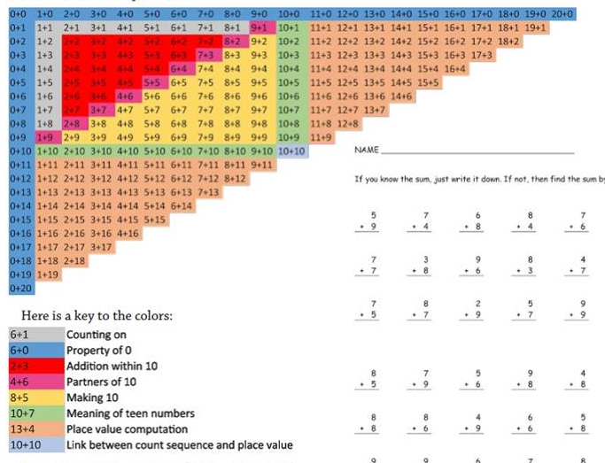
https://tinyurl.com/JZAdditionTable

Slide 27
Section 3: How do grades 1 through 4 students progress to fluency with adding and subtracting multi-digit whole numbers using the standard algorithm?
Notes:
Janelle

Slide 28
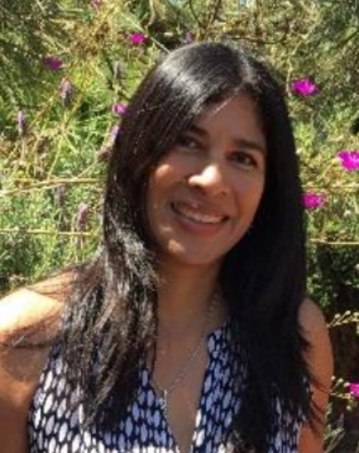
Myuriel von Aspen
Instructional Coach
Lake Forest, CA
Notes:
Janelle

Slide 29
A Careful Progression to Fluency
 | Within 5 | Within 10 | Within 20 | Within 100 | Within 1,000 | Within 1,000,000
Grade K
Grade 1
Grade 2
Grade 3
Grade 4

Slide 30
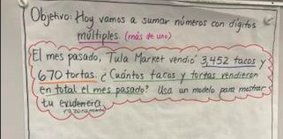
Where Are We Headed?
Notes:
This frames where students are going by the time they get to grade 4. The standards outline a very deliberate progression in grades K-3 that prepares students for multi-digit addition (and subtraction) in grade 4. A lot of the work really lives in grade 1 and 2 in both the OA and NBT domains. Today’s session is a trip through the progressions.
This comes from a Core Advocate and dual language immersion teacher and coach in Orange County.

Slide 32
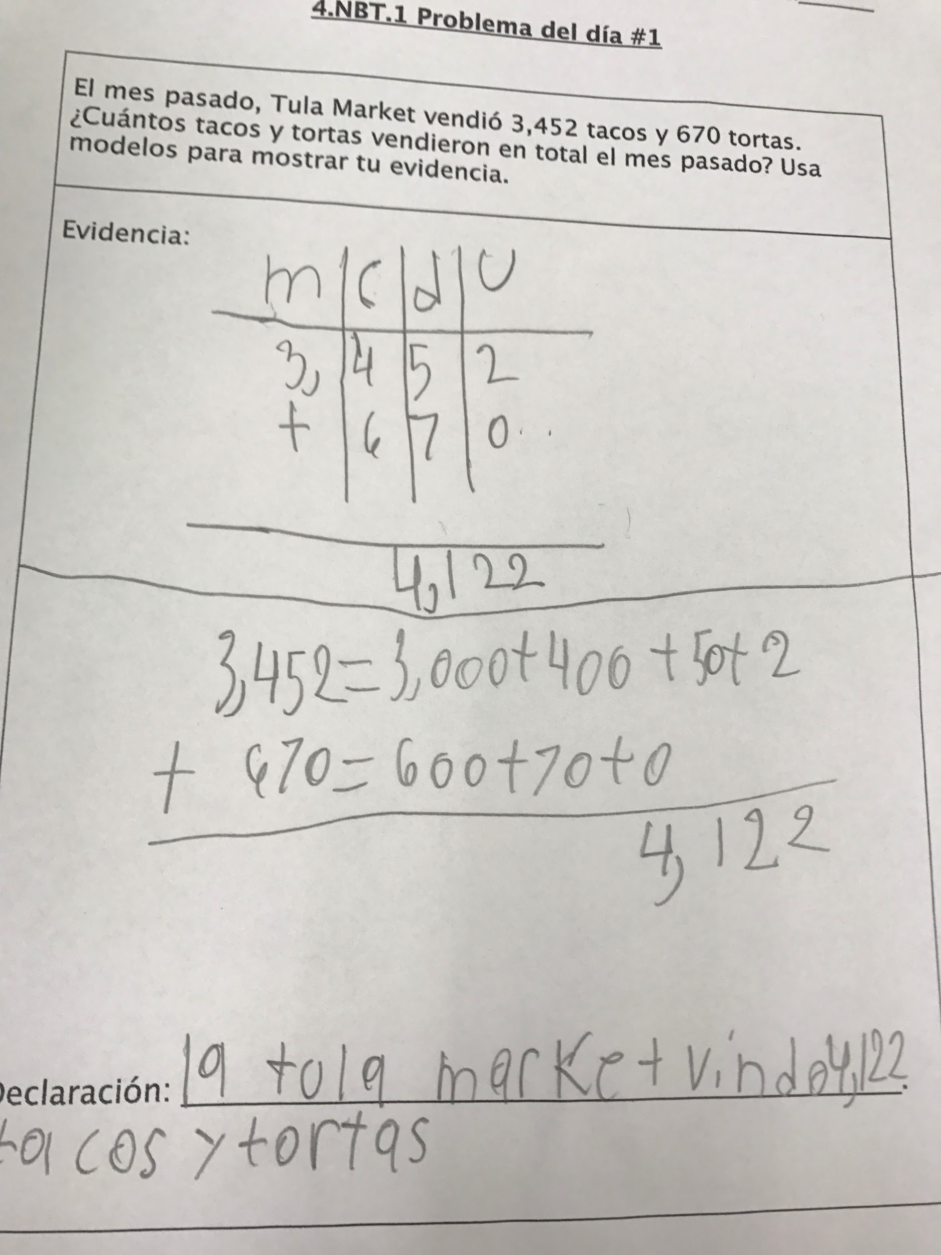
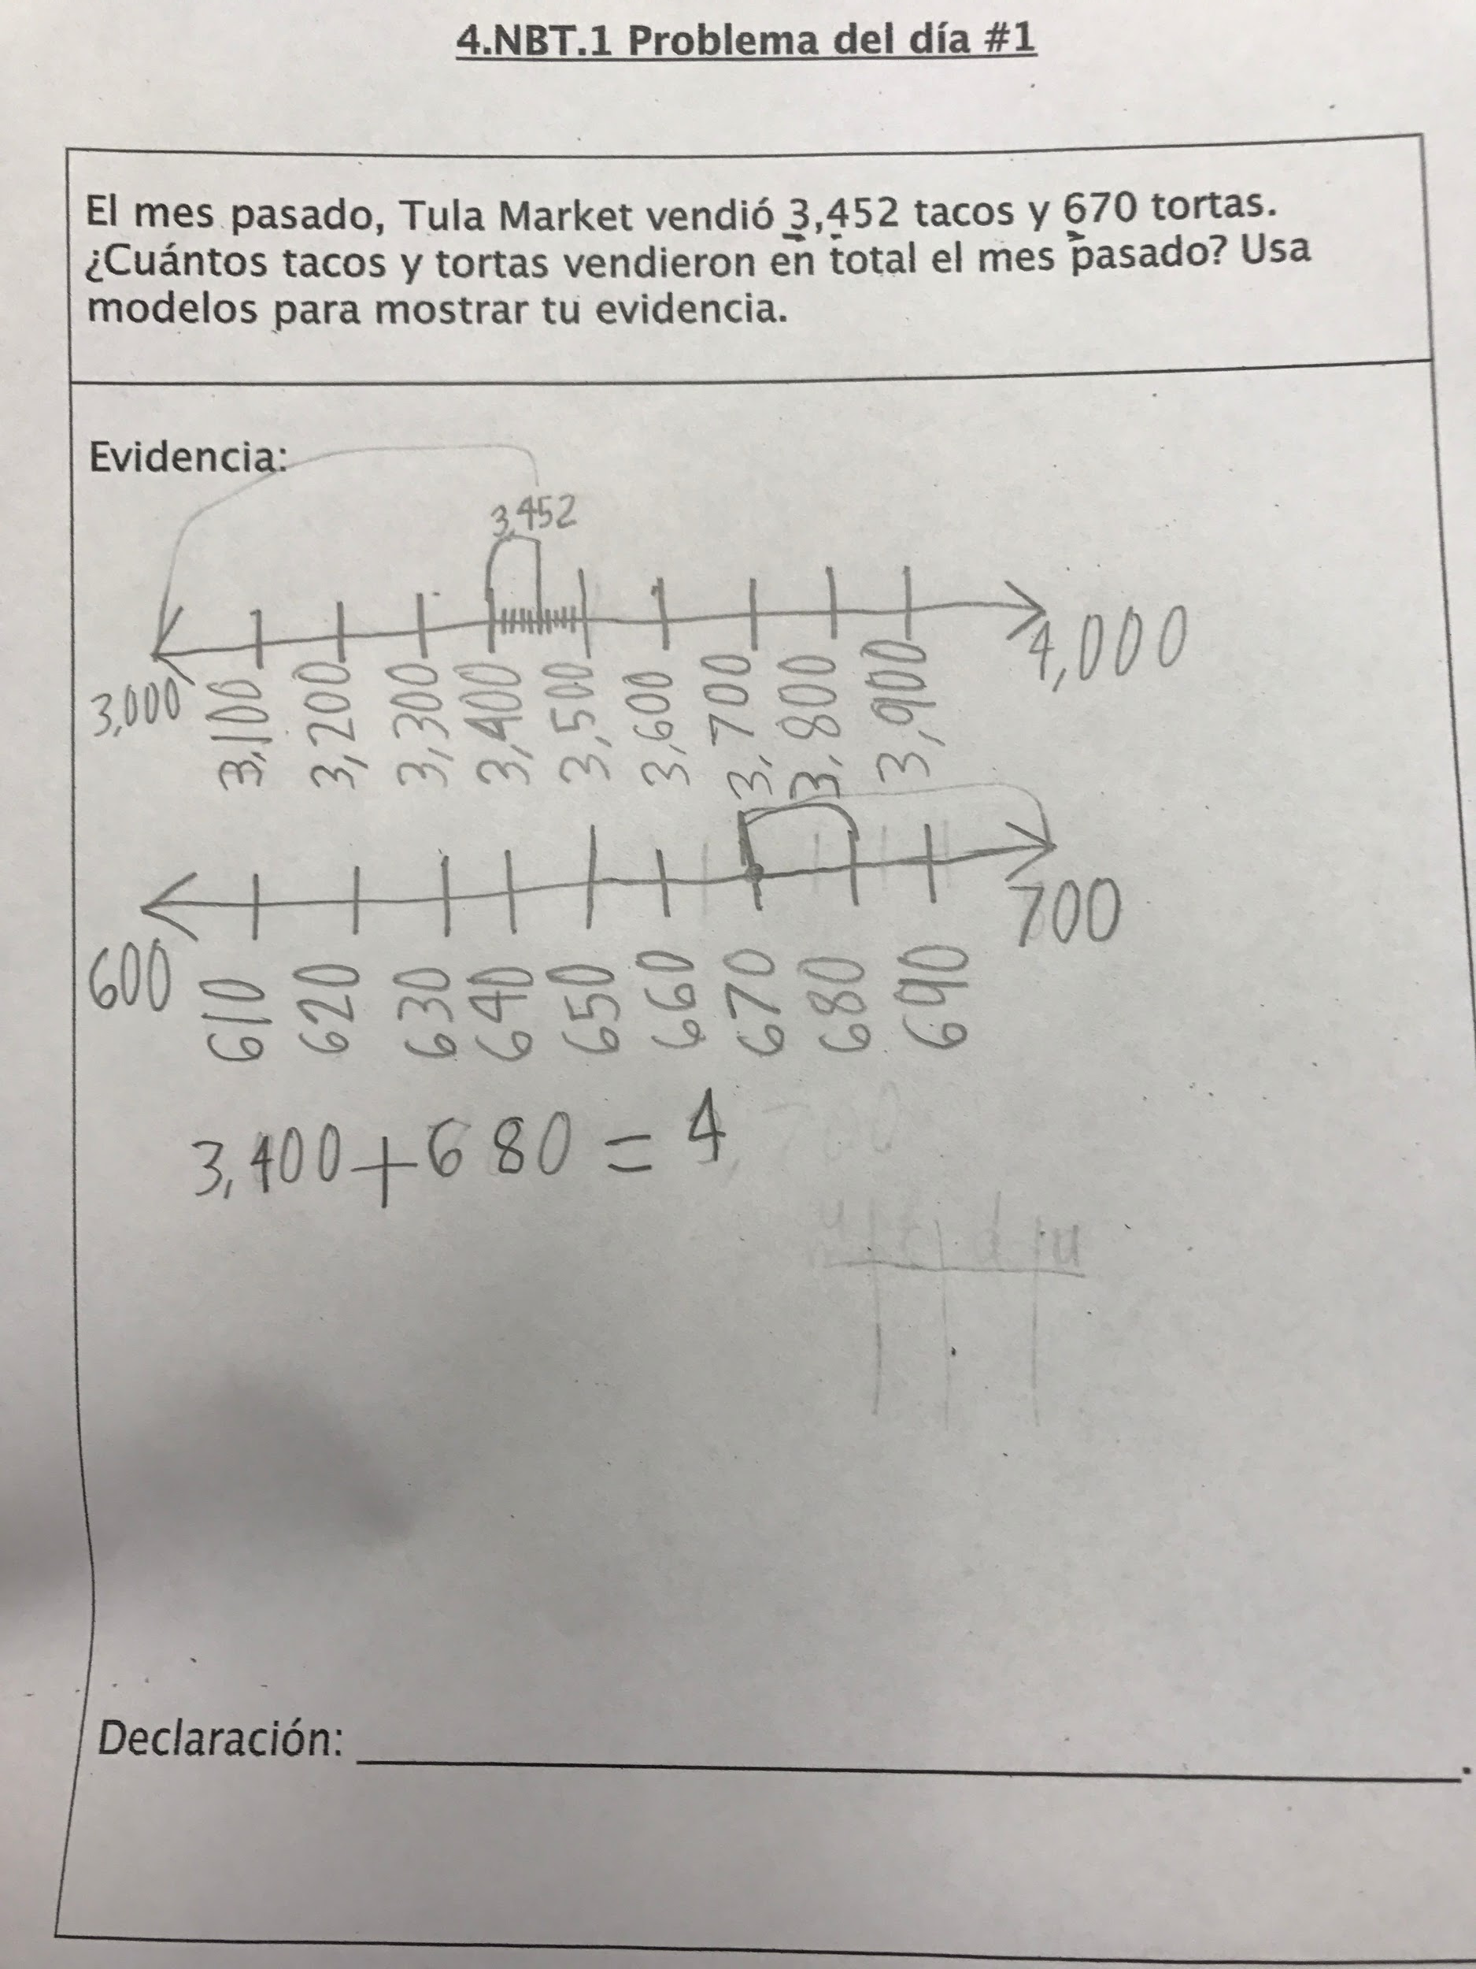
Bernard
Jacob

Slide 33
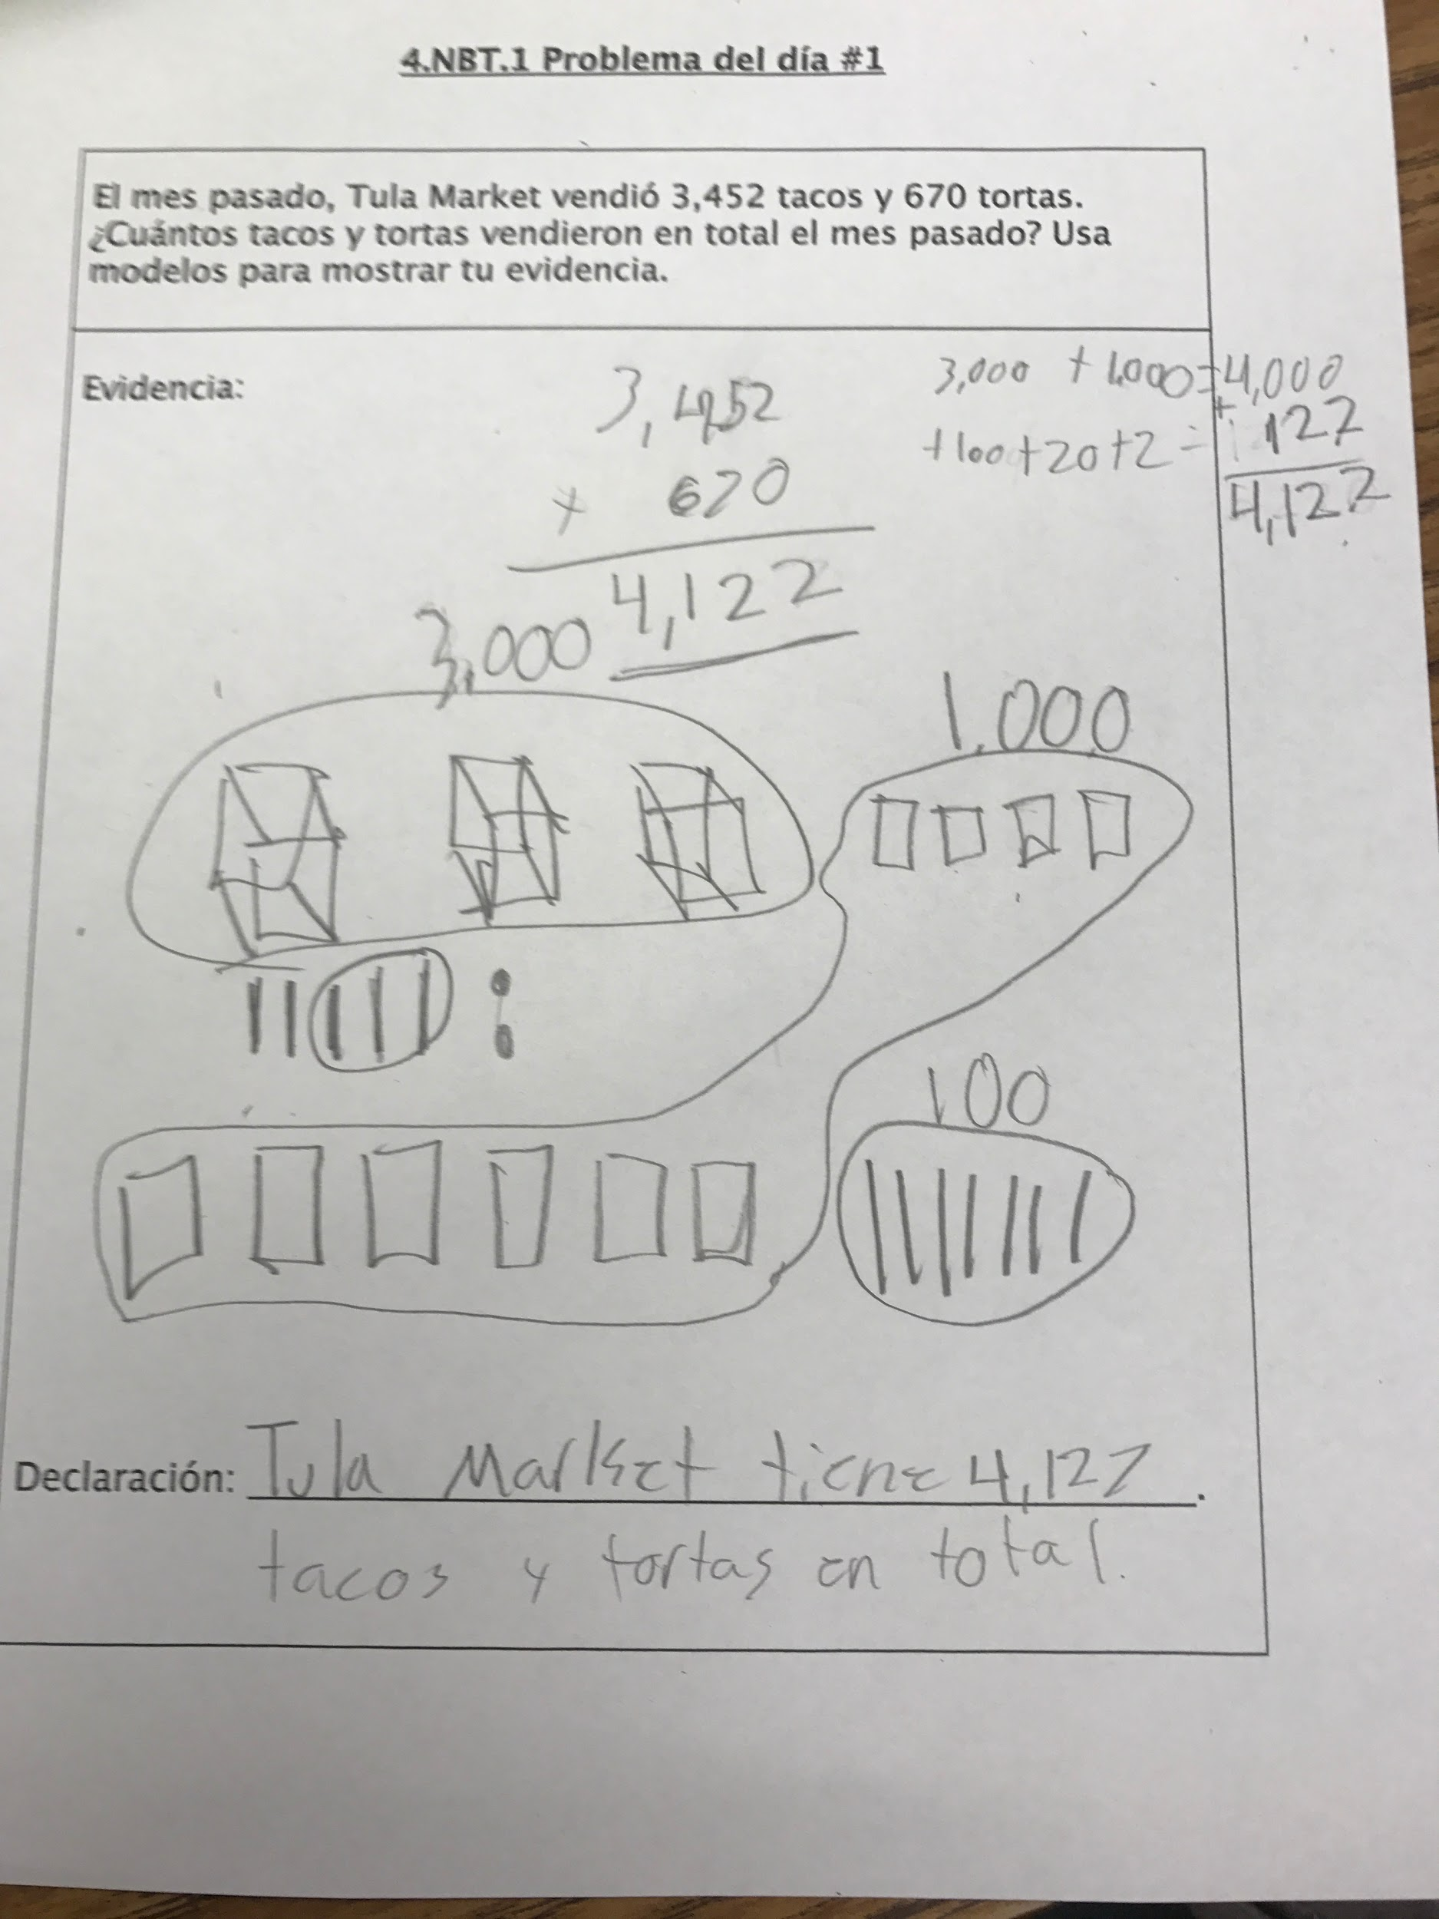
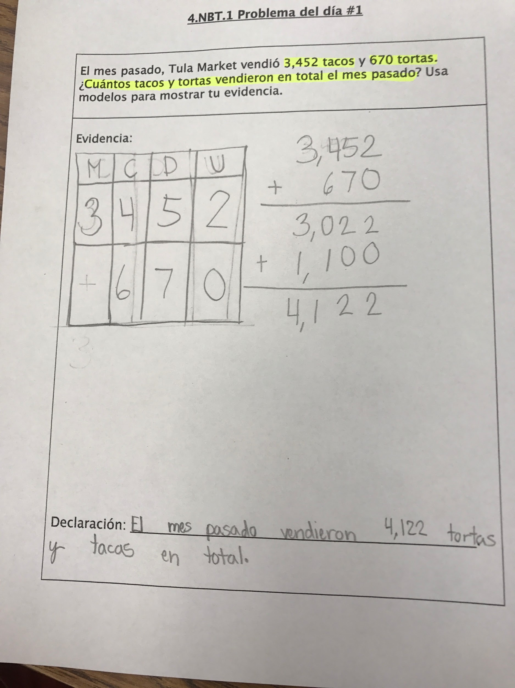
Lillian
Jake

Slide 34
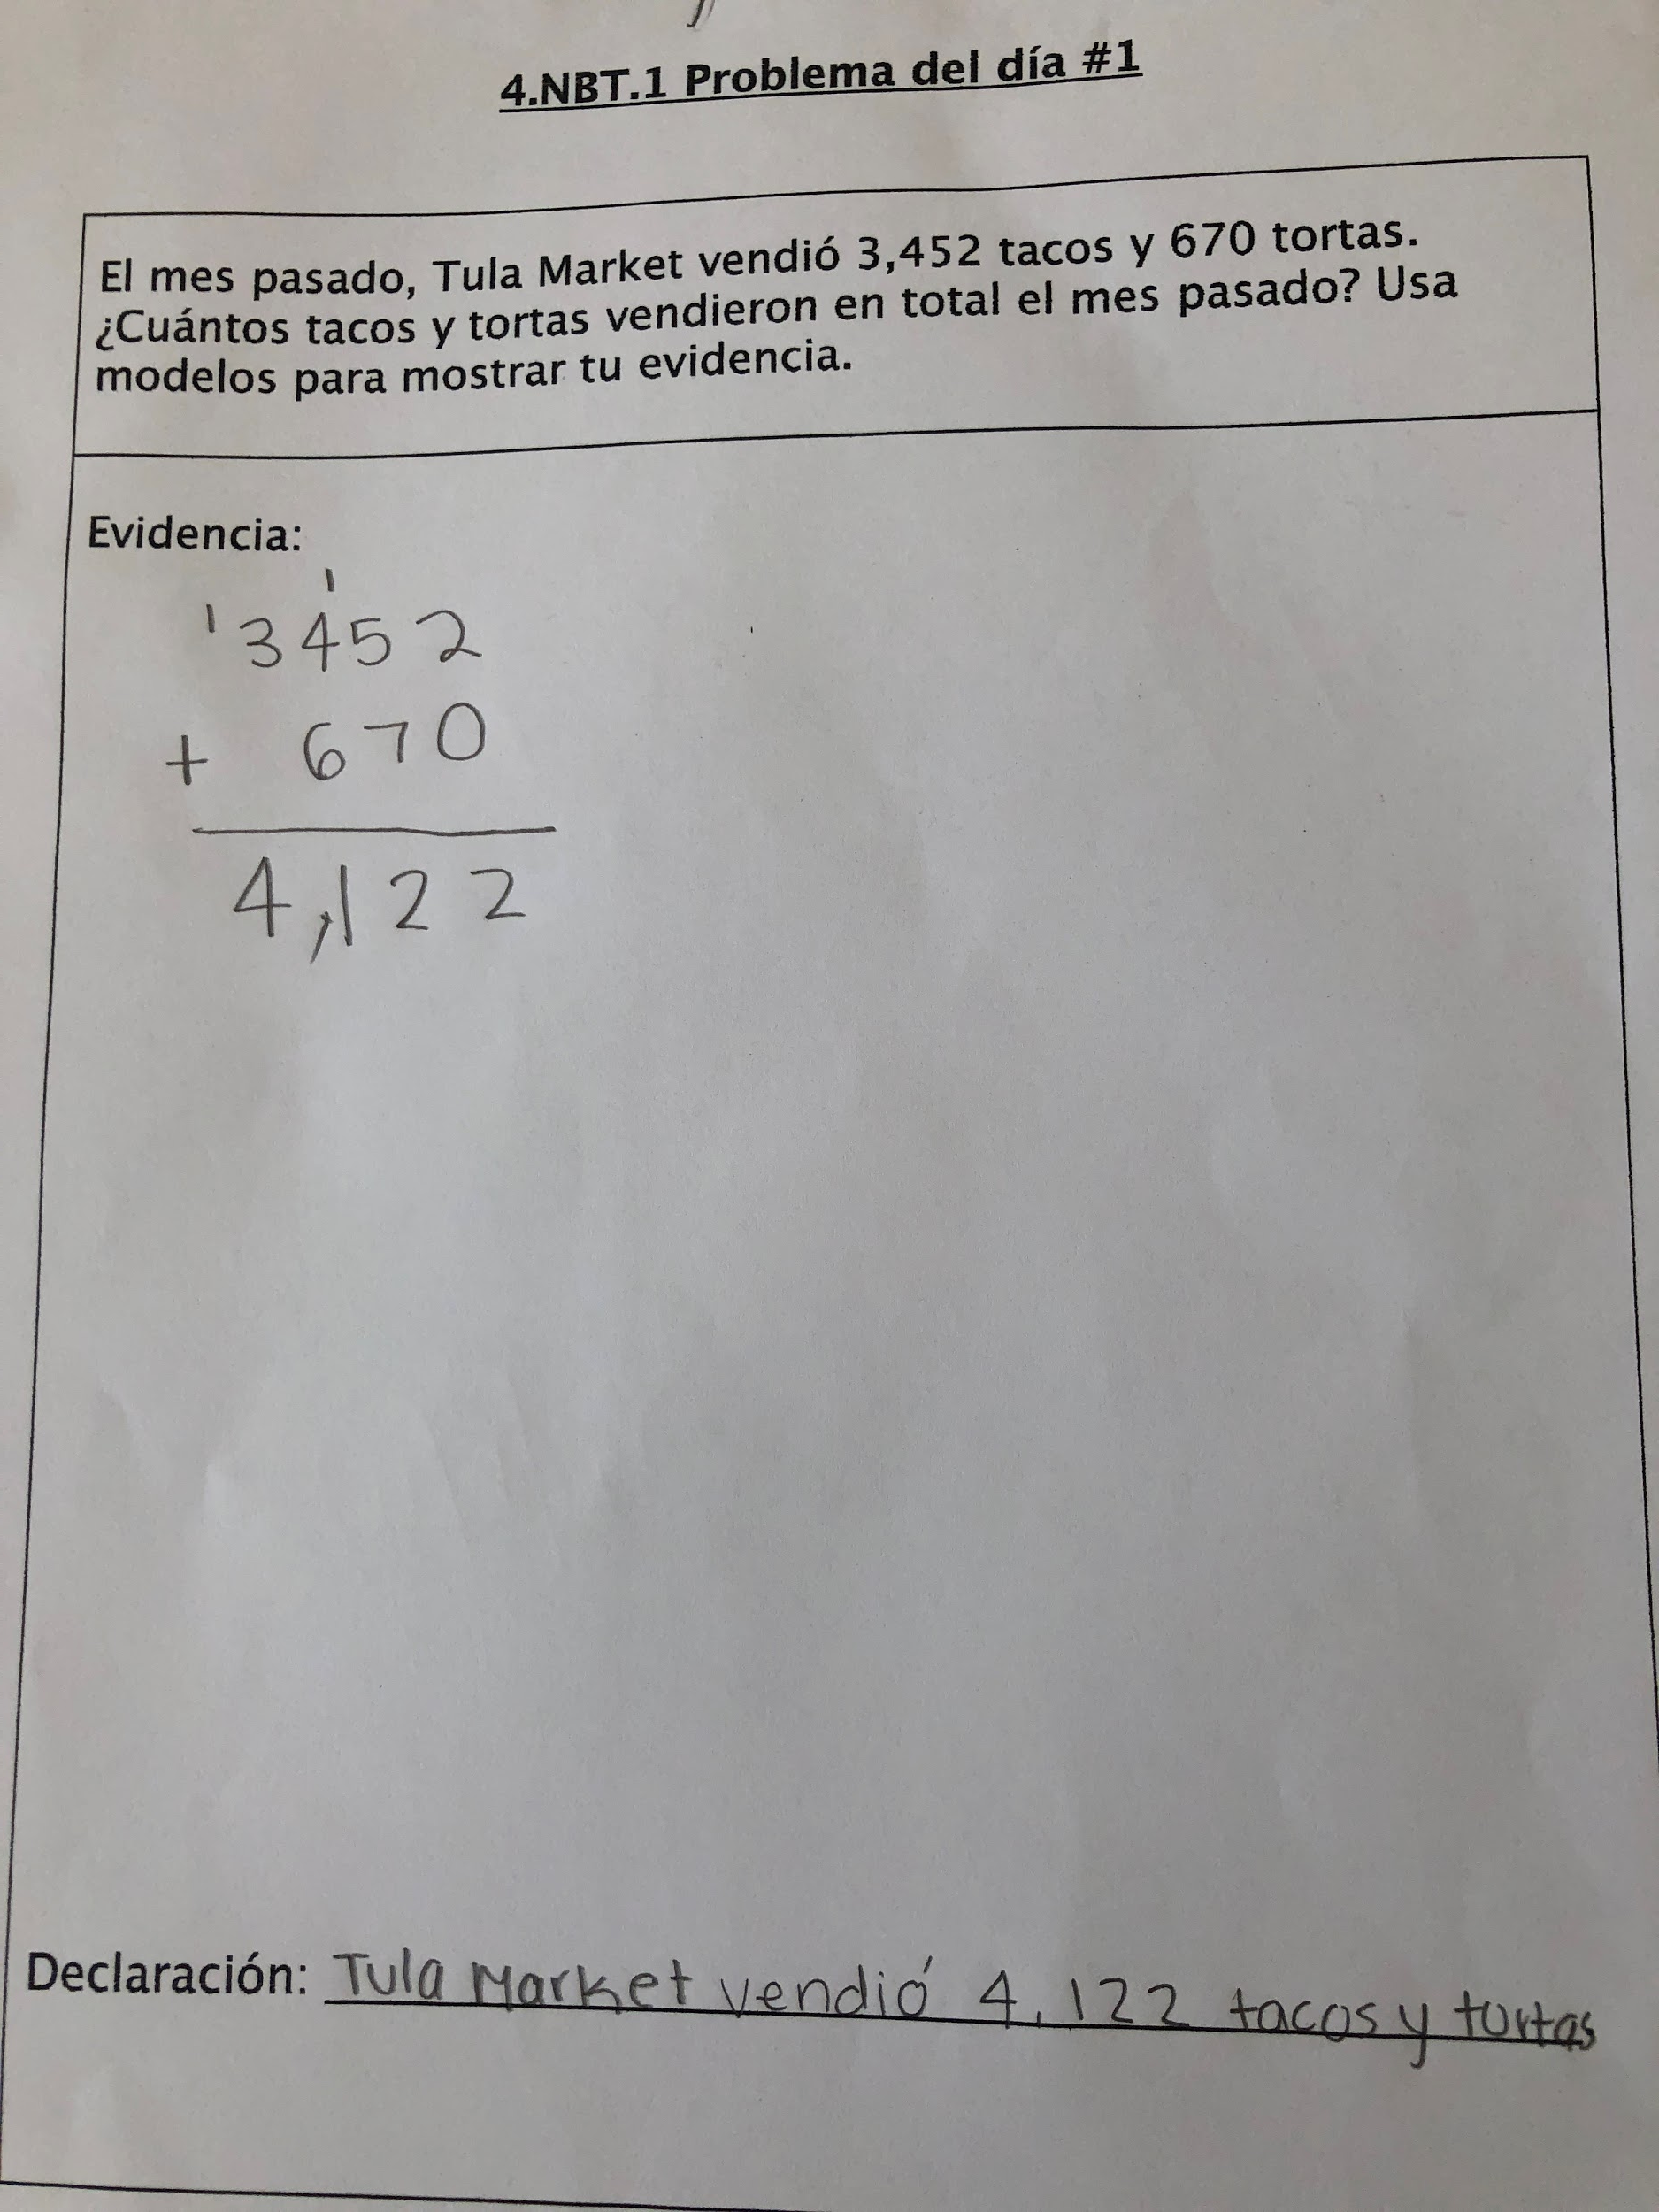
Ashley

Slide 35
Which student work would you select to share?
How would you sequence them?
(Use students’ names)
Please use the Questions tab on your control panel to respond.

Slide 37
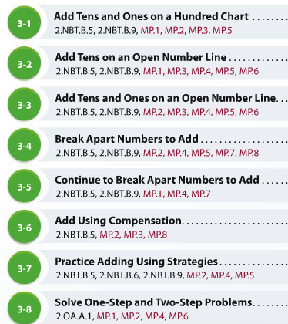

Slide 38
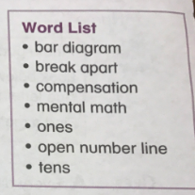
Notes:
This student work comes from a textbook that puts a lot of emphasis on the different ways kids can add and subtract without distinguishing models and strategies. In the end, we don’t know a lot about what this kid is able to do.

Slide 39
A Careful Progression to Addition Fluency
 | Within 5 | Within 10 | Within 20 | Within 100 | Within 1,000 | Within 1,000,000
Grade K
Grade 1
Grade 2
Grade 3
Grade 4
Notes:
The shaded circles represent the fluency expectations for addition and subtraction at each grade. The half-shaded circles indicate where students are developing conceptual understanding to build to the fluency expectations.
It is striking the amount of work that happens in grades 1 and 2 with a good deal of fluency and procedural skill expectations built into grade 2. The work in grade 3 is less as students are developing understanding and fluency with multiplication and division. This heavy emphasis in grade 1 and 2 should be reflected in the way time and energy are spent in classrooms.
One challenge for teachers of a single grade, is the ability to understand their specific grade-level expectations in the context of the whole progression. It is helpful to share this progression so that teachers can understand what’s most important at their grade-level and how to set kids up for later work.

Slide 40
Questions for Our Guests?
Notes:
Are there resources for developing fluency? Share in the chat: https://achievethecore.org/page/2948/fluency-resources-for-grade-level-routines
I teach first/second grade and my students have been taught the standard algorithm by their parents. What should I do?

Slide 41
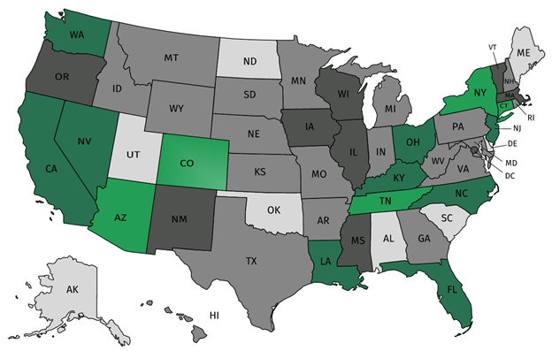
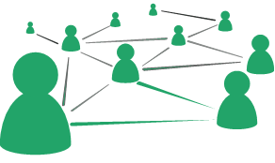
Join our network!
Join a national network of educators
Connect with state networks
Be a part of creating new tools and resources in partnership with SAP
Keep up to date on free resources, upcoming SAP webinars/professional learning opportunities, job postings and more!
Notes:
If you found tonight’s webinar helpful, we’d like to invite you to join our Core Advocate network! We’re committed to solving real problems that real teachers have and we know the best way to do this is to know more about what folks are experiencing.
As part of our national network, you have opportunities to connect with educators across the country, maybe even the network in your state! You can keep up to date on tools and resources available on Achieve the Core, as well as a variety of virtual learning opportunities and other ways to engage with us. We also work with educators in our network to help us build tools and resources.
We’d love to learn about who you are, where you work, the types of things you’re interested in and the expertise you already have. This way, we will be able to tailor our webinars and other opportunities to your needs and interests (we may even tap you to be our next webinar panelist).

Slide 42
Please Join Us!
https://achievethecore.org/ca-signup
Twitter: twitter.com/achievethecore
Facebook: facebook.com/achievethecore
Pinterest: pinterest.com/achievethecore
Notes:
We encourage you to join the network by filling out this survey completely at atc.org/ca-signup

Slide 43
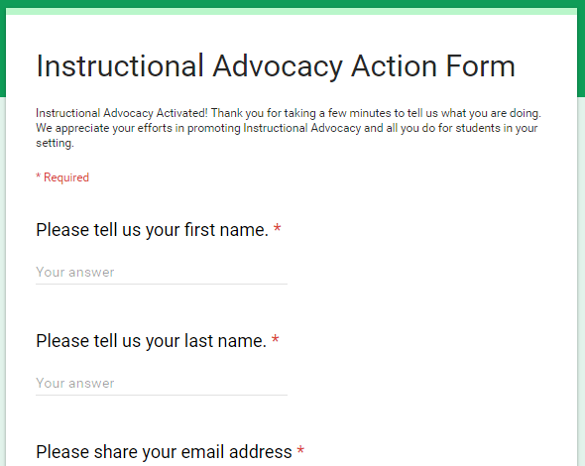
Tell Us About Your Efforts
www.achievethecore.org/educators-taking-action
Notes:
We like to invite Core Advocates to share what they are doing more broadly. Whether its you trying a strategy or a tool, we’d like to know how it went. Please let us know about your advocacy with our IAAF.

Slide 44
Please Join Us Again!
2018 Opportunities to learn with us:
First Wednesday of each month at 7:00 p.m. ET
September 8: Leveraging Pear Deck to Actively Engage Students
October 3: Setting and Keeping Professional Learning Goals
November 7: Math Language Routines – The What, the Why, the How
December 5: Literacy topic TBD
January 9: Foundational Skills Instruction in Action

Slide 45
Register to Join Us Next Month!
Next month’s mini-webinar: Leveraging Pear Deck to Actively Engage Students
Wednesday, September 12, 7:00 - 7:30 p.m. ET
Register Here: https://event.on24.com/wcc/r/1811952/6D7DD08DDA79F81DD5C55B5B42710063

Slide 46
Thank You!

