Slide 1

Pear Deck
Taking your lessons to the next level
The webinar will begin shortly.

Slide 2
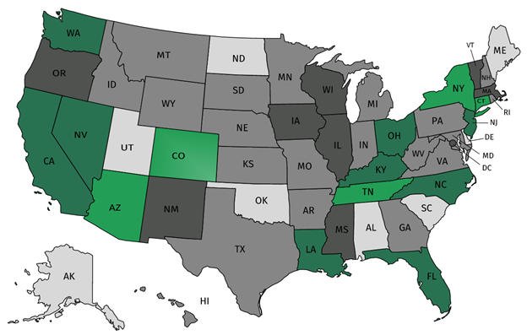
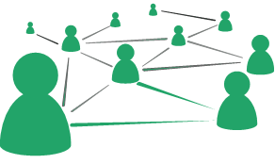



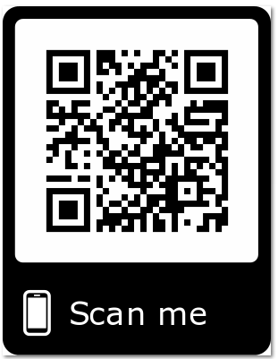
Join the Core Advocate network!
Join a national network of educators
Connect with state networks
Be a part of creating new tools and resources in partnership with SAP
Keep up to date on free resources, upcoming SAP webinars/professional learning opportunities, job postings and more!
https://achievethecore.org/ca-signup
Notes:
If you found tonight’s webinar helpful, we’d like to invite you to join our Core Advocate network! We’re committed to solving real problems that real teachers have and we know the best way to do this is to know more about what folks are experiencing.
As part of our national network, you have opportunities to connect with educators across the country, maybe even the network in your state! You can keep up to date on tools and resources available on Achieve the Core, as well as a variety of virtual learning opportunities and other ways to engage with us. We also work with educators in our network to help us build tools and resources.
We’d love to learn about who you are, where you work, the types of things you’re interested in and the expertise you already have. This way, we will be able to tailor our webinars and other opportunities to your needs and interests (we may even tap you to be our next webinar panelist).

Slide 3

Tweet with us!
Please feel free to tweet during and after the webinar using #CoreAdvocates
Find us on Twitter!
@achievethecore
@JNCTeach06
@peardeck

Slide 4
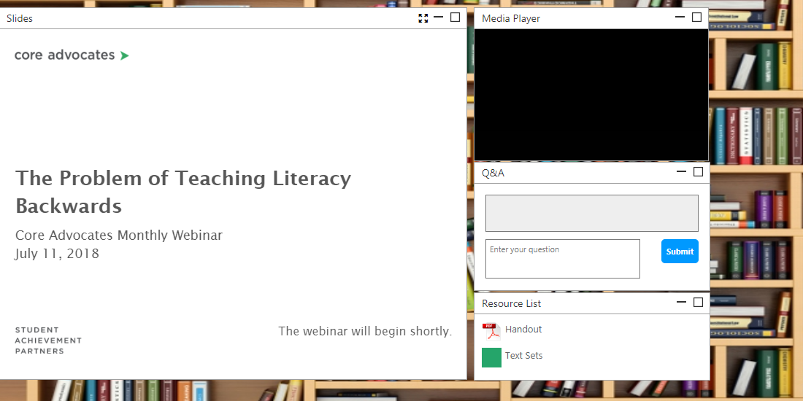
Engage with us!
During the webinar
– Questions option
– Find the handouts and
resources
After the webinar
– Access to recorded
webinar

Slide 5

Jeff Crayton
High School Math Teacher
Buncombe County Schools
North Carolina

Slide 6
Special opportunity for webinar attendees
2-month trial of Pear Deck Premium
All features we’ll discuss today are available in the free version.
If you’d like to explore the features in Premium, visit; http://bit.ly/2QarkuO before the end of 2018 to access the trial.
No credit card or obligation to sign up. Your account will revert to the free version if you choose not to sign up after the trial, but anything you’ve designed in Premium is yours to keep!

Slide 7

Goals of the webinar:
Goal 1: Learn to create interactive
student activities
Goal 2: Learn to use data to support
your students
Goal 3: Learn to collaborate with
PLNs to create the best lessons
possible

Slide 8
Pear Deck vs. PowerPoint
Places the content on each student’s screen
Allows student interaction with problems, text, maps, diagrams, etc.
Useful any time during a lesson or unit

Slide 9
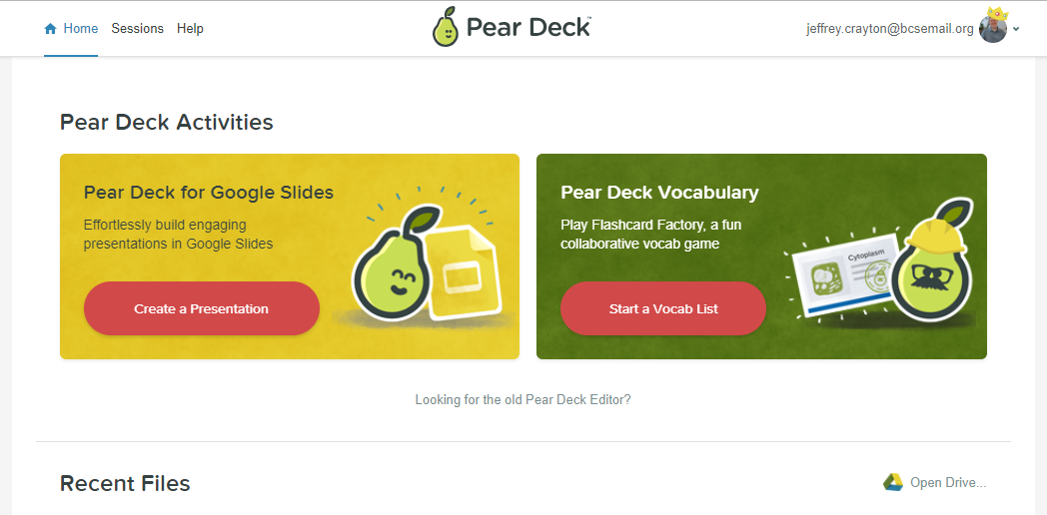
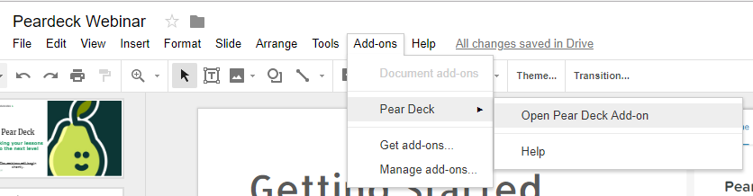
Getting Started
Log in through
peardeck.com
Use the Google
Add-on in Google
Slides

Slide 10
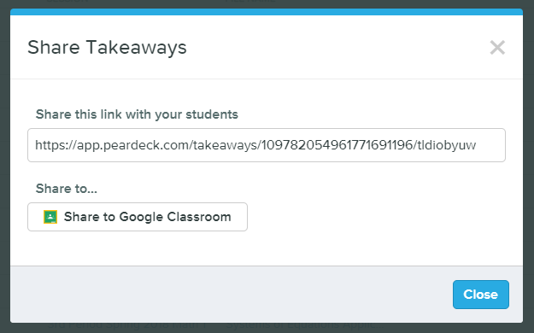
Google Partnership
Add-On - allows adaptation of current Google Slide Presentations
Google Classroom - syncs with
Google Classroom to allow
students to reference
(Takeaways)
Notes:
Takeaways allows Pear Deck to create a Google Doc for each student with the entire presentation and their individual responses. Students can then use these as notes to reference when studying on their own outside of class.

Slide 11
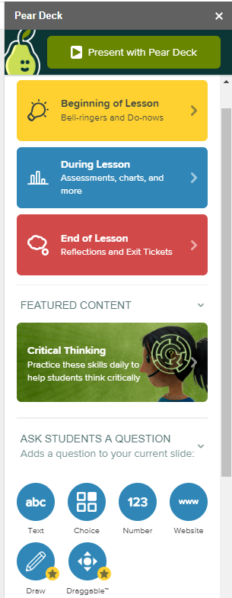
Types of questions
Notes:
Live slide with clickable links shown on presenter’s screen

Slide 12




Examples
Notes:
Live slide with clickable links shown on presenter’s screen

Slide 13
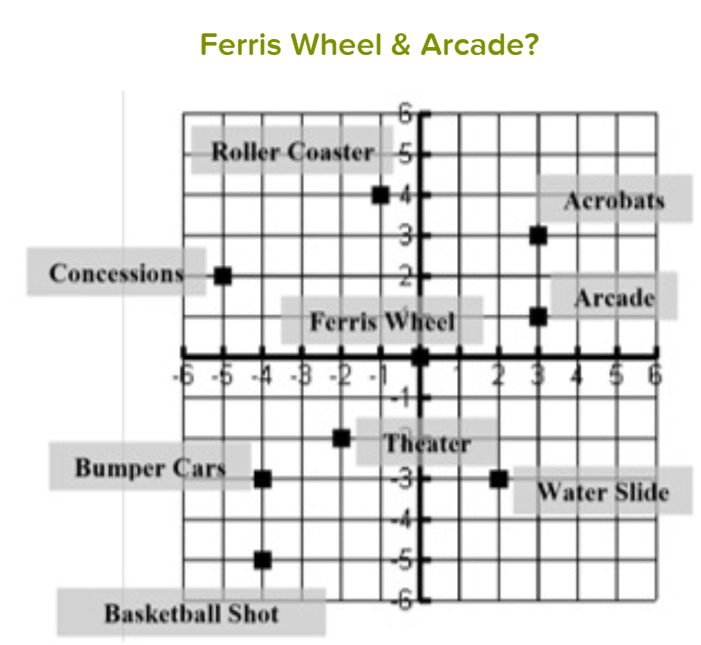
Live data vs End Session Data
Live Data
Watch students work
Give student feedback
Keep students on task
End Session Data
Send student work to Google Drive
Export to Google Sheets
Formatively assess student needs
Notes:
Live slide with clickable links shown on presenter’s screen

Slide 14

PLN Collaboration
Peardeck Files
Stored in Google Drive
  Decks, Exports, Takeaways, Uploads, Vocabulary
Share with other teachers
  Stores as shared with me
  Creates individual copies when presenting

Slide 15

Thank you for joining!
Don’t forget you have free access to the Premium version for 2-months.
Any questions?

Slide 16




Thank you for joining us!
https://achievethecore.org/ca-signup
Twitter: twitter.com/achievethecore
Facebook: facebook.com/achievethecore
Pinterest: pinterest.com/achievethecore
Notes:
We encourage you to join the network by filling out this survey completely at atc.org/ca-signup

