Slide 1
Foundational Skills Instruction in Action
Core Advocates Monthly Webinar
January 9, 2019
The webinar will begin shortly.
Check your Resource widget to preview the resources for today’s session!
Notes:
While we’re waiting, we’d like you to participate in a quick poll so we can get an understanding of who’s on the webinar with us tonight.

Slide 2
Introductions
Your host from the Professional Learning Team
Nicole Bravo, Project Manager
This Month’s Guests -
Tori Filler, Literacy Specialist
Joyce Harrison, Shelby County Schools, TN

Slide 3
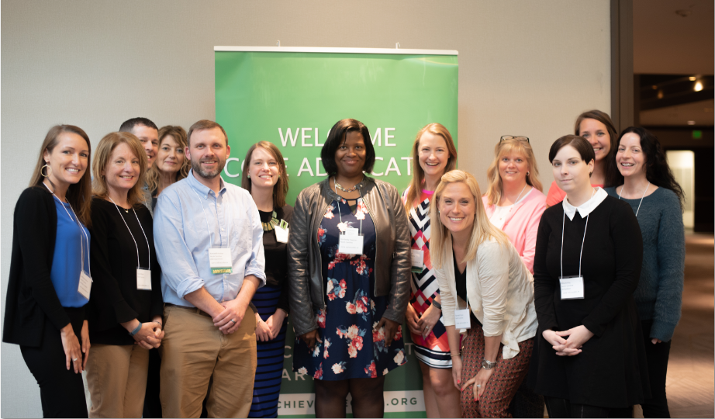
Who Are Core Advocates?
Core Advocates believe in the power of standards to prepare all students for college and/or careers.
They are eager to support and collaborate with their colleagues and communities in understanding and translating the Shifts into instructional practice.
Core Advocates have the tools and knowledge to advocate for high-quality instruction, instructional resources, and professional learning in their communities.
Notes:
CAs are teachers from all over the country who believe in the potential of high quality standards and the importance of all students being prepared for college and careers.
They support their colleagues in understanding and advocating for the standards and embrace the Shifts in instruction
The Core Advocate network is over 10K educator strong and we’d love for you to join us if you have not already

Slide 4
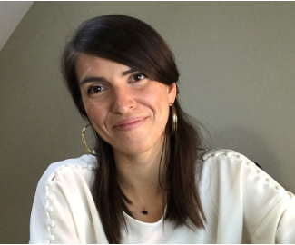
Tori Filler
Literacy Specialist
Professional Learning Team
Student Achievement Partners

Slide 5
Goals of the Webinar
Understand the goals and structure of the Foundational Skills Observation Tool
Discuss observable examples of each indicator and consider implications for observation or reflection
Identify potential use cases of the tool and hear about one district’s experience

Slide 6
Why Foundational Skills?

Slide 7
Use the “Group Chat” widget to type your response.
What word (or words) come to mind when you think about foundational skills instruction?

Slide 8
Strong foundational skills instruction for all students is an issue of equitable access to college- and career-ready readiness.

Slide 9
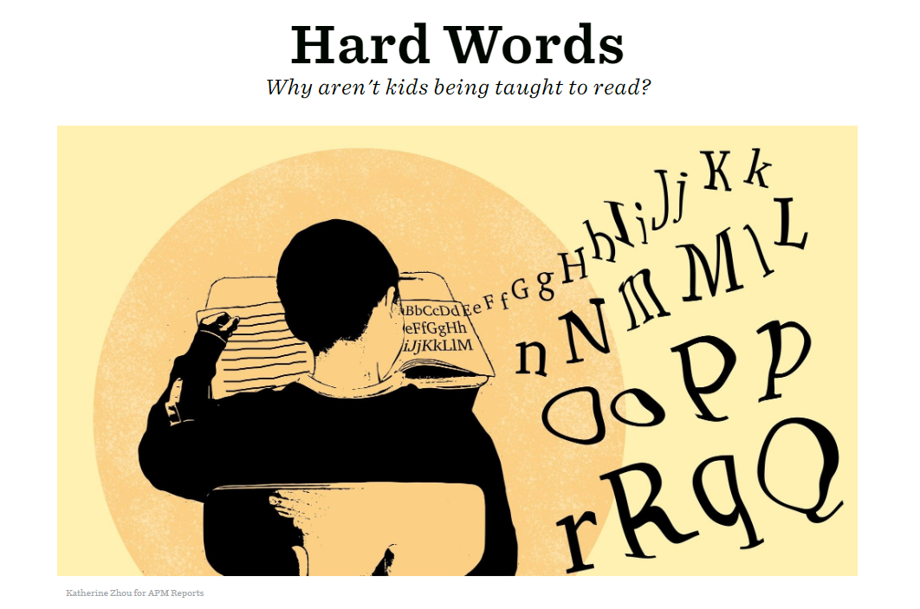
American Public Media Report by Emily Hanford
“One of the most consistent findings in all of education research is that children become better readers when they get explicit and systematic phonics instruction.”
“...according to the research, kids who can't decode will never be good readers. Some children learn decoding quickly with minimal instruction. Others need a lot more help. But good phonics instruction is beneficial for all kids, even those who learn to decode easily; research shows they become better spellers.”
READING IS NOT “NATURAL”
APM Report: Hard Words
https://www.apmreports.org/story/2018/09/10/hard-words-why-american-kids-arent-being-taught-to-read
Notes:
From “Hard Words: Why aren’t kids being taught to read?”
“We are born wired to talk. Kids learn to talk by being talked to, by being surrounded with spoken language. That's all it takes. No one has to teach them to talk.
But, as numerous studies have shown, reading is different. Our brains don't know how to do it. That's because human beings didn't invent written language until relatively recently in human history, just a few thousand years ago. To be able to read, structures in our brain that were designed for things such as object recognition have to get rewired a bit. Another big takeaway from decades of scientific research is that, while we use our eyes to read, the starting point for reading is sound. What a child must do to become a reader is to figure out how the words she hears and knows how to say connect to letters on the page. Writing is a code humans invented to represent speech sounds. Kids have to crack that code to become readers.
Children don't crack the code naturally. They need to be taught how letters represent speech sounds.”

Slide 10
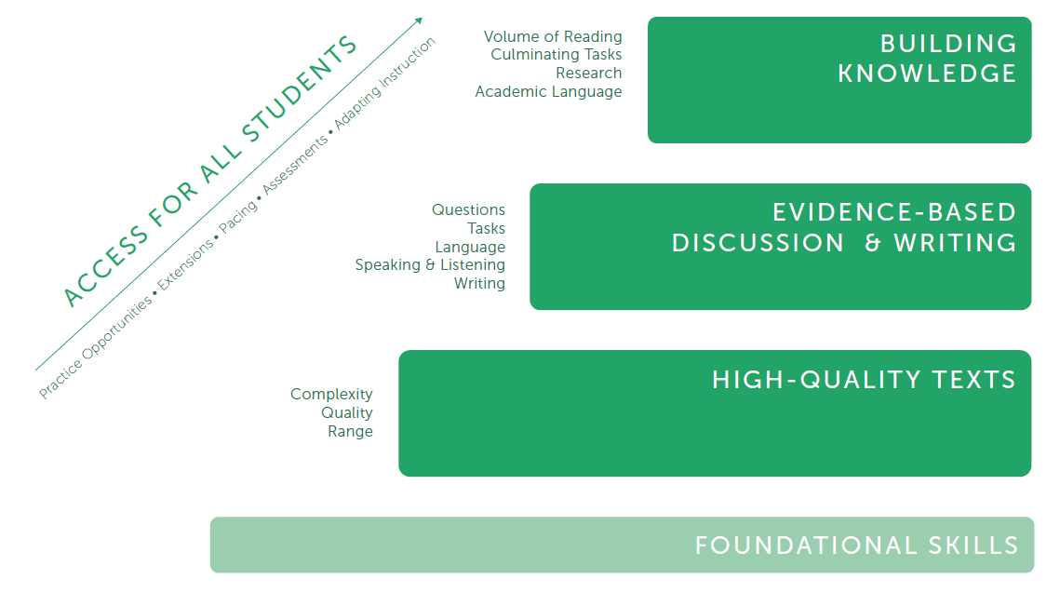
Foundational Skills are the Foundation
Notes:
We know that kids need solid foundational skills to do all of the other work they need to do to meet college- and career-ready expectations.

Slide 11
How We Got Here

Slide 12
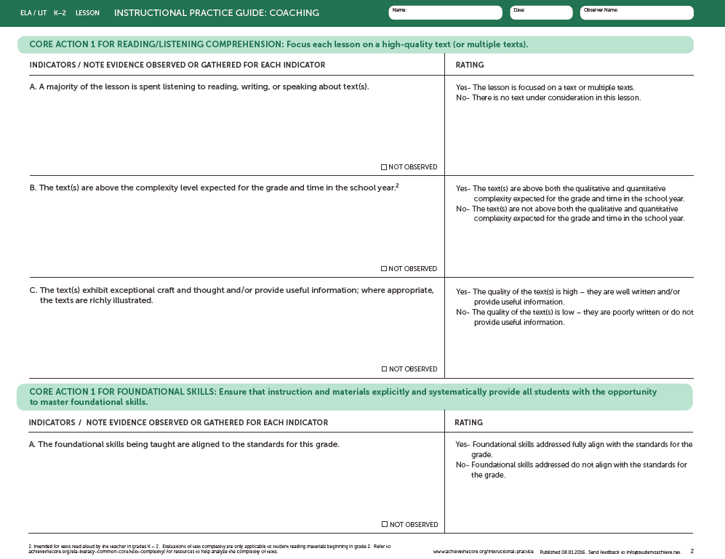
Instructional Practice Guide: Old K-2 Version
I still don’t know what I’m looking for with for foundational skills!
How does this all work together?
Notes:
In the previous version of the IPG, we had Core Action 1 for Reading/Listening Comp and Core Action 1 for Foundational Skills.
Previous IPG Foundational Skills indicators not specific enough to support observation and actionable feedback
Confusion around using Core Action 1 for Foundational Skills and Core Actions 2 & 3

Slide 13
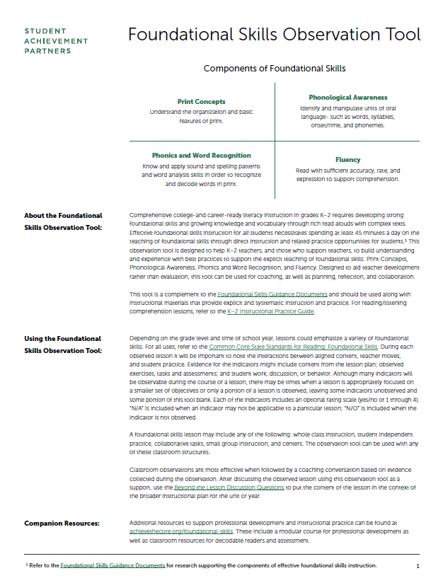
Observation Tools for K-2
Instructional Practice Guide
Foundational Skills Observation Tool
https://achievethecore.org/page/1119/instructional-practice-guide
Notes:
So now here with two tools - the updated version of the K-2 IPT for Reading/Listening Comprehension and the Foundational Skills Observation Tool - which is still developing!
IPG: Observing reading comprehension lessons with rich texts - often read aloud.
FS: Lessons focused on explicit direct foundational skills instruction and related practice opportunities.
3f in the IPG is still Foundational Skills because this work may be supported during while working on reading comprehension as well. Think of a second grader, who is applying their foundational skills knowledge during a reread of a rich, grade-level text.

Slide 14
The Foundational Skills Observation Tool

Slide 15
Please open the Foundational Skills Observation Tool from the resource widget in your toolbar.
https://achievethecore.org/content/upload/Foundational%20Skills%20Observation%20Tool.pdf

Slide 16
Meet the Foundational Skills Observation Tool
Coaching, planning, reflection, collaboration
Designed for use with K-2 instruction utilizing a systematic foundational skills program
Can be used to observe whole group, small group, centers or independent tasks

Slide 17
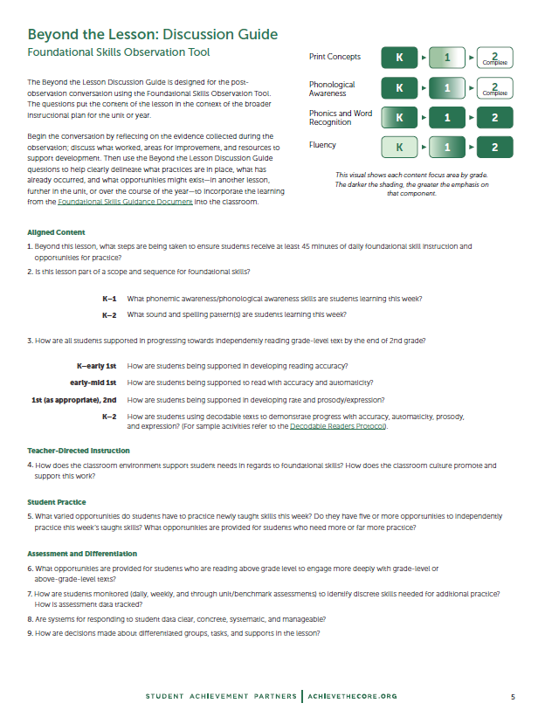
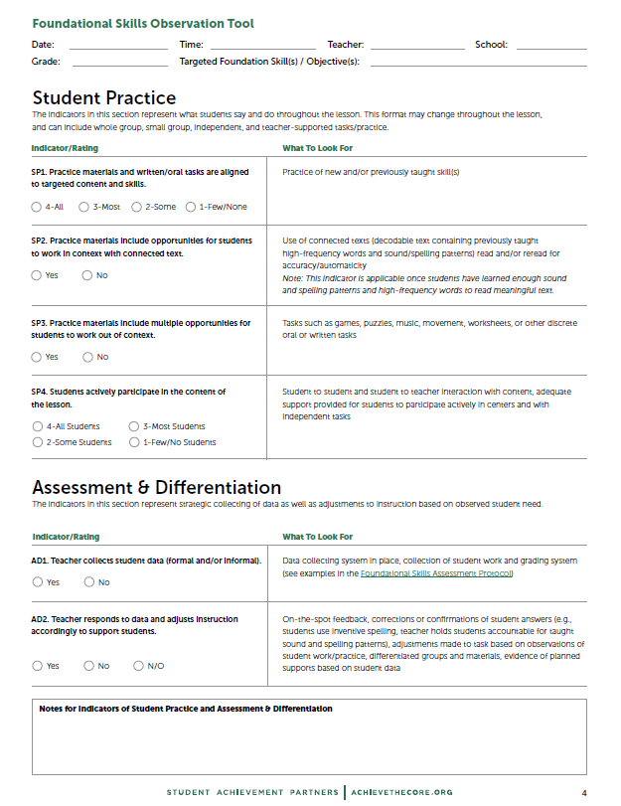
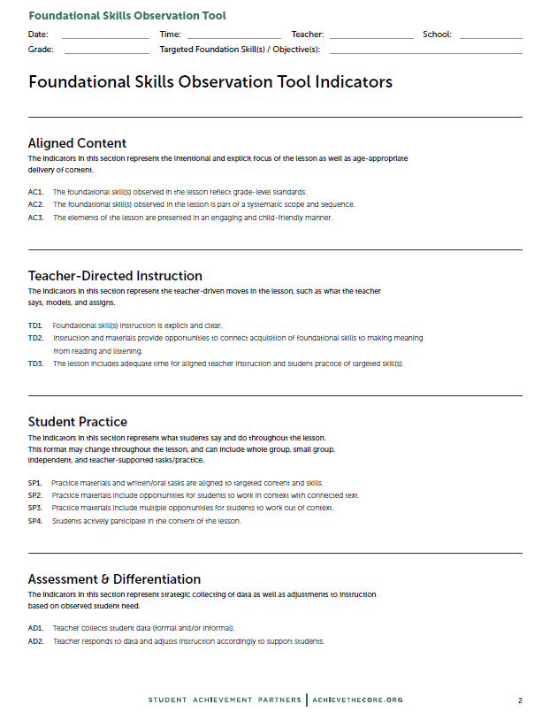
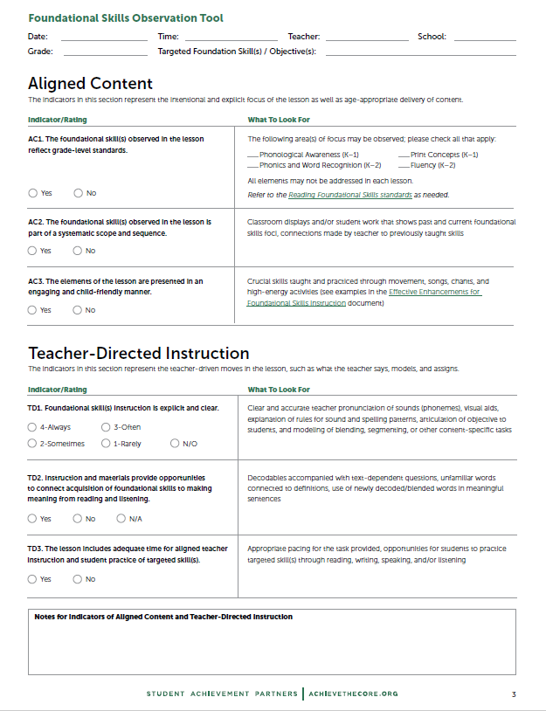
FS Observation Tool Structure
Page 1: Introduction
Page 2: All indicators 1-pager
Pages 3-4: Indicators with rating language and “What to Look for”
Page 5: Beyond the Lesson: Discussion Guide
Notes:
Note: may also want to keep new K-2 IPG 1-pager handy in case you do not know what type of instruction you might see in a K-2 classroom!

Slide 18
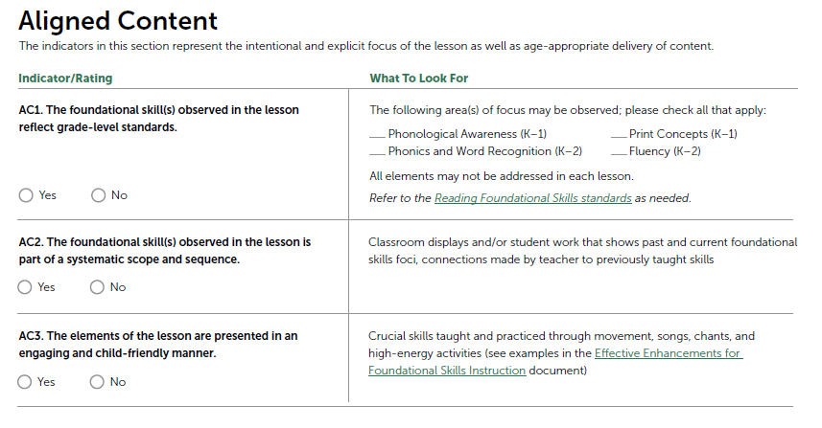
FS Observation Tool: Design
Category of indicators (lens for observation)
Evidence of indicators
Indicator
Rating
Companion resources
Notes:
Indicator language slightly different to reflect lack of Core Actions and differentiate from IPG.

Slide 19
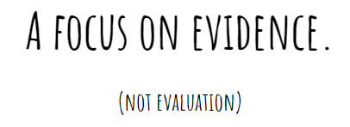

Slide 21
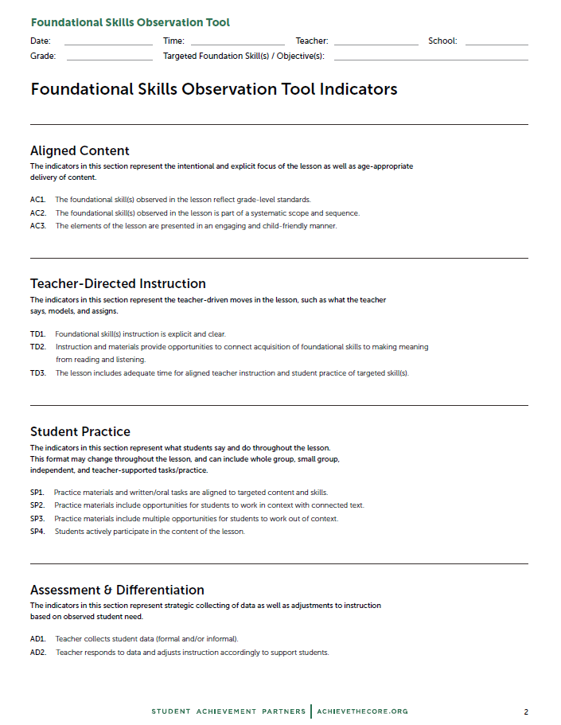
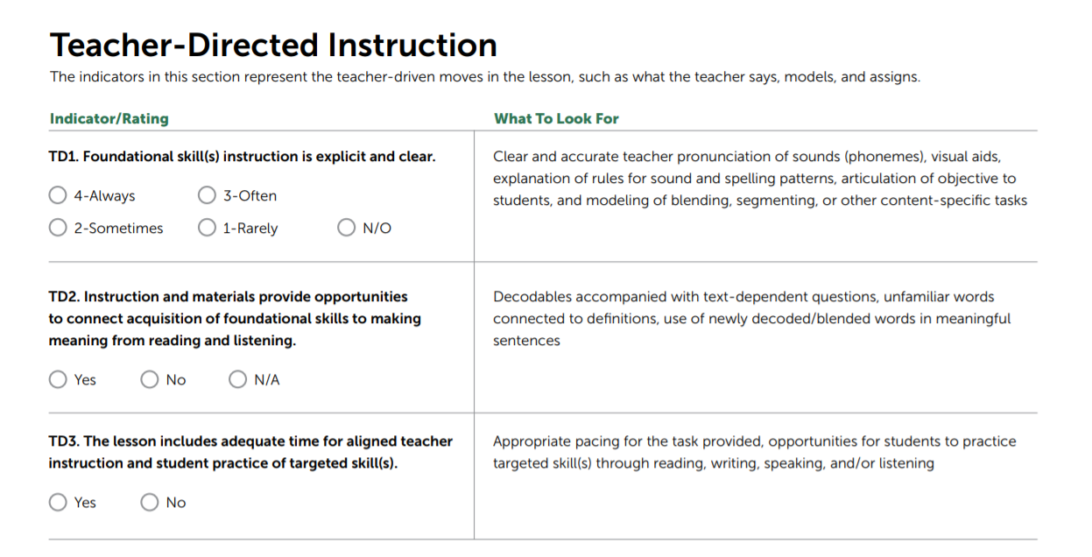
How many indicators are in the Teacher-Directed content bucket?
3
Page 3
Page 2

Slide 22
What are the rating options under the “AD1” indicator?
Page 4

Slide 23
FSOT Indicators

Slide 24
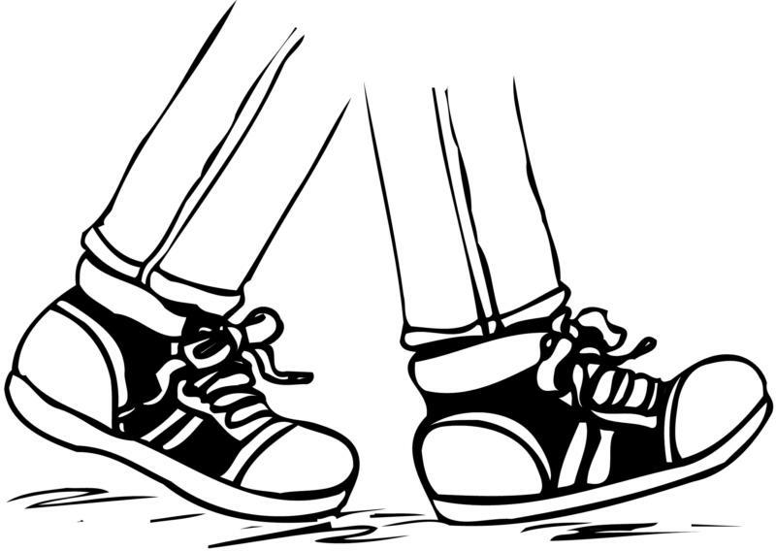
Let’s walk through the tool together!
...to do that, we’ll use some examples from a mock Kindergarten lesson.

Slide 25
ALIGNED CONTENT INDICATORS
FSOT: Page 3

Slide 26
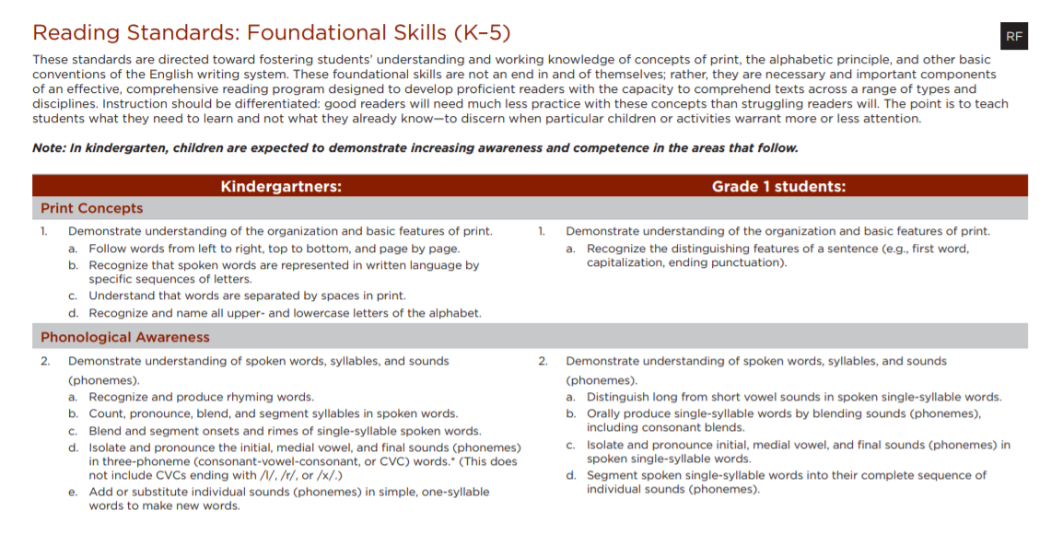
AC1
Notes:
AC1 similar to 1A for Foundational Skills on the old IPG. The answer could be no because of remediating skills from previous years, but no doesn’t mean bad!
For both AC1/ AC2 may need to do some follow up after the lesson (just like Core Action 1).

Slide 27
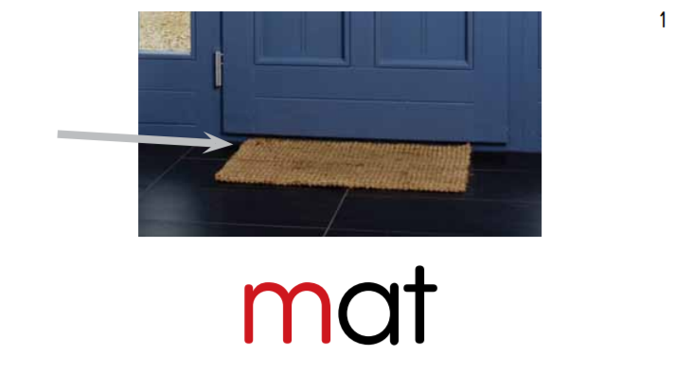
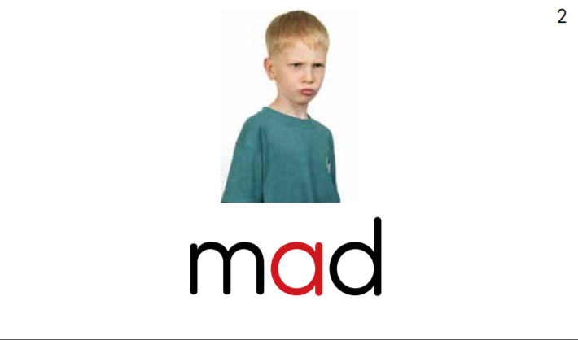
AC2.
Yesterday we learned how to write the /a/ sound.
Today we have a new sound… / t /!
Core Knowledge Language Arts Materials
Notes:
For both AC1/ AC2 may need to do some follow up after the lesson (just like Core Action 1).

Slide 28
AC3.
AC3.
What could high-quality evidence
for “Yes” look like?
Notes:
AC3: This doesn’t mean every lesson is a dance party, but foundational skills should be fun!

Slide 29
AC3.
Ok - it’s riddle time! The answer to the riddle will begin with our new sound /t/. When you think you know the answer, whisper it to your partner and then stand up! Ready?
I’m thinking of something inside your mouth that you use to chew.
Core Knowledge Language Arts Materials
Notes:
AC3: This doesn’t mean every lesson is a dance party, but foundational skills should be fun!

Slide 30
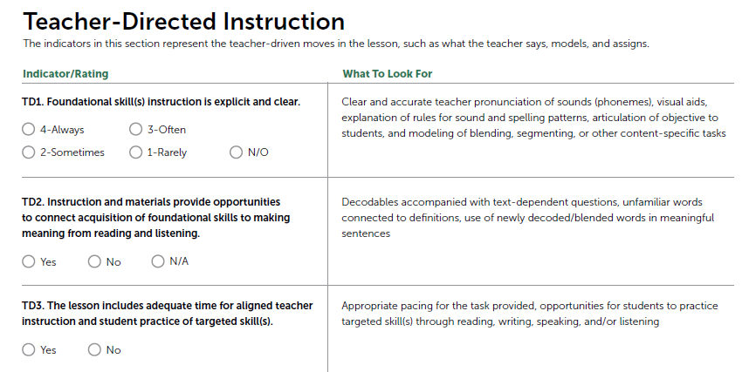
TEACHER-DIRECTED INSTRUCTION INDICATORS
FSOT: Page 3

Slide 31
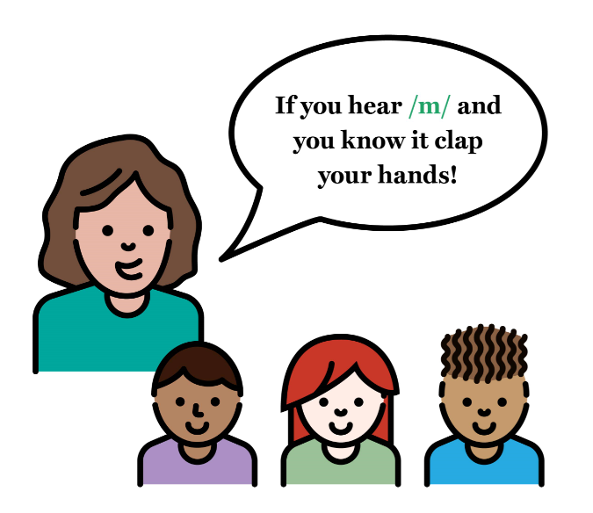
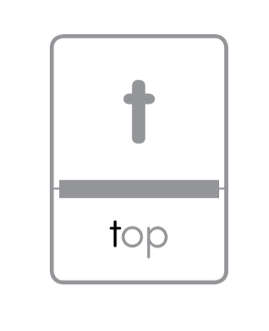
TD1.
I’m going to show you how to write the /t/ sound. Watch me!
Notes:
I’m going to use my arm to draw a picture of this sound in the air.

Slide 32
TD2.
Top can also mean a small toy that spins on its pointy bottom.

Slide 33
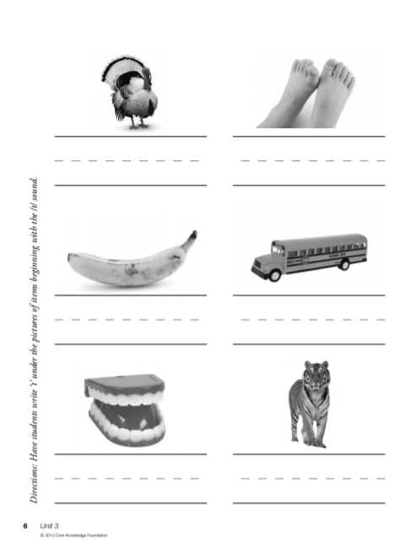
TD3.
Let’s write the /t/ sound in the air together three times. Then you’ll have a chance to practice with a partner!
Core Knowledge Language Arts Materials

Slide 34
N/O = Not Observed “I didn’t see it!”
N/A = Not Applicable “Doesn’t apply to this
lesson (or part of the
lesson).”
Reread TD1.
When might you select N/O for this indicator?
Notes:
TD1: Direct instruction. N/O would be selected if no explicit instruction was observed.
TD2: very similar to 1D for Foundational Skills with old IPG.
TD3: Reflects both explicit teacher-directed instruction and opportunities for student practice.
For TD1, it just would mean you were observing something like centers or student partnerships- you didn't see any TD instruction...so, NO (vs seeing it, and having it rarely be clear!)
For TD2, if the st's were blending/segmenting mom instead of top, that's a good place for NA. If the word was top (or the example I always use, which is "kit") and they don't define it, that's a no. N/A might be selected if it is likely that all words involved were likely familiar to students and/or students were working exclusively out of context. For example, reading or spelling the words cat and hat.

Slide 35
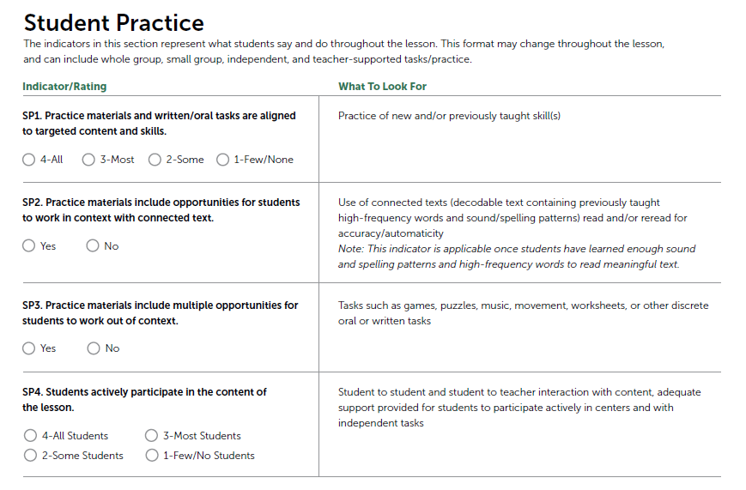
STUDENT PRACTICE INDICATORS
FSOT: Page 4
Notes:
TD1: Direct instruction. N/O would be selected if no explicit instruction was observed.
TD2: very similar to 1D for Foundational Skills with old IPG.
TD3: Reflects both explicit teacher-directed instruction and opportunities for student practice.
N/A might be selected if it is likely that all words involved were likely familiar to students and/or students were working exclusively out of context. For example, reading or spelling the words cat and hat.

Slide 36
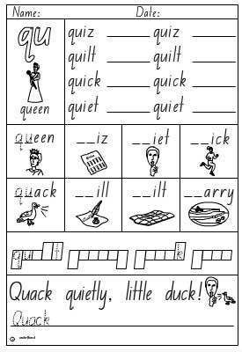
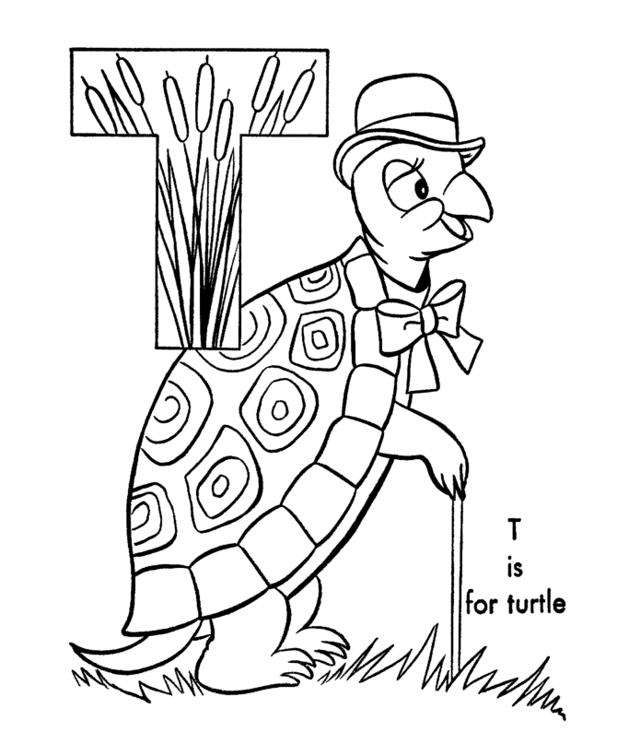
SP1.
Sound Hunt Center
How many things in the room can you find with the /t/, /m/, or /a/ sounds?
Aligned
Not aligned
Notes:
Aligned practice tasks:
Worksheet - discriminating whether words represented by pictures start with /t/.
Students completing a sound hunt around the room, looking for words that start with /t/
Not aligned:
qu worksheet - not aligned to current sound-spelling pattern
Color the turtle worksheet - while at first glance this may appear to be focused on the new sound-spelling pattern, are students being asked to USE their knowledge of this new sound and spelling pattern in any meaningful way?

Slide 37
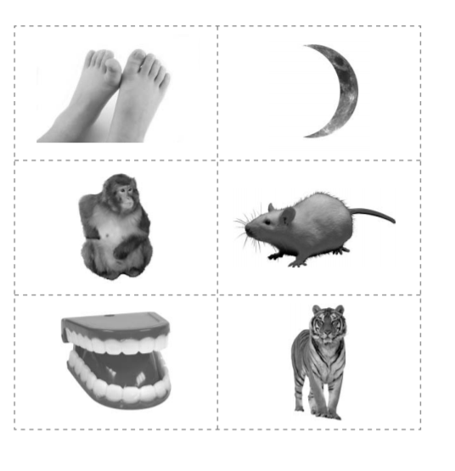
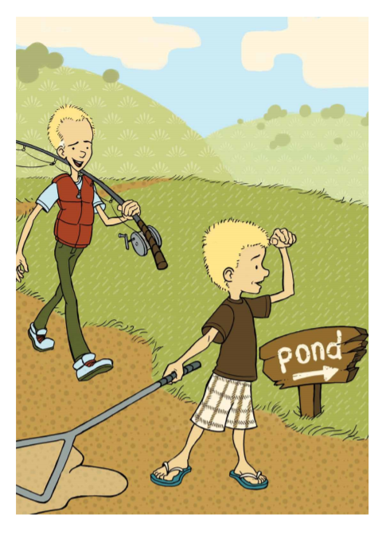
SP2. & SP3.
IN CONTEXT
OUT OF CONTEXT
These early-K students might not be reading decodable text yet, but later in the year we expect to see…
Sort the pictures by their initial sound!
Core Knowledge Language Arts Materials

Slide 38
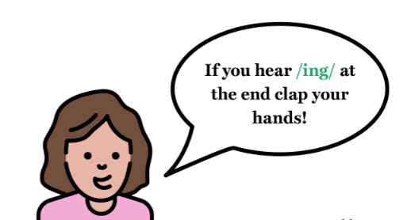
SP4.
Few students
All students
c
a
t
Could someone come up to write the word ‘cat’ on the board?
What other instructional strategies would be strong evidence for this indicator?
Notes:
Few students: teacher asking one student at a time to come up and spell a word on the board while the other children watch.
All students: students working in small groups to spell those same words with letter cards.
Note: this isn't just about movement/action-- that active participation also means students are fully completing work in partners or independent work time, etc

Slide 39
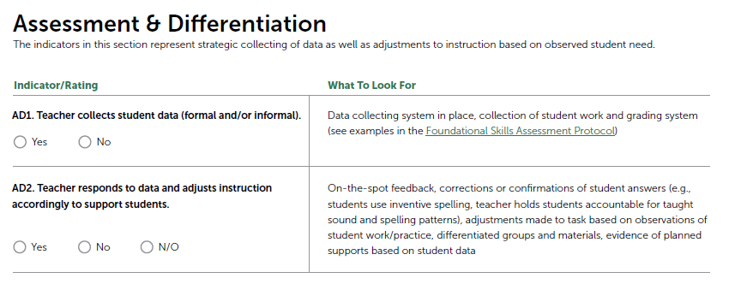
ASSESSMENT & DIFFERENTIATION INDICATORS
AD1. Teacher uses a checklist to note which students are accurately sorting /t/ and non-/t/ words
Adrian | ✅
David | ?
Hanley | ✅
Samiah | ✅
FSOT: Page 4
Notes:
AD1. Checklist, notetaking, collecting student work
AD2. Small moves (giving in the moment feedback) to pre-planned groups and differentiated tasks.

Slide 40
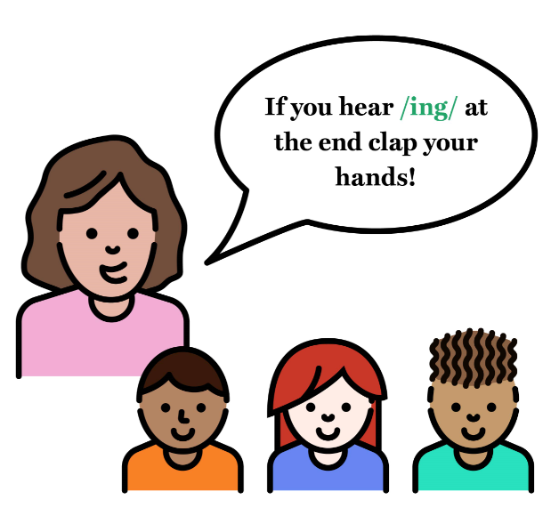
ASSESSMENT & DIFFERENTIATION INDICATORS
AD2. Teacher pulls an “ad hoc” small group of students who are struggling with /t/ discrimination activity
Join me on the carpet!
FSOT: Page 4
Notes:
AD1. Checklist, notetaking, collecting student work
AD2. Small moves (giving in the moment feedback) to pre-planned groups and differentiated tasks.

Slide 41
Beyond the Lesson: Discussion Guide

Slide 42
Beyond the Lesson: Discussion Guide
Designed to facilitate a post-observation conversation. Just like the IPG, an essential part of the document.
Questions grouped by same categories as indicators.
FSOT: Page 5

Slide 43
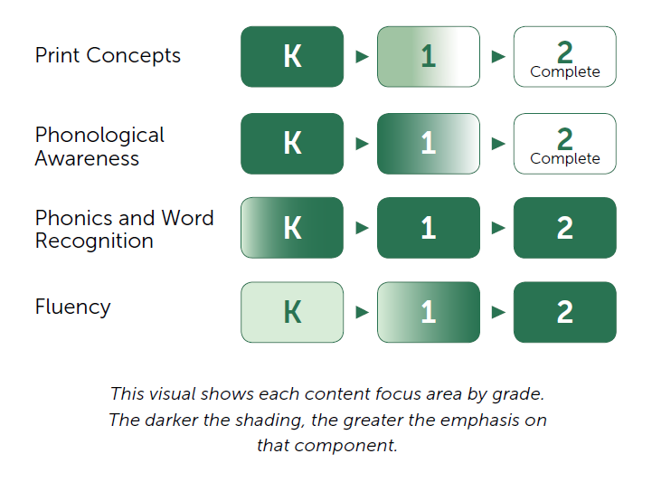
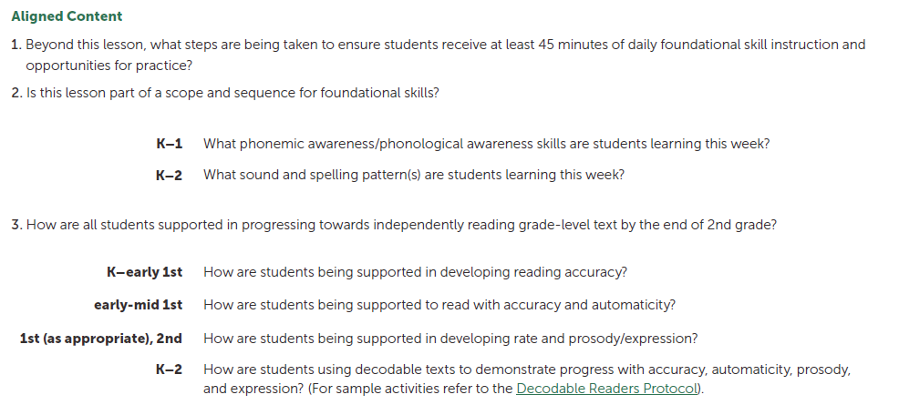
Support for Grade Level Foci
Notes:
Nuance added to grade level standards

Slide 44
Joyce Harrison
Literacy Instructional Advisor,
Curriculum & Instruction
Shelby County Schools
please enter a head shot here

Slide 45
Using the FSOT in Shelby County
Beginning stages of tool use
Teacher observations of foundational skills lessons

Slide 46
Reflections
Success | Challenge
Providing more “Look Fors” that are specific for foundational skills
Finding alignment between this tool and other observation tools already in use in the district (e.g., “in context and out of context”)

Slide 47
Other Considerations
Create a team! Foundational Skills Early Literacy Team
Use the Beyond the Lesson to support conversation and/or reflection

Slide 48
Closing

Slide 49
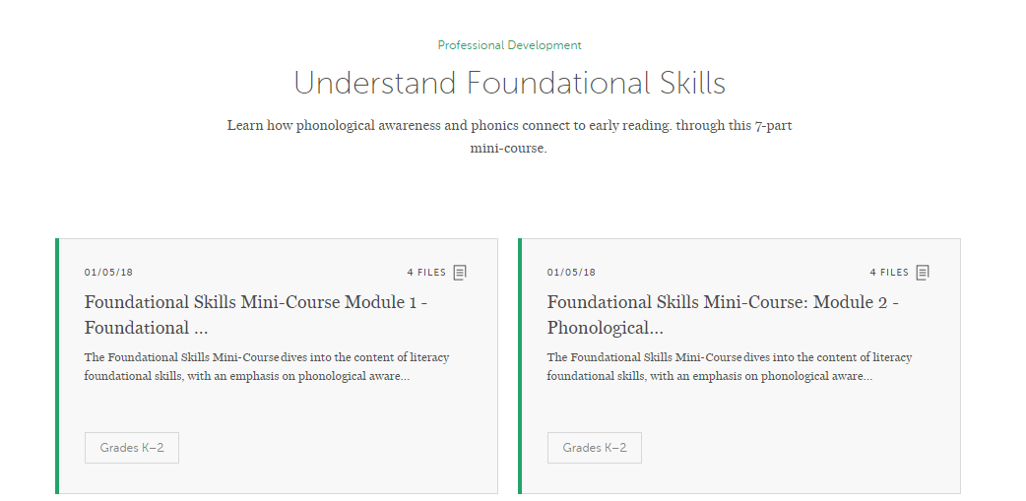
Additional Professional Learning Opportunities
Foundational Skills Mini-Course (previously posted)
Foundational Skills Observation Tool Virtual Professional Learning Community (coming April 2019)
Module 1: Nuts & Bolts
Module 2: Phonological Awareness
Module 3: Phonics Part 2
Module 4: Phonics Part 2
Module 5: Early Reading
Module 6: Practice
Module 7: Assessment

Slide 50
We’d Love Your Feedback on the Tool!
http://bit.ly/FSOTfeedback
FSOT Feedback Survey

Slide 51
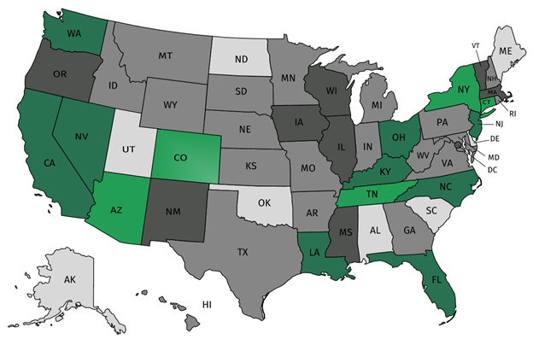
Join Our Network!
Join a national network of educators
Connect with state networks
Be a part of creating new tools and resources in partnership with SAP
Keep up to date on free resources, upcoming SAP webinars/professional learning opportunities, job postings and more!
Notes:
If you found tonight’s webinar helpful, we’d like to invite you to join our Core Advocate network! We’re committed to solving real problems that real teachers have and we know the best way to do this is to know more about what folks are experiencing.
As part of our national network, you have opportunities to connect with educators across the country, maybe even the network in your state! You can keep up to date on tools and resources available on Achieve the Core, as well as a variety of virtual learning opportunities and other ways to engage with us. We also work with educators in our network to help us build tools and resources.
We’d love to learn about who you are, where you work, the types of things you’re interested in and the expertise you already have. This way, we will be able to tailor our webinars and other opportunities to your needs and interests (we may even tap you to be our next webinar panelist).

Slide 52
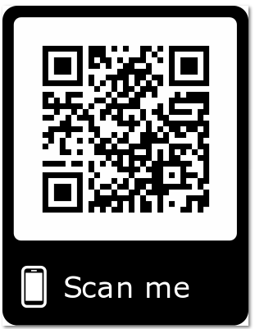
Please Join Us!
Or, sign up right now using the Core Advocate Survey link in your Resource widget!
https://achievethecore.org/ca-signup
Twitter: twitter.com/achievethecore
Facebook: facebook.com/achievethecore
Pinterest: pinterest.com/achievethecore
Notes:
We encourage you to join the network by filling out this survey completely at atc.org/ca-signup.
If you found tonight’s webinar helpful, we’d like to invite you to join our Core Advocate network! We’re committed to solving real problems that real teachers have and we know the best way to do this is to know more about what folks are experiencing.
We’d love to learn about who you are, where you work, the types of things you’re interested in and the expertise you already have. This way, we will be able to tailor our webinars and other opportunities to your needs and interests (we may even tap you to be our next webinar panelist). So we encourage you to join the network by filling out this survey completely at atc.org/ca-signup

Slide 53
Please Join Us Again Next Month!
Next month’s webinar: Building Mathematical Content Knowledge
Date & Time: February 6, 2019 at 7:00 pm ET
Register Here: https://event.on24.com/wcc/r/1897356/0175AE46A7B8579B33FBB059A0B517ED
Register for Next Month’s Webinar

Slide 54
Thank You!

