Slide 1
Building Knowledge: Expanding the World Through Reading
Module 3a (K-2nd grade)- The “How”
Notes:
This module was last updated on June 2019.

Slide 2
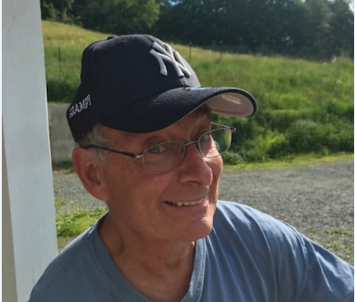
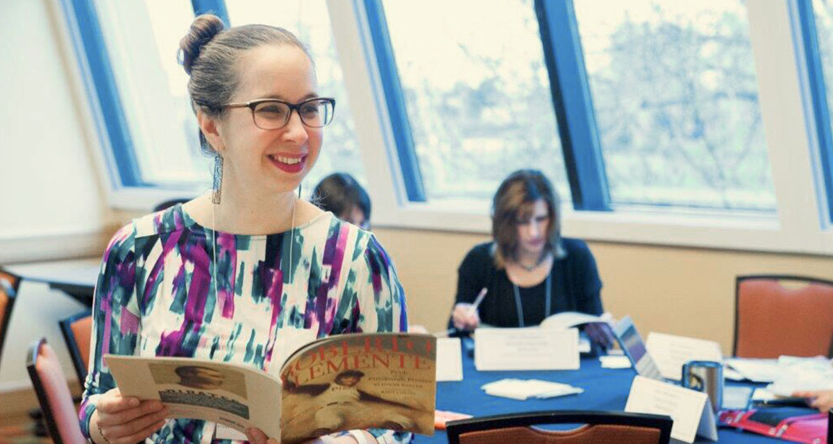
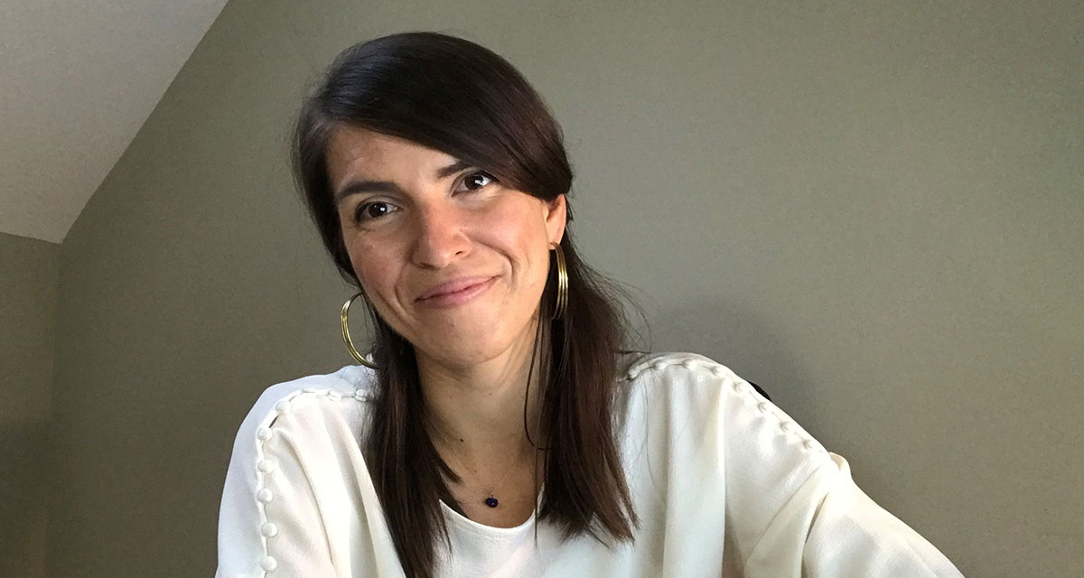
Your Presenters
David Liben
Senior Fellow
Carey Swanson
Senior ELA/Literacy Content Specialist
Tori Filler
ELA/Literacy Content Specialist

Slide 3

Identify indicators of knowledge building in high-quality instructional materials.
Pinpoint adaptations educators can make to existing materials to amplify knowledge building.
Identify knowledge-building resources to supplement their existing materials.

Slide 4
Let’s Review

Slide 5
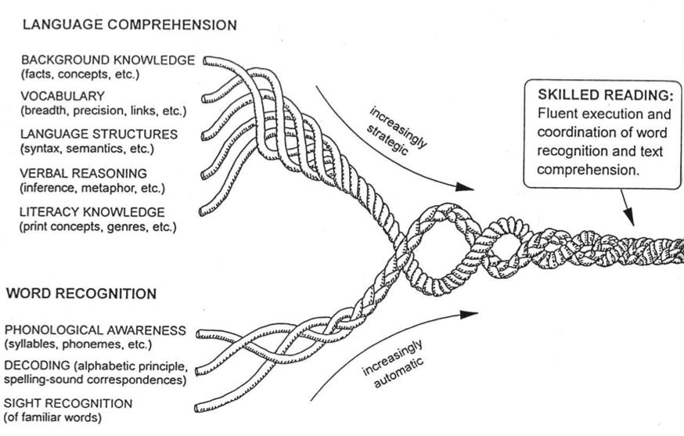
Remember Scarborough’s Rope
Knowledge Based:
Background Knowledge
Vocabulary
Language Structures
Verbal Reasoning
Literacy Knowledge

Slide 6

The Work of Schools
Vocabulary
Knowledge

Slide 7
K-2 Classroom Structures to Support Building Knowledge

Slide 8
Ingredients of Knowledge-Building Classrooms
Knowledge/vocabulary gained as a purpose for instruction
Multiple texts/resources on a topic
Attention to rich academic vocabulary
Opportunities to showcase learning
The What
Notes:
Knowledge gain from the text as purpose for instruction (e.g., Let go of strategies/skills focus)
Connect lit backwards (would a week of lessons on text features help you access this text)
Connect standards called for by the text
Adult task: Owl moon what are all the different knowledge demands! What can students learn? What’s the big idea?
Multiple texts on a topic

Slide 9







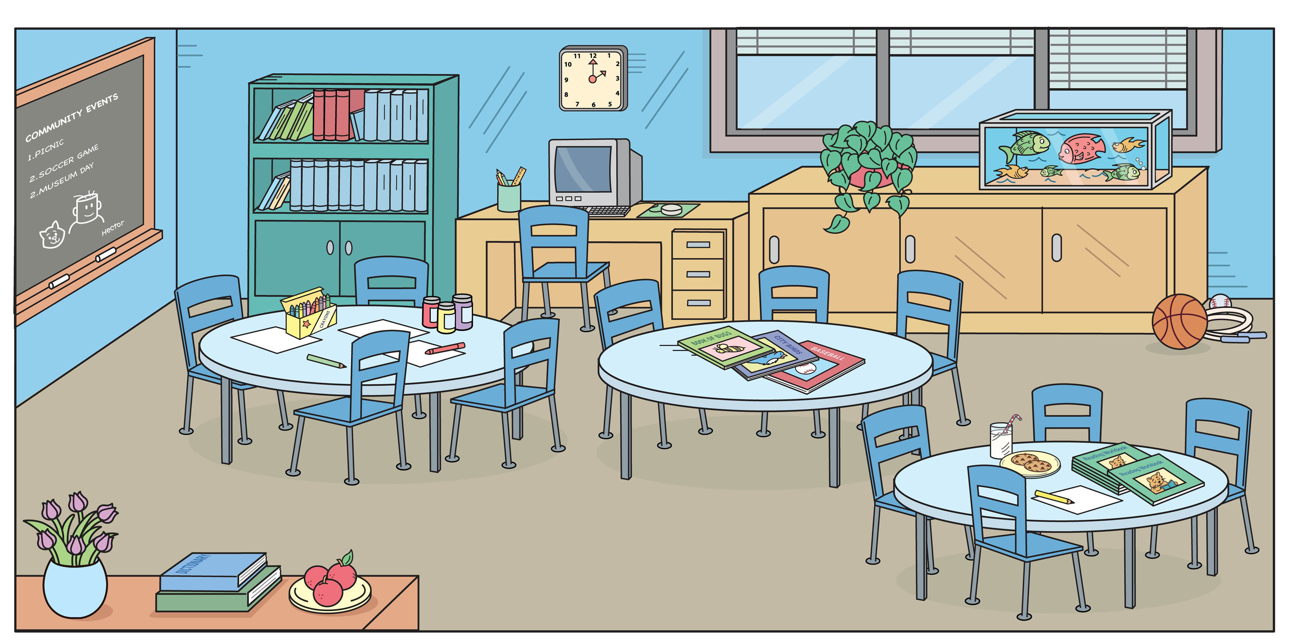
The How
Classroom Materials
Classroom Structures

Slide 10
Whole Class Instruction
“To help us understand more about Fern’s life on the farm from the first few chapters of Charlotte’s Web, we’re going to look at some texts together about farm life.”
Supplement an Anchor Text
Connect to a Social Studies or Science Topic
Connect Reading to Writing
“Before we dig into our unit on plant life cycles, we’re going to watch a short video showing how a seed grows into a plant.”
Notes:
Ask-
What is a strength

Slide 11
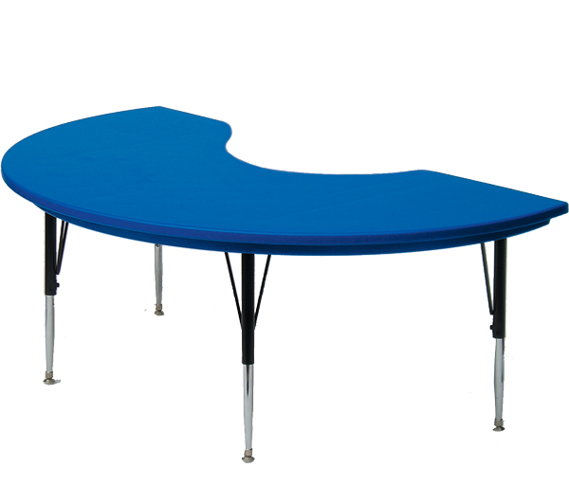
Small Group Instruction
Repurpose “Guided Reading”
  Research Groups
  Re-reading portions of the anchor text
  Connected/related texts at a range of complexity
“Our group is going to get to read a book today that gives us more information about how and why chameleons use camouflage.”
“Today we’ll work in our research groups at center time to see pictures of and texts about the animal adaptation we chose.”

Slide 12

Small Group Instruction Revisiting an Anchor Text:
Stop and summarize
Paraphrase challenging text
Reviewing where students got lost/confused
Re-reading to connect sections of the text to one another

Slide 13

Independent Reading
“What do you want to learn about?”
“Check out the new solar system bins in the library when you go book shopping this week!”

Slide 14
What are strengths and challenges to incorporating knowledge building within these 3 structures?
Whole Class Instruction
Small Group Instruction
Independent Reading
Strengths
Community built through studying the same topic 1 set of materials
Potential Challenges
Varying the scaffolding needed to support all readers
Strengths
Varied opportunities to meet student needs. Built in differentiation.
Potential Challenges
Multiple sets of materials
Strengths
Miles on the page! Student voice and choice.
Potential Challenges
Monitoring student reading. Library organization by topic.
Notes:
Pause to generate list first.
Reveal masks.

Slide 15

Close Reading of Complex Text Is Important…
But Not Enough!
 | Close Reading | Volume Reading
Text | Grade-level text, fewer pages | Variety of text complexity levels, more pages
Support | Heavy support | Lighter support
Purpose | Solely instructional | Guided or independent
Notes:
Big Idea: Wonders has lots of planned opportunities for close reading, but we also need to ensure that kids are getting access to VOLUME of reading.
Students on track for college and career are learning approximately 3,000 new vocabulary words each year (Nagy & Anderson, 984); it is impossible to learn this many words through vocabulary exercises.
Notes:
Volume of reading is done with the leveled readers and any teacher assigned text.
(click) Close read the Literature Anthology in 2-6. Literature Big Book or Literature Anthology with K-1. Depending on the week, you may also be using another particularly rich text.
Leveled Readers are the Wonders selected primarily used text for Volume Reading (unless teacher is assigning additional or supplemental reading)

Slide 16
What does knowledge building look like in instructional materials?

Slide 17
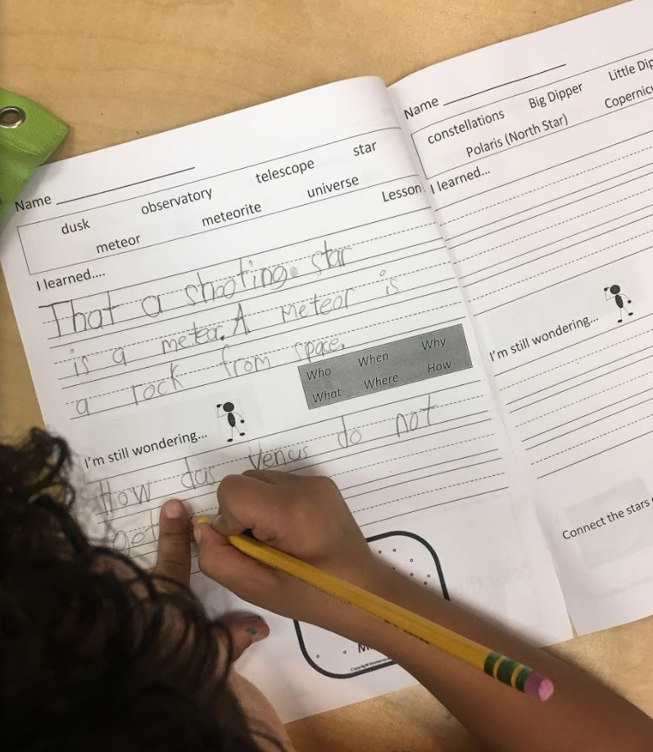

Core Knowledge
Language Arts
Notes:
https://www.coreknowledge.org/free-resource/ckla-domain-06-astronomy/

Slide 18
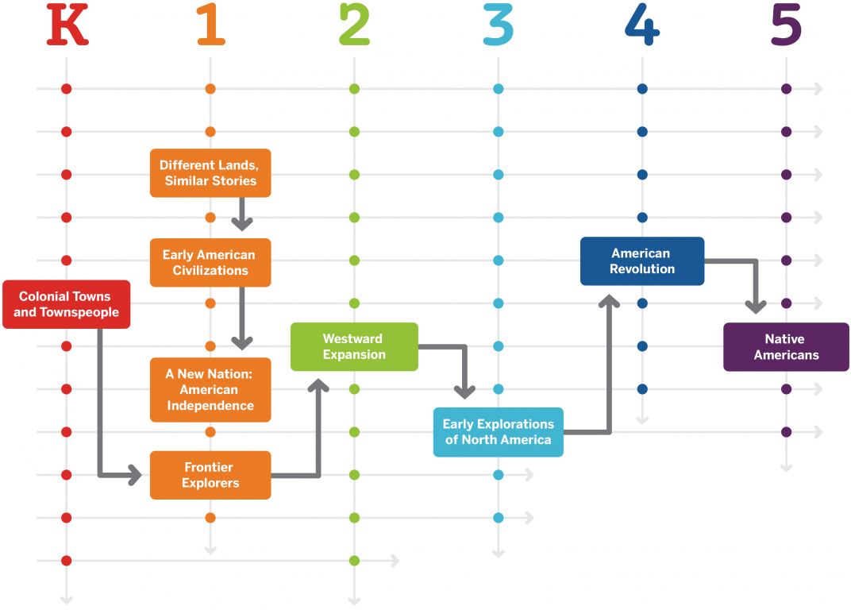
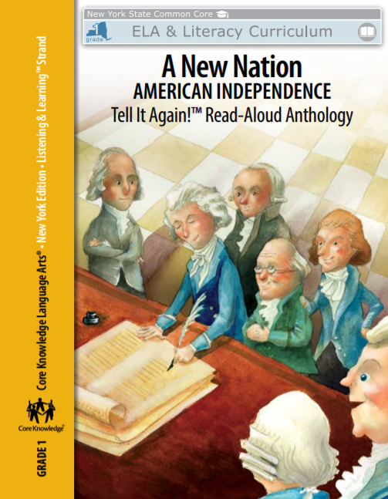
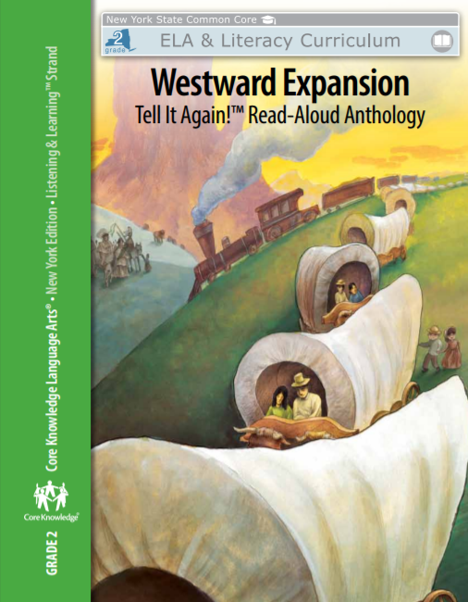
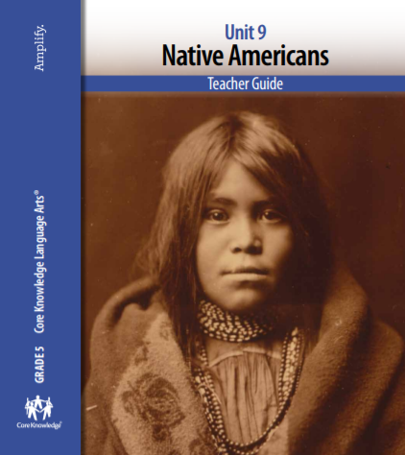
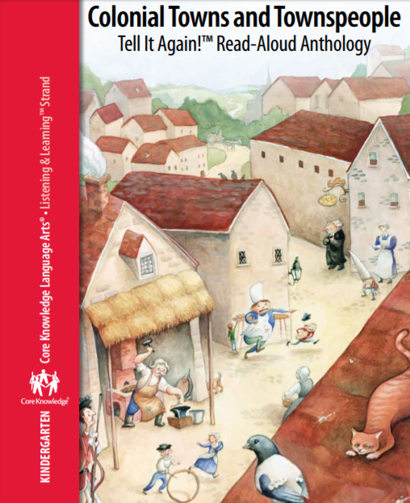
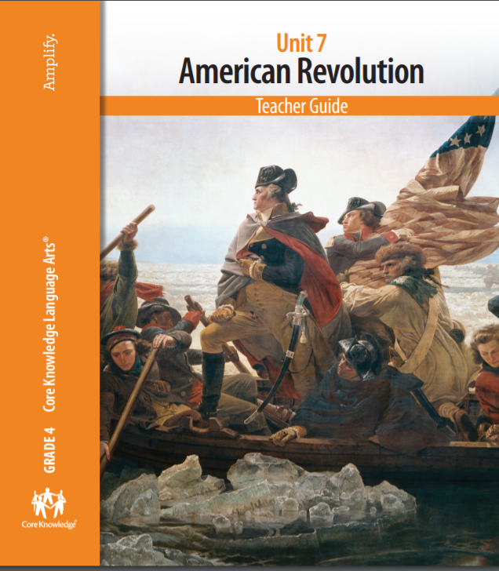

Core Knowledge Language Arts

Slide 19
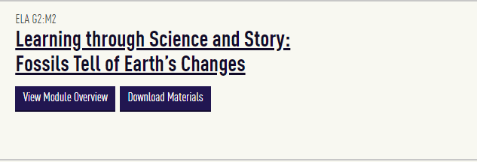
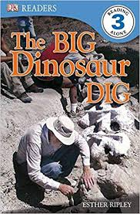
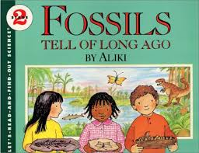

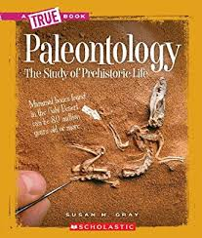
EL Education: Grade 2
Notes:
https://curriculum.eleducation.org/curriculum/ela/grade-2/module-2

Slide 20

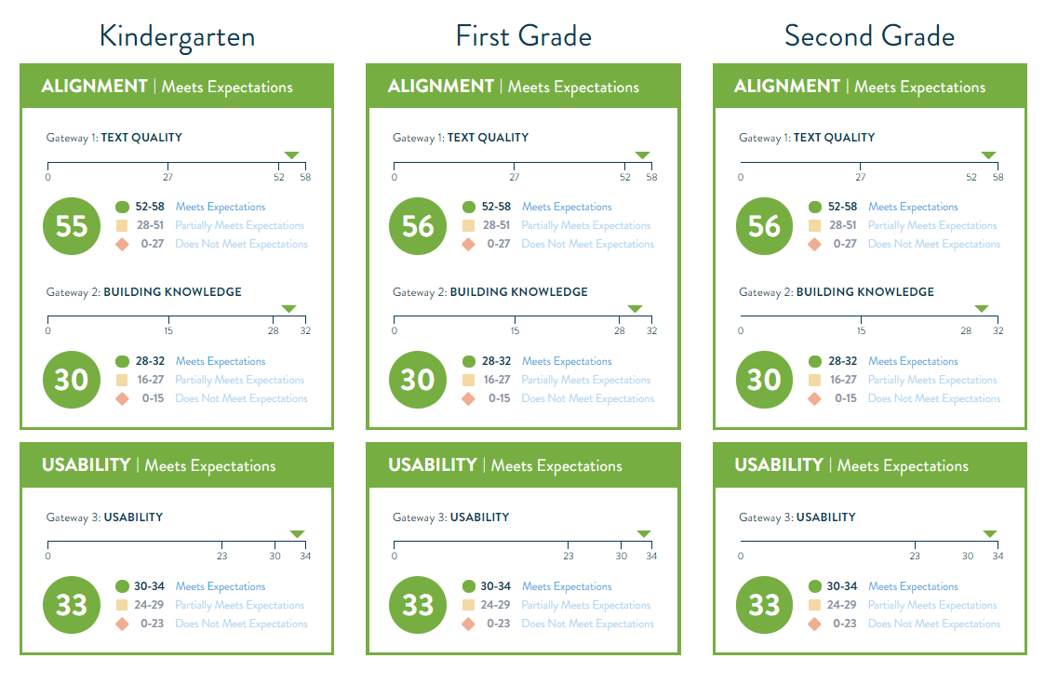
EdReports: Building Knowledge
Notes:
CKLA

Slide 21






High Quality Instructional Materials
Build Knowledge
Notes:
CKLA

Slide 22
Material Adaptations

Slide 23

Do-It-Yourself
Build off your anchor text
Select ONE topic (e.g., pharaohs of Egypt)
Create research groups (e.g., animal adaptations)

Slide 24
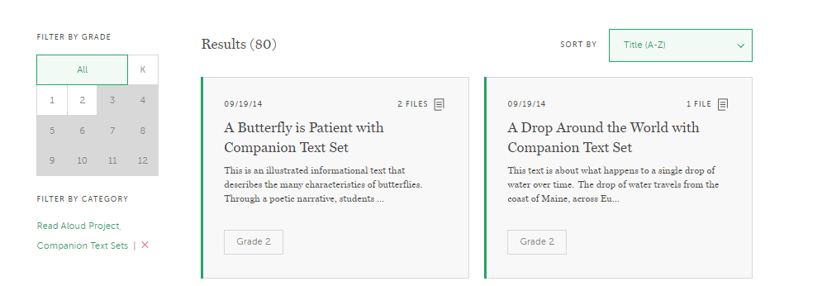
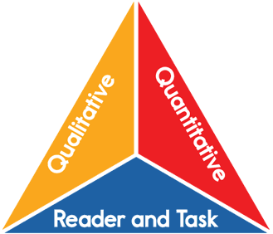

Achieve the Core Resources:
Read Aloud Project + Text Set (K-2)
+
Complexity
Knowledge

Slide 25
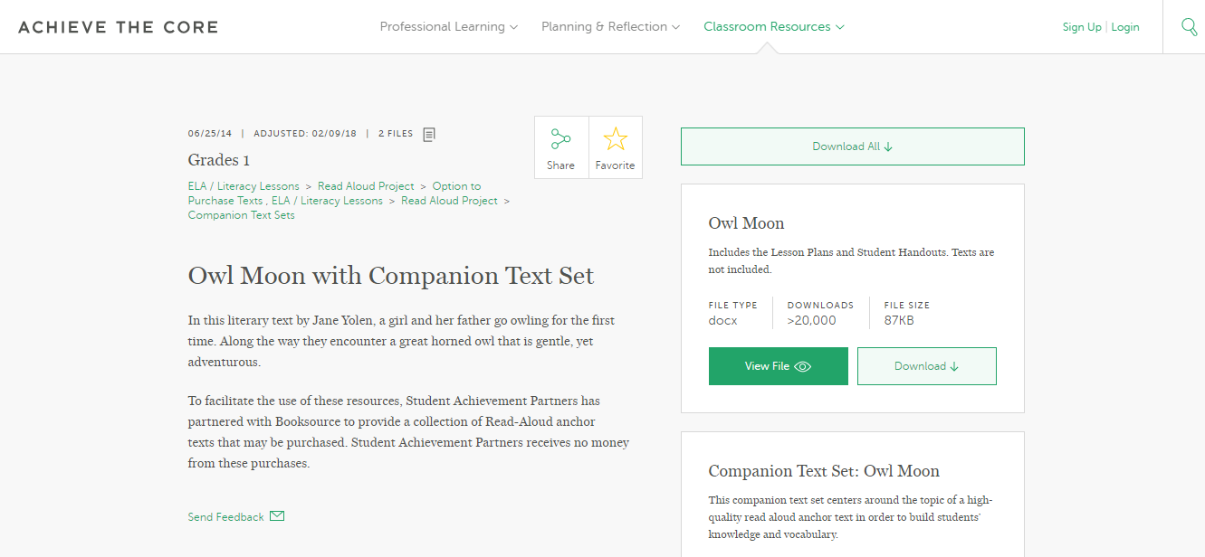

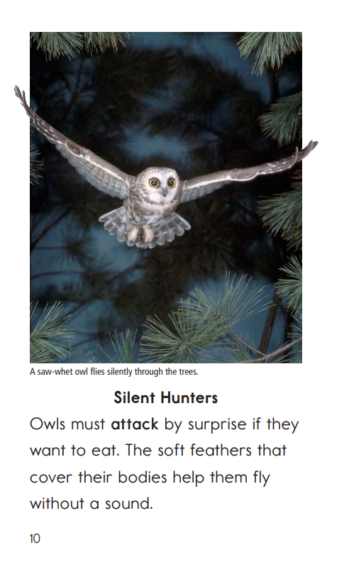

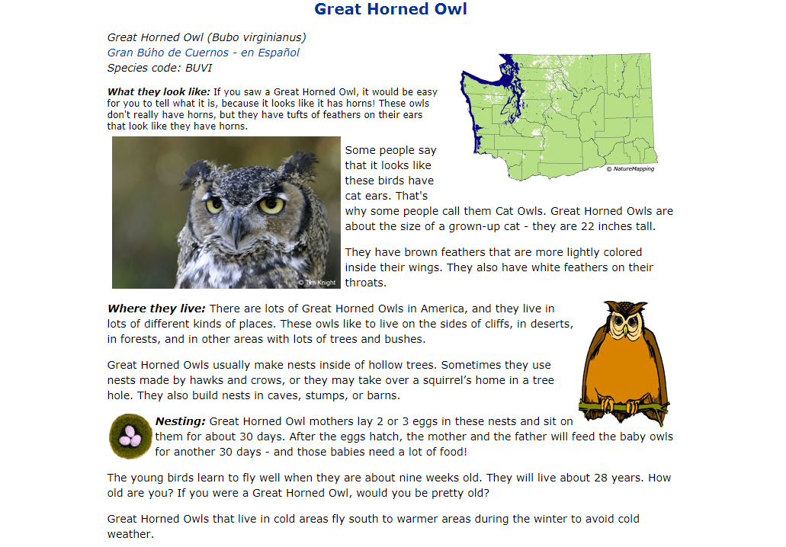
Owl Moon with Companion Text Set

Slide 26
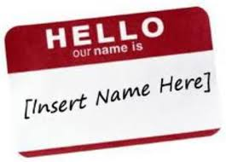
[Insert your program/text here]
Identify the knowledge found in the most complex or anchor text!
Analyze what makes that text complex.
Determine where knowledge building can enhance the student experience!
  Is the knowledge complexity high? Scaffold access!
  Is the knowledge complexity low? Build on the foundation.

Slide 27


How could you build knowledge with this text?
This week we’ll describe characters with The Snowy Day.
Notes:
“It’s February 3rd, it’s predictions week!”

Slide 28

Module 2: Connect to Practice Task
What opportunities are there to build knowledge with this anchor text?
Where might you look for these additional resources?

Slide 29
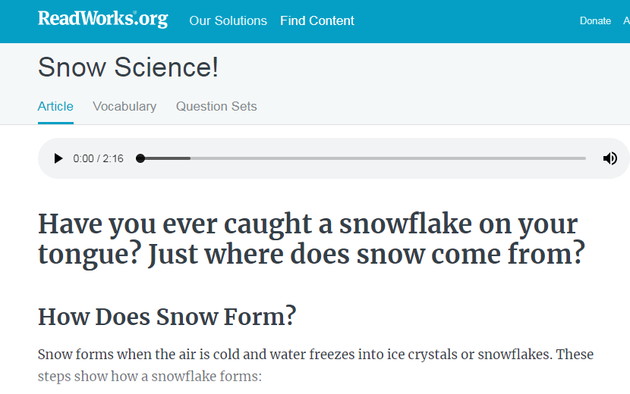
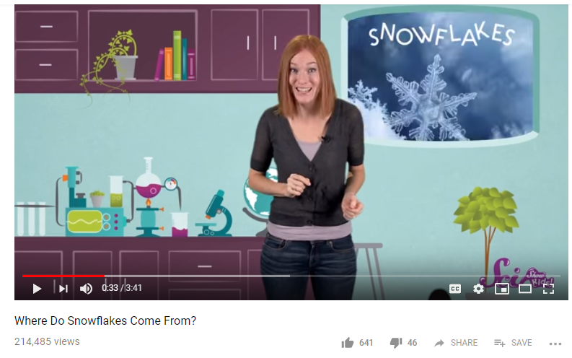





This work can be done in any of these structures!
Whole Class Instruction
Small Group Instruction
Independent Reading

Slide 30
Textbook Adaptations

Slide 31
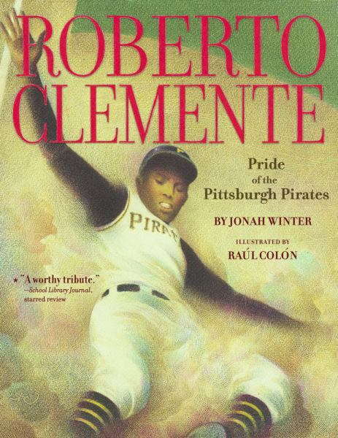
Build Off Your Read Aloud Anchor Text

Slide 32


Roberto Clemente: Amplify, Adjust, or Cut?
Read full anchor text in one day.
Read and re-read text over multiple lessons.

Slide 33
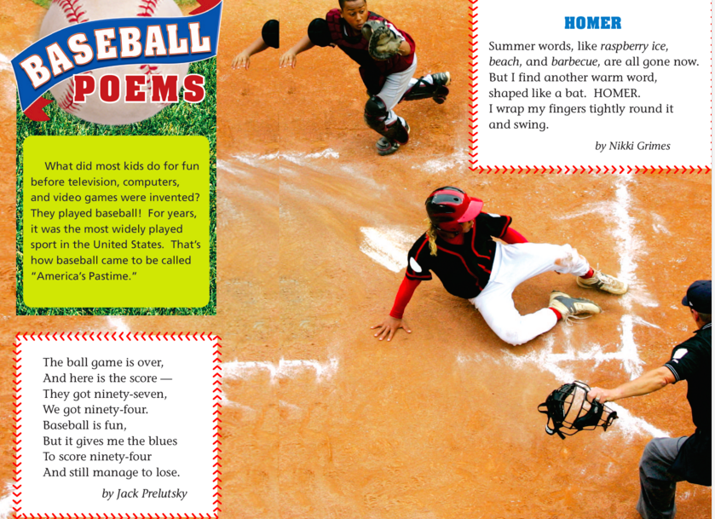
Roberto Clemente: Amplify, Adjust, or Cut?

Slide 34
Roberto Clemente: Amplify, Adjust, or Cut?
Essential Question→
What makes someone a hero?
Why was Roberto Clemente a hero to so many?

Slide 35
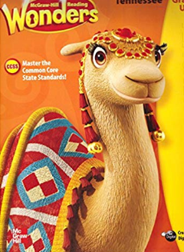
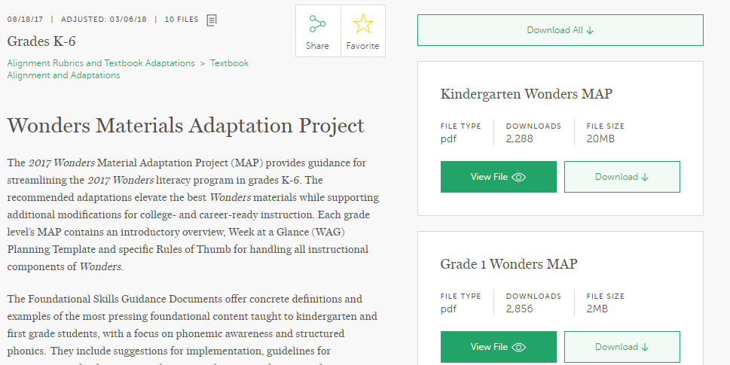
Wonders...

Slide 36
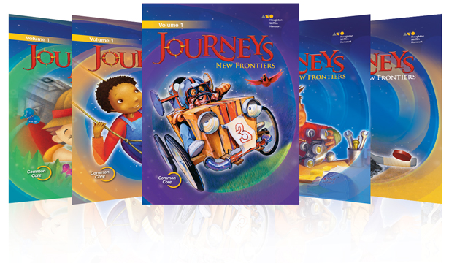
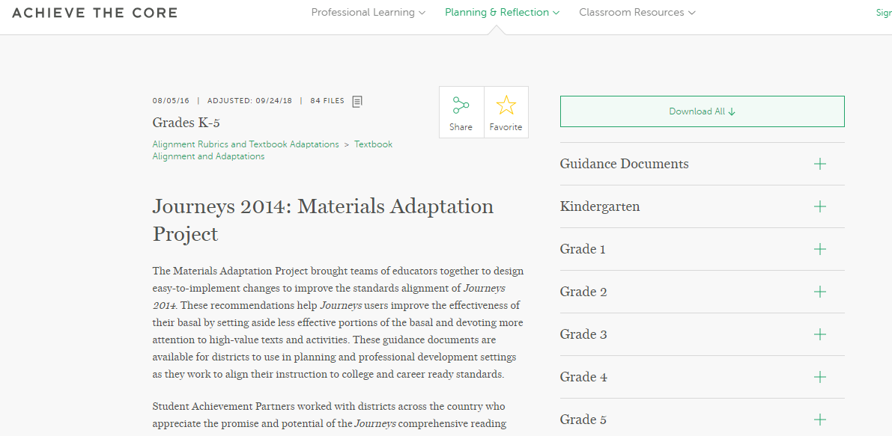
Journeys…

Slide 37

General Guidance
Amplify connected texts
Cut disconnected/extraneous materials and tasks that do not build knowledge
Adjust tasks to enhance knowledge building opportunities
Identify knowledge demands to support

Slide 38
Classroom Library Adaptations

Slide 39

Change Up the Classroom Book Baskets

Slide 40


Slide 41
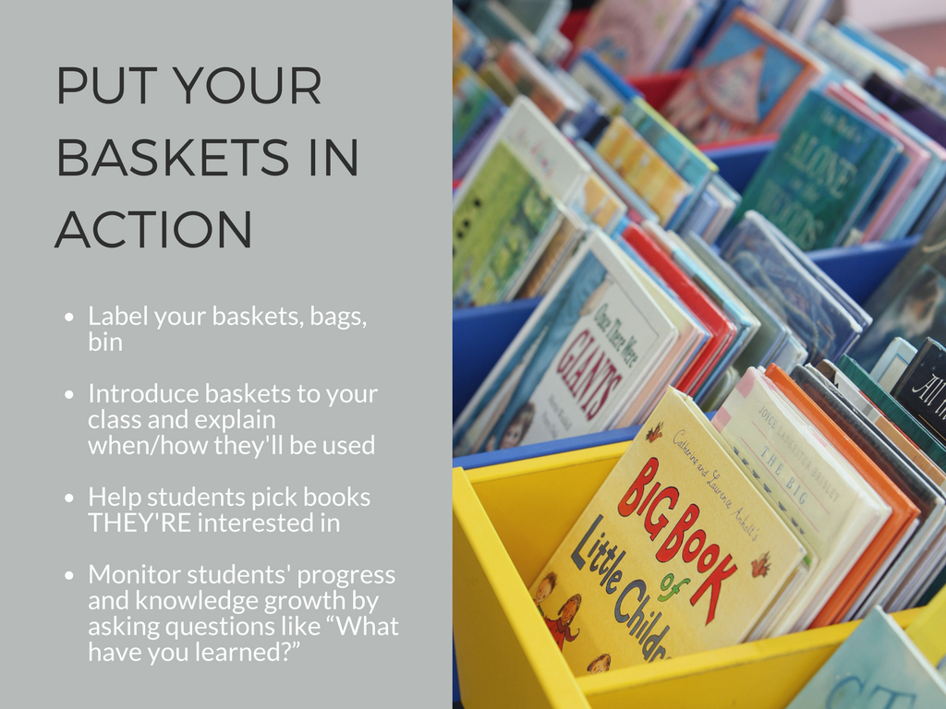
Notes:
www.achievethecore.org/book_basket

Slide 42
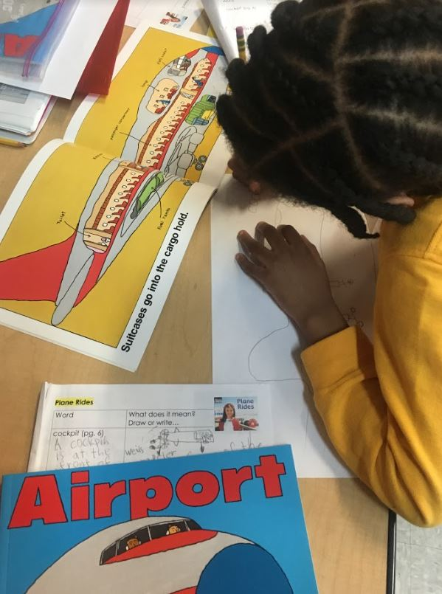
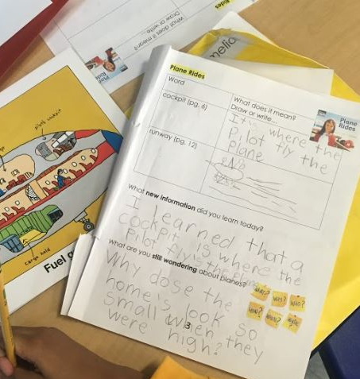
Lightweight Student Accountability for Knowledge-Building Independent Reading or Centers Work
Notes:
Cockpit
Runway
What new information did you learn today? What are you still wondering about planes?

