Slide 1
Building Knowledge: Expanding the World Through Reading
Module 1- The “Why”
Notes:
This module was last updated on June 2019.

Slide 2



Your Presenters
David Liben
Senior Fellow
Carey Swanson
Senior ELA/Literacy Content Specialist
Tori Filler
ELA/Literacy Content Specialist

Slide 3

Understand the research behind Shift 3: Build Knowledge Through Content-Rich Nonfiction.
Understand the benefits that linking texts by topic can have on students’ knowledge and vocabulary.
Identify key moves to support English Language Learners that relate to building knowledge.

Slide 4
What is “Building Knowledge”?

Slide 5






The Shifts
What makes college- and career-ready standards different?
In Mathematics:
Focus strongly where the standards focus.
Coherence: Think across grades and link to major topics within grades.
Rigor: In major topics, pursue conceptual understanding, procedural skill and fluency, and application with equal intensity.
In ELA/Literacy:
Complexity: Practice regularly with complex text and its academic language.
Evidence: Ground reading, writing, and speaking in evidence from text, both literary and informational.
Knowledge: Build knowledge through content-rich nonfiction.

Slide 6
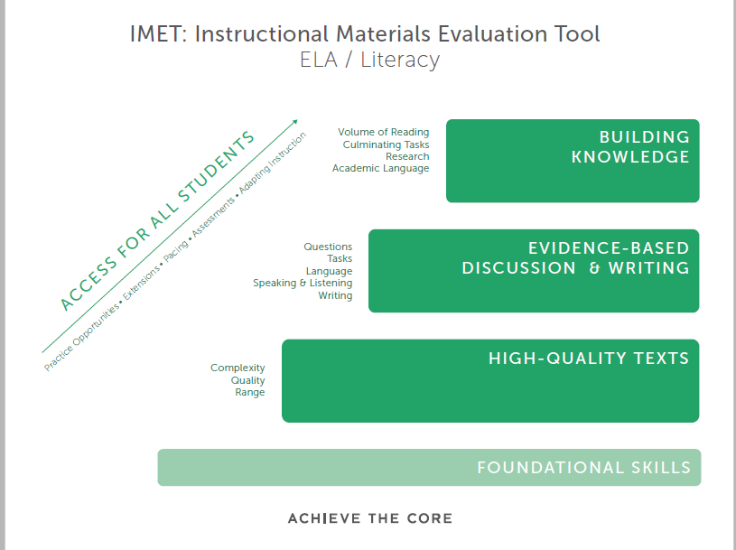
Notes:
Big Idea:
This graphic comes from the Instructional Materials Evaluation Tool (IMET). This tool helps distill the key elements of aligned instruction.

Slide 7
The Simple View of Reading
D
X
LC
=
RC
Decoding
Language Comprehension
Reading Comprehension
(Gough and Turner, 1986)

Slide 8
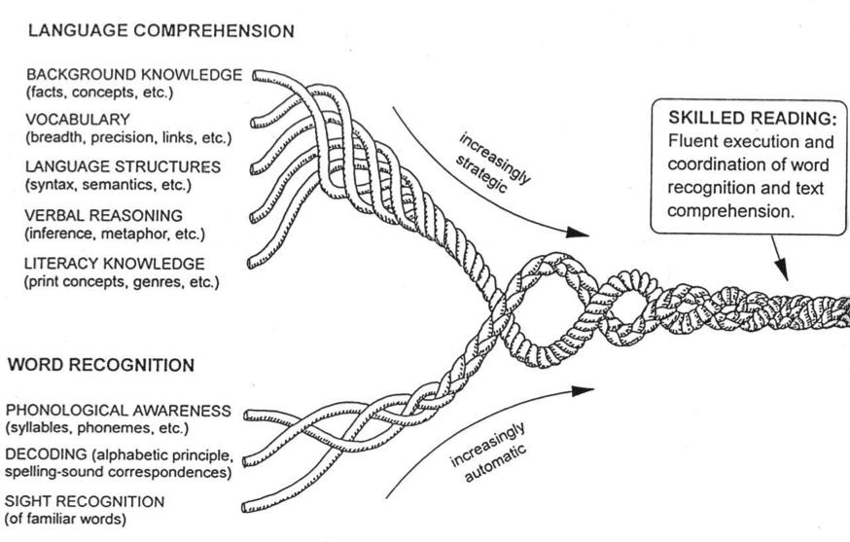
Scarborough’s Rope
Vocabulary and Knowledge
Background Knowledge
Vocabulary
Language Structures
Verbal Reasoning
Literacy Knowledge
Foundational Skills Based:
Phonological Awareness
Decoding
Sight Recognition
Scarborough (2002)
Notes:
Strands of early literacy development. Reprinted from Connecting early language and literacy to later reading (dis)abilities: Evidence, theory, and practice, by H. S. Scarborough, in S. B. Newman & D. K. Dickinson (Eds.), 2002, Handbook of early literacy research, p. 98, Copyright 2002, New York, NY: Guilford Press. Reprinted with permission.
Note from David: Should point out that there is nothing here about strategies, and that these are not all equal.

Slide 9
Reading Accelerators
Vocabulary and Knowledge
Background Knowledge
Vocabulary
Language Structures
Verbal Reasoning
Literacy Knowledge
Vocabulary and Knowledge
Foundational Skills Based:
Phonological Awareness
Decoding
Sight Recognition
Decoding and Fluency

Slide 10
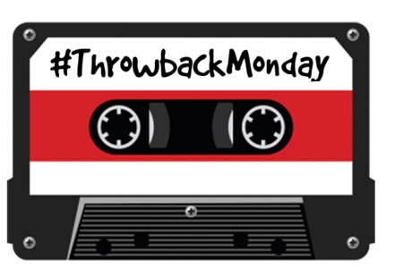
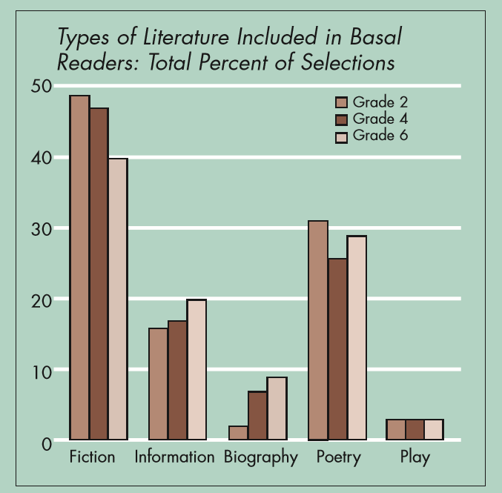
Let’s recall why this was a “Shift” at all!
?
Moss and Newton (2002)
Notes:
Ask: What types of literature were included 2002 basal readers? What percentage were informational texts?
“Studies since the mid-1980s have consistently shown that basal readers include very little informational text. For example, Flood and Lapp (1986) looked at the first- through sixth-grade content of eight basals finding that narrative selections accounted for more than 66 percent of the pages. Smith (1991), who looked at the content of three basals for grades one, three, and five, found that 15 to 20 percent was nonfiction content. More recently, Moss and Newton (2002) examined how many selections from informational trade books were included in six popular basal readers published from 1995 to 1997.”
Susan B. Neuman
http://www.aft.org/sites/default/files/periodicals/Neuman.pdf

Slide 11




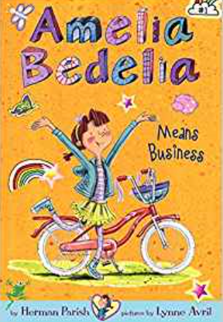

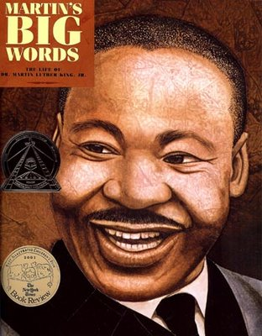
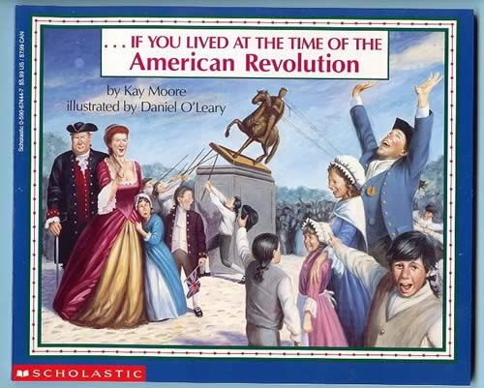
What This Meant!
A whole lot of…
And not a whole lot of…
Notes:
…and that doesn’t mean that we abandon the great literature on the left, but that we create balance!

Slide 12


Pause and Reflect
When you ask your students, “What are you learning about in reading?”—
what do you expect them to say?

Slide 13

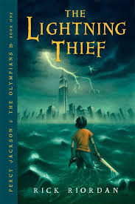
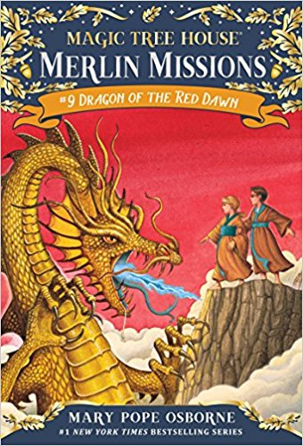


Building Knowledge with Fiction Texts
Notes:
Magic Tree House: Jack and Annie are headed to a land of fierce samurai and great beauty, the capital city of Edo (now the city of Tokyo), in ancient Japan in the 1600s. They bring only a research book to guide them and a magic wand with three special rules.
Pink and Say Patricia Polacco: The story is about two boy soldiers who meet each other in the battlefield during the American Civil War.
Lightening Thief: The Lightning Thief is an American fantasy-adventure novel based on Greek mythology.
A Day with Yayah: Set in the Nicola Valley, British Columbia, in Canada's westernmost province, a First Nations family goes on an outing to forage for herbs and mushrooms. A grandmother passes down her knowledge of plant life and the natural world to her young grandchildren.

Slide 14
What does it really mean to “build knowledge”?

Slide 15
What is the central idea of this excerpt of text?
“This mandala from the Sakya School of Tibetan Buddhism depicts the Hevajra Mandala, which is associated with one of the most important Dakini Tantras. It is in the lineage of the tenth-century Indian mahasiddha Dombipa, shown with his dakini consort riding on a tiger (upper-left corner). The lama in the upper-right corner is Kunga-Nyingpo, a Sakya lama considered to be a pre-incarnation of the soul destined to become one of the Dalai Lamas. Two Sakya dharma protectors adorn the lower corners.
TASK: What would you have to know more about to make more meaning from this text?
Notes:
Pause and make a list

Slide 16

Does this image help you make more meaning?
Mandala of Hevajra and Dakini Nairatmya
Tibet; 17th century

Slide 17

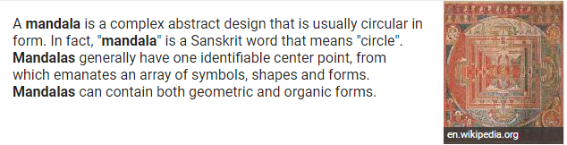
Do the pictures and vocab here help you make more meaning?

Slide 18
Do these text excerpts help?
The Secret World of the Tantra
His Holiness the 14th Dalai Lama of Tibet
There’s more to Tantra than you might think! Join us for a special tour series to illuminate the esoteric rituals of Tantra, which its practitioners believed would provide a faster path to enlightenment. Explore the iconography and symbols in Tantric artwork and how they relate to the practice of achieving Buddhahood in one lifetime.
Source: Rubin Museum art exhibit
The Dalai Lamas are believed to be manifestations of Avalokiteshvara or Chenrezig, the Bodhisattva of Compassion and the patron saint of Tibet. Bodhisattvas are realized beings inspired by a wish to attain Buddhahood for the benefit of all sentient beings, who have vowed to be reborn in the world to help humanity.
Source: Dalai Lama biography
Notes:
Excerpt 1 from http://rubinmuseum.org/events/event/the-secret-world-of-tantra-01-11-2017
Excerpt 2 from https://www.dalailama.com/the-dalai-lama/biography-and-daily-life/brief-biography

Slide 19
Let’s try it again:
What is the central idea of this excerpt of text?
“This mandala from the Sakya School of Tibetan Buddhism depicts the Hevajra Mandala, which is associated with one of the most important Dakini Tantras. It is in the lineage of the tenth-century Indian mahasiddha Dombipa, shown with his dakini consort riding on a tiger (upper-left corner). The lama in the upper-right corner is Kunga-Nyingpo, a Sakya lama considered to be a pre-incarnation of the soul destined to become one of the Dalai Lamas. Two Sakya dharma protectors adorn the lower corners.
Notes:
Pause and make a list

Slide 20


Did that task help build your knowledge ?

Slide 21

What To Do About Vocabulary and Knowledge
“Building knowledge systematically in English language arts is like giving children various pieces of a puzzle in each grade that, over time, will form one big picture…”
Notes:
Big Idea: Does anyone know where this passage comes from? From the Common Core State Standards, page 33.
Details:
This begins in the earliest grades through reading aloud content-rich grade appropriate texts.
Building knowledge systematically in English language arts is like giving children various pieces of a puzzle in each grade that, over time, will form one big picture. At a curricular or instructional level, texts—within and across grade levels—need to be selected around topics or themes that systematically develop the knowledge base of students. Within a grade level, there should be an adequate number of titles on a single topic that would allow children to study that topic for a sustained period. The knowledge children have learned about particular topics in early grade levels should then be expanded and developed in subsequent grade levels to ensure an increasingly deeper understanding of these topics. Children in the upper elementary grades will generally be expected to read these texts independently and reflect on them in writing. However, children in the early grades (particularly K–2) should participate in rich, structured conversations with an adult in response to the written texts that are read aloud, orally comparing and contrasting as well as analyzing and synthesizing, in the manner called for by the Standards. Preparation for reading complex informational texts should begin at the very earliest elementary school grades. What follows is one example that uses domain specific nonfiction titles across grade levels to illustrate how curriculum designers and classroom teachers can infuse the English language arts block with rich, age-appropriate content knowledge and vocabulary in history/social studies, science, and the arts. Having students listen to informational read-alouds in the early grades helps lay the necessary foundation for students’ reading and understanding of increasingly complex texts on their own in subsequent grades.

Slide 22
Research: The Role of Knowledge

Slide 23
Everyone knows knowledge plays a role in comprehension, but how big of a role?
Notes:
No one disputes that prior knowledge is important to comprehension, but when students struggle with comprehension, we rarely focus on building knowledge as our primary intervention. Instead we practice comprehension strategies, attempt to build stamina, or simply ask kids to practice.
When many things seems important, knowing how big the impact of each factor is, helps us to choose an area to focus on.

Slide 24

“The Baseball Study”
Recht & Leslie (1988)
Notes:
Recht and Leslie sought to answer exactly this question, by comparing the relative impact of reading ability to the impact of knowledge of a topic. They had students read a passage about baseball and then tested students comprehension of the passage.
“Effect of Prior Knowledge on Good and Poor Readers‘ Memory of Text” from Journal of Educational Psychology 1988, Vol. SO, No. 1, 16-20
Had 7th and 8th grade students read a short text about baseball and tested them for comprehension using:
Verbal retelling
Reenactment with figurines
Verbal summary
Rating ideas from the story in terms of importance.

Slide 25

“The Baseball Study”
Recht & Leslie (1988)
Compared reading comprehension for four categories of students:
High reading ability High knowledge of baseball | High reading ability Low knowledge of baseball
Low reading ability High knowledge of baseball | Low reading ability Low knowledge of baseball
Pause to make your predictions
Notes:
Quick check for understanding/following along. Ask people who they think was in each category (i.e. likely “jocks” in the low reading ability, high baseball knowledge group; “nerds” in the high ability low knowledge of baseball group).
The students in these 4 groups read a passage about baseball and then took a test of their comprehension. Ask participants to predict what % of questions on a reading comprehension test each category of student would get right. The best is for them to draw a grid on their paper and put an actual % of predicted questions correct in each quadrant. Tell them that the colors are so they can quickly match the group with the graphs on the next slide.
Technical Notes:
“The high-ability /high-knowledge cell had 10 boys and 6 girls; the high ability/low-knowledge cell had 3 boys and 13 girls; the low-ability/
high-knowledge cell had 12 boys and 4 girls; and the low-ability/low knowledge cell had 7 boys and 9 girls.”
High reading ability was defined as 70th percentile or higher on a standardized test of reading. Low reading ability was defined as 30th percentile or lower.
High knowledge of baseball was defined as 70th percentile or higher on a test of baseball knowledge. Low baseball ability was defined as 30th percentile or lower.

Slide 26
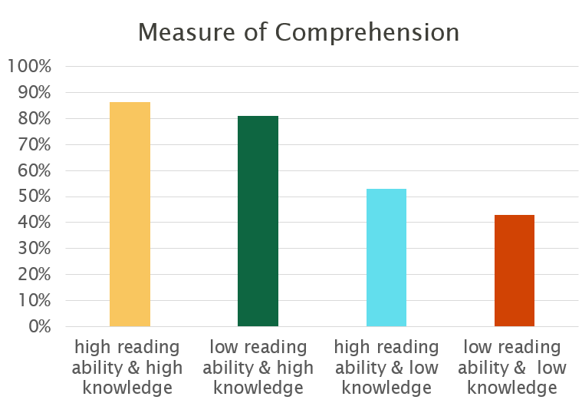
Notes:
After they predict percentages, show them this slide and give them a minute to take it in. They should notice that the low reading ability students with high knowledge outperformed the high reading ability students with low knowledge. In addition there is little difference between the two high knowledge groups and the two low knowledge groups.
from pg. 18, table 1, Recht & Leslie 1988. (Qualitative Measure) Note: conversion from raw numbers to percentages achieved by dividing score by achieved by total possible score.
Frequently Asked Questions:
Is this study generalizable? Yes! In fact a European study replicated the finding exactly with students of a totally different background on the topic of soccer. Additional research has shown similar results on a wide variety of other topic and subject areas.
Is the impact here from knowledge or from interest? Knowledge. It’s hard to disentangle these variables, but a separate study using basketball was able to distinguish the two and found that the one that had the major impact was knowledge.
If knowledge is so important does this undermine the value of close reading? No. Close reading teaches students how to gain knowledge from text by attending to it carefully. But, as we will soon discuss, high volume reading of informational text is also necessary to build the base of knowledge and vocabulary necessary to succeed with close reading. This is a BOTH, AND type of question, not an either or.

Slide 27

Findings of the “Baseball Study”
Knowledge of the topic had a MUCH bigger impact on comprehension than generalized reading ability did (p. 18).
With sufficient prior knowledge, “low ability” students performed similarly to higher ability students (p. 19). The difference in their performance was not statistically significant.
Notes:
The second bullet point here has a big implication for student scaffolds. By helping students build their knowledge, “low readers” can perform at levels similar to “high readers.”
Reference:
“With adequate prior knowledge, those students who are comprehending below the 30th percentile on the SRA [standardize reading assessment] are comparable with those above the 30th percentile in reenactment, verbal recall, and the ability to summarize text.” (pg. 19)

Slide 28

A student doesn’t have ONE level.
Each student has MANY LEVELS depending on topic & knowledge.
Implications
Notes:
This research is in direct opposition to current instructional practice where we identify a reader by an F & P level, and if you are a level J then you read only level J books. But a level J reader on science passages may be a level T reader on explorers, if they have knowledge of that topic. By letting them read only level J texts we deny them access to more complex text that they could access and learn from on a topic on which they have knowledge.

Slide 29
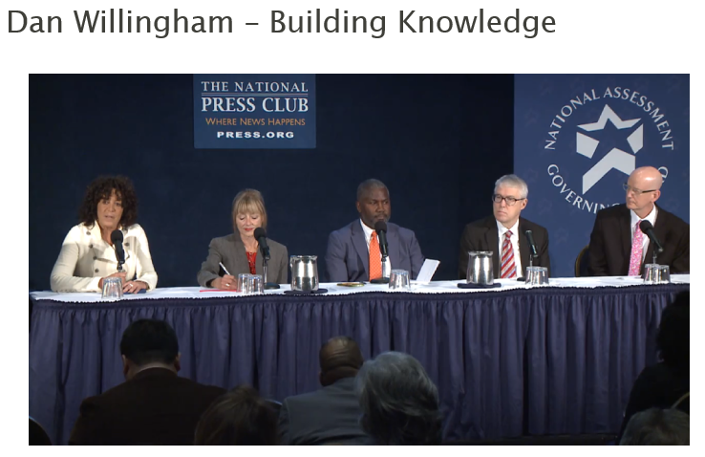
https://www.youtube.com/watch?v=9LKTVC9jEdM
Begin at the 7:20 minute mark and watch until the 11:37 minute mark.

Slide 30
Pause and Reflect
“How are we going to ensure that all of our students have that type of broad knowledge that will allow them to tackle any text that they encounter?”
“Once kids are fluent decoders, a key determinant of comprehension is what kids know about the topic of the texts they are about to read.”
What do these quotes from Dr. Dan Willingham mean for your work with students?

Slide 31
Why do we use the phrase “BUILDING knowledge”?
All students come to school with their own
background knowledge about the world.
Notes:
Big idea: background is as unique and varied as the children themselves. It will be uneven no matter what the topic or subject is to ask students to activate their background knowledge. We can’t count on commonality of background knowledge and doing so leaves some students out of the conversation since they lack content, no matter what the content is.

Slide 32

Why do we use the term “BUILDING knowledge?”
background knowledge
…schools are not in the business of background knowledge!
But schools can build students’ general knowledge of the world

Slide 33





Our Job
Our job is to build knowledge for all students through careful selection of knowledge-rich resources and supporting activities.
Notes:
WHICH knowledge can be a local choice.

Slide 34
Knowledge’s Relationship with Vocabulary
Notes:
Big Idea: Shift 1, regular practice with complex text and its academic language, demonstrates the importance of focusing on vocabulary and syntax in the Common Core State Standards. Vocabulary is integral to building knowledge and some of the strategies for growing vocabulary compliment strategies for building knowledge.
Details:
Appendix A of the CCSS ELA/Literacy contains a section devoted to acquiring vocabulary (pages 32-35). This section is well worth digging into if you are looking for additional PLC or training resources.

Slide 35
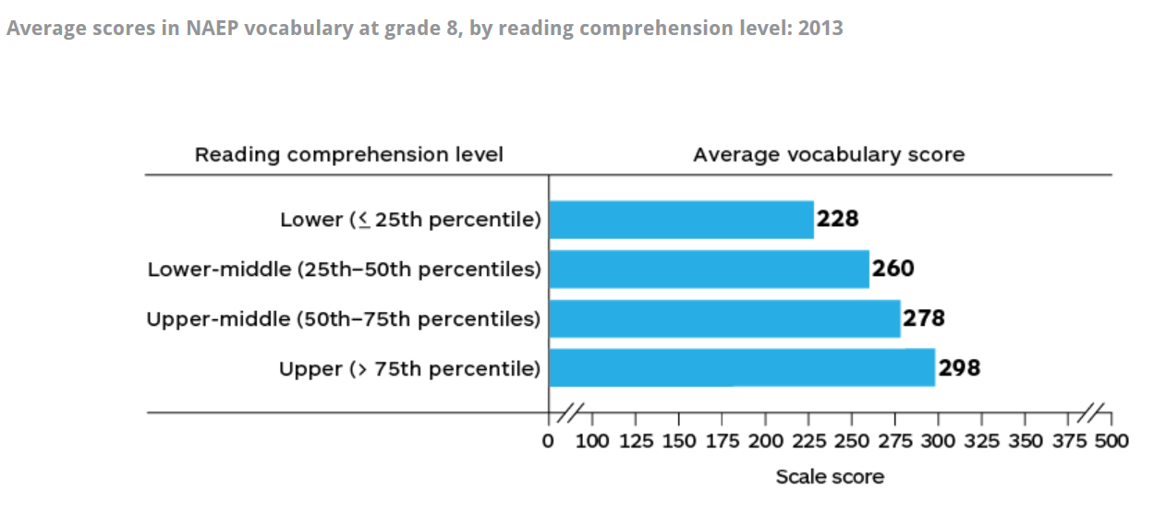
Vocabulary and Comprehension Are Tightly Linked
Notes:
Big Idea: Academic vocabulary and knowledge are tightly linked
Students who performed well on the vocabulary questions also performed well overall in reading comprehension.
https://www.nationsreportcard.gov/reading_2013/vocabulary/#comprehension
(Recall the importance of the ACT research in “Reading Between the Lines” how can students stand up to these demands without knowledge of words and the world?!)
Background: Structure of NAEP
Comprehension Full-length passages containing up to:
800 words at grade 4 1,000 words at grade 8 1,200 words at grade 12 Approximately 10 multiple-choice and constructed-response questions, 2 of which were multiple-choice vocabulary questions

Slide 36
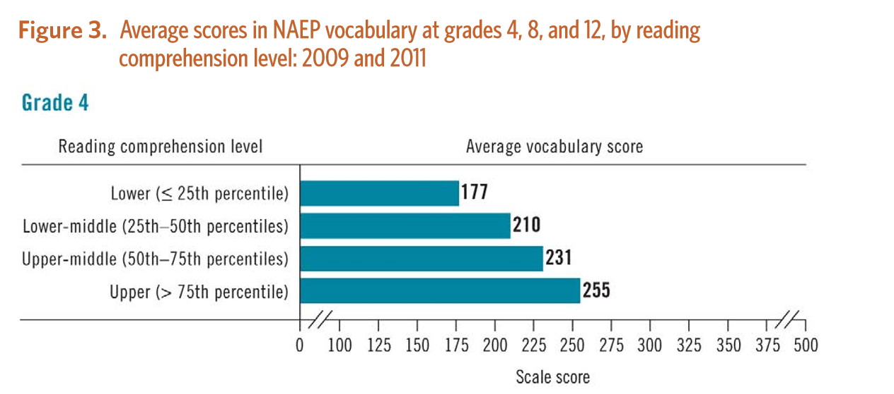
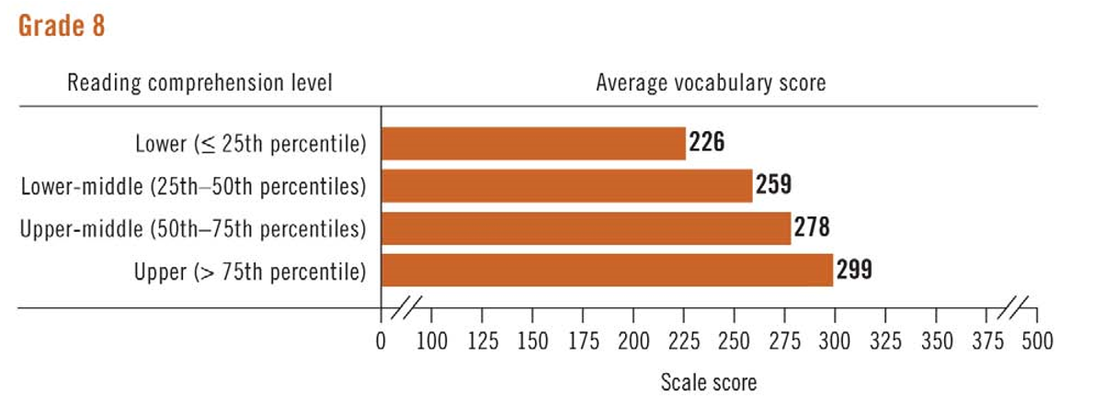
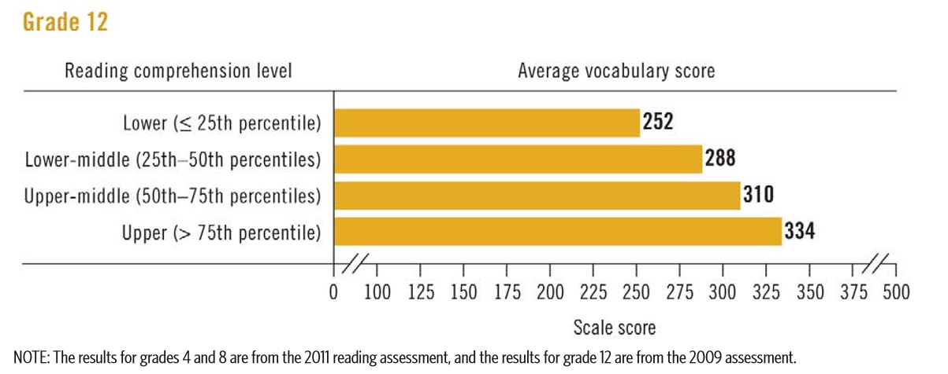
Correlations Remains Across Grade Level
Notes:
https://nces.ed.gov/nationsreportcard/pdf/main2011/2013452.pdf
At all three grades, students who had the highest average vocabulary scores in 2013 were the students performing above the 75th percentile in reading comprehension; and students who had the lowest vocabulary scores were those students performing at or below the 25th percentile in reading comprehension.

Slide 37
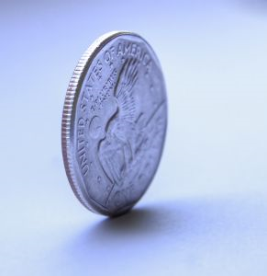
Two Sides of the Same Coin
Knowledge
Vocabulary
Notes:
It makes sense that vocabulary and comprehension are so tightly linked because knowledge and vocabulary grow together. The more you learn about the world, the larger your vocabulary gets. The more you know about the world and the more words you know, the better comprehension you demonstrate because of that knowledge.

Slide 38
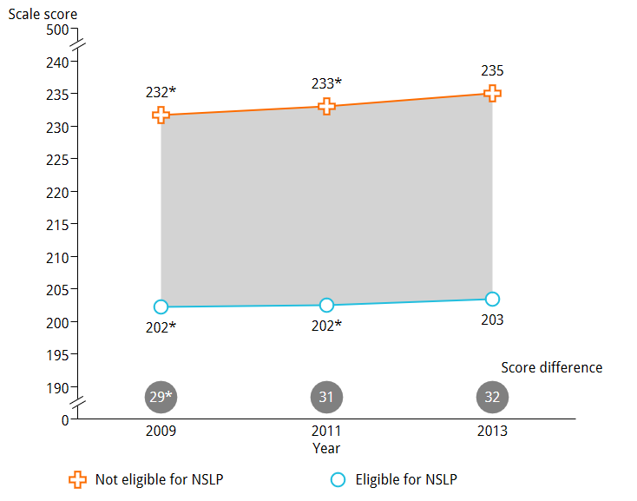
Vocabulary Gap by Income (National School Lunch Program)
Grade 4
Notes:
But, there is a clear gap in vocabulary knowledge. Here we can see that gap by income level.
At grade 4, the 32-point score gap in 2013 between fourth-graders who were not eligible for the National School Lunch Program (NSLP) and fourth-graders who were eligible was not significantly different from the gap in 2011, but was larger than the gap in 2009.
https://www.nationsreportcard.gov/reading_2013/vocabulary/#achievement-gaps

Slide 39
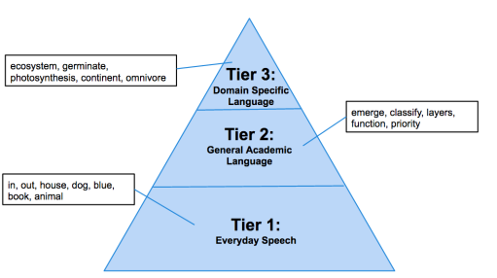
Building Knowledge Also Builds Vocabulary!

Slide 40
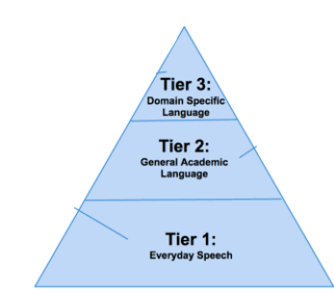
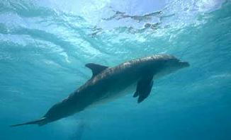
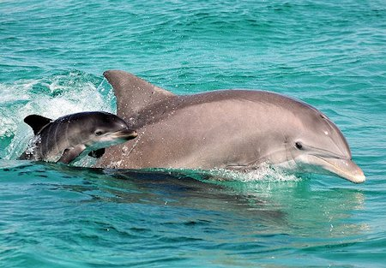
“Dolphins ascend to the surface to breathe through their blowholes, and descend once again to locate their prey underwater. Some large dolphins eat marine mammals, but most dolphins feed on fish.”
v
Building knowledge also builds vocabulary!
Tier 3: domain-specific vocabulary
Tier 2: high-leverage academic vocabulary

Slide 41

Did you know?
Pause to make a prediction
Students typically learn between _____________ and
__________ new words a year.
1,000
2,000
Biemiller, 2010; Anderson and Nagy, 1992
Notes:
In Grades K–2, they need to learn 1,000 to 2,000 words per year (Biemiller, 2010; Anderson and Nagy, 1992) to stay on track.

Slide 42


We learn lots of new words from context.
Vocabulary can be built through words students are reading (or hearing in context through read aloud), not just words you directly teach!

Slide 43
The Opportunity Gap at Work
Below Level: shelter, splattered, fixed, rescue
On Level: journal, tremors, traction, interval, volunteered, retrieve
Above Level: generation, abandoned, languished, terrified, warble, galvanized, debris, hoisted, shuddered
Notes:
Leveled readers and basal leveled texts

Slide 44
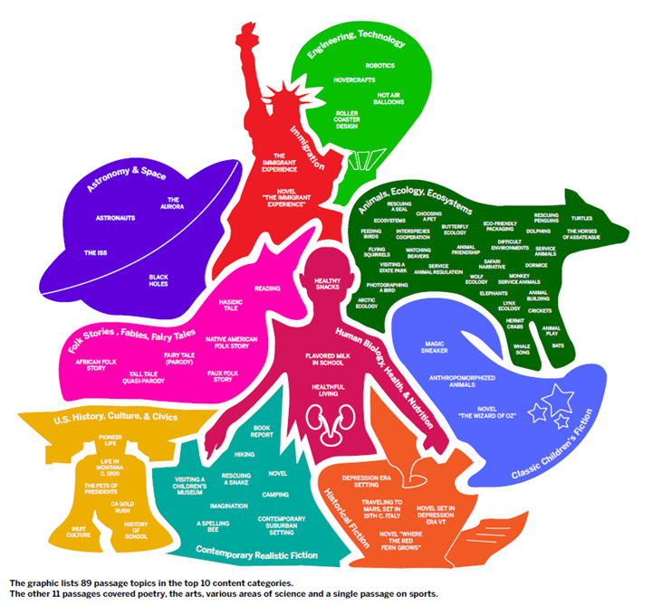
Learning to Read, a Primer Part 2
Center for Early Reading
Amplify
Top 10 topics by content on standardized tests
Notes:
Source: https://go.info.amplify.com/hubfs/Primer%20II/Primer2_2018_Final.pdf

Slide 45
Building Knowledge:
Supporting English Language Learners

Slide 46

These Strategies
Good for everyone!
Best for English Language learners!

Slide 47
Old Paradigm
Content
Language
Source: Understanding Language Project

Slide 48
Leveling Students OUT of Tier 2 and Tier 3 Instruction

Slide 49
What happens if we focus only on “Everyday Speech”?

Slide 50
New Paradigm
ELs must have full access to high-quality English language arts, mathematics, science, and social studies content, as well as other subjects, at the same time that they are progressing through the ELD-level continuum.
Language
Discourse
Text (complex text)
Explanation
Argumentation
Author Purpose
Text Structures
Sentence Structures
Vocabulary
Grammar
Content
Source: Understanding Language Project
Notes:
First, the CA ELD Standards highlight and amplify those CA CCSS for ELA/Literacy that promote ELs’ abilities to interact in meaningful ways during rich instruction so that they develop both English and content knowledge.
Second, the CA ELD Standards guide teachers to build ELs’ knowledge about how the English language works in different contexts to achieve specific communicative purposes.

Slide 51
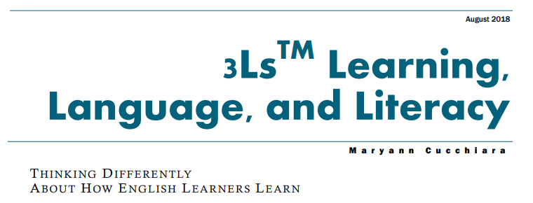
What does this look like in action?
LEARNING: as the content objectives
LANGUAGE: as the words to express the content
LITERACY: as the tools for interacting with the content
Notes:
Work comes from https://www.cgcs.org/cms/lib/DC00001581/Centricity/Domain/251/2018_09%20Final%203Ls%20Brochure--non-booklet.pdf

Slide 52


Supporting English Language Learners
An Annotated Bibliography Curated by Student Achievement Partners
Opportunities to engage with complex text
Opportunities for student talk

Slide 53

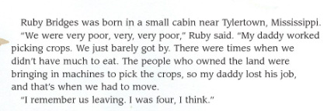
Supporting Action 1A:
Select grade-level complex anchor texts that:
• Are brief and engaging to students.
• Feature a variety of academic vocabulary words for potential study.
• Are connected to a given unit of study and build student knowledge on the topic.
• Provide details and examples that help students understand new concepts and vocabulary.
• Contain ideas that lend themselves to students thinking, writing, and talking about the text from a variety of perspectives.
Notes:
https://achievethecore.org/page/3165/supporting-english-language-learners-an-annotated-bibliography-curated-by-student-achievement-partners
Key Source: Key Source: Council of the Great City Schools. (2017). Re-envisioning English Language Arts and English
language development for English language learners.

Slide 54


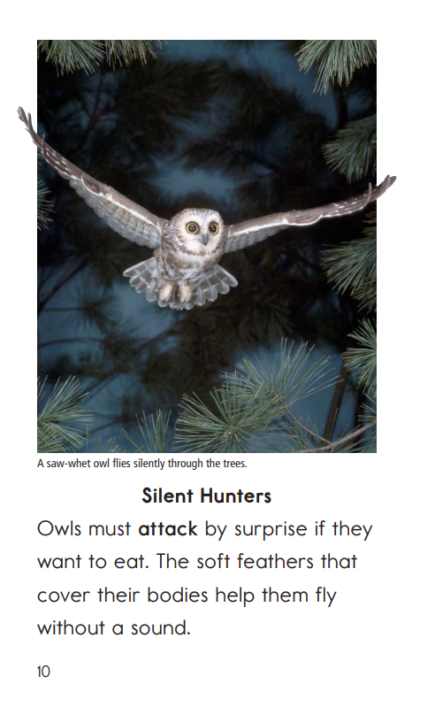
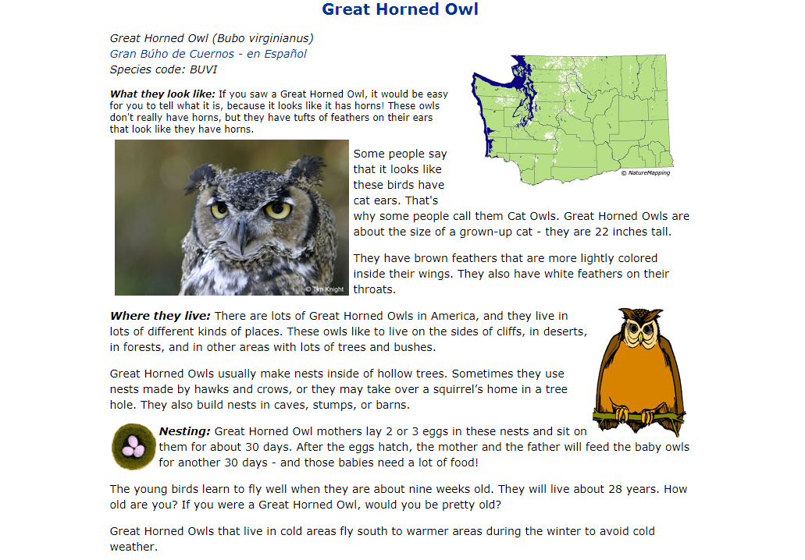
Supporting Action 1B:
Engage students in reading auxiliary texts and reviewing resources (illustrations, photographs, video
clips) on the topic tied to the anchor text to build the knowledge and vocabulary necessary for students
to tackle grade-level complex text.
Notes:
Key Source: August, D., Fenner, D. S., & Snyder, S. (2014). Scaffolding instruction for English language
learners: A resource guide for English Language Arts. Washington, DC: American Institutes for Research.
Retrieved from https://www.engageny.org/resource/scaffolding-instruction-english-language-learners-
resource-guides-english-language-arts-and
Key Source: Council of the Great City Schools (2017). Re-envisioning English Language Arts and English
language development for English language learners. Retrieved from
https://www.cgcs.org/cms/lib/DC00001581/Centricity/Domain/4/CGCS_ReinvisEngLang_pub_final.pdf

Slide 55
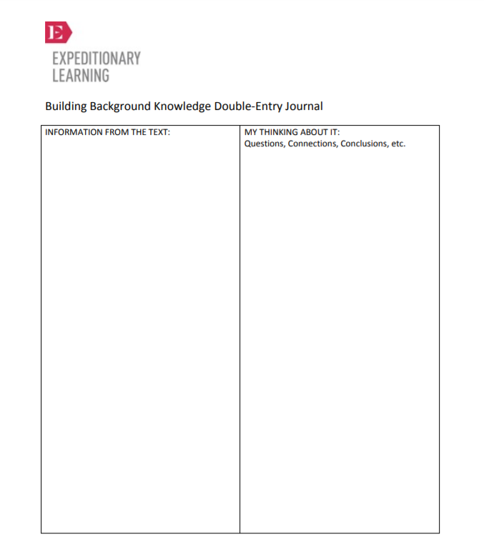
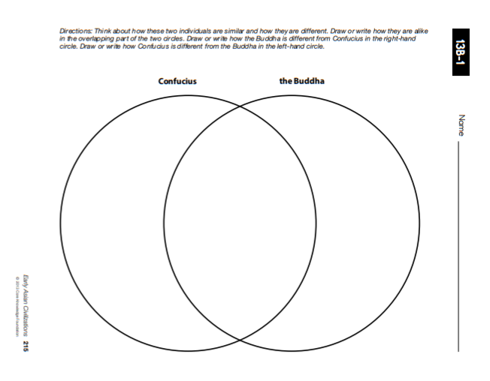
Supporting Action 1F:
Provide graphic organizers (or other tools, such as in-text highlighting and annotating) to help students capture and reflect on new knowledge. Graphic organizers can support students in preparing for content-focused writing and discussion.
Notes:
Key Source: August, D., Branum-Martin, L., Cardenas- Hagan, E., & Francis, D. J. (2009). The impact of an instructional intervention on the science and language learning of middle grade English language learners. Journal of Research on Educational Effectiveness, 2(4), 345-376. doi:10.1080/19345740903217623
Key Source: Baker, S., Lesaux, N., Jayanthi, M., Dimino, J., Proctor, C. P., Morris, J., Gersten, R., Haymond, K., Kieffer, M. J., Linan-Thompson, S., & Newman-Gonchar, R. (2014). Teaching academic content and literacy to English learners in elementary and middle school (NCEE 2014-4012). Washington, DC: National Center for Education Evaluation and Regional Assistance (NCEE), Institute of Education Sciences, U.S. Department of Education. Retrieved from the NCEE website: http://ies.ed.gov/ncee/wwc/publications_reviews.aspx
https://www.engageny.org/resource/grades-3-5-ela-curriculum-appendix-2-graphic-organizers
http://mc-14193-39844713.us-east-1.elb.amazonaws.com/resource/grade-2-listening-learning-domain-2-anthology-early-asian-civilizations

Slide 56

Objective 2
Provide daily opportunities for students to talk (and listen to others talk) about content, anchored around topics present in the texts they are reading, to build their confidence and knowledge, and practice newly acquired skills.

Slide 57
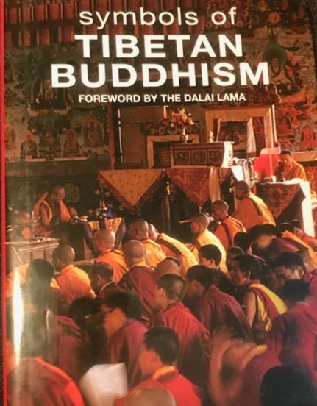

Pause and Reflect
What did this approach do for your learning?
How might this be enhanced further when working with English Language Learners?

Slide 58
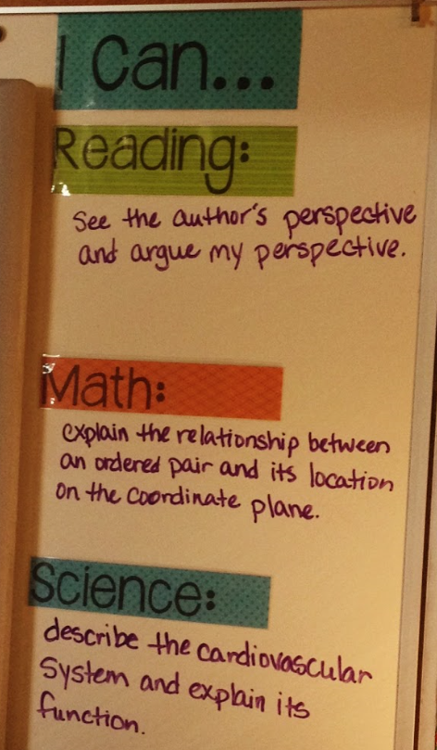

Within a Lesson…
What knowledge do I want students to gain?
What do you notice about building knowledge in relation to these objectives?
Notes:
Big Idea: Focus your lesson around building knowledge of the text and knowledge of the world.
Notes:
We sometimes set our lessons up to be focused around strategies or skills, instead of content. Look at the content a student is walking away with during the science lesson. During the reading lesson, students are focused on seeing the author’s perspective, instead of digging into the knowledge of the text.

Slide 59

Module 1: Connect to Practice Task
Option A:
Teacher option
Select a text that you have taught or will be teaching.
Identify the knowledge demands of the text. What does the author expect the reader to know and understand to make meaning?
Option B:
Take a stand: Select an audience and make a one page “flyer” or “advertisement” explaining the benefits of a building-knowledge approach to content in the ELA classrooms.

