Slide 1
High School Modeling: Best Practices for Implementing High-Intensity Tasks for All Students
The webinar will begin shortly.
Check your Resource widget to preview the resources for today’s session!
Use the Group Chat to introduce yourself!
You can also use this time to consider this task:
Core Advocates Monthly Webinar
December 4, 2019
Estimate the total number of text messages that are sent monthly by all Americans.
Explain your answer using numbers, words, and/or pictures. Include any assumptions you used.

Slide 2
Introductions
Your hosts from Student Achievement Partners:
Pascale Joseph Project Coordinator,
Tools and Classroom Resources, SAP
This month’s presenters:
Barbara Beske Senior Mathematics Specialist, Tools and Classroom Resources, SAP
Scott Meltzer
Director of Mathematics, American Paradigm Schools
Arpi Lajinian
Teacher of Mathematics and Instructional Coach
Northern Valley Regional HS at Old Tappan, NJ
Kate Nowak
Director of K–12 Curriculum Strategy
Illustrative Mathematics

Slide 3
How many Core Advocate Webinars have you attended?

Slide 4
Join Our Network!
www.achievethecore.org/ca-signup

Slide 5
Learn More About Us!
Contact Jennie Beltramini (jbeltramini@studentsachieve.net ) Joy Delizo-Osborne
(jdelizo-osborne@studentsachieve.net)
Complete this survey to join our database (and mailing list): www.achievethecore.org/ca-signup
Visit our website: www.achievethecore.org

Slide 6
Tweet with Us!
Please feel free to tweet during and after the webinar using #coreadvocates
@achievethecore
@beske3
@ALajinian
@k8nowak
@APS_math
Click here!

Slide 7
Engage with Us!
During the webinar:
Question just for the presenters/ tech help
Resources
Group chat
After the webinar:
– Access to recording will be emailed to you.
Take our survey in 2 weeks and receive a certificate verifying 1 hour of professional learning.

Slide 8
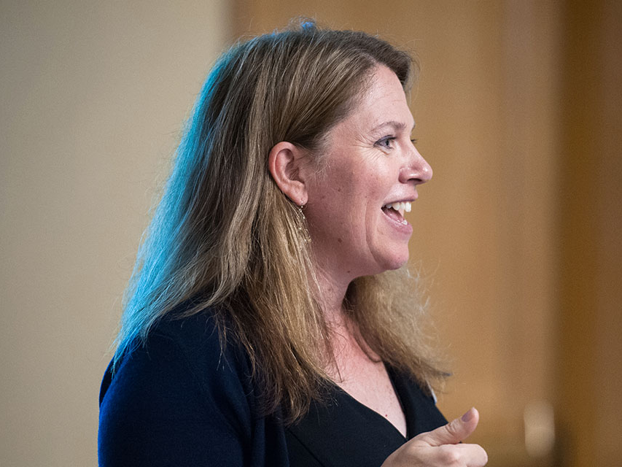
Barbara Beske
Senior Mathematics Specialist,
Tools and Classroom Resources, SAP

Slide 9
Goals of the Webinar
Develop an understanding of what it means to “model with mathematics.”
Investigate the connections between modeling and equity. What content is covered in modeling tasks? Who has access to high-intensity modeling work? How can modeling address unfinished learning?
Discuss best practices for implementing modeling.
Learn where to find free modeling tasks.
Notes:
We have five main goals for our webinar tonight. They are to...

Slide 10
Section 1: What is Modeling?

Slide 11
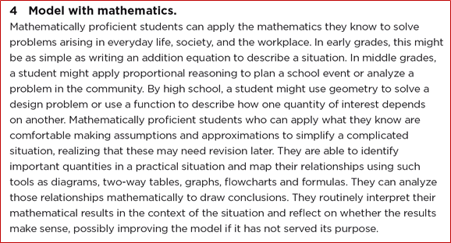
What is Modeling?
“Model with mathematics” (MP.4)

Slide 12
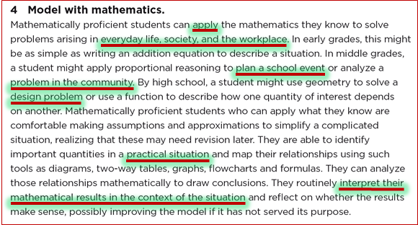
What is Modeling?
“Model with mathematics” (MP.4)

Slide 13
What is Modeling?
“Model with mathematics” (MP.4) means applying mathematics to solve a problem in context.

Slide 14
Modeling in HS

Slide 15
What is Modeling?
“A process that uses mathematics to represent, analyze, make predictions or otherwise provide insight into real-world phenomena”
GAIMME 2019, p. 8
Notes:
Society for Industrial and Applied Mathematics and Consortium for Mathematics and Its Applications COMAP, Inc.released the freely downloadable second edition of the GAIMME report in February 2019. You can find the PDF in the resources tab. GAIMME stands for GUIDELINES FOR ASSESSMENT & INSTRUCTION IN MATHEMATICAL MODELING EDUCATION
Most short definitions we find emphasize this most important aspect, namely the relation between modeling and the world around us. – Using the language of mathematics to quantify real-world phenomena and analyze behaviors. – Using math to explore and develop our understanding of real world problems. – An iterative problem solving process in which mathematics is used to investigate and develop deeper understanding.

Slide 16
Some Hallmarks of Modeling Tasks
The math techniques to be used are not stated explicitly in the problem.
Various assumptions must be imposed by the students to apply the techniques; these assumptions are not explicitly stated in the problem; and differing sets of assumptions could all be considered reasonable.
The task involves making a decision about something.
The task involves an optimization of some kind.
The context is not a pretext. While the task inevitably teaches mathematics, its primary focus is the situation or phenomenon at hand.
The phenomenon or situation is interesting or worthwhile beyond the academic discourse of the classroom.

Slide 17
How often is modeling happening in your setting?
Notes:
Not at all
Rarely
It depends on the students/courses
It depends on the teachers
All students experience modeling on a regular basis

Slide 18
Best Practices for Implementation
Guiding principles for teachers as they consider how to introduce mathematical modeling into their classrooms:
Start small
Scaffold initial experiences with leading questions and class discussion
Use common, everyday experiences to motivate the use of mathematics
Use bite-sized modeling scenarios that require only one or two components of a full modeling cycle
Share your goals and instructional practices with parents and administrators
GAIMME 2019, p. 75
Notes:
As you listen to the webinar today - keep some of these ideas in your mind - especially if you or your students are new to modeling

Slide 19
Best Practices for Implementation
Teachers might ask themselves the following questions:
What kinds of questions will the students have about the context?
What additional information will they need or want? How will they get that additional information?
What assumptions will they make as they begin to build their models? How can I help students feel comfortable about making assumptions?
What kinds of problem-solving strategies are students likely to use?
NCTM: Mathematical Modeling in the High School Curriculum
Notes:
I also want you to think about these great questions from an NCTM article on modeling (that is linked in your resource folder)

Slide 20
Best Practices for Implementation
Teachers might ask themselves the following questions:
How do I want to balance small-group and whole-class discussions?
At what point in the modeling process are students likely to get stuck?
What kinds of strategies can I use to intervene without taking over the modeling process?
What tools will students use to analyze their solutions and assess their models?
NCTM: Mathematical Modeling in the High School Curriculum
Notes:
One of the challenges is that the answers to these questions depend on you, your students, the modeling task at hand, and everyone’s experience with modeling. For now, know that these are great questions to consider as you plan to do more modeling in your classroom and that the answers to these can really help structure how modeling will take place.

Slide 21
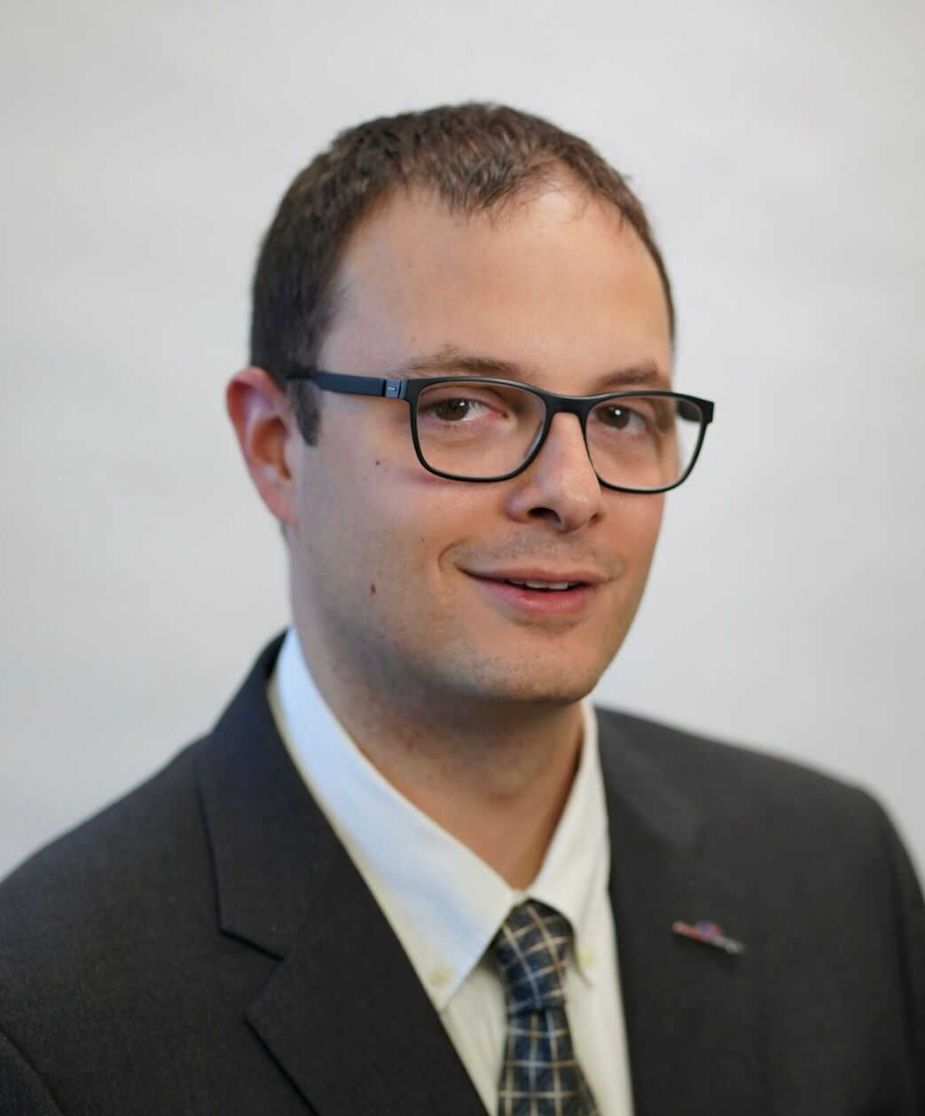
Scott Meltzer
Director of Mathematics, American Paradigm Schools

Slide 22
Section 2: How does modeling fit within the context of the high school standards?

Slide 23
Modeling in HS

Slide 24
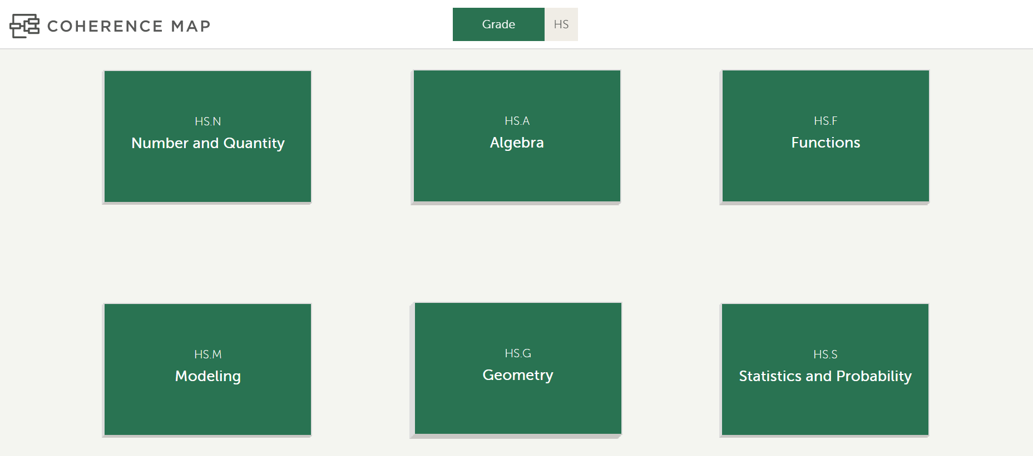
Modeling in HS
HS.N-Q.A.1
HS.A-SSE.A.1
HS.F-TF.B.5
HS.G-MG.A.3
HS.S-ID.C.7
www.achievethecore.org/coherence-map

Slide 25
Modeling in HS
www.achievethecore.org/coherence-map

Slide 26
Modeling in HS
www.achievethecore.org/coherence-map

Slide 27
Modeling in HS
HS.N-Q.A.1
HS.A-SSE.A.1
HS.F-TF.B.5
HS.G-MG.A.3
HS.S-ID.C.7
www.achievethecore.org/coherence-map

Slide 28
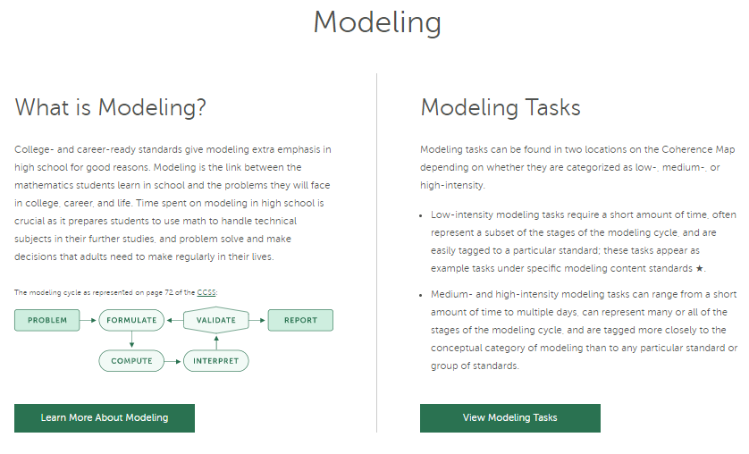
Modeling in HS
www.achievethecore.org/coherence-map

Slide 29
Modeling in HS
“High schools focus on elementary applications of advanced mathematics whereas most people really make more use of sophisticated applications of elementary mathematics. … Many who master high school mathematics cannot think clearly about percentages or ratios.”
Steen (2007)

Slide 30
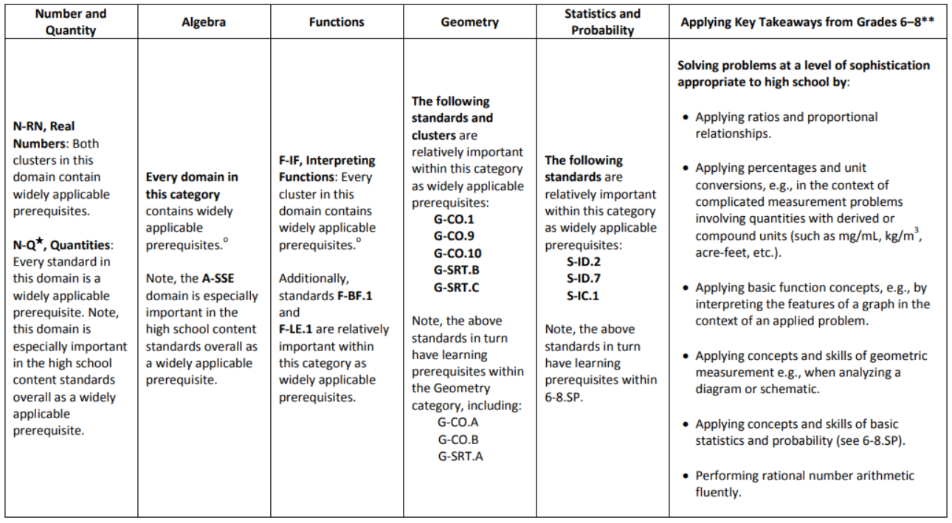
Modeling in HS
From HS Publishers’ Criteria, www.corestandards.org/resources
Also at www.achievethecore.org/focus

Slide 31
Modeling in HS
In High School courses, students should occasionally do a high-intensity modeling task.
For some of these tasks, use content from the present course.
Because the content is newer, don’t make the level of modeling sophistication excessively high.
For others, use content from previous courses and grades 6-8.
Because the content is more familiar, don’t make the level of modeling sophistication excessively low. “HECLA” Tasks (High Expertise, Content-Lagged Applications)

Slide 32
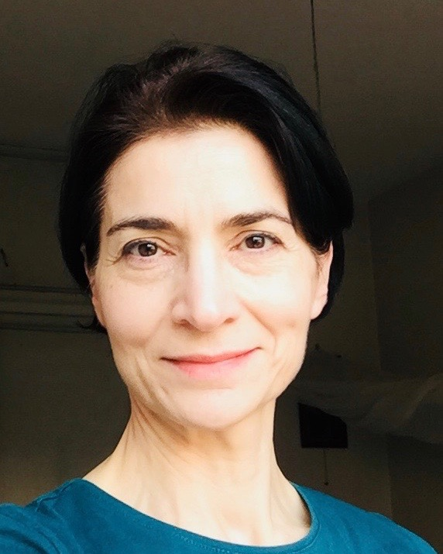
Arpi Lajinian
Teacher of Mathematics,
Instructional Coach,
Northern Valley Regional HS,
Old Tappan, NJ
please enter a head shot here

Slide 33
Section 3: What are Hallmarks of the Modeling Cycle ?

Slide 34
Modeling in HS
In High School, students go deeply into the Modeling cycle.

Slide 35
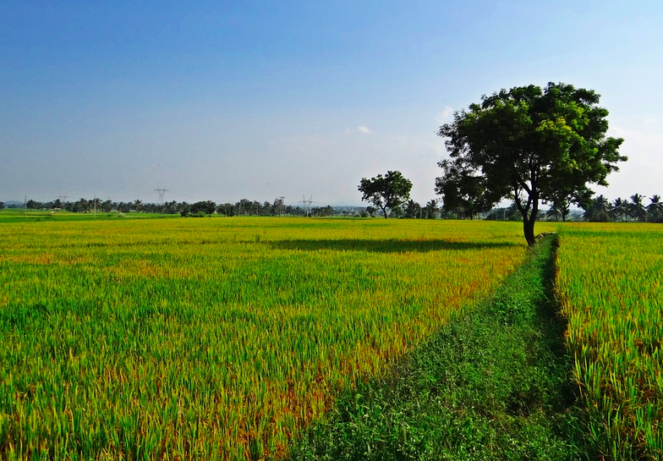
Modeling Task: Karnataka
Modeling Task: Karnataka
Karnataka
Source: PARCC
Create a model to represent the relationship between crop yield and fertilizer use to make predictions and recommendations.

Slide 36
Make Sense of the Context and Identify the Question
• Students make sense of the real world context of a problem.
• Students identify the question.

Slide 37
Identify Variables and Make Assumptions
• Students identify quantities that are relevant to the task,
• They select the variables that represent essential features, and
• Make assumptions about variables that they will not consider.

Slide 38
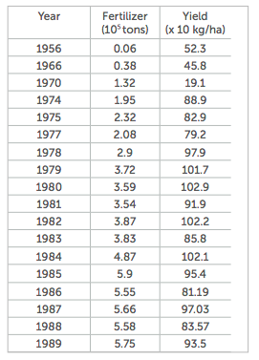
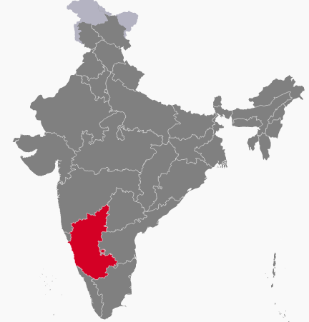
Modeling Task: Karnataka
Modeling Task: Karnataka
Karnataka is a state in
southwest India. The
accompanying table is
agricultural data on
fertilizer use and grain
crop yield in Karnataka.
Fertilizer is measured in 100,000 tons. Crop yield is measured in 10 kilograms per hectare.
Throughout the years over which these data were gathered, the amount of land in cultivation remained fairly constant.

Slide 39
Formulate a Model
• Students use mathematical tools to create a model that describes
relationships between the variables they identified.
• Tools may include geometric, graphical, tabular, algebraic or
statistical representations of the variables.

Slide 40
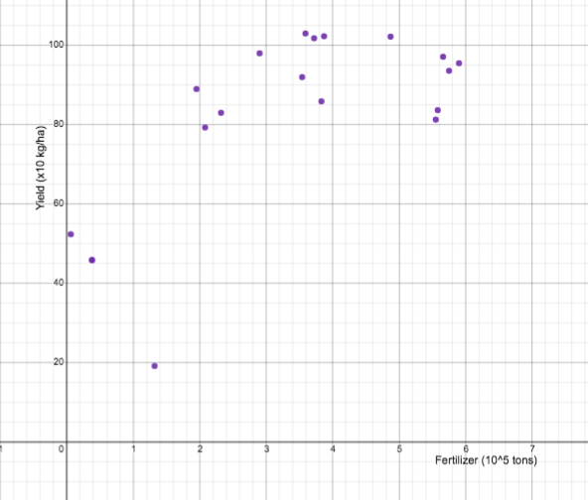
Karnataka - ct’d
Modeling Task: Karnataka

Slide 41
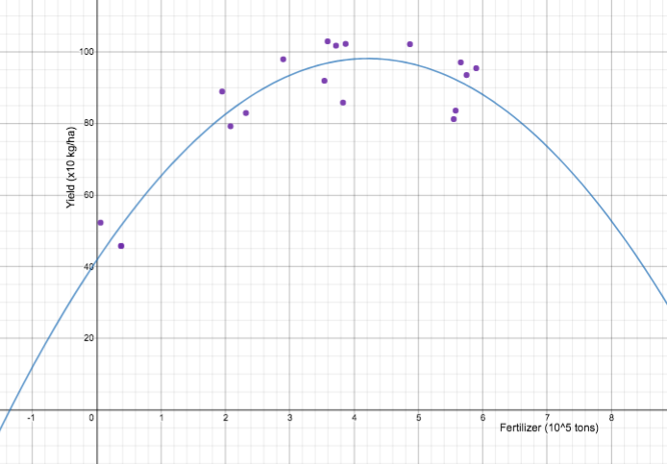
Karnataka - ct’d
Modeling Task: Karnataka
Part 1: Write a mathematical function that models the relationship
between fertilizer use and grain crop yield. Show your work.

Slide 42
Compute Using the Model
• Students analyze the model and use it to perform operations
or calculations and draw conclusions.
Karnataka - ct’d
Part 2: Use the function you have chosen to predict the yield if the
fertilizer use is 500,000 tons.

Slide 43
Interpret the Solution
• Translate the mathematical results into the context of the task.
• Interpret the results using the terminology of the task.
Karnataka - ct’d
Part 2: Use the function you have chosen to predict the yield if the
fertilizer use is 500,000 tons.

Slide 44
Validate and Assess the Solution
Does the solution make sense when translated back to the real life context of the task?
• Are the results practical?
• Are the answers reasonable?
• Are the consequences acceptable?
• Can the model be improved?

Slide 45
Karnataka - ct’d
Modeling Task: Karnataka
• If the model can be improved,
then return to formulate and repeat the cycle for a new model.

Slide 46
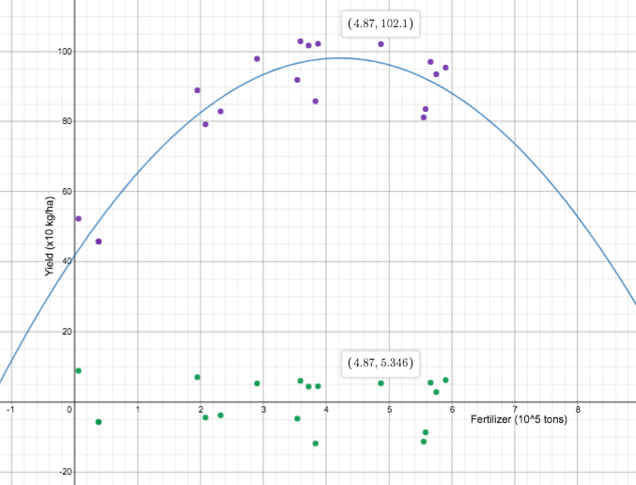
Karnataka - ct’d
Modeling Task: Karnataka
Part 3: How precise is the prediction you made in Part 2? Explain.

Slide 47
Report Results
• Report the conclusions and the reasoning that led to them.
This might include:
• Assumptions • The model
• A conclusion • Recommendations
Karnataka - ct’d
Part 4: Based on the data and your function, what advice can you offer the government of Karnataka about fertilizer use? Explain.

Slide 48
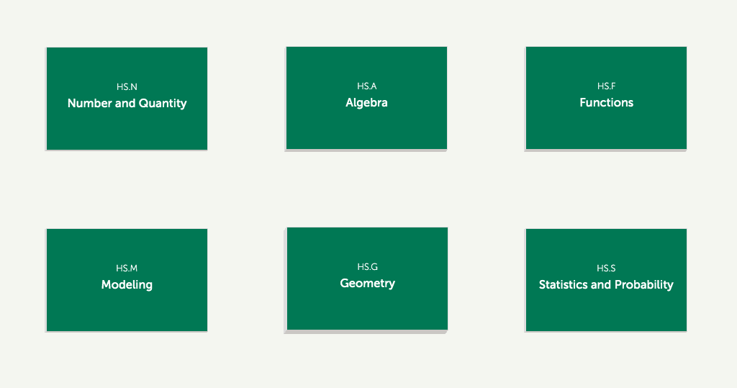
Modeling Tasks in the HS Coherence Map
https://achievethecore.org/coherence-map/HS

Slide 49
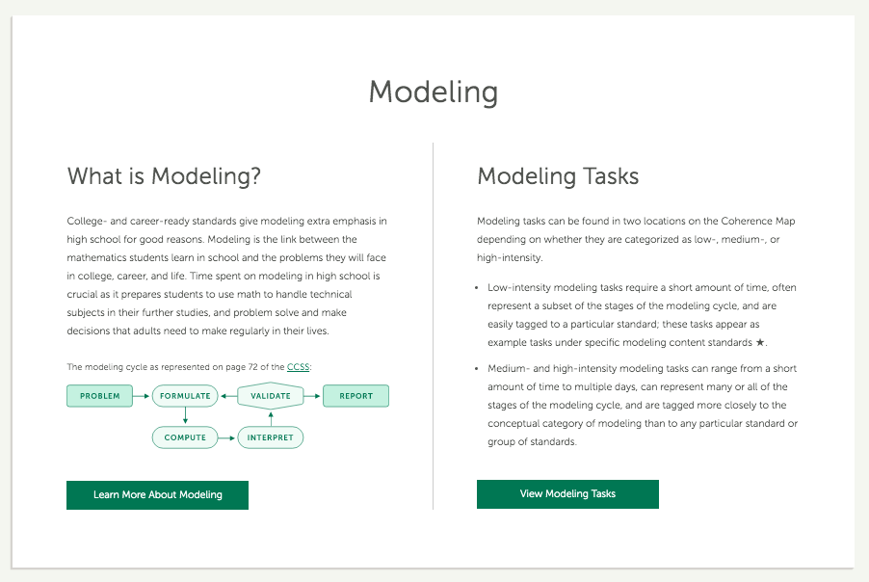
Modeling Tasks in the HS Coherence Map

Slide 50
Which of the following are true?
All stages of the modeling cycle must occur in every modeling task.
The validation stage may result in students creating a new model.
Modeling tasks need to be aligned to particular standards.
Modeling tasks are meant to solve interesting problems.

Slide 51
Section 4: Modeling and Equity

Slide 52
Modeling and Equity
Reflect on the following two questions.
In your setting:
who gets to do the modeling?
where you see modeling lacking, what do you think are some of the causes?

Slide 53
Why Modeling?
What are some of the benefits of modeling?
Opportunities to tackle unfinished learning
Opportunities to do mathematics that are based in real world applications
Opportunities to explore social justice issues

Slide 54
Modeling and Equity
What needs to occur for all HS students to be given experiences with high-intensity modeling?
"Providing all students with access is not enough; educators must have the knowledge, skills, and disposition necessary to support effective, equitable mathematics teaching and learning."
NCTM Position Paper on Access and Equity in Math Education

Slide 55
Modeling and Equity
Flint Water Crisis:
Walmart, Coca Cola, Nestlé, PepsiCo said that they will donate bottles of water for school children in Flint, Michigan, to help with the city’s public health crisis over lead contaminated water. On January 26 the companies said that they are planning to “collectively donate water to meet the daily needs of over 10,000 school children for the balance of the calendar year”. To do so, the companies will send 176 truckloads of bottled water – up to 6.5 million bottles – to Flint.
How do we know how much water will be enough to meet the daily needs of Flint school children until December 31, 2016?
Is the companies’ plan a good one?

Slide 56
Modeling and Equity
Social Justice and Modeling
How long will it take for the US to fill one football field sized landfill with trash?
Is paying more for a hybrid car worth the investment?
Investigate the mathematics behind gerrymandering.
Estimating crowd sizes
Examining national debt
Water conservation: Shower or Bath?
Prisons, racial profiling, death penalty
Poverty, minimum/living wage
Housing, gentrification, homeownership
War, defense budgets, military recruiting
Public Health
www.radicalmath.org
Educational access

Slide 57
Section 4: Best Practice for Implementation

Slide 58
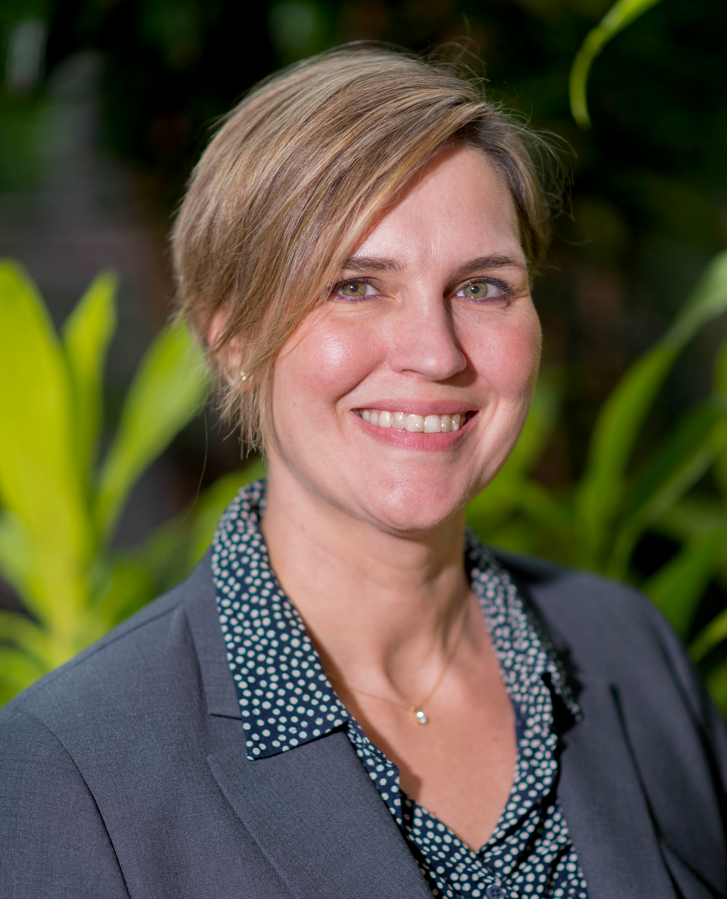
Kate Nowak
Director of K–12
Curriculum Strategy
Illustrative Mathematics
please enter a head shot here

Slide 59
VIDEO

Slide 60
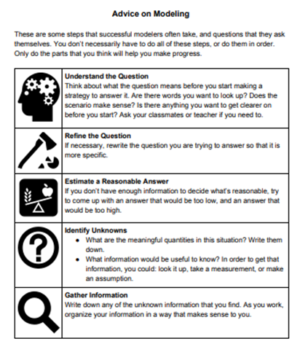
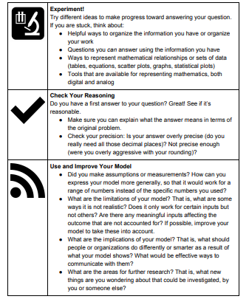
Best Practices for Implementation
Illustrative Mathematics
http://bit.ly/2mrtNHm

Slide 61
Best Practices for Implementation
Other Burning Questions:
How often?
How long do they take?
Independent work? Group work?
In class? Projects?
Should the math represent what is being taught in that unit?
Check out: https://im.kendallhunt.com/HS/teachers/mathematical_modeling_prompts.html

Slide 62
Questions for Our Guests?

Slide 63
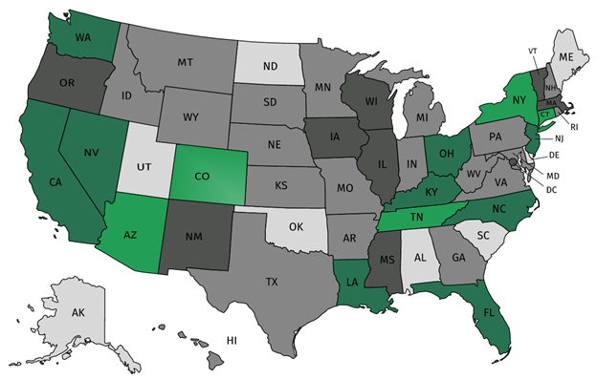
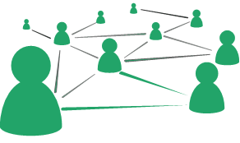
Join our network!
Join a national network of educators
Connect with state networks
Be a part of creating new tools and resources in partnership with SAP
Keep up to date on free resources, upcoming SAP webinars/professional learning opportunities, job postings and more!

Slide 64
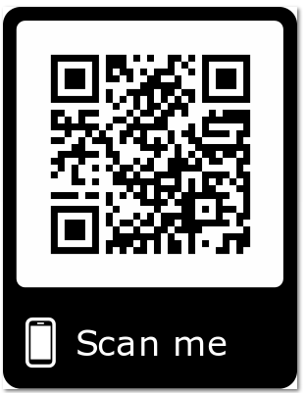
Please Join Us!
https://achievethecore.org/ca-signup
Twitter: twitter.com/achievethecore
Facebook: facebook.com/achievethecore
Pinterest: pinterest.com/achievethecore

Slide 65
Please Join Us Again Next Month!
Next month’s webinar:
New Year, New Perspective: Questions Every Educator Should Ask Themselves When Planning and Reflecting
January 8, 2020 @7pm EST
Register Here:
https://event.on24.com/wcc/r/2138260/A4B837A7084C29A4E4BE90AF76EEAB6D

Slide 66
Thank You!

