Slide 1

Integrating Curriculum and Assessment: An Example from Grade 3 Fractions
Core Advocates Monthly Webinar
February 5, 2020
The webinar will begin shortly.
Check your Resource widget to preview the resources for today’s session! Use the Group Chat to introduce yourself!
Notes:
First timer poll
Handouts:
While we’re waiting, we’d like you to participate in a quick poll so we can get an understanding of who’s on the webinar with us tonight.

Slide 2
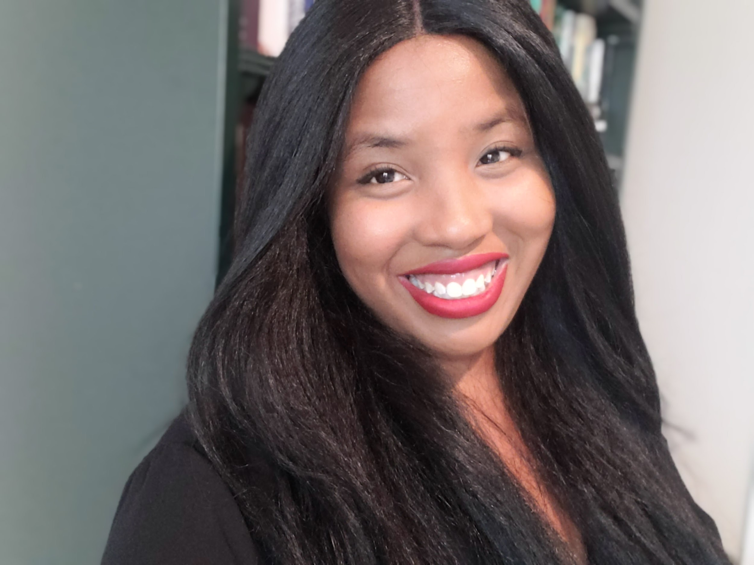
Introductions
Your hosts from Student Achievement Partners:
Pascale Joseph
Project Coordinator,
Tools and Classroom Resources, SAP
This month’s presenters:
Shelbi Cole
Mathematics Specialist
SAP
Raven Redmond
Math Content Lead
Memphis Delta Prep
Jennifer Ahearn
Math Coach
Teaneck Public Schools

Slide 3
How many Core Advocate Webinars have you attended?
Please use the Questions tab on your control panel to respond.
If using a poll, please put up to 5 answer choices in the notes section below and indicate if attendees should choose only one response or multiple responses.

Slide 4

Join Our Network!
www.achievethecore.org/ca-signup
Notes:
If you find tonight’s webinar helpful, we’d like to invite you to join our Core Advocate network! We’re committed to solving real problems that real teachers have and we know the best way to do this is to know more about what folks are experiencing.
We’d love to learn about who you are, where you work, the types of things you’re interested in and the expertise you already have. This way, we will be able to tailor our webinars and other opportunities to your needs and interests (we may even tap you to be our next webinar panelist). So we encourage you to join the network by filling out this survey completely at atc.org/ca-signup

Slide 5


Learn More About Us!
Contact Jennie Beltramini (jbeltramini@studentsachieve.net )
Joy Delizo-Osborne
(jdelizo-osborne@studentsachieve.net)
Complete this survey to join our database (and mailing list): www.achievethecore.org/ca-signup
Visit our website: www.achievethecore.org
Notes:
If you’d like to learn more about the network, contact Jennie (her email is here).
We also want to invite you to join the network by signing up at achievethecore.org/ca-signup and visit our website for more info and opportunities

Slide 6

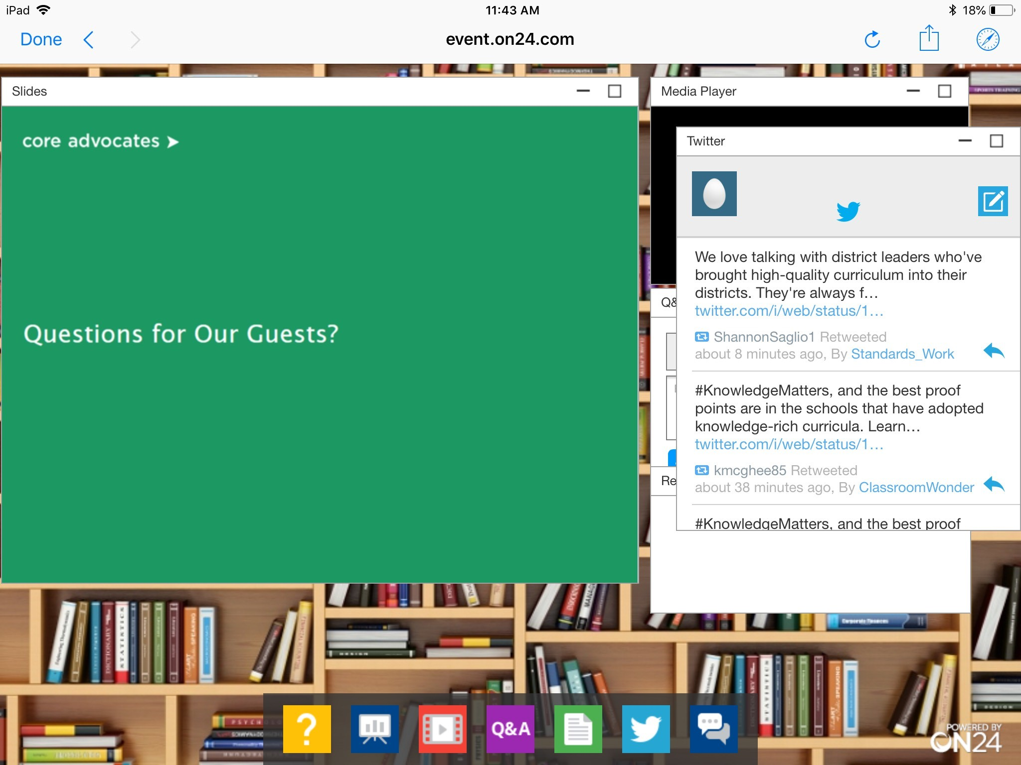
Tweet with Us!
Please feel free to tweet during and after the webinar using #coreadvocates
@achievethecore
@JennieBeltro
@ShelbiCole1
Click here!

Slide 7

Engage with Us!
During the webinar:
Question just for the presenters/ tech help
Resources
Group chat
After the webinar:
– Access to recording will be emailed to you.
Take our survey in 2 weeks and receive a certificate verifying 1 hour of professional learning.

Slide 8
Goals of the Webinar
To understand how curriculum and assessment must be analyzed separately and together to be integrated successfully into a standards-aligned system.
Notes:
We have three main goals for our webinar tonight. They are to...

Slide 9
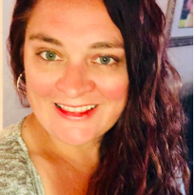
Shelbi Cole
Senior Mathematics Specialist
Student Achievement Partners

Slide 10
Section 1: What should I consider in deciding whether to use the assessments in the curriculum materials or external assessments?

Slide 11
A Quick Look At Why This Matters
“Shelbi Cole of Student Achievement Partners says there is still a substantial mismatch between the questions used in textbooks and the tasks on the assessment. As an example, many of the texts have a large number of word problems in the K–5 Number and Operations in Base Ten (NBT) domain, but this is not the case on the Smarter Balanced test, which emphasizes conceptual understanding and procedural skill aligned to the expectations of the standards.”
--Failing and Passing the Tiffany Test, part I, David Wakelyn
5.NBT.B.6 Find whole-number quotients of whole numbers with up to four-digit dividends and two-digit divisors, using strategies based on place value, the properties of operations, and/or the relationship between multiplication and division. Illustrate and explain the calculation by using equations, rectangular arrays, and/or area models.

Slide 12
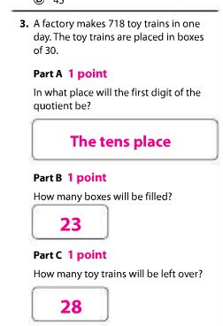
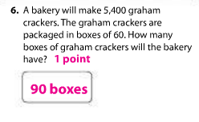
5.NBT.B.6 (EnVision Math)
Notes:
Another reason for changes to the Topic Assessments is a misaligned item. Here we see a procedural skill/fluency standard that requires a conceptual foundation, 5.NBT.B.6; however, the items do not adequately target procedure skill. In fact, #6 is an application problem. It is important to ensure that the items align to the aspect of rigor targeted by the standard.

Slide 13
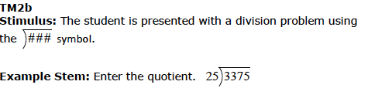

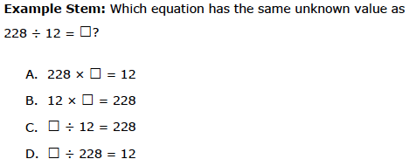
5.NBT.B.6 (Smarter Balanced)

Slide 14
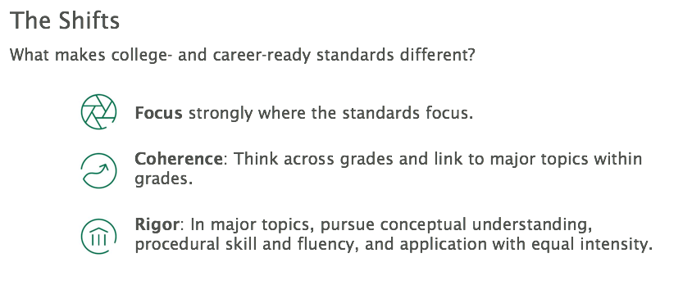

Slide 15
“To prepare students for Algebra, the curriculum must simultaneously develop conceptual understanding, computational fluency, and problem- solving skills…These capabilities are mutually supportive, each facilitating learning of the others.”
-National Mathematics Advisory Panel, 2008
National Mathematics Advisory Panel. (2008). Foundations for success: The final report of the National Mathematics Advisory Panel. Washington, DC: U.S. Department of Education. Retrieved from https://www2.ed.gov/about/bdscomm/list/mathpanel/report/final-report.pdf p. xix.

Slide 16
The Aspects of Rigor (AOR) Matrix
 | The item does not involve application. | The item involves an application.
The item targets procedural skill expected by the grade level. | P | P-A
The item targets conceptual understanding and procedural skill expected by the grade level OR targets conceptual understanding but can also be answered using at least some procedural skill expected by the grade level. | P-C | P-C-A
The item targets conceptual understanding. Students may explain, strategize, evaluate, determine, compare, or classify. | C | C-A
A procedure is a step-by-step sequence that can be memorized and executed without understanding or attending to the meaning of the quantities; a procedure is useful for a class of problems or situations. Computations that are likely to be known from memory are considered procedural.
Conceptual understanding refers to the mathematics used to respond to an item, not the complexity of the question itself.
Names or mathematical referents (e.g., units of measure) may be present in item, but should not be considered application in the sense intended by the shifts in CCR standards.

Slide 17
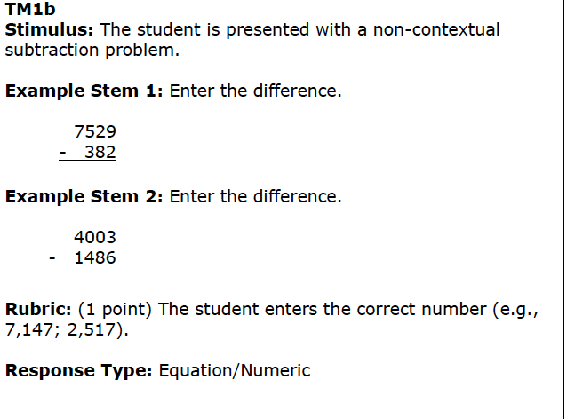
Multi-Digit Subtraction: Procedural, Conceptual, Application
From Smarter Balanced

Slide 18
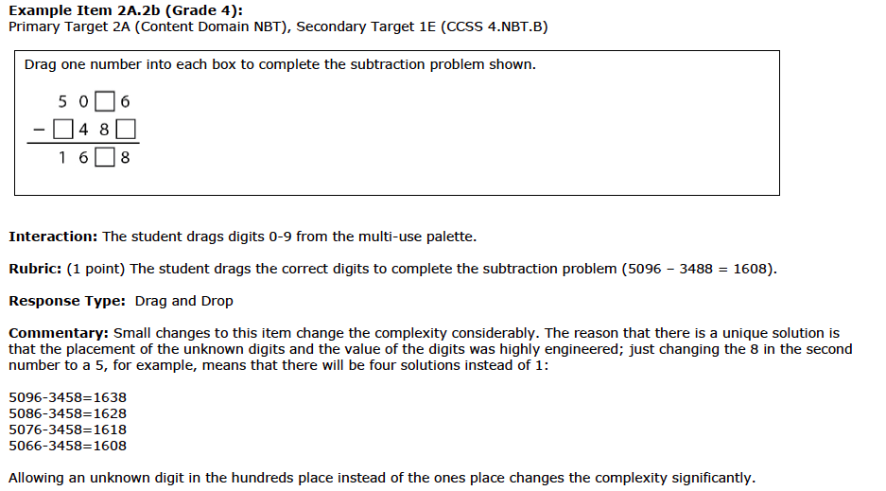
Multi-Digit Subtraction: Procedural, Conceptual, Application
From Smarter Balanced

Slide 19
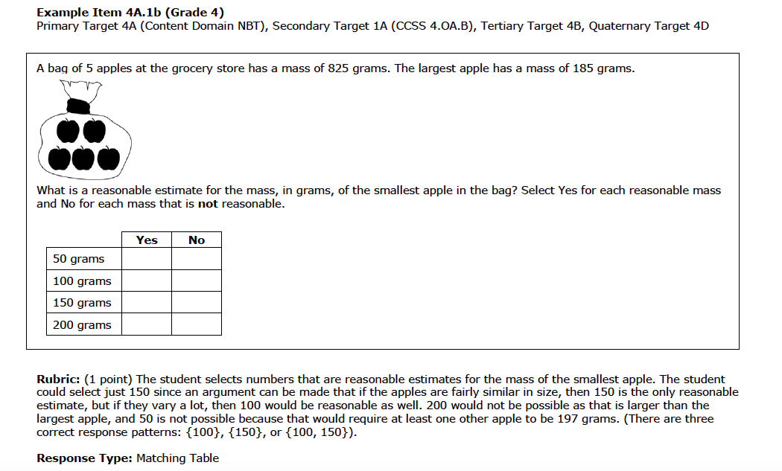
Multi-Digit Subtraction: Procedural, Conceptual, Application
From Smarter Balanced

Slide 20
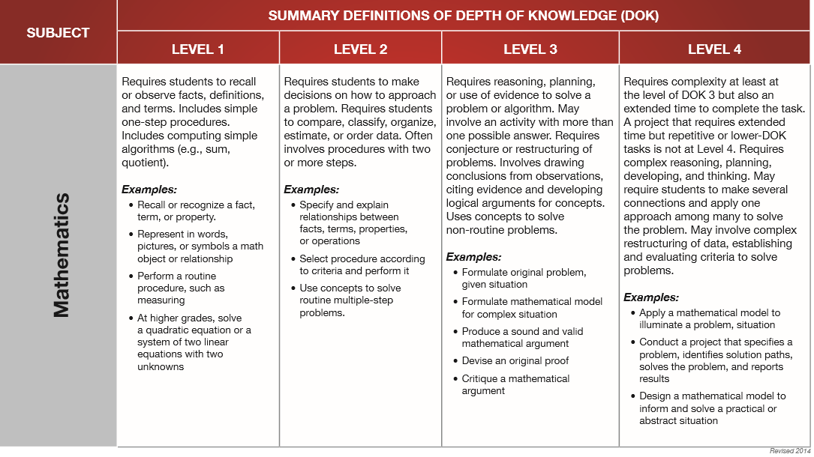
Depth Of Knowledge
http://www.webbalign.org/Webbs-DOK-Levels-Summary.pdf

Slide 21
How can thinking about cognitive complexity together with rigor help us reach the intended depth of college- and career-ready math standards?

Slide 22
 | Level 1 | Level 2 | Level 3
Procedural Complexity: | Solving the problem entails little procedural demand or procedural demand is below grade level. | Solving the problem entails common or grade-level procedure(s) with friendly numbers. | Solving the problem requires common or grade-level procedure(s) with unfriendly numbers, an unconventional combination of procedures, or requires unusual perseverance or organizational skills in the execution of the procedure(s).
Application Complexity: | Solving the problem entails an application of mathematics, but the required mathematics is either directly indicated or obvious. | Solving the problem entails an application of mathematics and requires an interpretation of the context to determine the procedure or concept (may include extraneous information). The mathematics is not immediately obvious. Solving the problem requires students to decide what to do. | In addition to an interpretation of the context, solving the problem requires recognizing important features, and formulating, computing, and interpreting results as part of a modeling process.
Conceptual Complexity: | Solving the problem requires students to recall or recognize a grade-level concept. The student does not need to relate concepts or demonstrate a line of reasoning. | Students may need to relate multiple grade-level concepts of different types, create multiple representations or solutions, or connect concepts with procedures or strategies. The student must do some reasoning, but may not need to demonstrate a line of reasoning. | Solving the problem requires students to relate multiple grade-level concepts and to evidence reasoning, planning, analysis, judgment, and/or creative thought OR work with a sophisticated (nontypical) line of reasoning.
Notes:
https://www.achieve.org/mathematics-assessment-cognitive-complexity-framework

Slide 23
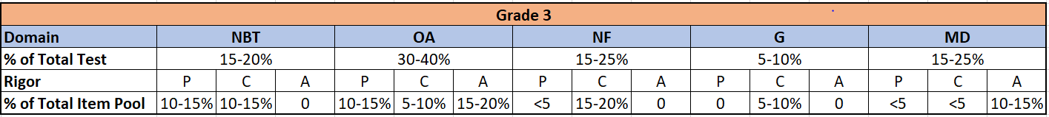
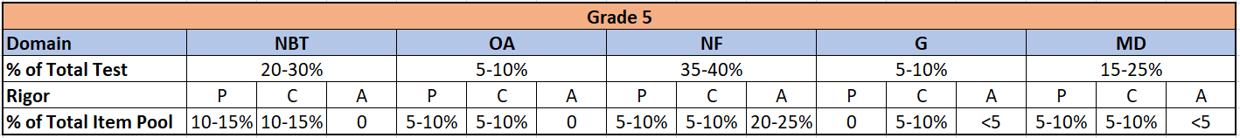
Pool distribution - Grade 3 to Grade 5

Slide 24
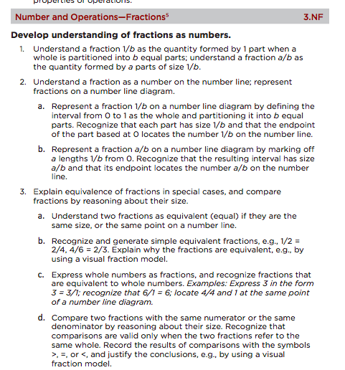
In the Grade 3.NF domain, is conceptual understanding, procedural skill and fluency, or application most emphasized?

Slide 25
Question or Poll:
In the Grade 3.NF domain, is conceptual understanding, procedural skill and fluency, or application most emphasized?
procedural skill and fluency
conceptual understanding
application
they are all equally emphasized in Grade 3 fractions
Please use the Questions tab on your control panel to respond.
If using a poll, please put up to 5 answer choices in the notes section below and indicate if attendees should choose only one response or multiple responses.

Slide 26
Is a fraction a number?
How is the work of fractions positioned (or not) as an extension of students K-2 work with whole numbers?
Even in “well-aligned” materials, how might this understanding get lost?
How can pairing assessments and curricular materials help us to surface some issues?

Slide 27
So...Is a fraction a number?

Slide 28
VIDEO CLIP NO. 1

Slide 29
Why fractions?
“The coherence and sequential nature of mathematics dictate the foundational skills that are necessary for the learning of algebra. The most important foundational skill not presently developed appears to be proficiency with fractions. The teaching of fractions must be acknowledged as critically important and improved before an increase in student achievement in algebra can be expected.”
Source: Final Report of the National Mathematics Advisory Panel (2008, p. 18)

Slide 30
What has changed?
WHOLE
NUMBERS
FRACTIONS
“Children must adopt new rules for fractions that often conflict with well-established ideas about whole number”
Bezuk & Cramer, 1989

Slide 31
What has changed?
WHOLE
NUMBERS
FRACTIONS
4.NF.B Build fractions from unit fractions by applying and extending previous understandings of operations on whole numbers.
5.NF.B Apply and extend previous understandings
of multiplication and division to multiply and
divide fractions.
3.NF.A Develop understanding of fractions as numbers.

Slide 32
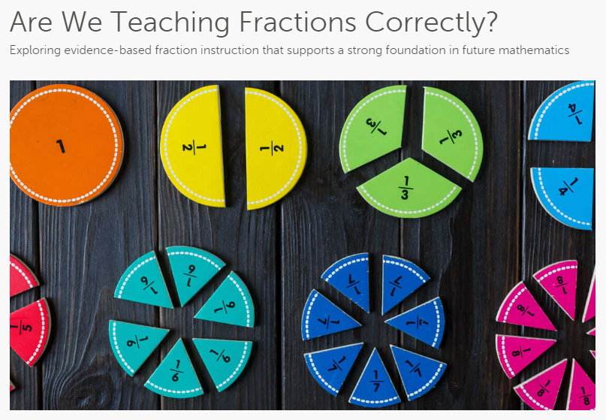
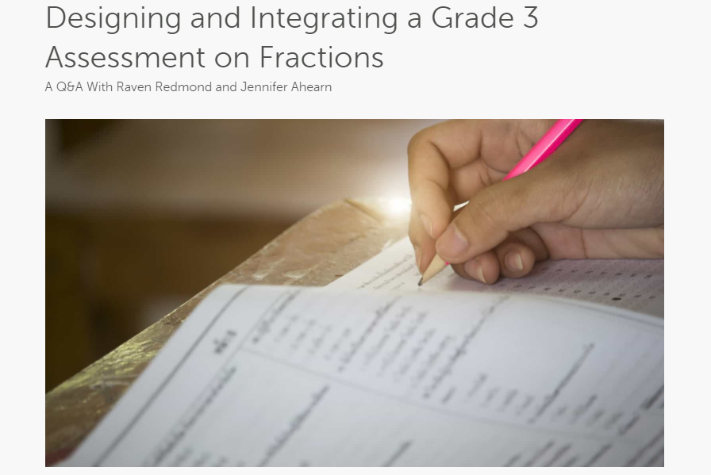
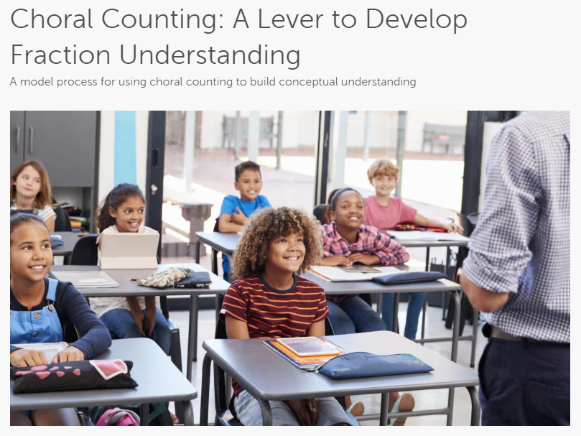
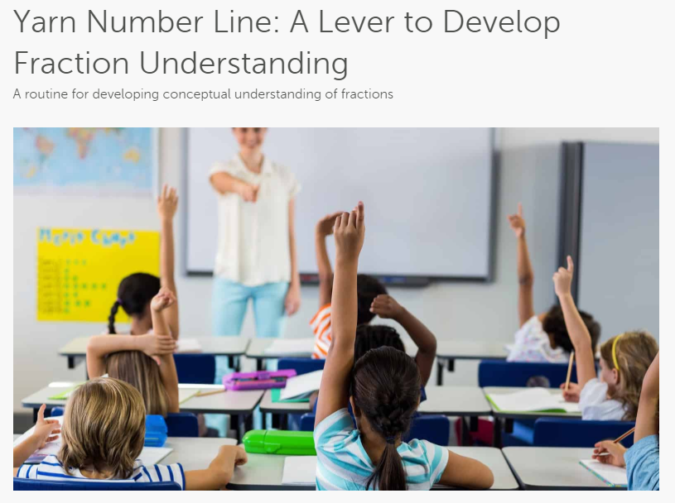
Aligned Blog Resources

Slide 33

Raven Redmond
5th Grade Lead Instructor
Memphis Delta Preparatory Charter School
Memphis, TN

Slide 34
Section 2: What did we learn when we compared the Grade 3 Fraction Mini-Assessment to the Eureka Math materials?
Notes:
In this section we are going to look at how the Grade 3 Eureka Math units on fractions line up with some of the assessment questions and describe how the assessment has helped us to think about what to emphasize more and less in the materials to really get to the goals of the standards.

Slide 35
Our Design Process
Examined Standards
Examined the Grade 3 standards with a lens toward rigor and complexity.
Looked at Instructional Materials
Lorem 2
Examined problems from existing materials and assessments.
Bridged the gap
Filled in some problems, mostly at the higher end of the Grade 3 complexity to reach the full depth of the domain.
Notes:
Our design process was fairly straightforward -- we started by looking at the standards, focusing strongly on the idea at the cluster level of understanding a fraction as a number. We identified that the domain is almost entirely conceptual understanding -- that is, there is relatively little procedural skill and fluency and no requirement for application, or word problems. Then we looked through materials and began discussing different problems and how well they got at the heart of the domain or not. We used some problems as models and adapted those for the mini-assessment, but we fell short in having enough really rich conceptual problems. So we designed a few of our own, especially those that integrated knowledge from across standards within the domain.

Slide 36
Some Design Principles
A couple of key decisions informed the work on this assessment:
Since there is no requirement in the grade 3.NF standards for solving real-world problems, this assessment does not contain any problems with real-world context to ensure that the evidence elicited by the items clearly reflects the intended expectations of the standards.
To ensure that the body of evidence is targeting the key understanding of “fractions as numbers,” the assessment has a heavier balance of items that represent fractions on a number line and fewer that use area model representations.
Notes:
There were two big things that we wanted to make sure we did on the mini-assessment -- the first decision was that there would be no application problems. Because Grade 3 introduces a fraction as a number, but does not introduce any operations on fractions, we kept the emphasis on conceptual understanding. Additionally, we know that some materials still spend too much time on area models -- rectangles, circles, squares -- while these may be “easier” for students, they don’t neatly translate to the goal of the domain which is the understanding of a fraction as a number. So you will see on the mini assessment more problems that use the number line representation and only two that use area model representations.

Slide 37
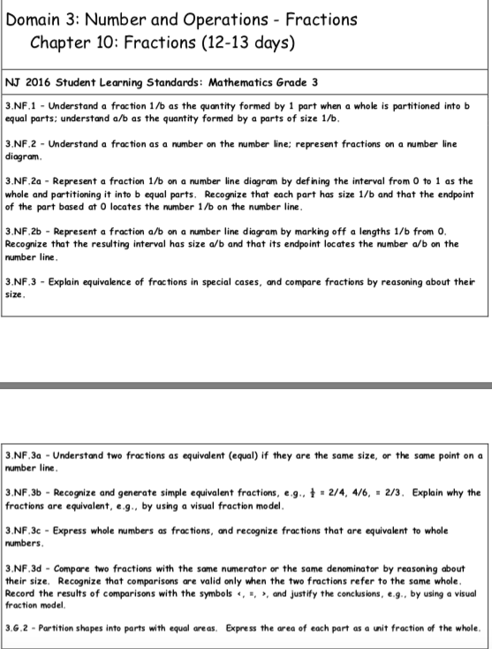
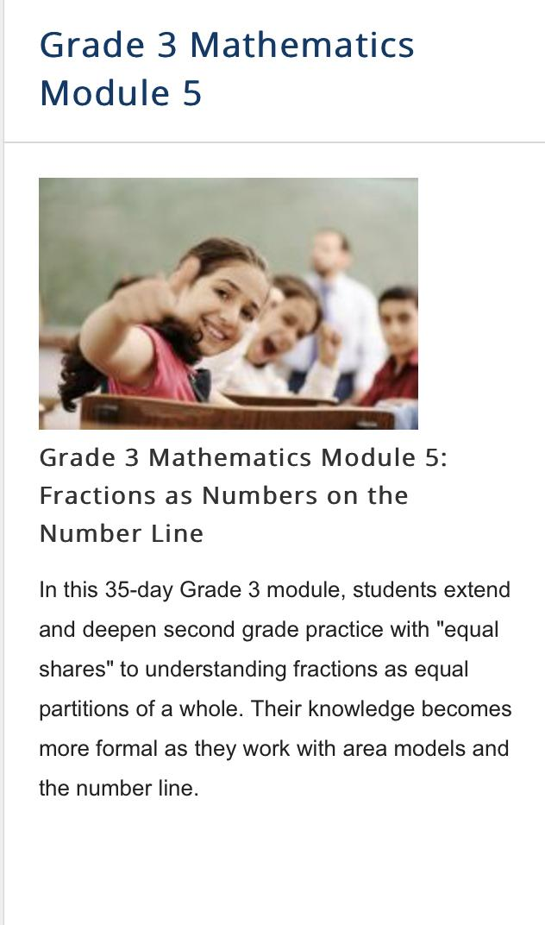
What do you notice?
What do you wonder?
Eureka Math G3 Fraction Module
District G3 Fraction Pacing Guide
Notes:
For starters, when we talk about Eureka we are talking about a resource that is generally pretty well aligned to the math standards. Compared to some other resources, the suggested pacing for Grade 3 fractions in Eureka is 7 weeks, or 35 school days -- notice the comparison is a pacing guide where students only spend 2 ½ weeks -- that is a big difference. So while Eureka certainly gets it right in terms of the amount of time invested in fractions, in this section we identify some places where even a well-aligned resource can be made stronger as we examine the Grade 3 mini-assessment that we designed.

Slide 38
A Close Examination of the Assessment Compared to Eureka Math
Assessment Item | Eureka Lessons | Assessment Item | Eureka Lessons
1 | Lessons 14-15 | 7 | Lesson 30
2 | Lessons 14-15 | 8 | Lessons 14-15
3 | Lesson 7 | 9 | Lessons 16-17
4 | Lesson 16 | 10 | Lessons 22-23
5 | Lessons 16-17 | 11 | Lessons 24-25
6 | Lesson 29 | 12 | Lesson 11
Notes:
Some things to notice: In the first 13 lessons of Eureka, only Lessons 7 and 11 have a “match” on this assessment. Eureka spends quite a long time engaging students with area model representations of fractions before moving to the number line. While this representation is often viewed as “easier for students to understand,” it’s difficult to make an argument that we are actually reaching the overall goal of the Grade 3 domain which is to understand a fraction as a number. So one thing for Eureka users to consider is whether to trim down the work on area model representations and intensify the focus on fractions as numbers.

Slide 39
Zoom in on Materials: Lesson 18 of 35
Word Problems from Eureka Grade 3 Module 5 Lesson 18
6. Liz and Jay each have a piece of string. Liz’s string is 4/6 yards long, and Jay’s string is 5/7 yards long. Whose string is longer? Draw a number line to model the length of both strings. Explain the comparison using pictures, numbers, and words.
7. In a long jump competition, Wendy jumped 9/10 meters, and Judy jumped 10/9 meters. Draw a number line to model the distance of each girl’s long jump. Who jumped the shorter distance? Explain how you know using pictures, numbers, and words.
8. Nikki has 3 pieces of yarn. The first piece is 5/6 feet long, the second piece is 5/3 feet long, and the third piece is 3/2 feet long. She wants to arrange them from the shortest to the longest. Draw a number line to model the length of each piece of yarn. Write a number sentence using <, >, or = to compare the pieces. Explain using pictures, numbers, and words.
3.NF.A.3. Explain equivalence of fractions in special cases, and compare fractions by reasoning about their size.
d. Compare two fractions with the same numerator or the same denominator by reasoning about their size. Recognize that comparisons are valid only when the two fractions refer to the same whole. Record the results of comparisons with the symbols >, =, or <, and justify the conclusions, e.g., by using a visual
fraction model.
Notes:
I want you to take a look at problem 7. How well aligned is that problem to the intent of the standard listed? Feel free to make some comments in the chat about what you’re thinking about with this alignment.
After they’ve had time to think:
First of all, this whole page is word problems. While having a sprinkling of word problems in Grade 3 fractions isn’t necessarily a huge issue, we do want to ask whether it is taking kids away from the expectations of the standards. Is it adding complexity in places where we don’t necessarily need it and could that time be better spent?
Secondly, these fractions don’t have the same numerator or the same denominator. So although students could likely do the problem (by using their knowledge of 10/10 and 9/9 both being equal to 1), it is above the ceiling of the grade 3 standard. So we aren’t talking necessarily about whether students can do the problem, just whether it is the best investment of time given the overall goals of the domain.

Slide 40
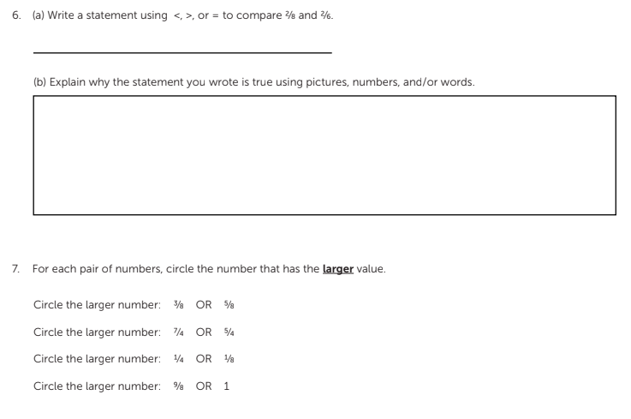
Zooming in to some problems from the Grade 3 Fractions Mini-Assessment
Notes:
As you can see on the mini-assessment, we have a couple of problems asking students to compare fractions. The first is tightly aligned to the goal of the standard asking students to compare fractions with the same numerator and to explain how they made the comparison. In the second problem, we wanted to remove the requirement for students to use the mathematical comparison symbols to ensure that they had the basic understanding of the standard -- determining in a pair of fractions with either the same numerator or same denominator which is larger. We lifted the complexity of the 4th example in #7 slightly where students may need knowledge from another standard in the domain (knowing that 1 is equal to either 8/8 or 9/9 to make the comparison)

Slide 41
VIDEO CLIP NO. 2
Notes:
This video shows a 4th grader comparing 3/7 and 6/13. While historically we have programmed kids to always find like denominators to compare fractions, you’ll see how he leverages the grade 3 understanding to compare two fractions with unlike numerators and denominators.

Slide 42
What are some reasons we need to closely examine even “aligned” materials?
Please Use the Group Chat to Share Your Responses.

Slide 43

Jennifer Ahearn
Math Coach
Lowell Elementary School
Teaneck, NJ

Slide 44
Section 3: What did we learn when we compared the Grade 3 Fraction Mini-Assessment to Go Math! materials?

Slide 45
A Close Examination of the Assessment Compared to Go Math!
Assessment Item | Go Math! Lessons | Assessment Item | Go Math! Lessons
1 | Lesson 8.5 | 7 | Lessons 9.2, 9.3, 9.4
2 | Lesson 8.4 | 8 | Lesson 8.5
3 | Lesson 8.5 | 9 | Lessons 9.6, 9.7
4 | Lesson 8.5 | 10 | Lessons 9.6, 9.7
5 | Lesson 8.5 | 11 | Lesson 8.6
6 | Lesson 9.3 | 12 | Lesson 8.3
Notes:
This table shows a mapping of each assessment item to the corresponding lessons in Go Math where students are most likely to have access to the knowledge and skills needed. Since the bulk of the emphasis seems to be on lessons 8.3-8.6 one thing I might do if I were using Go Math is to examine whether there is anything in those lessons where we should be spending time or going deeper? I also would want to look at the content of lessons that aren’t listed at all to see if time needs to be reallocated to strenghten students’ understanding of fractions as numbers.

Slide 46
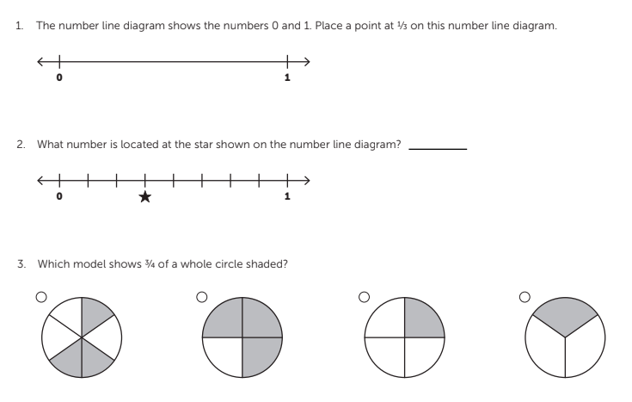
Predicting How Well Go Math! Attends to these Mathematical Ideas
Notes:
Here are the first three questions from the mini-assessment we designed. These questions are typical of those you would see in either curriculum -- Eureka Math or Go Math. Because they are the first three questions on the assessment we wanted to measure some of the basic understandings before going deeper -- the first really gets at understanding the idea of the unit fraction and how a number line can be partitioned in a way that gives us more numbers, or fractions. The second is a basic understanding of a non-unit fraction still using the number line representation. And the third is one of the two area model questions on the assessment. We included this problem because we think it would tell us a lot about our work with students and possibly our curriculum materials if they could answer this one but not the other two.

Slide 47
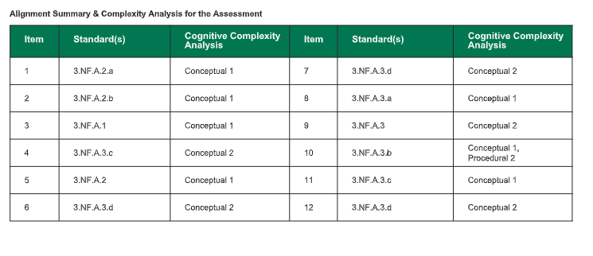
Summary of Grade 3 Fraction Mini-Assessment Cognitive Complexity
Notes:
This table shows the overall complexity of the assessment we designed using the framework that Shelbi described earlier. You’ll notice that we tried to have a pretty good balance of conceptual level 1 and level 2 problems to get at both the basic understandings of the standards but also go a little deeper in some places. The first three questions on the assessment are conceptual level 1, which Go Math students should be okay with. It is some of the conceptual level 2 problems that they would likely find more challenging… let’s look at an example

Slide 48
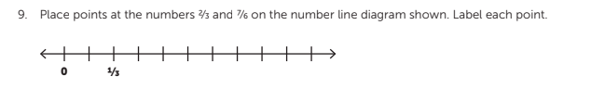
One Potential Area for Adapting Go Math!
Notes:
Give people a few moments to engage with the mathematics of the question -- then describe why it might be challenging for learners using Go Math.
Question 9 on the mini-assessment will likely be particularly difficult for students who have only been exposed to the Go Math! curriculum, because, in this program, when students are asked to practice representing fractions as points on a number line in Lesson 8.5, every example shows the unit fractions as “one length away from zero.” This signals that Go Math! users should consider incorporating supplemental lessons into the curriculum to focus on the use of number lines and representing the value of a fraction on the number line.

Slide 49
Let us know how you’re using the mini-assessment!
Take a look at the whole mini-assessment.
https://achievethecore.org/page/3233/understanding-a-fraction-as-a-number
If you learn anything interesting from it, we’d love to know how it has made you think differently about your instruction OR your materials.
Email Shelbi: scole@studentsachieve.net
Notes:
I’ll take this slide!! Shelbi

Slide 50
Questions for Our Guests?

Slide 51
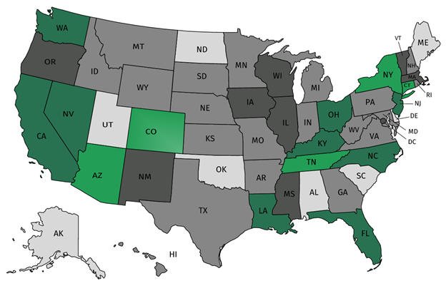
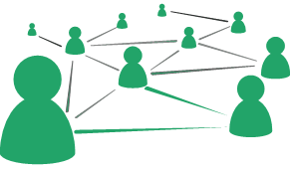



Join our network!
Join a national network of educators
Connect with state networks
Be a part of creating new tools and resources in partnership with SAP
Keep up to date on free resources, upcoming SAP webinars/professional learning opportunities, job postings and more!
Notes:
If you found tonight’s webinar helpful, we’d like to invite you to join our Core Advocate network! We’re committed to solving real problems that real teachers have and we know the best way to do this is to know more about what folks are experiencing.
As part of our national network, you have opportunities to connect with educators across the country, maybe even the network in your state! You can keep up to date on tools and resources available on Achieve the Core, as well as a variety of virtual learning opportunities and other ways to engage with us. We also work with educators in our network to help us build tools and resources.
We’d love to learn about who you are, where you work, the types of things you’re interested in and the expertise you already have. This way, we will be able to tailor our webinars and other opportunities to your needs and interests (we may even tap you to be our next webinar panelist).

Slide 52




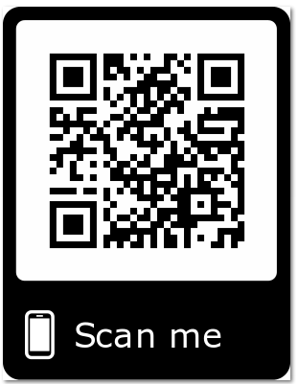
Please Join Us!
https://achievethecore.org/ca-signup
Twitter: twitter.com/achievethecore
Facebook: facebook.com/achievethecore
Pinterest: pinterest.com/achievethecore
Notes:
We encourage you to join the network by filling out this survey completely at atc.org/ca-signup

Slide 53
Please Join Us Again Next Month!
Next month’s webinar:
Professional Learning: Actionable Steps to Improve Quality and Content
Wednesday, 4 March @7pm EST
Register Here:
https://event.on24.com/wcc/r/2188054/08DD6791190DACDE024743AF21F3EEEA

Slide 54
Thank You!

