Slide 1
Reading, Learning, Growing:
Creative Ideas to Build Knowledge and Support Literacy Across Subjects
Core Advocates Monthly Webinar
June 3, 2020
The webinar will begin shortly.
Check your Resource widget to preview the resources for today’s session! Use the Group Chat to introduce yourself!
Notes:
First timer poll
Handouts:
While we’re waiting, we’d like you to participate in a quick poll so we can get an understanding of who’s on the webinar with us tonight.

Slide 2
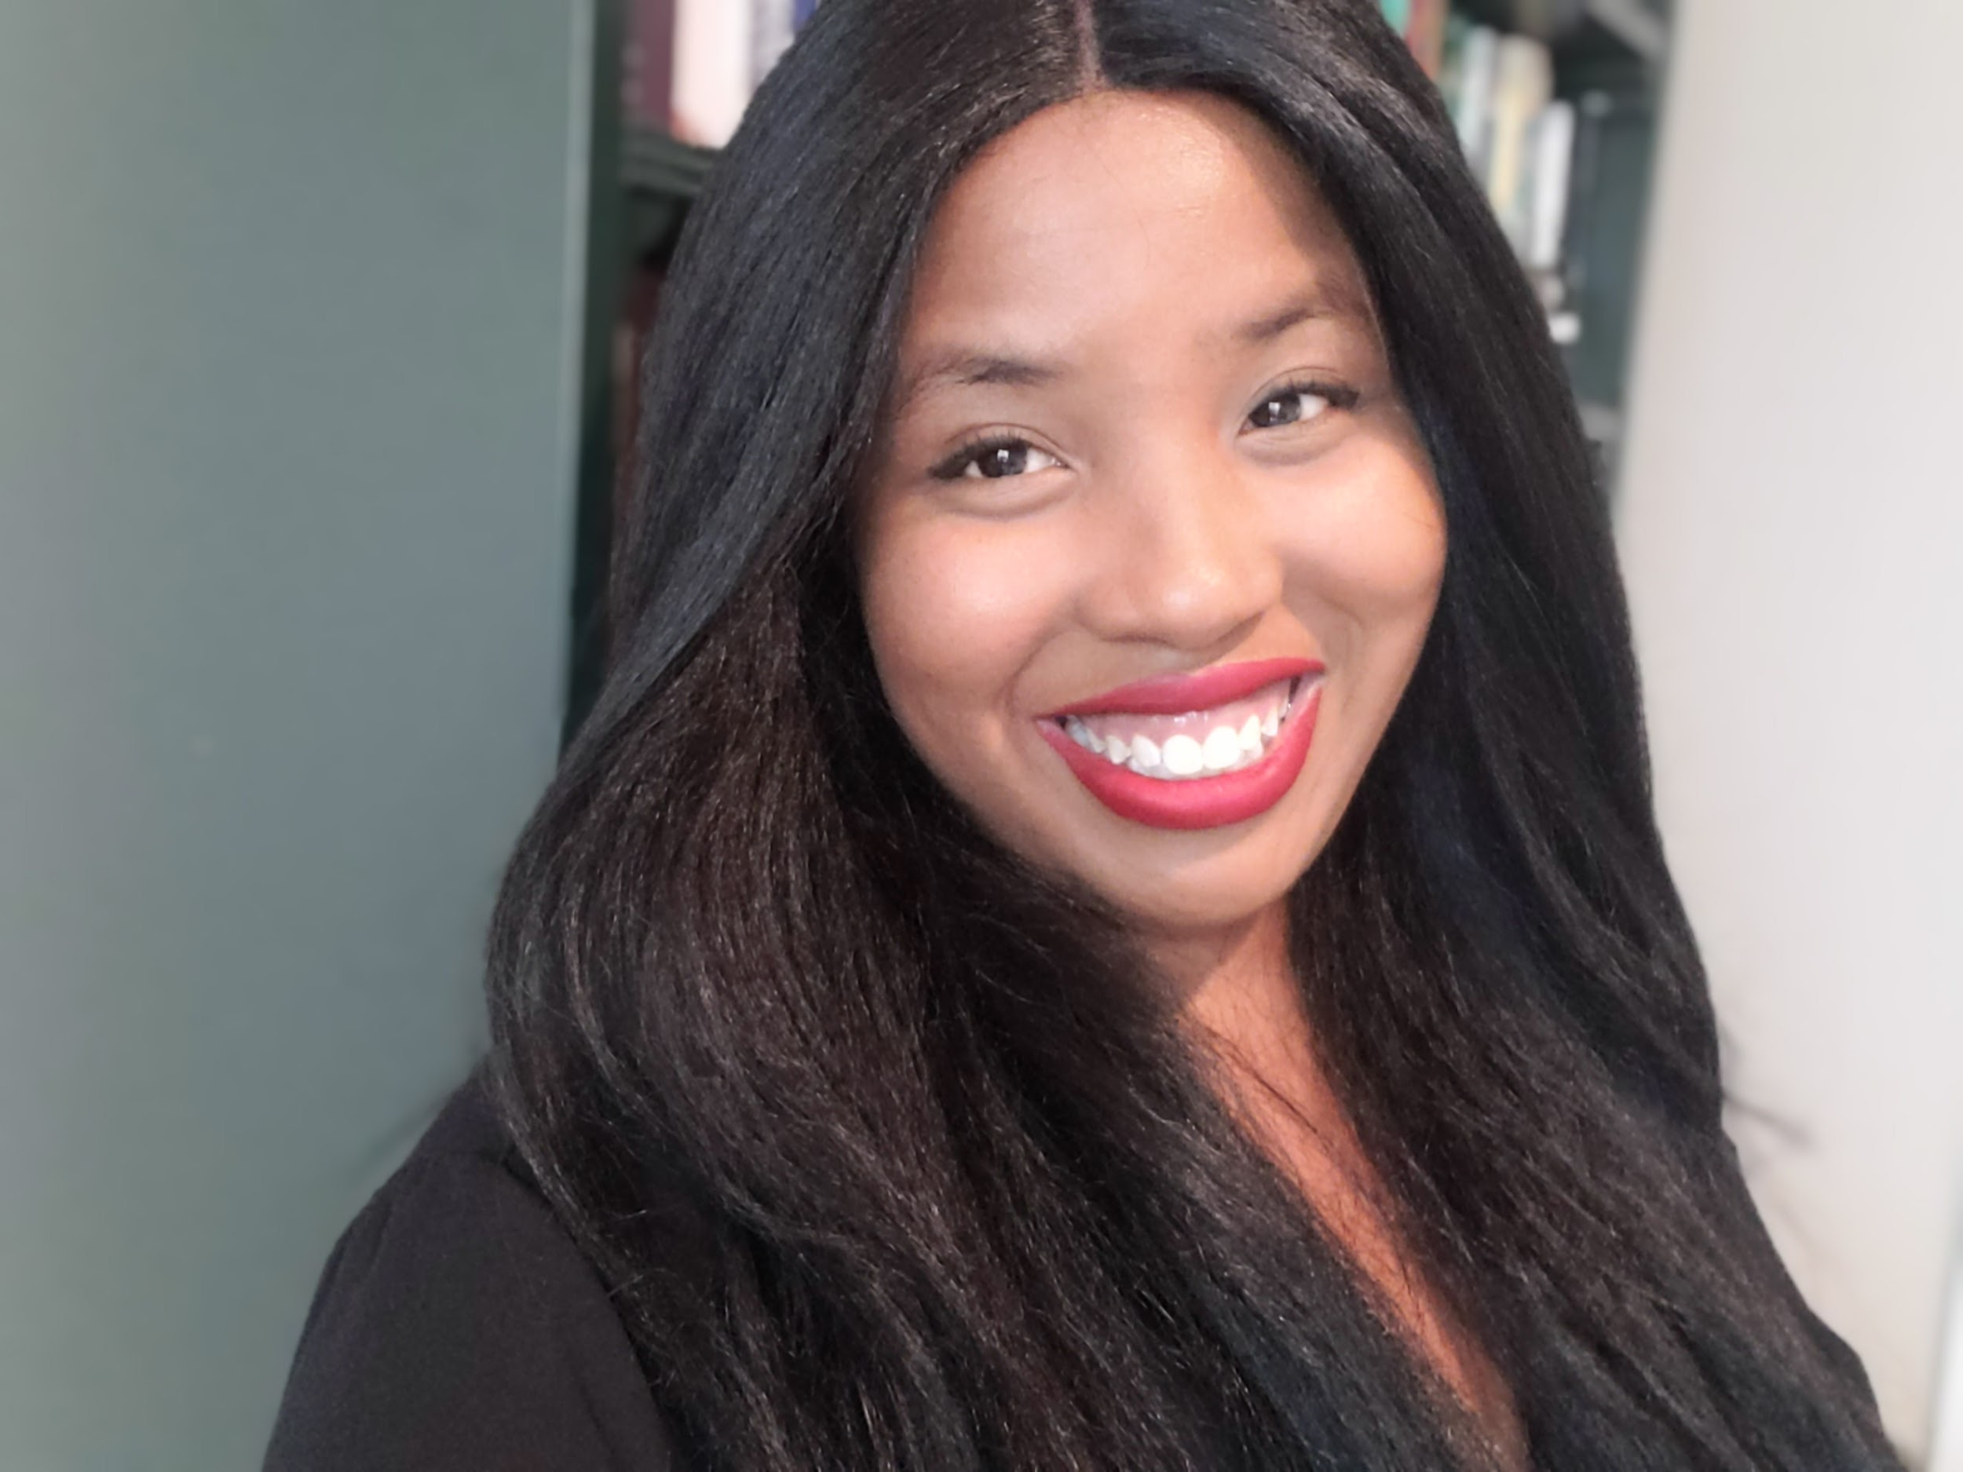
Introductions
Your hosts from Student Achievement Partners:
Pascale Joseph Project Coordinator,
Tools and Classroom Resources, SAP
This month’s presenter:
Zachary Chan Kindergarten Teacher
Irving Dual Language Academy, San Antonio ISD
Tori Filler ELA/Literacy Specialist, Professional Learning
Student Achievement Partners
Claire Rivero Digital Strategy Manager
Student Achievement Partners
Carey Swanson Senior Literacy Specialist, Advisory Support
Student Achievement Partners

Slide 3
How many Core Advocate Webinars have you attended?
Please use the Questions tab on your control panel to respond.
If using a poll, please put up to 5 answer choices in the notes section below and indicate if attendees should choose only one response or multiple responses.

Slide 4
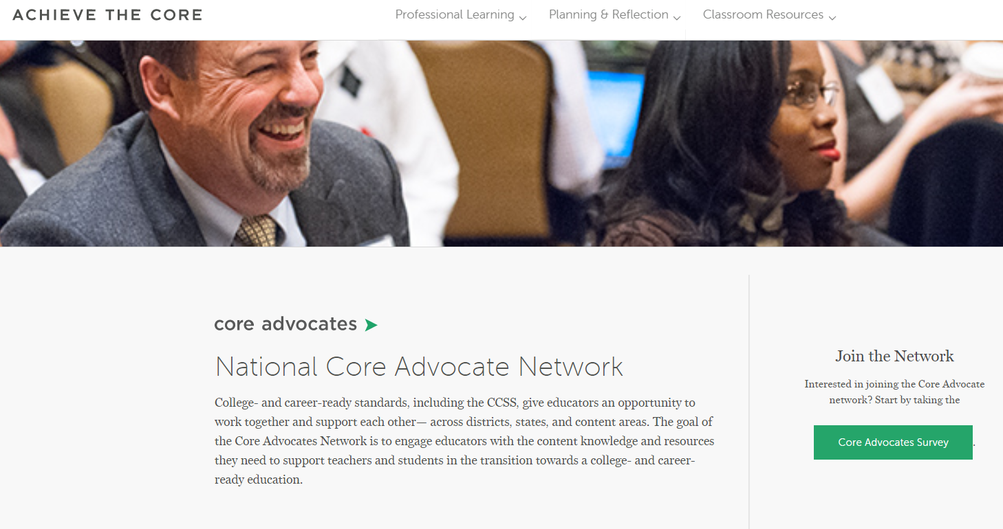
Join Our Network!
www.achievethecore.org/ca-signup
Notes:
If you find tonight’s webinar helpful, we’d like to invite you to join our Core Advocate network! We’re committed to solving real problems that real teachers have and we know the best way to do this is to know more about what folks are experiencing.
We’d love to learn about who you are, where you work, the types of things you’re interested in and the expertise you already have. This way, we will be able to tailor our webinars and other opportunities to your needs and interests (we may even tap you to be our next webinar panelist). So we encourage you to join the network by filling out this survey completely at atc.org/ca-signup

Slide 5
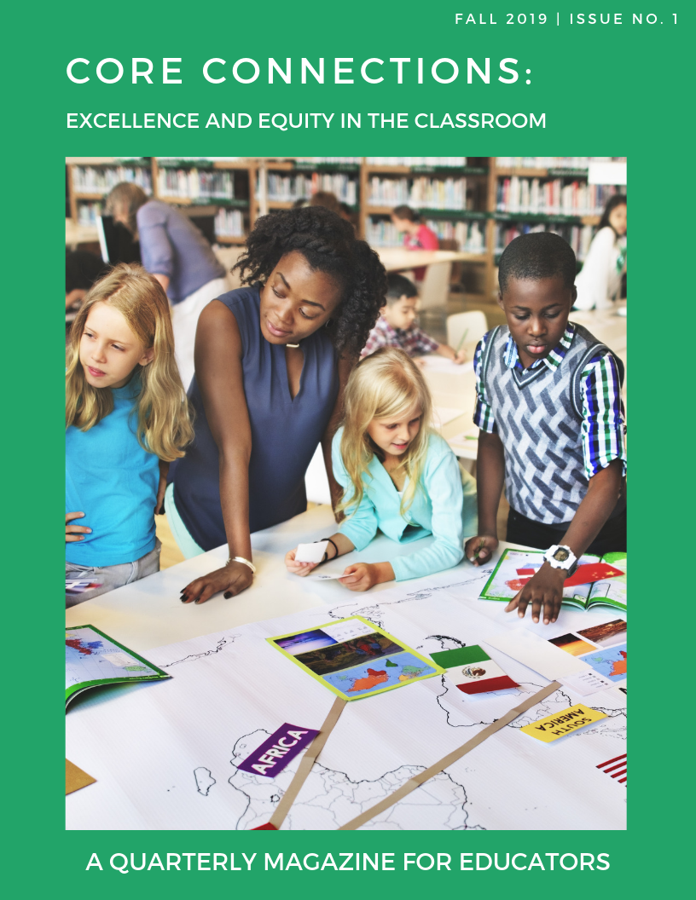
Learn More About Us!
Contact Jennie Beltramini (jbeltramini@studentsachieve.net ) Joy Delizo-Osborne
(jdelizo-osborne@studentsachieve.net)
Complete this survey to join our database (and mailing list): www.achievethecore.org/ca-signup
Visit our website: www.achievethecore.org
Notes:
If you’d like to learn more about the network, contact Jennie (her email is here).
We also want to invite you to join the network by signing up at achievethecore.org/ca-signup and visit our website for more info and opportunities

Slide 6
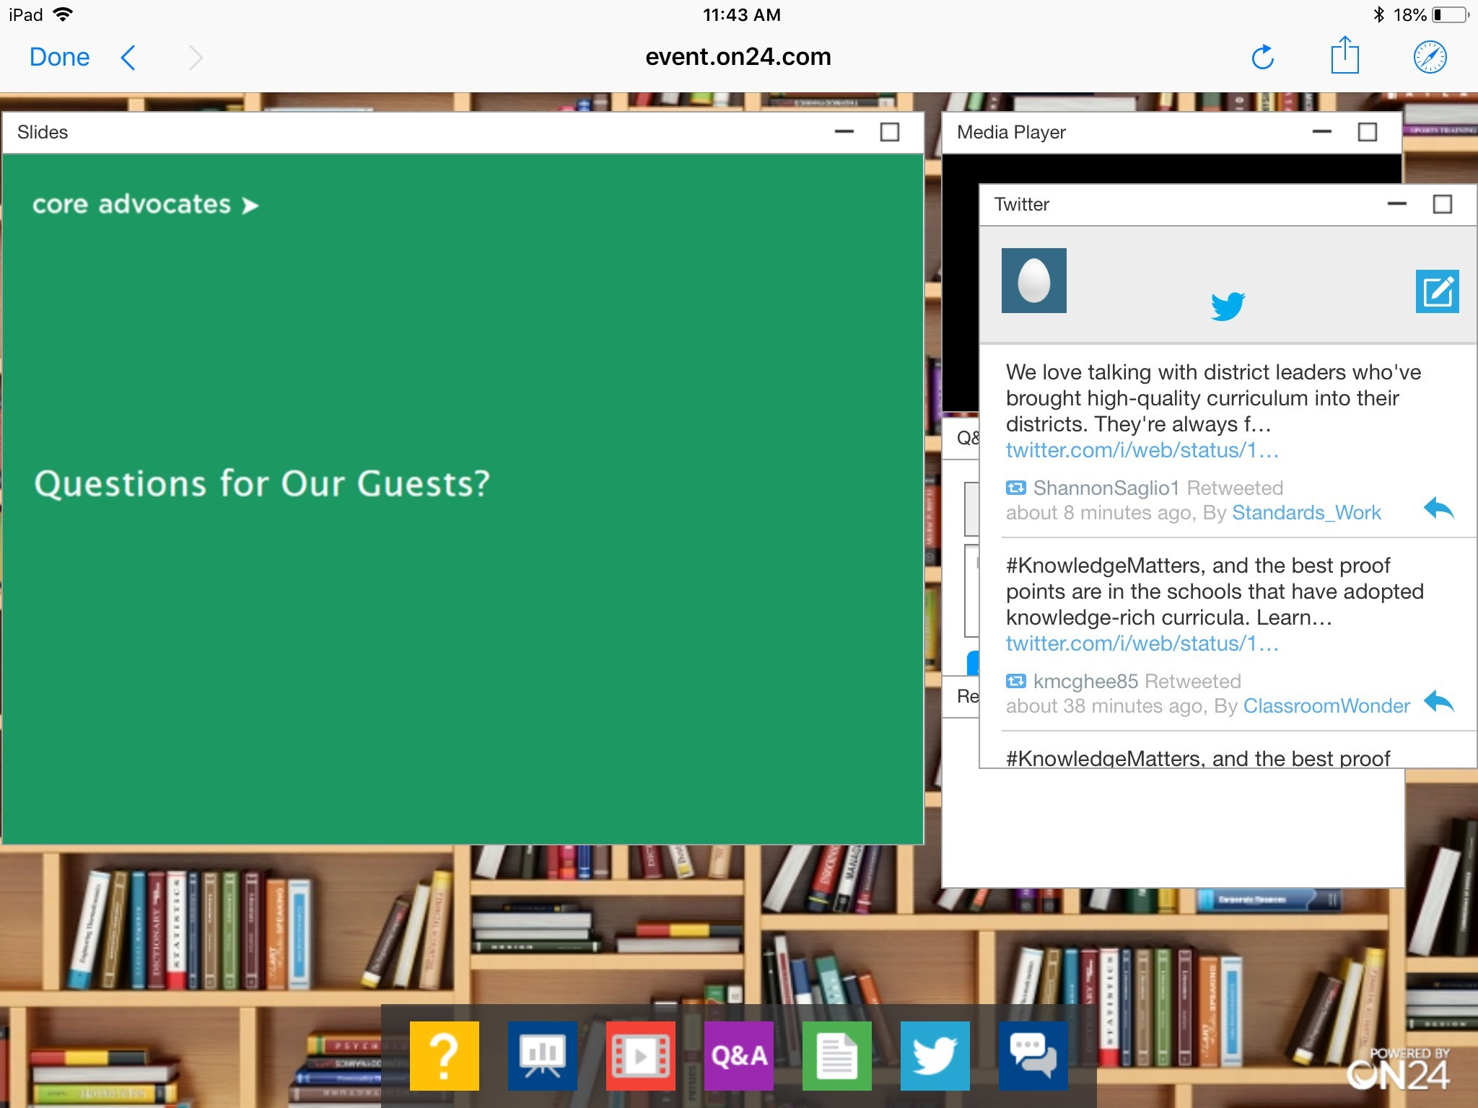
Tweet with Us!
Please feel free to tweet during and after the webinar using #coreadvocates
@achievethecore
@JennieBeltro
@CareySSwanson
Click here!

Slide 7
Engage with Us!
During the webinar:
Question just for the presenters/ tech help
Resources
Group chat
After the webinar:
– Access to recording will be emailed to you.
Take our survey in 2 weeks and receive a certificate verifying 1 hour of professional learning.

Slide 8
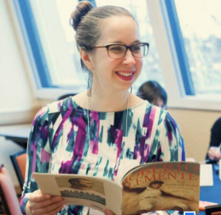
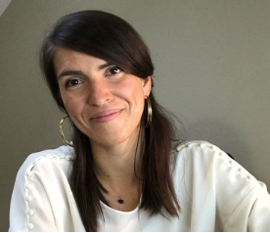
Carey Swanson
ELA/Literacy Specialist
SAP
Tori Filler
ELA/Literacy Specialist
SAP
Insert Headshot Here
Insert Headshot Here

Slide 9
Respond in the chat:
Why did you attend this webinar?
Why does building knowledge for students matter to you?

Slide 10
On June 3rd, 2020.
Notes:
At the time of this recording in June 2020 there are many things on our collective minds. Educators have either just finished or are in the midst of teaching via some form of distance learning during a global pandemic, communities across the country are processing, protesting, and reacting to the recent murders of Ahmaud Arbery, Breonna Taylor, and George Floyd - among others - and many of us are angry, many of us have heavy hearts…...
As we think about our time together tonight and the topic of building knowledge with students…
We know that historically, the choices of which knowledge to prioritize, whose voices are amplified, and what stories get told in the classroom have reinforced systems that benefit some and oppress other, that benefit white children and oppress Black children and students of color.
Part of thinking about building knowledge is creating space for all students to learn about themselves and their communities, to see pieces of their identities reflected in texts in positive and affirming ways...AND to also to ensure that students are exposed to learning about the many identities and experiences that are different from their own. Representation matters. Learning about the experiences of others’ matters.
Framing our literacy instruction with the lens of what knowledge will my students connect to or learn about the world has the potential to be a transformative practice.
When we create environments where students regularly engage in the practice of building knowledge about the world around them, we are helping them build the muscles they need to be informed changemakers in their communities, lifelong knowledge seekers, and empathetic community members.
So in this webinar, as many of you are thinking about ways to engage your students about what is happening around us - either now, or when you return to teaching in the fall -we want to start a conversation and learn from you too. We certainly don’t have all the answers but we hope that tonight we can share ideas and potentially surface some things we can all do as we move forward together.

Slide 11
Goals of the Webinar
Understand the rationale behind knowledge building in the ELA/literacy classroom.
Identify concrete ways to build knowledge for all students through text sets, utilizing immersive units, and podcasts
Hear about an educator’s experience building knowledge in his classrooms
Notes:
We have three main goals for our webinar tonight. They are to...

Slide 12
Section 1: Why Building Knowledge?

Slide 13
Let’s ask Zoe
Notes:
Very quick Q and A about what Zoe remembers learning about the post (pre K- solar system, K-3 science “Project lead the way”) and what she’s picking to learn about now (Megan Rapinoe, Ruth Bader Ginsberg, history of legos) and why she likes learning about real stuff.

Slide 14
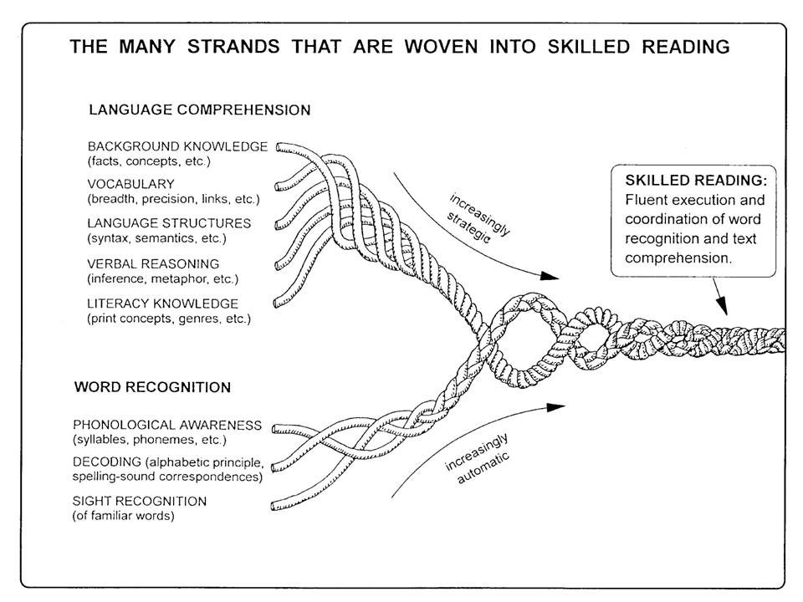
Scarborough’s Rope
Notes:
This is how research tells us that reading work. Background knowledge and vocabulary play an important role and weave their way into what it means to be a proficient reader.
https://dyslexiaida.org/scarboroughs-reading-rope-a-groundbreaking-infographic/

Slide 15
What do funds of knowledge do my students already have that can be leveraged in service of understanding this text?
What background knowledge do students need to access this text? How can I ensure all students have access to that knowledge?
“Background” Knowledge
They don’t have the background knowledge...
Do these questions and ideas resonate with you? Why or why not? What would you add/change?
Notes:
We often hear that educators talk about students’ perceived lack of background knowledge and the challenges this can pose while reading.
What if instead of saying “they don’t have the background knowledge” - we asked ourselves these two questions:
What do funds of knowledge do my students already have that can be leveraged in service of understanding this text?
What background knowledge do students need to access this text? How can I ensure all students have access to that knowledge?
We must keep in mind that all students have rich funds of knowledge. Sometimes these funds of knowledge are a match for the text the teacher has selected, while other times they will not support their access to the content selected. You’ll hear much more about that in the next section. As educators, we can consider our students, whether they are their likely funds of knowledge will or won’t be represented in the texts we have chosen, and determine how to support or scaffold their access accordingly.

Slide 16
Everyone knows knowledge plays a role in comprehension, but how big of a role?
Let’s take a look at what happened to one student’s writing after engaging with a Text Set: a group of texts and resources centered on building knowledge of a topic.
Notes:
No one disputes that prior knowledge is important to comprehension, but when students struggle with comprehension, we rarely focus on building knowledge as our primary intervention. Instead we practice comprehension strategies, attempt to build stamina, or simply ask kids to practice.
When many things seems important, knowing how big the impact of each factor is helps us to choose an area to focus on.

Slide 17
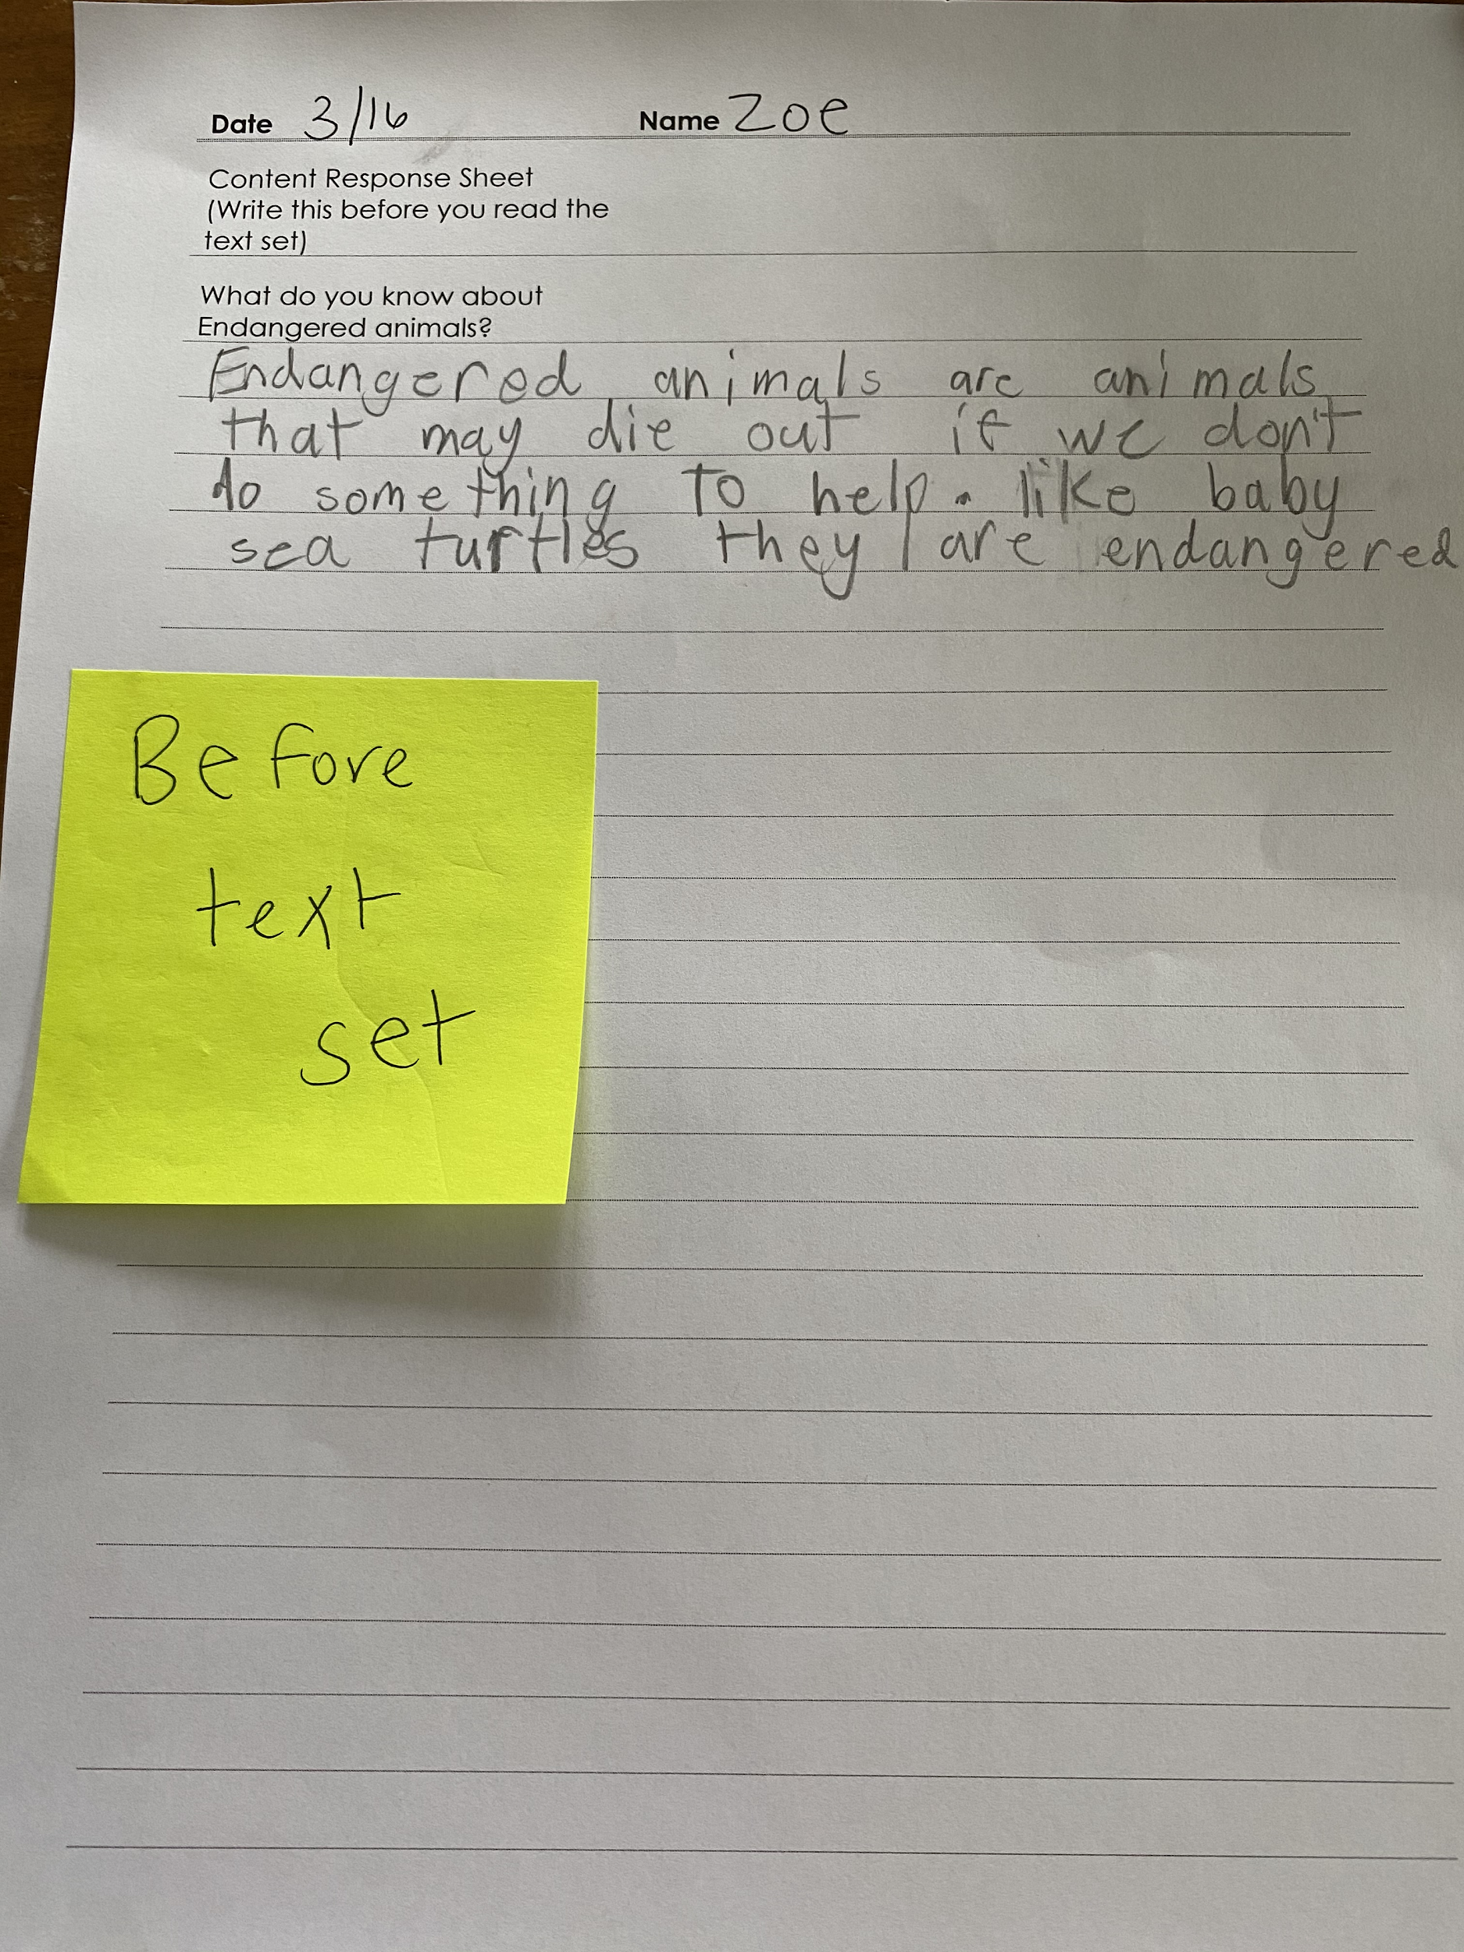
“What do you know about endangered animals?”
before text set
Endangered animals are animals that may die out if we don’t do something to help. like baby sea turtles they are endangered.
Notes:
Let’s take a look at what this looks like when trying to build knowledge of unfamiliar world content. On the screen you see a sample of a 3rd grade student writing prompt when given the question “what do you know about endangered animals.” The response is in blue- take a quick read.

Slide 18
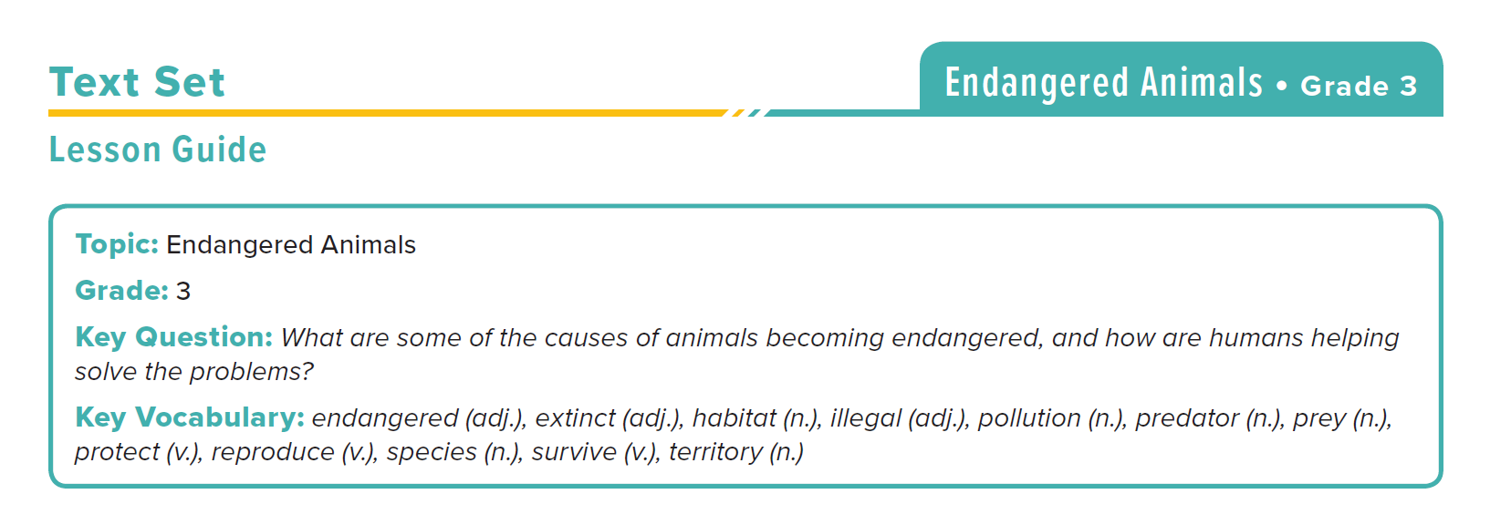
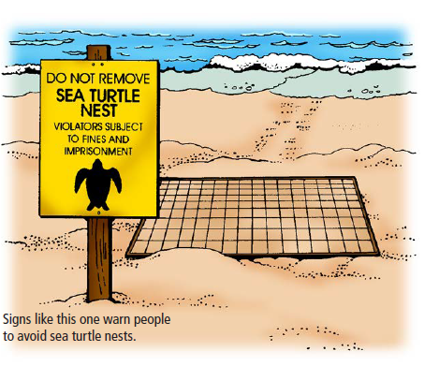
source:
Learning A-Z
“Endangered Animals’ Text Set
Grade 3
Notes:
Next, the student spent time reading through the texts from a text set on endangered animals, which came from Learning A-Z’s text set collection. You can see a few samples from the resources here.

Slide 19
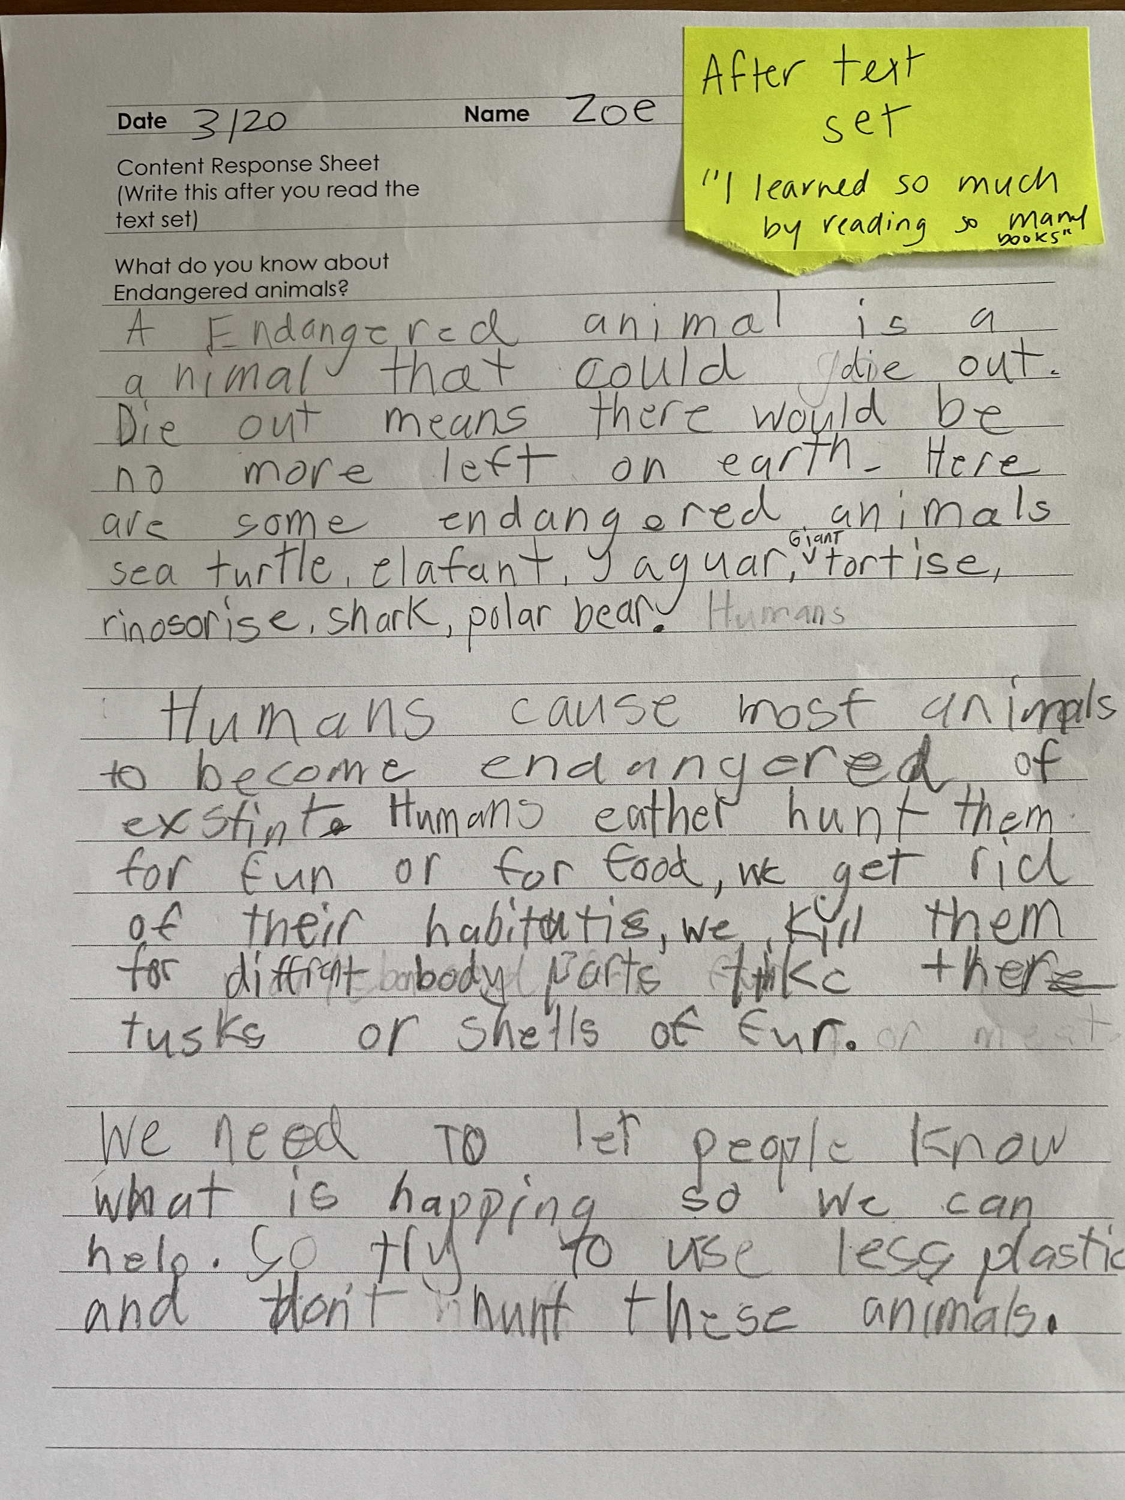
“What do you know about endangered animals?”
after text set
A Endangered animal is a animal that could die out. Die out means there would be no more left on earth. Here are some endangered animals sea turtle, elafant, jaguar, giant tortise, rinosorise, shark, polar bear.
Humans cause most animals to become endangered or exstint. Humans eather hunt them for fun or for food, we get rid of their habitatis, we kill them for different body parts take there tusks or shells or fur.
We need to let people know what is happening so we can help. So try to use less plastic and don’t hurt these animals.
What do you notice about this students “after” writing? What do you wonder?
Notes:
After reading multiple texts on this topic, the prompt was given again. Here is the same students’ work after interacting with this content. What do you notice/ what do you wonder.

Slide 20
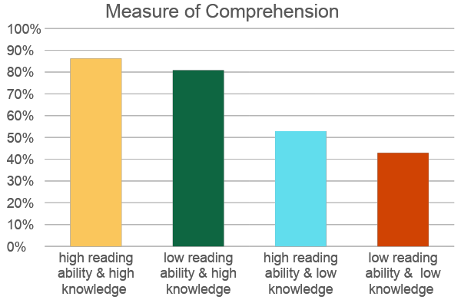
“The Baseball Study” by Recht and Leslie (1988)
Notes:
Key Idea:
The students in these 4 groups read a passage about baseball and then took a test of their comprehension.
Talking Points:
Groups were divided in two ways: reading ability and knowledge of baseball.
They were then subdivided further into high reading ability, high knowledge of baseball, high reading ability, low knowledge of baseball, low reading ability, high knowledge of baseball, and low reading ability, low knowledge of baseball.
Technical Notes:
High reading ability was defined as 70th percentile or higher on a standardized test of reading. Low reading ability was defined as 30th percentile or lower.
High knowledge of baseball was defined as 70th percentile or higher on a test of baseball knowledge. Low baseball ability was defined as 30th percentile or lower.
Key Idea:
Knowledge of baseball played a huge role in students success on the assessment.
Talking Points:
Students with ”low reading ability and high knowledge” performed almost equally as well as students with “high reading ability and high knowledge.”
In addition there is little difference between the two high knowledge groups and the two low knowledge groups.
from pg. 18, table 1, Recht & Leslie 1988. (Qualitative Measure) Note: conversion from raw numbers to percentages achieved by dividing score by achieved by total possible score.

Slide 21
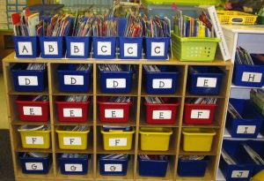
A student doesn’t have ONE level.
Each student has MANY LEVELS depending on topic & knowledge.
Knowledge can support access to rich texts.
Implications

Slide 22
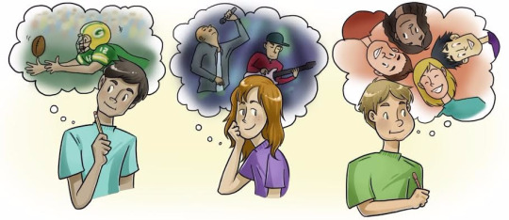
Build Knowledge...About What?
Empower Students with Knowledge about Current Events and Issues that Impact their Communities | Connecting to Students’ Identities & Interests | Connecting to the Core Curriculum & Anchor Texts | Connecting Across Content Areas
Notes:
The WHAT of knowledge building is not defined by college- and career-ready standards.
As we discussed at the start of our time together, we need to make choices as educators about what knowledge we prioritize for instruction.
This involves thinking about how we can connect to knowledge about current events, student identities/interests, the core curriculum, and content areas.

Slide 23
Question or Poll:
Have you used text sets in your classroom?
What is a text set again?
Don’t use text sets yet
Sometimes
Use consistently Please use the Questions tab on your control panel to respond.
If using a poll, please put up to 5 answer choices in the notes section below and indicate if attendees should choose only one response or multiple responses.

Slide 24
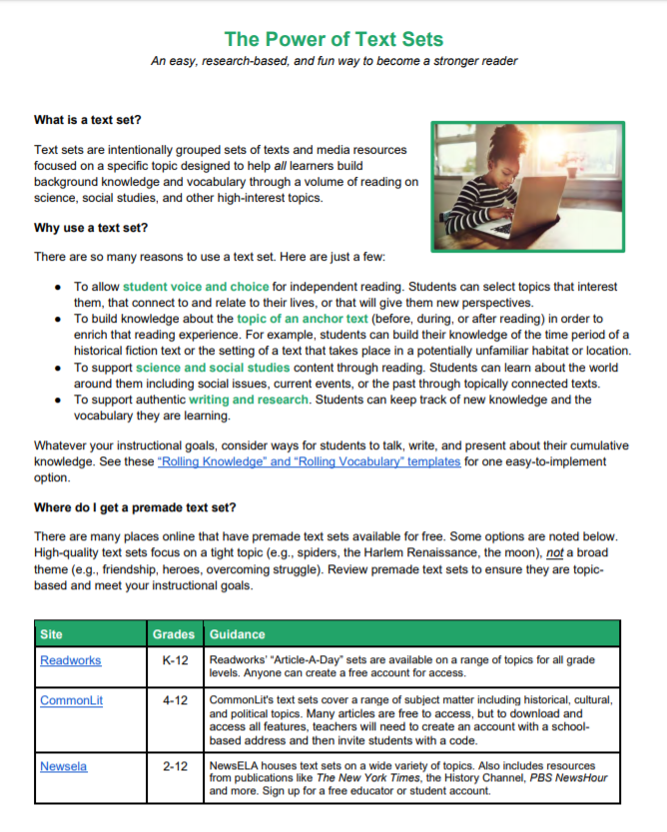
Grow as much as
4X vocabulary with connected texts (multiple resources on a topic).
(Landauer & Dumais, 1997)
Notes:
There is a handy resource in your resource tab titled “The Power of Text Sets.” We’ll talk through some of the key content on this webinar.

Slide 25
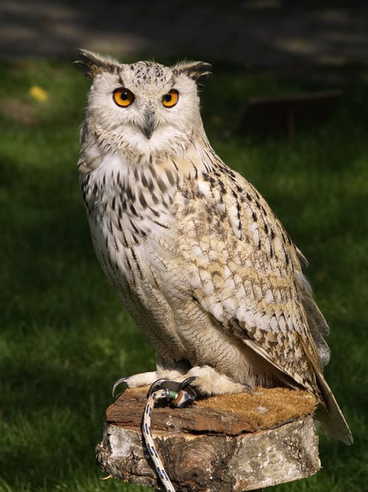
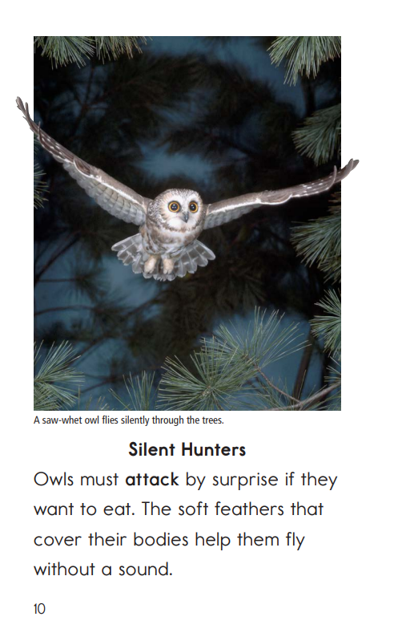
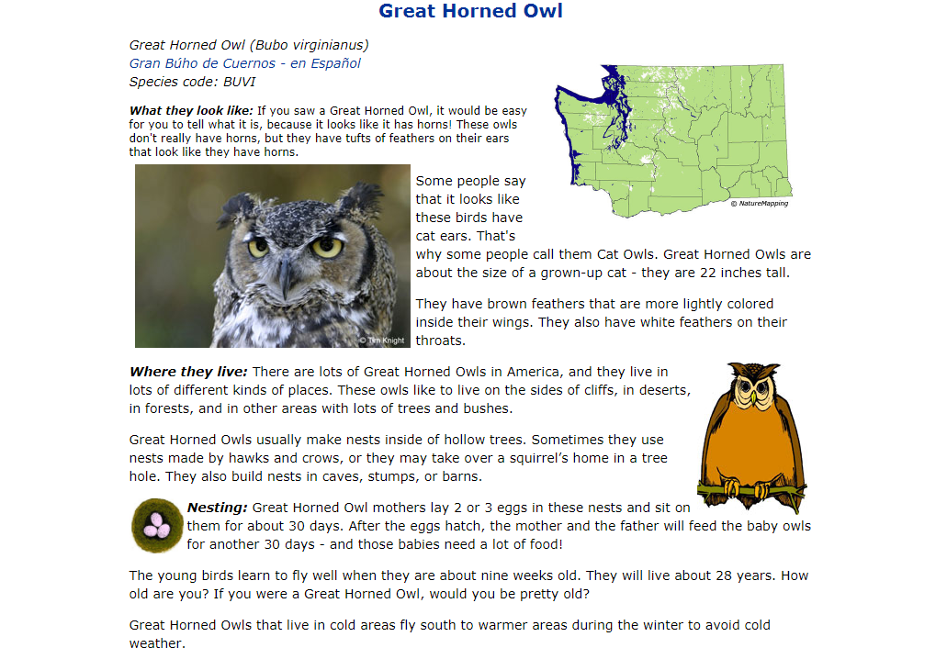
Text Sets to Support Building Knowledge
Make your own!
Text sets are intentionally grouped sets of texts and media resources focused on a specific topic designed to help all learners build background knowledge and vocabulary through a volume of reading on science, social studies, and other high-interest topics.
Use a premade set!
Notes:
Multiple resources grouped around a tight topic
Text sets may include varied genres (fiction, nonfiction, poetry, and so forth) and media (such as blogs, maps, photographs, art, primary-source documents, and audio recordings).
Can be used small group, whole group, or independently
Best text sets are ordered from easiest texts to most challenging texts and include ways for students to keep track of/share their cumulative knowledge
Example: https://achievethecore.org/content/upload/CORAL%20REEFS%20Expert%20Pack.pdf
About text sets: https://achievethecore.org/content/upload/Text%20Set%20Guidance.pdf?utm_source=Subscriber+Master+List&utm_campaign=825f01c19f-EMAIL_CAMPAIGN_2020_04_09_07_59&utm_medium=email&utm_term=0_a3f2445f50-825f01c19f-320962437
Premade text set:
https://www.commonlit.org/en/text-sets/ancient-egypt

Slide 26
Where?!
Where do you find texts online?
Free texts online
premade Text sets!
(and resources to make your own)
Make your own!
*
*Requires subscription
Note: Texts for this knowledge-building work do not all need to be trade books or rich, publishable quality texts.
Notes:
Here are some sources of text sets online.

Slide 27
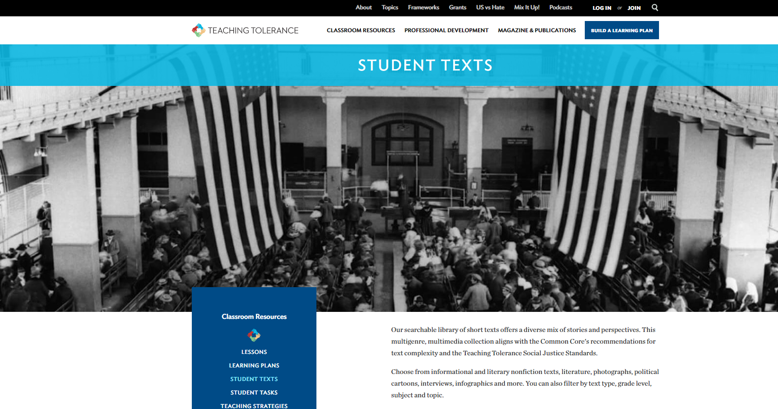
Notes:
Tonight we wanted to highlight resources from Teaching Tolerance, a project from the Southern Poverty Law Center. This site has a plethora of resources for anti-bias education - including lesson plans, texts for students, and professional development resources.
This upcoming text set was built using resources primarily form the Teaching Tolerance website, https://www.tolerance.org/ .
Teaching Tolerance provides free resources to educators—teachers, administrators, counselors and other practitioners—who work with children from kindergarten through high school. Educators use our materials to supplement the curriculum, to inform their practices, and to create civil and inclusive school communities where children are respected, valued and welcome participants.
Our program emphasizes social justice and anti-bias. The anti-bias approach encourages children and young people to challenge prejudice and learn how to be agents of change in their own lives. Our Social Justice Standards show how anti-bias education works through the four domains of identity, diversity, justice and action.

Slide 28
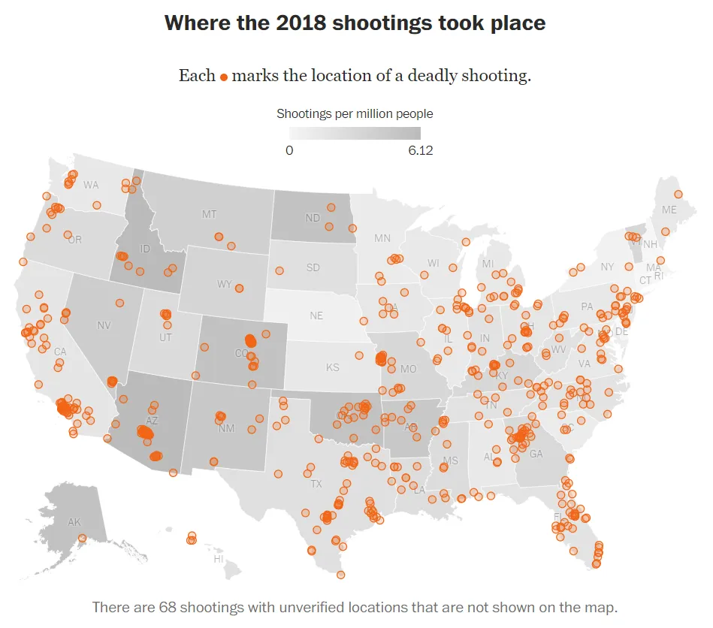
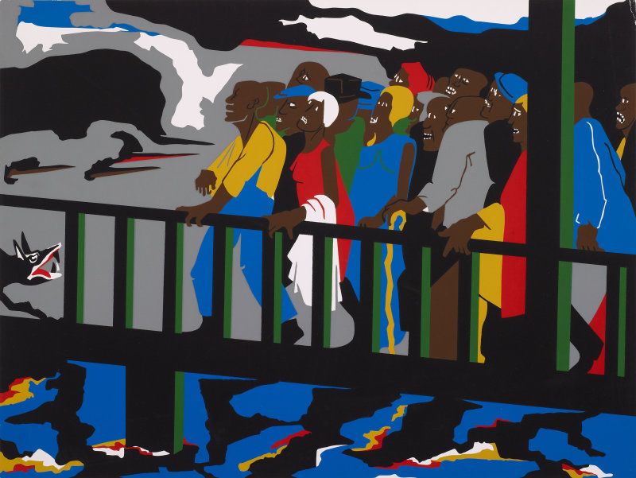
Anchor Texts + Text Sets
Topically Connected Text Set
Anchor Text
Art
Infographic
Notes:
For example, many middle schools include the text The Hate You Give as an anchor text. We were able to find great resources to support the themes and topics of that text from resources on that site that had to do with police brutality. Then show how this works to build knowledge of anchor texts as well https://www.tolerance.org/magazine/why-the-texas-policestop-video-is-a-problem
https://www.tolerance.org/magazine/police-violence-new-jersey-bill-puts-onus-and-blame-on-children
https://www.tolerance.org/classroom-resources/texts/yall-still-dont-hear-me-though
https://www.tolerance.org/classroom-resources/texts/confrontation-at-the-bridge
Source
© 2013 The Jacob and Gwendolyn Lawrence Foundation, Seattle / Artists Rights Society (ARS), New York Reproduction, including downloading of Jacob Lawrence works is prohibited by copyright laws and international conventions wihtout the express written per
https://www.washingtonpost.com/graphics/investigations/police-shootings-database/

Slide 29
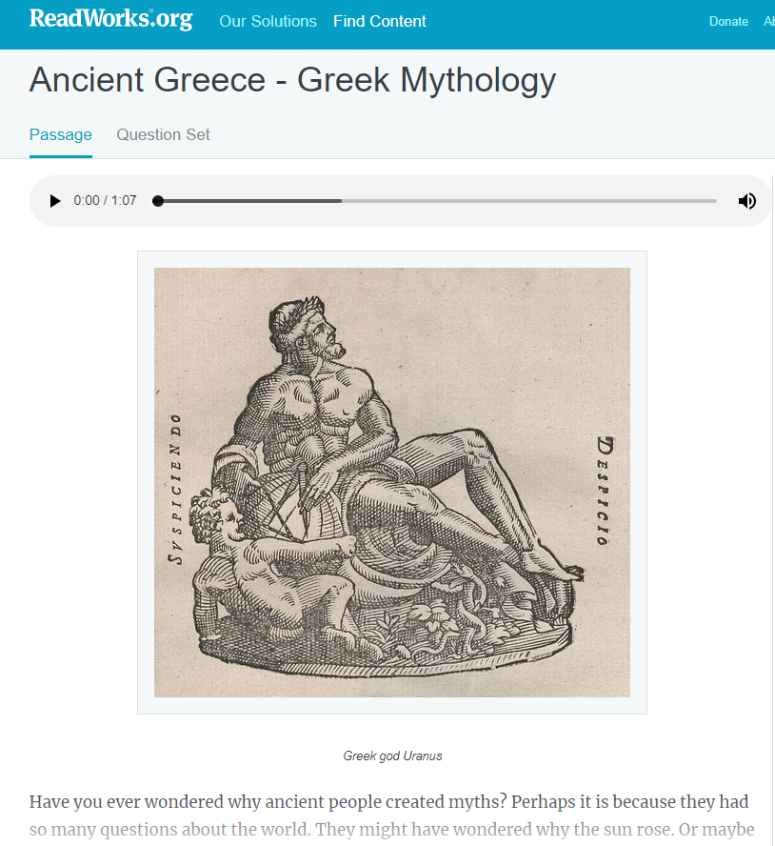
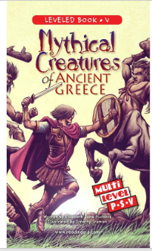
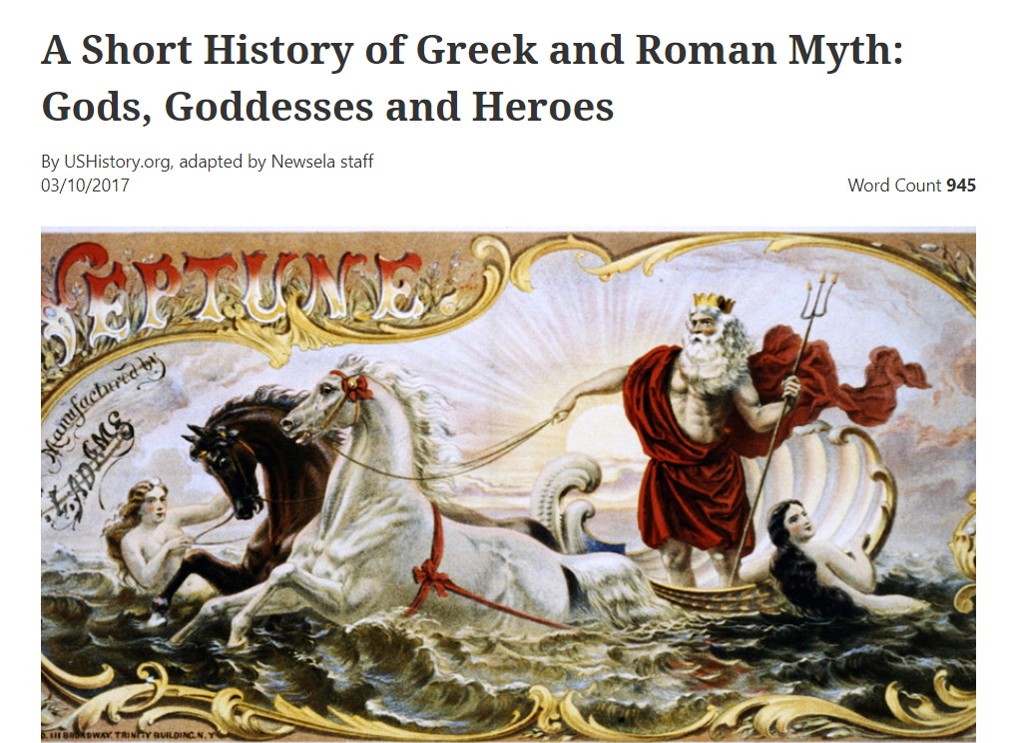
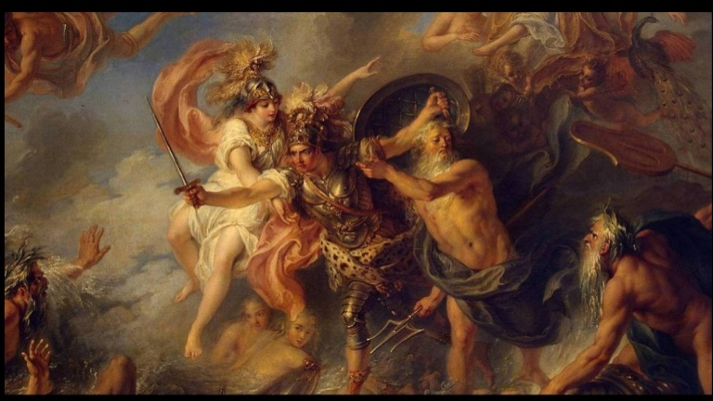
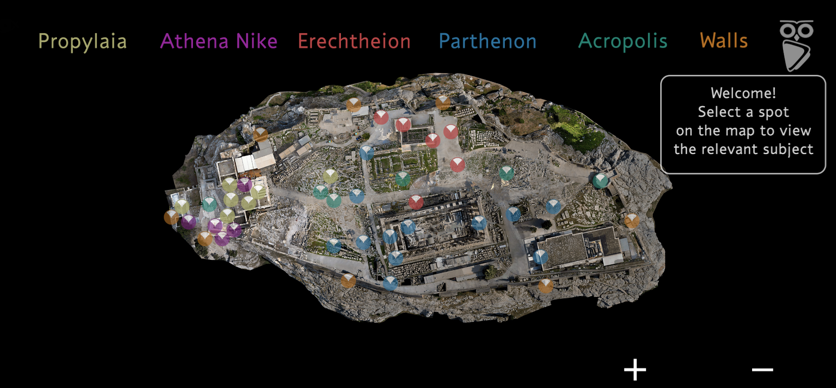
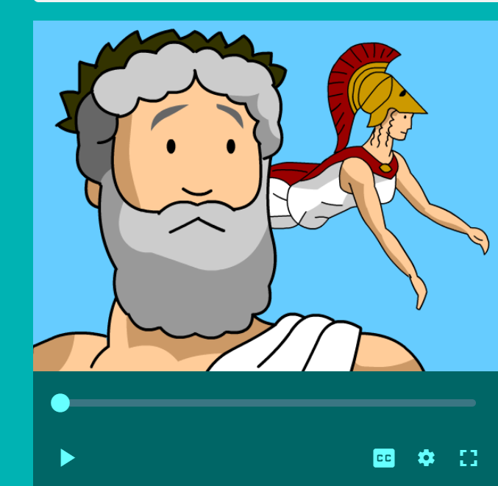
Anchor Texts + Text Sets
Topically Connected Text Set
Texts
Virtual Field Trip
Anchor Text
Art
Video
Notes:
Many high quality instructional materials utilize a “text set” approach, and if your curriculum includes strong trade books, you can adjust to do something similar. For example, here are some ways you might make good use of the topics addressed through the book The Lightning Thief.
The first installment in the “Percy Jackson” series, entitled “The Lightning Thief,” centers around the relation of its namesake demigod protagonist with his father, Poseidon, the Greek god of the sea. Poseidon at the time is charged by Zeus with stealing his master bolt of lightning.
Texts:
https://www.readinga-z.com/book.php?id=2528
https://www.readworks.org/article/Ancient-Greece---Greek-Mythology/72b7d7da-9cd8-4c37-998f-9ffce9ac1aa9#!articleTab:content/
https://newsela.com/read/lib-ushistory-greek-mythology
Video:
https://www.brainpop.com/socialstudies/ancientcultures/greekgods/

Slide 30
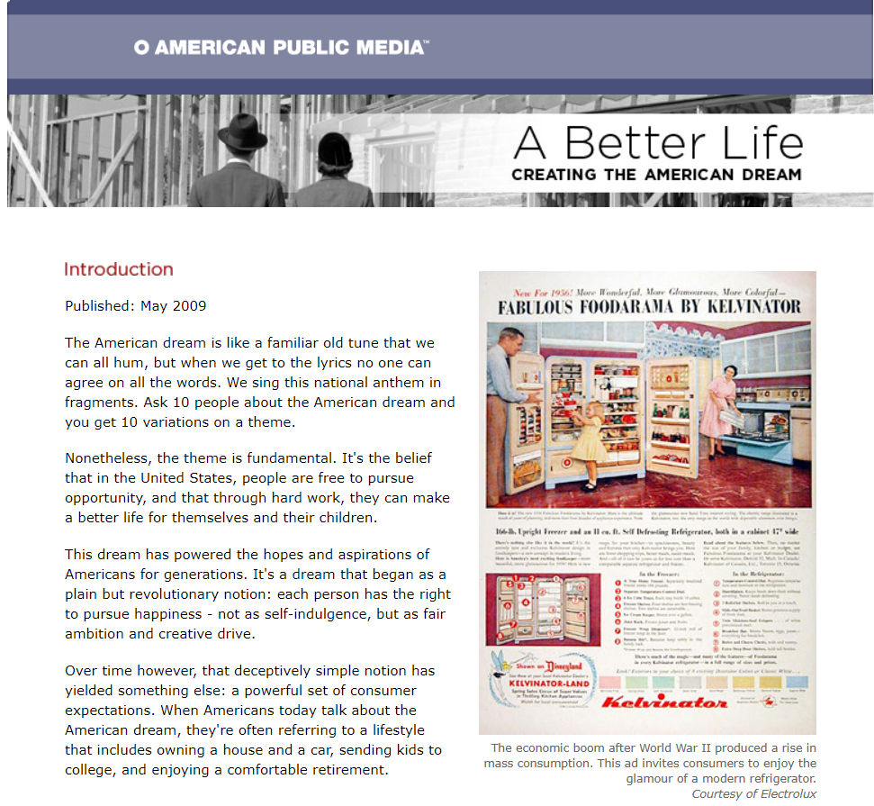
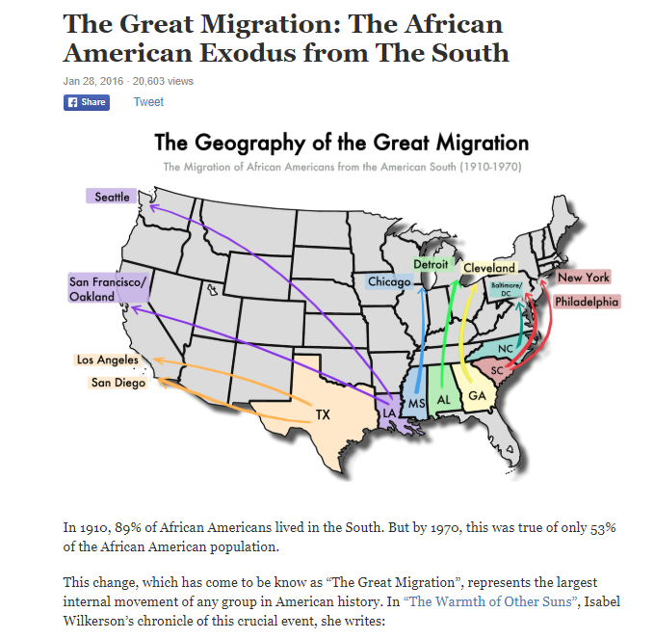
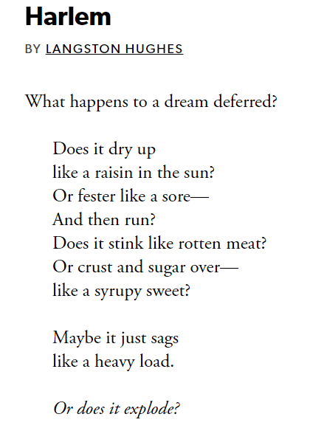
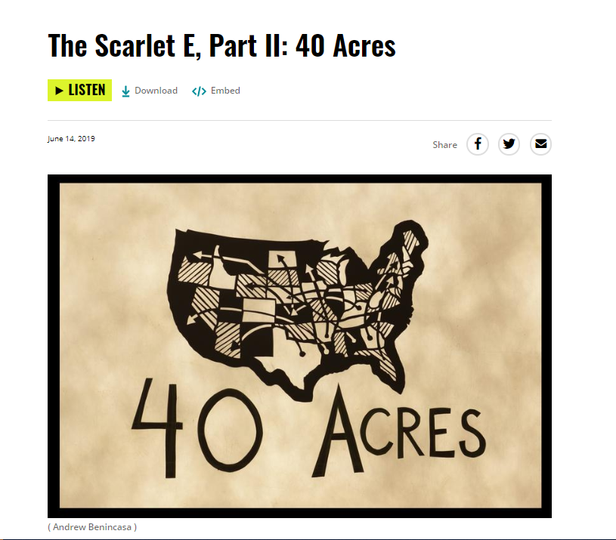
Anchor Texts + Text Sets
(in high-quality
instructional materials)
Topically Connected Text Set
Texts
Anchor Text
Poem
Podcast
Notes:
Examples from: https://www.matchfishtank.org/curriculum/english-language-arts/7th-grade-english/pursuing-dreams-a-raisin-in-the-sun/
A Raisin in the Sun: A Raisin in the Sun is a play by Lorraine Hansberry that debuted on Broadway in 1959. The title comes from the poem "Harlem" (also known as "A Dream Deferred") by Langston Hughes. The story tells of a black family's experiences in south Chicago, as they attempt to improve their financial circumstances with an insurance payout following the death of the father.
Supporting texts in this unit that support the anchor text:
Poem: “Harlem” by Langston Hughes (the Poetry Foundation)
Article: “A Better Life: Creating the American Dream” by Kate Ellis and Ellen Guettler (American Public Media, 2009)
Article: “The Great Migration: The African American Exodus from The South” by Dan Kopf (Priceonomics)
Radio Segment: “The Scarlet E, Part II: 40 Acres” (WNYC Studios)

Slide 31
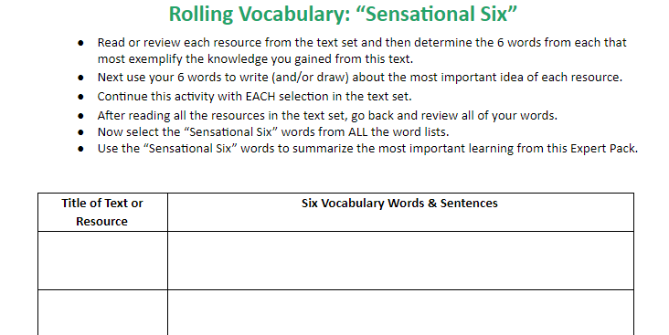
One Way to Capture and Share Knowledge
Notes:
Or have students use a journal and set up their own! Or, have students end you a photo of their rolling knowledge/vocabulary journal. Or, film themselves teaching about the topic they have been reading about and send it to you.

Slide 32
Zachary Chan
Kindergarten Teacher
Irving Dual Language Academy, San Antonio ISD
Insert Headshot Here

Slide 33
Section 2: Supporting English Learners Through Immersive Units

Slide 34
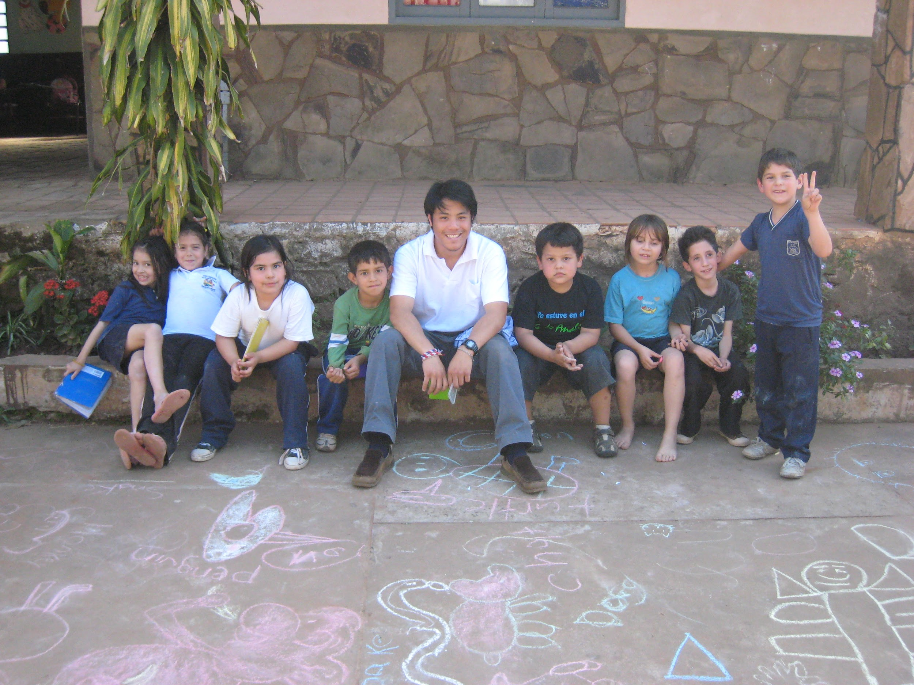
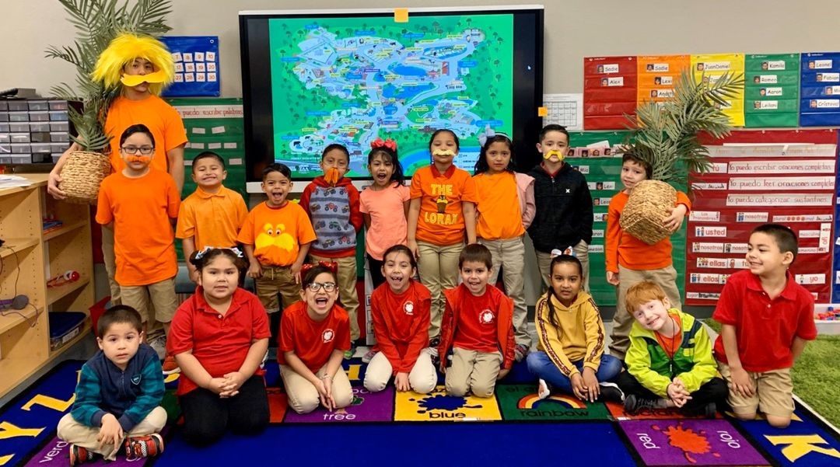
About Me
9th year of teaching! Kinder, pre-k, and 3rd grade
Knowledge and language building is a huge passion of mine!

Slide 35
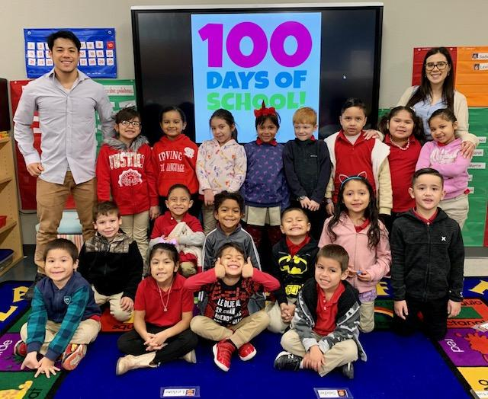
About my students
Currently teaching at Irving Dual Language Academy in San Antonio ISD
two-way dual language (English and Spanish acquisition)
80/20% model - building funds of knowledge is ESSENTIAL

Slide 36
Immersive Units
Primary objective is to build knowledge, “Text is king”
One to two weeks long, varies in scope and intensity
Today’s touchpoints will be how:
Anchor texts guide instruction
People/characters from text build knowledge
Vocabulary gets acquired in many ways

Slide 37
Anchor Texts Guide Instruction
Anchor texts must be relevant
teacher decides on anchor text based on relevancy
students decide where to focus attention

Slide 38
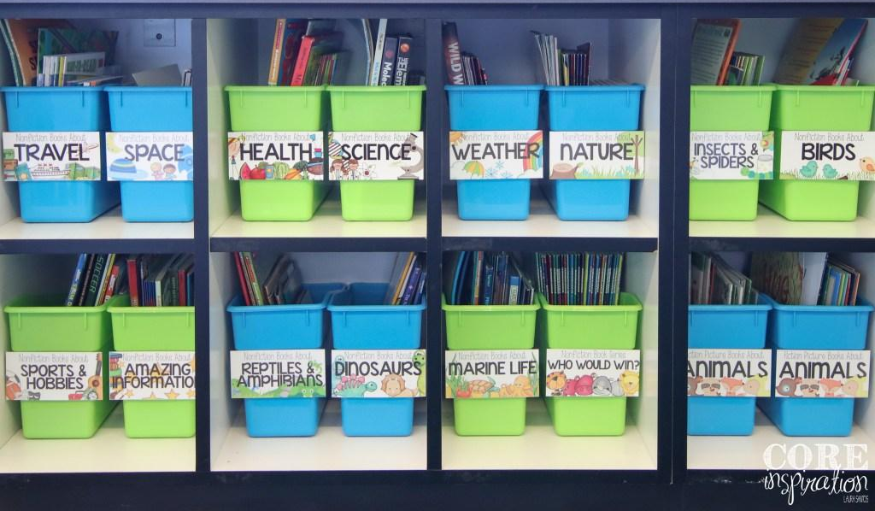
Texts are organized by topic - not by reading level
fiction and nonfiction
may have subsets - tight topics!
accessible and editable by students

Slide 39
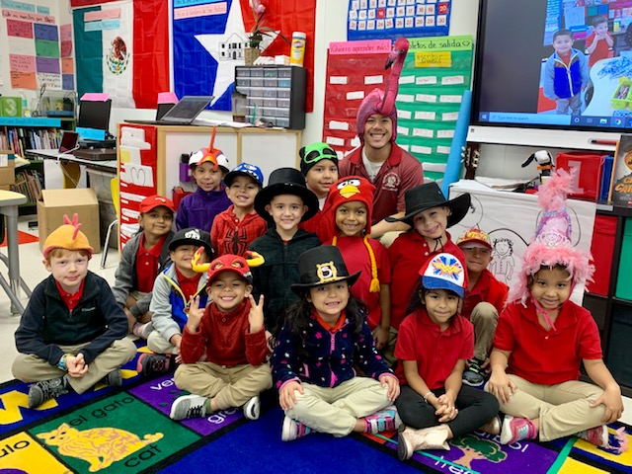
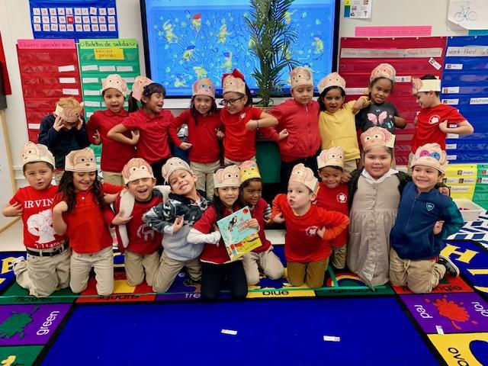
Anchor Texts Guide Instruction
Anchor texts are the “Lead actors” and rest of text sets are “supporting actors”

Slide 40
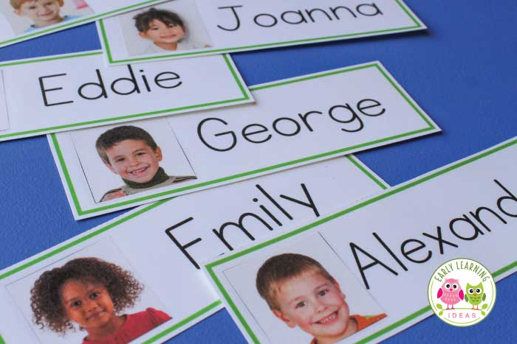
Characters Build Knowledge
Integrate characters as peers
main characters are part of the class

Slide 41
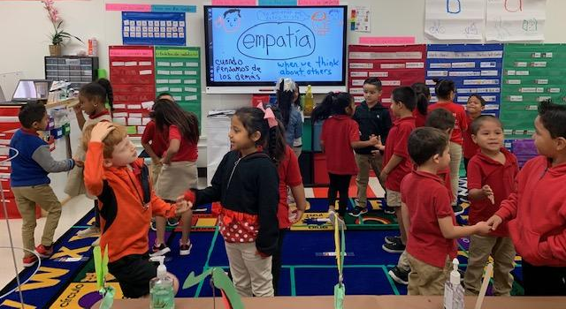
Characters Build Knowledge
Integrate characters as peers
main characters are part of the class
character traits/values are taught in SEL

Slide 42
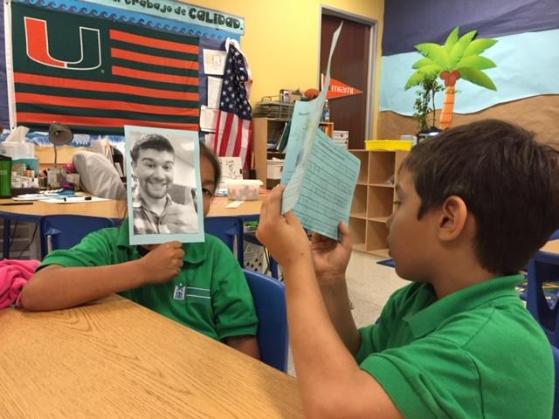
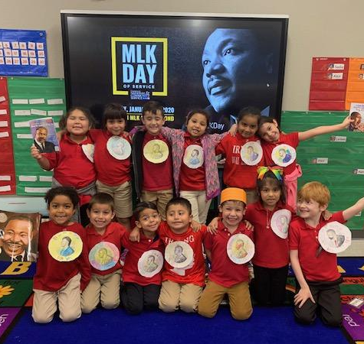
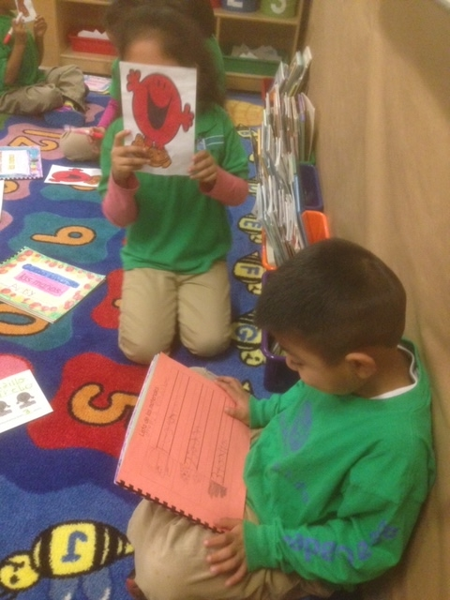
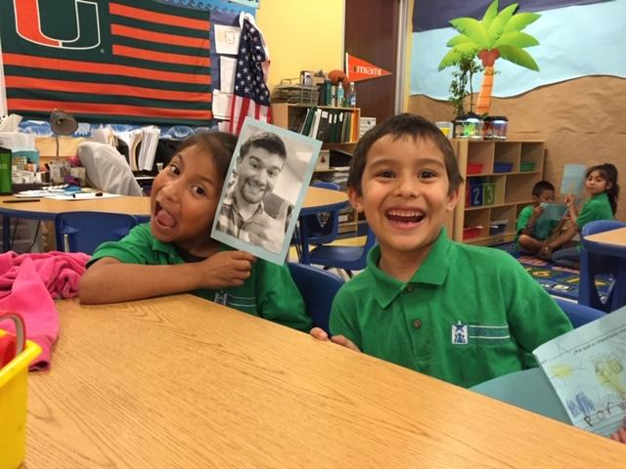
Characters Build Knowledge
Role playing opportunities heighten experiential learning

Slide 43
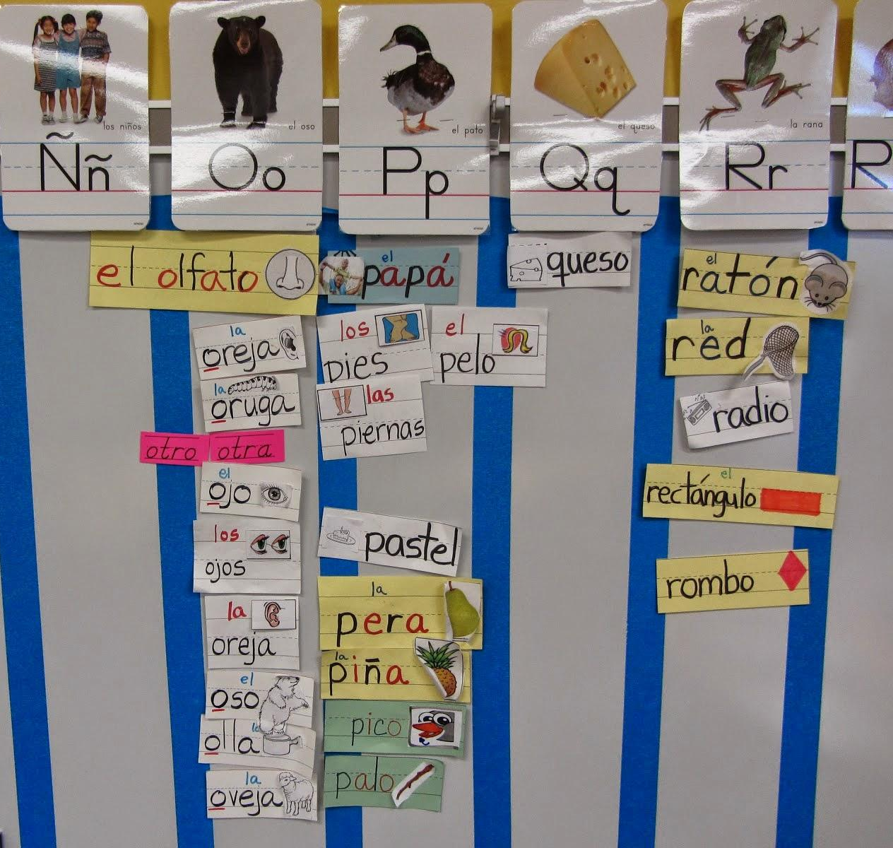
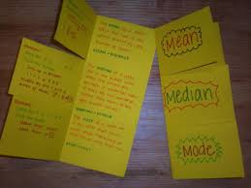
Vocabulary in Many Ways!
Direct vocabulary instruction is important - but only a small part of the puzzle!

Slide 44
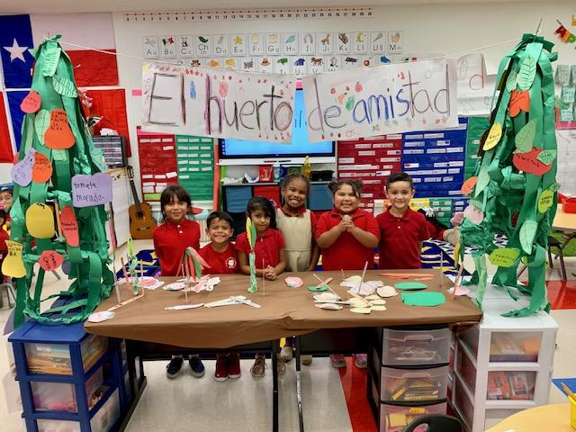
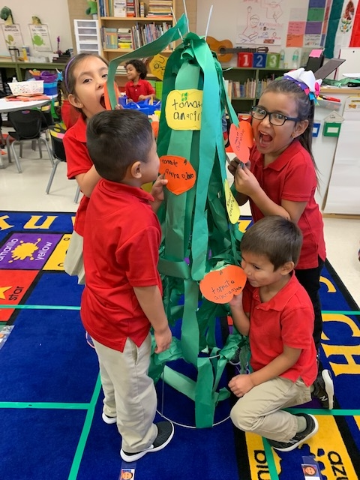
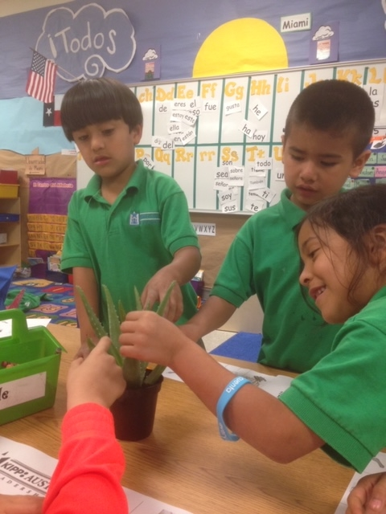
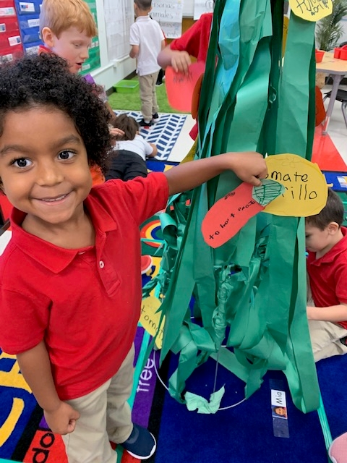
Vocabulary in Many Ways!
Realia and student-centered

Slide 45
Vocabulary in Many Ways!
Realia and student-centered

Slide 46
Vocabulary in Many Ways!
Use words from mentor text to supplement
word work, grammar, and/or phonics instruction
Notes:
Make note that this work is more of a supplement and not a replacement
*kids learn phonics better from words they are interested in (relevancy)

Slide 47
Further Steps - leveraging that knowledge
Deeper dives into texts = deeper analysis
Characters and character traits become referred to throughout the year
lends well to comparing and contrasting
New content is easily introduced
Retelling, writing, art expectations become more rigorous

Slide 48
Key Takeaways and Results
Anchor texts guide instruction
Character study help build knowledge
Vocabulary gets taught in many ways
Results
Second language vocabulary development increased significantly for both English and Spanish dominant students
Student contributions are valued more! Students take more ownership of their learning!
Love of reading!!!

Slide 49
Section 3: Podcasts

Slide 50
Claire Rivero
Digital Strategy Manager
Student Achievement Partners
Insert Headshot Here
With content from Jon Gustafson’s Aligned article: Press Play

Slide 52
Using Podcasts to Scaffold
Preview of tier 3 vocabulary (allows you to prioritize instructional time for tier 2)
Consider creating a short glossary of “words to listen for”
Preview themes and concepts for greater comprehension success with subsequent texts
Private processing time (including in students’ home language) to prepare for greater engagement in whole class discussion
Provide extra practice with prosody and pronunciation

Slide 53
Using Podcasts to Supplement
Reinforce--Re-engagement with vocabulary and concepts within grade-level text
Challenge--Podcasts may introduce above-grade-level vocabulary and content accessible to students through leveraging text-based knowledge they’ve acquired
Provide writing opportunities--Craft questions that leverage knowledge built texts and podcasts
Provide an alternative to “traditional” writing--Older students can create their own podcast scripts
Flexible Learning--Listen and learn outside traditional classroom settings
Extra practice at home
A class “walkabout”-- students walk school grounds while listening then come together for discussion

Slide 54
Podcasts for Your Classroom -- STEM

Slide 55
Podcasts for Your Classroom -- History/Social Studies

Slide 56
Podcasts for Your Classroom -- General Interest

Slide 57
What podcasts have you used in the classroom?
Respond in the Group Chat!

Slide 58
Questions for Our Guests?

Slide 59
The Building Knowledge Mini Course!

Slide 60
Interested in learning more?
knowledgematterscampaign.org
Notes:
https://edpolicy.education.jhu.edu/wp-content/uploads/2018/04/ELsFINAL.pdf?mc_cid=1a7546050f&mc_eid=89e5d6fb61
https://knowledgematterscampaign.org/
https://www.empoweringells.com/text-set/ from WIDA’s Essential Actions: A Handbook for Implementing WIDA’s Framework for English Language Development Standards (Gottlieb, 2013)
https://www.colorincolorado.org/content-instruction-ells

Slide 61
Resource Name | Link
Join Our Network! | www.achievethecore.org/ca-signup
The Power of Text Sets | https://achievethecore.org/content/upload/Text%20Set%20Guidance.pdf?utm_source=Subscriber+Master+List&utm_campaign=825f01c19f-EMAIL_CAMPAIGN_2020_04_09_07_59&utm_medium=email&utm_term=0_a3f2445f50-825f01c19f-320962437
Free texts online | https://sites.google.com/dpi.nc.gov/englishlanguagearts/resources/third-party-resources/free-texts
The Building Knowledge Mini Course | https://achievethecore.org/page/3204/building-knowledge-expanding-the-world-through-reading
Empowering ELLs with Text Sets | https://www.empoweringells.com/text-set/
Content Instruction for English Learners | https://www.colorincolorado.org/content-instruction-ells
Knowledge Matters | https://knowledgematterscampaign.org/
The Naked Scientists | https://www.thenakedscientists.com/
NPR’S StoryCorps Podcast | https://www.npr.org/podcasts/510200/storycorps
Freakonomics Radio Archive | https://freakonomics.com/archive/
Stuff You Should Know Podcast | https://www.iheart.com/podcast/105-stuff-you-should-know-26940277/
Podcasts from Teaching Tolerance | https://www.tolerance.org/podcasts

Slide 62
Resource Name | Link
NOVA Making North America | https://www.pbs.org/wgbh/nova/series/making-north-america/
1619 Podcast | https://www.nytimes.com/2020/01/23/podcasts/1619-podcast.html
Code Switch Podcast | https://www.npr.org/podcasts/510312/codeswitch
Backstory Podcast | https://www.backstoryradio.org/
Uncivil (Civil War) Podcast | https://gimletmedia.com/shows/uncivil
Teaching Hard History Podcast | https://www.splcenter.org/20180131/teaching-hard-history
Revisionist History Podcast | http://revisionisthistory.com/
But Why: A Podcast for Curious Kids | https://www.vpr.org/programs/why-podcast-curious-kids#stream/0
Earth Rangers Podcast | https://www.earthrangers.com/podcast/
WOW in the World Podcast | https://www.npr.org/podcasts/510321/wow-in-the-world
Brains On! Podcast | https://www.brainson.org/
Tumble: A Science Podcast for Kids | https://beta.prx.org/series/38125
Science Rules! A Bill Nye Podcast | https://www.askbillnye.com/
60 Second Science By Scientific American Podcast | https://www.scientificamerican.com/podcast/60-second-science/

Slide 63
Join our network!
Join a national network of educators
Connect with state networks
Be a part of creating new tools and resources in partnership with SAP
Keep up to date on free resources, upcoming SAP webinars/professional learning opportunities, job postings and more!
Notes:
If you found tonight’s webinar helpful, we’d like to invite you to join our Core Advocate network! We’re committed to solving real problems that real teachers have and we know the best way to do this is to know more about what folks are experiencing.
As part of our national network, you have opportunities to connect with educators across the country, maybe even the network in your state! You can keep up to date on tools and resources available on Achieve the Core, as well as a variety of virtual learning opportunities and other ways to engage with us. We also work with educators in our network to help us build tools and resources.
We’d love to learn about who you are, where you work, the types of things you’re interested in and the expertise you already have. This way, we will be able to tailor our webinars and other opportunities to your needs and interests (we may even tap you to be our next webinar panelist).

Slide 64
Please Join Us!
https://achievethecore.org/ca-signup
Twitter: twitter.com/achievethecore
Facebook: facebook.com/achievethecore
Pinterest: pinterest.com/achievethecore
Notes:
We encourage you to join the network by filling out this survey completely at atc.org/ca-signup

Slide 65
Stay Tuned!
We have an exciting season planned for you.
Look out for July’s topic coming soon!
In the meantime, please access our on-demand webinars, below.
CLICK HERE

Slide 66
Thank You!

