Slide 1



Addressing Social Emotional Academic Development through a Racial Equity Lens
Coffee and Conversation
Drop your answer in the chat:
How are you taking care of yourself and/or your community these days?

Slide 2

You can now expect monthly Coffee and Conversation events!
Balancing Academic and SEL Needs in the Virtual Classroom
Addressing SEAD Through a Racial Equity Lens
Summer Break for the C&C Team :)
What Must Schools Offer to Keep Kids Logging on to Virtual Classrooms?
Materials will be available after this call on Achieve The Core.
This event will focus on what students believe teachers and schools can do to maintain student engagement as schools open in the fall. We will feature a student panel as well as our usual grade band-based discussion groups!
1
May
June
July
August
Registration will be live for the August C&C in mid-July. Be on the lookout for a Core Advocates email then, or follow us on Eventbrite for updates!

Slide 3
Welcome!
Tech Tips
Please use the chat feature throughout today- we value your voices! Feel free to share ideas, resources, and comments. We will add relevant resources shared via chat to the list we’ve compiled!
While we are sharing our screen, it may be best to exit ‘full screen’ by pressing ESC.
As noted on the event page, we will be recording this session. Affinity group discussions will not be recorded.
All details for affinity group discussions can be found on the Eventbrite page you used to get here :).

Slide 4
Your Hosts Today
Joy Delizo-Osborne
Program Manager, SAP
Jennie Beltramini
Math Specialist, SAP
Tanji Reed Marshall
Director of P-12 Practice, EdTrust

Slide 5
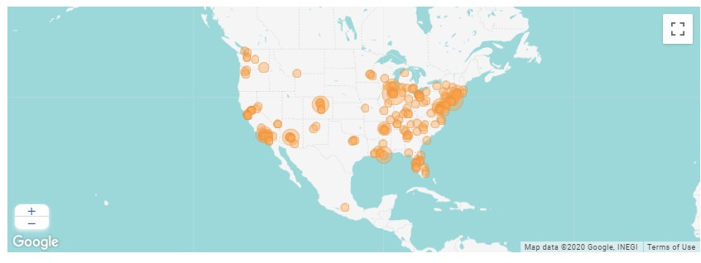
Let’s Check In
In the chat, tell us:
What is your role?
Where do you live and/or work?
Notes:
Take a moment to appreciate diversity of location, role and experience

Slide 6

What We Believe:
Academic standards are a promise of equity. When every student is expected to learn rich content, and is supported every day in doing so from kindergarten to high school graduation, we deliver on that promise.
We believe that a transformative education is not a luxury reserved only for some. We believe that educating every single student in the richly complex disciplines of literacy and mathematics not only safeguards democracy, but cultivates it further.
This is not the current reality for most students. And a devastating amount of evidence tells us the distance between vision and reality is even greater for students facing barriers of racism or poverty. We are convinced there is much work still to do.
Notes:
Key Idea:
Student Achievement Partners believes in translating the best of what we’ve learned from research into evidence based practices. We are also stewards of college and career readiness standards.
Talking Points:
Our goal is to improve educational achievement for all students, particularly those who face barriers of race and poverty, through improving the implementation of research-based college- and career- ready standards.
We work with all stakeholders in the educational system: from classroom teachers to publishers of textbooks to state departments of education.

Slide 7
Our Mission
The Education Trust is a national nonprofit that works to close opportunity gaps that disproportionately affect students of color and students from low-income families. Through our research and advocacy, Ed Trust supports efforts that expand excellence and equity in education from preschool through college, increase college access and completion particularly for historically underserved students, engage diverse communities dedicated to education equity, and increase political and public will to act on equity issues.

Slide 8
Structure of Today’s Session:
Nancy Duchesneau of EdTrust will share her knowledge with us!
After the presentation, log off from this call and log into an optional affinity-based discussion group
  Affinity groups will be organized by 1) grade level you serve and 2) your racial identity
Each affinity group will have a same-identity facilitator present to frame the conversation and close the experience out.
Why Affinity Groups for this conversation?
Black folks and non-Black folks of color need opportunities to connect and support each other in discussing the unique ways our race impacts our role in changing practices in the K-12 space.
For white folks, affinity groups offer a space for you to question your lens and make meaning of your role in the work of advancing racial equity.

Slide 9


6/18/20
SEAD Through an Equity Lens (Draft)
© Copyright 2018 The Education Trust @EdTrust /edtrust edtrust www.edtrust.org

Slide 10

Our roadmap for today
Common Definitions of SEAD
About Our Research Project
Findings
Implications
Policy & Practice Recommendations
Notes:
Add SOLD research

Slide 11
Science of Learning and Development
Reciprocal relationship between biology and environment
Development progresses over time
Relationships are foundational to development
Multiple levels of context influence development – positively and negatively
  Children need buffers to stress
Students are active agents in their own learning
Context is the defining influence on development.
Osher, Cantor, Berg, Steyer, & Rose (2019)

Slide 12
Common Definitions of Social-Emotional Learning (SEL)?
“Social and emotional learning (SEL) is the process through which children and adults understand and manage emotions, set and achieve positive goals, feel and show empathy for others, establish and maintain positive relationships, and make responsible decisions.”
~Collaborative for Academic, Social, and Emotional Learning (CASEL)
“These so-called noncognitive qualities are diverse and collectively facilitate goal-directed effort (e.g., grit, self-control, growth mindset), healthy social relationships (e.g., gratitude, emotional intelligence, social belonging), and sound judgment and decision making (e.g., curiosity, open-mindedness).”
~Angela Duckworth & David Scott Yeager
Notes:
Social emotional learning has to do with a wide variety of competencies outside of traditional academic subjects, and there is no consensus on what skills are most important. However, most frameworks include:
Self-awareness
Self-management
Goal-directed behavior
Social awareness and relationship skills
Responsible decision-making
Conflict resolution
CASEL is a thought leader in SEL. While we generally align with each other when we have conversations, we do have some concerns about their framework and the current SEL narrative in education.

Slide 13
Current Focus
Currently, social-emotional frameworks focus attention on the specific social emotional competencies students should learn, such as self-management and social awareness
This has led to efforts on explicitly teaching students these competencies with less attention to the systems in place that influence social emotional development

Slide 14
Risks of SEAD work
Approaches that
  lack an explicit equity lens,
  fail to acknowledge the role of students’ racial and cultural experiences in social-emotional development,
  that treat social-emotional and academic learning as separate,
  fail to address the processes and structures in schools that systemically disadvantage students of color, low-income students, and immigrant youths
May do more harm than good.
Notes:
Should add something that ties to programs and standards

Slide 15

Why it needs to shift
Societal realities (e.g. racism, sexism, etc.)
Individual realities (e.g. responsibilities outside of school)
Cultural background

Slide 16
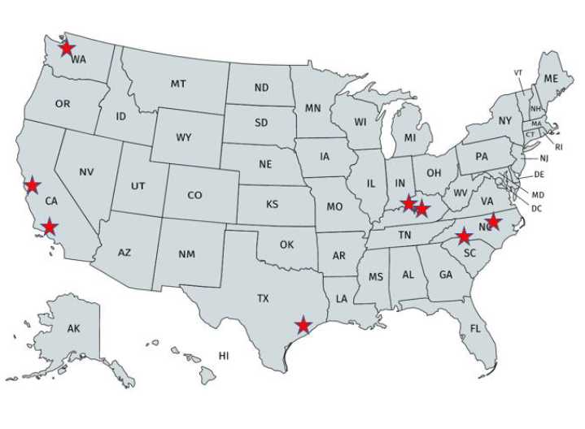
Our Research Study
We spoke with students and families of color in 8 locations across 5 states.
Our sample consisted of
  70 students of color ages 12-18 (self-identifying as Black, Latinx, Mixed, or Other)
  76 Black and Latinx family members

Slide 17
Our Research Questions
We sought to understand:
  How students and families of color perceive SEAD
  What SEAD factors they believe to be important for students of color
  How schools can support SEAD for students of color

Slide 18


Slide 19

How do students and families of color perceive SEAD?
SEAD is a part of success.
  “I think [social and emotional skills] play the biggest role, especially understanding your wellbeing and all of that.”
  ~ Latina student
  “[I hope my grandchildren become] good people, generous, with good hearts.”
  ~ Latina grandmother
It starts in the home, but schools play a role.
  “It’s your family [who is responsible] … But at the same time, it’s school, because you spend eight hours, you know, five times a week at that place. So, it’s almost like, everybody should be on the same page.”
  ~ Latina student
  “It takes a village to get it done … To make sure that we opening doors for them to walk into and so they’ll learn how to open their own doors to pursue they own paths.”
  ~ Black mother

Slide 20
What SEAD factors are important for success?
Identity is the core of SEAD.
  Know your culture
    “Knowledge of self – Who they are, their culture. They need to learn how to love within.”
    ~ Black mother
  Codeswitch
    “I think it’s like, learning to adapt to your surroundings, one and two, just knowing that there’s other cultures, you know, out there, and respecting those cultures the same way that you would want them to respect, you know, your culture.”
    ~ Latina student

Slide 21
SEL 102
Black and Latinx students are often already learning (and are expected by society to learn) social-emotional competence at a different level (SEL102) because of the context of race
Black and Latinx students are not being recognized for their social and emotional competence
  This is due in large part to a disconnect between educators and their students. When adults do not understand the backgrounds and lives of their students, or when bias influences what behavior is deemed acceptable by what students, adults do not recognize when students are socially and emotionally competent.

Slide 22
What should schools do to support SEAD?
Participants do not trust schools to teach SEAD to students of color. They worried about the decontextualization of SEL and the lack of focus on identity
  “We all have a story … We have schools that would rather just kind of put kids on a mute button to get through – go through the motions of every day.”
  ~ Black mother

Slide 23
  “The way schools are structured now, and the way education is structured, it’s not set up for students to succeed in those environments. And not to say students don’t succeed, but not all students do. Some students make it out, but aren’t ready for the world after high school, or even after middle school. So it’s like you’re not always set up to succeed based on how schools are structured.”
~Black & Latino Student

Slide 24
What should schools do to support SEAD? (Cont’d)
Create learning environments where students see themselves and truly belong
  Allow students to be their authentic selves.
    “School should be a safe zone for a kid to be able to come and really be their self.”
    ~ Black grandmother
  Teach our history
    “I think that we should talk about other people, other than just Rosa Parks and Martin Luther King … I’ve been learning about that since I was like in first grade … I had to read myself about people like Malcolm X and things like that … Why can’t we talk about other people?”
    ~ Black student
  Diversify the teaching workforce
    “Hire more Black teachers.”
    ~ Black father
Notes:
Black and Latinx students and families believe school environment must change and must meaningfully engage the communities they serve in order to support SEAD for all students

Slide 25

What should schools do to support SEAD? (Cont’d)
Challenge students to thrive and truly believe they can.
  Provide challenging coursework and equitable opportunities for advanced course pathways.
    “It’s been like a cultural shock when I go into programs and I see that like, 99% of the population there is either Caucasian or Asian of some type.”
    ~ Latina student
    “I think being a Black girl had a little bit to do with [not feeling like I belong], especially because … I took two AP classes my senior year, and in both of those classes, I was the only Black person. And I think that that’s happened throughout my entire high school career.”
    ~Black student
  Address adult bias.
    “At least have [teachers] in the place culturally competent so that they understand, and they don’t just make assumptions.”
    ~ Black mother

Slide 26
What should schools do to support SEAD? (Cont’d)
Provide the academic and non-academic supports they need to thrive.
  Partner with students, parents, and communities.
    “Parents have a lot to do with culture, and know their culture better than the schools that deal with everyone.”
    ~ Latina mother
  Provide non-academic supports.
    “At our school, lots of people were depressed. Lots of people had anxiety. Things like that were everywhere, and it kind of become normalized, and it shouldn’t have been, right? We should have had [supports] and people should have been seeking help.”
    ~ Black student
    “We have a counselor that goes above and beyond the call of duty, and what she does is open doors and give opportunities or – ultimately, you know, we’re the ones who step up and do it, but somebody who , somebody in power like, who opens doors, gives us opportunities.”
    ~Latina student

Slide 27
IMPLICATIONS

Slide 28
Shifting the Focus
FROM a focus on teaching specific student competencies and “fixing kids”
TO an asset-based approach that includes a focus on adult beliefs and mindsets and the systems and policies necessary to create equitable learning environments

Slide 29
Societal context
School/district factors
Classroom factors
Students’ social-emotional skills, mindsets, etc.
Shifting our focus from this….

Slide 30
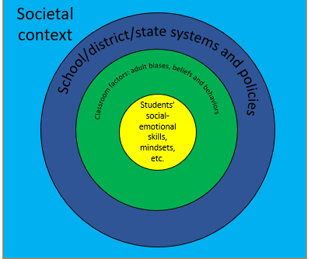
To this…

Slide 31
Changing Adult Beliefs and Mindsets
Shift from a deficit-based mindset to a strength-based mindset
  Educators must recognize the assets students bring to the classroom and have high expectations for students of color and low-income students.
Address bias in adult perceptions
  Educators who interact with students must address the explicit and implicit biases. Not only must these biases be addressed, but educators must shift their mindsets to an active orientation towards dismantling oppression
Move from one-size-fits-all to recognizing cultural and contextual influences
  Educators must recognize and value differences in students and accept that what works for one student may not work for all students

Slide 32
Adult (Educator) Beliefs and Behaviors
Adult biases, beliefs and skills
Adult behaviors
Student mindsets, beliefs and skills
Notes:
Implicit biases and beliefs about students, beliefs in own ability to make a difference, and skills e.g. classroom management and culturally sustaining pedagogy
Impact
What they choose to teach, how they choose to teach it, and how they interact with students
Educators must:
Communicate high expectations and confidence in students
Explicitly recognize and reduce implicit biases
Provide opportunities for students to bring their own ideas, experiences, and opinions into the classroom
Provide frequent, concrete feedback and opportunities for students to improve their work - Mistakes are part of the process!
A racial equity lens requires looking at each of these in terms of how they affect students of diverse racial, ethnic, and cultural backgrounds, and taking the required steps to ensure educators see students through their strengths. Push back on statements that center students of color and low-income students as “lacking” these skills. Such comments suggest adult beliefs and behaviors need to be addressed.
How could this play out without attention to these factors? (Ex: Taking time away from rigorous instruction to teach self-management vs. integrating SEL into rigorous instruction.)

Slide 33
Implicit biases and beliefs about students
Adult biases, beliefs and skills
Beliefs in own ability to make a difference
Skills: Classroom management, culturally sustaining pedagogy, etc.

Slide 34
What educators choose to teach
Adult behaviors
How educators choose to teach it
How educators interact with students

Slide 35
Changing Systems and Structures
Change policies and practices to support what evidence shows is important for students to develop social and emotional competence
This means all policies should aim to meet these goals:
Foster student belonging
Challenge all students to thrive
Provide academic and non-academic supports
Notes:
Belonging
Social experiences matter for learning and research shows whether students feel they belong in the classroom and the school is critical.
Students of color, English learners, and students from low-income families often receive the message that they aren’t welcome and don’t belong.
Policy and practice should aim to ensure all students feel they belong in the classroom and in the school.
Challenge
Providing challenging work for students and encouraging them to meet high expectations leads to higher academic outcomes and social emotional development
When bias creeps into schools and classrooms, educators are less likely to believe historically marginalized students can do challenging work and may provide easier material. However, easier material leads to less engagement.
Policy and practice should aim to ensure students are met with high expectations and rigorous material.
Supports
Students will require academic and non-academic supports to meet the high expectations policies and educators put in place for them.
If basic needs such as hunger and housing are not met, students may struggle to give their full attention to their education.
Policy and practice should aim to support students given their contexts

Slide 36
Changing Systems and Structures
We know that these factors are critical for positive school climate, and lead to increased academic engagement
But these goals are less often the focus of SEAD for students of color and low-income students
An equity lens for SEAD means recognizing this gap in how schools treat students of color and making these structural changes
Student Belonging
Positive School Climate
SEL and Academic Engagement
Challenging Opportunities
Academic and Nonacademic Supports

Slide 37
Policy & Practice Recommendations
Ongoing professional development and coaching on changing mindsets and building skills such as:
  Reducing bias
  Culturally sustaining pedagogy
  Restorative justice practices
  Positive classroom management
  Student and community strengths
  Providing feedback that conveys high standards

Slide 38
Policy & Practice Recommendations
Diversify the educator workforce by:
  Creating proactive hiring strategies that increase hiring of educators of color
  Improving working environments and conditions to retain educators of color
Co-create inclusive discipline and dress code policies by:
  Ensuring they do not discriminate based on race or gender
  Adopting discipline policies focused on maintaining and repairing relationships, rather than retributive or exclusionary consequences

Slide 39
Policy & Practice Recommendations
Ensure equitable access to rigorous and culturally sustaining curriculum
  Adopting rigorous curriculum that provides a balanced and non-stereotypical representation of ethnically, culturally, and racially diverse students
  Integrating SEL into rigorous academic instruction
  Ensuring inclusive opportunities for historically marginalized students to access advanced course pathways
  Using classroom practices, such as place-based learning, that support students’ connections to their communities through academics

Slide 40
Policy & Practice Recommendations
Ensure wraparound services and supports are available by
  Developing early warning systems to identify who needs supports and adopt multi-tiered systems of support to meet student needs
  Hiring sufficient school support staff including school counselors and school psychologists
  Partnering with community-based organizations and other government institutions to provide services schools are unable to provide
  Adopting a community schools model

Slide 41
Policy & Practice Recommendations
Meaningfully engage parents and youth as full partners in schooling by:
  Using climate and voice surveys to determine needed areas of school improvement
  Including family and student voice in policy decisions
  Creating student-teacher advisory groups that meet regularly outside of classes
  Adopting a home visit program
  Including more time for parent-teacher conference
  Hiring translators for communication with parents who are uncomfortable with English

Slide 42

Questions?
Contact:
Nancy Duchesneau
NDuchesneau@edtrust.org
To sign up to receive the report when it’s released, go to
www.EdTrust.org/SEAD

Slide 43
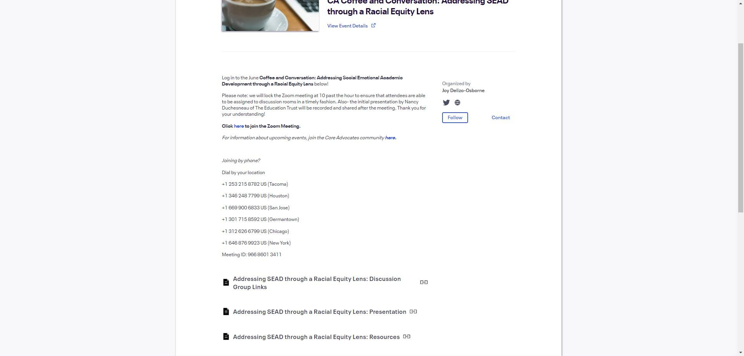
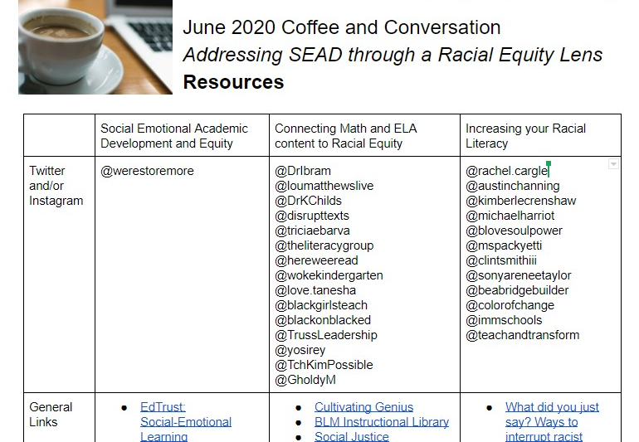
Resources to Continue Your Learning

Slide 45
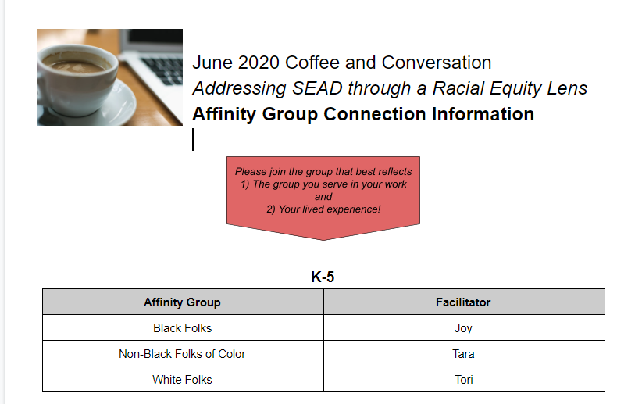
Affinity Group Links

Slide 46
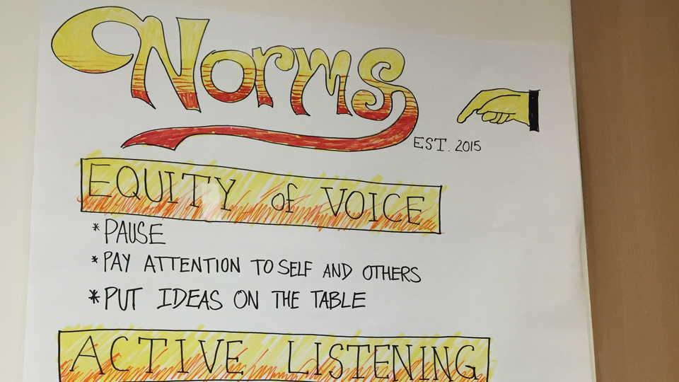
Affinity Group Norms
Stay engaged: Staying engaged means “remaining morally, emotionally, intellectually, and socially involved in the dialogue”
Experience discomfort: This norm acknowledges that discomfort is inevitable, especially in dialogue about race, and that participants make a commitment to bring issues into the open. It is not talking about these issues that create divisiveness. The divisiveness already exists in society and in our schools. It is through dialogue, even when uncomfortable, that healing and change begin.
Speak your truth: This means being open about thoughts and feelings and not just saying what you think others want to hear. Also consider using this space as a place to practice taking risks when it comes to disrupting oppressive patterns, assumptions, and statements.
***
Please use the chat to share ideas, resources, and comments. We will download the chat to add resources shared to the list we’ve compiled!
This conversation is off the record. We are not recording, tweeting, or sharing.
*norms based on and modified from Courageous Conversations about Race by Glenn Singleton and The Aspen Institute
Notes:
*Affinity Group facilitators to review*

Slide 47

Affinity Group Conversation
Introduction Round Robin
Share your name, your role, and your location
Warm Up Question: What in the presentation challenged your thinking? What was an ‘aha’?
Discussion Questions:
How did today’s presentation relate to the current context of anti-racism protests across the country?
  How will you help your students process the events of this summer in classrooms this school year?
  How can you support the development of positive racial identities for all of your students in the fall?
How do you see the role of race in the social emotional academic development of your students?
  What role has race had in your or your school’s social emotional learning work in the past? How has your view changed?
Notes:
*Affinity Group facilitators to review*

Slide 48

Feedback is the TRUE breakfast of champions!
Please take a moment to share your thoughts on this experience with us! We are learning what it looks like to connect with you most effectively, and every comment counts.
If you did not receive the invite to today’s session yourself, and would like to join our Core Advocates community for future opportunities, please sign up here:
https://bit.ly/june2020ccfeedback
http://bit.ly/coreadvocatesignup
Notes:
*Affinity Group facilitators to review*

