Slide 1

Priority Instructional Content: Leveraging the Structure of College- and Career-Ready Math and ELA/Literacy Standards
Core Advocates Monthly Webinar
August 5th, 2020
The webinar will begin shortly.
Check your Resource widget to preview the resources for today’s session! Use the Group Chat to introduce yourself!
Notes:
First timer poll
Handouts:
While we’re waiting, we’d like you to participate in a quick poll so we can get an understanding of who’s on the webinar with us tonight.

Slide 2



Introductions
Your hosts from Student Achievement Partners:
Pascale Joseph
Project Coordinator,
Tools and Classroom Resources, SAP
This month’s presenters:
Jun Li
Mathematics Specialist
Professional Learning, SAP
Kate Crist
ELA/Literacy Specialist
Professional Learning, SAP

Slide 3
How many Core Advocate Webinars have you attended?
Please use the Questions tab on your control panel to respond.
If using a poll, please put up to 5 answer choices in the notes section below and indicate if attendees should choose only one response or multiple responses.

Slide 4

Join Our Network!
www.achievethecore.org/ca-signup
Notes:
If you find tonight’s webinar helpful, we’d like to invite you to join our Core Advocate network! We’re committed to solving real problems that real teachers have and we know the best way to do this is to know more about what folks are experiencing.
We’d love to learn about who you are, where you work, the types of things you’re interested in and the expertise you already have. This way, we will be able to tailor our webinars and other opportunities to your needs and interests (we may even tap you to be our next webinar panelist). So we encourage you to join the network by filling out this survey completely at atc.org/ca-signup

Slide 5


Learn More About Us!
Contact Jennie Beltramini (jbeltramini@studentsachieve.net )
Joy Delizo-Osborne
(jdelizo-osborne@studentsachieve.net)
Complete this survey to join our database (and mailing list): www.achievethecore.org/ca-signup
Visit our website: www.achievethecore.org
Notes:
If you’d like to learn more about the network, contact Jennie (her email is here).
We also want to invite you to join the network by signing up at achievethecore.org/ca-signup and visit our website for more info and opportunities

Slide 6

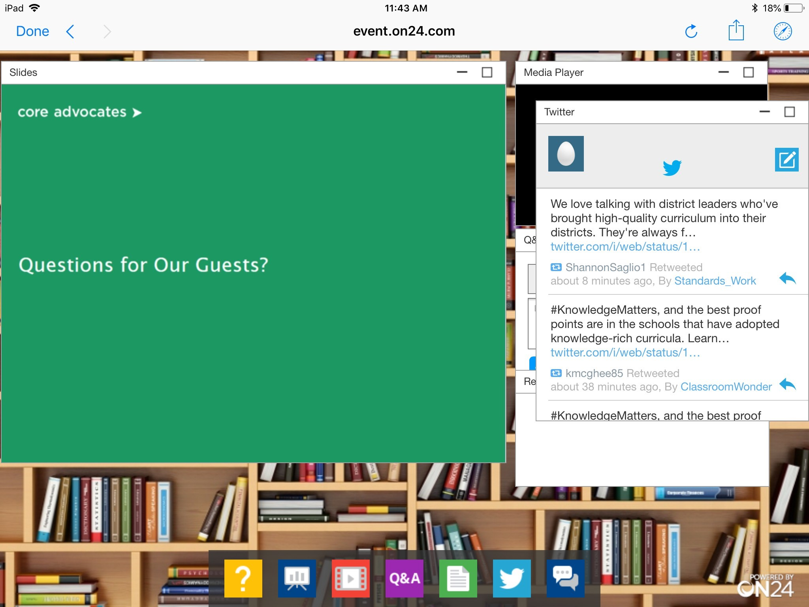
Tweet with Us!
Please feel free to tweet during and after the webinar using #coreadvocates
@achievethecore
@sfkato
Click here!

Slide 7

Engage with Us!
During the webinar:
Question just for the presenters/ tech help
Resources
Group chat
Certificate
After the webinar:
– Access to recording will be emailed to you.
Take our short survey in 2 weeks and be entered into a raffle for a $25 Amazon gift card.

Slide 8
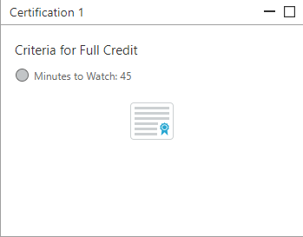
Certification Will Be Provided
A certificate will be available via the Certification box to the right.
Click on the blue-ribbon icon to print or download the certificate at the end of the webinar.

Slide 9
Goals of the Webinar
Gain a deeper understanding of the Priority Instructional Content
Explore how educators are using the Priority Instructional Content to inform their work for the upcoming school year
Consider how you might use the Priority Instructional Content to guide teaching and learning for the upcoming school year
Notes:
We have three main goals for our webinar tonight. They are to...
What is the Priority Instructional Content? 15 minutes
Overview of Math & ELA 10 minutes
How have Educators Used the Priority Instructional Content? 30 minutes
Questions 5 minutes

Slide 10
Section 1: What is the Priority Instructional Content?

Slide 11
Please select the statement that best reflects your familiarity with the Priority Instructional Content.
Please use the Questions tab on your control panel to respond.
Notes:
(choose one answer)
I am very familiar with the resources - I’ve read all 111 pages!
I have skimmed through for the gist.
I am unclear what the Priority Instructional Content is.

Slide 12


Review the Priority Instructional Content
bit.ly/PIClinks
Notice its structure.
Notice its content.
Notes:
2 min
https://achievethecore.org/content/upload/2020%E2%80%9321%20Priority%20Instructional%20Content%20in%20ELA%20Literacy%20and%20Mathematics_June%202020.pdf
Give folks a moment to orient to the document.
This session will review the PIC in some detail, but this review cannot replace the work of reading the PIC - for content area and grade band you are implementing materials, changes, policy, etc. for.

Slide 13


Review the Priority Instructional Content
Read page 4 of the Priority Instructional Content.
What sentence or phrase sticks out to you?
Share what you notice in the chat.
Notes:
5 min
Introduction provides insight into the what and why - give folks some time to read and review

Slide 14

Why create the Priority Instructional Content?
Amplify what instructional content matters most
Accelerate all students’ learning
Hold high expectations for all students
Foster students’ social-emotional development
Notes:
2 min
Big Idea: PIC amplifies critical instructional content so students continue to learn through the uncertainty of SY 2020-2021

Slide 15

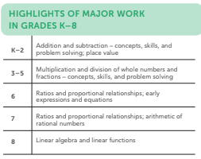



What is the Priority Instructional Content?
For 2020-2021 school year
Strategic choices about which content to prioritize.
Focus of instruction for mathematics and ELA/literacy
Leverages structure and emphasis of college- and career-ready standards
Notes:
2 min
Big Idea: the PIC makes clear what are the strategic choices for educators to make during the 2020-2021 school year. This priority is derived from the structure and emphasis of CCR standards - we are not creating something new, but signaling priority for this school year from within existing standards.

Slide 16

What about assessment?
Mathematics & ELA/Literacy
Assessment in service of equitable grade-level instruction
How to bring students into grade-level - not if.
Formative practices to inform instruction.
Use targeted checks (phonics or math fluency inventories).
In the PIC:
Introduction p. 5
Mathematics p. 11 - 12
ELA/Literacy p. 65 - 66
Notes:
3 min
Big Idea: Assessment should be used in service of grade-level instruction and should NOT be the first thing we ‘do to students’ when the return to learning in the fall.
Formative practices
Targeted skills check when appropriate for instructional purposes
Notice what we haven’t encouraged: interim assessments divorced from instructional materials, sorting/leveling/grouping/tracking students according to assessment results

Slide 17

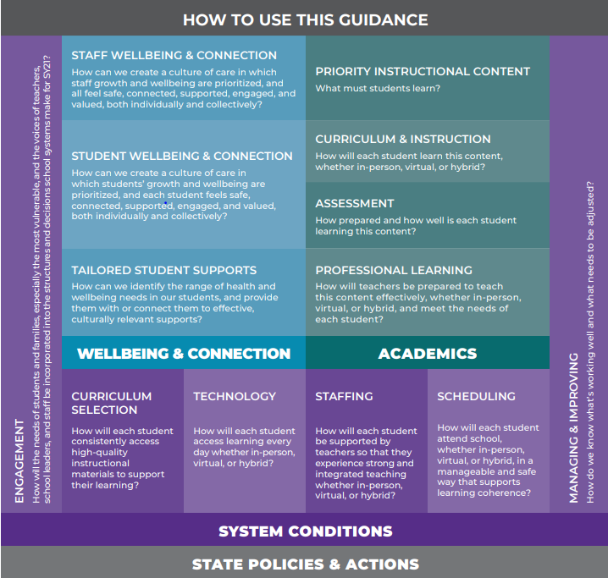
The Priority Instructional Content is Part of the Work
“To support leaders as they strive for equity, are mindful of health and safety, and focus on teaching and learning, CCSSO today released Restart and Recovery: Considerations for Teaching and Learning.”
Notes:
2min
Big Idea: Part of the guidance released by CCSSO - notice that academics is only part of this puzzle. Wellbeing & Connection and System Conditions also need attention. The CCSSO guidance is helpful for these various concerns.
https://ccsso.org/blog/ccsso-releases-restart-recovery-considerations-teaching-learning

Slide 18
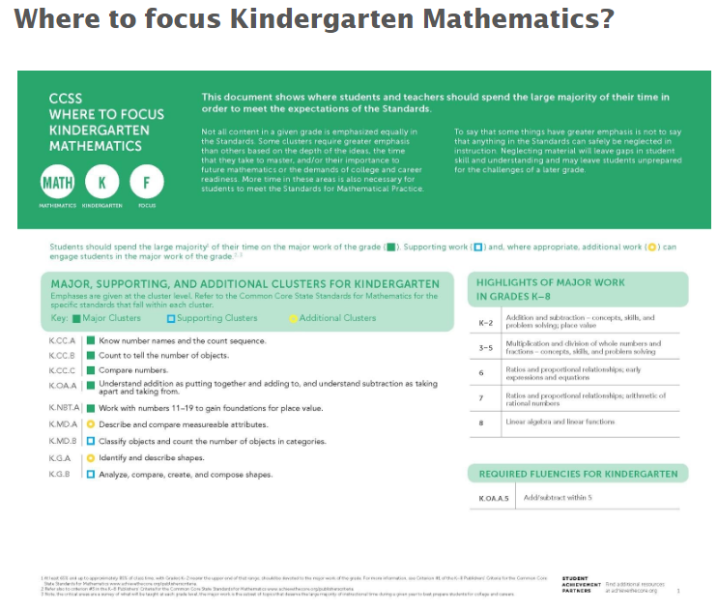
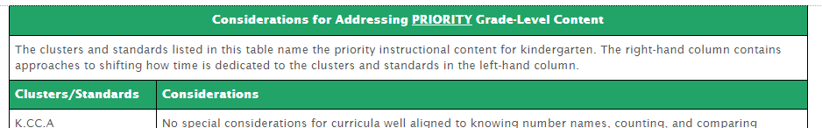
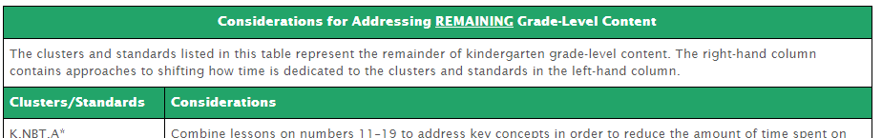
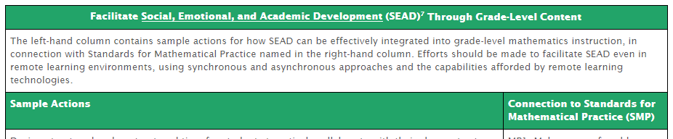
Overview: Math
For every grade-level…
Notes:
3min
The guidance at each grade level follows a similar structure.
We first point to the Focus documents because they highlight the important emphasis at each grade level for CCR math standards.
The next table names the priority instructional content for SY20-21 and considerations for how to spend time on that content.
The next table provides such considerations for remaining grade-level content.
And the last table for each grade level gives some sample actions for facilitating SEAD.

Slide 19
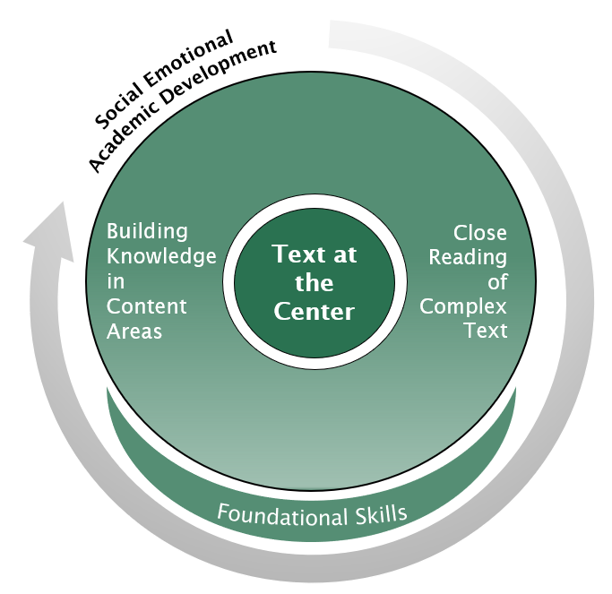
Overview: ELA/Literacy
“...each of our students in every learning community needs to be engaged in college- and career-ready study. What’s always been important is especially important now.”
Priority Instructional Content, p. 61
Focus on Standards that Represent the Major Work of ELA/Literacy Instruction
K -3: Teach Students to Read
K -12: Keep Grade-Level Complex Text at the Center of Reading, Writing, Speaking and Listening, and Language Instruction
K - 12: Build Knowledge Through Reading, Writing, and Speaking about Topics Across Content Areas
Notes:
Big Idea: In ELA we are not saying anything new - we are elevating key components of the standards to create a strong spine for learning in the 2020-2021 SY
Three main areas: Teaching students to read (foundational skills), Keeping Gradel-Level Complex text at the center of tasks & instruction, and Building knowledge by studying and working with topics across the content areas.
Note: Read aloud for early grades - K/1 and transitioning

Slide 20
Pause & Reflect
Consider what you have heard so far.
What's one idea that you want to think more about as you look ahead to next year?
Drop your thoughts in the chat.

Slide 21
Section 2: How have educators used the Priority Instructional Content?

Slide 22
Please select the statement that best reflects why are you are joining this webinar. I wonder how Priority Instructional Content might inform...
Please use the Questions tab on your control panel to respond.
Notes:
(choose all that apply)
my classroom teaching for this school year.
my instructional coaching with teachers this school year.
decisions for assessment and/or scheduling my school or district makes this school year.
decisions about or adjustments to instructional materials this school year.

Slide 23


How has the field applied Priority Instructional Content?
Publishers: Design modifications for SY 2020-2021
PL Providers: Design aligned adult learning for SY 2020-2021
Notes:
Big Idea: Let’s take a look at what some educators in the field have done with the PIC - we’ll look at publishers and PL providers.

Slide 24

Adaptation of Instructional Materials
Using standards-aligned instructional materials?
“To support school systems as they plan for academic instruction, the Collaborative has asked all publishers whose materials that are rated green on EdReports, to provide information about the adaptations, programs, and resources being developed to meet the COVID context.”
Notes:
Big Idea: Standards-aligned instructional materials providers are largely creating guidance for users of their curriculum for the 2020-2021 school year.
https://forstudentsuccess.org/our-campaigns/reopening-schools/

Slide 25


Adaptation of Instructional Materials
Instructional Materials Providers Using Priority Instructional Content
Guidance on distance learning, strategic supports, materials adjustments, etc.
Notes:
Big Idea: These instructional materials developers have used the PIC to guide their work on materials use for SY 2020-2021
Match Fishtank: Blog about return to school 2020, curriculum link

Slide 26



Adaptation of Instructional Materials
Educators Consider Priority Instructional Content
No standards-aligned instructional materials?
Intentional decisions to guide the use of instructional materials
What to prioritize?
What reduce or eliminate?
What just-in-time supports students might need?
Notes:
Big Idea: How can teachers and other educators use the PIC to guide their instructional materials use if the PIC has not yet been used to make intentional choices around instructional content for SY 2020-2021?
In ELA: Consider the three bucks: Learning to read, Close Reading, and Building Knowledge. Materials will have some resources to to each. Those resources outside of these bounds (three cueing system, leveled text, skills-based instruction outside of FS) should be cut in the interest of focus, time, and student learning.

Slide 27

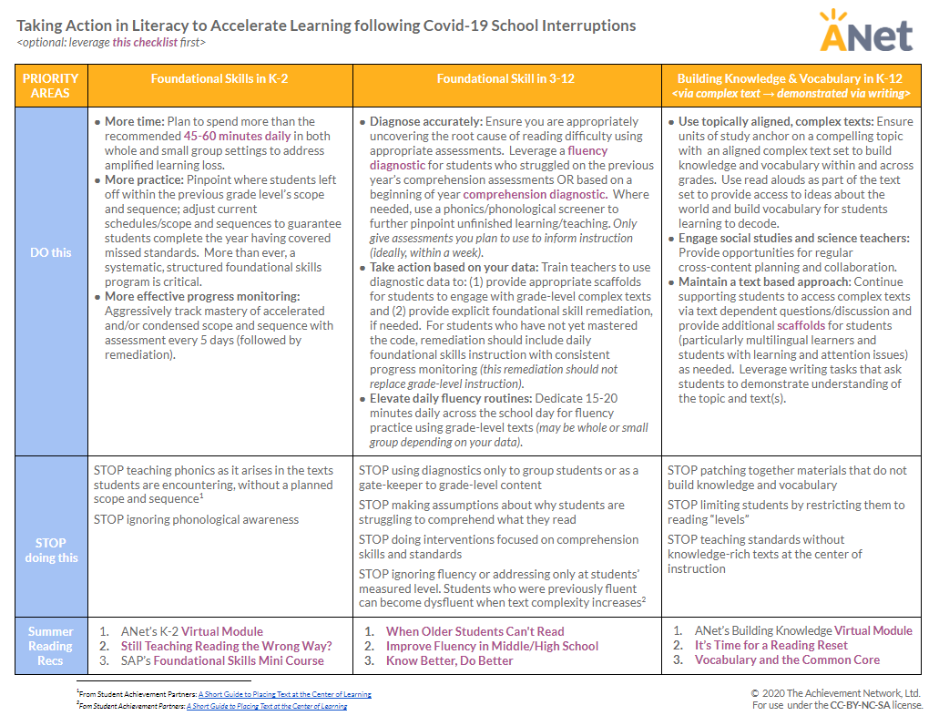
Professional Learning Providers
School Level Guidance
“The message that we believe will have the greatest impact in the next phase of instruction is to teach in alignment with the shifts/standards and the research based, science of reading.”
Notes:
Big Idea: ANet has developed resources for educators to use in schools - they provide clear and crisp guidance in ELA and math about decisions made in classrooms K-12.
Pictured here is ANet’s Taking Action Guide from Lit Recovery Framework

Slide 28
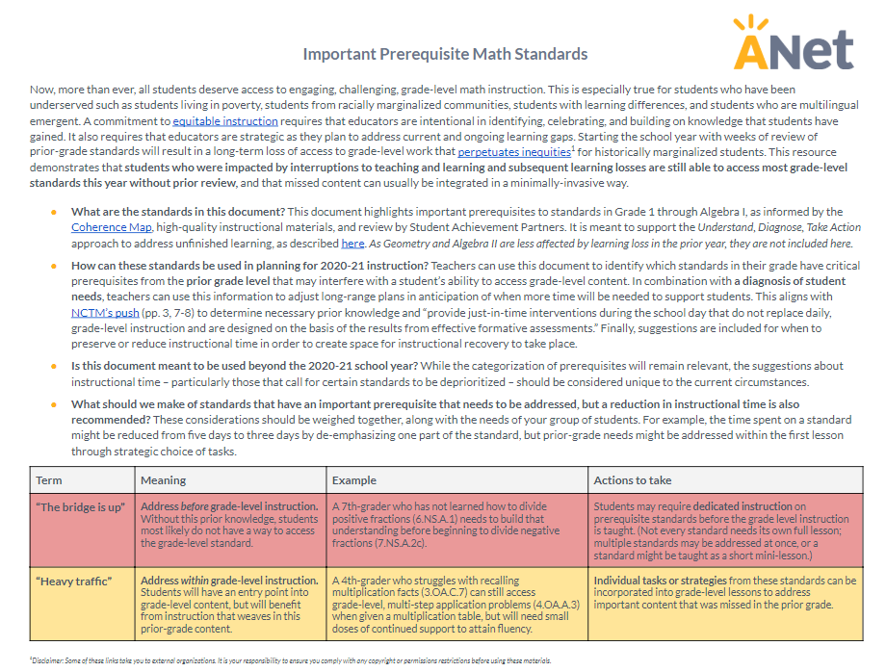
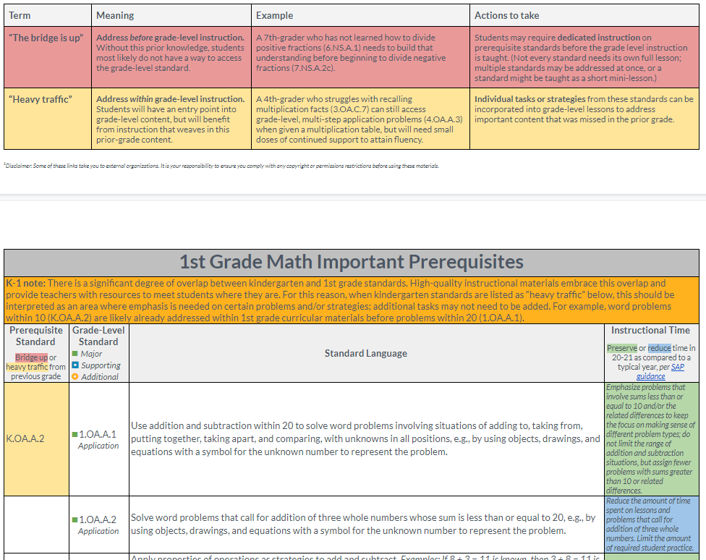
Professional Learning Providers
School Level Guidance
This resource demonstrates that students who were impacted by interruptions to teaching and learning and subsequent learning losses are still able to access most grade-level standards this year without prior review, and that missed content can usually be integrated in a minimally-invasive way.
Notes:
Big Idea: ANet has developed resources for educators to use in schools - they provide clear and crisp guidance in ELA and math about decisions made in classrooms K-12.
Pictured here is ANet’s ANet's Important Prerequisite Math Standards
Talking Points:
This guidance is consistent with the guidance in our PIC but with a slightly different audience. Whereas our guidance was meant to inform decisions that publishers, district leaders, PL providers, and SEAs are making, this guidance includes educators in schools -- esp. teachers who may need to make these instructional decisions b/c the curriculum they’re using hasn’t yet made the modifications or because their central office hasn’t yet provided guidance
I want to read to you a part of the first paragraph b/c it emphasizes a key idea underlying this guidance: “A commitment to equitable instruction requires that educators are intentional in identifying, celebrating, and building on knowledge that students have gained. It also requires that educators are strategic as they plan to address current and ongoing learning gaps. Starting the school year with weeks of review of prior-grade standards will result in a long-term loss of access to grade-level work that perpetuates inequities for historically marginalized students. (Then text on slide)
The doc categorizes standards by whether they are “bridge is up” (red) or “heavy traffic” (yellow).
Bridge is up means there is content from a prior grade level that might need to be addressed before grade-level instruction. That could mean a full lesson but oftentimes a mini-lesson or select tasks may be sufficient.
Heavy traffic means there is content from a prior grade level that can be addressed during grade-level instruction, often with select tasks.
(Process) A teacher would find their grade level, the standards for the upcoming unit and look to the left for whether there is prior content to consider. Then, based on whether the prior content has a bridge is up or heavy traffic designation, one can look to the right for how to think about instructional time.

Slide 29
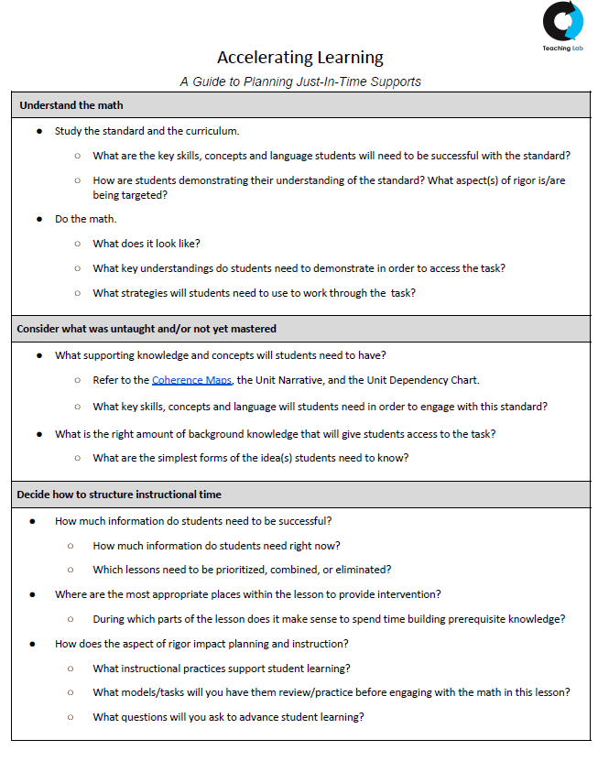


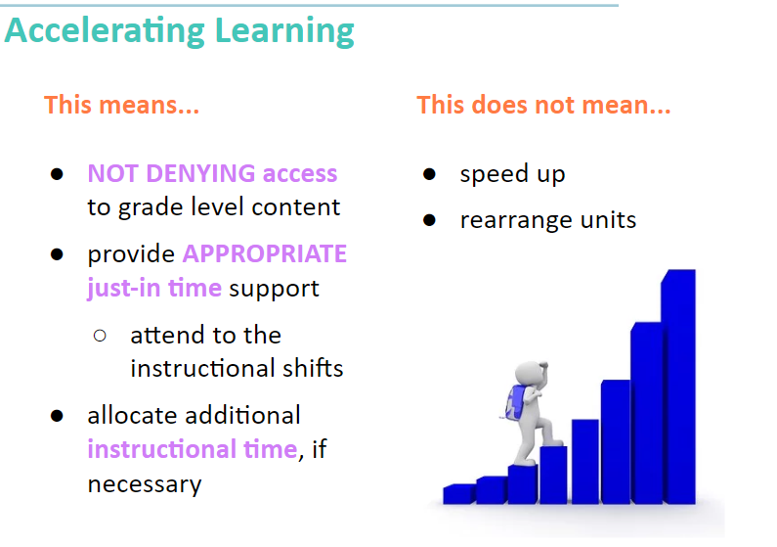
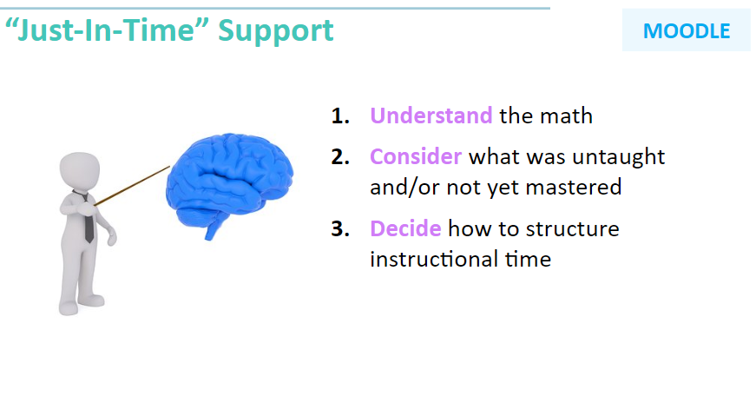
Professional Learning Providers
School Level Guidance
Notes:
Big Idea: Teaching Lab has framed teacher PL to focus on accelerating learning so that students start with grade-level work and receive just-in-time supports as needed for student learning.
The second slide (on the right) details their process for providing just in time supports in math and the PDF guide to planning just-in-time supports https://drive.google.com/file/d/1gGyKb9A-LzYgeGNODQ6AuqMjTvwnB3Ev/view
For more information, email Vaishali Joshi (vaishali.joshi@teachinglab.org) and/or Ryan Colón (ryan.colon@teachinglab.org) with any questions or follow up.
Talking Points:
Another PL provider we work closely with is Teaching Lab, and what’s unique about their approach is how curriculum-specific their work is
These two slides are from a session they’ve developed for their partners on what it means (and doesn’t mean) to accelerate learning next year. Note that it’s the same message as we saw in PIC and from ANet. We need to start students on grade-level content and be strategic about how we keep them there.
Their resource, a Just-in-Time support guide provides a helpful process for how to take in all the guidance out there and make decisions about instructional time. In broad sweeps, that process is to understand what the grade-level math is, then consider related content (using guidance from the curriculum at hand, tools like the Coherence Map, and guidance similar to the PIC), and make decisions about instructional time based on what students need to be successful, identifying opportunities in a lesson to provide supports, and being strategic with tasks and instructional practices.

Slide 30
Section 3: How might I use the Priority Instructional Content to guide teaching and learning for school year 2020-2021?
Notes:
Now we’re going to give you some time with these resources

Slide 31

Explore Resources
bit.ly/PIClinks
Select and review one of the resources that reflect the Priority Instructional Content OR Review Grade-Level Guidance in the Priority Instructional Content
Consider how this resource might impact your work during the 2020-2021 school year.
Prepare a takeaway to share with the group.
Notes:
15 minutes
Big Idea: Folks can either check out one of the resources we reviewed in the “how has the field used the PIC” OR check out the grade level guidance for the grades they teach/support.
Select & Review
Consider possible implications
Share thoughts in the chat

Slide 32
Pause & Reflect
How might you use the Priority Instructional Content or aligned resources for SY 2020 - 2021?
Drop your thoughts in the chat.

Slide 33
Questions for Our Presenters?

Slide 34
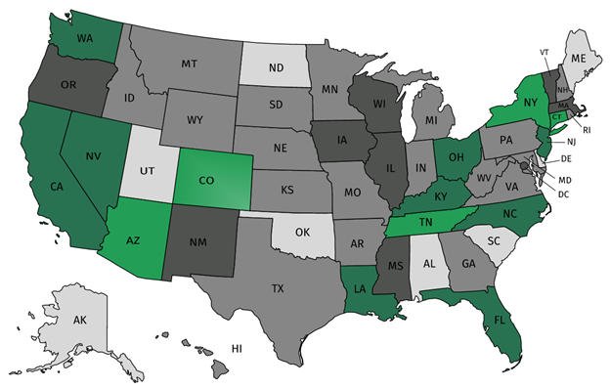




Join our network!
Join a national network of educators
Connect with state networks
Be a part of creating new tools and resources in partnership with SAP
Keep up to date on free resources, upcoming SAP webinars/professional learning opportunities, job postings and more!
Notes:
If you found tonight’s webinar helpful, we’d like to invite you to join our Core Advocate network! We’re committed to solving real problems that real teachers have and we know the best way to do this is to know more about what folks are experiencing.
As part of our national network, you have opportunities to connect with educators across the country, maybe even the network in your state! You can keep up to date on tools and resources available on Achieve the Core, as well as a variety of virtual learning opportunities and other ways to engage with us. We also work with educators in our network to help us build tools and resources.
We’d love to learn about who you are, where you work, the types of things you’re interested in and the expertise you already have. This way, we will be able to tailor our webinars and other opportunities to your needs and interests (we may even tap you to be our next webinar panelist).

Slide 35





Please Join Us!
https://achievethecore.org/ca-signup
Twitter: twitter.com/achievethecore
Facebook: facebook.com/achievethecore
Pinterest: pinterest.com/achievethecore
Notes:
We encourage you to join the network by filling out this survey completely at atc.org/ca-signup

Slide 36
Please Join Us Again Next Month!
Next month’s webinar:
Fostering Culturally Responsive Classrooms in the Age of COVID
2 September 2020 @ 7PM EST
Register Here:
https://event.on24.com/wcc/r/2494927/04E2762A168035E20E5F42E927F5E964

Slide 37
Thank You!

