Slide 1

Fraction Content Collection
Core Advocates Monthly Webinar
October 22, 2020
The webinar will begin shortly.
Check your Resource widget to preview the resources for today’s session! Use the Group Chat to introduce yourself!

Slide 2


Introductions
Your host:
Pascale Joseph
This month’s presenters:
Astrid Fossum
Senior Mathematics Specialist
Advisory Support, SAP
Raven Redmond
Math Content Lead/Instructor
Memphis Delta Preparatory Charter School

Slide 3
How many Core Advocate Webinars have you attended?
Please use the Questions tab on your control panel to respond.
If using a poll, please put up to 5 answer choices in the notes section below and indicate if attendees should choose only one response or multiple responses.

Slide 4


Join Our Network!
Learn More About Us!
Visit our website: www.achievethecore.org
https://achievethecore.org/ca-signup
Keep up to date on free resources, upcoming SAP webinars/professional learning opportunities, job postings and more!

Slide 5

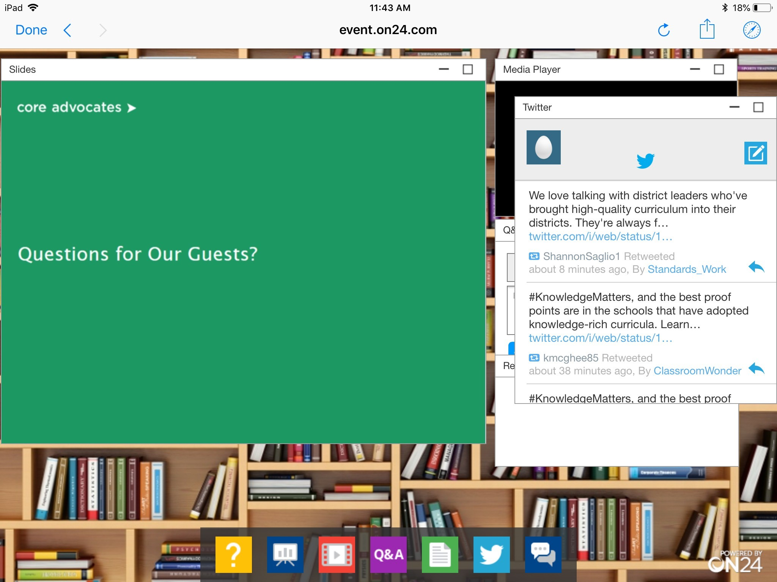
Tweet with Us!
Please feel free to tweet during and after the webinar using #coreadvocates
@achievethecore
@AstridFossum
Click here!

Slide 6

Engage with Us!
During the webinar:
Question just for the presenters/ tech help
Resources
Group chat
Certificate
After the webinar:
– Access to recording will be emailed to you.
Take our short survey in 2 weeks and be entered into a raffle for a $25 Amazon gift card.

Slide 7
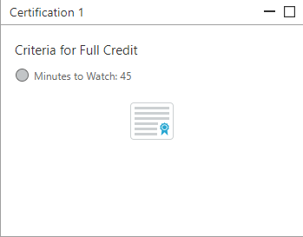
Certification Will Be Provided
A certificate will be available via the Certification box to the right.
Click on the blue-ribbon icon to print or download the certificate at the end of the webinar.

Slide 8

Goals of the Webinar
Identify and understand the components in the ”Fraction Content Collection”
Share best practices and resources for engaging in the difficult work of teaching and learning fraction content

Slide 9
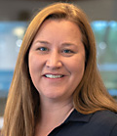
Astrid Fossum
Senior Mathematics Specialist
SAP / Milwaukee, Wisconsin
please enter a head shot here

Slide 10
Let’s Hear from You!
Share your responses in the chat.
What are your biggest challenges teaching fractions?

Slide 11
Section 1: What’s included in the Fraction Content Collection?

Slide 12
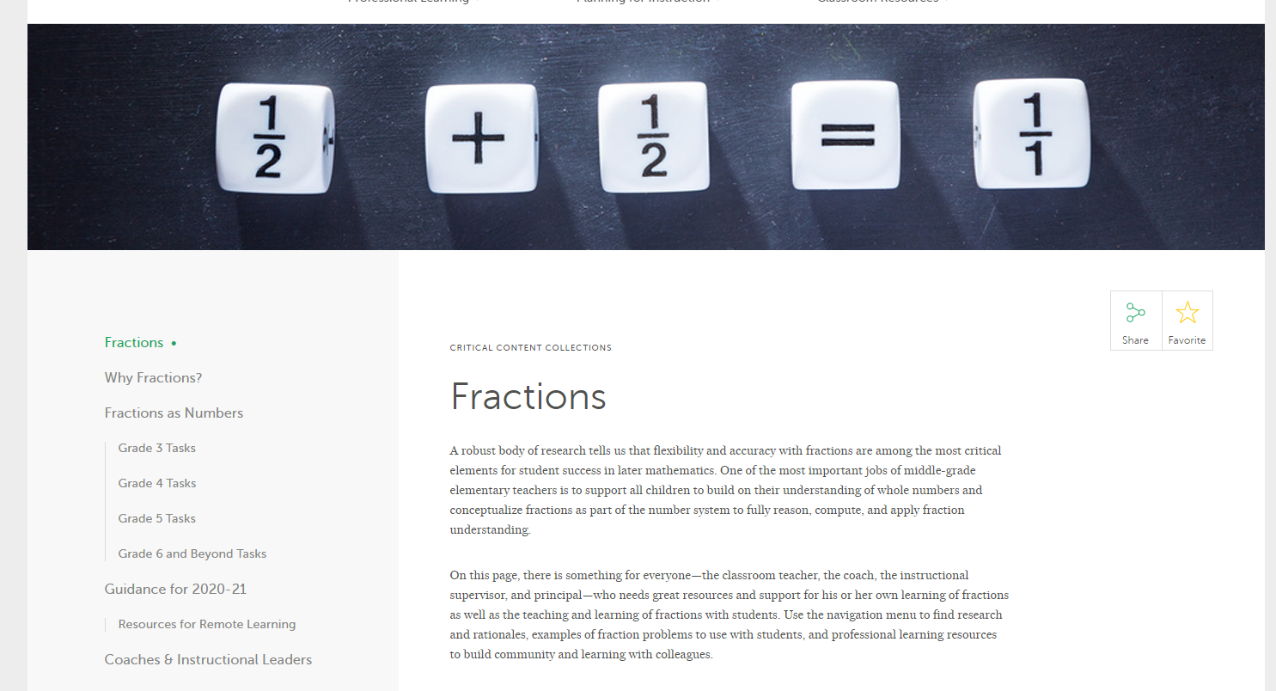
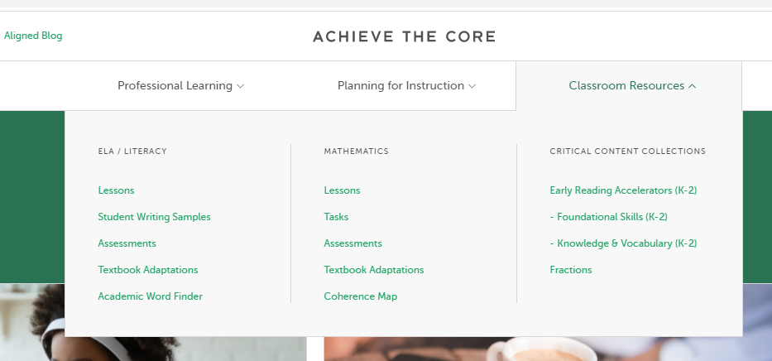

Slide 13
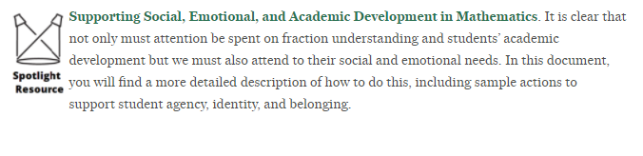
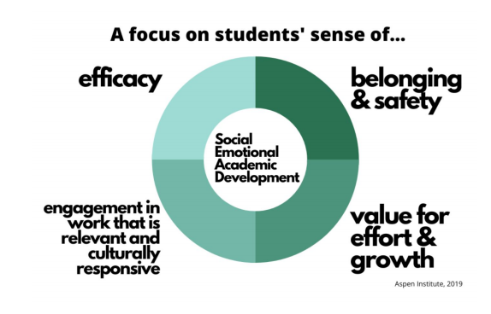
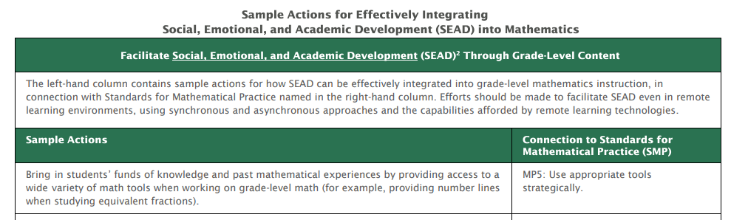
How can we support students’ Social, Emotional, and Academic Development (SEAD) while engaging in the content of math?

Slide 14
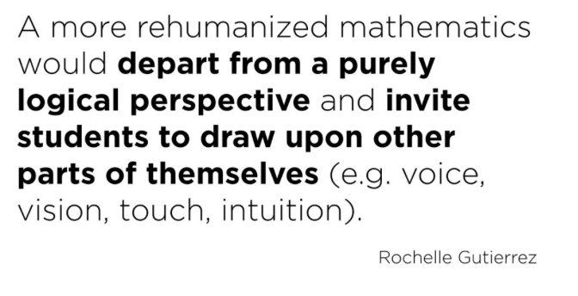
identity
agency
belonging

Slide 15
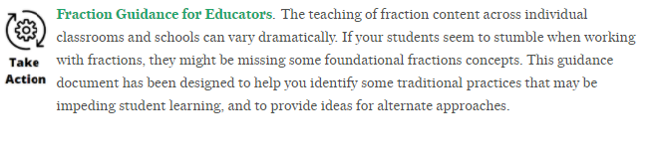
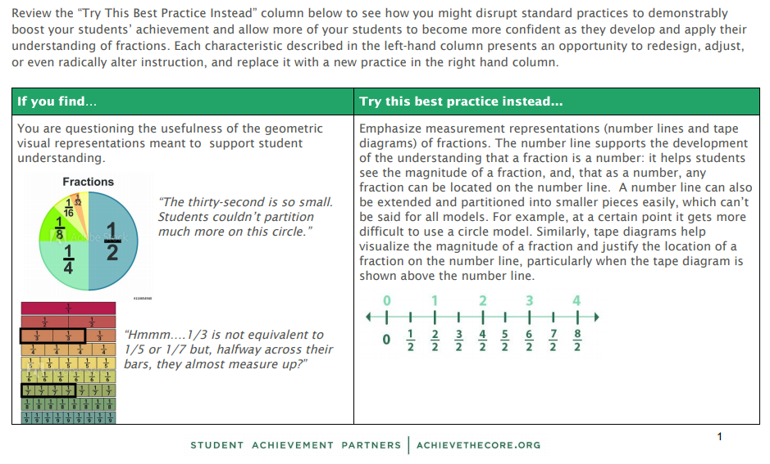

Slide 16

Raven Redmond
Math Content Lead
MDP/ Memphis, TN

Slide 17
Poll:
Is a fraction a number? Please use the Questions tab on your control panel to respond.
If using a poll, please put up to 5 answer choices in the notes section below and indicate if attendees should choose only one response or multiple responses.

Slide 18
Section 2: Grade Level Tasks

Slide 19
What’s included in the grade level task collections?
Grade Levels 3-5
Alignment to Common Core Standards
Readiness for higher level math

Slide 20
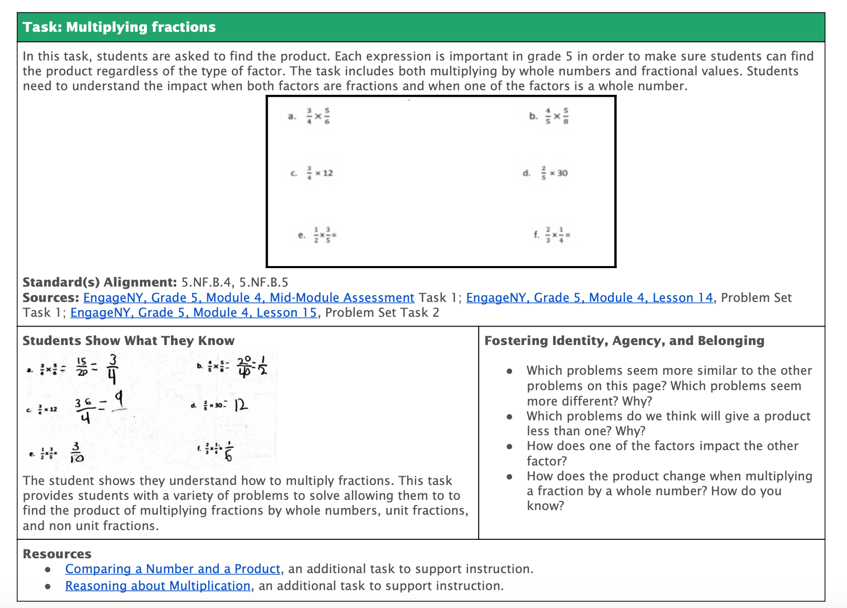
For each task, you will find:

Slide 21
For each task, you will find:

Slide 22
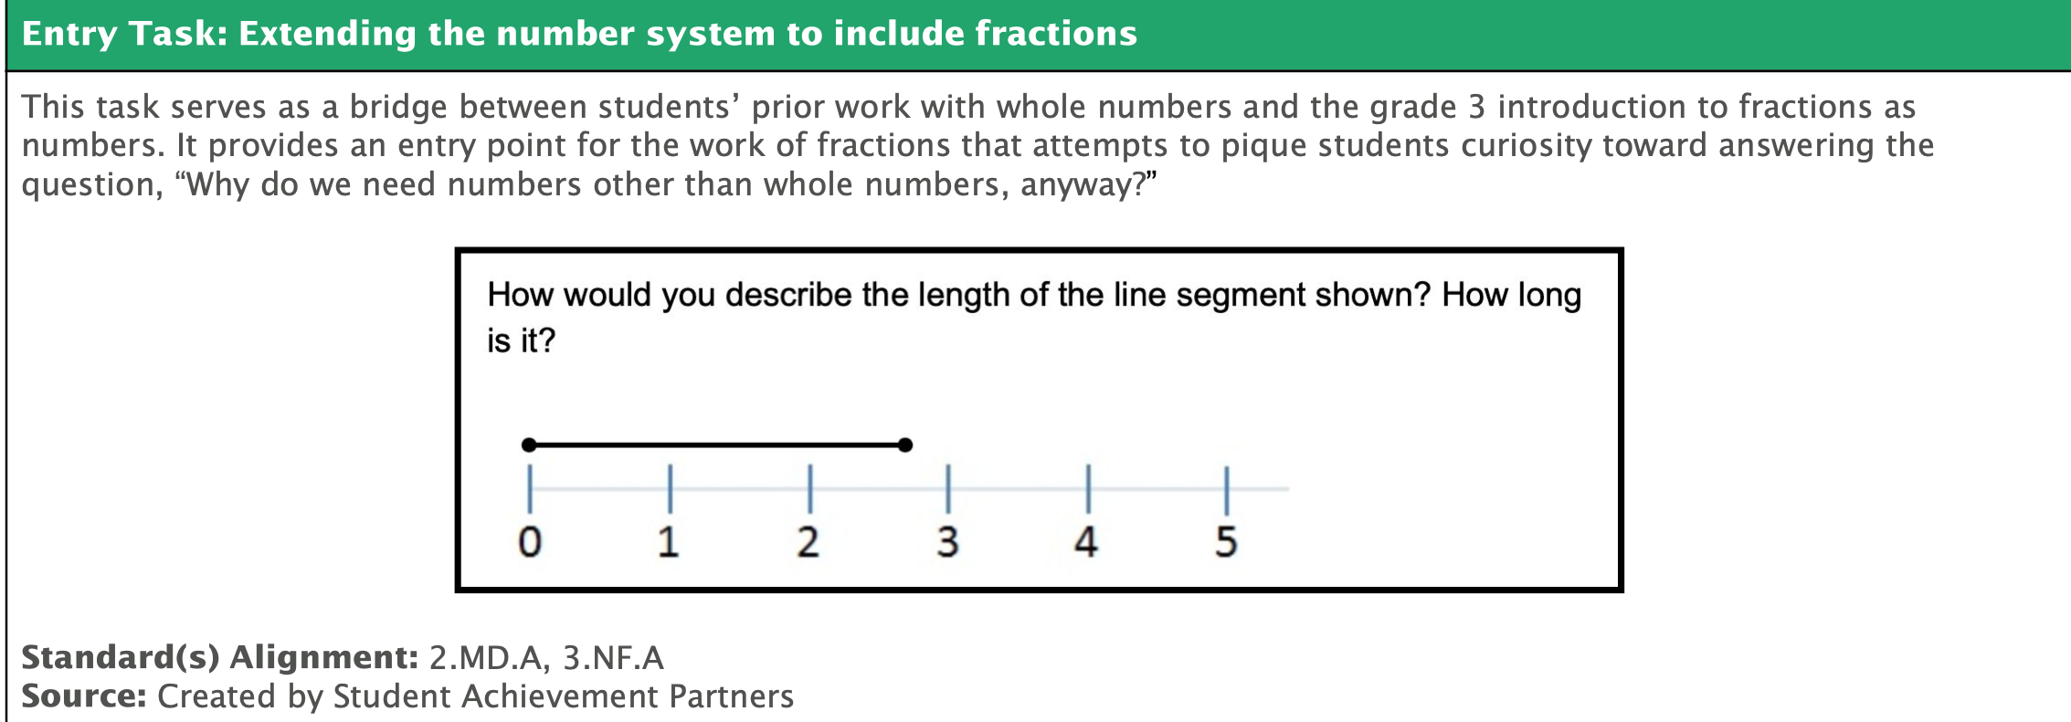
Entry Level Tasks

Slide 24
Let’s Hear from You!
Share your responses in the chat.
What question would you ask the student in the video to help her better understand the length of the segment?

Slide 25
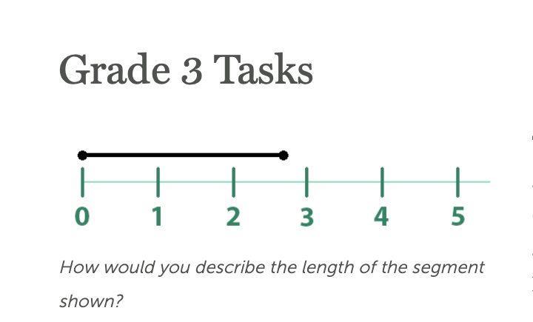

Slide 26
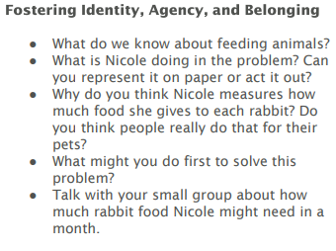
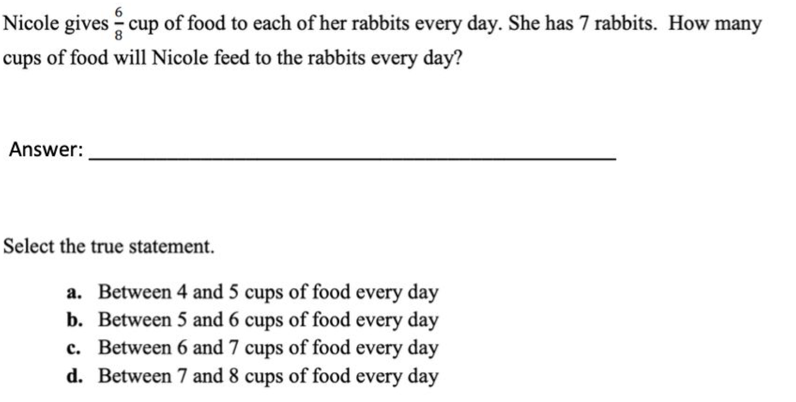
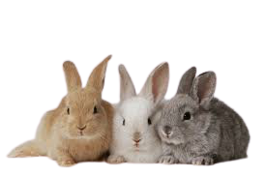
Grade 4 Example

Slide 27
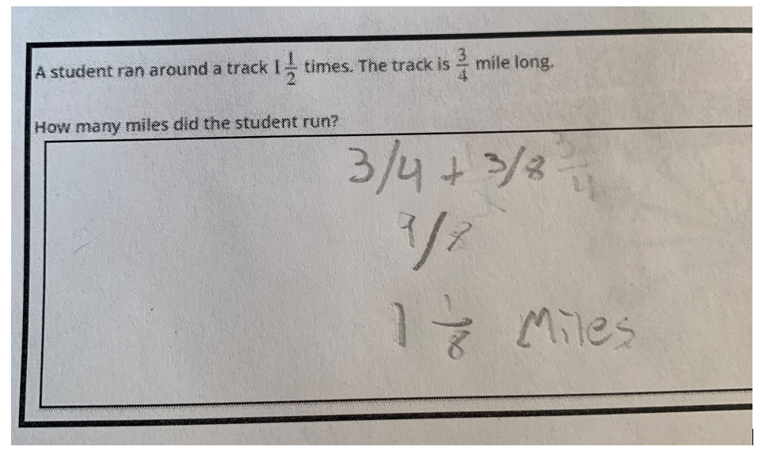
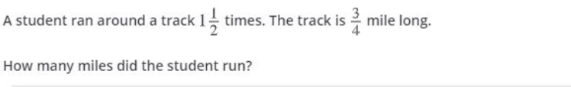
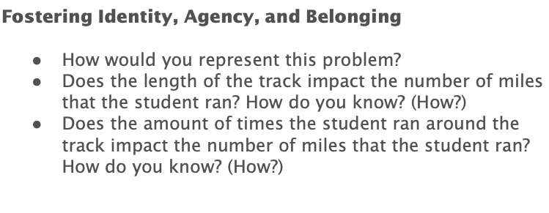
Grade 5 Example

Slide 28
Let’s Hear from You!
Share your responses in the chat.
How does understanding fractions as numbers impact future grade level understanding?

Slide 29
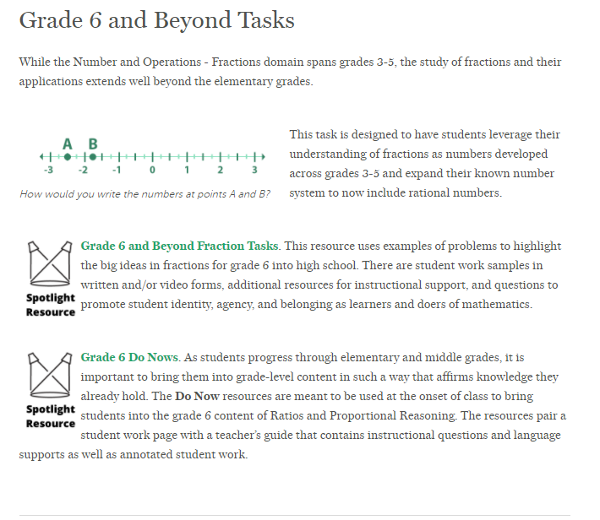
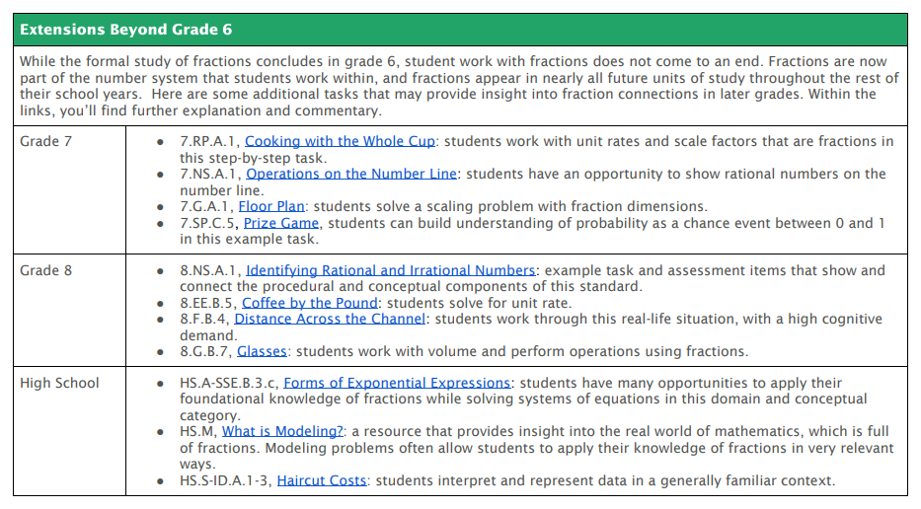

Slide 30
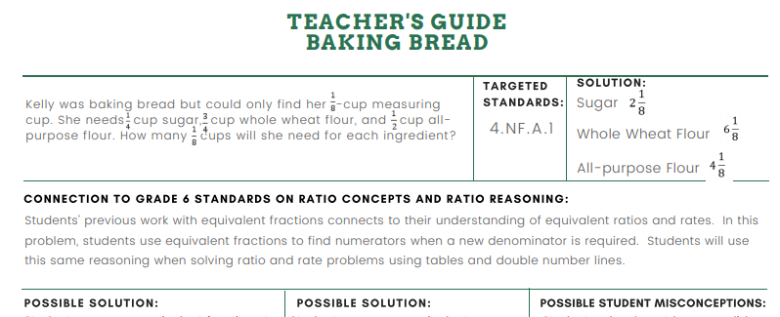

Slide 31
Section 3: Resources for Coaches and Instructional Leaders

Slide 32
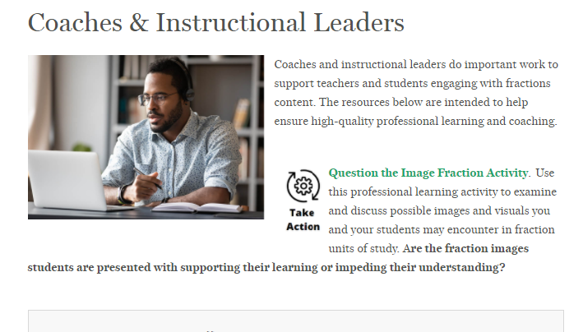
Resources to Support All Learners
Resources to Support Adult Learners
Resources to Support Equitable Instruction

Slide 33
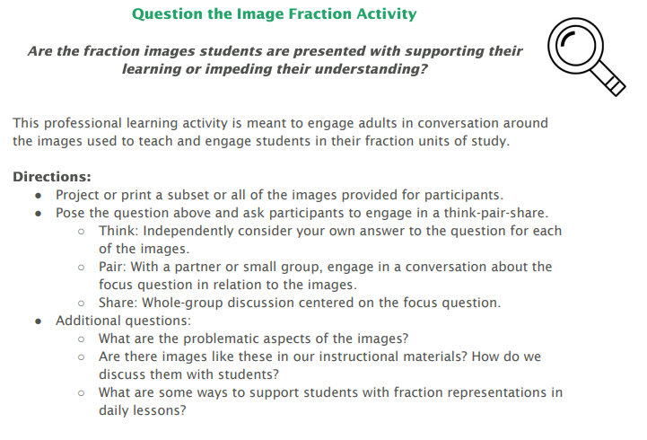

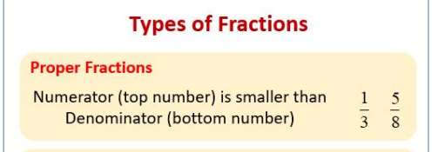

Slide 34
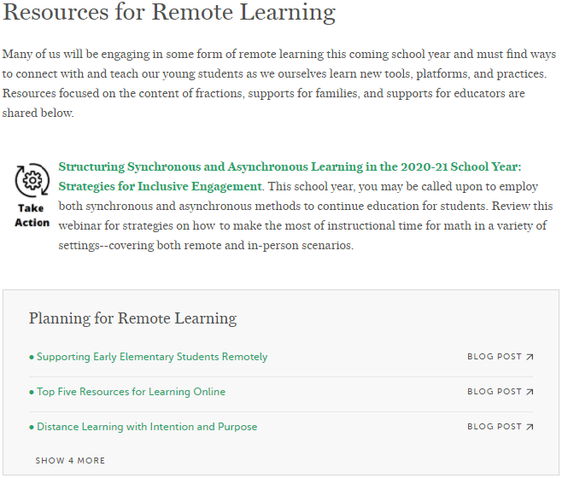


Slide 35
Questions for Our Guests?

Slide 36
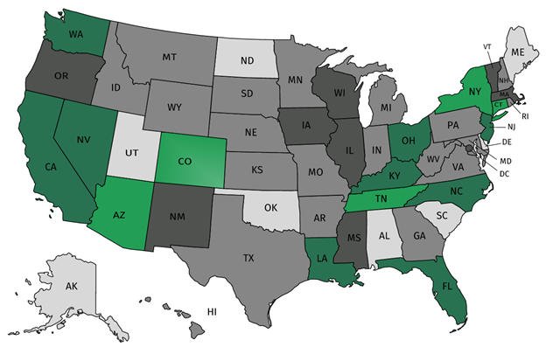
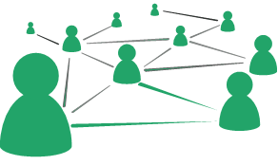



Join our network!
Join a national network of educators
Connect with state networks
Be a part of creating new tools and resources in partnership with SAP
Keep up to date on free resources, upcoming SAP webinars/professional learning opportunities, job postings and more!

Slide 37




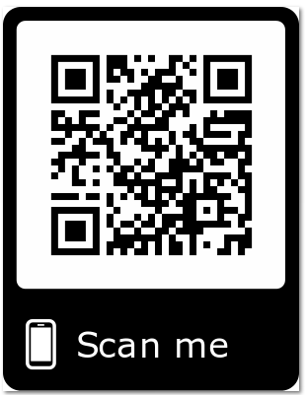
Please Join Us!
https://achievethecore.org/ca-signup
Twitter: twitter.com/achievethecore
Facebook: facebook.com/achievethecore
Pinterest: pinterest.com/achievethecore

Slide 38
Thank You!

