Slide 1


Decolonizing Instruction
Welcome! Please introduce yourself by sharing your pronouns, grade level, content area expertise, where you are tuning in from, and Indigenous land you are on. You can use https://native-land.ca/ for support!
Notes:
https://native-land.ca/

Slide 2


Engaging Respectfully With Each Other Tonight
Please use the chat feature throughout this conversation—we value your voices! Feel free to share constructive ideas, resources, and comments.
As noted on the event page, we will be recording the presentation portion of this session.
We will have the opportunity to come together for Q&A at the end of the session. Please keep track of your questions until then.
Participants who engaging in cyberbullying or deliberate attempts to intimidate other commenters or disrupt conversation will be promptly removed.
Lastly, feel free to discuss the conversation on social media as we chat tonight!
@decolonizeliteracy and @achievethecoreSAP
@achievethecore #coreadvocates

Slide 3
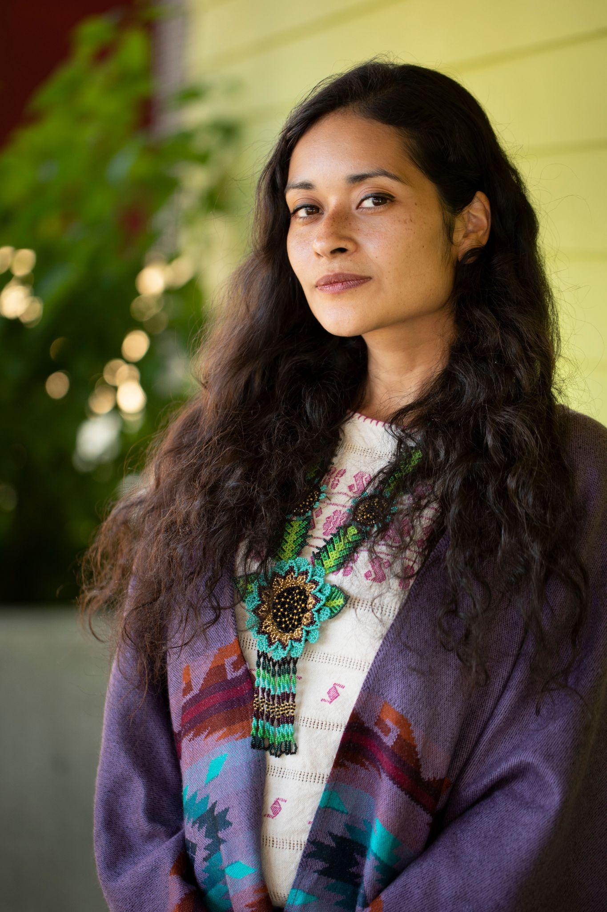

Our Guest:
Maribel Gonzalez
she/her/hers
Xicana STEM Integration Instructional Coach
@decolonizeliteracy

Slide 4
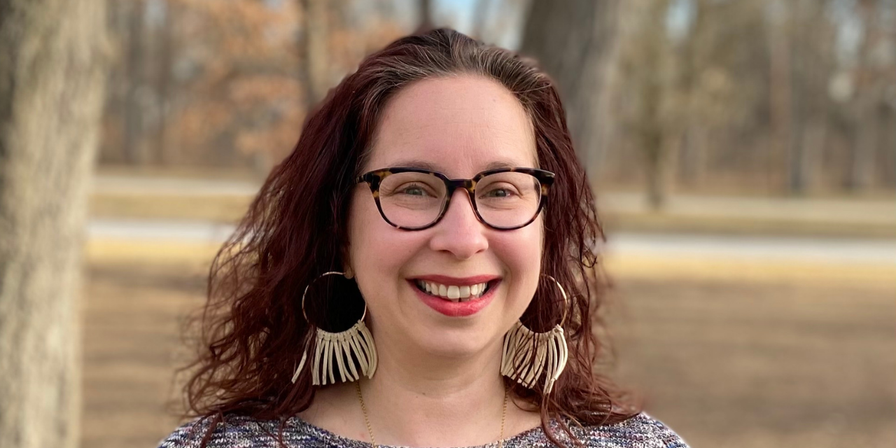

Discussion Questions:
What is your why for this work?
2) Can you share some specific classroom examples? How do you decolonize grading practices, teacher talk, or turn and talks?
3) What suggestions do you have for educators facing resistance or reluctance in this work from administrators, parents, or teachers in their school community?
Q&A to follow!

Slide 5
Decolonizing Instruction Framework
There are two ways you can teach that will plant the seeds for an acceptance of Indigenous sovereignty in our broader communities:
Part 1: Alignment of teaching practices with Indigenous values | Part 2: Explicit Instruction that Empowers Student-Driven Activism
Align procedures, instructional decisions, and learning intentions in the classroom to represent indigenous values such as reciprocity, harmony with the land, and interconnectedness. | Create a year-long driving question that will cultivate student-led activism around connecting youth to the original stewards of the land where you live. For example, how can we connect the learning we are doing in school to supporting the efforts of the original caretakers of the land we are on?
Notes:
Pause recording!
Drop links in the chat:
https://docs.google.com/document/d/1N2GK6_1nmnY0-3U8tiPL4RbwsxSyAtTNUDUZ-745KP8/edit?usp=sharing

Slide 6

Conversation Groups
20 minutes
Introductions
Review Framework: 2-3 minutes
Identify one instructional strategy to try (example- think/pair/share)
Apply the framework to the strategy- deconstruct and rebuild! Take notes in the google doc.
Note: If you get stuck, use “comments” to add a note! Maribel will take a look at the comments to address during the Q and A!
Notes:
Pause recording!
Drop links in the chat:
https://docs.google.com/document/d/1N2GK6_1nmnY0-3U8tiPL4RbwsxSyAtTNUDUZ-745KP8/edit?usp=sharing

Slide 7

Q&A Time
What questions do you have?
Notes:
If 30-50 participants- questions in the chat
Possible space for feedback on the protocols.

Slide 8
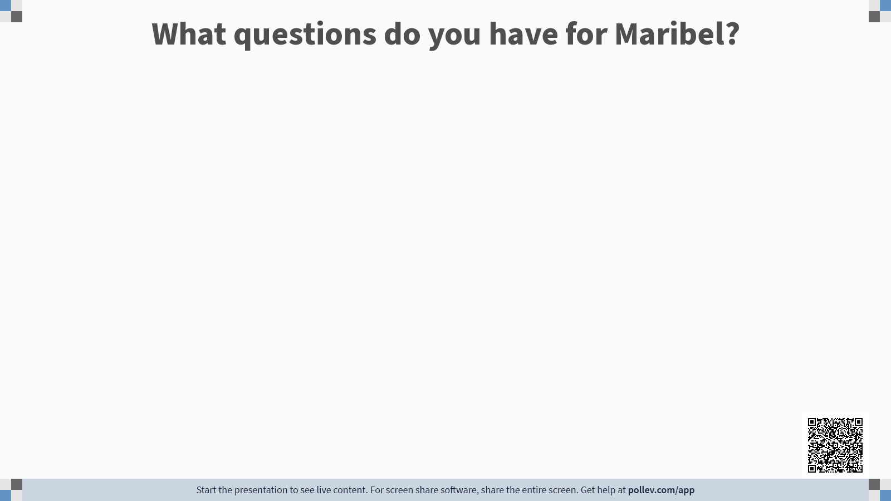
Notes:
https://PollEv.com/sap001

Slide 9
Resources
Culturally Sustaining Pedagogies: Teaching and Learning for Justice in a Changing World Edited by Django Paris and H. Samy Alim
Decolonizing Our Practice - Indigenizing Our Teaching by Shauneen Pete, Bettina Schneider, Kathleen O’Reilly
Rigorous PBL by Design by Michael McDowell
Download the decolonizing instruction framework one-pager here: https://bit.ly/maribelvg
Notes:
Decolonizing Our Practice - Indigenizing Our Teaching by Shauneen Pete, Bettina Schneider, Kathleen O’Reilly
Download the decolonizing instruction framework one-pager here: https://bit.ly/maribelvg

Slide 10
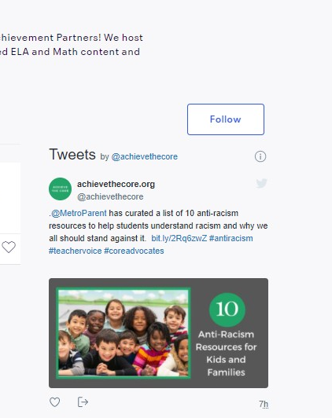
Upcoming Events!
All events take place at 7 p.m. ET.
Coffee & Conversation: Centering the Brilliance of Black and Latinx Students Through Research-Supported Strategies in Mathematics with Dr. Adrian Mims, Sr.
Follow us on Eventbrite! CoreAdvocates.Eventbrite.com
Notes:
http://CoreAdvocates.Eventbrite.com

Slide 11

Feedback is the TRUE breakfast of champions!
Please take a moment to share your thoughts on this experience with us! We are learning what it looks like to connect with you most effectively, and every comment counts.
To be among the first to hear about future events, please join our community! This sign-up will also offer you first access to our new events this fall that focus on bringing aligned instruction in conversation with anti-racist principles.
http://bit.ly/2021CandC
http://bit.ly/coreadvocatesignup
Notes:
http://bit.ly/2021CandC
http://bit.ly/coreadvocatesignup

