Slide 1
Learning from Mistakes: Easier Said Than Done
A Session on Mistake Literacy
Middle School Director, St. Francis School
zak@thecorecollaborative.com
@cohen_zak
zakcoheneducation.com
Zak Cohen
As you arrive--introduce yourself in the chat. Where are you joining us from and what grades do you teach or support?

Slide 2
Housekeeping Items
You’ll have access to a recording, the slide deck, and the Professional Learning Playlist
We will be recording this session. You will be emailed a copy of the recording, the slide deck, and the Professional Learning Playlist after the webinar
You can receive professional learning credit
Those who attend tonight’s webinar are eligible for one hour of professional learning time. Simply fill out the survey at the end of the webinar, and confirmation will be sent to you.
Engaging Respectfully With Each Other Tonight
Please use the chat feature throughout this conversation—we value your voices!
Feel free to share constructive ideas, resources, and comments about what’s resonating
Participants who engage in cyberbullying or deliberate attempts to intimidate other commenters or disrupt conversation will be promptly removed.

Slide 3
When it comes to mistake-making, there are no negative consequences beyond the moment. There's nothing that sparks structural wounds in them; so, when they make mistakes, it's easier for them to recover. This is a mindset that we don't teach to girls and to people of color.

Slide 4
Session participants will know…
What the research tells us about how to optimize learning from mistakes
How to apply this research to suit their individual school context

Slide 5
Agenda
What, why, and how of Mistake Literacy (direct instruction)
So What, Here’s What, Now What (small groups)
Debrief (full group)

Slide 6
Question #1
Think back to when you were a student: did you ever make a mistake that you learned from?

Slide 7
Question #2
Think back to when you were a student: did you ever make a mistake that you didn’t learn from?

Slide 8
Question #3
Think back to when you were a student: what accounted for the difference between a mistake you learned from and one you didn’t.

Slide 9
In 2015, Chris Davis struck out 208 times. In 2016, Chris Davis struck out 219 times. Why didn’t those 208 strikeouts translates in 208 singles, walks, or homeruns in 2016?

Slide 10
Mistake Literacy
A mindset that builds students’ capacity and capability to recognize, react to, and repair their mistakes.

Slide 11
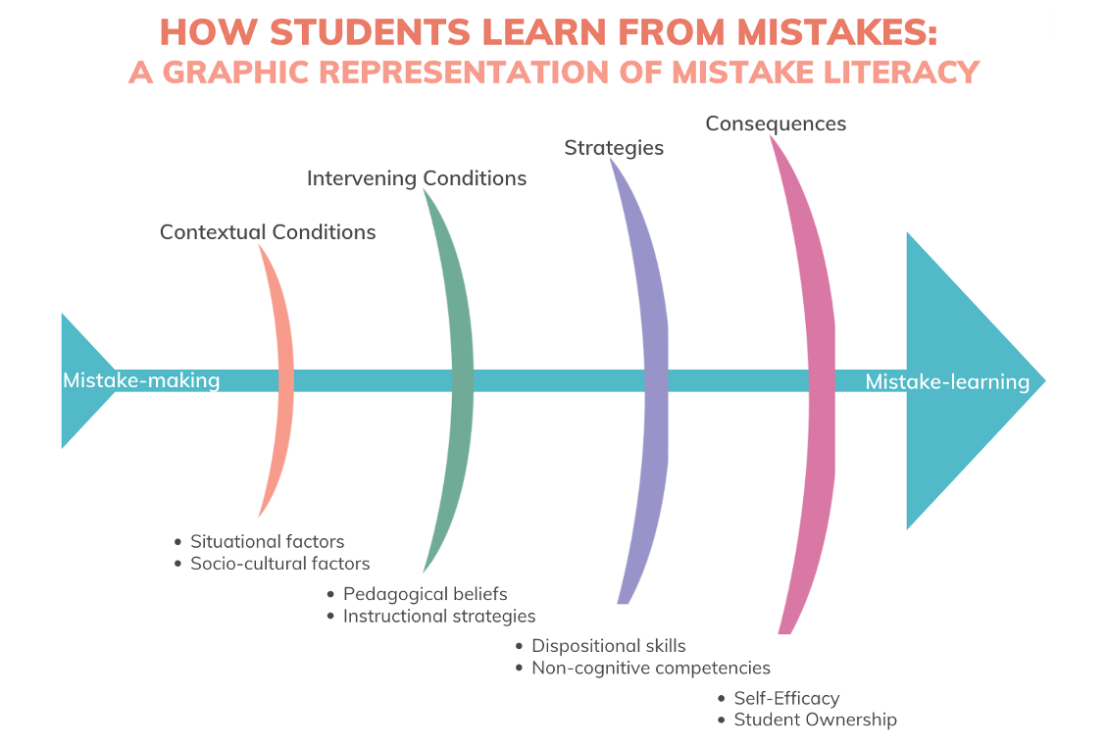

Slide 13
This willingness to learn from mistakes is not a sign of self-doubt, but of faith: it tests and humbles you, allows newness into your life. Best of all, being open to one’s errors, banishes the stifling effects of certainty. Certainty kills curiosity and change.
– Jerry Saltz, How to be an Artist

Slide 15
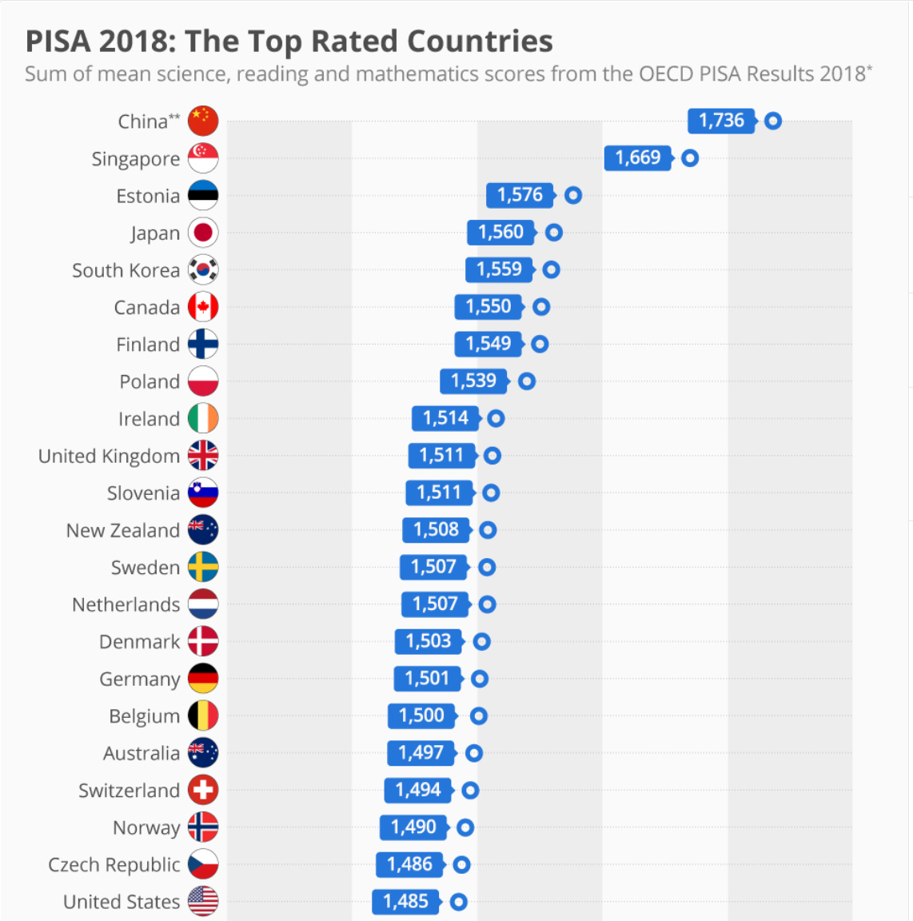
Instructional practices in China and Japan suggest there exist operational and optimal methods that can be deployed to not just maximize learning from mistakes, but, as evidenced by 2018 PISA results, actually leverage mistakes to maximize student achievement.

Slide 16
In particular, four teacher-specific qualities can bring a high error climate to fruition: acknowledging students’ mistakes, emphasizing the learning potential of mistakes, exhibiting patience when mistakes are made, and impeding negative reactions from classmates.

Slide 17
Humor has a much more disarming, leveling, humbling, and most importantly, comforting effect than many might admit. A professional playfulness can relax tensions, and create a more forgiving atmosphere for content exploration

Slide 18
The distance between an erroneous response and the conscious recognition of one’s wrongness must be traversed by the learner, not the teacher. Teachers simply cannot do students’ pushups for them and expect their students to gain any muscle mass.

Slide 19
The qualities that define a strong student-teacher relationship are the building blocks of student success in a high error climate. Building relations with students encourages agency, efficacy, and allows the experiences of the child to be recognized in the classroom.

Slide 20
What instructional strategies are best suited to turn mistakes into salutary lessons?

Slide 21
An EMT learning environment is characterized by the teacher’s frequent and proportional use of a rolodex of adaptive responses to mistakes, including whole-class discussion, error correction being returned to the student who made the mistake, teacher wait time before reformulating the question or giving a hint, and an emphasis placed on the learning potential of a mistake.

Slide 22
A period of inquiry followed by direct instruction has been found to strengthen the semantic network associated with the task, enhancing retention of the correct response. Findings show that PF results in students significantly outperforming their counterparts…on procedural knowledge, conceptual understanding, and problem-solving competency.

Slide 23
By providing students with recursive, formative opportunities to seek and apply feedback, they begin to understand that mistakes do not define their learning but are merely a signpost on a longer learning journey.

Slide 24
Instructional Strategies
Dispositions
Humor
Error Management Training
Instructional Strategies
Dispositions
Patience
Productive Failure
Student-Teacher Relationship
Instructional Strategies
Dispositions
Formative Feedback

Slide 25
Use the Jamboard that corresponds to your breakout room #
As a group, discuss then document your responses to the three questions
10 minutes; be prepared to share with group when we return

Slide 26
Middle School Director, St. Francis School
zak@thecorecollaborative.com
@cohen_zak
zakcoheneducation.com

Slide 27
Certificate Sign-Up
Resources you’ll receive:
https://bit.ly/LearningFromMistakes329
Note: This sign-up form is for LIVE PARTICIPANTS ONLY. If you are watching this webinar on-demand via Teachbale, you do not need to complete this form.
Link to webinar recording
Webinar slide deck
Mistake Literacy Professional Learning Playlist

Slide 28
Thank You!

Slide 29
Please Join Us!
Website: achievethecore.org
Twitter: twitter.com/achievethecore
Facebook: facebook.com/achievethecore
Instagram: instagram.com/achievethecoresap/

