Slide 1
Who’s Doing the Work? - Shifting the Lift in ELA
Core Advocates Monthly Webinar
October 4, 2017
The webinar will begin shortly. You may wish to download the handouts (check the tab on your webinar control panel) while you wait.

Slide 2
Introductions
Your hosts from the Field Impact Team
Sandra Alberti, Director
Janelle Fann, Project Manager
Lynda Nguyen, Team Coordinator
Jennie Beltramini, Teacher Engagement Manager
Joanie Funderburk, Manager of Professional Learning
This Month’s Guests
Tori Filler, SAP ELA
Carey Swanson, SAP ELA
Bev Davis, VT Core Advocate
Lindsey James, WA Core Advocate

Slide 3
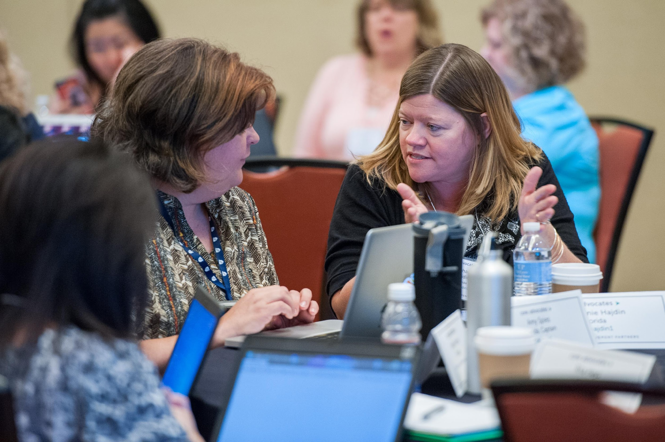
Who are Core Advocates?
Core Advocates are educators who:
Believe in the potential of the CCSS to prepare all students for college and careers;
Are eager to support their colleagues and communities in understanding and advocating for the CCSS and CCSS-aligned instruction;
Understand and embrace the shifts in instruction and assessment required by the CCSS

Slide 4
To learn more about Core Advocates…
Contact Jennie Beltramini (jbeltramini@studentsachieve.net ) or Joanie Funderburk (jfunderburk@studentsachieve.net)
Complete this survey to join our database (and mailing lists): https://achievethecore.org/ca-signup
Visit our website: www.achievethecore.org

Slide 5
Tweet with us
Please feel free to tweet during and after the webinar using #coreadvocates
@achievethecore
@JoanieFun, @salberti, @JennieBeltro
@mslindseyjames

Slide 6
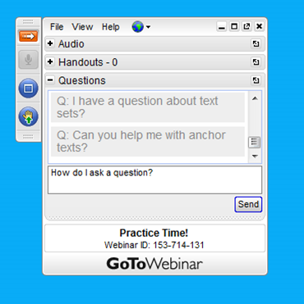
Webinar protocols
During the webinar
– Accessing Documents
– Questions option
– Polling
After the webinar
– Survey
– Access to recorded webinar

Slide 7
Instructional Advocacy – A Definition
Grounded in a firm understanding of the Shifts, educators owning, supporting, and promoting the resources, tools, and practices that create learning environments in which students develop college- and career- readiness.

Slide 8
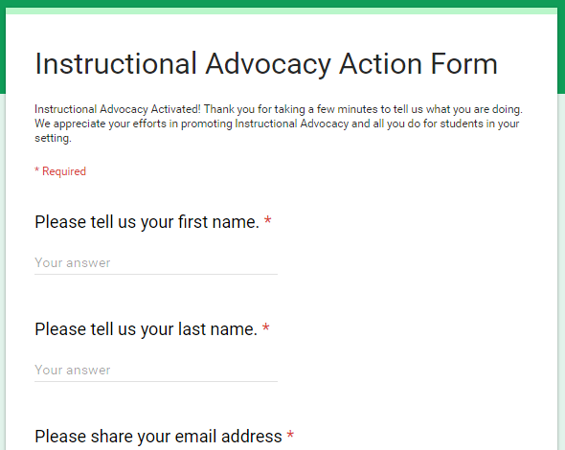
Tell us about your efforts
www.achievethecore.org/educators-taking-action

Slide 9
Goals of the webinar
Understand the rationale for limiting “teacher talk”
Learn about practical, concrete moves teachers can make to increase the amount of student work (discussion, writing, and reading) during literacy lessons
Hear about the impact these moves have on student learning and engagement

Slide 10
Why is it important to limit “teacher talk?”

Slide 11
Why limit teacher talk?
Engaging in a volume of reading benefits all students
“To grow, our students must read lots, and more specifically they must read lots of ‘complex’ texts—texts that offer them new language, new knowledge, and new modes of thought.” Adams (2000)
“…reading yields significant dividends for everyone—not just for the “smart kids” or the more able readers. Even the child
with limited reading and comprehension skills will build vocabulary and cognitive structures through reading.”
Cunningham and Stanovich (1998)

Slide 12
Why limit teacher talk?
Students need to read aloud, read to themselves, and re-read:
“Research suggests that techniques like paired reading (in which kids read and reread texts to each other), reading while listening, echo reading, radio reading, etc. can all be good choices. In all of these techniques, many students are able to practice simultaneously, they read relatively challenging materials, and then they reread these in an effort to improve the quality.”
Tim Shanahan
National Reading Panel (2000) - Relevant finding (pg. 15):
A meta-analysis concluded that guided oral reading and repeated
reading procedures (such as those used in close reading) increase both fluency and comprehension.

Slide 13
Why limit teacher talk?
Students need to connect reading and writing to speaking and listening
From Appendix A of the standards:
The interrelationship between oral and written language is illustrated in the table below, using the distinction linguists make between receptive language (language that is heard, processed, and understood by an individual) and expressive language (language that is generated and produced by an individual).
Children’s oral language competence is strongly predictive of their facility in learning to read and write: listening and speaking vocabulary and even mastery of syntax set boundaries as to what children can read and understand no matter how well they can decode.
From “Why Talk Is Important in Classrooms” by Douglas Fisher, Nancy Frey and Carol Rothenberg

Slide 14
Connections with Anchor Standards
Reading
Anchor
10
S&L
Anchor
1
Writing
Anchor
9

Slide 15
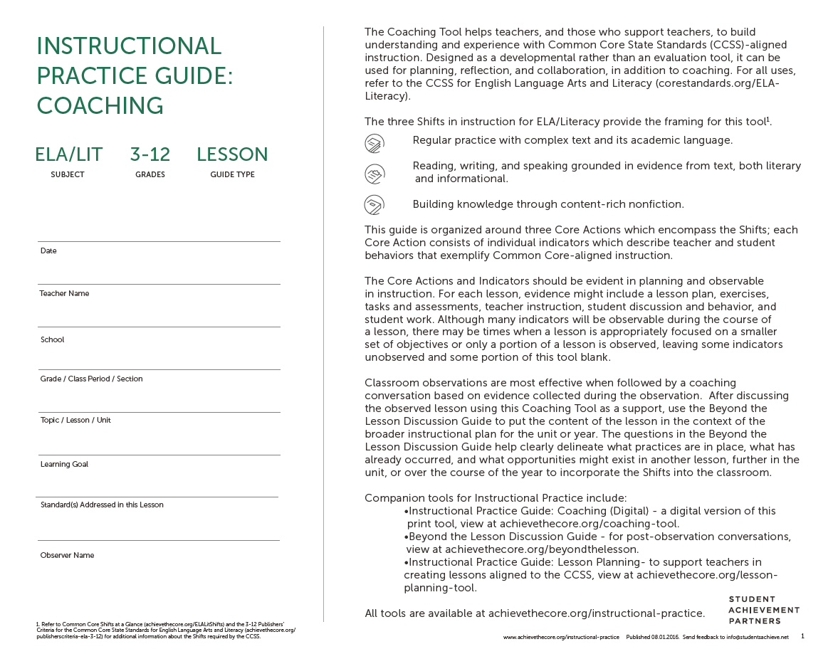
Instructional Practice Guide
IPG available on Achieve the Core

Slide 16
ELA Instructional Practice Guide Core Actions
Core Action 1
Focus each lesson on a high-quality text (or multiple texts).
Core Action 2
Employ questions and tasks, both oral and written, that are text-specific and accurately address the analytical thinking required by the standards.
Core Action 3
Provide all students with opportunities to engage in the work of the lesson.

Slide 17
Instructional Practice Guide Core Action 3

Slide 18
Question:
Which indicator(s) of Core Action 3 do you find most challenging in your classroom? Why?
Please use your Questions tab to respond.

Slide 19
Project background
Balanced Literacy Focus Group
Who’s Doing the Work? by Burkins & Yaris
Tim Shanahan’s blog: http://www.shanahanonliteracy.com/

Slide 20
Before “Who’s Doing the Work?”
Who’s doing the work? How do you know?

Slide 21
Poll:
Which teacher and student behaviors did you see in the video?
Please use your Questions tab to respond.

Slide 22
What can teachers do to increase the amount of work and thinking students do during the lesson?

Slide 23
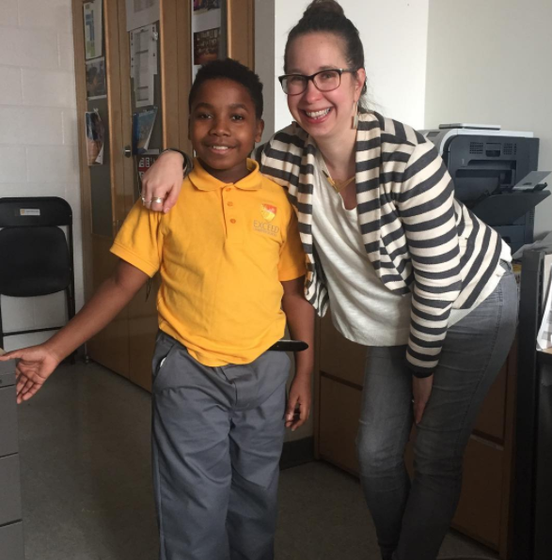
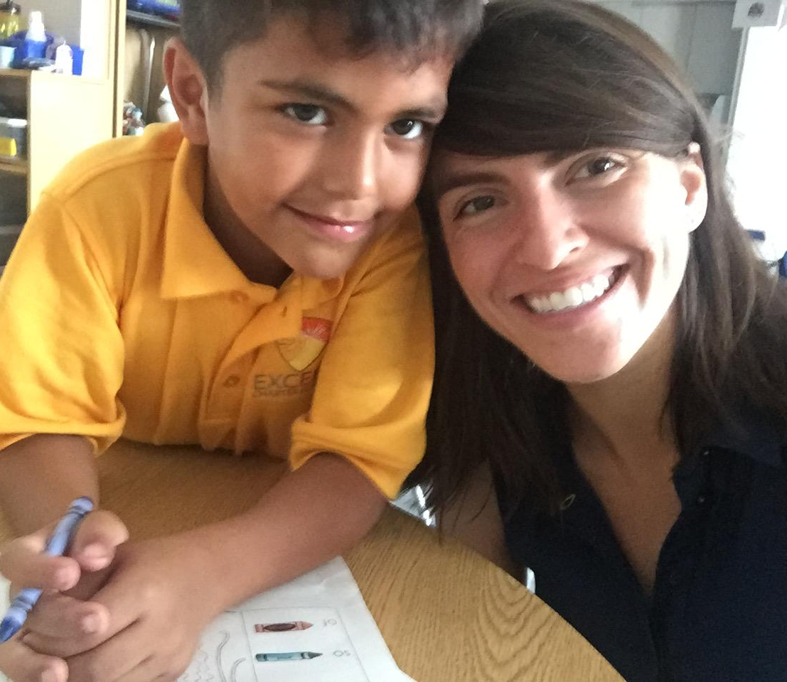
Your presenters
Carey Swanson Tori Filler

Slide 24
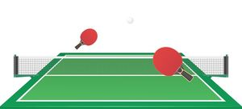
IRE Conversations
Initiate: Teacher poses question
Respond: Student responds
Evaluate: Teacher evaluates response

Slide 25
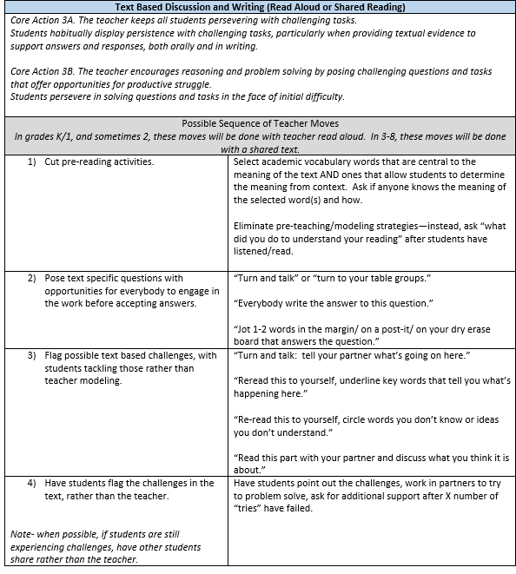
WDW Teacher Strategy Tools
Content Area
Read Aloud or Shared Reading
Reading Complex Text (3-8)
Foundational Reading or Fluency (Guided Reading)
IPG Core Action Indicators
Possible Sequence of Teacher Moves
Available on
Achieve the Core

Slide 26
Strategies to “Shift the Lift”
Limit teacher modeling.
Pose text-specific questions with opportunities for everyone to engage in the work before accepting answers.
Facilitate student-led discussion, intervening to pace the lesson or direct students to misconceptions.
Involve student voices in reading or re-reading text.

Slide 27
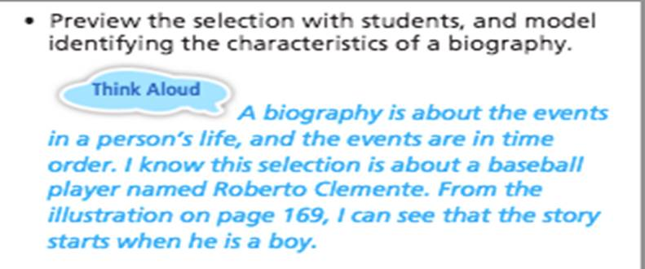
Limit Teacher Modeling
Instead of…
Try…
Look at the illustration on page 169. Who do you think the boy in the tree is?
Why do you think that?

Slide 28
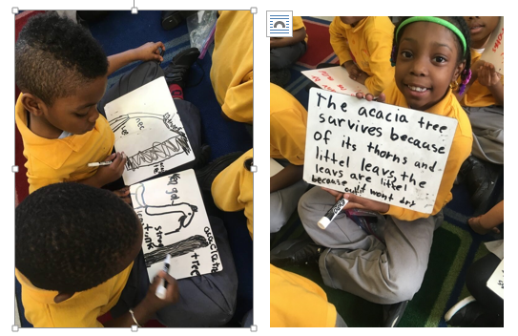
Ask all students to engage in the work!
Think-Pair-Share / Turn & Talk
Everybody Writes
Voting

Slide 29
Facilitate student-led discussion
Challenge yourself not to repeat, rephrase or validate what students say.
Use open-ended prompts before jumping in to clarify student misconceptions.
What do you all think? Agree? Disagree? Add on?
What could you do next?
What have you tried so far?

Slide 30
Involve more student voices in reading and re-reading!
Independent Reading
Read to yourself and stop at page 3.
Reread this paragraph and circle words that describe the sun.

Slide 31
Involve more student voices in reading and re-reading!
Multiple student voices
Choral read (We all read together)
Echo read (Teacher reads, students repeat)
Partner or buddy reading

Slide 32
After Who’s Doing the Work
insert classroom video here

Slide 33
Video debrief
What instructional moves supported students doing the work?
Students read: “Read our word for the day”
Everybody writes: Everyone write definition of culture
Students evaluate each other’s responses: Thumbs up/down
Students read and reread: Students go back into the text for examples

Slide 34
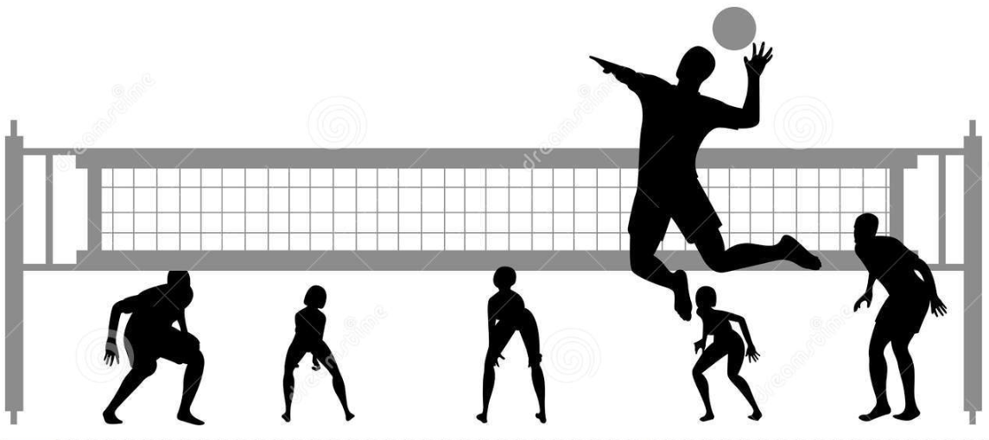
Student Driven Conversations
Truly conversational
High accountability for students

Slide 35
Thinking about next steps…
Limit teacher modeling.
Pose text-specific questions with opportunities for everyone to engage in the work before accepting answers.
Facilitate student-led discussion, intervening to pace the lesson or direct students to misconceptions.
Involve student voices in reading or re-reading text.
Which of these strategies are you excited about trying first?
Please use your Questions tab to respond.

Slide 36
How is this information being used by teachers, and what is the impact on student learning?

Slide 37
Special Guest Core Advocate:
Bev Davis
Superintendent
Orleans Central Supervisory Union, VT

Slide 38
Overview of ELA Instruction and Initiatives in
Orleans Central Supervisory Union (OCSU):
ELA Instruction and Programs
Teachers working hard, student disengaged
Student Engagement and Formative Assessment
Focus for 2+ years with little shift in practice

Slide 39
The Course:
Increasing student Independence During the Literacy Block
The text - Who’s Doing the Work by Burkins and Yaris
Developing the course (objectives, standards for educators)

Slide 40
Course Objectives:
Participants will:
Understand the importance of developing an environment where students are doing more of the work.
Know strategies that promote student independence during literacy instruction
Be able to assess and reflect on their own literacy instruction

Slide 41
Course Assignments
First Class - Recording of lesson
Each Week:
Read and discuss one chapter
Try out at least one technique from the chapter and
reflect on it in online forum
Weekly assignment from menu
Last Class - Next Steps Project

Slide 42
Impact - Quotes from Teachers
“This course really helped me wrap my head around the gradual release strategies for developing a strong independent reading program in my classroom. I'm excited for next year!”
“I must admit that I can overtake the Guided Reading lesson with my planned agenda, and the responsiveness to my students can be overshadowed. I am doing A LOT of the work, which up until this chapter, has felt normal.”

Slide 43
Impact - Quotes from Teachers
“Often I find myself looking at student work in a fully independent setting and it surprises me how much they seem to "forget" all the strategies I have given them. Reading this chapter made me realize that the problem is they still feel like I have to "give them" the strategies.”
“I appreciate the idea from this chapter that "unless children have lots of opportunities noticing and resolving the troublesome spots in text, they will not be able to read sophisticated text independently." I need to step back and let them struggle just a bit.....and then if it reaches a frustration point, jump in and direct teach, and support.”

Slide 44
Impact - Quotes from Teachers
“I have been giving my students opportunities to explore grammar, vocabulary, and essential questions with less direction from me, and I have noticed a much higher level of engagement too. They really do take a lot of pride in being able to do it "all by themselves." At first I thought they would be frustrated when I ask them to try and identify the meaning of a word without me or the dictionary, or a physical context. What I found was that even when students were only able to come up with bits and pieces of the right answers on their own, they were much more excited about the learning that was going on.
I guess my point is this: We often say that students would be passive learners if we let them, and we have to force them to be engaged in the learning. However, I think it is the opposite. As teachers we often take the path of least resistance, the path that feels cleaner, easier to manage. And that path is "giving" content and students "learn" the content from us. My students really want to be in control, grappling with challenging concepts, so that they can prove to me and themselves that they can do it.”

Slide 45
Special Guest Core Advocate:
Lindsey James
High School English Teacher
Walla Walla Public Schools, Washington
@mslindseyjames
Please insert a head shot here

Slide 47
Feedback Circles
Established a structured protocol for sharing targeted feedback
Students solicit the feedback they most want
Students take turns as the “reader” for one round and provide targeted feedback for the rest of their group members
Reader: Share your request for feedback with your group before reading. Read your draft clearly and with emotion. | Group: Give each person kind, specific, and helpful feedback that addresses all three of the following areas: Address the reader’s request for feedback thoughtfully Express one thing you value or that is working well Your description of ___ is particularly insightful because ____. Your reference to ____ strongly supports the point you make about____. Words like _____ and _____ are especially characteristic of ___’s diction. Ask probing questions or offer suggestions for revision What are the connections you see between ____ and ____ ? If this were my writing, I might try ______.

Slide 48
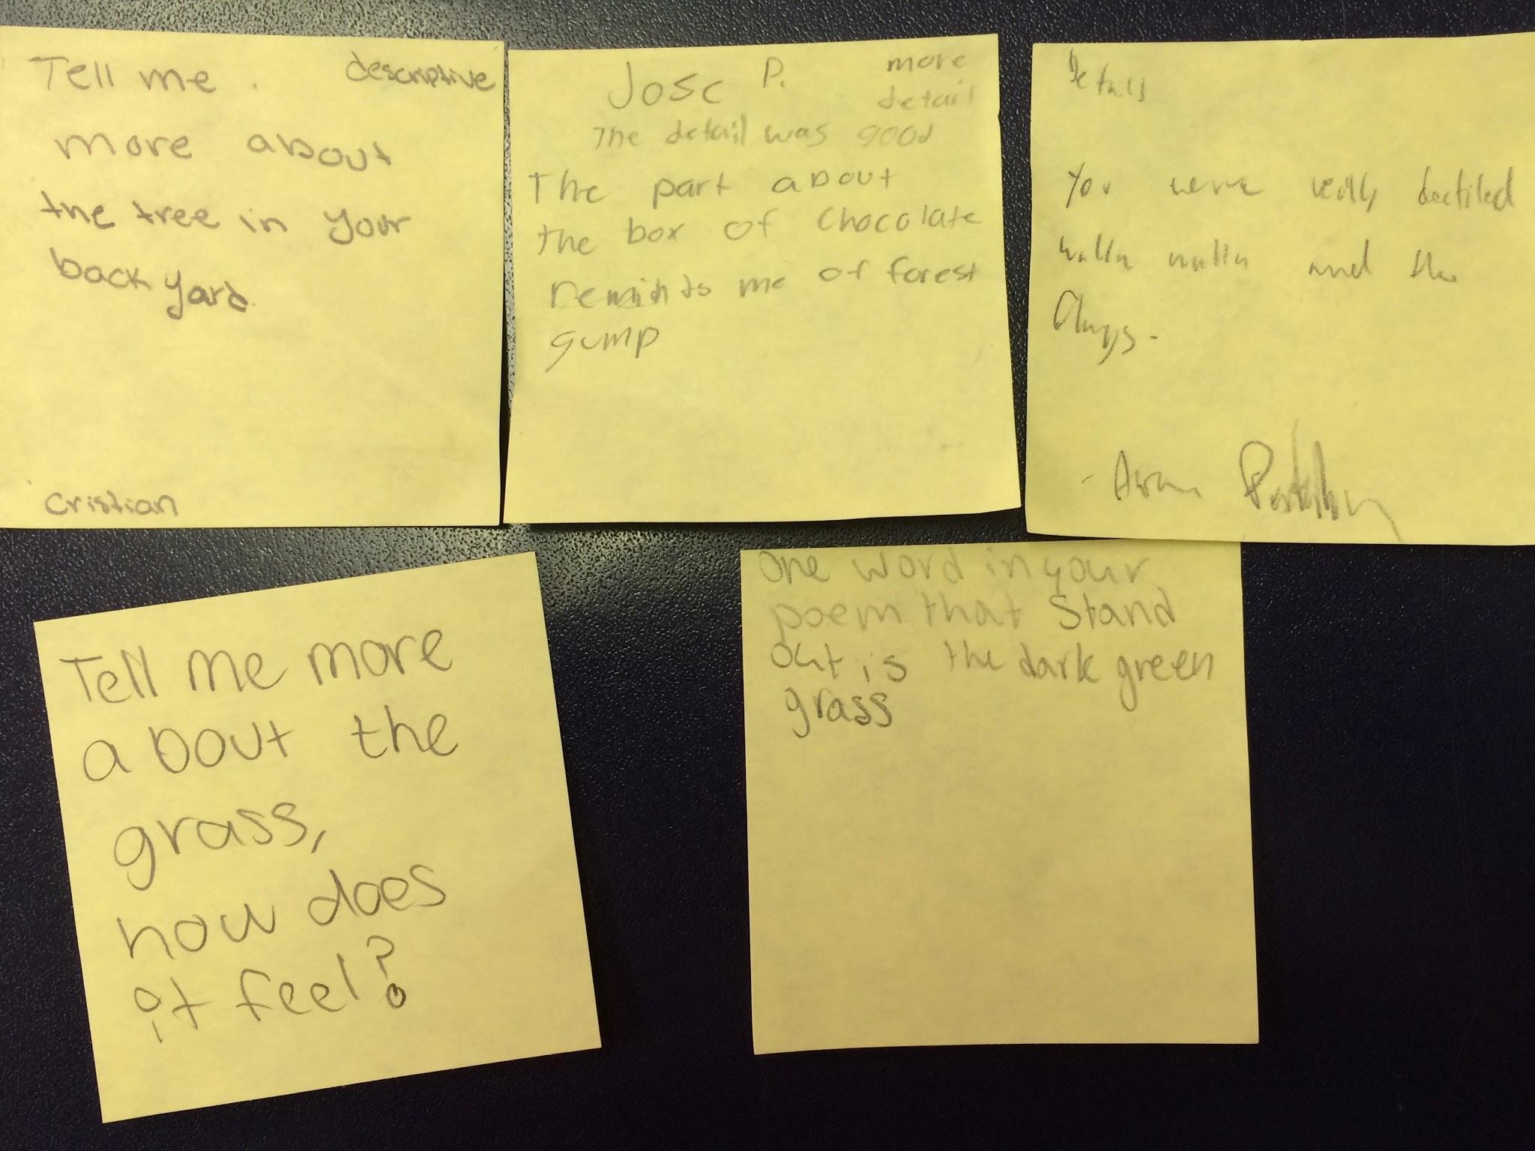
How does it “shift the lift”?
Every student’s voice is heard and honored
Pushed to think and speak about detail
Immediately actionable feedback
Provides multiple exposures to the form

Slide 49
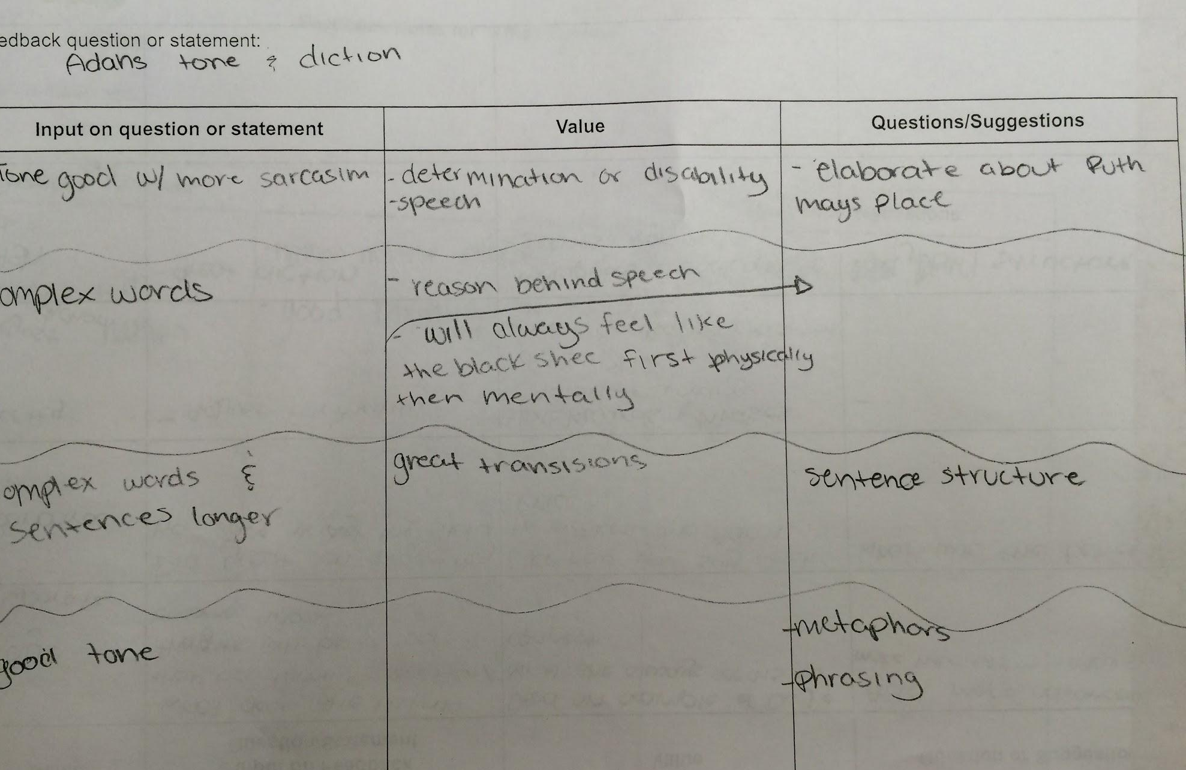
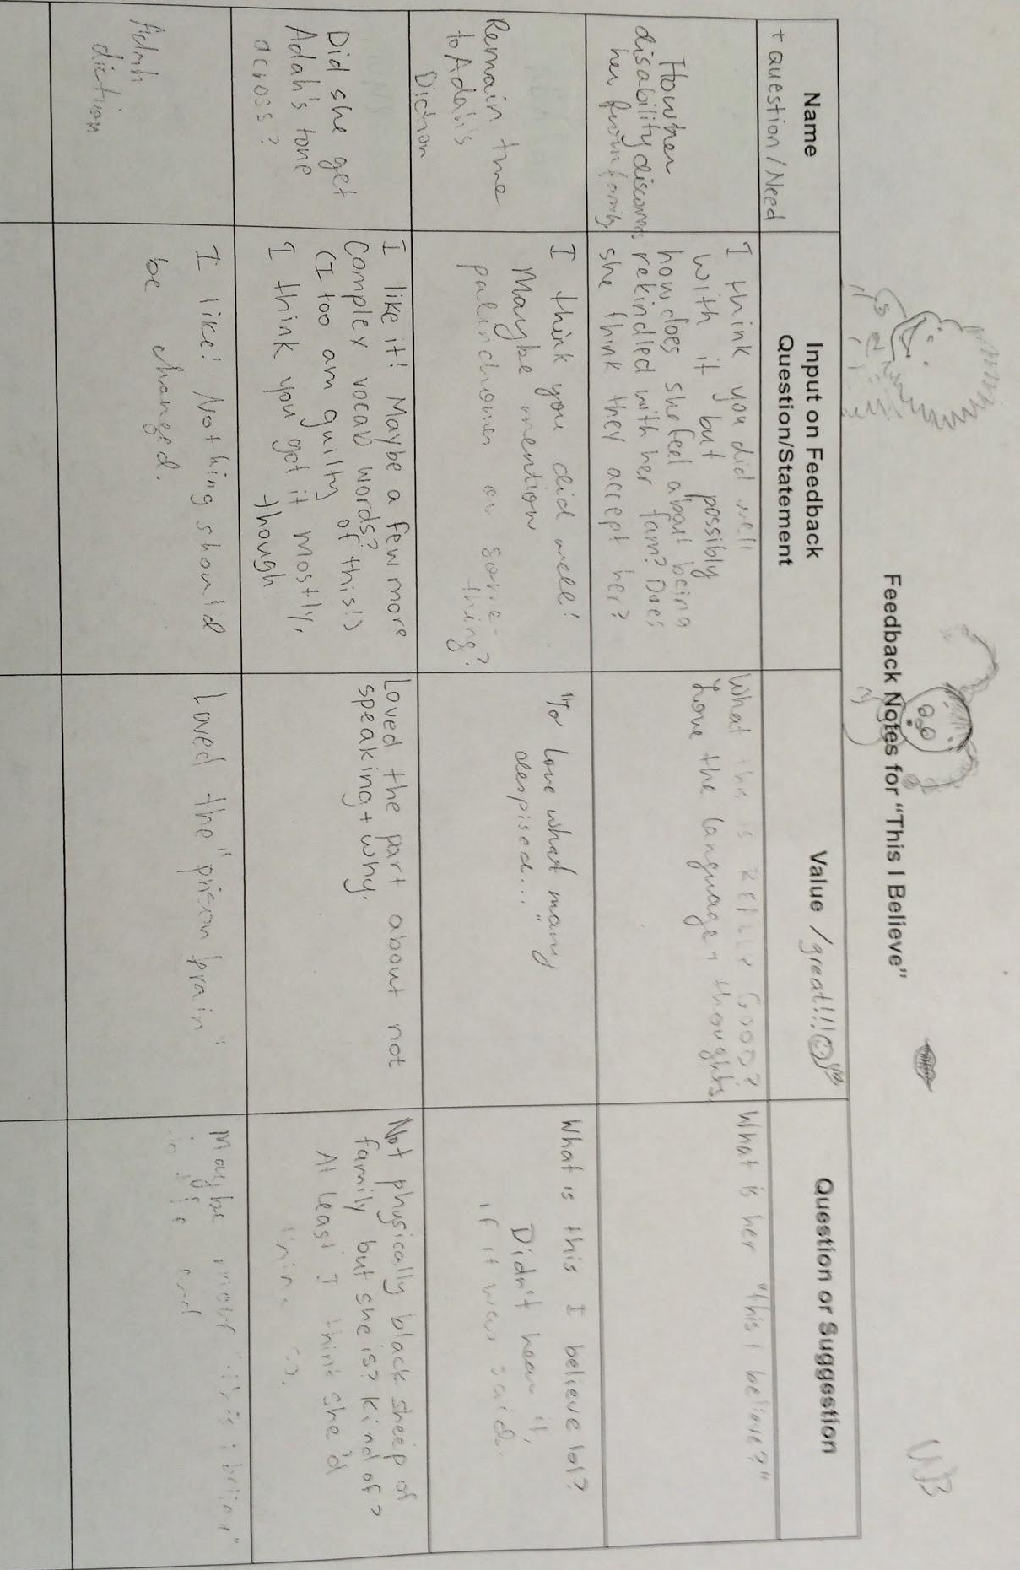
Unanticipated Consequences
Calling attention to each other’s evocative words and phrases
Justifying their choices using evidence from the source text
Collaborating to help each other solve “sticky spots” in the writing
Experimenting with new techniques

Slide 50
Questions for webinar guests?

Slide 51
Set a goal:
As you reflect on the indicators of Core Action 3 of the IPG, set an intention around improving one or more in your own classroom.
What evidence could you collect to measure your progress?
What evidence could you collect to determine the impact on student learning?

Slide 52
Instructional Advocacy – A Definition
Grounded in a firm understanding of the Shifts, educators owning, supporting, and promoting the resources, tools, and practices that create learning environments in which students develop college- and career- readiness.

Slide 53
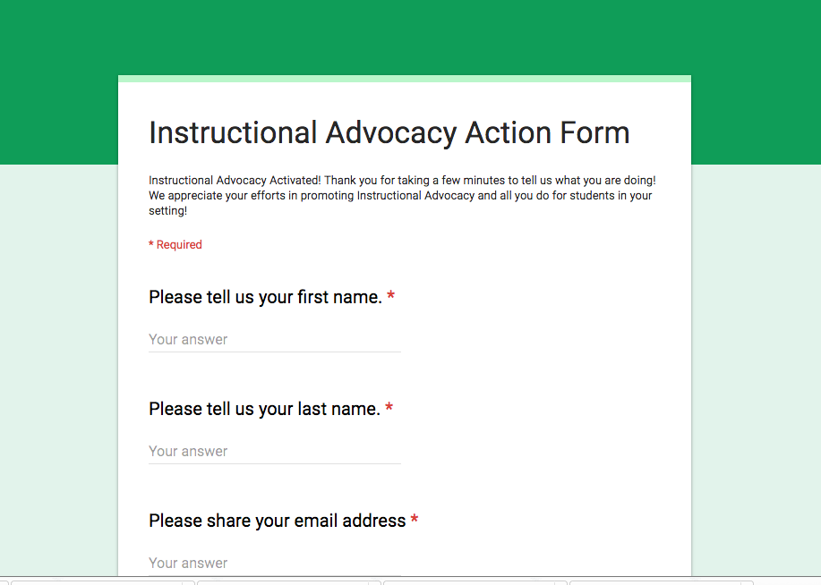
Tell us about your successes
http://tinyurl.com/educatorstakingaction

Slide 54
Please join us again next month!
Next month’s topic: Book Baskets: Optimizing your classroom library
Wednesday, November 1, 2017 7:00 - 8:00 pm Eastern
Register Here: https://attendee.gotowebinar.com/register/6396412576359538435

Slide 55
Thank You!

