Slide 1
Building Knowledge: Expanding the World Through Reading
Module 3b (3rd- 8th grade)- The “How”
Notes:
This module was last updated on June 2019.

Slide 2

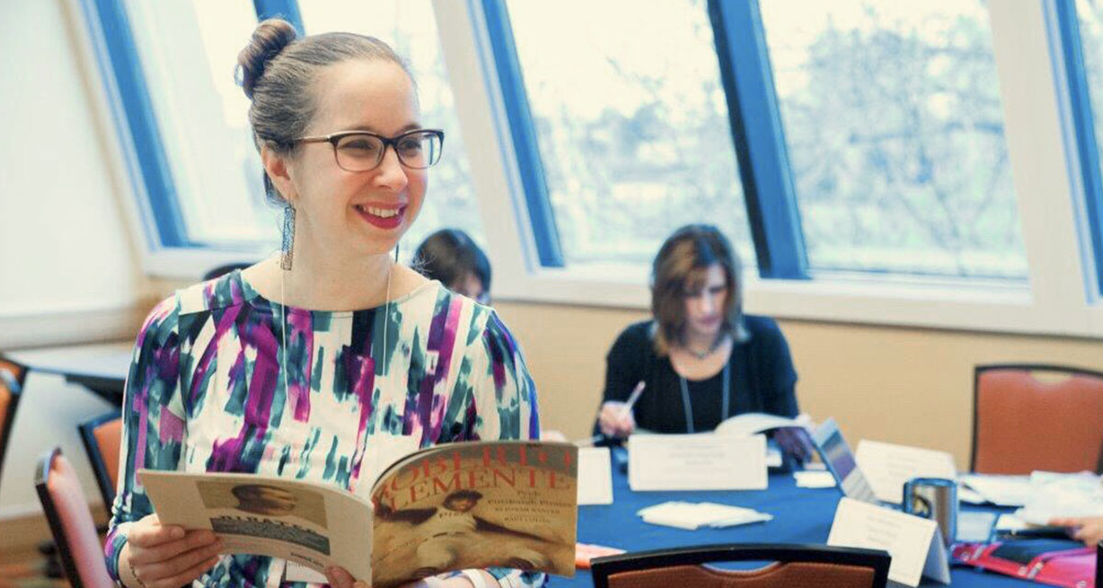

Your Presenters
David Liben
Senior Fellow
Carey Swanson
Senior ELA/Literacy Content Specialist
Tori Filler
ELA/Literacy Content Specialist

Slide 3

Identify indicators of knowledge building in high quality instructional materials.
Pinpoint adaptations they can make to existing materials to amplify knowledge building.
Identify knowledge building resources to supplement their existing materials.

Slide 4
Let’s Review

Slide 5
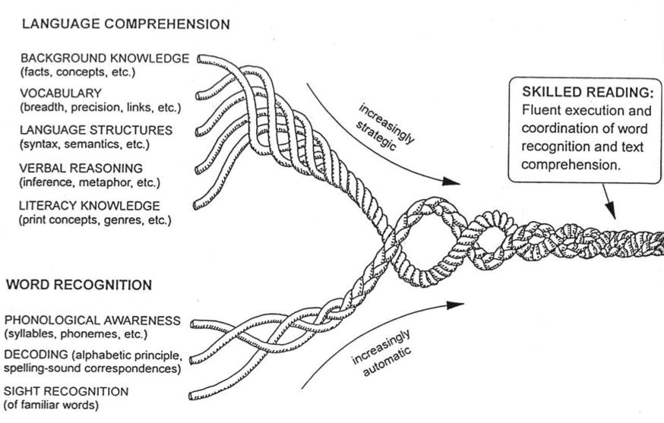
The Reading Rope
Knowledge Based:
Background Knowledge
Vocabulary
Language Structures
Verbal Reasoning
Literacy Knowledge

Slide 6

The Work of Schools
Vocabulary
Knowledge

Slide 7
3rd-8th Grade Classroom Structures to Support Building Knowledge

Slide 8
Ingredients of Knowledge-Building Classrooms
Knowledge/vocabulary gained as a purpose for instruction
Multiple texts/resources on a topic
Attention to rich academic vocabulary
Opportunities to showcase learning
The What
Notes:
Knowledge gain from the text as purpose for instruction (e.g., Let go of strategies/skills focus)
Connect lit backwards (would a week of lessons on text features help you access this text)
Connect standards called for by the text
Adult task: Owl moon what are all the different knowledge demands! What can students learn? What’s the big idea?
Multiple texts on a topic

Slide 9







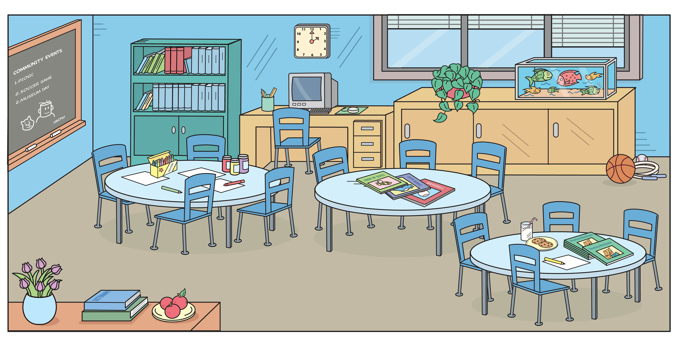
The How
Classroom Materials
Classroom Structures

Slide 10
Whole Class Instruction
“To help us understand more about Jacqueline Woodson’s life in Brown Girl Dreaming we’re going to read an article today about the remnants of Jim Crow Laws in the 1960s.”
Supplement an Anchor Text
Connect to a Social Studies or Science Topic
Connect Reading to Writing
“Before we dig into our unit on Lewis and Clark’s expeditions, we’re going to watch a short video about their interactions with the Nez Pierce tribe.”
Notes:
Ask-
What is a strength

Slide 11
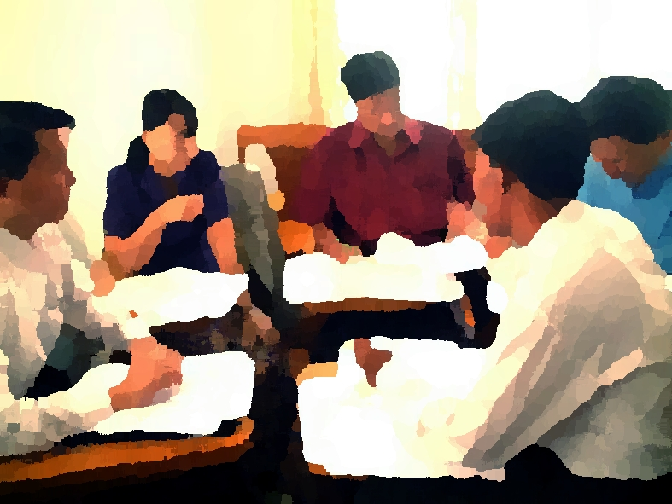
Small Group Instruction
Repurpose “Guided Reading” and/or Establish Purposeful Small Group Lessons
  Research Groups
  Re-reading portions of the anchor text
  Connected/related texts at a range of complexity
“Our group is going to get to read a book today that gives us more information about how and why chameleons use camouflage.”
“Today we’ll work in our research groups to read more resources about the significant historical landmark we chose.”

Slide 12

Small Group Instruction Revisiting an Anchor Text:
Stop and summarize
Paraphrase challenging text
Reviewing where students got lost/confused
Re-reading to connect sections of the text to one another

Slide 13

Independent Reading
“What do you want to learn about?”
“This text will build nicely on your interest in what motivates individuals to go to war.”

Slide 14
What are strengths and challenges to incorporating knowledge building within these 3 structures?
Whole Class Instruction
Small Group Instruction
Independent Reading
Strengths
Community built through studying the same topic 1 set of materials
Potential Challenges
Varying the scaffolding needed to support all readers
Strengths
Varied opportunities to meet student needs. Built in differentiation.
Potential Challenges
Multiple sets of materials Time!
Strengths
Miles on the page! Student voice and choice.
Potential Challenges
Monitoring student reading. Library organization by topic. Time.
Notes:
Pause to generate list first.
Reveal masks.

Slide 15

Close Reading of Complex Text Is Important…
But Not Enough!
 | Close Reading | Volume Reading
Text | Grade-level text, fewer pages | Variety of text complexity levels, more pages
Support | Heavy support | Lighter support
Purpose | Solely instructional | Guided or independent
Notes:
Big Idea: Wonders has lots of planned opportunities for close reading, but we also need to ensure that kids are getting access to VOLUME of reading.
Students on track for college and career are learning approximately 3,000 new vocabulary words each year (Nagy & Anderson, 984); it is impossible to learn this many words through vocabulary exercises.
Notes:
Volume of reading is done with the leveled readers and any teacher assigned text.
(click) Close read the Literature Anthology in 2-6. Literature Big Book or Literature Anthology with K-1. Depending on the week, you may also be using another particularly rich text.
Leveled Readers are the Wonders selected primarily used text for Volume Reading (unless teacher is assigning additional or supplemental reading)

Slide 16
What does knowledge building look like in high-quality instructional materials? (Gr 3-8)

Slide 17
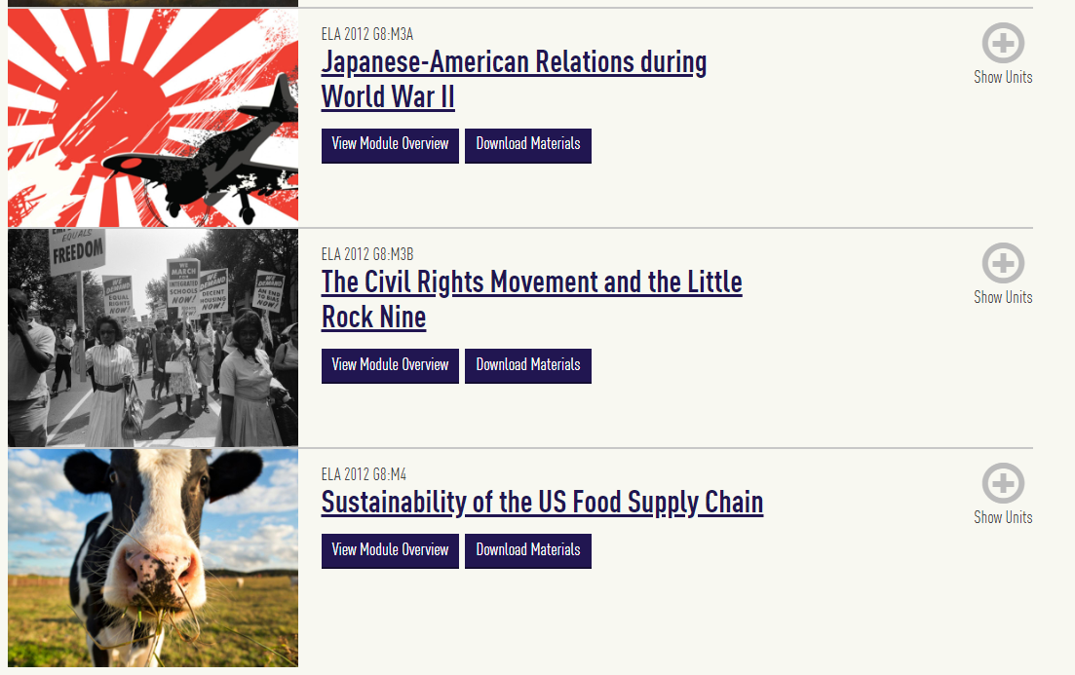
Example: EL Education
Notes:
Grade 8

Slide 18

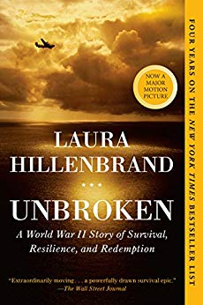
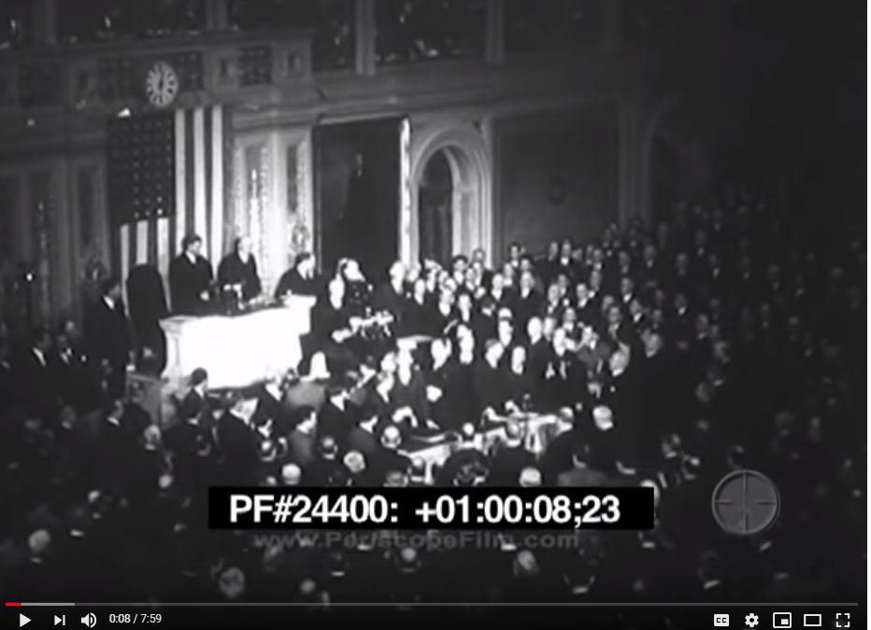
EL Education: Grade 8
“FDR’s Day of Infamy” Speech
Notes:
https://curriculum.eleducation.org/curriculum/ela/grade-2/module-2

Slide 19
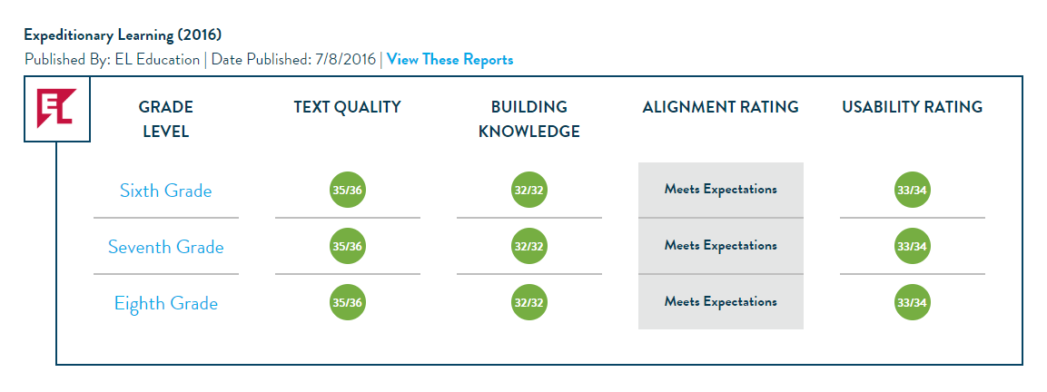
EdReports: Building Knowledge
Notes:
CKLA

Slide 20







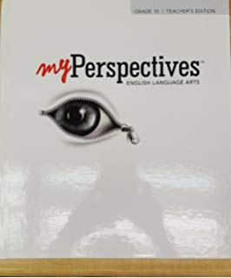



High Quality Instructional Materials
Build Knowledge
Notes:
CKLA

Slide 21
Material Adaptations for Knowledge Building (3rd-8th)

Slide 22

General Guidance
Amplify connected texts
Cut disconnected/extraneous materials and tasks that do not build knowledge
Adjust tasks to enhance knowledge building opportunities
Identify knowledge demands to support

Slide 23
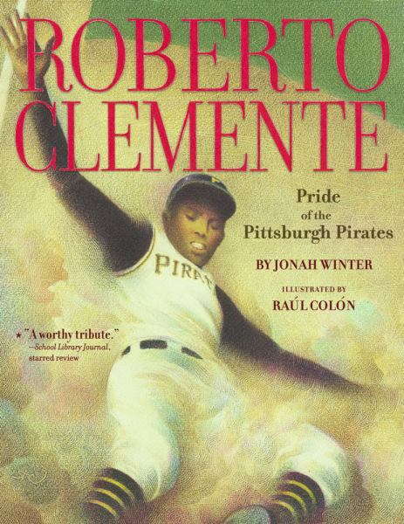
Build Off Your Anchor Text

Slide 24


Roberto Clemente: Amplify, Adjust, or Cut?
Read full anchor text in one day.
Read and re-read text over multiple lessons.

Slide 25
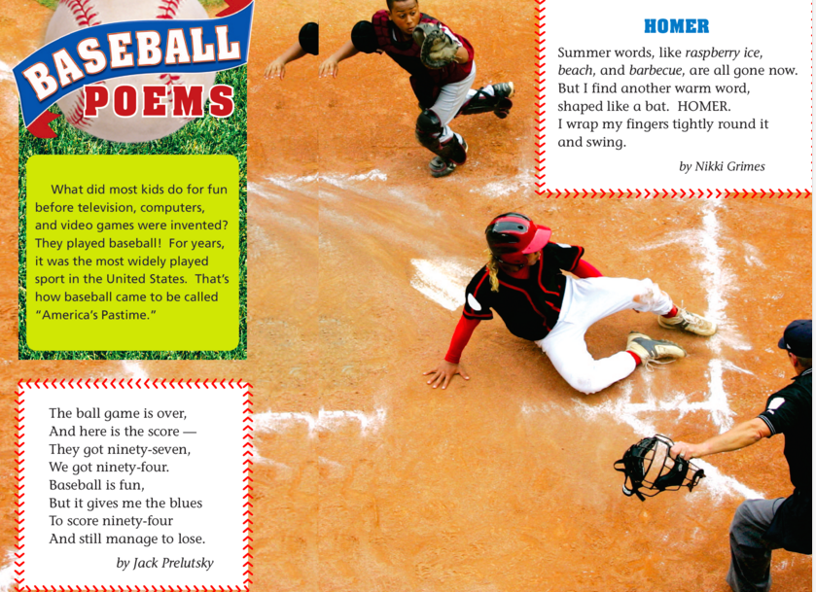
Roberto Clemente: Amplify, Adjust, or Cut?

Slide 26
Roberto Clemente: Amplify, Adjust, or Cut?
Essential Question→
What makes someone a hero?
Why was Roberto Clemente a hero to so many?

Slide 27
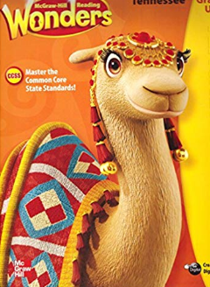
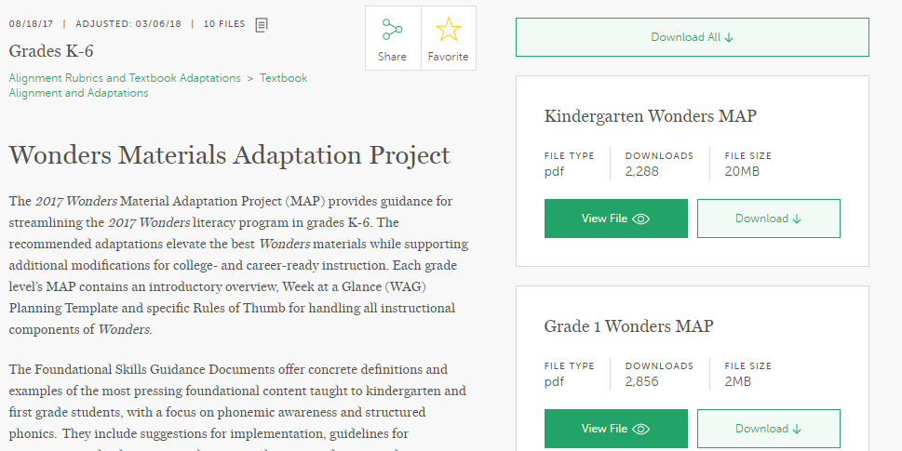
Wonders…

Slide 28
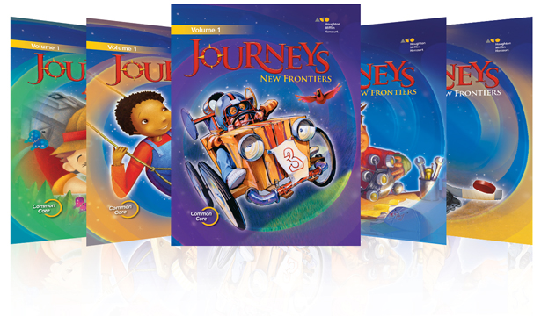
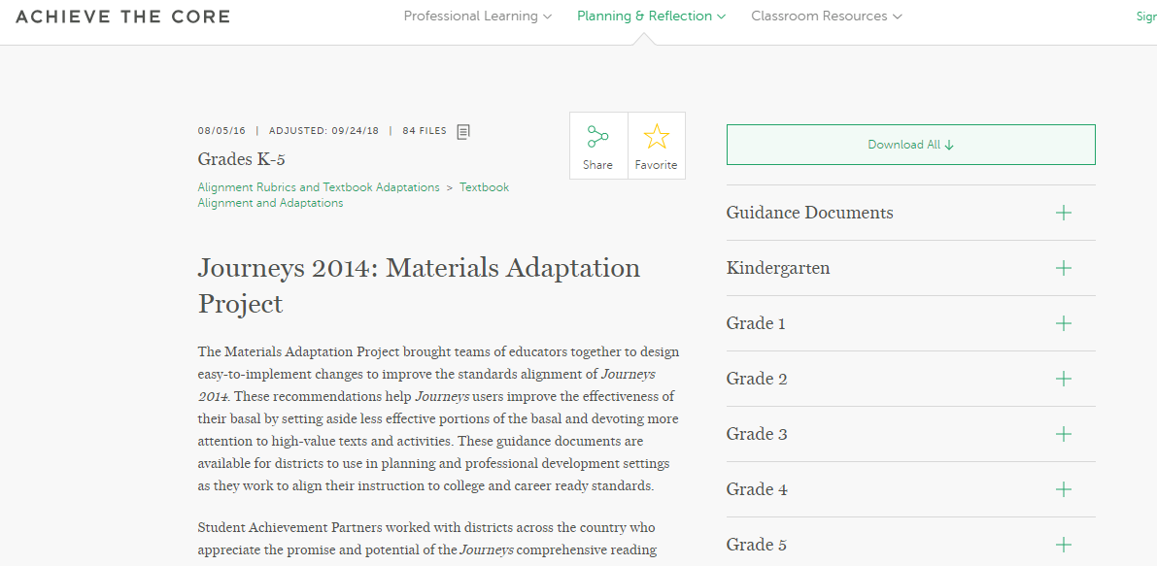
Journeys…

Slide 29
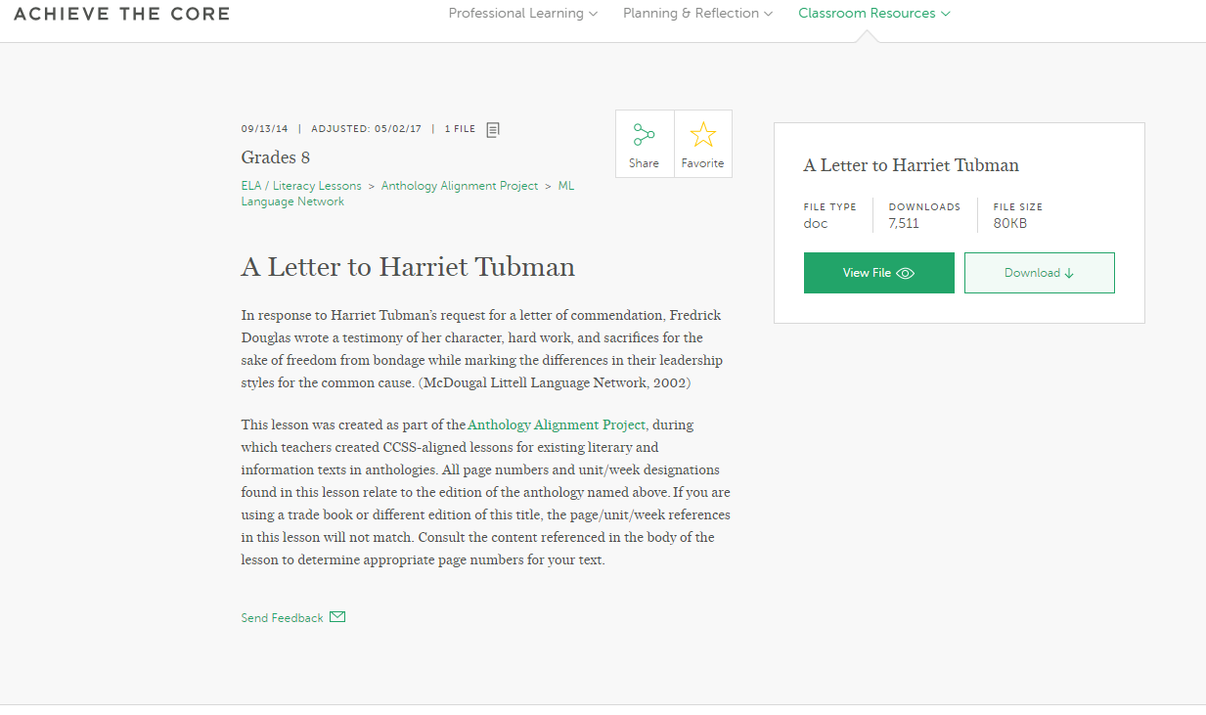
Anthology Alignment Project – Grades 6-11

Slide 30
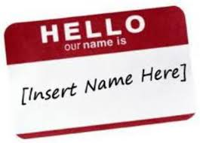
[Insert your program/text here]
Identify the knowledge found in the most complex or anchor text!
Analyze what makes that text complex.
Determine where knowledge building can enhance the student experience!
  Is the knowledge complexity high? Scaffold access!
  Is the knowledge complexity low? Build on the foundation.

Slide 31
Independent Reading Adaptations

Slide 32

Change up the Classroom Book Baskets

Slide 33


Slide 34


Slide 35
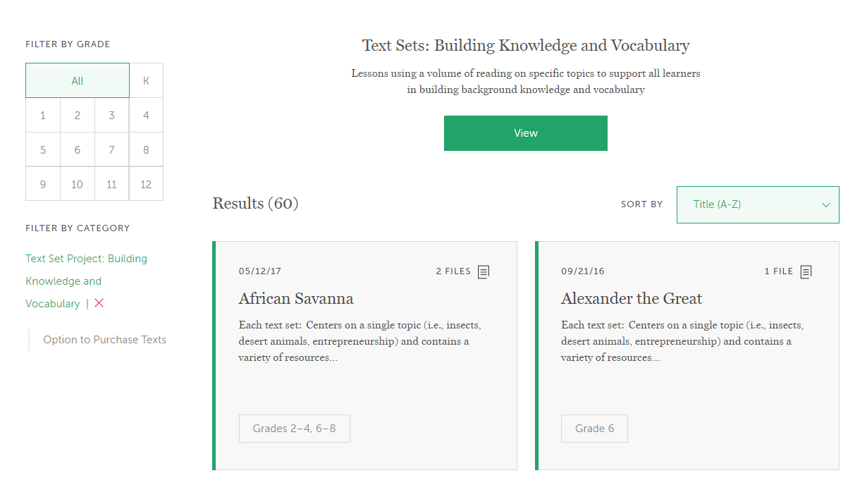
Achieve the Core Text Sets

Slide 36
Knowledge Building in Action (3-8)

Slide 37
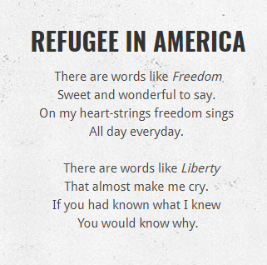
Let’s Practice Together
8th Grade
Lesson plan with 2 texts- “Refugee in America” and “I, Too” by Langston Hughes

Slide 38
Let’s look at this text: What makes it complex?
Subtle and/or frequent transitions
Multiple and/or subtle themes and purposes
Density of information
Unfamiliar settings, topics or events
Lack of repetition, overlap or similarity in words and sentences
Complex sentences
Uncommon vocabulary
Lack of words, sentences or paragraphs that review or pull things together for the student
Longer paragraphs
Any text structure which is less narrative and/or mixes structures
Notes:
Notes:
Refugees in American is a poem, so no lexile level. Common words used in uncommon ways!
Heavy focus on two vocabulary words– liberty and freedom. Nuance in the different connotations of these two words.
Understanding the text depends on understanding information about Hughes, the time period, and the difference between

Slide 39
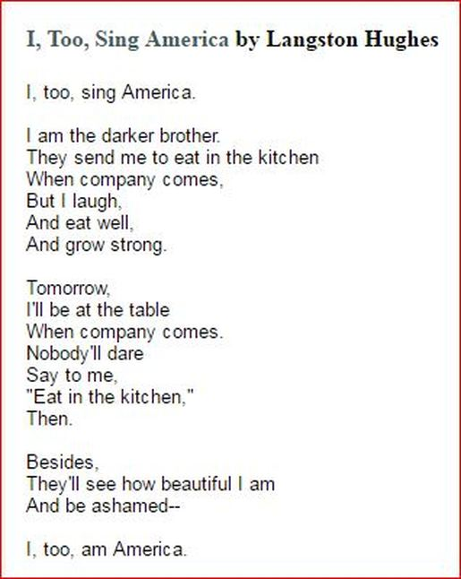
Consider what’s coming next. What opportunities are there to build knowledge?

Slide 40
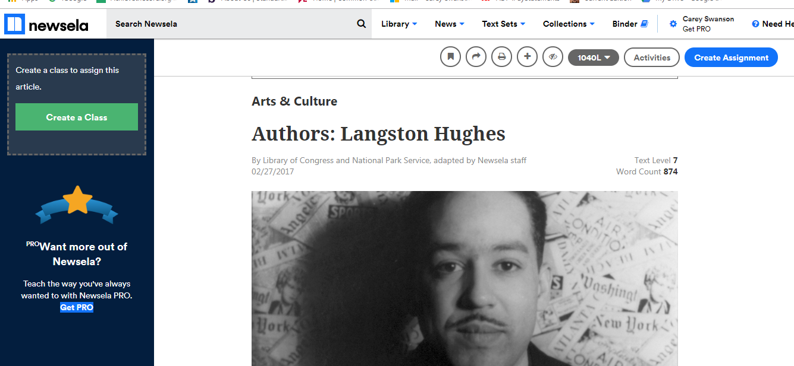
Langston Hughes Biography

Slide 41
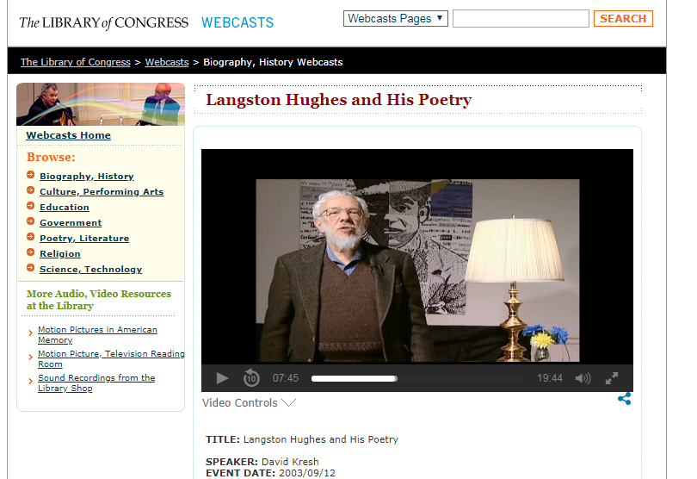

Slide 42
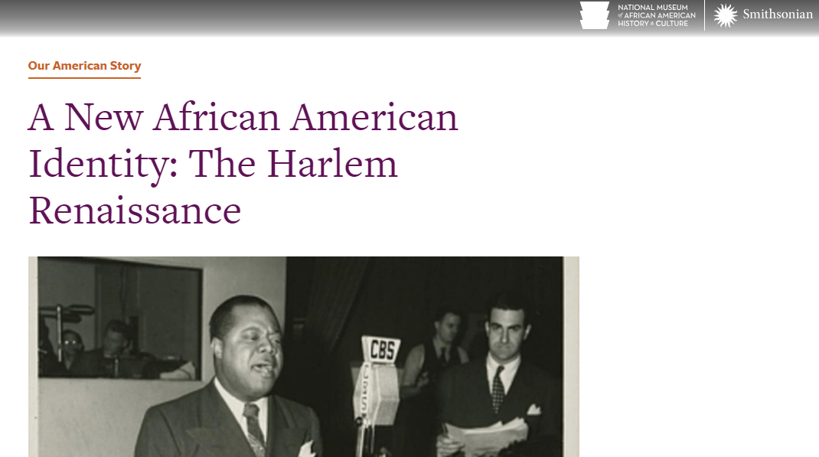
The National Museum of African American History

Slide 43
Classroom Materials
Classroom Structures

Slide 44
Thank you/closing

