Slide 1
Building Knowledge: Expanding the World Through Reading
Module 2- The “What”
Notes:
This module was last updated on June 2019.

Slide 2

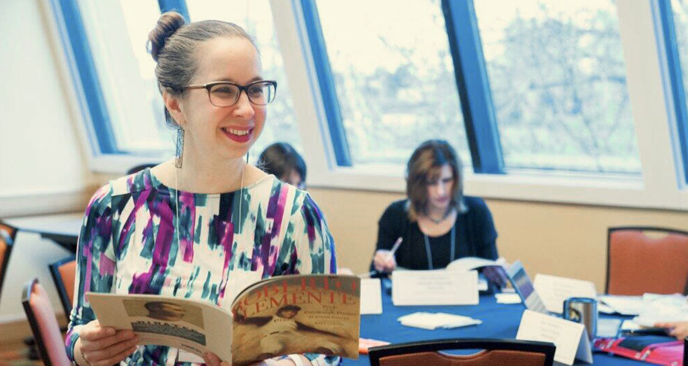

Your Presenters
David Liben
Senior Fellow
Carey Swanson
Senior ELA/Literacy Content Specialist
Tori Filler
ELA/Literacy Content Specialist

Slide 3

Distinguish between options for classroom structures that support knowledge building.
Identify the key ingredients of knowledge-building classrooms.

Slide 4
The Matthew Effect

Slide 5

The Matthew Effect
Notes:
Which…leads to something called the Matthew Effect. Let’s watch this short video from the Washington Core Advocates to find out more.

Slide 6
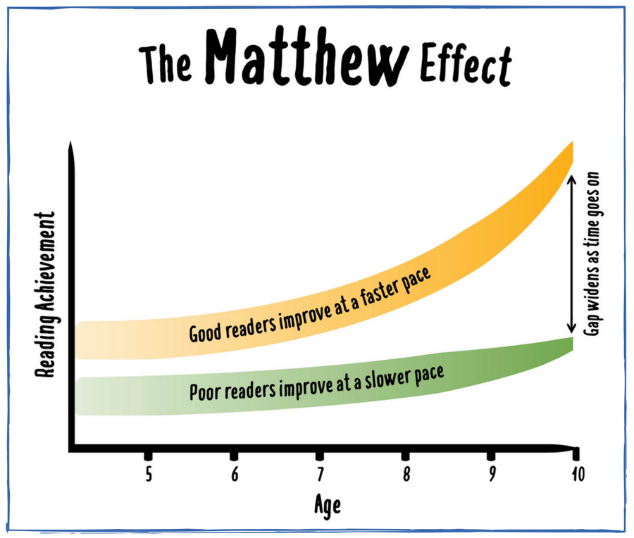
The Rich Get Richer; The Poor Get Poorer
Stop to Reflect:
How would you explain this the Matthew Effect to a colleague?
What questions or ideas does this bring up for you?

Slide 7


Real Talk
It is all of our jobs to support students by doing this work in schools!
Notes:
Now you know how important knowledge about the world is to reading.

Slide 8
Ingredients of Knowledge-Building Instruction

Slide 9
What is the author’s purpose in this paragraph?
“But 'nowhere' does not mean nothing; rather, region in general lies therein, and disclosedness of the world in general for essentially spatial being-in. Therefore, what is threatening cannot come closer from a definite direction within nearness, it is already 'there' — and yet nowhere. It is so near that it is oppressive and takes one’s breath — and yet it is nowhere.”
-Excerpt from Being and Time by Martin Heidegger

Slide 10
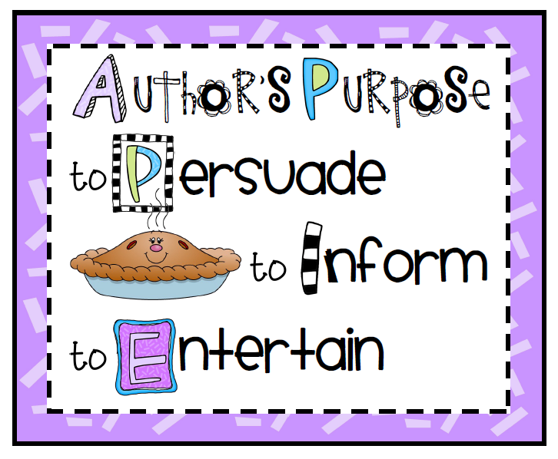
Does this help?

Slide 11
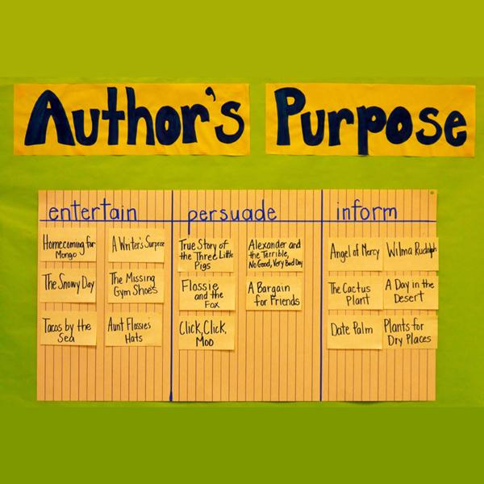
How about a week of Author’s Purpose lessons with different texts?

Slide 12

Can you do it now????
"But 'nowhere' does not mean nothing; rather, region in general lies therein, and disclosedness of the world in general for essentially spatial being-in. Therefore, what is threatening cannot come closer from a definite direction within nearness, it is already 'there' — and yet nowhere. It is so near that it is oppressive and takes one’s breath — and yet it is nowhere.“
-Excerpt from Being and Time by Martin Heidegger
Notes:
Ask: What would it take for you to be able to identify the author’s purpose of that paragraph?
Note: Being and Time is a 1927 book by a German philosopher and existentialist analyzing the concept of being.

Slide 13
What should we do instead?

Slide 14
Ingredients of Knowledge-Building Classrooms
Knowledge/vocabulary gained as a purpose for instruction
Multiple texts/resources on a topic
Attention to rich academic vocabulary
Opportunities to showcase learning

Slide 15
Ingredients of Knowledge-Building Classrooms
Knowledge/vocabulary gained as a purpose for instruction
Multiple texts/resources on a topic
Attention to rich academic vocabulary
Opportunities to showcase learning

Slide 16
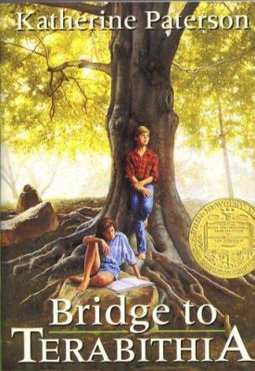

Traditional Literacy Instruction Isolates Comprehension Skills
This week we’ll describe characters with Bridge to Terabithia.
Notes:
“It’s February 3rd, it’s predictions week!”

Slide 17

Good Readers Draw on Many Skills & Strategies to Comprehend a Text
Standard of Coherence:
The types and strengths of coherence the reader aims to maintain during reading

Slide 18

Instead…
CCSS.ELA-LITERACY.RL.1.7
Use illustrations and details in a story to describe its characters, setting, or events.
CCSS.ELA-LITERACY.RL.1.4
Identify words and phrases in stories or poems that suggest feelings or appeal to the senses.
CCSS.ELA-LITERACY.RL.1.1
Ask and answer questions about key details in a text.
CCSS.ELA-LITERACY.RL.1.2
Retell stories, including key details, and demonstrate understanding of their central message or lesson.
How can I help students understand this text?
ELA reading, writing, listening and language standards should be approached holistically, the text itself pointing to which distinct standards arise from its particular demands.
Notes:
Reading/writing/speaking & listening standards are designed to be annual targets and reference points. They hold us to a common set of expectations for what well-educated students should be able to know and do by the end of each grade to be on track for success by the time students end their public school careers and move on into careers or more study, and into active engagement in civic affairs. These standards should be referenced in instructional planning and kept top of mind while teaching students to plumb, at the appropriate challenge, the particular structure(s), concepts, vocabulary, ideas, and details of the texts students are reading in order to consider what standard is being called for by the text demands. But they are not the goal of daily instruction.

Slide 19
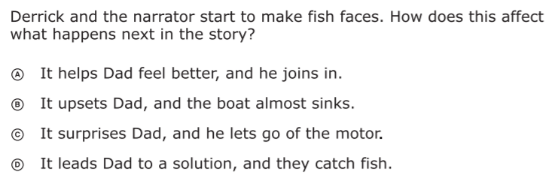
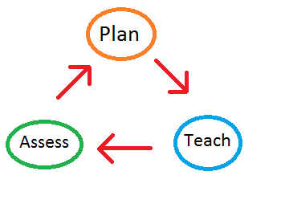
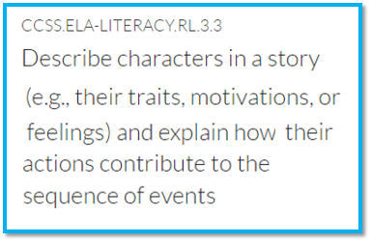
Traditional Literacy Instruction Oversimplifies Reading
Could be...
But could also be...
Vocabulary
Density of information presented
Syntax
Fluency
Stamina
Knowledge demands
...among other things.
Notes:
Question from released 3rd grade state assessment.

Slide 20
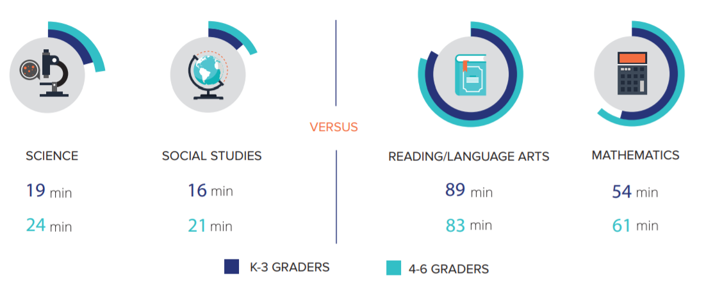
Knowledge Takes Time…Time We Aren’t Giving It!
Knowledge Matters
Notes:
http://knowledgematterscampaign.org/wp-content/uploads/2016/05/Parents-infographic.pdf
http://www.horizon-research.com/2012nssme/wp-content/uploads/2013/02/2012-NSSME-Full-Report1.pdf

Slide 21

How do we maximize knowledge building?

Slide 22
Ingredients of Knowledge-Building Classrooms
Knowledge/vocabulary gained as a purpose for instruction
Multiple texts/resources on a topic
Attention to rich academic vocabulary
Opportunities to showcase learning
Notes:
Knowledge gain from the text as purpose for instruction (e.g., Let go of strategies/skills focus)
Connect lit backwards (would a week of lessons on text features help you access this text)
Connect standards called for by the text
Adult task: Owl moon what are all the different knowledge demands! What can students learn? What’s the big idea?
Multiple texts on a topic

Slide 23

Topics vs. Themes
Conceptually Coherent Topics
Abstract Themes
Topics
Themes
Sea Mammals
Explorers
Vampires
Influenza
Dragonflies
Iroquois
Airplanes
Children in Vietnam
Immigrants (1900s)
Courage
Friendship
Survival
Growing Up
Decisions
Family
Respect
“We Help Each Other”
What is the difference between a topic and a theme?
What impact do you think using topics or themes has on student learning?

Slide 24

How does this look during a lesson…over the course of a unit…a year…several years?

Slide 25
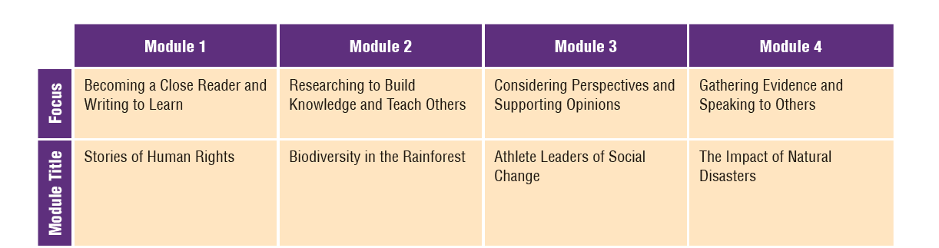
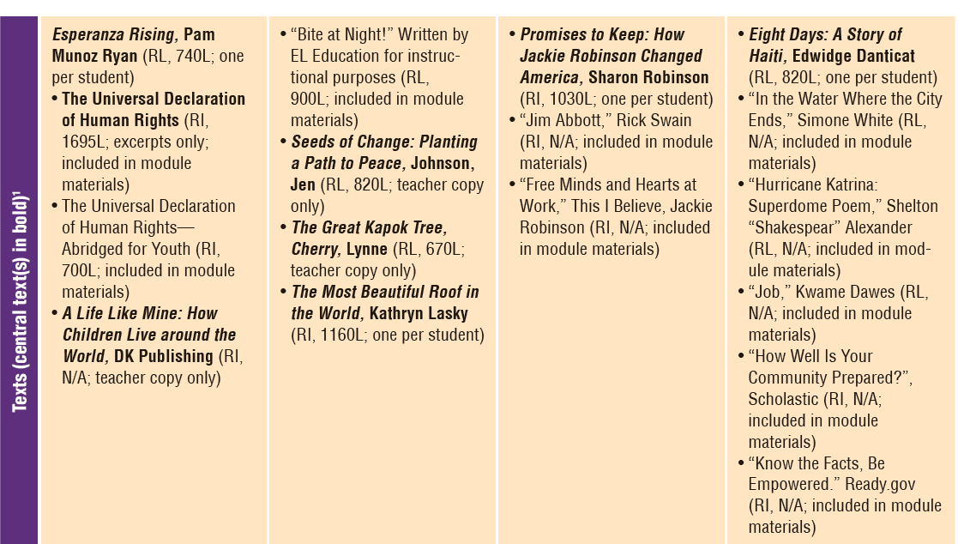
Over a Unit or a Year…
Building Knowledge?
Example or Non-Example?
Notes:
Expeditionary Learning Grade 5
Notes:
Only 4 units this whole year – all with a focus as indicated in the module title
Full length texts can serve as their own “topic”
In Module 1, there is a balance of a fiction chapter book and nonfiction texts
Biodiversity in the rainforest is a tight topic

Slide 26
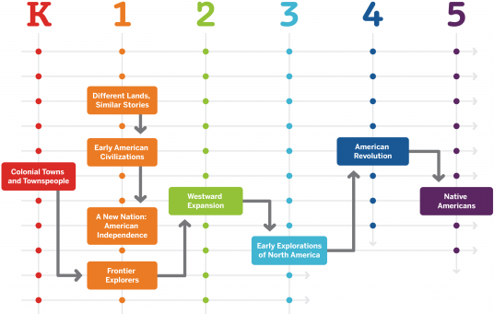
Over Multiple Years…
Core Knowledge Language Arts
Notes:
From the Core Knowledge Sequence

Slide 27
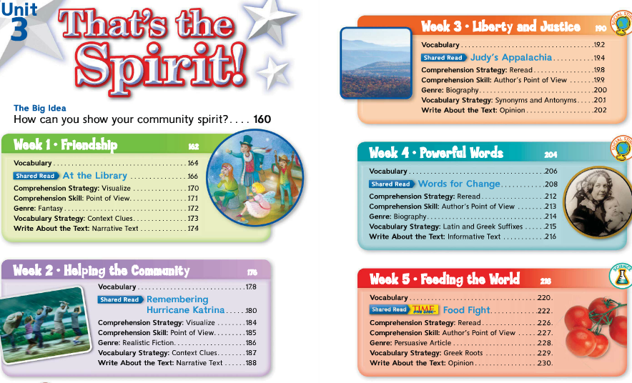
What if your resources are non-examples?

Slide 28

Remember… We’re putting the (knowledge-building) puzzle pieces together!

Slide 29
Ingredients of Knowledge-Building Classrooms
Knowledge/vocabulary gained as a purpose for instruction
Multiple texts/resources on a topic
Attention to rich academic vocabulary
Opportunities to showcase learning
Notes:
Knowledge gain from the text as purpose for instruction (e.g., Let go of strategies/skills focus)
Connect lit backwards (would a week of lessons on text features help you access this text)
Connect standards called for by the text
Adult task: Owl moon what are all the different knowledge demands! What can students learn? What’s the big idea?
Multiple texts on a topic

Slide 30

Using Topics to Build Knowledge
Up to
X
vocabulary growth with connected text
Landauer and Dumais (1997)
Notes:
Big Idea: Remember, we see much better growth with vocabulary
This normal process of word acquisition occurs up to four times faster for Tier Three words when students have become familiar with the domain of the discourse and encounter the word in different contexts (Landauer & Dumais, 1997). Hence, vocabulary development for these words occurs most effectively through a coherent course of study in which subject matters are integrated and coordinated across the curriculum and domains become familiar to the student over several days or weeks.
Computer simulation study

Slide 31
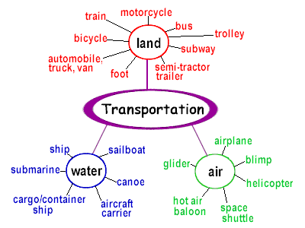
Vocabulary and Knowledge are Connected
Notes:
Semantic mapping is a visual strategy for vocabulary expansion and extension of knowledge by displaying in categories words related to one another" (Kholi, & Sharifafar, 2013).
Image and quote from: http://mavoigt.weebly.com/semantic-maps.html

Slide 32
Ingredients of Knowledge-Building Classrooms
Knowledge/vocabulary gained as a purpose for instruction
Multiple texts/resources on a topic
Attention to rich academic vocabulary
Opportunities to showcase learning

Slide 33

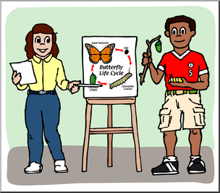



How can students showcase their learning?
Showcase knowledge and vocabulary
Could be lightweight or more structured
Reading, writing, speaking & listening

Slide 34
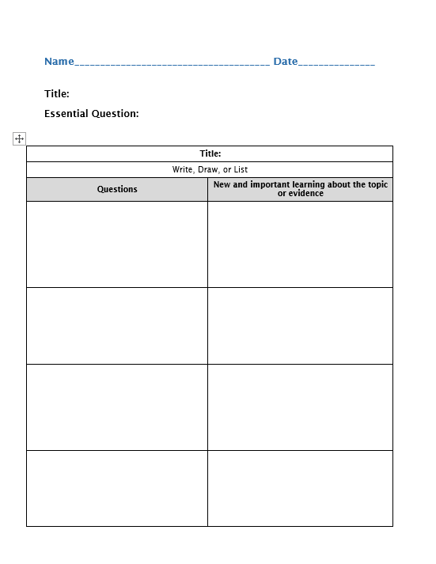

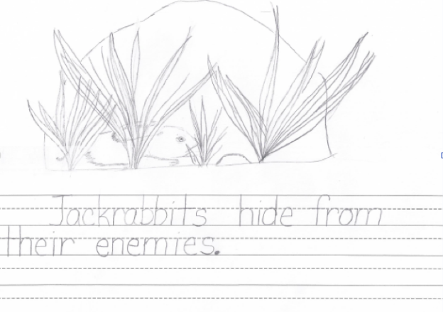
Lightweight Options: Showcase Knowledge

Slide 35
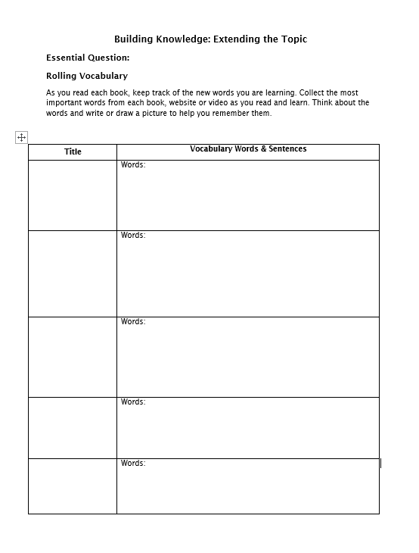

Lightweight Options: Vocabulary
Vocab

Slide 36

Text-Specific Writing Opportunity
Tier 2 and
Tier 3
Vocabulary
Word Bank
Evidence-based writing using vocabulary and multiple knowledge-building resources

Slide 37
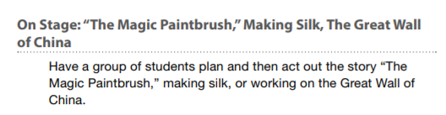
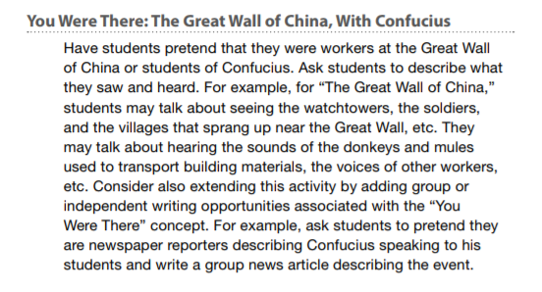
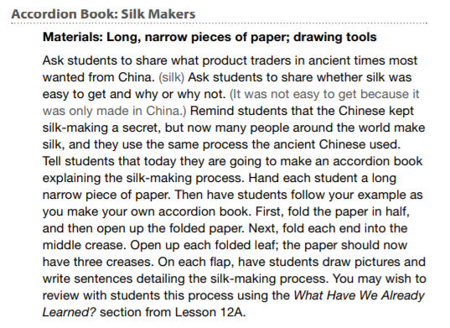
Other Knowledge-Showcasing Opportunities

Slide 38
Ingredients of Knowledge-Building Classrooms
Knowledge/vocabulary gained as a purpose for instruction
Multiple texts/resources on a topic
Attention to rich academic vocabulary
Opportunities to showcase learning
Notes:
Knowledge gain from the text as purpose for instruction (e.g., Let go of strategies/skills focus)
Connect lit backwards (would a week of lessons on text features help you access this text)
Connect standards called for by the text
Adult task: Owl moon what are all the different knowledge demands! What can students learn? What’s the big idea?
Multiple texts on a topic

Slide 39

Module 2: Connect to Practice Task
Option A:
Teacher option
Do you already have these ingredients in your program?
Do you need to make adjustments?
Reflect: How can you incorporate knowledge building into your classroom, or enhance what you are already doing?
Option B:
Write a letter, email, or presentation to a colleague:
How can we use building knowledge to change the impact of the Matthew Effect on our students?
Feel free to be creative– make a book snap or animation we can share on Achieve the Core! #achievethecore

