Slide 1
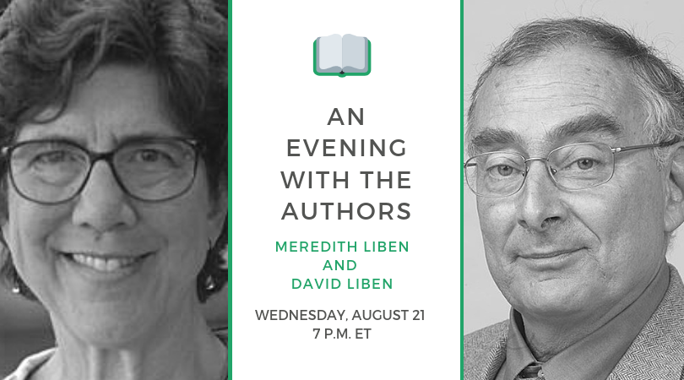

The webinar will begin shortly.
Check your Resource widget to preview the resources for today’s session!

Slide 2
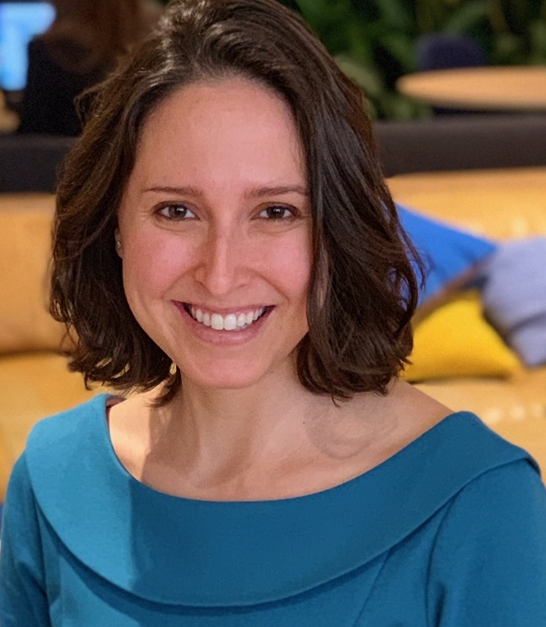
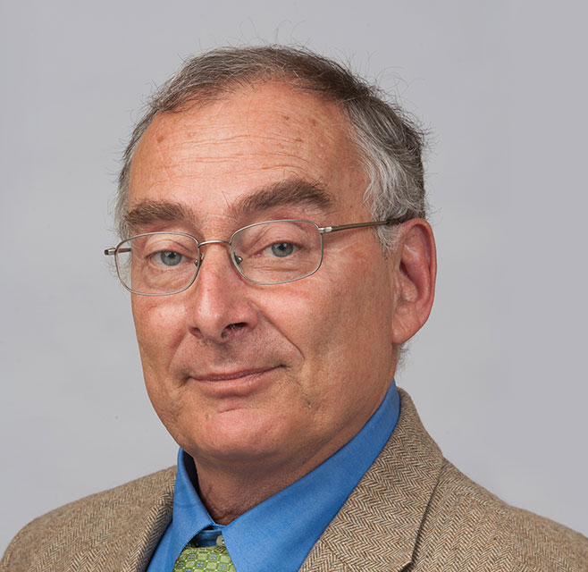
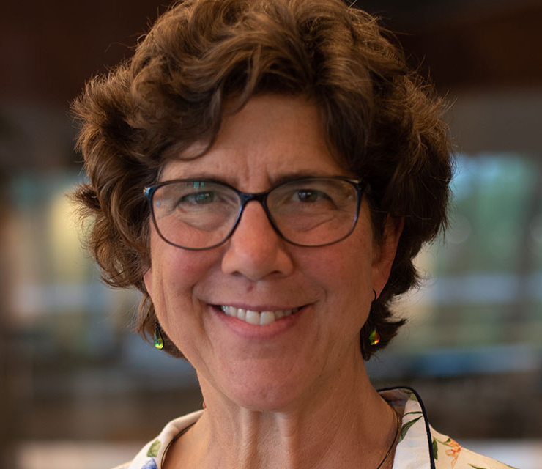
Introductions
Your host:
Claire Rivero
Digital Strategy Manager, Student Achievement Partners
This Month’s Guests
Meredith Liben
David Liben
Authors of Know Better, Do Better: Teaching the Foundations So Every Child Can Read

Slide 3
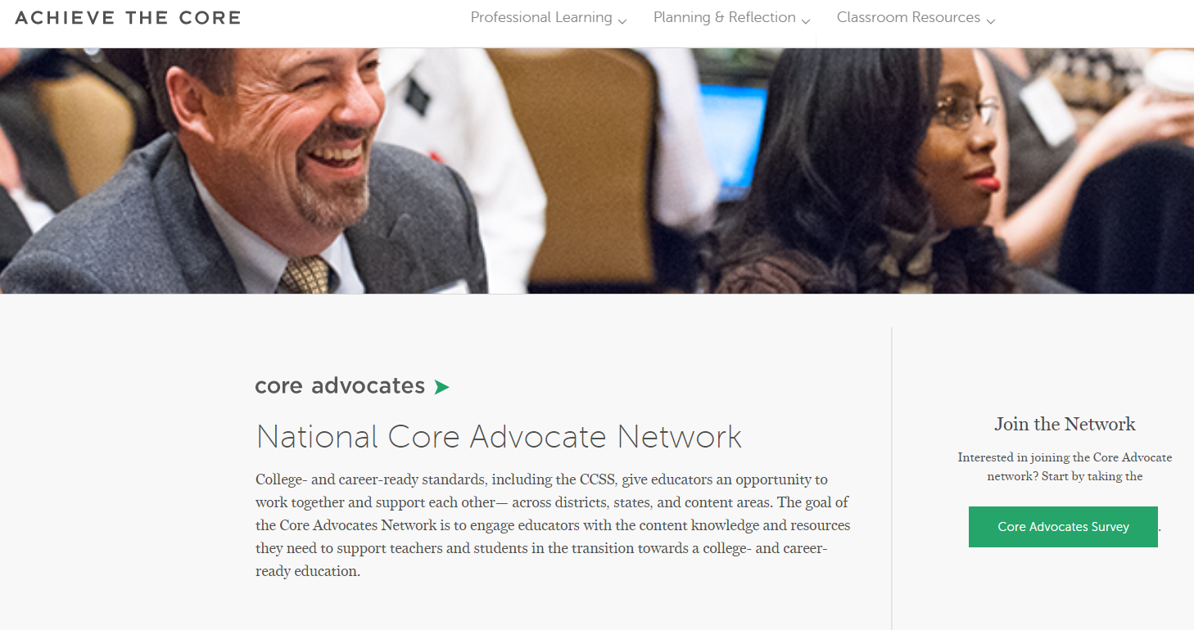
Join Our Network!
www.achievethecore.org/ca-signup

Slide 4


Learn More About Us!
Contact Jennie Beltramini (jbeltramini@studentsachieve.net )
Complete this survey to join our database (and mailing list): www.achievethecore.org/ca-signup
Visit our website: www.achievethecore.org

Slide 5

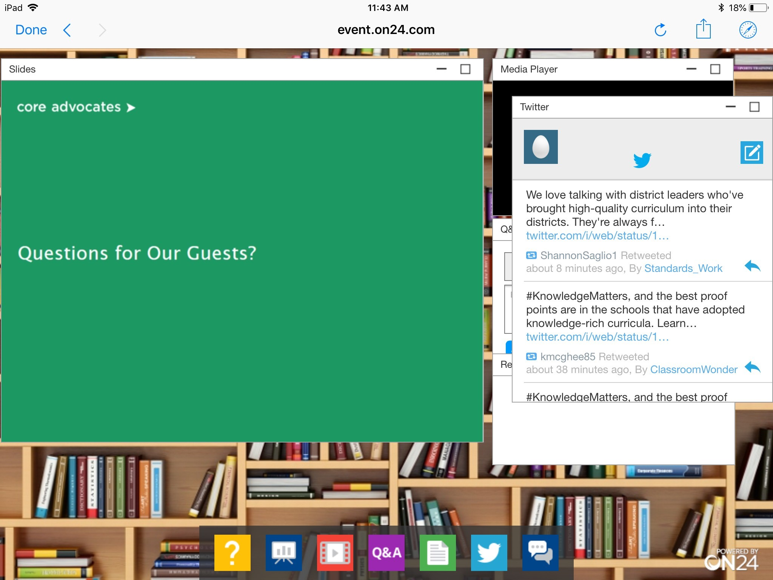
Tweet with Us!
Please feel free to tweet during and after the webinar using #coreadvocates
@achievethecore
@mjliben
@libendavid
Click here!

Slide 6

Engage with Us!
During the webinar
Q&A Button to Submit Questions for Meredith and David
Group Chat to connect with fellow participants
Resources widget for links mentioned
After the webinar
Access to recorded discussion will be emailed to you
In 2 weeks, you’ll receive a survey via email. Completing that survey will generate a completion certificate

Slide 7

David Liben
Meredith Liben

Slide 8
Questions?
Please Use the Q&A Widget to Submit a Question!

Slide 9
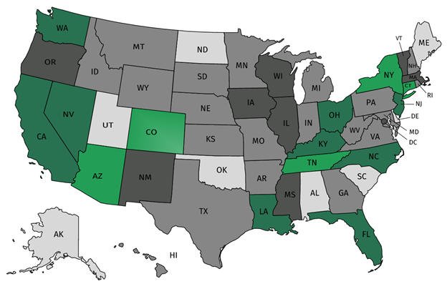
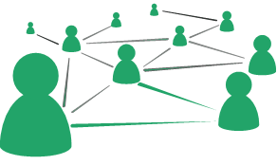



Join our network!
Join a national network of educators
Connect with state networks
Be a part of creating new tools and resources in partnership with SAP
Keep up to date on free resources, upcoming SAP webinars/professional learning opportunities, job postings and more!

Slide 10




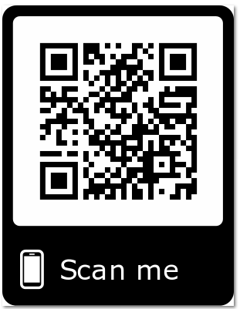
Please Join Us!
https://achievethecore.org/ca-signup
Twitter: twitter.com/achievethecore
Facebook: facebook.com/achievethecore
Pinterest: pinterest.com/achievethecore
Notes:
We encourage you to join the network by filling out this survey completely at atc.org/ca-signup

Slide 11
Please Join Us Again Next Month!
Next month’s webinar: Formative Assessment Strategy: Thinking Beyond the Paper-Pencil Test
Register Here: https://event.on24.com/wcc/r/2062144/C9F6E1A62E752F9FCA3F576548C9C946

Slide 12
Thank You!

