Slide 1

Comparing Reading Research to Program Design
Core Advocates Monthly Webinar
April 1, 2020
The webinar will begin shortly.
Check your Resource widget to preview the resources for today’s session! Use the Group Chat to introduce yourself!
Notes:
First timer poll
Handouts:
While we’re waiting, we’d like you to participate in a quick poll so we can get an understanding of who’s on the webinar with us tonight.

Slide 2

Introductions
Your hosts from Student Achievement Partners:
Pascale Joseph
Project Coordinator,
Tools and Classroom Resources, SAP
This month’s presenters:
Susan Pimentel
Founding Partner
Student Achievement Partners
David Paige
Associate Professor
Bellarmine University, Louisville, KY
Timothy Shanahan
Distinguished Professor, Emeritus
University of Illinois at Chicago
Claude Goldenberg
Nomellini & Olivier Professor of Education Emeritus
Stanford University

Slide 3
How many Core Advocate Webinars have you attended?
Please use the Questions tab on your control panel to respond.
If using a poll, please put up to 5 answer choices in the notes section below and indicate if attendees should choose only one response or multiple responses.

Slide 4


Learn More About Us!
Contact Jennie Beltramini (jbeltramini@studentsachieve.net )
Joy Delizo-Osborne
(jdelizo-osborne@studentsachieve.net)
Complete this survey to join our database (and mailing list): www.achievethecore.org/ca-signup
Visit our website: www.achievethecore.org
Notes:
If you’d like to learn more about the network, contact Jennie (her email is here).
We also want to invite you to join the network by signing up at achievethecore.org/ca-signup and visit our website for more info and opportunities

Slide 5


Tweet with Us!
Please feel free to tweet during and after the webinar using #coreadvocates
@achievethecore
@JennieBeltro
@ReadingShanahan
Click here!

Slide 6

Engage with Us!
During the webinar:
Question just for the presenters/ tech help
Resources
Group chat
After the webinar:
– Access to recording will be emailed to you.
Take our survey in 2 weeks and receive a certificate verifying 1 hour of professional learning.

Slide 7
Section 1: Discussion Overview

Slide 8
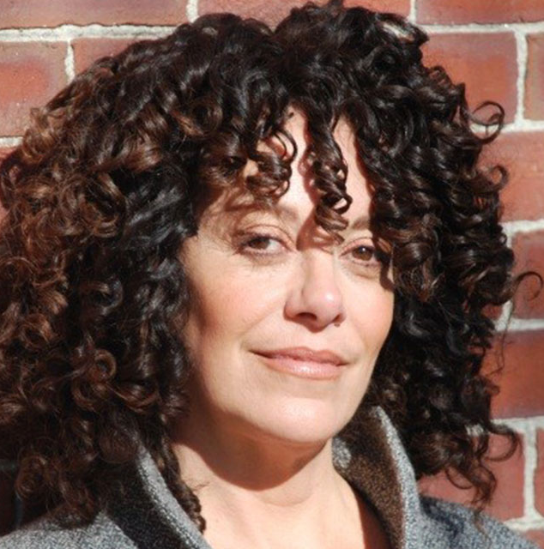
Susan Pimentel
Founding Partner
Student Achievement Partners

Slide 9
Goals of the Webinar
  Show how you can use Student Achievement Partners’ research reviews of curriculum.
  Share the key research findings of Teachers College Units of Study in the following four areas:
    Sufficiency of Foundational Reading Skills instruction
    Regular opportunities to read complex texts and develop language
    Building knowledge and vocabulary
    Adequacy of English learner supports
  Share what’s coming next.
Notes:
We have three main goals for our webinar tonight. They are to...

Slide 10

Why is SAP undertaking research reviews of various curricula?
Reading achievement is stagnant—particularly for students living in poverty or student who are of color.
Educators rightly worry that the curriculum they are using doesn’t adequately align to the reading science.
Need to make transparent for those responsible for adopting materials, the research-based practices that should be evident in curricular programs.

Slide 11
How is this curriculum analysis different from an EdReports-Type Review?
EdReports-Type Reviews | SAP Research Reviews
Look at how closely curriculum aligns to research-based standards. | Look at how closely curriculum aligns to the reading research base.
Standards define the “what,” not the “how” of instruction. | Reading research explains “how” to teach the “what” with nuance and fidelity.
Ex.: The standards set clear expectations for text complexity and vocabulary development. | Ex: Research explains how to build students’ vocabularies and teach complex texts efficiently and effectively.

Slide 12
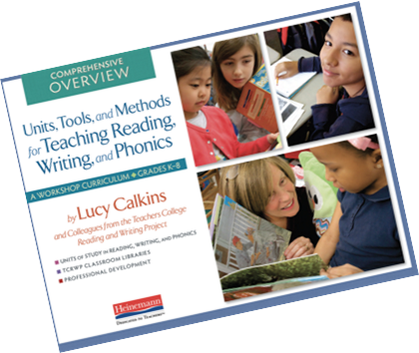
Why review Teachers’ College Units of Study?
TC Units of Study is a curriculum in broad use.
Regularly, we get questions about the program.
And it is not a curriculum that EdReports had reviewed.

Slide 13
Seven preeminent experts weighed in on four fundamental areas of literacy:
Drs. David Paige and Timothy Rasinski analyzed the sufficiency of foundational skills instruction, including reading fluency.
Drs. Timothy Shanahan and Lily Wong Fillmore analyzed the extent to which TC provides students with regular opportunities to read complex text and develop academic language.
Drs. Marilyn Jager Adams and Jane Oakhill analyzed the program for its attention to building vocabulary and knowledge about the world.
Dr. Claude Goldenberg analyzed the adequacy of supports for English learners present in the program.

Slide 14
Section 2: Foundational Skills

Slide 15

David Paige
Associate Professor
Bellarmine University
Louisville, KY
(soon to be Northern Illinois, DeKalb, IL)

Slide 16

Foundational Reading Skills are Critical to Reading Success
By foundational reading skills we mean:
    The reading processes necessary for a student to become a fluent reader. These include:
      Concepts of print
      Awareness that words are composed of letters that link to sounds and that there is a systematic relationship between letters and sounds (alphabetic principle, phonological and phonemic awareness)
      Phonics and word recognition skills
      Fluent reading of connected text

Slide 17

Findings: Scope and Sequence
An explicit scope and sequence, the “Instructional Roadmap,” is made available online
Not embedded, not explicit across daily lessons which is what most teachers will access
The scope and sequence is packed into K-1
Too fast and too thin for many readers who need deep instruction across K-2, if not K-3
Very likely that many children will be left with insufficient instruction

Slide 18

Findings: Phonemic Awareness
Units of Study lessons across K-2 lack the instruction necessary for many students to acquire phonemic awareness at the isolation and manipulation level
This will quickly become problematic for many children
Puts adequate growth with decoding skills in jeopardy.

Slide 19

Findings: Developmental Spelling
The authors emphasize the teaching of “high utility” letter features
Assumption is the learner will fill in the rest
Many children need explicit instruction across the broader scope of features
The pace across K-1 and early 2nd-grade is very fast
Many students will not be able to keep up

Slide 20

Findings: Memorized Word (sight-word) Instruction
Units of Study provides 50 words to be memorized in kindergarten
Another 100 in 1st-grade with the focus continuing into 2nd-grade
There is little research to guide the volume of words to be memorized by early readers

Slide 21

Findings: Instructional Time
The authors recommend:
    20 minutes/day for whole-class
    7 -10 minutes for small groups
Reading and writing workshop lessons: do not “talk back” to the phonics units.
Extension activities are optional
Authors state:
“Every minute you spend teaching phonics (or preparing phonics materials to use in your lessons) is less time spent teaching other things.”
(p. 4, A Guide to the Phonics Unit of Study).

Slide 22

Findings: Independent Practice
7-10 minutes to work in pairs during rug time.
This may be sufficient for some students
Inadequate for many students who require more time working with decoding concepts.

Slide 23
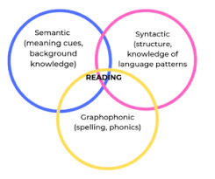
Findings: Units of Study Promotes Strong Use of the Three-Cueing System
Is the least effective method of word identification
Actually gives implicit permission to cease and desist from phonics instruction
Does harm by withholding efficacious instruction
Reinforces the avoidance of assessments that track decoding development

Slide 24

Findings: The Role of Assessment
There are assessments in the program materials
Not part of the daily lessons which is what most teachers will use to guide instruction
Little guidance on how to use the assessments and interpret the results
Particularly problematic:
“In small groups, you’ll launch kids to work in ways that lead not to correctness, necessarily, but to continual improvement” (Small Groups, p. 66).

Slide 25

Findings: Differentiation
Because students quickly diverge in their rate of reading acquisition, differentiation of instruction becomes important
Units of Study relies on a whole-class delivery method
Many students will have unmet instructional needs

Slide 26
Section 3: Text Complexity

Slide 27

Timothy Shanahan
Distinguished Professor, Emeritus
University of Illinois at Chicago

Slide 28

Texts Used to Teach Reading are Important
Texts used to teach reading impact student reading progress
A review of a traditional program would examine the books and draw conclusions about what’s likely to be learned
That’s more difficult with Units of Study because it includes no specific books
It builds lessons around a few anchor texts that are read to the students and recommends the purchase of a library of books, but none of this is required

Slide 29

Analyzing the Texts of a Program
Teachers are expected to use different collections of books and student choices drive the program, so each student will read different books
This design means there is no guarantee that students will be exposed to a powerful collection of readings
This means that I couldn’t review book complexity, we could only review the relevant theories, claims, instructional recommendations and guidance that the program provides

Slide 30
Texts Read to Students are Too Easy
What are the chances Units of Study will teach students to read complex texts?
Anchor books to be read aloud to students are at levels most states have adopted for the kids to read
Reading to students is an opportunity to expose them to content/language exceeding their current abilities
The recommended texts are at an appropriate range of complexity, but students might not choose to read sufficiently challenging text

Slide 31

Discouraging Reading of Complex Texts
Even if students choose complex texts, Units tells teachers to discourage this
The teacher’s guides espouse “instructional level theory” (the idea that learning comes from reading books that students can read with 95-98% accuracy and 75-89% comprehension) – students are discouraged from reading books harder than this
Research shows that students make greater reading progress when they work with books harder than those encouraged in the program and most state standards require that students learn to read more challenging texts

Slide 32

Weak Reading Guidance
Units includes mini-lessons, some group work, and occasionally other learning activities
Most reading guidance is provided through individual reading conferences
Students read on their own and then teachers discuss text with them for 1-3 minutes
Teachers will often not know the books students are reading, so these discussions are unlikely to identify problems or to provide explanations that would help kids to improve their reading

Slide 33
Section 4: Building Knowledge and Vocabulary

Slide 34

TC Units of Study Fall Short on Building Knowledge
Students frequently read different books of their own choosing and limited to their current comfort level.
They do so largely without regard for the topic of mentor texts so the opportunity for building knowledge is unfulfilled, variable, and weak.
Students whose comfort level is below grade level suffer greater impacts because their opportunities for knowledge are not maximized.

Slide 35
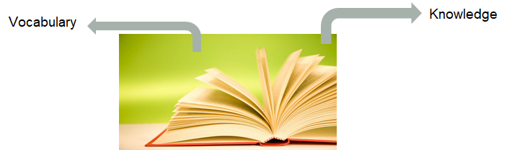
TC Units of Study Provide Little Guidance on How to Build Children’s Vocabularies and Word Acumen
Vocabulary supports rely heavily on implicit vocabulary acquisition by readers.
Because most instructional time is dedicated to student-selected “just-right” books, students don’t have the teacher supports required to build their knowledge of unfamiliar words.
This is coupled with insufficient support from other vocabulary strategies: attention on core meanings, similarities/differences in the meanings of near-synonyms, and morphology.

Slide 36
Section 5: Support for English Learners

Slide 37

Claude Goldenberg
Nomellini & Olivier
Professor of Education, Emeritus
Stanford University

Slide 38
Key points for teaching English Learners (ELs)
The foundation of effective literacy practices for ELs is the same as effective literacy practices for non ELs.
ELs learning to read in English face a dual challenge and require additional supports.
Teachers of ELs also require additional supports.
All of the above will be more effective if done in a structured and systematic way.
Notes:
#4 and to anticipate my punchline, TCUOS comes up short in all 4

Slide 39
The foundation of effective literacy practices for ELs = effective literacy practices for nonELs
Same ones already identified:
phonological awareness
phonics
fluency
vocabulary
comprehension instruction
FOUNDATIONAL for efficient application of sound/symbol mapping system → speech can be turned into writing; writing can be turned into speech
Ample practice & opportunities to engage in meaningful and motivating reading and writing.

Slide 40
ELs learning to read in English face dual challenge and therefore require additional supports
Learning English literacy while learning to speak and understand English
Necessarily more complex
Must learn the sound-symbol (alphabetic) system to become literate
Can make good progress with structured, systematic instruction
Must learn vocabulary as they learn the system
Also need separate ELD, emphasizing oral English, but reinforcing text connections as possible
Notes:
more complex for students and teachers
visuals, graphic organizers, physical activity and presentations, encouragement and supports for verbal participation, and primary language support such as brief translations and definitions of unfamiliar words in the students’ home language. Supports also include targeting language objectives along with content objectives, activating prior knowledge and building background knowledge needed to access texts, pointing out cognates, using very clear and explicit instructional language, and moderating rate of speech to facilitate comprehension.

Slide 41
Teachers of ELs require supports
Effective direct and explicit teaching strategies, e.g.:
    clear objectives and learning outcomes
    clear instructions
    checking for student understanding
    active student engagement
    informative feedback to students
    ongoing formative assessment
AND additional supports (aka sheltered techniques), e.g.:
    visuals, graphic organizers, videos
    physical activity and presentations
    encouragement and supports for verbal participation (e.g., sentence frames)
    primary language support (e.g., brief translations, cognates)
    very clear and explicit instructional language
    moderating rate of speech
Well-organized and sequenced curriculum
Embedded supports that are specific to lesson and activity content
Notes:
more complex for students and teachers

Slide 42
The problem with the TC Units of Study is that they...
do not provide adequate materials and instruction for the development of ELs’ foundational literacy skills;
do not provide adequate embedded supports for ELs and teachers;
and
purport to provide needed ELD instruction but do not.

Slide 43
Section 6: Looking Forward

Slide 44

What’s Next?
TC Units of Study is first in a short series of research reviews SAP plans to undertake in 2020-2021.
Research reviews will follow for three other types of programs, including:
    One basal reading program,
    One knowledge-based curriculum, and
    One innovative model that doesn’t neatly fit into any category.
  Each review will be a model of how to
review a type of program.
Notes:
Our reviews will be models of how to review a type of program

Slide 45
Future Research Reviews Will Look at the Same Four Literacy Areas Against the Relevant Research
Foundational skills and fluency
Regular opportunities to read complex text and develop academic language
Building vocabulary and knowledge
Adequacy of supports for English learners

Slide 46
Questions for Our Guests?

Slide 47
Resource Name | Link
Join Our Network! | www.achievethecore.org/ca-signup
Comparing Reading Research to Program Design: An Examination of Teachers College Units of Study | https://achievethecore.org/content/upload/Comparing%20Reading%20Research%20to%20Program%20Design_An%20Examination%20of%20Teachers%20College%20Units%20of%20Study%20FINAL.pdf

Slide 48
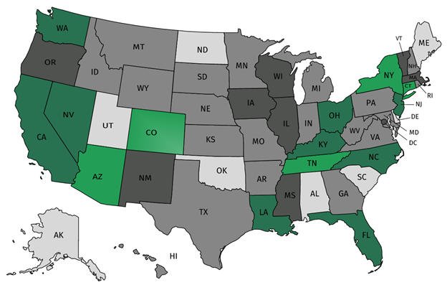




Join our network!
Join a national network of educators
Connect with state networks
Be a part of creating new tools and resources in partnership with SAP
Keep up to date on free resources, upcoming SAP webinars/professional learning opportunities, job postings and more!
Notes:
If you found tonight’s webinar helpful, we’d like to invite you to join our Core Advocate network! We’re committed to solving real problems that real teachers have and we know the best way to do this is to know more about what folks are experiencing.
As part of our national network, you have opportunities to connect with educators across the country, maybe even the network in your state! You can keep up to date on tools and resources available on Achieve the Core, as well as a variety of virtual learning opportunities and other ways to engage with us. We also work with educators in our network to help us build tools and resources.
We’d love to learn about who you are, where you work, the types of things you’re interested in and the expertise you already have. This way, we will be able to tailor our webinars and other opportunities to your needs and interests (we may even tap you to be our next webinar panelist).

Slide 49





Please Join Us!
https://achievethecore.org/ca-signup
Twitter: twitter.com/achievethecore
Facebook: facebook.com/achievethecore
Pinterest: pinterest.com/achievethecore
Notes:
We encourage you to join the network by filling out this survey completely at atc.org/ca-signup

Slide 50
Please Join Us Again!
April Special Edition webinar:
Reading Practice in a Time of Remote Learning
April 15, 2020 @7PM EST
Register Here:
https://event.on24.com/wcc/r/2255621/80B1125BB5D3164A0997F3D9850531EB
May Webinar:
Math Resource Fixers Uppers with Jason Zimba
May 6, 2020 @7PM EST
Register Here:
https://event.on24.com/wcc/r/2258898/4892BBD9D5CC0AA4607F8118466C2798

Slide 51
Thank You!

