Slide 1
Making Materials Better: enVisionmath 2.0 Materials Adaptation Project
Core Advocates Monthly Webinar
March 7, 2018
The webinar will begin shortly. You may wish to download the handouts (check the tab on your webinar control panel) while you wait.

Slide 2
Introductions
Your hosts from the Field Impact Team
Lynda Nguyen, Team Coordinator
Jennie Beltramini, Teacher Engagement Manager
Janelle Fann, Project Manager
Sandra Alberti, Director
Joanie Funderburk, Manager of Professional Learning
This Month’s Guests -
Anna Schattauer Paille, Student Achievement Partners
Jaime Pitkin, Core Advocate

Slide 3
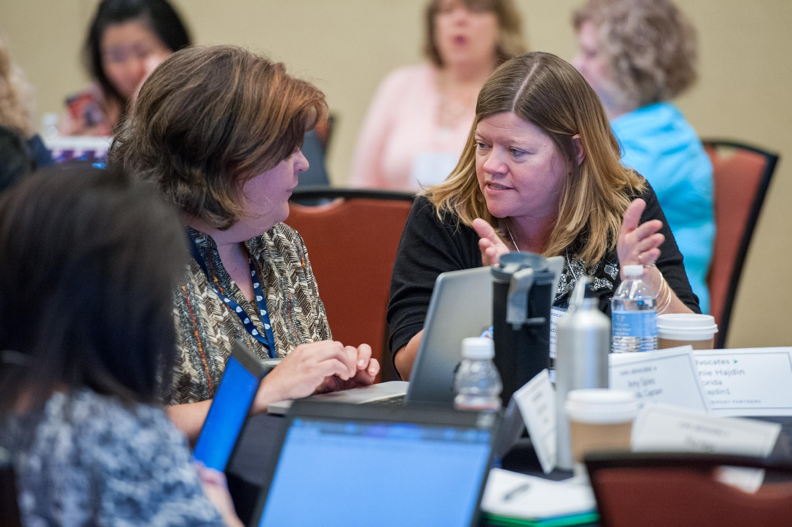
Who are Core Advocates?
Core Advocates are educators who:
  Believe in the potential of high-quality standards to prepare all students for college and careers;
  Are eager to support their colleagues and communities in understanding and advocating for the college- and career-ready standards, and standards-aligned instruction;
  Understand and embrace the Shifts in instruction and assessment required by the college- and career-ready standards
Notes:
CAs are teachers from all over the country who believe in the potential of high quality standards and the importance of all students being prepared for college and careers.
They support their colleagues in understanding and advocating for the standards and embrace the Shifts in instruction
The Core Advocate network is over 12K educator strong and we’d love for you to join us if you have not already

Slide 4

Learn more about us!
Contact Jennie Beltramini (jbeltramini@studentsachieve.net ) or Joanie Funderburk (jfunderburk@studentsachieve.net)
Complete this survey to join our database (and mailing lists): www.achievethecore.org/ca-signup
Visit our website: www.achievethecore.org
Notes:
If you’d like to learn more about the network, contact Joanie or Jennie.
We also want to invite you to join the network by signing up at achievethecore.org/ca-signup and visit our website for more info and opportunities.

Slide 5

Tweet with us!
Please feel free to tweet during and after the webinar using #coreadvocates
@achievethecore
@JoanieFun, @salberti, @JennieBeltro

Slide 6
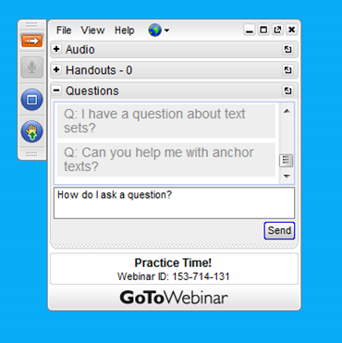
Engage with us!
During the webinar
– Accessing Documents
– Questions option
– Polling
After the webinar
– Survey
– Access to recorded webinar

Slide 7
Goals of the webinar
Understand the need for the Materials Adaptation Project (MAP), and the scope of the enVisionmath 2.0 MAP project
Get a preview of the Guidance Documents created for enVisionmath 2.0 as part of the MAP project
Hear from an educator who has used the Guidance Documents and get ideas for how you might use them

Slide 8
Section 1: Why Guidance Documents?

Slide 9

Notes:
Big idea: Acknowledge the hard work and complexity of teaching and the importance of instructional materials that support teachers in making instructional decisions
Details:
-This quote is the basis for why the guidance documents were created: To ensure teachers have support to use their instructional materials in ways that are aligned to the standards. This will relieve some of the daily decision-making about instructional materials from teachers so they can focus on their students.
-Dr. Boogren works for Marzano Research to support teachers.

Slide 10
Purpose of the enVisionmath 2.0 Guidance Documents
Provide support to educators about how to use enVisionmath 2.0 in a way that aligns to CCSS
  Connect content to expectations of the Standards and progressions
  Highlight strong tasks in the program
  Recommend changes to Topic Tests
Notes:
Big Idea: Share the purpose of the guidance documents
Details:
-The guidance documents provide support to teachers by:
-Calling out aligned features of the program and recommending how to use them across K-5
-Suggesting modification to lessons to align to the content expectations of the Standards for each Topic
-Suggesting modifications for Topic Tests that align to instructional changes, to ensure that students are assessed based on the expectations of the Standards

Slide 11











Notes:
Big Idea: These documents were the collaborative efforts of educators from 9 districts.
Details:
SAP held a convening in Summer 2017 to bring together educators who use enVisionmath to create the guidance documents.
Participants were from Philadelphia, PA, San Bernardino City, CA, Mastery Charter School, PA, Milwaukee, WI, Clark County, NV, Plainfield, CT, Poudre, CO, East Hartford, CT, Flemington-Raritan, NJ. Participants also included regional and national representatives from Pearson and Achievement Network.

Slide 12



Shifts in Mathematics
Focus: Focus strongly where the Standards focus.
Coherence: Think across grades, and link to major topics within grades.
Rigor: In major topics, pursue conceptual understanding, procedural skill and fluency, and application.
Notes:
Big Idea: Used the Shifts as our lens for making adaptations to the program.
Talking Points:
Issues identified and changes made to the program needed to be grounded in improving alignment to the Shifts
The Shifts were the bar for making changes and judging alignment

Slide 13
Places for Adaptations in enVisionmath 2.0
Increase opportunities for students to engage with mathematics of the grade
De-emphasize requirements for students to use a specific model or strategy, unless required by the Standards
Strengthen coherence within and across topics
Align work to the Aspect of Rigor required by individual clusters/standards
Notes:
Big Idea: In analyzing enVisionmath 2.0 and conducting focus groups, several key areas were identified to guide the creation of the guidance documents.
Details:
These areas are addressed at either the program- or topic-level.
Each of these areas of focus are reflected in different parts of the guidance documents, all align to the Shifts and expectations of the Standards.
While the guidance for enVisionmath 2.0 and the extent of these issues is specific to that program, these areas for adaptation are generalizable to other programs as well (remove forced strategies, remove scaffolds, etc.)

Slide 14
Download a sneak peek at the enVisionmath 2.0 guidance documents here:
https://achievethecore.org/page/3162/envisionmath-2-0-materials-adaptation-project

Slide 15
Poll:
Which of the identified places for adaptation in enVisionmath 2.0 most resonate with your experience of the program?
Notes:
Link to download the guidance docs: https://achievethecore.org/page/3162/envisionmath-2-0-materials-adaptation-project
Poll options: Select as many as apply:
1. Increase opportunities for students to engage with mathematics of the grade
2. De-emphasize requirements for students to use a specific model or strategy, unless required by the Standards
3. Strengthen coherence within and across topics
4. Align work to the Aspect of Rigor required by individual clusters/standards

Slide 16
Section 2: Elements of the enVisionmath 2.0 Guidance Documents

Slide 17
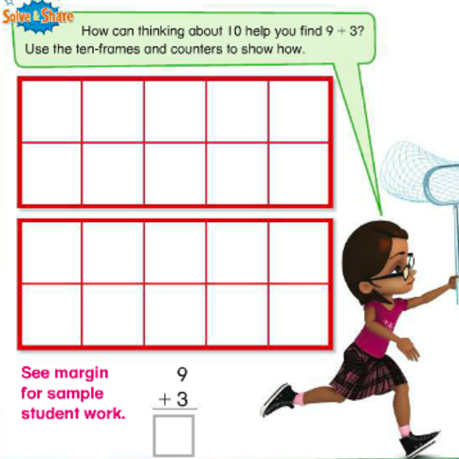
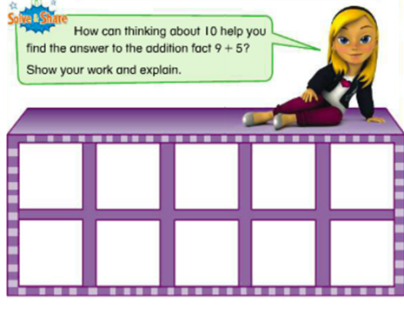
Grade 1 or 2? How sure are you?
Notes:
Big Idea: Illustrate that there is not always a clear distinction between grade-level expectations in enVisionmath 2.0.
Details:
-Ask participants to read the tasks on the slide and determine which appears in grade 1 and which appears in grade 2.
-Facilitate a short discussion on which problem is for which grade. The purpose of this illustration is to show that it is not clear that these problems belong in different grades, particularly when you look at the standards on the previous slide.
-Using a 10 frame and making a 10 is the work of grade 1; supporting individual students in grade 2 the 10 frame is great, but students should be choosing from the strategies they have learned from grade 1, not being assessed on their knowledge of a particular strategy, so that they can progress toward fluency.
- name why we made the guidance documents -- to clarify grade-level expectations so that teachers can make modifications to the enVision lessons
-The guidance documents provide support for how to use enVisionmath 2.0 in ways that ensure students meet grade-level expectations
Note: Although the answer to the question is not the main purpose of the discussion, the problem on the left is grade 2 and the problem on the right is grade 1.

Slide 18
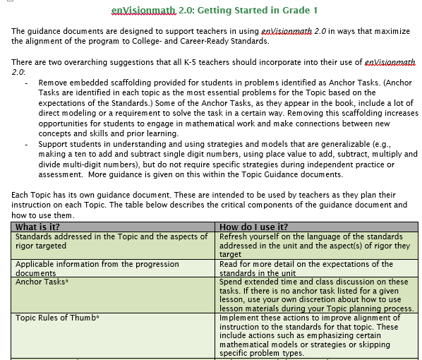
Getting Started
Notes:
Big Idea: Introduce the Getting Started docs.
Details:
- Each grade level has a “Getting Started” page. Start here! This one-pager provides general information about how to use the enVisionmath 2.0 guidance documents.
- Includes two overarching guidelines that apply K-5 - called Pro Tips - and explanation of the major features of the guidance documents.

Slide 19

Pro Tip #1
Remove embedded scaffolding provided for students in problems identified as Anchor Tasks. (Anchor Tasks are identified in each topic as the most essential problems for the Topic based on the expectations of the Standards.) Some of the Anchor Tasks, as they appear in the book, include a lot of direct modeling or a requirement to solve the task in a certain way. Removing this scaffolding increases opportunities for students to engage in mathematical work and make connections between new concepts and skills and prior learning.
Notes:
Big Idea: Introduce guidance on removing embedded scaffolding to increase opportunities for students to engage in the mathematics of the grade
Details:
There is a lot of scaffolding provided on problems in enVisionmath2.0.
Over-scaffolding reduces students’ ability to engage in MP.1, “Make sense of problems and persevere in solving them.” If the scaffolding does too much of the “making sense” work for the student, they never get the chance to “start by explaining to themselves the meaning of a problem and looking for entry points to its solution.”
This practice will not create mathematically proficient students. Students need opportunities to make sense of problems on their own.

Slide 20
Pro Tip #2
Support students in understanding and using strategies and models that are generalizable (e.g., making a ten to add and subtract single digit numbers, using place value to add, subtract, multiply and divide multi-digit numbers), but do not require specific strategies during independent practice or assessment. More guidance is given on this within the Topic Guidance documents.
Notes:
Big idea: Introduce guidance on requiring students to do computation without requiring specific models or strategies
Details:
There are a lot of models and strategies presented in enVisionmath 2.0, and most other instructional materials.
Not all strategies and models are equally useful as students move up through the grades. The emphasis on instruction should be on strategies that generalize.
A note that use of a specific strategy could be required during the instruction of a lesson, but use of specific strategies should not be required on the assessment. For assessment, it is important to let students decide which strategy to use because a) you test their knowledge of the content rather than the strategy and b) then students are really exhibiting MP.5 (using tools strategically).

Slide 21
What’s in the guidance documents?
Grade-level Topic Guidance
  Standards
  Excerpt from Progression documents
  Essential Question
  Anchor Tasks*
  Topic Rules of Thumb*
  Topic Test modifications
*only provided for topics aligned to Major Work of the grade
Notes:
Big Idea: Give a high-level overview of the structure of the documents
Details:
-The first section of the guidance documents provide an overview document for each grade enVisionmath 2.0. These include Pro Tips that apply across K-5.
-For each grade, there are Topic guidance documents that provide specific information on each Topic. The elements marked with an asterisk are only provided for topics aligned to Major Work of the Grade.

Slide 22
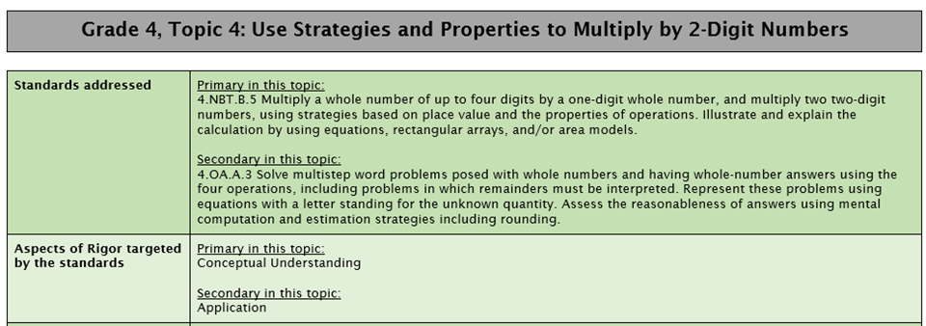
Standards Alignment and Aspects of Rigor
Notes:
Big Idea: Each Topic Guidance section begins by identifying the standards addressed and the targeted aspects of rigor for the Topic.
Details:
The “standards addressed” are the standards identified in the Topic Planner pages of enVisionmath 2.0. Classification into primary and secondary is based on the content of individual lessons and how the standard is addressed over the course of the year. (e.g., 4.NBT.B.4 is identified as a Primary standard in Topic 2 because this is the Topic in which it is fully addressed. 4.OA.A.3 is identified as Secondary here because it is revisited in later Topics.)
The “aspects of rigor targeted by the standards” details the Aspect(s) of Rigor targeted by the standards identified for this topic in enVisionmath 2.0. In this Topic, students will be working with Application problems but the main focus of the work should be on the conceptual understanding required by 4.NBT.B.5.

Slide 23
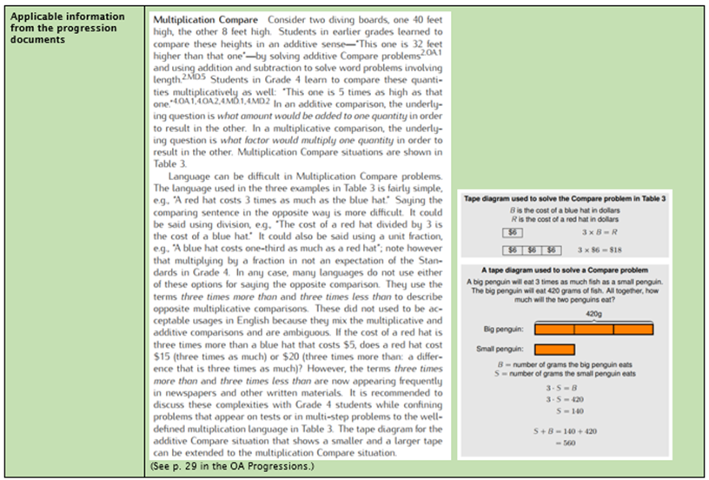
The Progressions
Notes:
Big Idea: Each Topic Guidance section includes excerpts from the Progression Documents
Details:
This information is specific to the work of the Topic and can be very useful in planning for the Topic.
All progression documents can be found at: http://ime.math.arizona.edu/progressions/

Slide 24
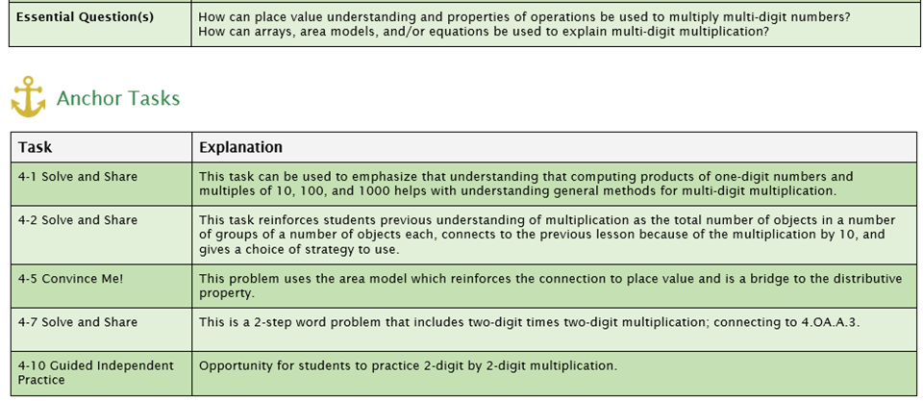
Essential Question(s) and Anchor Tasks
Notes:
Big Idea: Each topic has a recommended sequence of Anchor Tasks from enVisionmath 2.0 or alternative sources which have been identified to highlight coherence within the Topic.
Details:
With any program, there are often questions about how to use all the features of the program and still complete all the content. The Anchor Tasks are the highest-leverage, best-aligned tasks to build student mastery and knowledge of the topic.
- Anchor tasks highlight a coherent progression of the most important math of the Topic. Anchor Tasks are intended to be used as a launch for lessons and are worthy of extended instructional time.
Teachers should plan to spend more time on these tasks and use them for extended instruction and classroom discussion. Within a lesson, there may be other problems teachers decide to use, but the Anchor Tasks are the ones that merit extended instructional time.
Each Anchor Task includes an explanation as to why that problem was elevated as an Anchor Task; the explanations can support decision-making for what additional aspects of the lesson or topic to use or skip as teachers are planning.
Topic guidance also includes Essential Questions that can be helpful for planning Topics. These questions focus on the high-level mathematical purpose of the topic.

Slide 25
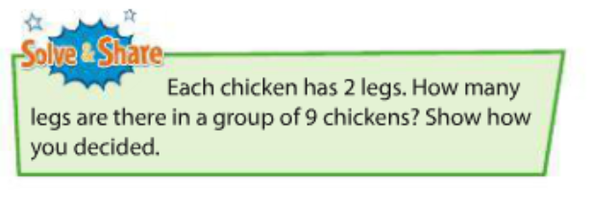
Grade 3 Anchor Task
Question:
What strategies would you expect to see from students, knowing this problem is at the beginning of grade 3?
Please use the Questions tab on your control panel to respond.
Notes:
Big Idea: Share an example of over scaffolding which limits the opportunity for students to engage in MP.1 and MP.3
Details:
This example comes from grade 3, lesson 2-1. Students have solved multiplication and division problems in Topic 1.
The requirement to use a table makes solving the problem more about filling in the table than doing the math. Including this scaffolding means that students may not generate different ways to solve 9 x 2 which would be powerful for a math discussion. Students can then help each other in seeing the various ways to solve the problem.
In this case, the ROT recommends just giving the text of the problem (in the green Solve and Share box) to allow students to solve the problem in a way that makes sense to them.

Slide 26
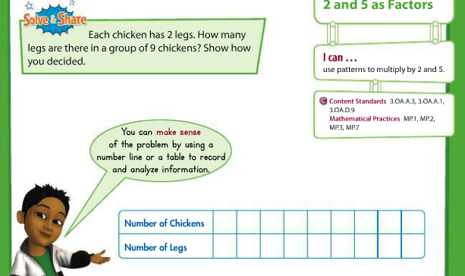
Grade 3 Anchor Task
Notes:
Big Idea: Share an example of over scaffolding which limits the opportunity for students to engage in MP.1 and MP.3
Details:
This example comes from grade 3, lesson 2-1. Students have solved multiplication and division problems in Topic 1.
The requirement to use a table makes solving the problem more about filling in the table than doing the math. Including this scaffolding means that students may not generate different ways to solve 9 x 2 which would be powerful for a math discussion. Students can then help each other in seeing the various ways to solve the problem.
In this case, the ROT recommends just giving the text of the problem (in the green Solve and Share box) to allow students to solve the problem in a way that makes sense to them.

Slide 27
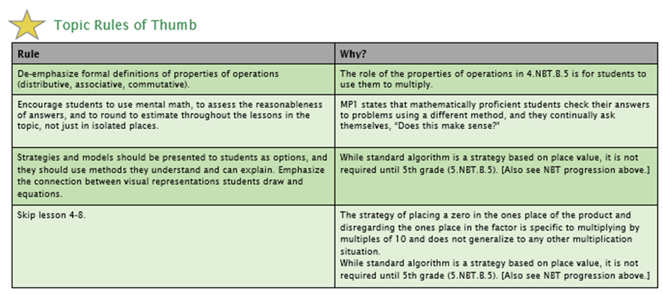
Topic Rules of Thumb
Notes:
Big Idea: Each Major Work Topic Guidance section includes Topic-specific Rules of Thumb
Details:
Each Topic has Topic Rules of Thumb that speak to the specifics of that topic.Topic Rules of Thumb suggest instructional choices designed to better align all of the work of the Topic to the expectations of the Standards. Each Rule of Thumb has a rationale that is based on the Standards and/or the Progression documents.
Often the Topic Rules of Thumb get into how the Pro Tips play out with the content of the particular topic (specifying which strategies/models to emphasize, etc.).
Topic Rules of Thumb also work to strengthen coherence by reordering lessons and providing guidance on making connections between concepts explicit for students.

Slide 28
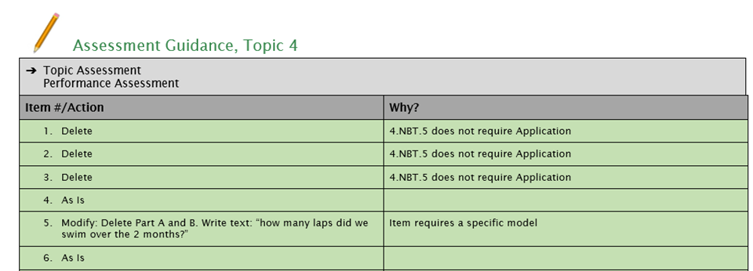
Topic Assessment Guidance
Notes:
Big Idea: Each Topic Guidance section includes guidance for modifying the Topic Assessment.
Details:
-Corresponding changes to the Topic Assessment are recommended based on the guidance above. The Topic or Performance Assessment is identified as the more aligned assessment choice.
-For each assessment item, an action is recommended in order to improve alignment. Many times, this consists of removing a specific model or strategy and just assessing students’ understanding of the mathematical concept, procedure or application. Some items are recommended to use “as is,” and it is recommended that some items are skipped.

Slide 29
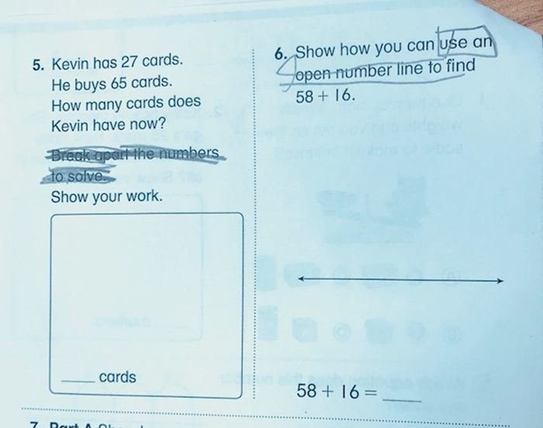
Notes:
Big Idea: Show an example of how a pilot teacher modified Topic Tests
Details:
This grade 2 Topic Test comes from a pilot classroom where the teacher had students cross out directions in order to better align the items to the expectations of the standards
The teacher used the Topic Assessment guidance to determine what to remove from the problems.
The crossed out text prompts students to use a particular strategies. By removing those prompts, this teacher will have a better sense of what her students know and can do.

Slide 30
Using the guidance documents to plan
Read the standards and progression excerpt.
Solve Anchor Tasks as your students might.
Plan out your Topic.
  Which anchor tasks/lessons may need more than one day?
  Which lessons should be skipped or combined?
  Read the Topic Rules of Thumb and think about how you will apply them throughout the topic.
Notes:
Big Idea: Provide a suggested framework for teachers to use as they plan for teaching a topic
Details:
These guidance documents will be most useful when used for planning instruction for an upcoming topic. Here you see a suggested framework for using the guidance documents to plan for topic.
Start with reading the standards and progressions excerpts to ground yourself in the key mathematical ideas for the topic.
Do the math! Complete the Anchor Tasks to figure out where the deep mathematical conversations can happen, come up with questions to get your students thinking, and identify the misconceptions you think your students will have.
Plan the topic - where might more time be needed? What can be skipped/combined? Reference the Topic RoTs and think about how you’ll apply them throughout the lesson.
With these adaptations, the program will better align to the expectations of the Shifts and Standards.

Slide 31
Question:
How do the guidance documents support teachers’ stronger understanding of the expectations of the standards?
Please use the Questions tab on your control panel to respond.

Slide 32
Section 3: District Roll-Out of the Guidance Documents

Slide 33

Jaime L Pitkin
Elementary Instructional Specialist of Mathematics
East Hartford, CT

Slide 34
Background Information
2014-2017 Realize Edition
  Only Partially Aligned with the standards
  Organized by Domains
  Topics were disjointed
  Pacing was unrealistic
2017-2018 changed to enVisionmath 2.0
Participated in the Summer 2017 Convening
  3 classrooms teachers: Grades 2, 3, and 5
  I worked as a SAP Consultant for 2nd grade
Notes:
8 elementary schools, 3040 total students in grades K-5
We already had a contract with Pearson. Met with Pearson and negotiated a “trade-in” of the Realize edition for the 2.0 edition.
Created a comparison of of the Realize edition and 2.0. Persuaded leaders this was the right decision because of the Materials Adaptation Project
I made the executive decision to use the piloted version of the guidance documents as a district. We couldn’t afford to spend another year teaching the entire textbook from cover to cover, we needed to focus on grade level content and we needed guidance.

Slide 35
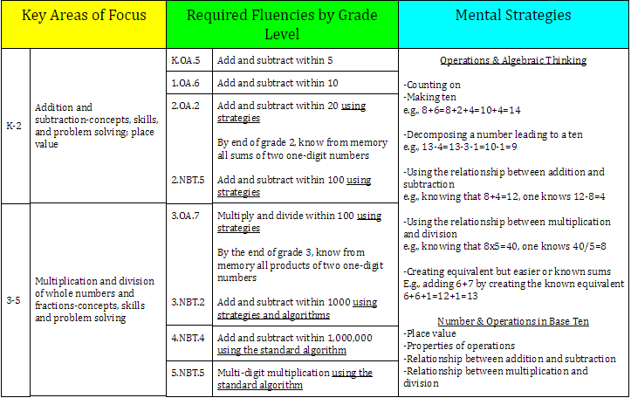
Guidance Document Implementation
1) Summary of Grade Level Work, Grades K-5
Key Area of Focus, Required Fluencies, Mental Strategies
Notes:
In order to utilize the guidance documents I had to create curricular documents that highlight the Major Focus and Work of the Year
Summary of Grade Level Work, all grades-one document, highlighting the work of the primary grades K-2 and intermediate grades 3-5 Key Areas, the grade level specific fluencies, and the strategies that support mental math
Main reason for this doc is to clear up any misinterpretations about grade level areas of focus and required fluencies

Slide 36
2) Guidance Document Terminology, Grades K-5
An explanation of the terminology
Pro Tips:
Overview of the program specifics, the big picture
Applies to Grades K-5 and to all topics
Addresses Vocabulary, Strategies and Models, Assessments, Fluency
Topic Rule of Thumb:
Provides an overview of the topic specifics, i.e. Topic 1 rule of thumb items are written specifically for content taught in Topic 1
Suggests instructional choices designed to better align the work of the topic to the expectation of the standards
Provides a rationale that is based on the standards and/or the progression documents
Essential Question:
Identifies the big ideas that unite the work of the topic
Anchor Tasks:
Identifies elements of enVisionmath 2.0 that have the strongest connections to the expectations of the identified standards and Essential Questions for the topic
Examples of Anchor Tasks in enVisionmath 2.0 are-
  Solve and Share
  Visual Learning Bridge
  Intervention Activity
The order of the tasks corresponds to the recommended instructional sequence
Are worthy of extended instructional time
Supplementary tasks or lessons are included to meet the full intent of the identified standards
The Anchor Task Explanation shares the rationale for highlighting the Anchor Task and its place in the sequence
ANY component of the lesson that is aligned with grade level and content standards may be incorporated into the lesson.
  For example: The Anchor Tasks for Kindergarten Topic 1 highlight lessons 1-1, 1-6, 1-7, 1-9. This does not mean that the teacher cannot use components of lessons 1-2, 1-3, 1-4, 1-5, 1-8. It simply means that the recommended Anchor Tasks are the priority.
Notes:
Guidance Document Terminology, one document for all grades, explains each of the sections that I chose to include in the Guidance documents for this year (PRoT, TRoT, Essential, AT, Essential Vocab, Assess Guidance)

Slide 37
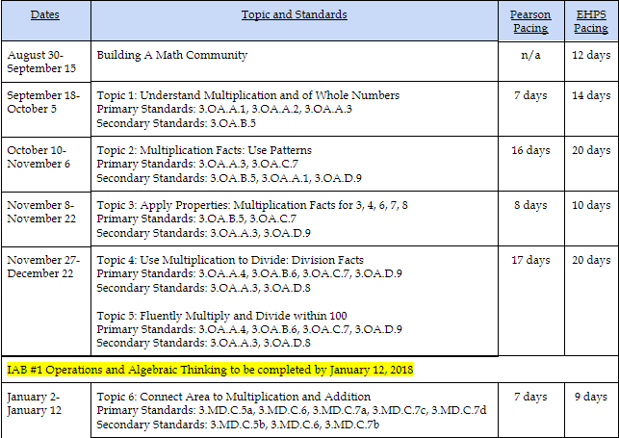
3) Pro Tips, Grades K-5
4) Scope and Sequence, Grade Level Specific
Dates, Topics, Primary/Secondary Standards, Instructional Days
Notes:
PRoT, document as-is, one document for all grades
Scope and Sequence-provides a year at a glance view with pacing which includes dates, instructional days and topic order, standards addressed, and district assessments. this has been revised numerous times, helps teachers prepare for reporting periods (report cards, 3x per year)

Slide 38
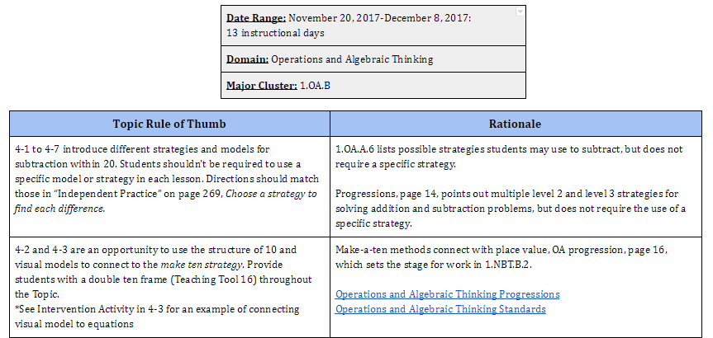
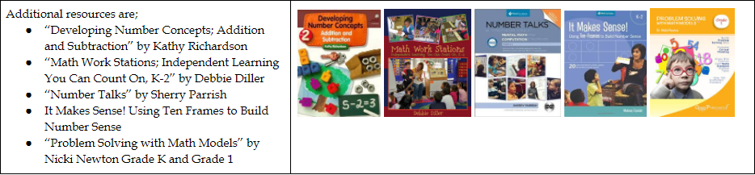
5) Revised version of the Guidance Documents, Grade Level and Topic Specific
Notes:
Revised version of the Guidance Documents-I did not include the Standards Addressed (hyperlinked in TRoT available on other docs), Aspects of Rigor, applicable info from the progression docs (available as a hyperlink in TRoT)
I created a revised version for 2 main reasons: 1) the focus for the pilot year was on the big picture; teaching grade level content, the WHAT and the WHY 2) I added an additional resources section highlighting resources we own as a district that should be embedded as part of the workshop model.

Slide 39
Professional Development
Month | Length of PD | Audience/Presenter
June 2017 | ½ Day | enVisionmath 2.0 training for Instructional Coaches facilitated by Pearson
August 2017 | 2 ½ Days | Materials Adaptation Project Convening facilitated by Student Achievement Partners
August 2017 | ½ Day | enVisionmath 2.0 introduction for Teachers facilitated by Instructional Coaches
September 2017 | Full Day | Guidance Document Implementation for Instructional Coaches and Administrators facilitated by the Instructional Specialist
October 2017 | Full Day | enVisionmath 2.0 training for Teachers facilitated by Pearson
February 2018 | Full Day | Guidance Document Planning for Teachers facilitated by the Instructional Specialist
Notes:
Admin/Instruction Coaches/Teacher Support
Each elementary school has 2 Instructional Coaches, Grades 3-5 are departmentalized in some buildings
Scope and Sequence began with 2 weeks of Building a Math Community. During this time I shared the curriculum documents with the Coaches and Administrators
This highlights the district level PD. I attend grade level meetings, present at staff meetings, and am constantly communicating with Data Team Leaders and Coaches
All documents are in draft form.

Slide 40
Guidance Document Topic Planner
When planning, begin by examining the purpose of the topic. Use the following questions to identify what the students need to learn and why.
Topic Overview:
What standard(s) and/or cluster(s) are you targeting in this Topic?
Which aspects of rigor do the targeted standards require?
  Conceptual Understanding
  Procedural Skill and Fluency
  Application
Analyze the Assessment Items: Which items are identified as As is, Modified or Deleted and why? Use this information when planning for instruction.
Anchor Tasks are identified as the most essential problems for the Topic based on the expectations of the Standards.
  Complete the first anchor task on your own. With your grade level team, share the strategies and/or models you used to solve the problem. Next, anticipate the various ways your students will approach the problem. Repeat this process!
  What do the anchor tasks ask of the students?
  How do the anchor tasks progress throughout the topic?
Notes:
February Pd Planning with Guidance Documents
-I created this template to provide grade level teams with discussion questions to aid in planning.

Slide 41
Teacher Glows
“The guidance documents simplified an otherwise overwhelming amount of math.” -2nd Grade Team
Strategies and Models
“Students know and use a greater variety of strategies, as they are always encouraged to use what is the most efficient for them.” -1st Grade Team
Anchor Tasks
“I am finding that my students are really loving the anchor tasks and learning to persevere through problems on their own” -5th Grade Teacher
Assessment
“Our favorite part is the Topic Assessment Guidance, which modifies the assessment and provides the rationale for problem.” -1st Grade Team
Notes:
Guidance Document Feedback:
-easy to follow, saves us time trying to weed through envisions to figure out what is best
-layout is teacher friendly, gives us direction
-program is more rigorous, works well with workshop model
-provide a concise outline of the concepts/standards addressed
-appreciate that the anchor tasks list the lessons and order that best address the standards rather than feeling the need to teach every lesson in order.

Slide 42

Teacher Grows
Understanding grade level content standards and expectations
Gravitate towards past practice and have a strong desire to re-teach
Intentional Planning
Notes:
-so many of our teachers, in all grade levels, have spent very little time teaching grade level content
-there are numerous beliefs and mis-interpretations of the standards
-how can I teach grade-level content when they haven’t mastered previous content (need teachers to realize that they are widening the students gap by constantly re-teaching, it’s a juggling act (expose students to grade level content-address specific gaps/deficits as part of guided groups-allow students to select the strategies and models(tools) that make the most sense to them)
Examples of misconceptions
-should teach area and perimeter together because that’s how we’ve always done it
-adding and subtracting fractions has to be taught before multiplying
-math problems must be solved from left to right 2 + 6 + 8, teacher told child they had to add 2 + 6 first (Making a Ten)
Planning
-harsh reality, math has been the convenient subject because worksheets can be photocopied. 80% Procedures beginning as early as 1st grade
-share Guidance Document Discussion Questions

Slide 43
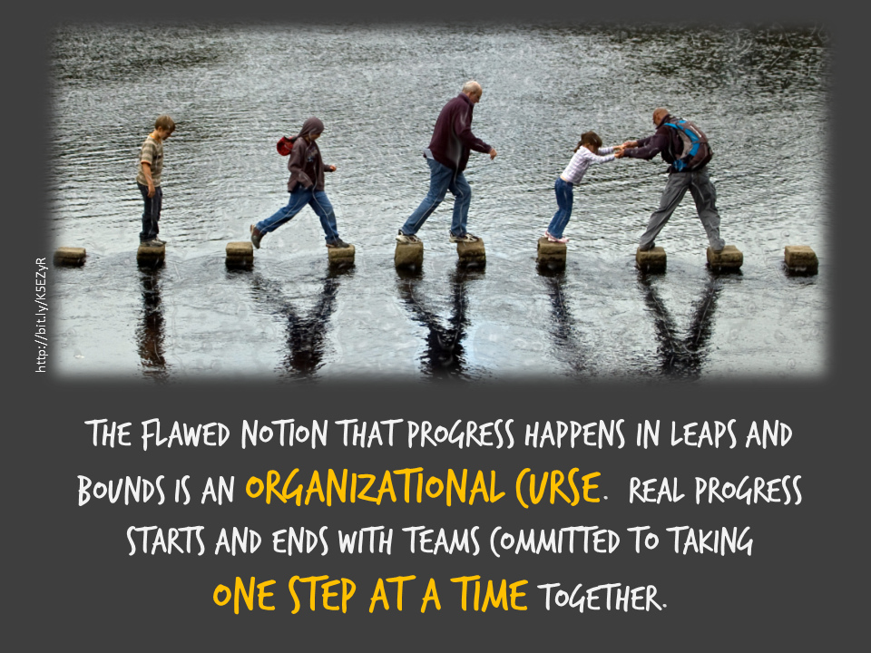
Next Steps
Examine Published Version and Revise Documents
Embed Supporting/Additional Clusters into Major Cluster Work through Workshop Model
Highlight Strategies and Models K-5
Utilize the Coherence Map to support Guided Group work
Create PD opportunities around Progressions Documents
Notes:
Embedding S&A Clusters
-time is precious and these topics shouldn’t be taught in isolation. Embedding them into the major cluster work will allow for more instructional days for the major clusters so teachers can dig deeper, it’s also important for teachers to understand how the standards interact and overlap with one another. this work will also be reinforced through use of the coherence map
-Teachers would a document that highlights the generalizable strategies (making a ten, counting on) that exist in K-1-2 etc. so they know the strategies students have been or should have been exposed to in previous grades. this applies to models (ten frame, number line, hundreds chart) as well
-the majority of our teachers were not aware the progressions documents existed. I need to provide an entry point to these documents since they are so dense.

Slide 44
Questions for our Guests?

Slide 45
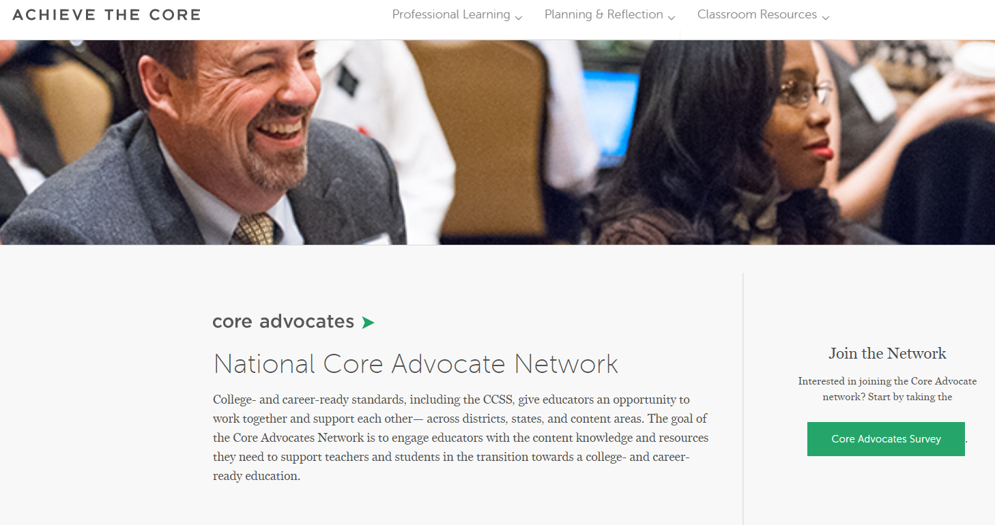
Join our network!
www.achievethecore.org/ca-signup
Notes:
If you found tonight’s webinar helpful, we’d like to invite you to join our Core Advocate network! We’re committed to solving real problems that real teachers have and we know the best way to do this is to know more about what folks are experiencing.
We’d love to learn about who you are, where you work, the types of things you’re interested in and the expertise you already have. This way, we will be able to tailor our webinars and other opportunities to your needs and interests (we may even tap you to be our next webinar panelist). So we encourage you to join the network by filling out this survey completely at atc.org/ca-signup

Slide 46
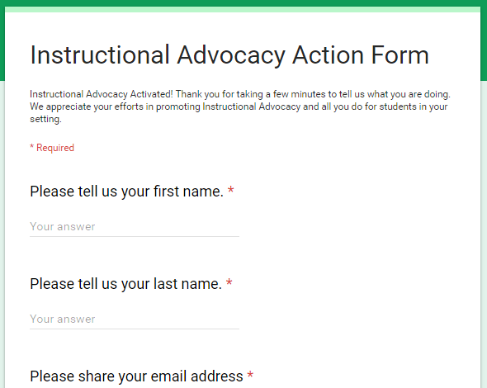
Tell us about your efforts
www.achievethecore.org/educators-taking-action
Notes:
We like to invite Core Advocates to share what they are doing more broadly. Whether its you trying a strategy or a tool, we’d like to know how it went. Please let us know about your advocacy with our IAAF.

Slide 47
Please join us again next month!
Next month’s webinar: Supporting English Language Learners with College- and Career-Ready Content
Wednesday, April 4, 7:00 - 8:00 p.m. ET
Register Here: https://attendee.gotowebinar.com/register/578633773902099457

Slide 48
Thank You!

